Slide 1

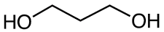
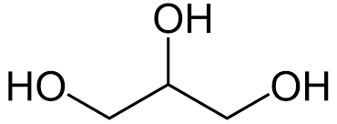
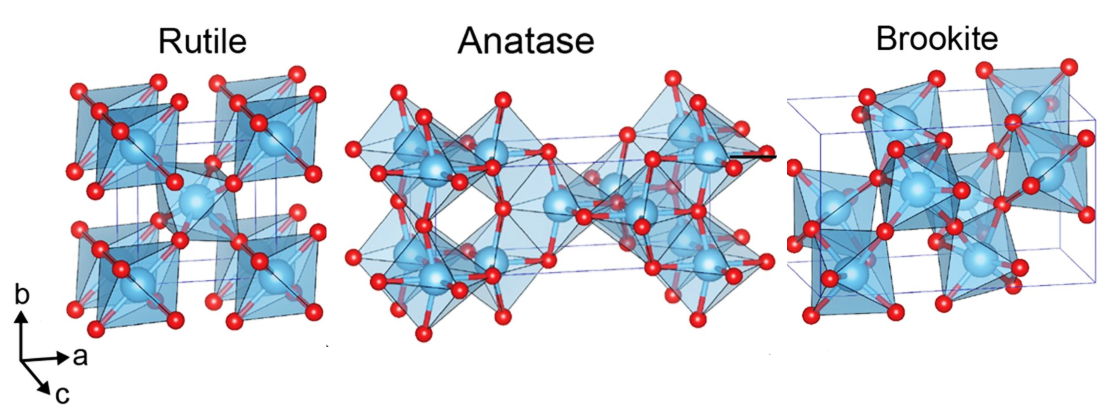


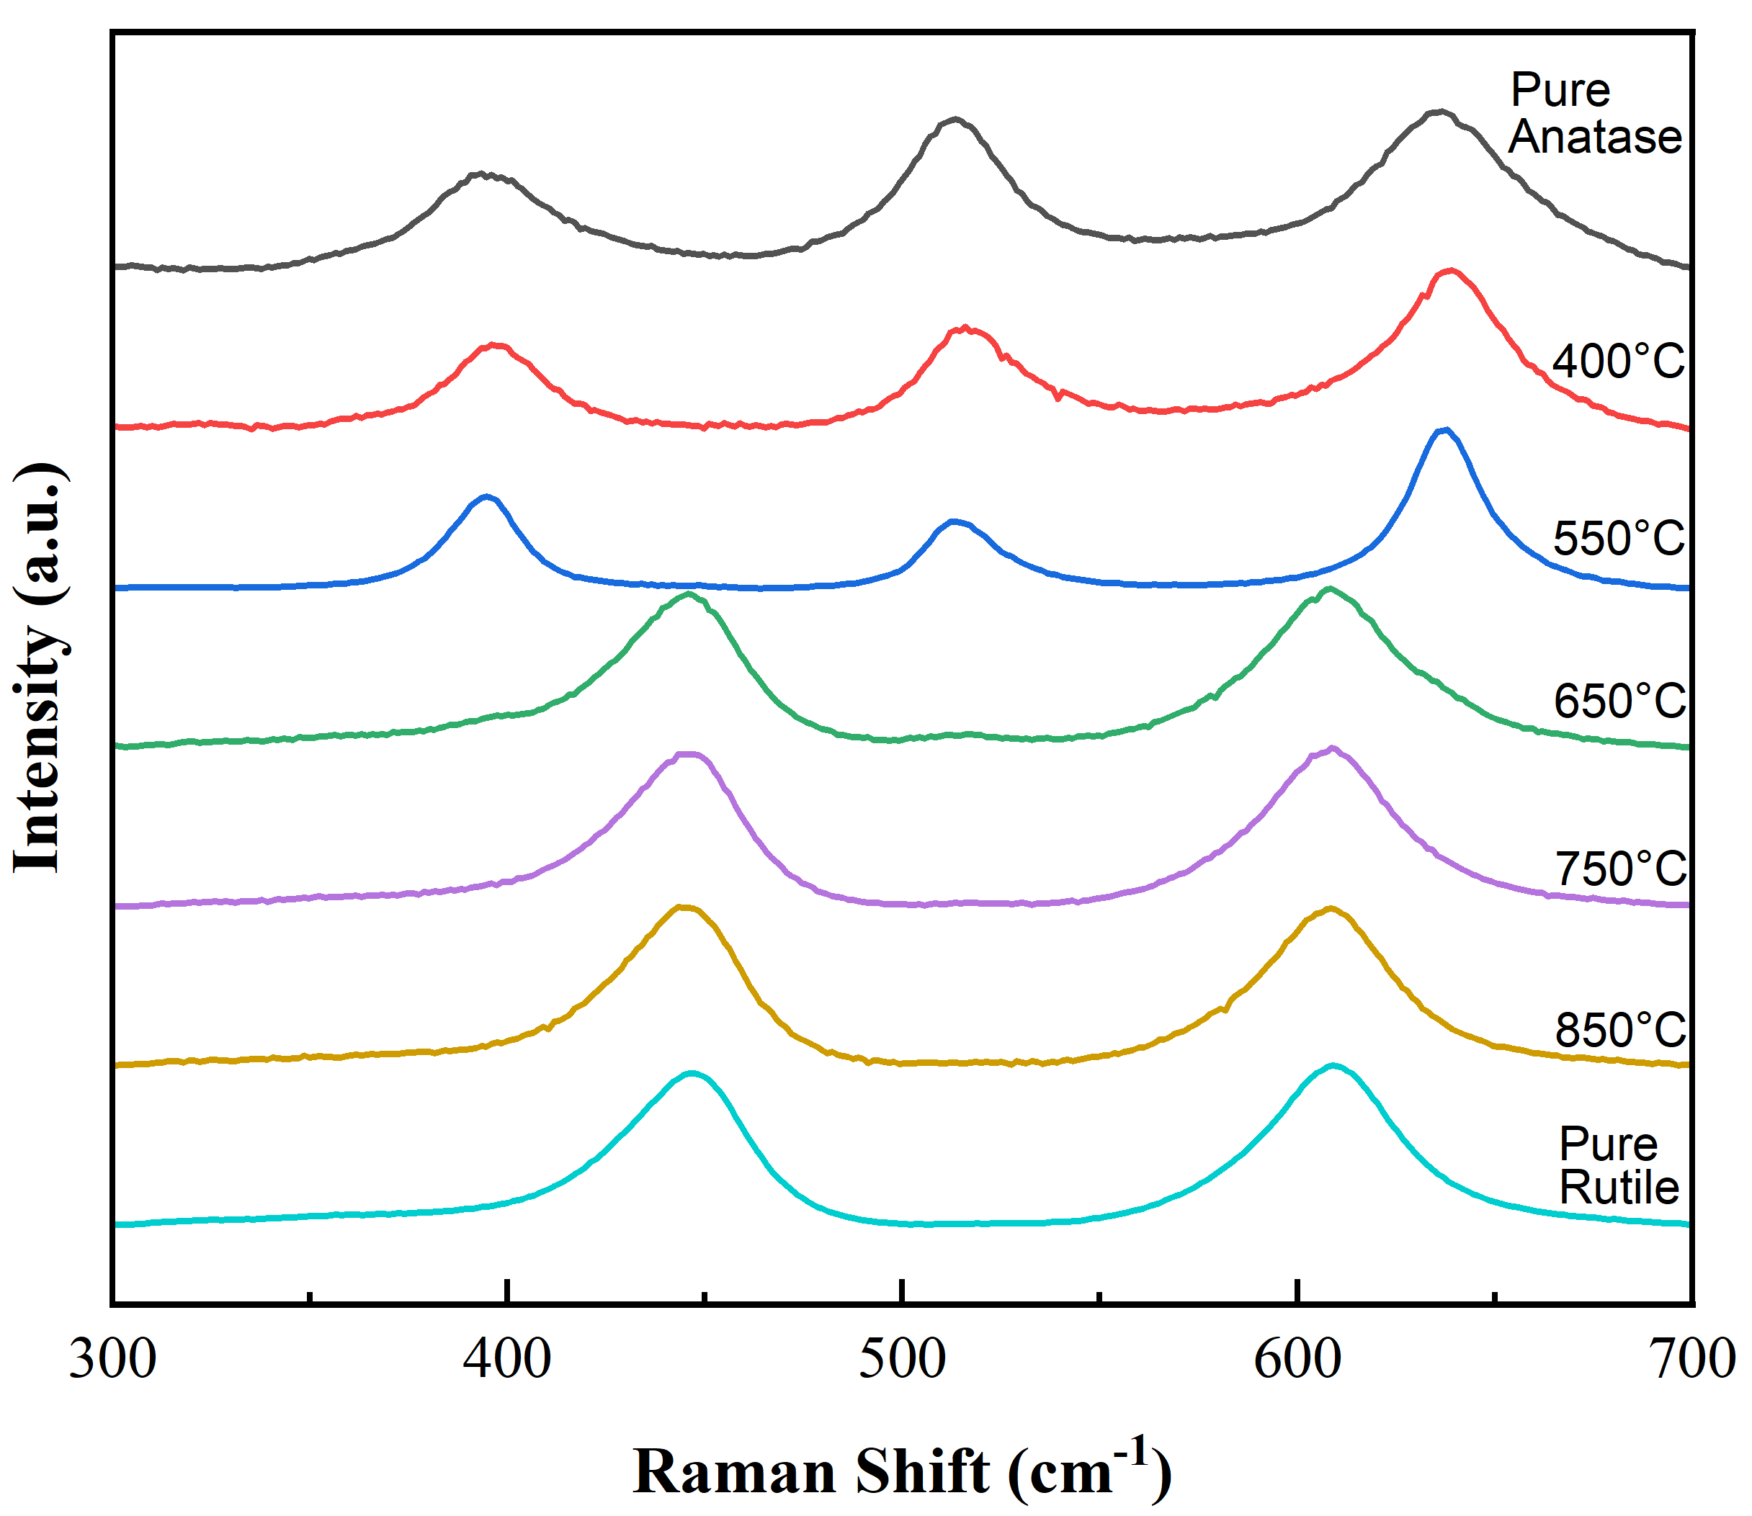
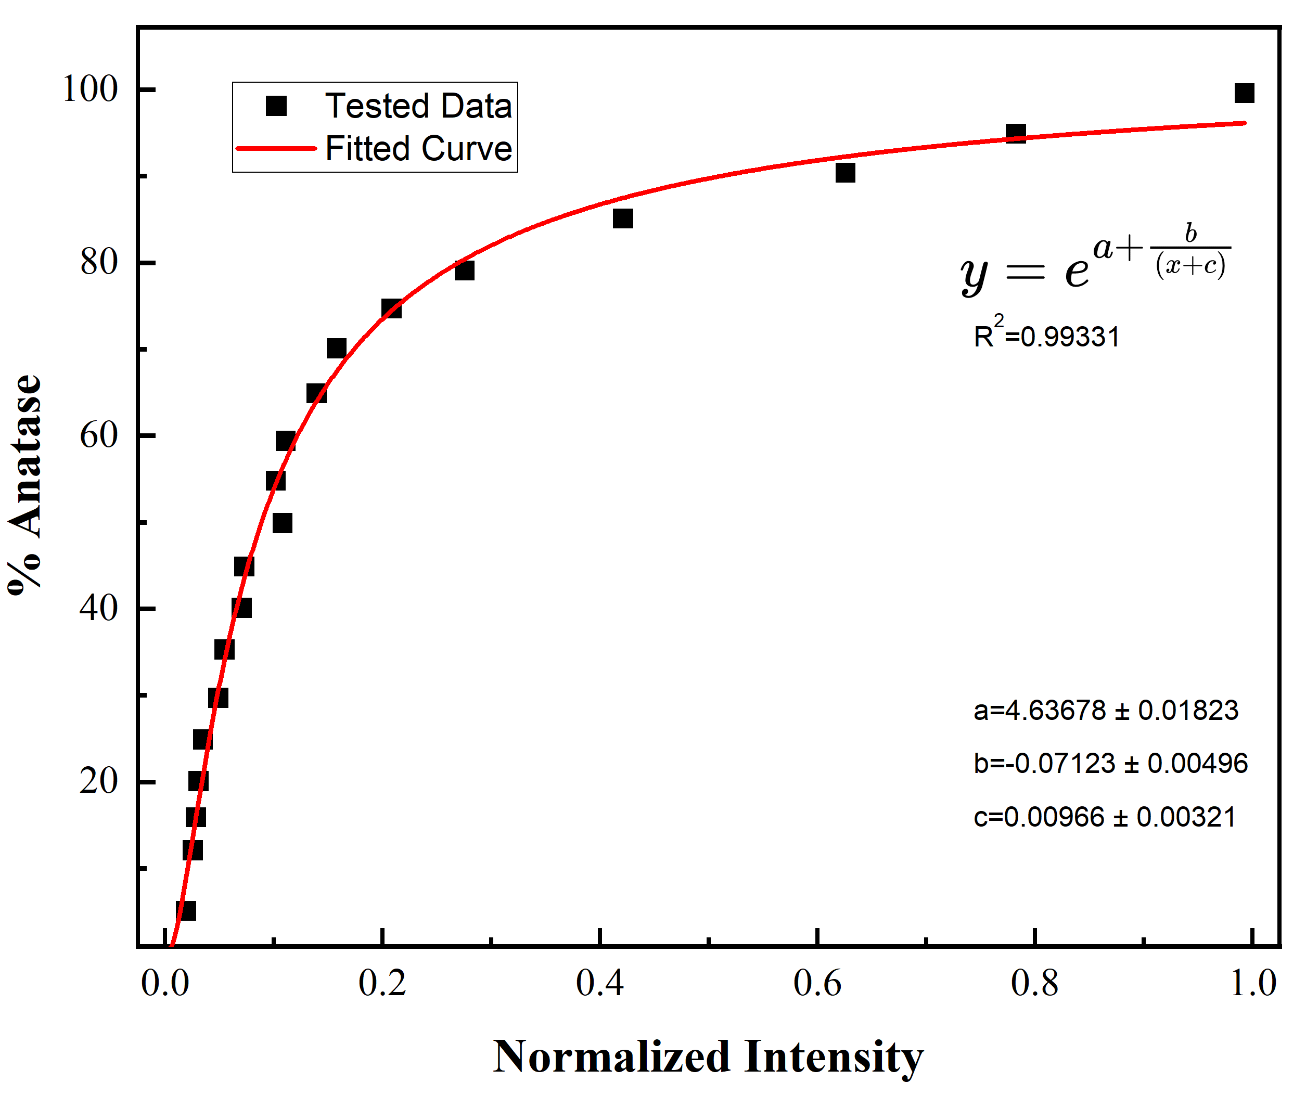

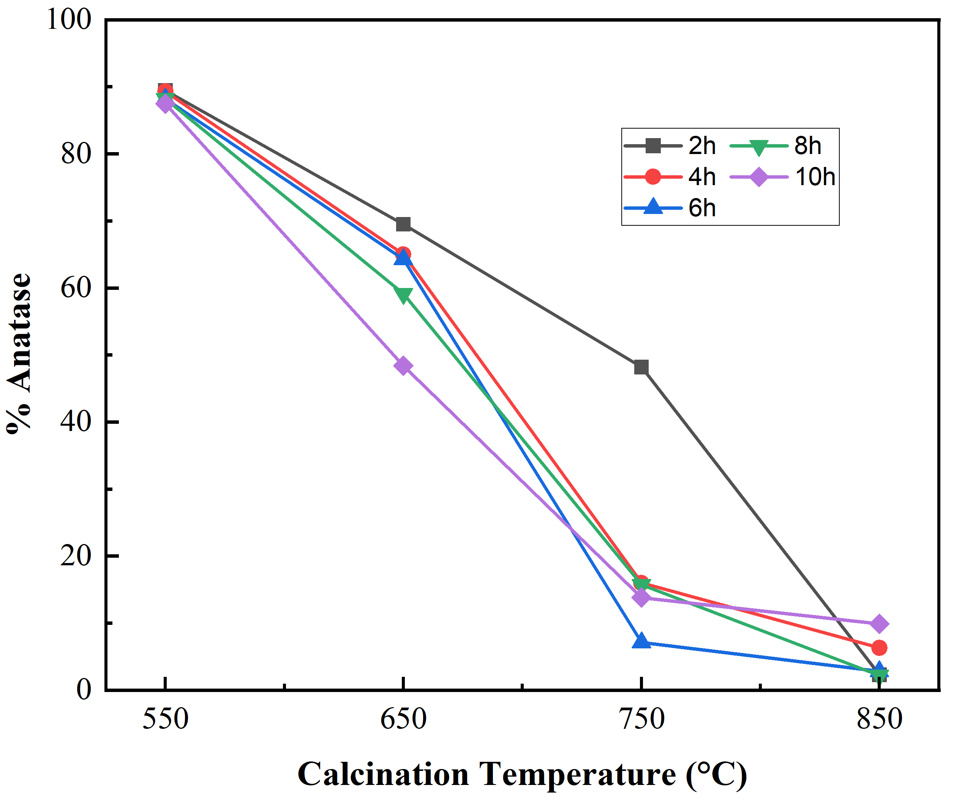
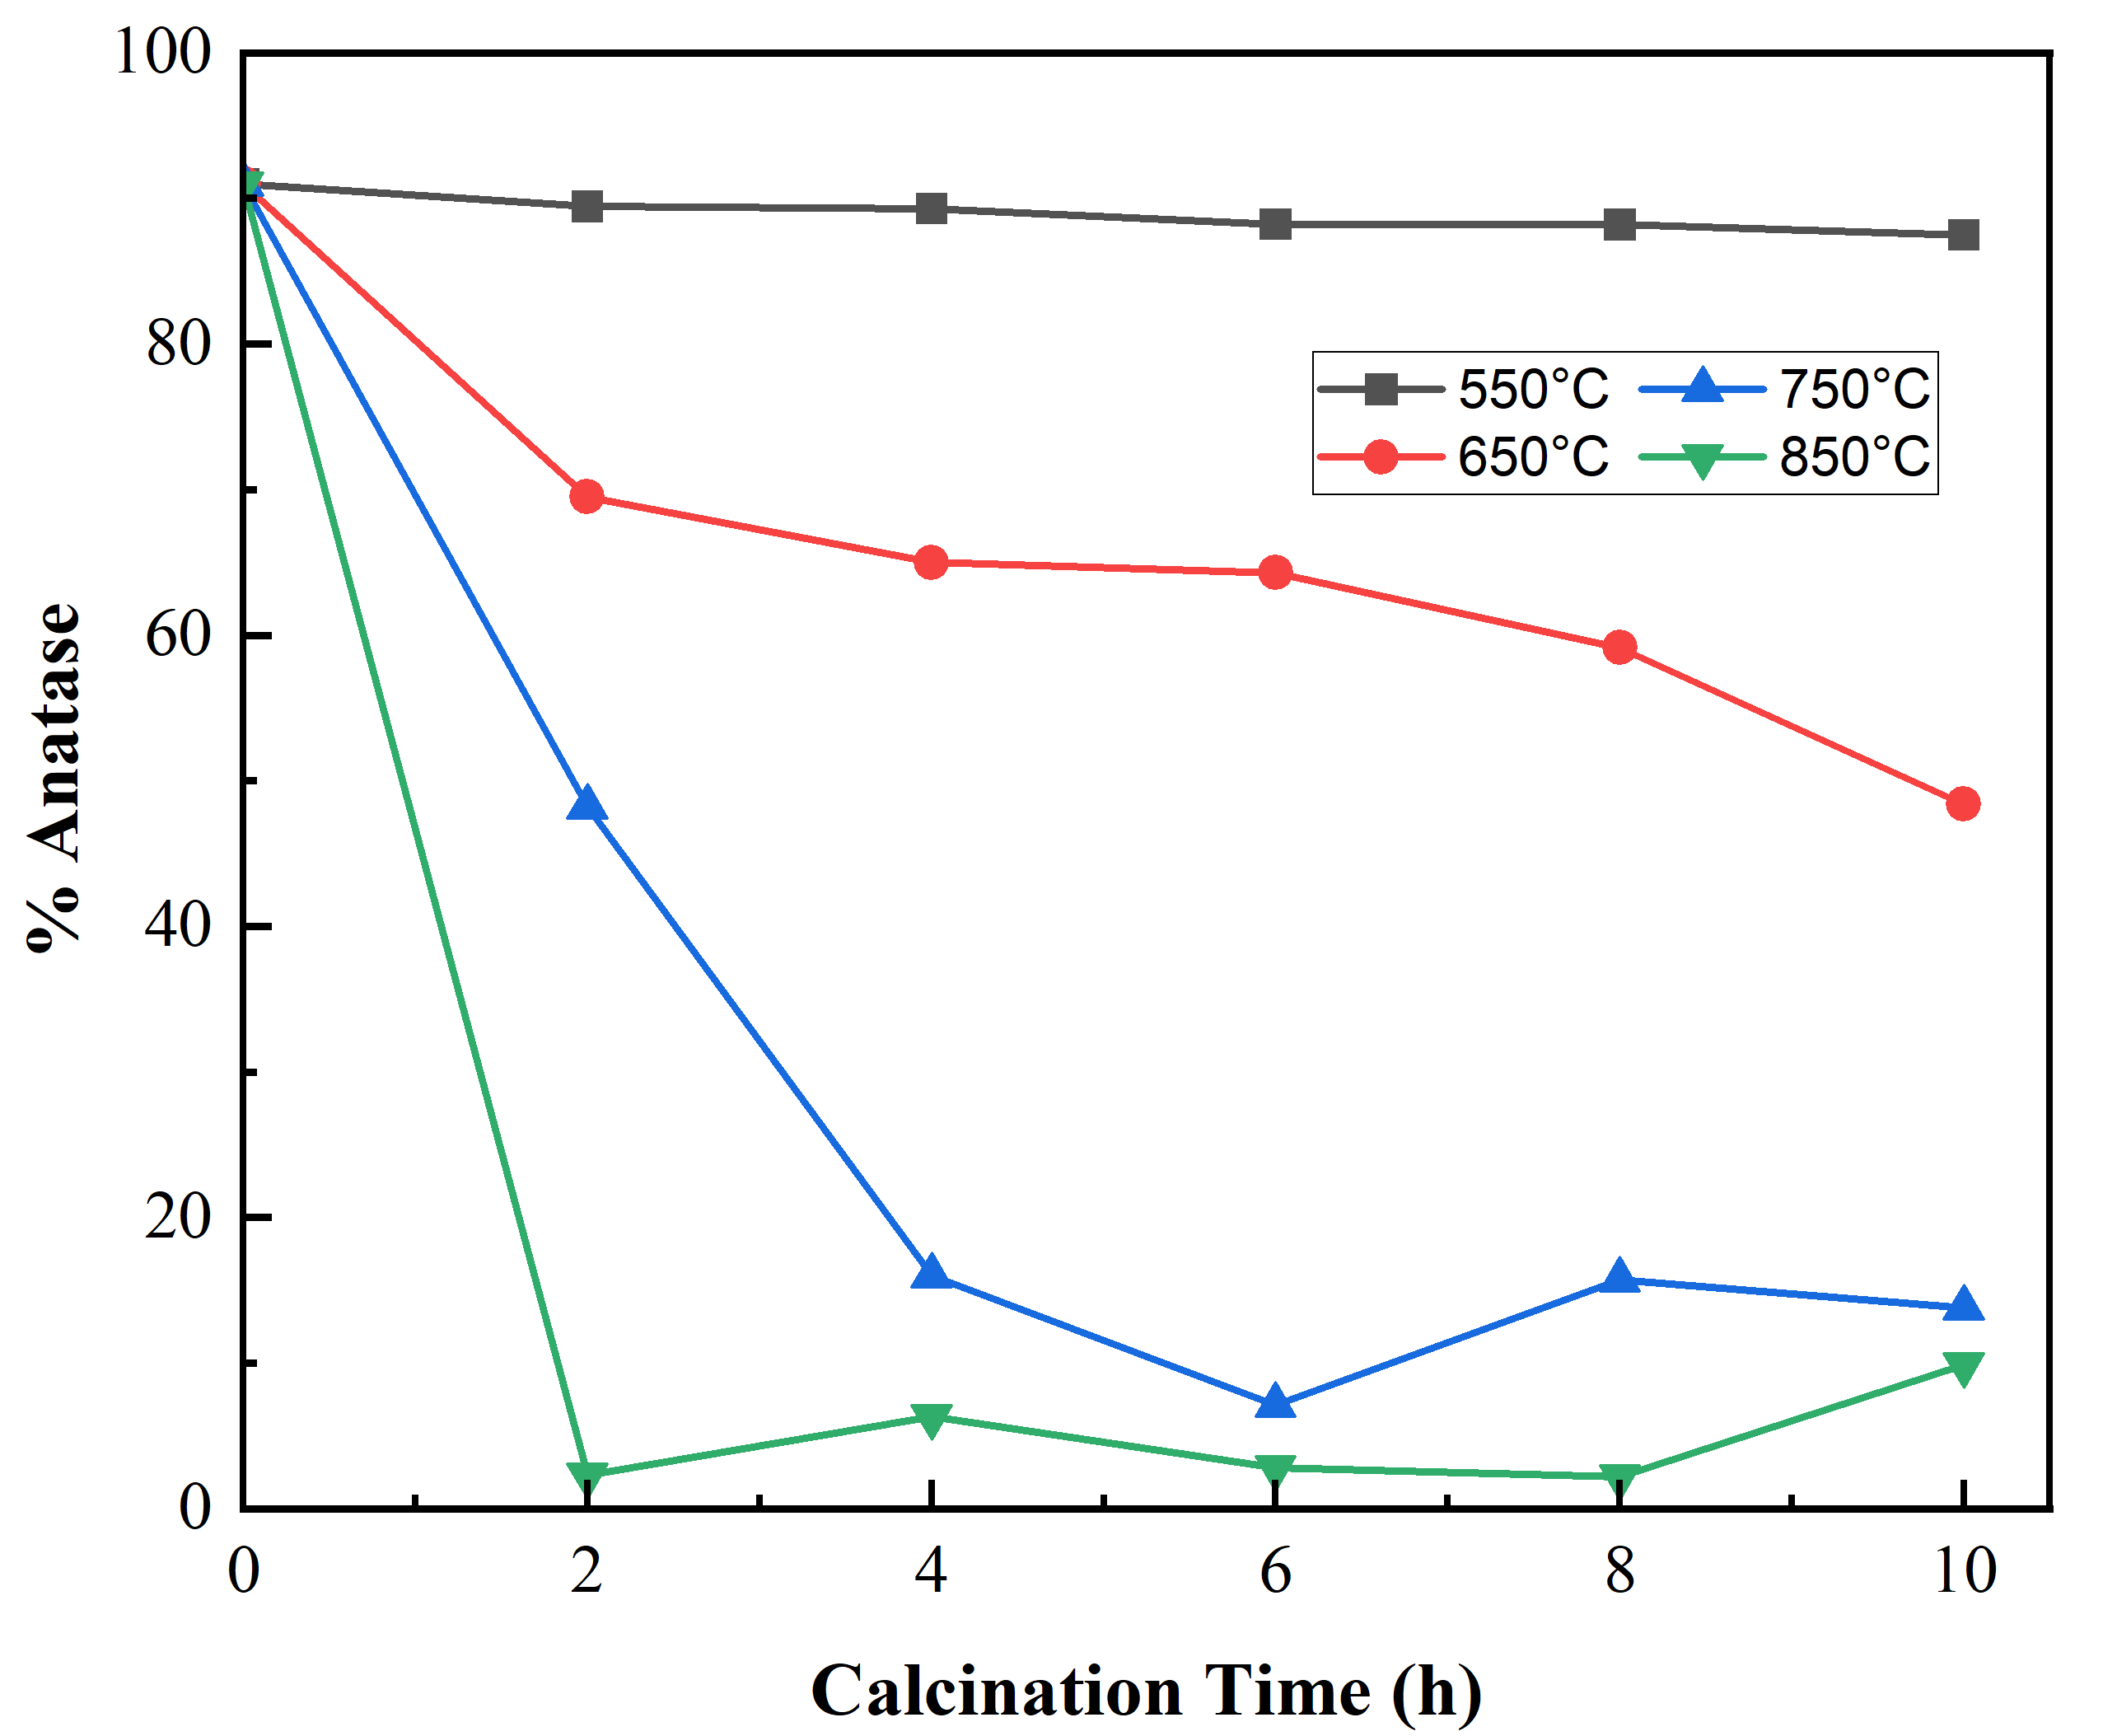
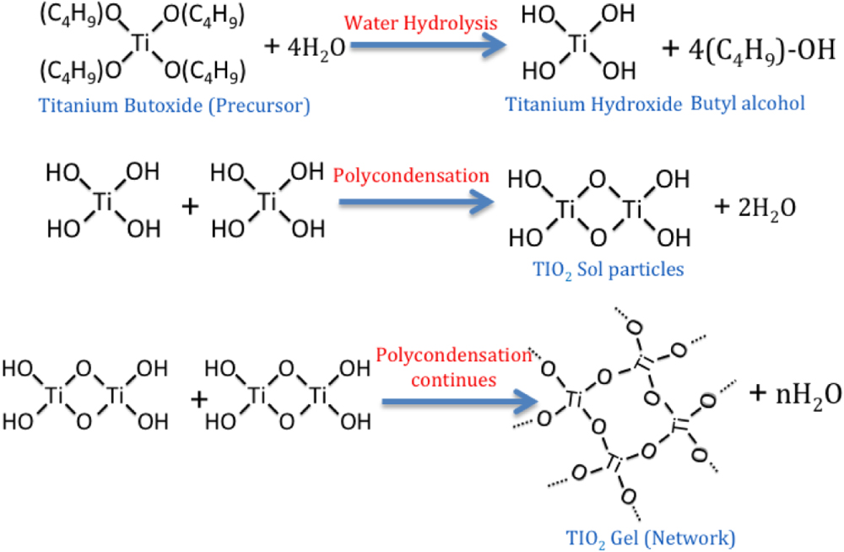
Titanium Dioxide (TiO₂): Anatase-Rutile Phase Transition
William Steere and Dr. Nan Yi
Department of Chemical Engineering and Bioengineering, University of New Hampshire, Durham, NH 03824
Introduction
Characterization and Methodology
Application
Titanium Dioxide (TiO₂) is a robust catalyst:
Cost-effective
High chemical stability
Versatile use in photo- and thermal-catalysis processes
Calcined in air
Anatase and rutile phases exhibit different patterns in Raman shift
Therefore, phase composition is quantifiable based on intensity of anatase's middle peak
Physically mixed samples of anatase and rutile were used for the correlation
Spectra were baseline adjusted and normalized in the 300-700 cm⁻¹ range
Normalized height of band at ~515 cm⁻¹ was related to phase composition^{[3]}
TiO₂ phases affect catalytic performance
The hydrogenolysis of glycerol to propanediols: the relationship between product selectivity and choice of TiO₂ phase
Anatase
Rutile
Transitions between morphologies are called phase transitions
High temperature and/or pressure are the phase transition conditions to convert Anatase to Rutile
Brookite phase in high purity is challenging to synthesize, making anatase and rutile more favorable structures
ART (Anatase-Rutile phase transition) aimed to collect optimal TiO₂ phase mixtures of anatase and rutile for its usage in catalytic reactions
Summary
Desirable phase mixtures can be synthesized by modifying calcination temperature and time
Addition of sufficient energy causes metastable anatase phase TiO₂ to irreversibly convert to the stable rutile phase
Varying TiO₂ phase mixtures will alter catalyst morphology and therefore characteristic behaviors in surface area, selectivity, and reactivity
Results
Synthesis
Anatase to Rutile transition occurred at temperatures above 550°C
Complete rutile phase achieved at 850°C
Smaller temperature increments would convey a smoother transition
Baseline noise resulted in high variance at low anatase percentage
Longer exposure and increased number of scans would remedy noise fluctuation
Sol-Gel Method^{[1]}
Combined Ti precursor (TTIP) with IPA in a 1:5 vol. ratio
Added H₂O dropwise in a 2.2:1 molar ratio with TTIP
Adjusted pH to 1-2 with 8 M HCl
Heated at 45°C until homogenous gel formed
Precipitate autoclaved to 200°C for 1h
Centrifuged and dried
Acknowledgments
Dr. Young Jo Kim, Dr. Guoqiang Cao, Seth Drahusz
The Hamel Center for Undergraduate Research
References
[1] Journal of Molecular Catalysis A: Chemical, 2005, 225, 203
[2] ChemistrySelect 2020, 5, 11530.
[3] Smart Materials and Structures 2014, 23,104004.
[2]

