Slide 1
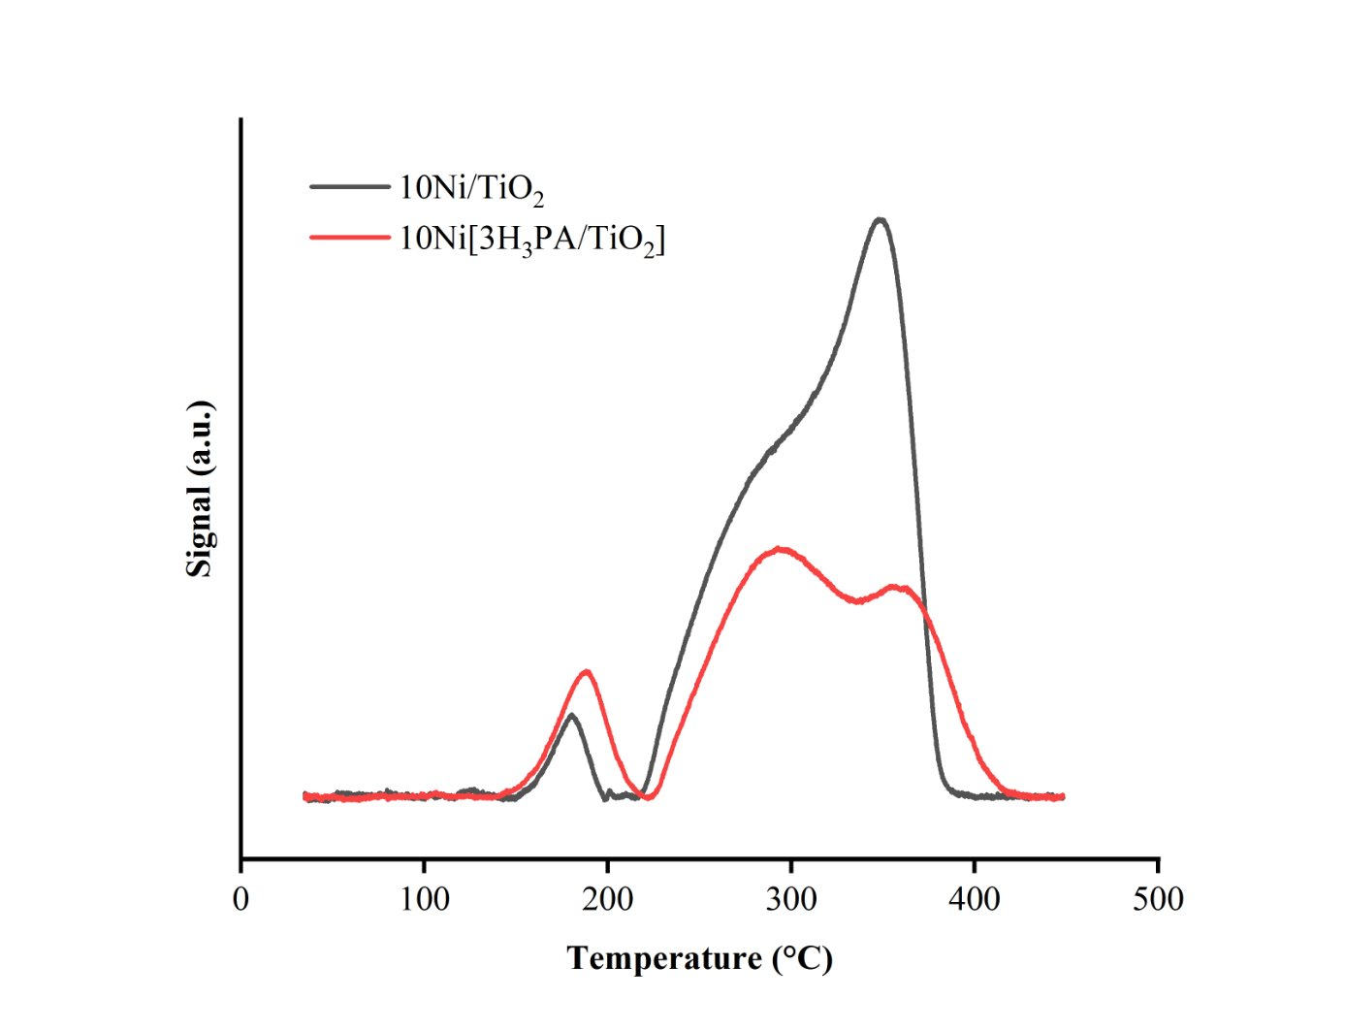
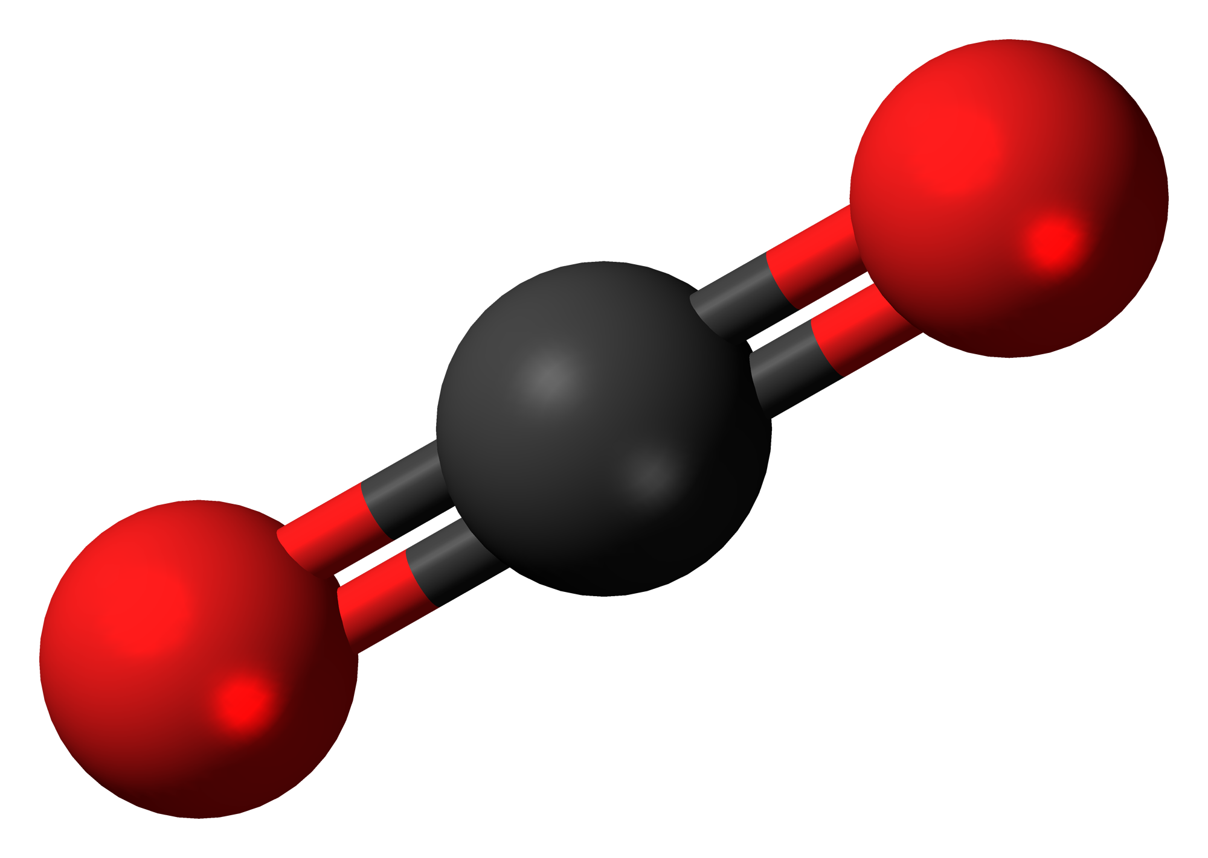
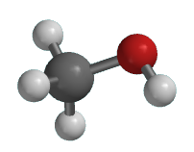
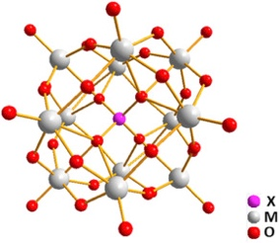
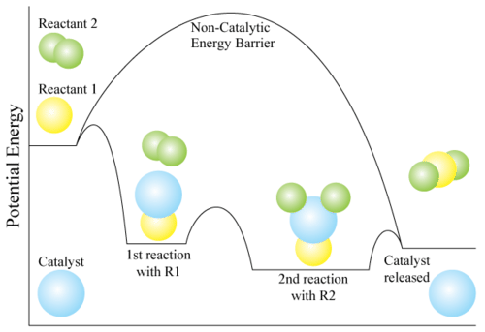
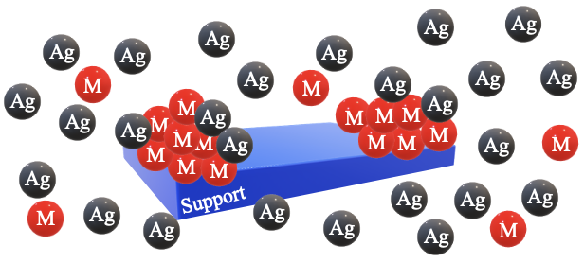
Waste to Wealth: Carbon Dioxide Conversion to Fuels Jaxon Boudreau, Dr. Nan Yi Chemical Engineering and Bioengineering, University of New Hampshire, Durham, NH 03824
Broad Impact
Nickel –Titanium Dioxide – Heteropoly Acid Catalysts
Global warming impacts the health of ecosystems around the world [1]
Efficient and effective removal of greenhouse gas emissions mitigates environmental impact
Catalysis plays a critical role in the chemical conversion of carbon dioxide
Thermal Gravimetric Analysis
Hydrogen Temperature Programmed Reduction
Activity Test
Summary
Optimal calcination temperature is 300ºC
The addition of heteropoly acid affects the interaction between nickel and titanium dioxide
Lower heteropoly acid loading leads to higher carbon dioxide conversion
10Ni[5H₃PA/TiO₂]
10Ni[15H₃PA/TiO₂]
10Ni[10H₃PA/TiO₂]
10Ni[3H₃PA/TiO₂]
$${CO}_{2}+ H_{2}$$
$$CH_{3}OH+ H_{2}O$$
$$CH_{4}+ {2H}_{2}O$$
Heteropoly Acid
(H₃PW₁₂O₄₀ | H₃PA)
Titanium Dioxide
(TiO₂)
Pretreatment: 450ºC for 2 hours with 30%H₂/He
Reaction Conditions: CO₂/H₂/He 1:4:18 |
0.1g | 52.5 mL/min
Catalysis
Nickel-Silver / Copper-Silver Supported Catalysts
Catalysts have the ability to adjust the rate of a chemical reaction
The goals of catalytic design are to produce a selective, active, and stable material
- Base metal (Cu or Ni)
Summary
Galvanic displacement is a well-controlled kinetic process
Amount of base metal that can be galvanically displaced is determined by i) temperature and concentration of reducible cation; ii) fraction of base metal existing in zero-valent state
Reaction time becomes an important variable for lower rates of displacement
- Support (SiO₂ or Al₂O₃)
Galvanic displacement
Reduction Potential
${Ag}^{+}+1e^{−}→Ag \left(∆E=0.80V\right)$
$Cu→{Cu}^{+2}+2e^{−} \left(∆E=−0.34V\right)$
$Ni→{Ni}^{+2}+2e^{−} (∆E=0.26V)$
Figure 1. Effect of a catalyst on a chemical reaction [2]
Table 1. Cost of precious metals [3]
Metal | Price Per Ounce
Copper (Cu) | $0.21
Nickel (Ni) | $0.66
Silver (Ag) | $19
Platinum (Pt) | $881
Gold (Au) | $1,715
Palladium (Pd) | $1,945
Rhodium (Rh) | $15,350
Future Work
Acknowledgements
References
Chemisorption to determine the active sites
Scanning Transmission Electron Microscopy analysis to understand the morphology
Dr. Nan Yi’s research group at the University of New Hampshire (special thanks to Matthew Noyer)
Dr. John Monnier’s research group at the University of South Carolina
Hamel Center of Undergraduate Research
The National Science Foundation
Bulletin of the American Meteorological Society, 2005, 86, 1571
Chemical Society Reviews, 2014, 43, 8226
Resources Policy, 2015, 45, 255

