Slide 1
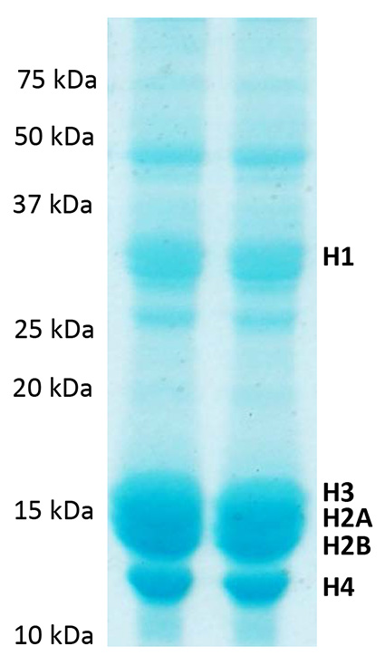
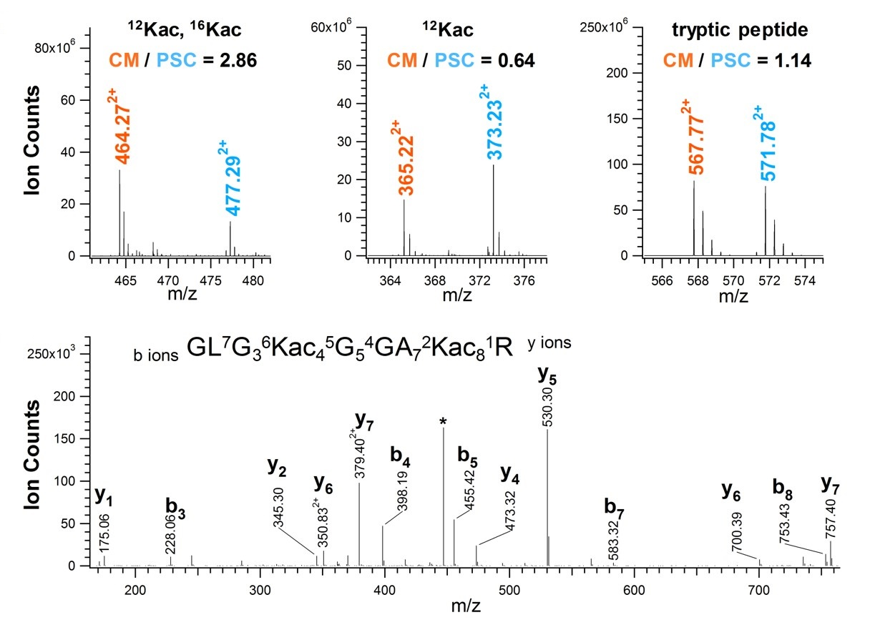
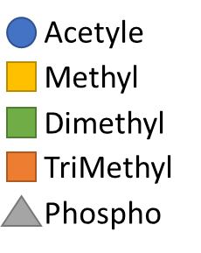
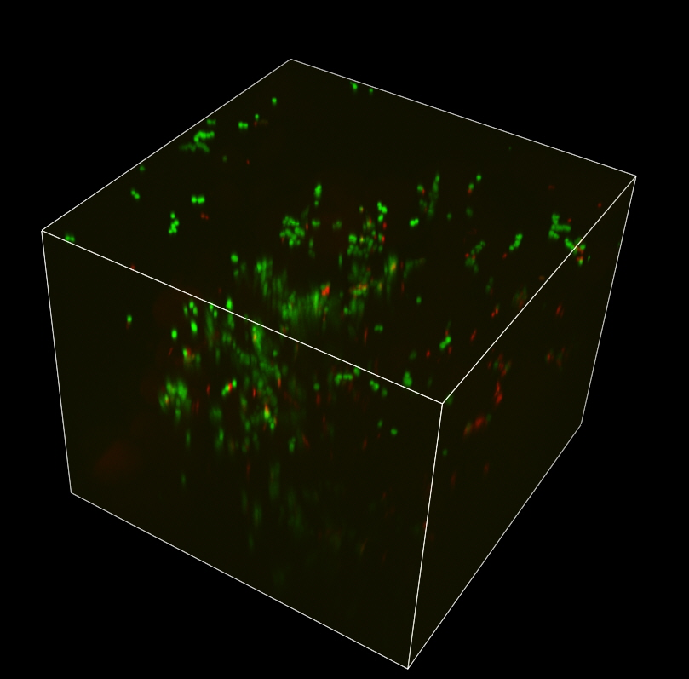
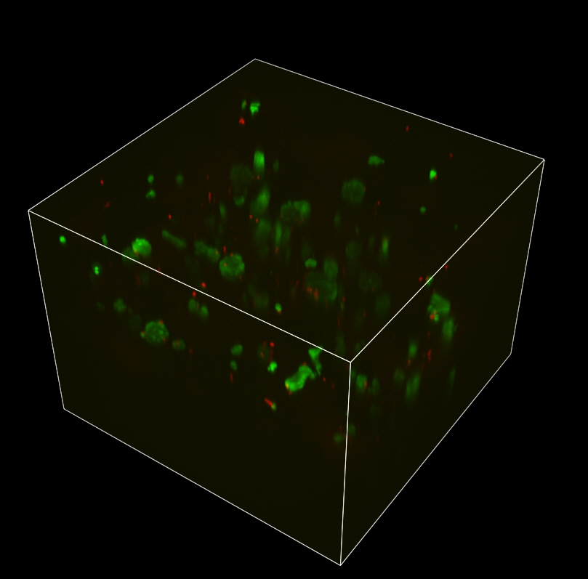
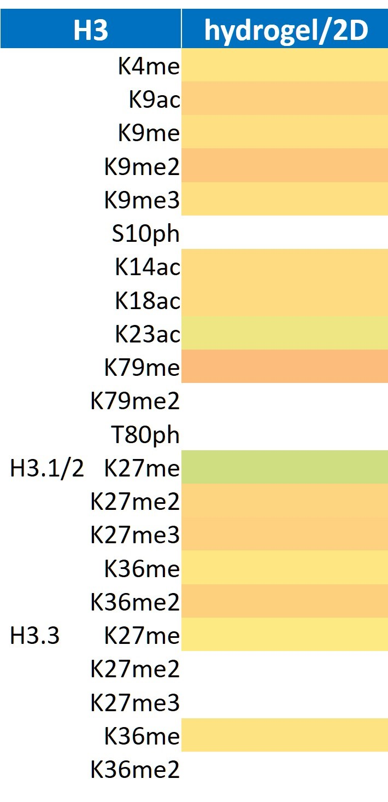
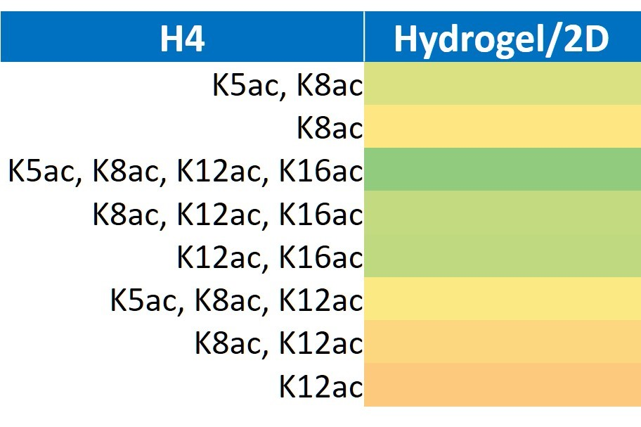
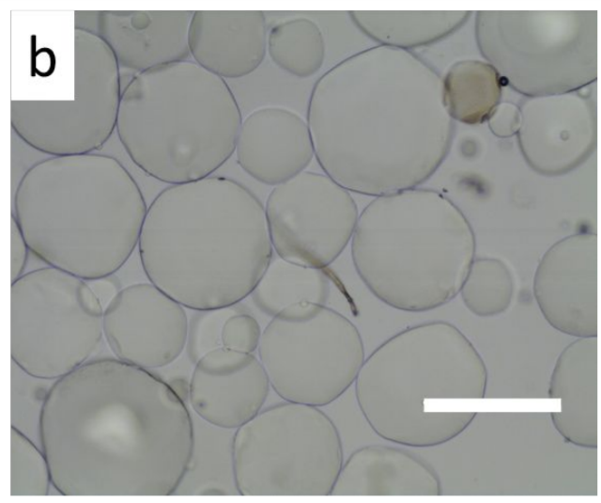
Histone Modifications during the Differentiation of Embryonic Stem Cells into Cardiomyocytes
University of New Hampshire - Chu Lab
Nan Yang
Histone modifications
Data Analysis
Chromatin fibers are composed of polymers of nucleosomes.
A nucleosome contains about 200 bp of DNA wrapped twice around an octamer composed of two copies of each histone protein: H2A, H2B, H3 and H4.
Histones are highly conserved proteins with a flexible N-terminal tail which can carry post-translational modifications such as acetylation, phosphorylation, ubiquitination, methylation.
Post-translational modifications in histone can influence a multitude of cellular processes, including transcription, replication, DNA repair, differentiation and so on.
SILAC Strategy (Stable Isotope Labeling of Amino Acids in Cell Culture)
Acid extracted histone proteins purified from equal number of undifferentiated mESCs and CMs derived from mESCs, differentially labeled with either light or heavy isotope Lys/Arg amino acid.
SDS-PAGE Gel
Results
Cells in Hydrogel and Differentiation
A
B
C
Cardiomyocyte Differentiation
Identifying epigenetic barriers in the ESC to CM transition
1 hour
24 hours
3D
2D
Cell Culture
Differentiation
Acid Extraction
SDS-PAGE
In-gel Digestion
Mass Spectrometry
Data Analysis
Living cells after 48 hours
Mass Spectrometry Data
0.4
ESC in Macroporous Hydrogel
0
-0.45
Assess the effects of microporous hydrogel on the epigenetic states
Biomimetic macroporous hydrogel can be modified to enhance CM differentiation and maturation process.
Heart disease leads to permanent damage and scarring of the heart muscle because of limited regenerative capacity of the adult human heart.
Decrease in transcription marks (e.g. H3K4me, K9ac, K14ac, K18ac, K36me, K79me; H4K5ac, K9ac, K12ac)
Increase in constitutive heterochromatin mark (H3K9me3)
Significant increase in H4K16ac levels in CM differentiation.
D
Hou, S., Lake, R., Park, S., Edwards, S., Jones, C., & Jeong, K. J. (2018). Injectable Macroporous Hydrogel Formed by Enzymatic Cross-Linking of Gelatin Microgels. ACS Applied Biomaterials.

