Slide 1
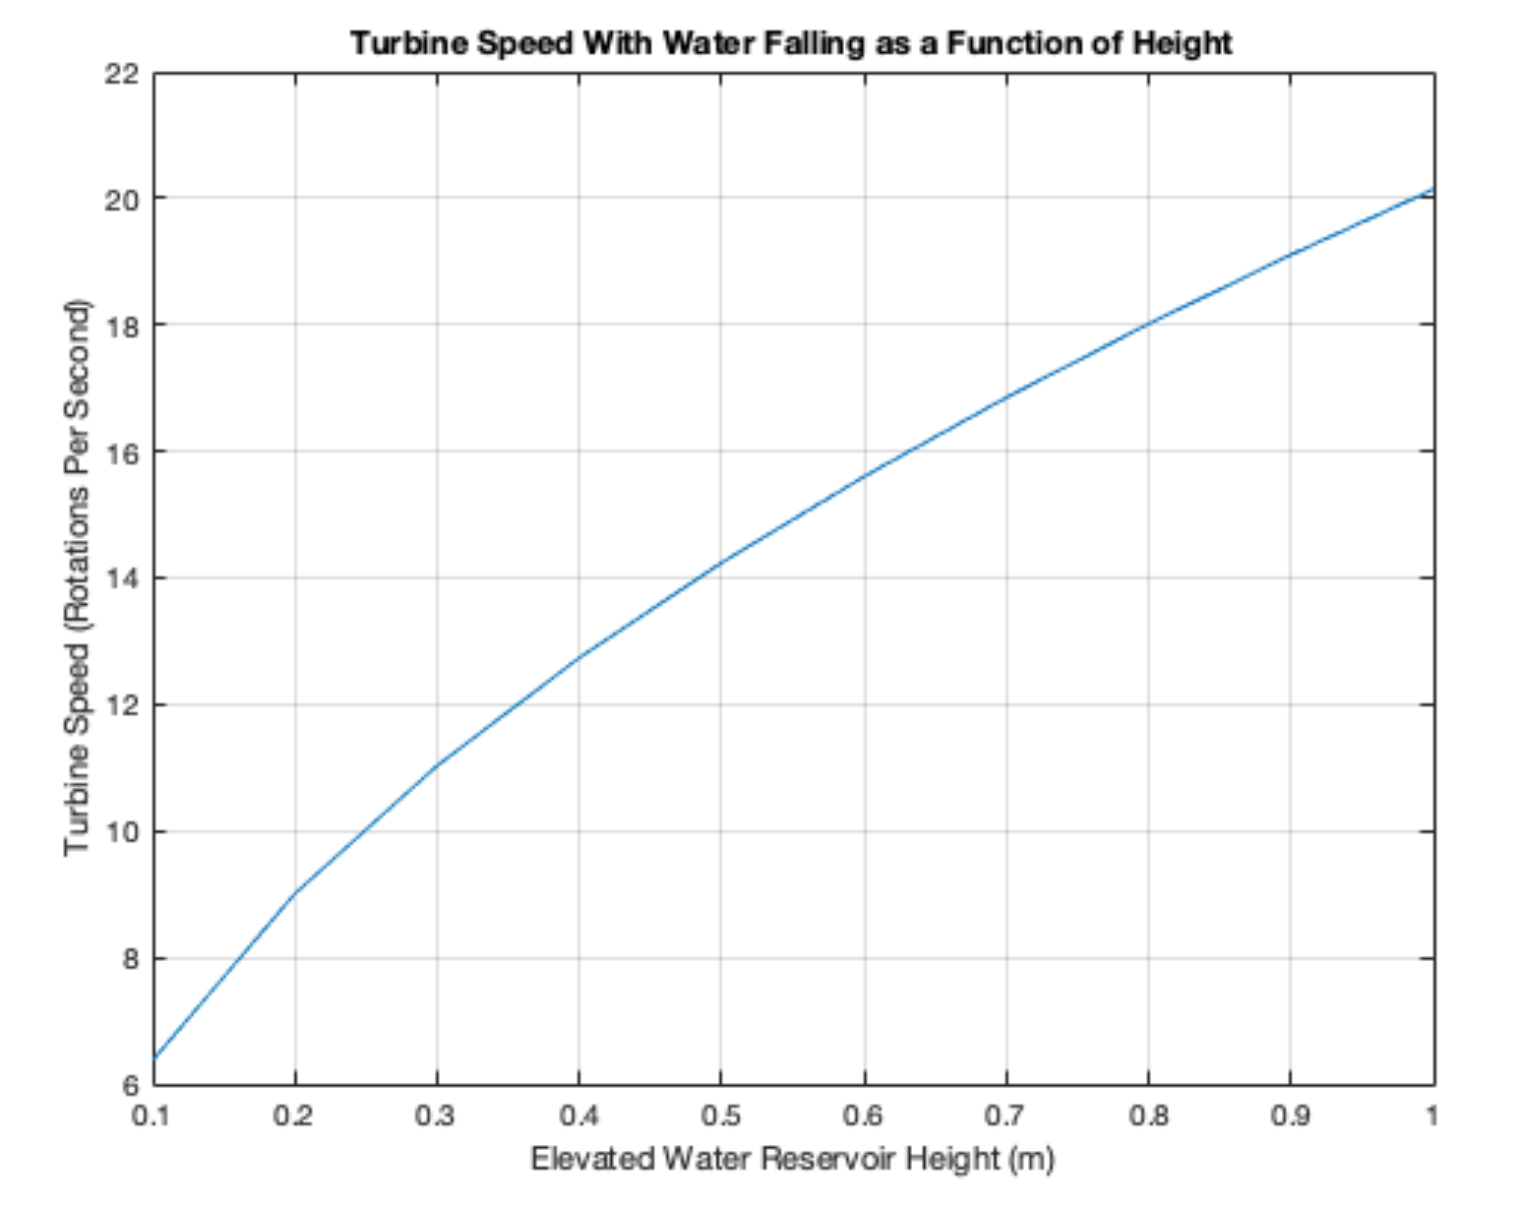
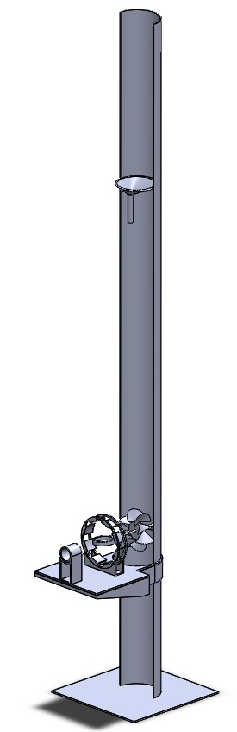
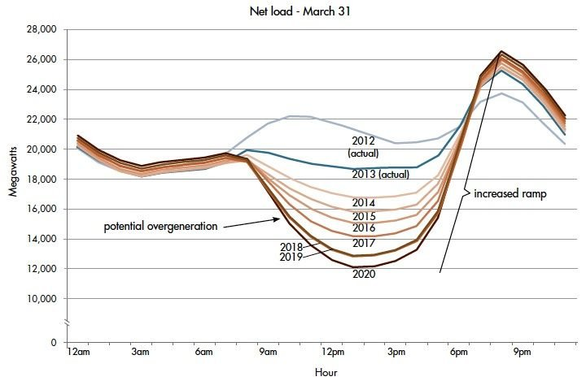
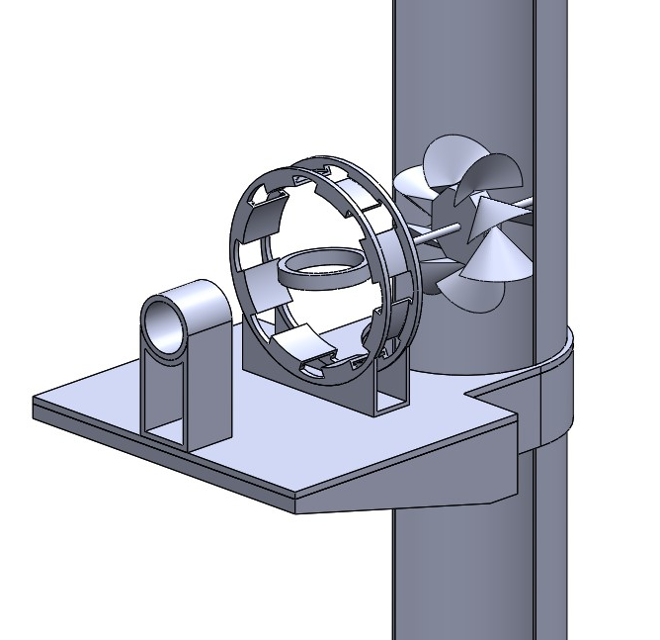
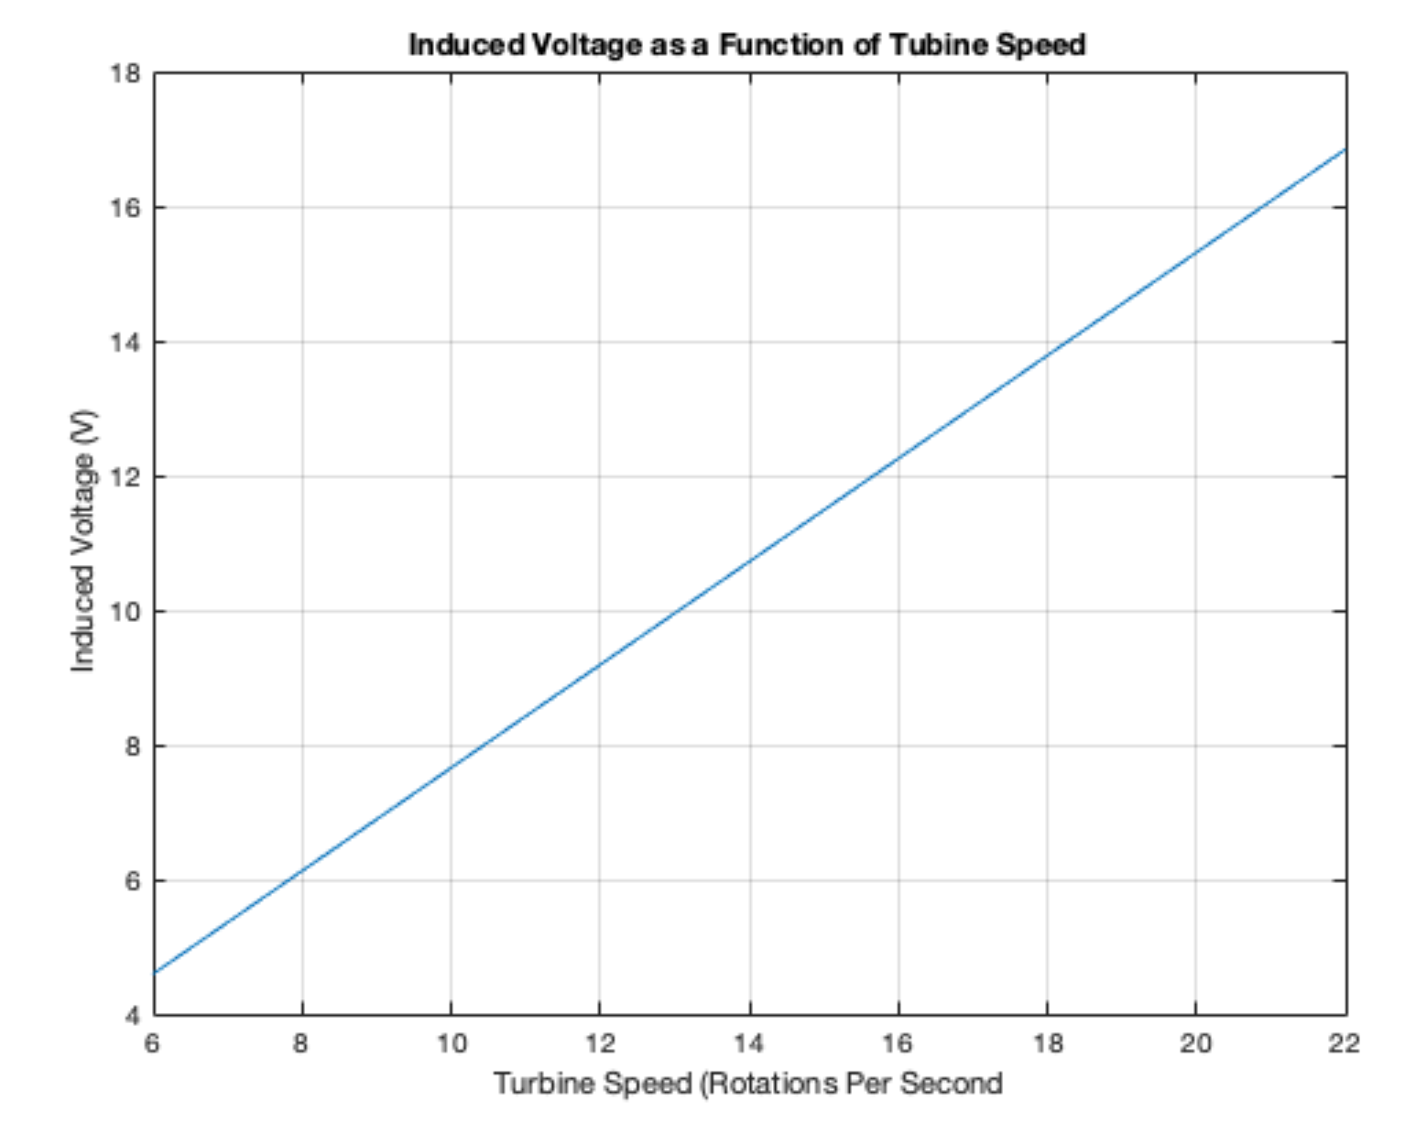
The Efficiency of a Hydro Pumped Energy Storage System
By Matt Hamilton, Advisor Professor Se Young Yoon, Department of Electrical and Computer Engineering, University of New Hampshire
background
Results
Design methods
Hydro pumped energy storage is a type of energy storage system that utilizes two water reservoirs at different elevations to store and generate electricity.
During periods of low energy demand or excess generation, electricity is used to pump water from the lower reservoir to the upper reservoir.
When energy demand is high, water is released from the upper reservoir back down to the lower reservoir through turbines, generating electricity as it descends.
This method has proven highly effective for large scale grid energy management, providing a renewable and flexible solution for balancing supply and demand, and enhancing grid stability.
On a customer scale in which distributed generation is utilized, lithium-ion batteries are the most popular solution. Lithium-ion batteries are highly efficient, but pollute the environment when disposed of.
Each component of the water turbine system was fabricated using a 3D printer. This allowed for precise control over the shape and dimensions of the parts
The mechanical aspect took a long time to make functional, as the water needs to fall in a stream and straight down.
Once assembled, the generator was tested by spinning it manually.
However, an issue was identified with the slip rings. The slip rings in question introduced excessive friction, which caused the operation of the turbine to fail.
Calculated the speed at which the turbine would spin using physics
Chose a magnet type (N42) due to its high magnetic field properties
Using Faraday’s laws, calculated the number of coils needed for 12V.
Utilized SolidWorks for designing all parts, which were used for 3D printing
Turbine Speed With Water as a Function of Height
Induced Voltage as a Function of Turbine Speed
“Duck” Demand Curve
Source: Energy.Gov
objectives
Generator Design
conclusions
Have a working prototype
Improve the efficiency of the system by altering the generator parameters
New ways of sustainable energy storage systems is crucial to a cleaner grid and environment.
The efficiency of systems is extremely important, and every component has its challenges and necessary adaptations to achieve high efficiency
System Design

