Slide 1

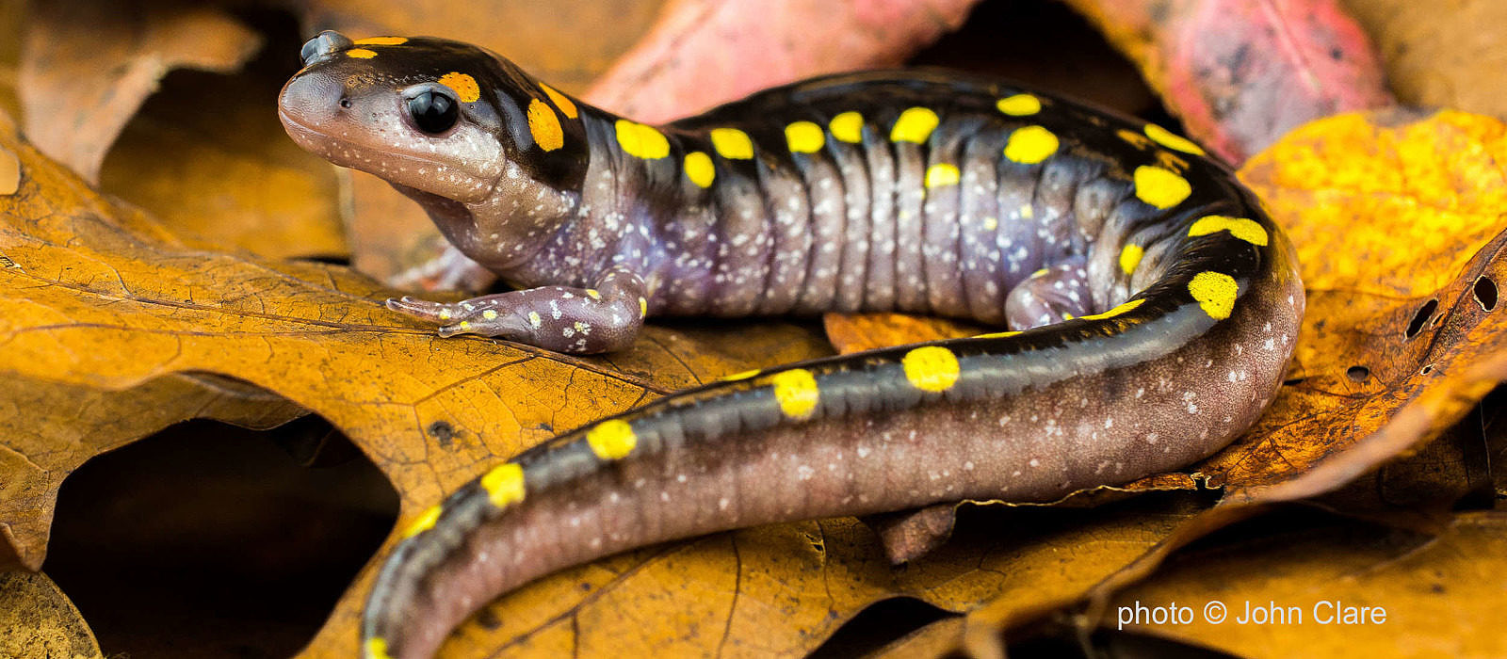
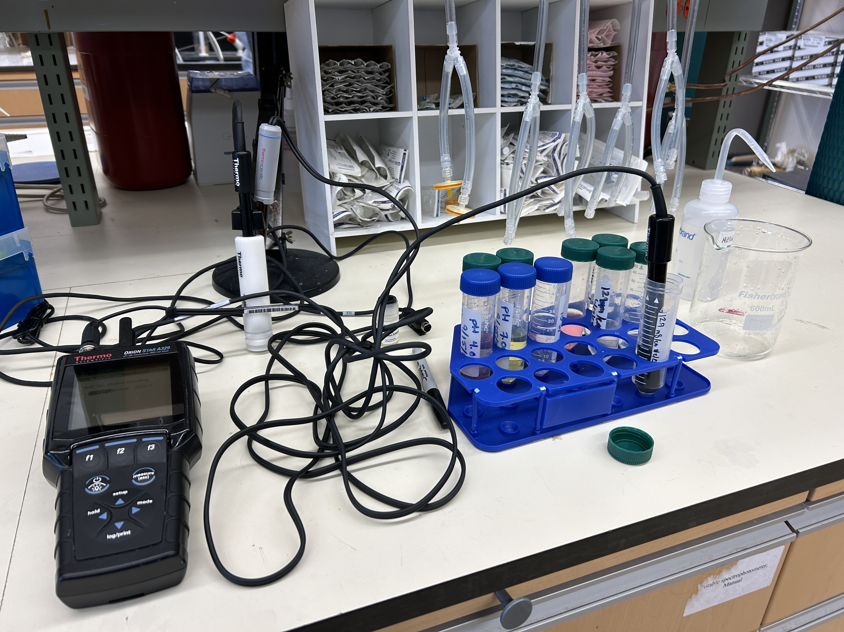
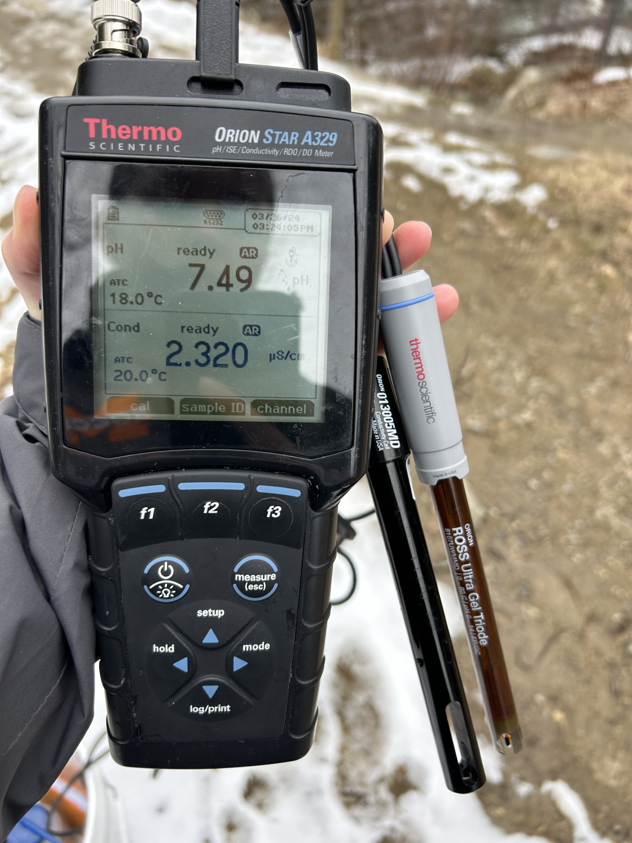
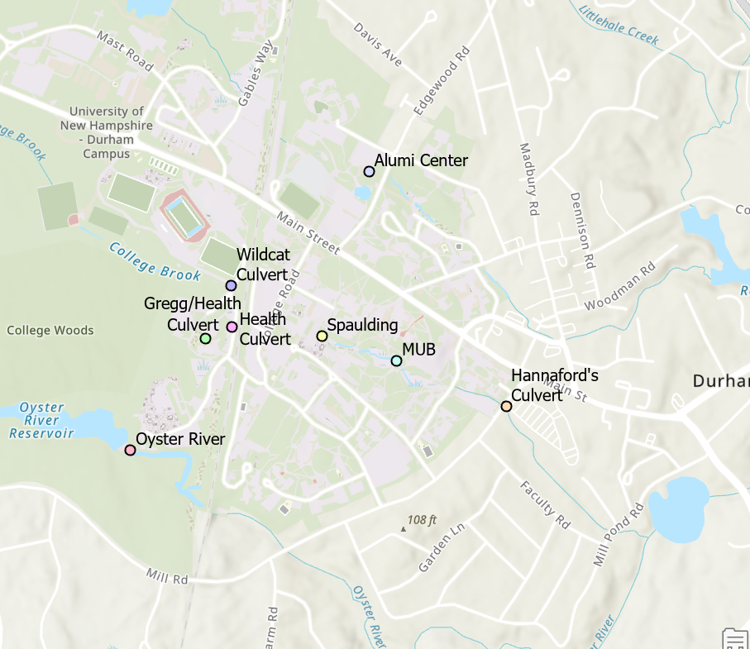
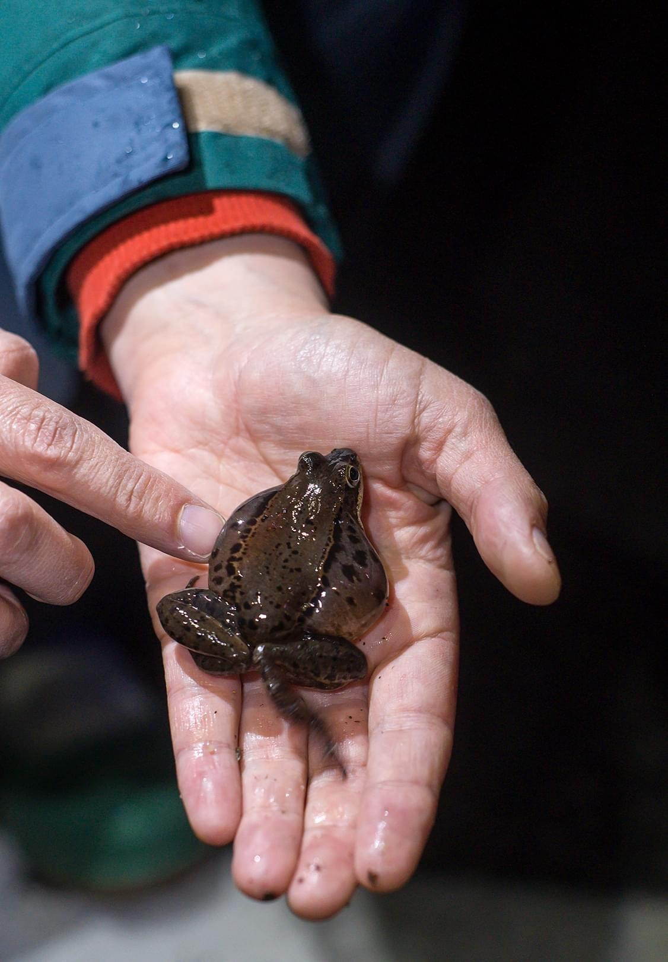
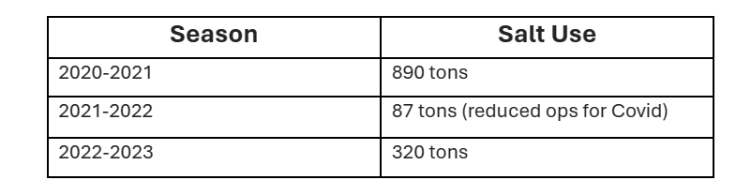
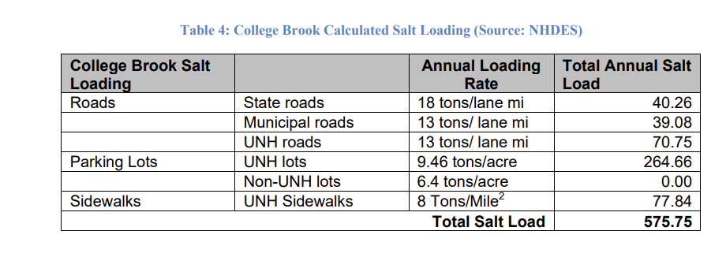
The Effect of Road Salt Runoff in Surface Waters around the University of New Hampshire
Tucker Hadwen and Kate Bowman
Advisor: Dr. Paula Mouser
Department of Civil and Environmental Engineering, College of Engineering and Physical Sciences
Background
Methodology
Salt is used on walkways and road to absorb water and make it less slippery to the user which is why it is used frequently in the winter, particularly when there is snow, or a possibility ice could form.
Salt that makes its way into water can cause that body of water to fluctuate in its pH and conductivity levels
This could potentially affect amphibians and their abilities to breath and their development.
Road salt has also been shown to reduce overall biomass in effected areas.
At moderate (500uS) and high (3000uS) conductivity, embryonic and larval survival decreases with the greatest effects of this being within 50m of roadways
CALIBRATION OF PROBES
LOCTATIONS OF SAMPLING
Each day we collected samples, we calibrated both the pH probe and the conductivity probe in the lab, shown in Image 2, before using them in the field for testing.
When we went out to take samples, we went to the same spots, shown in Image 4, to test the water's pH, conductivity, and temperature with the meter and probes shown in Image 3. Between each location we rinsed the probes with distilled water for the best results
Image 1: Photo by John Clare in 7 Reasons Amphibians are Awesome Article- By Brett Amy Thelen and Dave Huth
Source: IMPACTS OF ROAD DEICING SALT ON THE DEMOGRAPHYOF VERNAL POOL-BREEDING AMPHIBIANS BY- NANCY E. KARRAKER, JAMES P. GIBBS, AND JAMES R. VONESH
Image 2: Maine Big Night- Amphibian Migration Monitoring (Facebook Page)
Image 3: Lab Setup to calibrate probes
Image 4: Conductivity/pH Meter and probes
Image 5: Map of 8 Sites used for testing
UNH Salt Reduction Plan
Results
As of 2013 the EPA classifies College Brooke as being impaired for chloride concentration.
  Needed a 48% load reduction from 962 tons of salt in the 2012-2013 winter.
  Solutions provided included implementing better equipment and recalibrating equipment.
  962 tons of NaCl were used in 2012-2013 and then 320 tons in 2022-2023. Resulting in a 67% reduction in use.
PRELIMINARY DATA VISUALIZATION
Table 1 (left): Shows the amount of salt used during each winter season and how the amount of salt used has largely decreased from 2020-2021 to 2022-2023. Table given to us by Will Powers
Motivation and Research Objectives
Figure 1 (above): Shows the change of conductivity levels over time of sites around the campus of the University of New Hampshire. It shows how during winter there is an increase in the amount of conductivity in the bodies of water and how during weeks of big snow there is a sharp increase due to more salt being put out during those times.
Figure 2 (above): Shows the change of pH levels over time of sites around the campus of the University of New Hampshire. The pH stays relatively the same, but dips and increases in spots over the winter and during snowstorms.
Figure 3 (above): Shows the change in temperature each day of each location of the surface water throughout the testing process.
Test bodies of water around campus for pH and conductivity levels and see if/how road salt affects those levels. If it does change the levels, learn how it might affect amphibians living in this habitat.
Learning if levels of pH and conductivity in water areas change more during the winter due to road salt entering or if UNH does a good job with the amount of road salt put out and it doesn't affect the levels as much
ADDITIONAL COLLEGE BROOK DATA
DATA CONCLUSIONS
TEMPERATURE VS CONDUCTIVITY FINDINGS
From the conductivity graph you can see in most locations there was a constant increase in conductivity levels showing the salt influences in these areas as winter progresses
We can conclude from this data that salt is entering these waters and fluctuating with their normal levels which could impact amphibians in these areas
OBJECTIVES
Table 2 (above): This table shows the amount of salt put near college brook. This data was collected from NHDES.
To determine the effect of road salt runoff on surface water around campus.
Learn how extra salt in areas of waters around campus affect the pH and conductivity of the water and in turn how that affects wildlife in those areas.
Figure 4 (above): Shows the change in conductivity in relation to temperature.
Acknowledgements
Dr. Paula Mouser: guidance and feedback throughout the project process; Katherine Wieck, Leila Hassanpourmoghadam: feedback throughout the project and poster creation process

