Slide 1

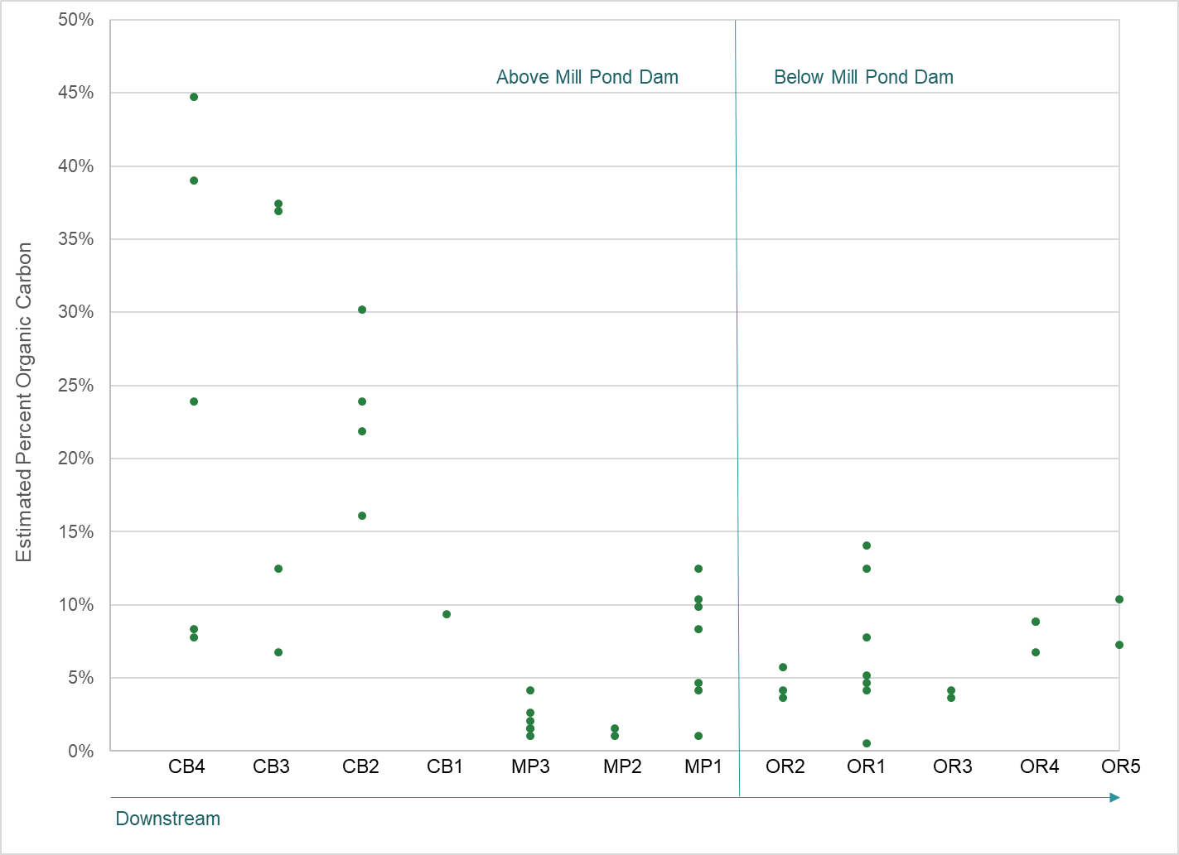
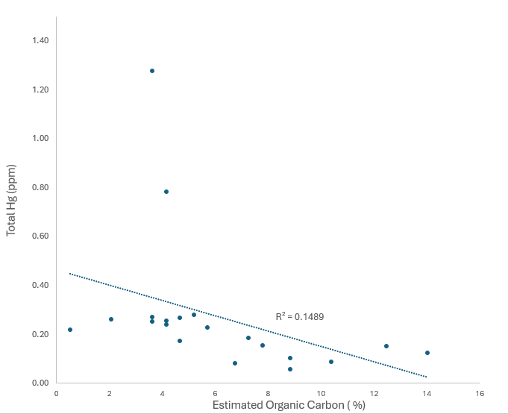
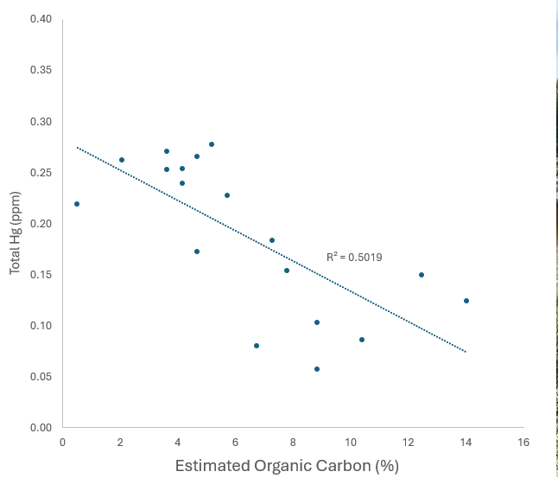
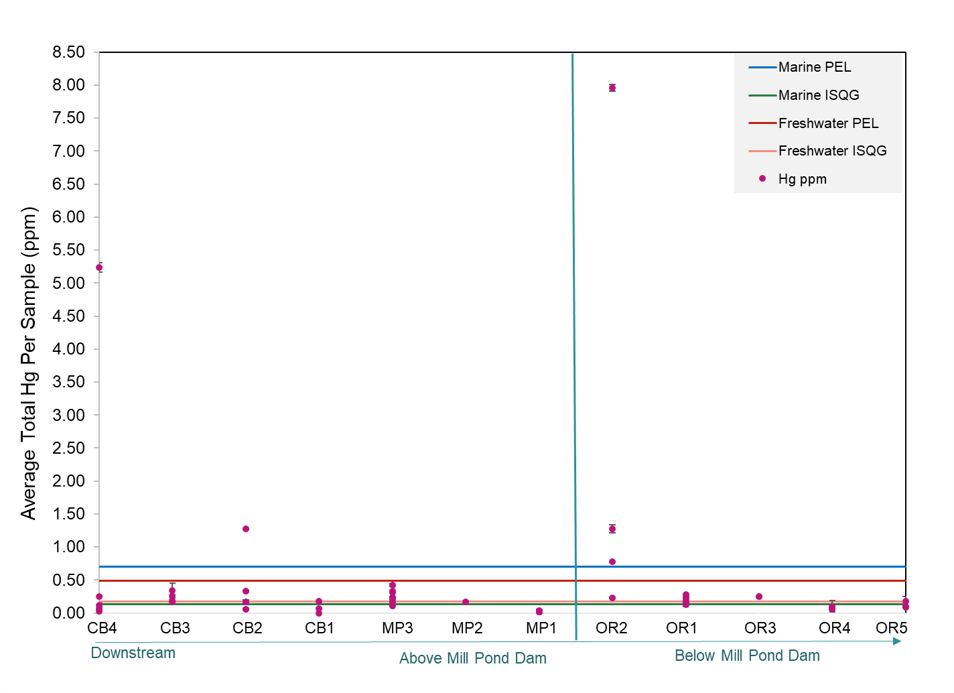
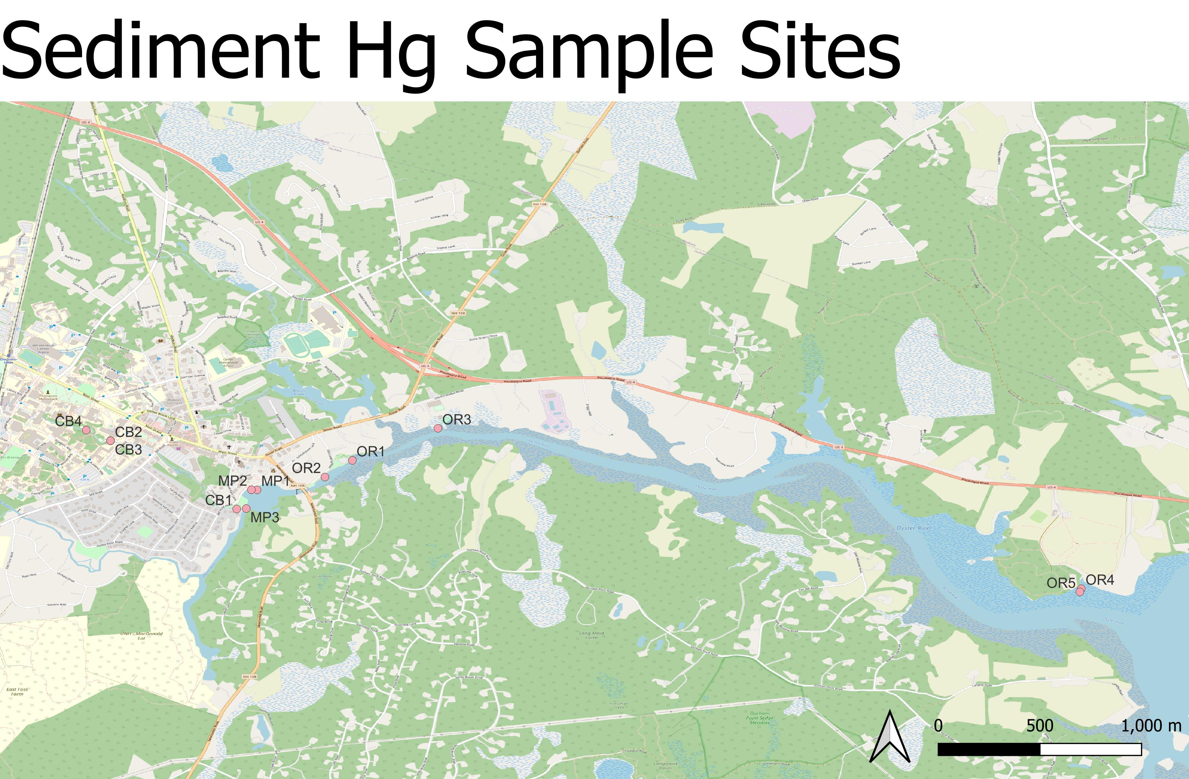
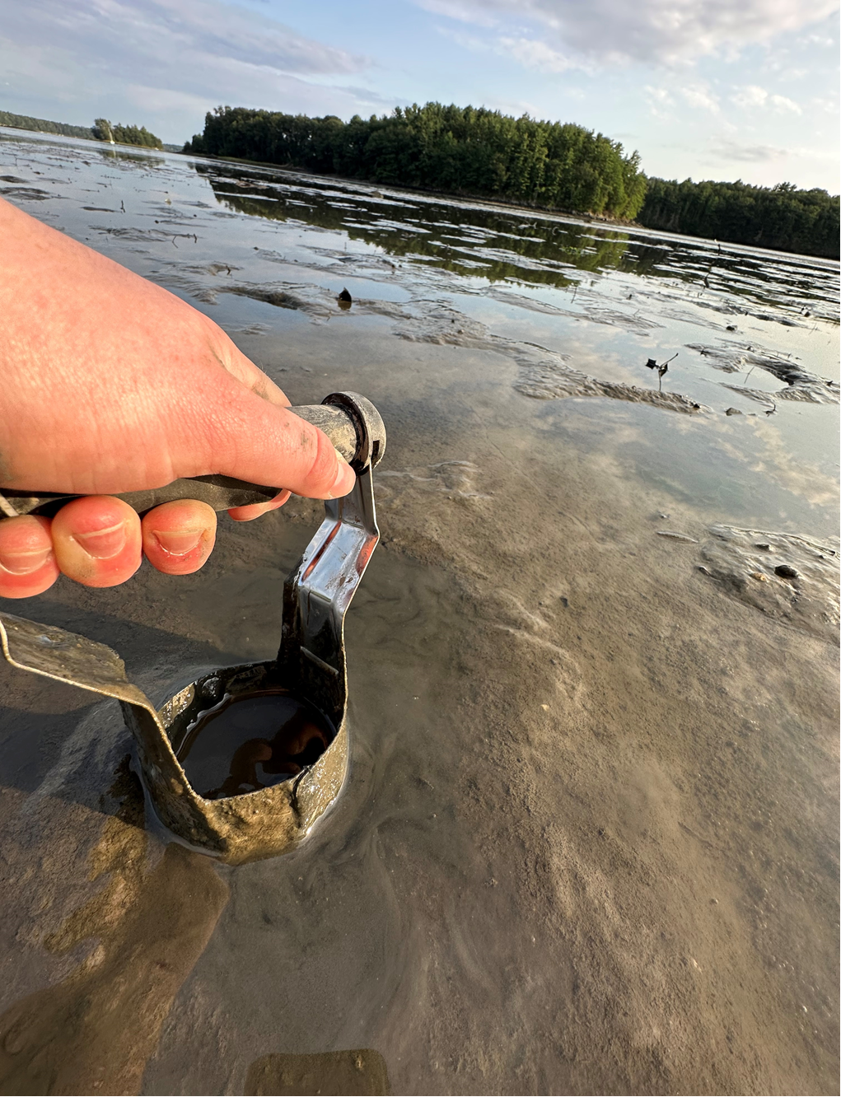
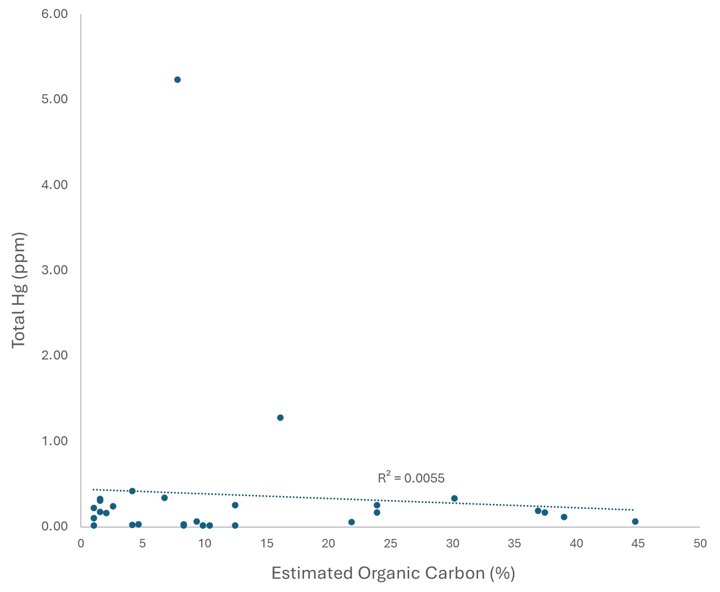
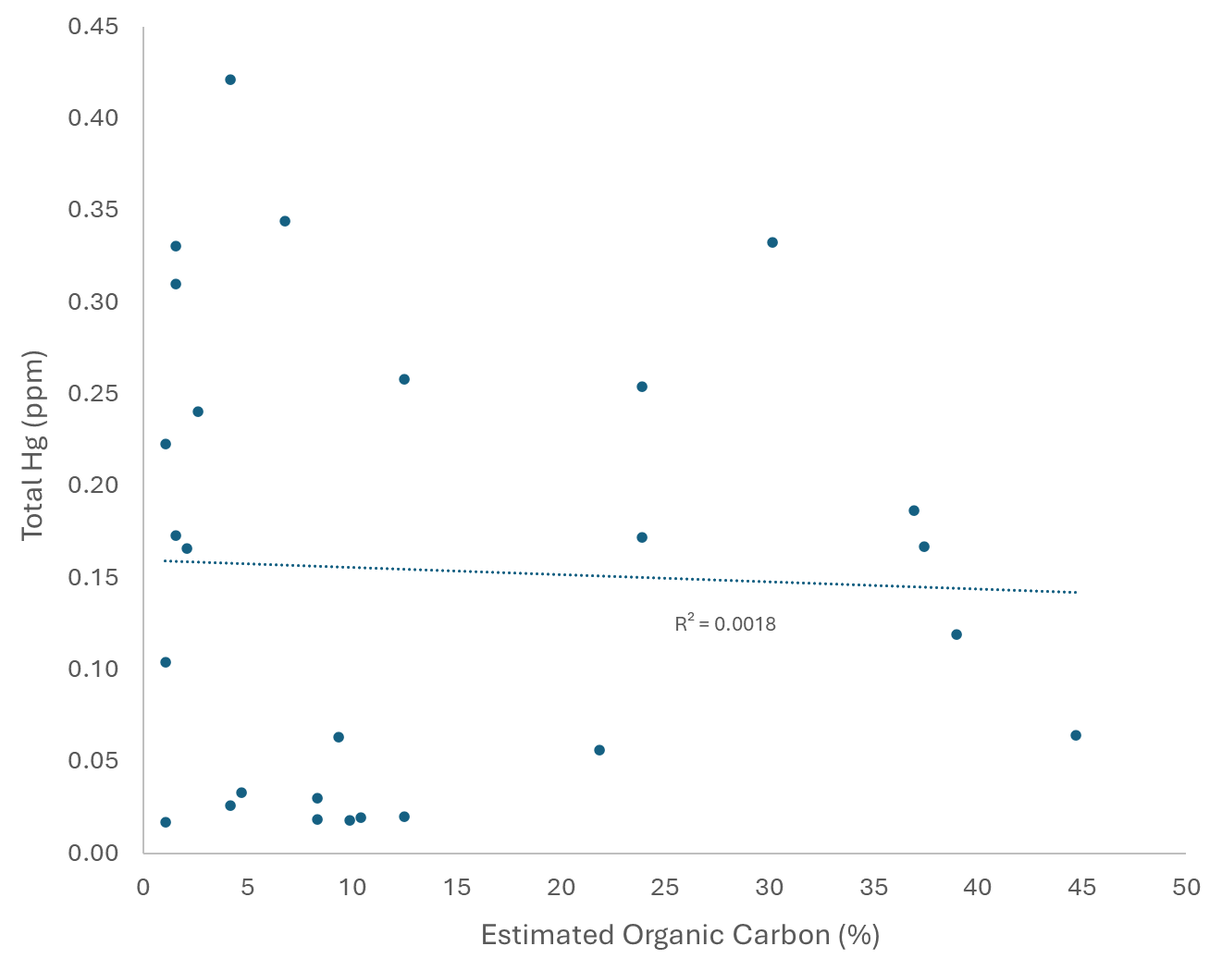
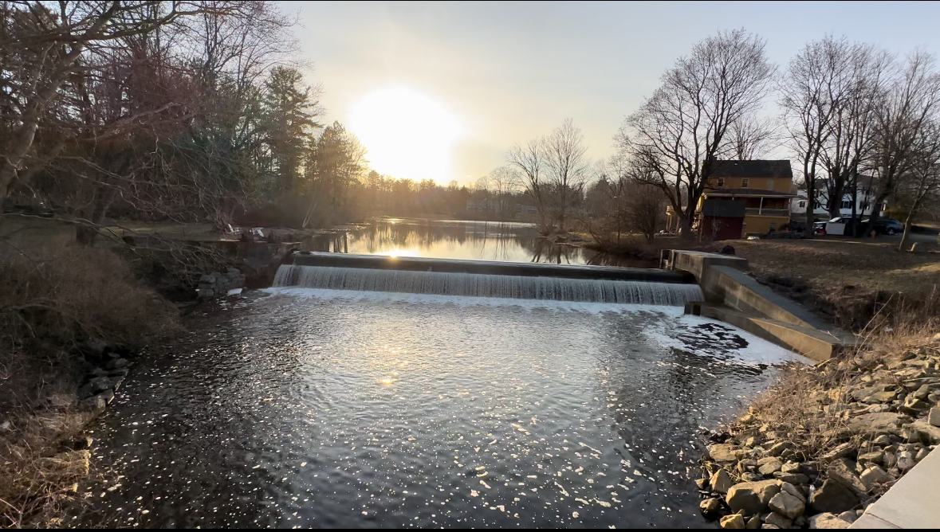
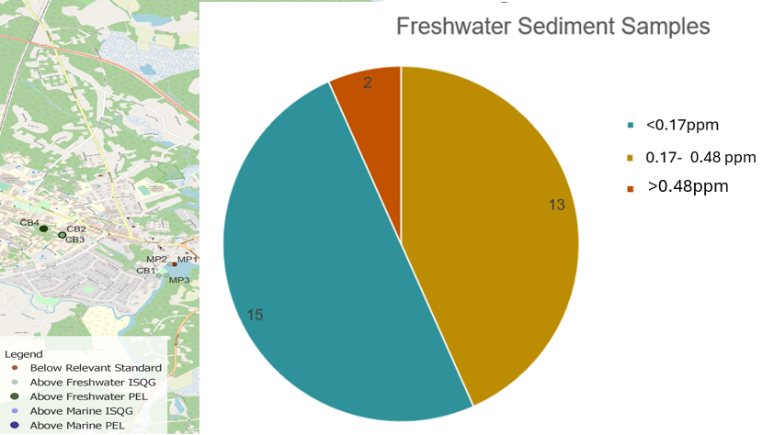
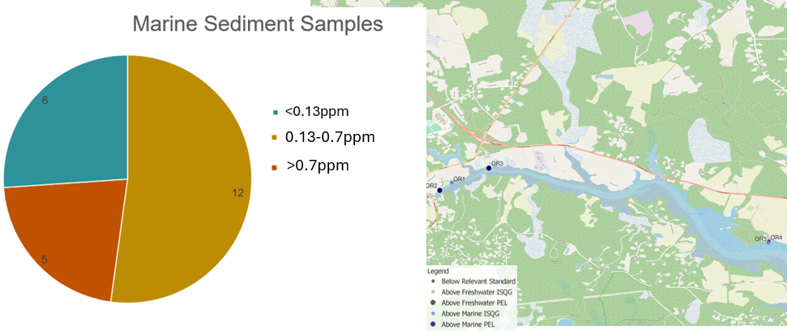
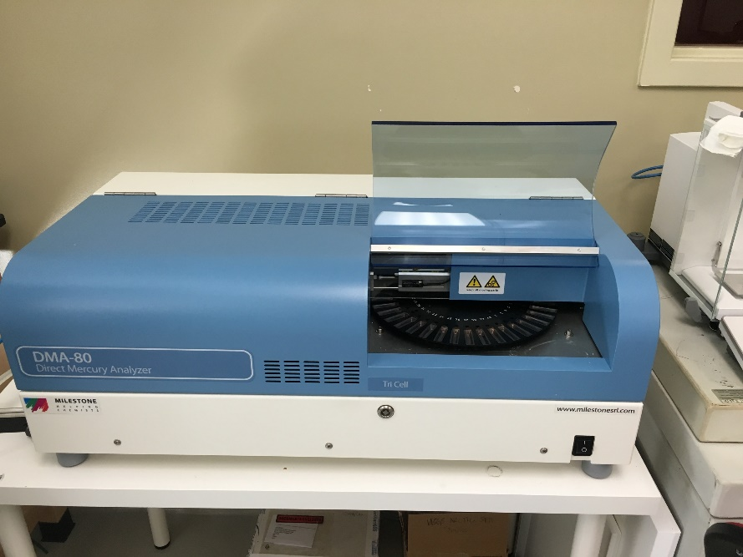
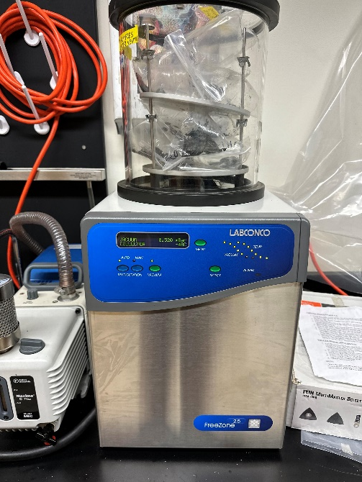
Sediment Mercury Above and Below the Head of Tide Mill Pond Dam in Durham NH
Julia Ward B.S Environmental Science | Advisors: Julie Bryce, Maria-Florencia Fahnestock
Department of Earth Sciences | University of New Hampshire
Background
Sample characterization
Discussion
The Mill Pond Dam, a head-of-tide dam in Durham, New Hampshire, separates tidal waters from fresh water in the Oyster River.
The Town of Durham voted to remove the dam in March 2022, due to interest in restoring the original wetlands and concerns of the structural integrity of the dam. (Dandurant, 2022)
Dam removal is a prominent issue in United States. In New Hampshire, 5% of dams have been removed, and only 7% of those removed have been studied (Foley et al., 2017). It is important to study sediments behind dams, as they could contain contaminants that could be transported downstream upon dam removal.
A contaminant of concern in Mill Pond is mercury (Hg). Prior research has identified areas with elevated levels of total Hg in cored sediments in Mill Pond (Miller, 2020). Mercury, particularly its methylated bioaccumulative form, is of chief environmental concern (Driscoll et al., 2013).
The Great Bay, the watershed below the Mill Pond Dam, contains elevated Hg concentrations that are higher then other local estuaries, and have the potential to cause adverse effects to the ecosystem. (2023 State of Our Estuaries Report, 2023). It is important to prevent more Hg from entering this watershed upon the removal of the Mill Pond Dam. Project goals were to evaluate how Hg concentrations, together with organic matter, varied above and below the Mill Pond Dam.
Figure 2: Percent estimated organic carbon per sample site. There were variable amounts of organic carbon in individual sample sites and throughout the whole watershed
Sediments both above and below the Mill Pond dam contain variable total sediment mercury concentrations both within each sample and across the watershed (Figures 2,3).
The Still River Watershed which drains into the Long Island Sound is a known Hg legacy contamination site. Surface sediment in this watershed contained Hg concentrations ranging from 0.13-1.9ppm (Anatone et al., 2020). Many sediment Hg concentrations in the Mill Pond-Oyster River watershed exceeded this range.
In an uncontaminated estuary, Hg tracks with a strong correlation to dissolved organic carbon. In contaminated estuary sites, there is internal cycling of mercury within the watershed, and Hg does not track or have a correlation to dissolved organic carbon (Seelen et al., 2021).
In the samples below the dam in the Oyster River, there was no relationship between the estimated amount of sediment organic carbon and mercury when all the samples were considered. When just the samples below the marine PEL were considered, there was some relationship between total mercury and organic carbon.
The relationship between total Hg and organic carbon in the marine sediments under the PEL is characteristic of uncontaminated sediments, but the lack of relationship between organic carbon and total mercury in the freshwater sediments resembles that seen in local, or legacy contaminated site.
The lack of relationship between organic carbon in the freshwater sediments above the dam indicates that these sites exhibit characteristics of legacy, local contamination sites.
Results
Figure 5: Relationship between estimated organic carbon, and total mercury in the marine sediment samples (left). Relationship between total Hg and estimated organic carbon in the marine sediment sample below the PEL (right).
Study Sites and sample collection
Samples were collected from the freshwater environment above the dam and the estuarine environment below it.
Sediment Samples were collected with a small auger from 1-4’’ beneath the surface.
Figure 6: Relationship between total Hg and estimated organic carbon in all freshwater sediment samples (left). Relationship between percent organic carbon and total Hg in the samples below the freshwater PEL (right).
Sample collection in the Oyster River(left)
The Mill Pond Dam (below)
Mill Pond Dam
Conclusions
Figure 3(left): Total Hg at each site in the Oyster River-Mill Pond watershed. Lines denote sediment quality guidelines. The Interim Sediment Quality Guideline (ISQG) indicates where Hg could be causing adverse effects on the ecosystem. The Probable Effect Level (PEL) indicates the concentration threshold where it is probable the Hg is causing negative effects on the ecosystem.
Sediments in the Oyster River NH watershed above and below the Mill Pond Dam are heterogeneous with respect to Hg content.
Many sites contain sediments marked by elevated Hg concentrations.
Hg-C relationships exhibit characteristics of locally contaminated sites in many of the freshwater sediments.
These findings are relevant to the removal of the Mill Pond Dam.
Figure 1: Complete map of sample sites from College Brook (CB), Mill Pond (MP), and the Oyster River (OR). No samples were collected in the stretch of the Oyster River between OR3 and OR4 as there is no public lands in that area.
methods
Acknowledgments and References
Samples were processed through freeze drying until all moisture was removed and they had a powder like texture
Samples were then analyzed for total mercury with a direct mercury analyzer (Milestone DMA-80).
Sample characterization consisted of loss on ignition analysis. Where Mass differences between an original sample and a heated sample provided an assessment of amount of organic matter loss on ignition which is used as a proxy for organic carbon.
Thank you to the Hamel Center for Undergraduate Research for the S.U.R.F grant which gave me the opportunity to work on this research this past summer. Project support was also provided in part from a New Hampshire NASA EPXCoR grant.
< ISQG
2023 State of Our Estuaries Report. (2023). Piscataqua Region Estuaries Partnership. https://www.stateofourestuaries.org/wp-content/uploads/2023/05/SOOE-2023-Digital.pdf
Anatone, K., Baumann, Z., Mason, R. P., Hansen, G., & Chernoff, B. (2020). Century-old mercury pollution: Evaluating the impacts on local fish from the eastern United States. Chemosphere, 259, 127484. https://doi.org/10.1016/j.chemosphere.2020.127484
Dandurant, K. (2022, March 8). Durham votes to remove Mill Pond dam with 74% of vote and large turnout. Portsmouth Herald. https://www.seacoastonline.com/story/news/local/2022/03/08/durham-nh-mill-pond-dam-vote-remove-oyster-river-school-board/9413482002/
Driscoll, C. T., Mason, R. P., Chan, H. M., Jacob, D. J., & Pirrone, N. (2013). Mercury as a Global Pollutant: Sources, Pathways, and Effects. Environmental Science & Technology, 47(10), 4967–4983. https://doi.org/10.1021/es305071v
Foley, M. M., Bellmore, J. R., O’Connor, J. E., Duda, J. J., East, A. E., Grant, G. E., Anderson, C. W., Bountry, J. A., Collins, M. J., Connolly, P. J., Craig, L. S., Evans, J. E., Greene, S. L., Magilligan, F. J., Magirl, C. S., Major, J. J., Pess, G. R., Randle, T. J., Shafroth, P. B., & Torgersen, C. E. (2017). Dam removal: Listening in. Water Resources Research, 53(7), 5229–5246. https://doi.org/10.1002/2017wr020457
Miller, H. (2020). Contributing to the Field of Dam Removal Science: Analyzing Sediment Characteristics in Mill Pond and Sawyer Mill. Inquiry Journal. https://www.unh.edu/inquiryjournal/blog/2020/04/contributing-field-dam-removal-science-analyzing-sediment-characteristics-mill-pond-sawyer-mill
Seelen, E. A., Chen, C. Y., Balcom, P. H., Buckman, K. L., Taylor, V. F., & Mason, R. P. (2021). Historic contamination alters mercury sources and cycling in temperate estuaries relative to uncontaminated sites. Water Research, 190, 116684–116684. https://doi.org/10.1016/j.watres.2020.116684
Left: Direct Mercury Analyzer-80
Right: Freeze Dryer
< ISQG
Figure 4(above): Breakdown of above and below dam sediment samples. The amount of sediment samples above each sediment quality guideline and where those samples were collected.

