Slide 1

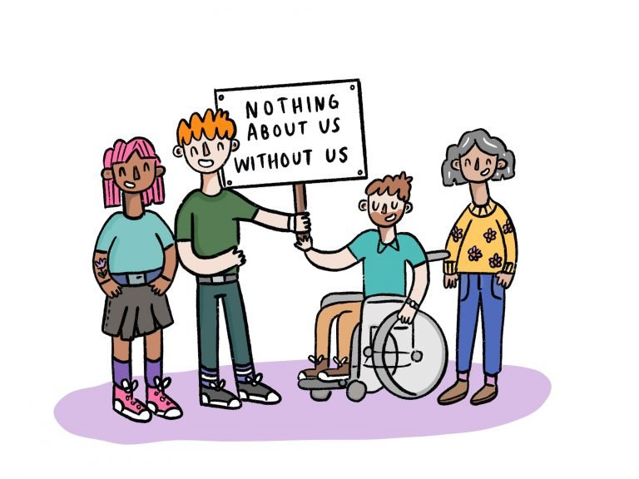
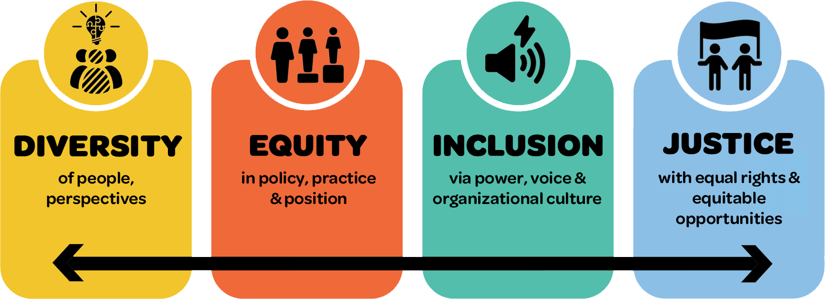



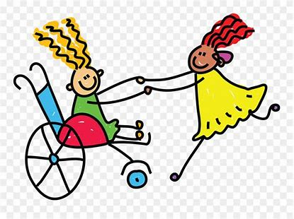
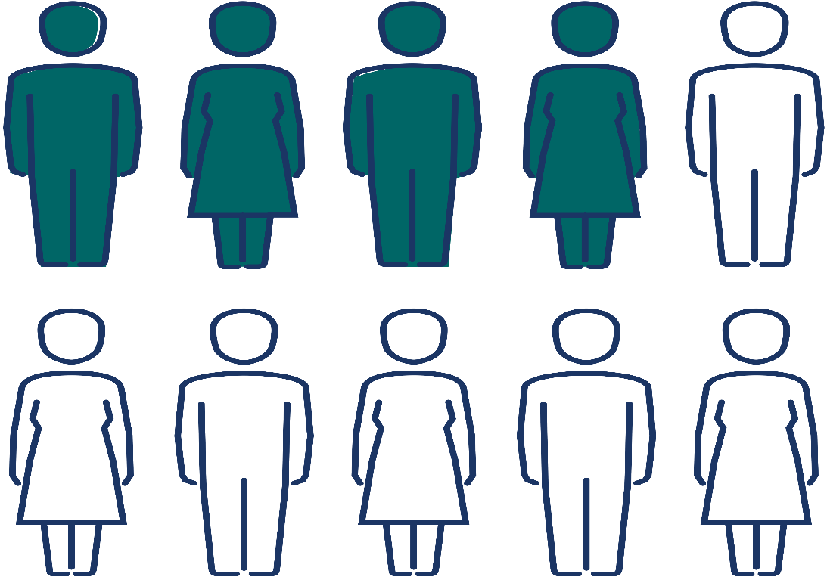
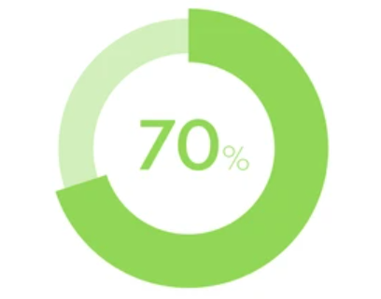
Suicide Prevention for Individuals with Intellectual and Developmental Disabilities (IDD)
Klarissa Wankel, BA Psychology
MSW Student, University of New Hampshire
Introduction
Relevant NH Legislation
The Future of Suicide Prevention
The New Hampshire Council on Developmental Disabilities is a federally-funded state agency that supports public policies and initiatives that remove barriers and promote opportunities in all areas of life for people with developmental disabilities. My LEND placement focused on policy and research in suicide prevention.
“Dedicated to the pursuit of dignity and justice, authentic community inclusion, cultural competency, and self-determination for all New Hampshire residents with developmental disabilities.” (NHCDD, 2024).
Two relevant bills introduced in the 2024 session:
HB 1473: Relative to social-emotional learning in public schools.
HB 1283: Relative to end of life options.
Both bills attempt to target issues in public health and social justice without actually addressing these issues. Neither bill addresses the root causes of suicide for the disability community. Rather, these bills are an easy out for not targeting systemic issues that directly affect those with disabilities in the state of NH.
We must train professionals and caregivers who support those with IDD in recognizing the signs of suicidal ideations in this population.
We must incorporate a trauma- and justice, equity, diversity, and inclusion (JEDI)- framework into suicide prevention practice for the IDD community.
Background Information
NH has a suicide rate higher than the national average (14.43) with 18.38 suicide deaths per 100,000 in the state (NH Suicide Prevention Council, 2022).
A JEDI-framework targets biases and misconceptions that negatively impact the health and well-being of those with IDD (Marraccini et al., 2023).
Suicide Risk and IDD
People with IDD are no less likely to experience suicidal ideations than those without this diagnosis – though this is a common misconception in the healthcare field (Ludi et al., 2012).
Under-identification of mental health disorders due to diagnostic overshadowing in people with IDD (Ludi et al., 2012).
A lack of appropriate suicide screening instruments for those with IDD (Ludi et al., 2012).
Feelings of isolation, burdensomeness, difficulty communicating needs, and limited access to a broader community, especially in rural areas (Washington State DSHS, 2023).
Experiencing abuse, neglect, challenging family circumstances, social disadvantage, peer neglect, peer exclusion, stigma, and political and institutional oppression or ableism (Marraccini et al., 2023).
People with disabilities are 2.5x more likely to make a suicide attempt (Marlow et al., 2022).
The DD Council advocates for policy, research, and community initiatives that seek to improve the lives of those with IDD. All of these things can help lower the rates of suicide in NH.
42% of children and adolescents with IDD are at risk for suicidal thoughts, behaviors, and death by suicide (Ludi et al., 2012).
References
Ludi, E., Ballard, E. D., Greenbaum, R., Pao, M., Bridge, J., Reynolds, W., & Horowitz, L. (2012). Suicide risk in youth with intellectual disabilities. Journal of Developmental & Behavioral Pediatrics, 33(5), 431–440. https://doi.org/10.1097/dbp.0b013e3182599295
Marraccini, M. E., Lindsay, C. A., Griffin, D., Greene, M. J., Simmons, K. T., & Ingram, K. M. (2023). A trauma- and justice, equity, diversity, and inclusion (JEDI)-informed approach to suicide prevention in school: Black boys’ lives matter. School Psychology Review, 52(3), 292–315. https://doi-org.unh.idm.oclc.org/10.1080/2372966X.2021.2010502
Marlow, N. M., Xie, Z., Tanner, R., Jacobs, M., Hogan, M. K., Joiner, T. E., & Kirby, A. V. (2022). Association between functional disability type and suicide-related outcomes among U.S. adults with disabilities in the National Survey on Drug Use and Health, 2015–2019. Journal of Psychiatric Research, 153, 213–222. https://doi.org/10.1016/j.jpsychires.2022.07.014
NH Suicide Prevention Council. (2022). The 2022 Annual Suicide Prevention Report. The Connect Program. https://theconnectprogram.org/wp-content/uploads/2024/03/2022-Annual-Suicide-Report-3-11-2024-Web.pdf
Washington State Department of Social and Health Services. (2023, February). Suicide among people with disabilities. Developmental Disabilities Administration: Caregiver Bulletin. https://www.dshs.wa.gov/sites/default/files/DDA/dda/documents/Suicide%20Among%20People%20with%20Disabilities.pdf
In a study of adults with IDD, 70% of clients who experienced suicidal ideations were not identified by caregivers or professionals (Ludi et al., 2012).

