Slide 1
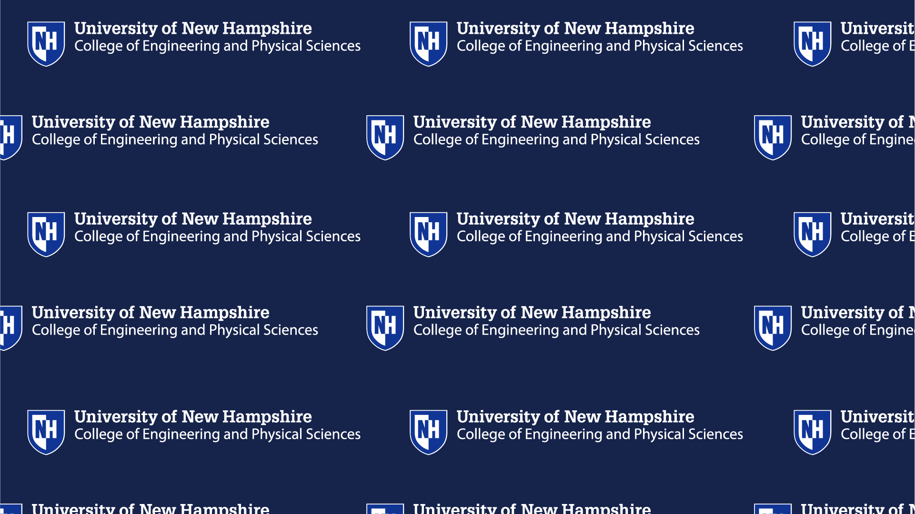


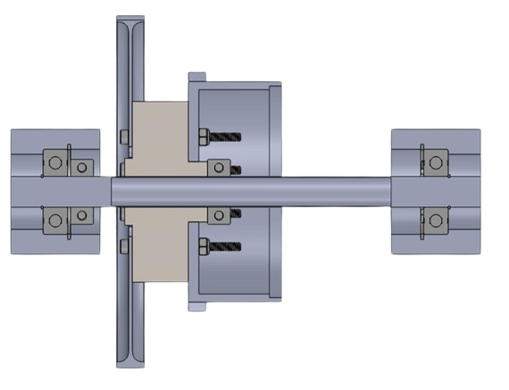
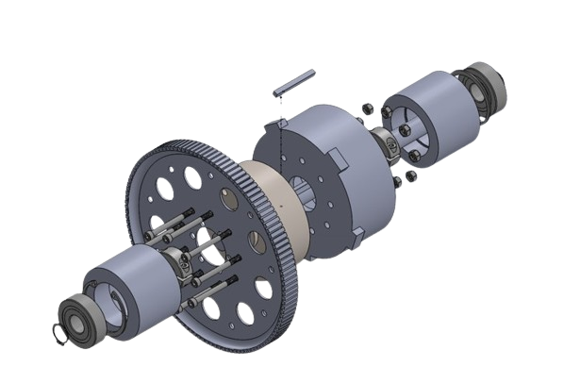
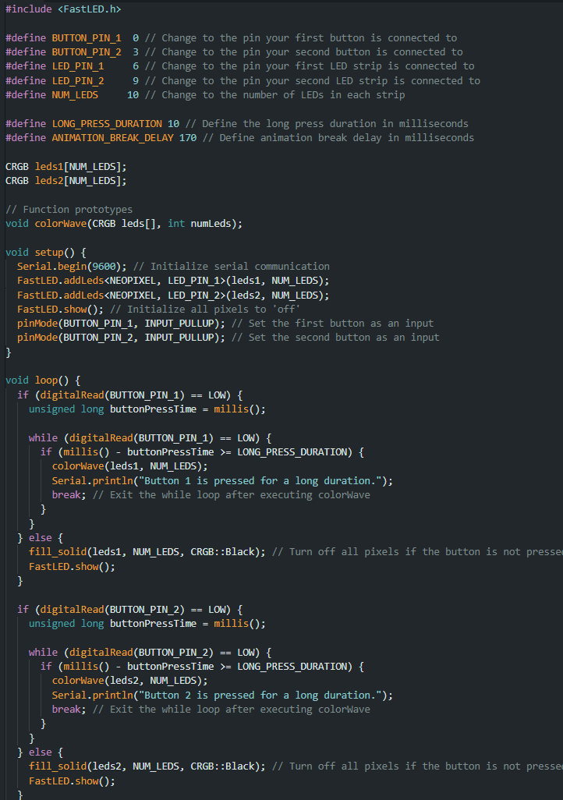
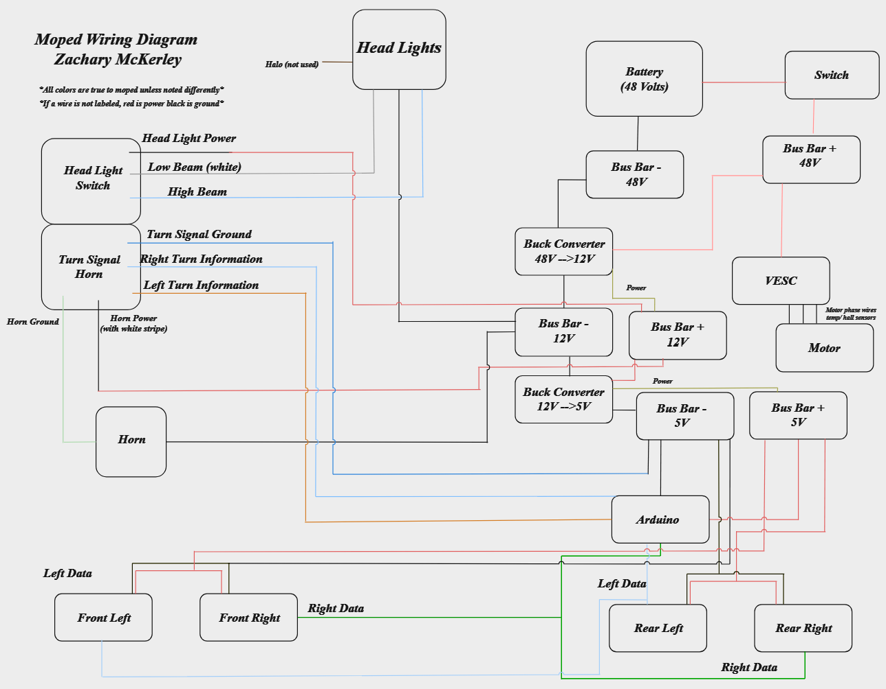
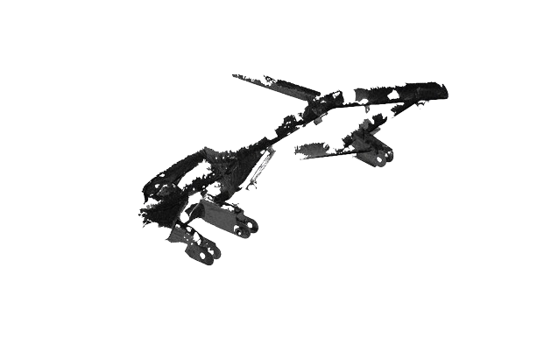

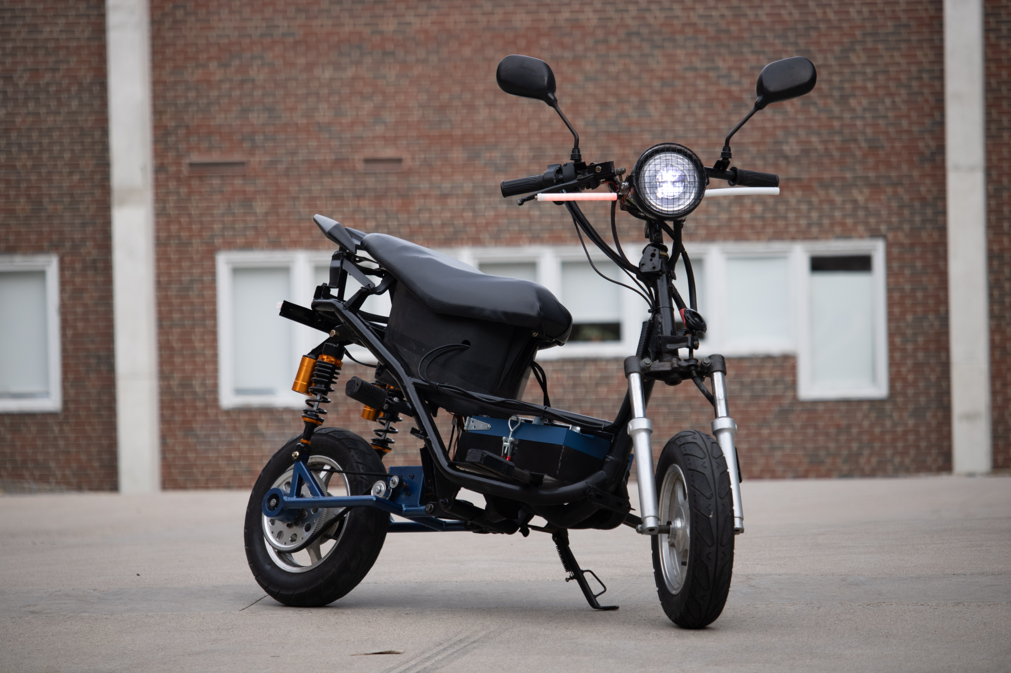
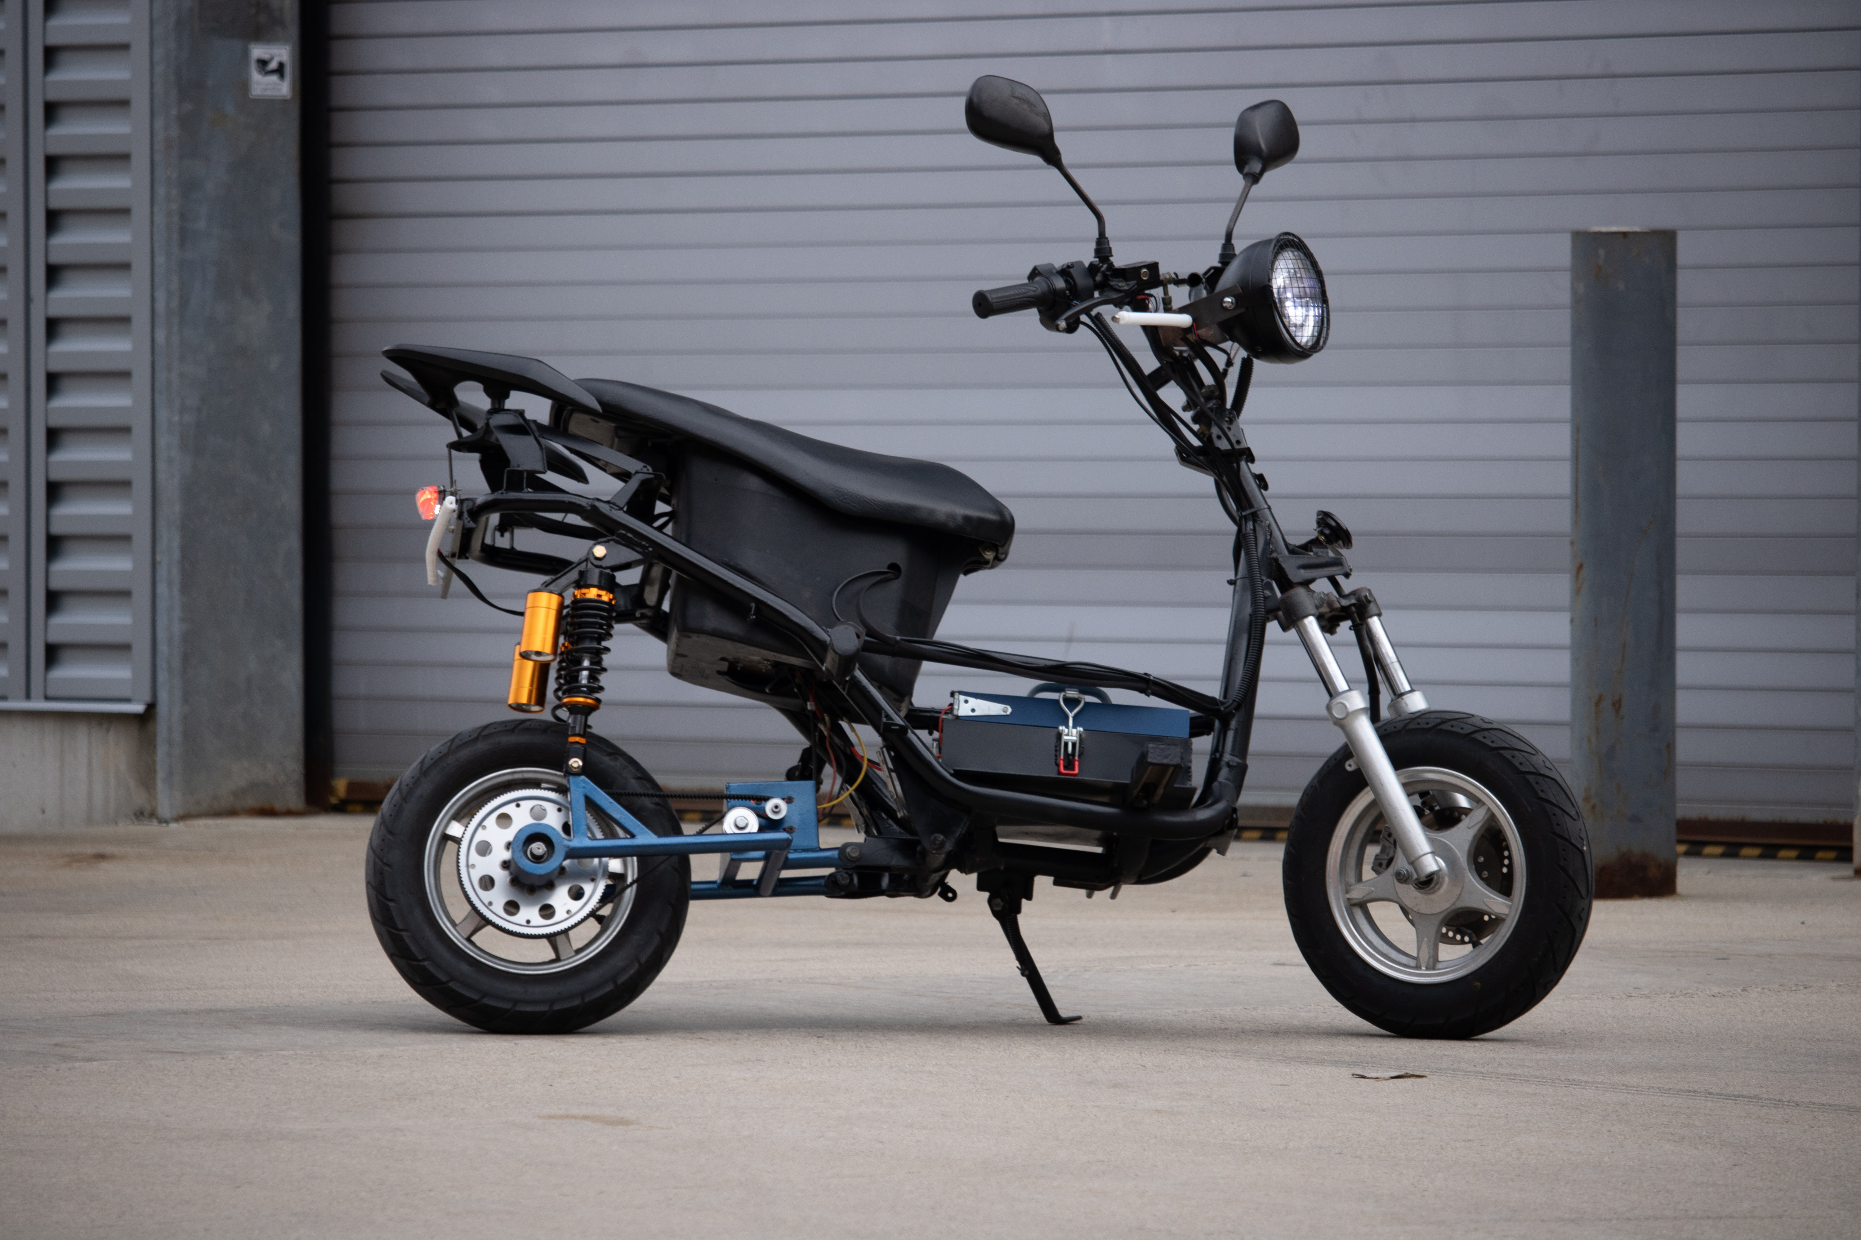
Electric Moped Conversion​
EVO (Electric Vehicle Organization)​
​
Zachary McKerley, Rowan Baptista, Ian Anderson,​
Department of Mechanical Engineering, University of New Hampshire​
Project Overview
Moped Information
Drivetrain
To make electric transportation more accessible for students on campus
Get students interested in electric vehicles and participation on projects in student led organizations
Battery- 48V 30Ah Battery (1.4kWh)
Motor- 6kW 170 kV
Speed- 47 mph (Limited at 30)
Range- Around 50 miles
Coding & Turn Signals
Electronics & Wiring
In the above photos it shows the drive train assembly
The drive train utilizes many of our in house engineered and machined parts specifically for this conversion
It uses bearings, snap rings and lock washers to keep everything in place
Students decided to make programable LED light strips for turn signals which let them utilize many important tools like Arduinos and coding like C++
Below is an annotated and simplified wiring diagram highlighting the moped functions
LiDAR Scans
Due to the nature of this project's tight requirements, students had to utilize high precision LiDAR scanning technology to design and fabricate vital frame mounts to keep up with the high-quality engineering requirements to ensure rider safety
Photos
*The LiDAR Scan
*The completed SolidWorks design
Contacts
Zachary McKerley - zachary.mckerley@unh.edu
Rowan Baptista -
rowan.baptista@unh.edu
Nicholas Niedzielski -
nicholas.niedzielski@unh.edu
Ian Anderson -
ian.anderson@unh.edu
References
.
Club Advisor: Ivo Nedyalkov
Safety Approval: Noah MacAdam
Machining: Scott Campbell

