Slide 1

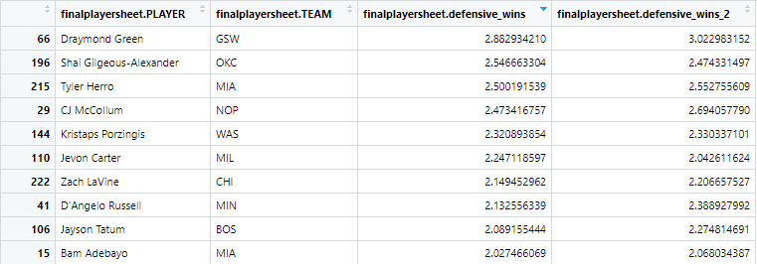
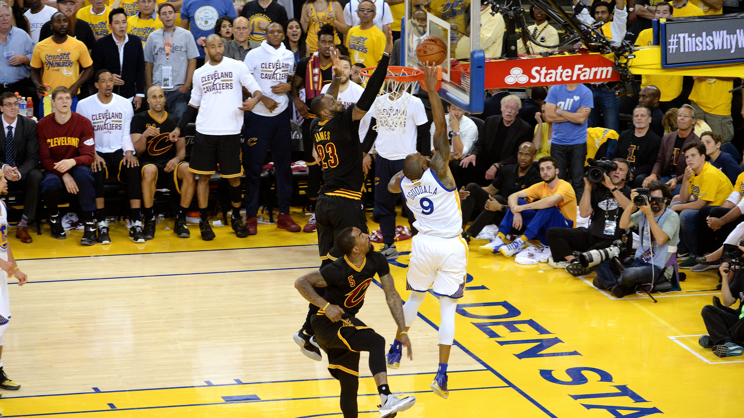

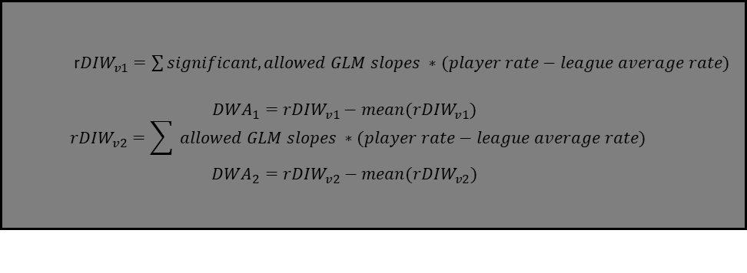
Defensive Impact Wins: Re-Evaluating Individual Player Defense in NBA Basketball
By Dylan Stiles
UNH College of Engineering and Physical Sciences
  r${DIW}_{v1}=\sum{significant, allowed GLM slopes ∗(player rate−league average rate)}$
  $${DWA}_{1}={rDIW}_{v1}−mean({rDIW}_{v1})$$
  $${rDIW}_{v2}=\sum{ allowed GLM slopes ∗(player rate−league average rate)}$$
  $${DWA}_{2}={rDIW}_{v2}−mean({rDIW}_{v2})$$
Analysis
Literature Review
Missing Data issues: nba.com data does not include individual player defensive numbers for putback or transition plays. Additionally, all plays listed as “offscreen” were removed for incorrect models. This issue could possibly have been avoided collecting data on multiple seasons
Some good defenders on bad defensive teams were recognized – Kristaps Porzingis worth about 3 wins on a terrible defensive Wizards team.
Some rankings pass the “smell test,” some do not.
  Draymond Green listed as the best defender, but Tyler Herro is listed as the third best.
Seems to not be scalable to teams the way MLB’s WAR is
The Wages of Wins - Berri, Schmidt, Brock - Book that introduced the Wins Produced and Win Score stats off of which this model is loosely based. In a chapter of this book, Berri produces the Win Score metric by regressing points, rebounds, assists, and other box score statistics against wins. Then, these slopes were rounded to either 1 or 0.5 and added to player stats.
Characterizing the Spatial Structure of Defensive Skill in Professional Basketball - Franks et al – The authors modeled defense as a hidden Markov model. The position of the defender is taken as relative to the hoop and the offensive player. This model has transitive properties to allow it to include switches. Among other checks, this model shows that defenders get closer to their man when he has the ball.
Counterpoints: Advanced Defensive Metrics for NBA Basketball – Franks et al – At the 2015 MIT Sloan Sports Analytics Conference, the authors of the previous work showed how they had used their model for defense to create Counterpoints, assigning credit and blame to every defensive possession of the 2013-14 season.
Data And Methods
Some Interpretations
Collect team defensive playtype data for the 2022-23 season
Fit binomial GLMs with stop, shooting foul, and turnover rates.
Disallow obviously-biased models (example: models that negatively associate forced TOVs and wins)
Find relative stop, foul, and turnover rates for players
Sum the slopes from the binomial models multiplied by relative player stats (difference from league average)
Multiply by proportion of minutes played
The goal is to create a metric that has real units (points or wins) that removes some of the team-bias I felt was present in existing defense metrics
By centering, we change the interpretation to “defensive wins added above average”
Draymond Green’s defense was worth about three wins in 2022-23.
The Miami Heat’s defense was worth about 5.5 wins in 2022-23.
Player ratings seem more correct than team ratings here.
  Teams might have a mix of good and bad defenders, but bad defenders will spend less time impacting the game. This model probably overemphasizes their effects even after adjusting for minutes played.
  The Spurs very bad defense was only worth about -2 wins. The Spurs lost 60 games in 2022-23.

