Slide 1

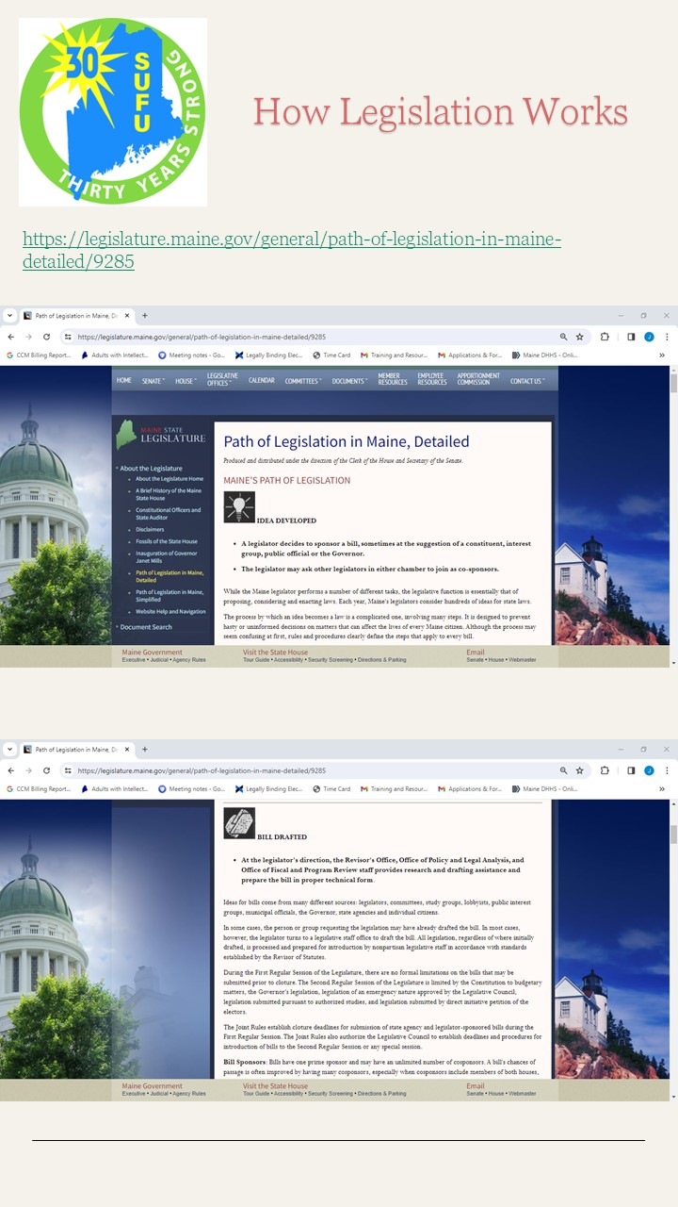
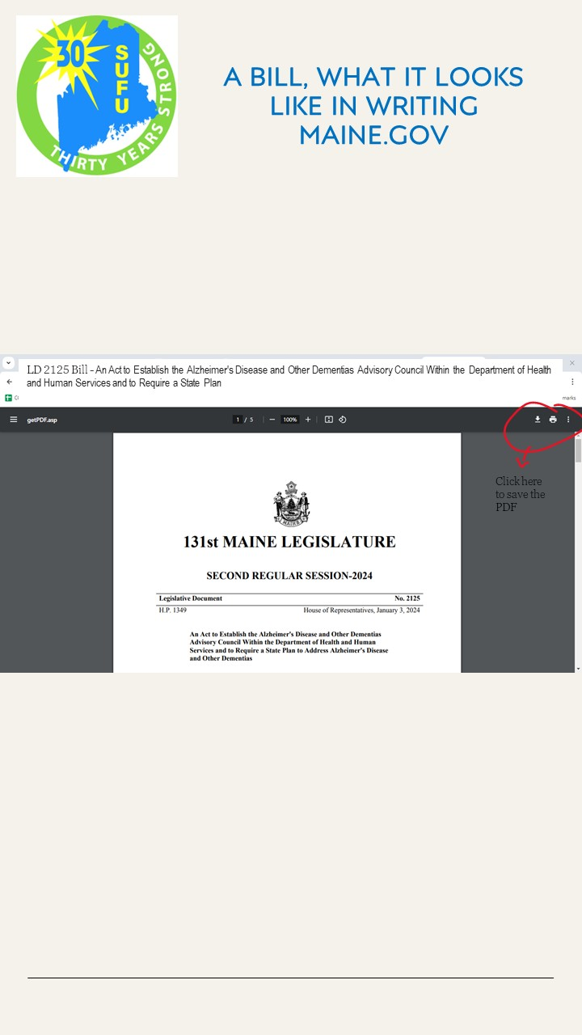
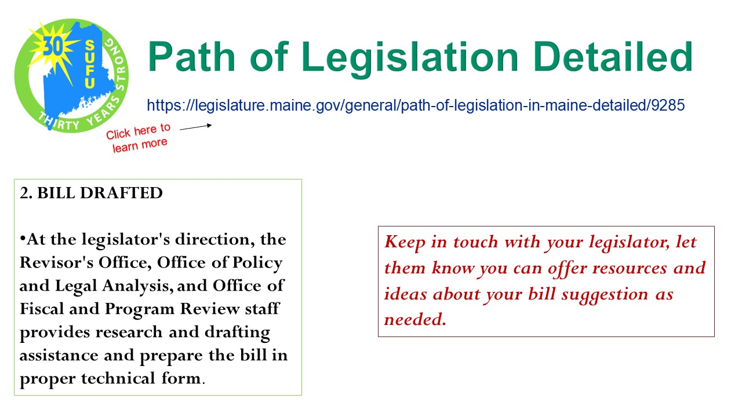
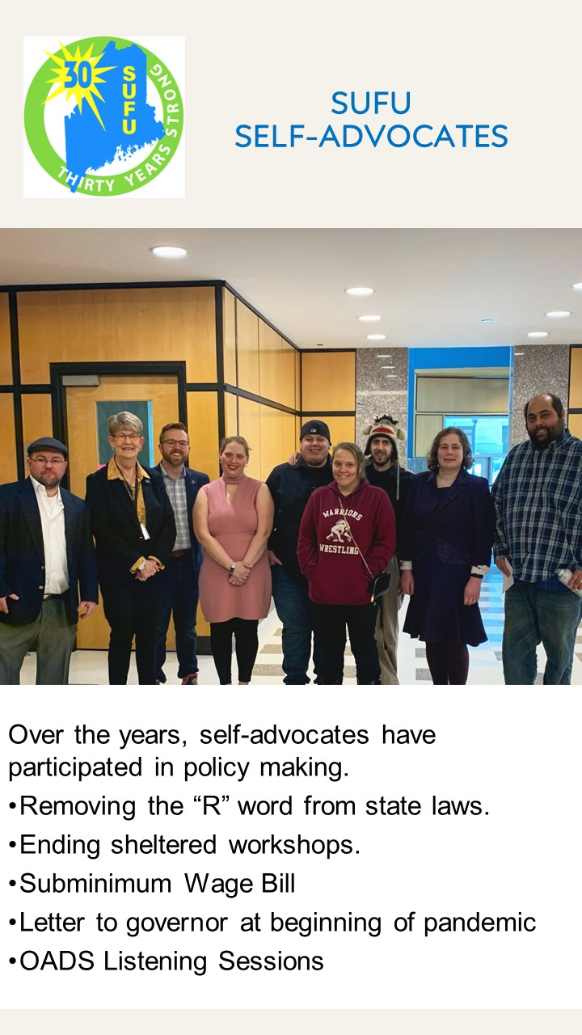
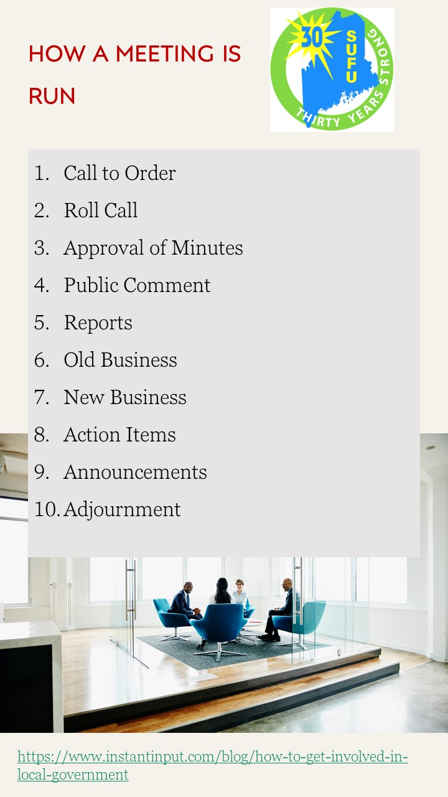
Speaking Up For Us Legislative Toolkit
Cynthia Cushing, UMaine LEND Trainee
Institute on Disability at the University of New Hampshire
Empowering Advocacy
Sample Pages
Print and Web Formats
Speaking Up For Us (SUFU) is an advocacy group for adults who live with developmental disabilities (IDD). Established in 1993, SUFU has been helping people with IDD provide a voice for their needs in Maine for over 30 years.
SUFU’s vision is to promote people living with IDD as valued. Inclusion in Maine’s legislative events is an important part of SUFU’s mission, which is to empower people with IDD to speak up and take action to improve their lives through education, advocacy, and leadership skills.
The Legislative Toolkit utilizes a format which can be printed as a book and promoted through the SUFU website via links and videos to provide all members of SUFU with information and guidance around: voting rights and importance; talking with one’s legislator; requesting a bill be created; responding to current issues with live and written testimony when appropriate; and many other important aspects of being an advocate for people with IDD.
Acknowledgements
Table of Contents
Special thanks to Monique Stairs, Executive Director of Speaking Up For Us, and for other members of SUFU for helping me with this project. Thank you, also, to Susan Russell, NH-ME LEND Training Co-Director, University of Maine, and the rest of the LEND team for allowing me to participate in LEND this year – it is because of LEND that I have been able to work more closely with SUFU.
The Legislative Toolkit includes details for SUFU members to be able to engage with legislative issues and includes direct links to the Maine Legislature website:
Table of Contents
Advocacy Law
Bills Legislative Sessions
Committees Public Policy
Governor SUFU in Action
Hearings Town/City Councils
Legislative Sessions Voting
BOLSTERING MEMBERSHIP
Despite SUFUs long-standing existence in Maine, the drive to incorporate new members, and to empower current members with a voice in the legislature continues to be difficult.
This project provides SUFU members with a Legislative Toolkit that they can use as a “how to” for steps they can take to share with their legislators what is important to them, and what is needed for them to be able to live as independently as possible.
References
Center for Community Inclusion and Disability Studies. (n.d.). Speaking up for us of Maine (SUFU) produces new resources for adults with I/DD - center for community inclusion and disability studies - university of Maine. https://ccids.umaine.edu/2022/03/29/speaking-up-for-us-of-maine-sufu-produces-new-resources-for-adults-with-i-dd/
Maine State Legislature. (n.d.). Welcome to the Maine Legislature. Maine State Legislature. https://legislature.maine.gov/
Speaking Up For Us. (n.d.). https://www.sufumaine.org/
As a group run by adults who live with developmental disabilities, we want to have more control of our lives, and use our voices to “Speak Up” for issues that are important to us, and to all people with disabilities.
This is our toolkit – an instructional manual that you can use to “Speak Up,” and to make your voice heard by policymakers.

