Slide 1
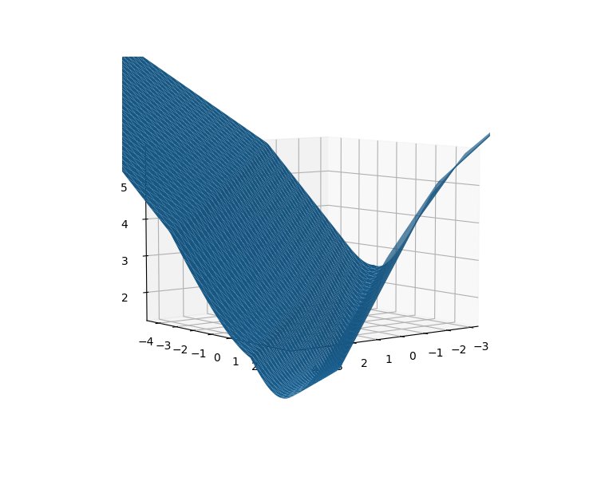
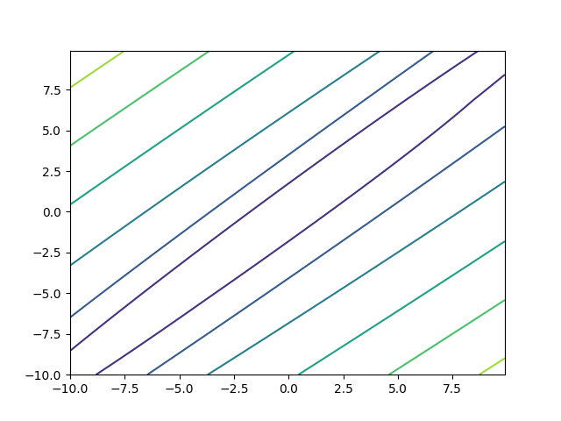
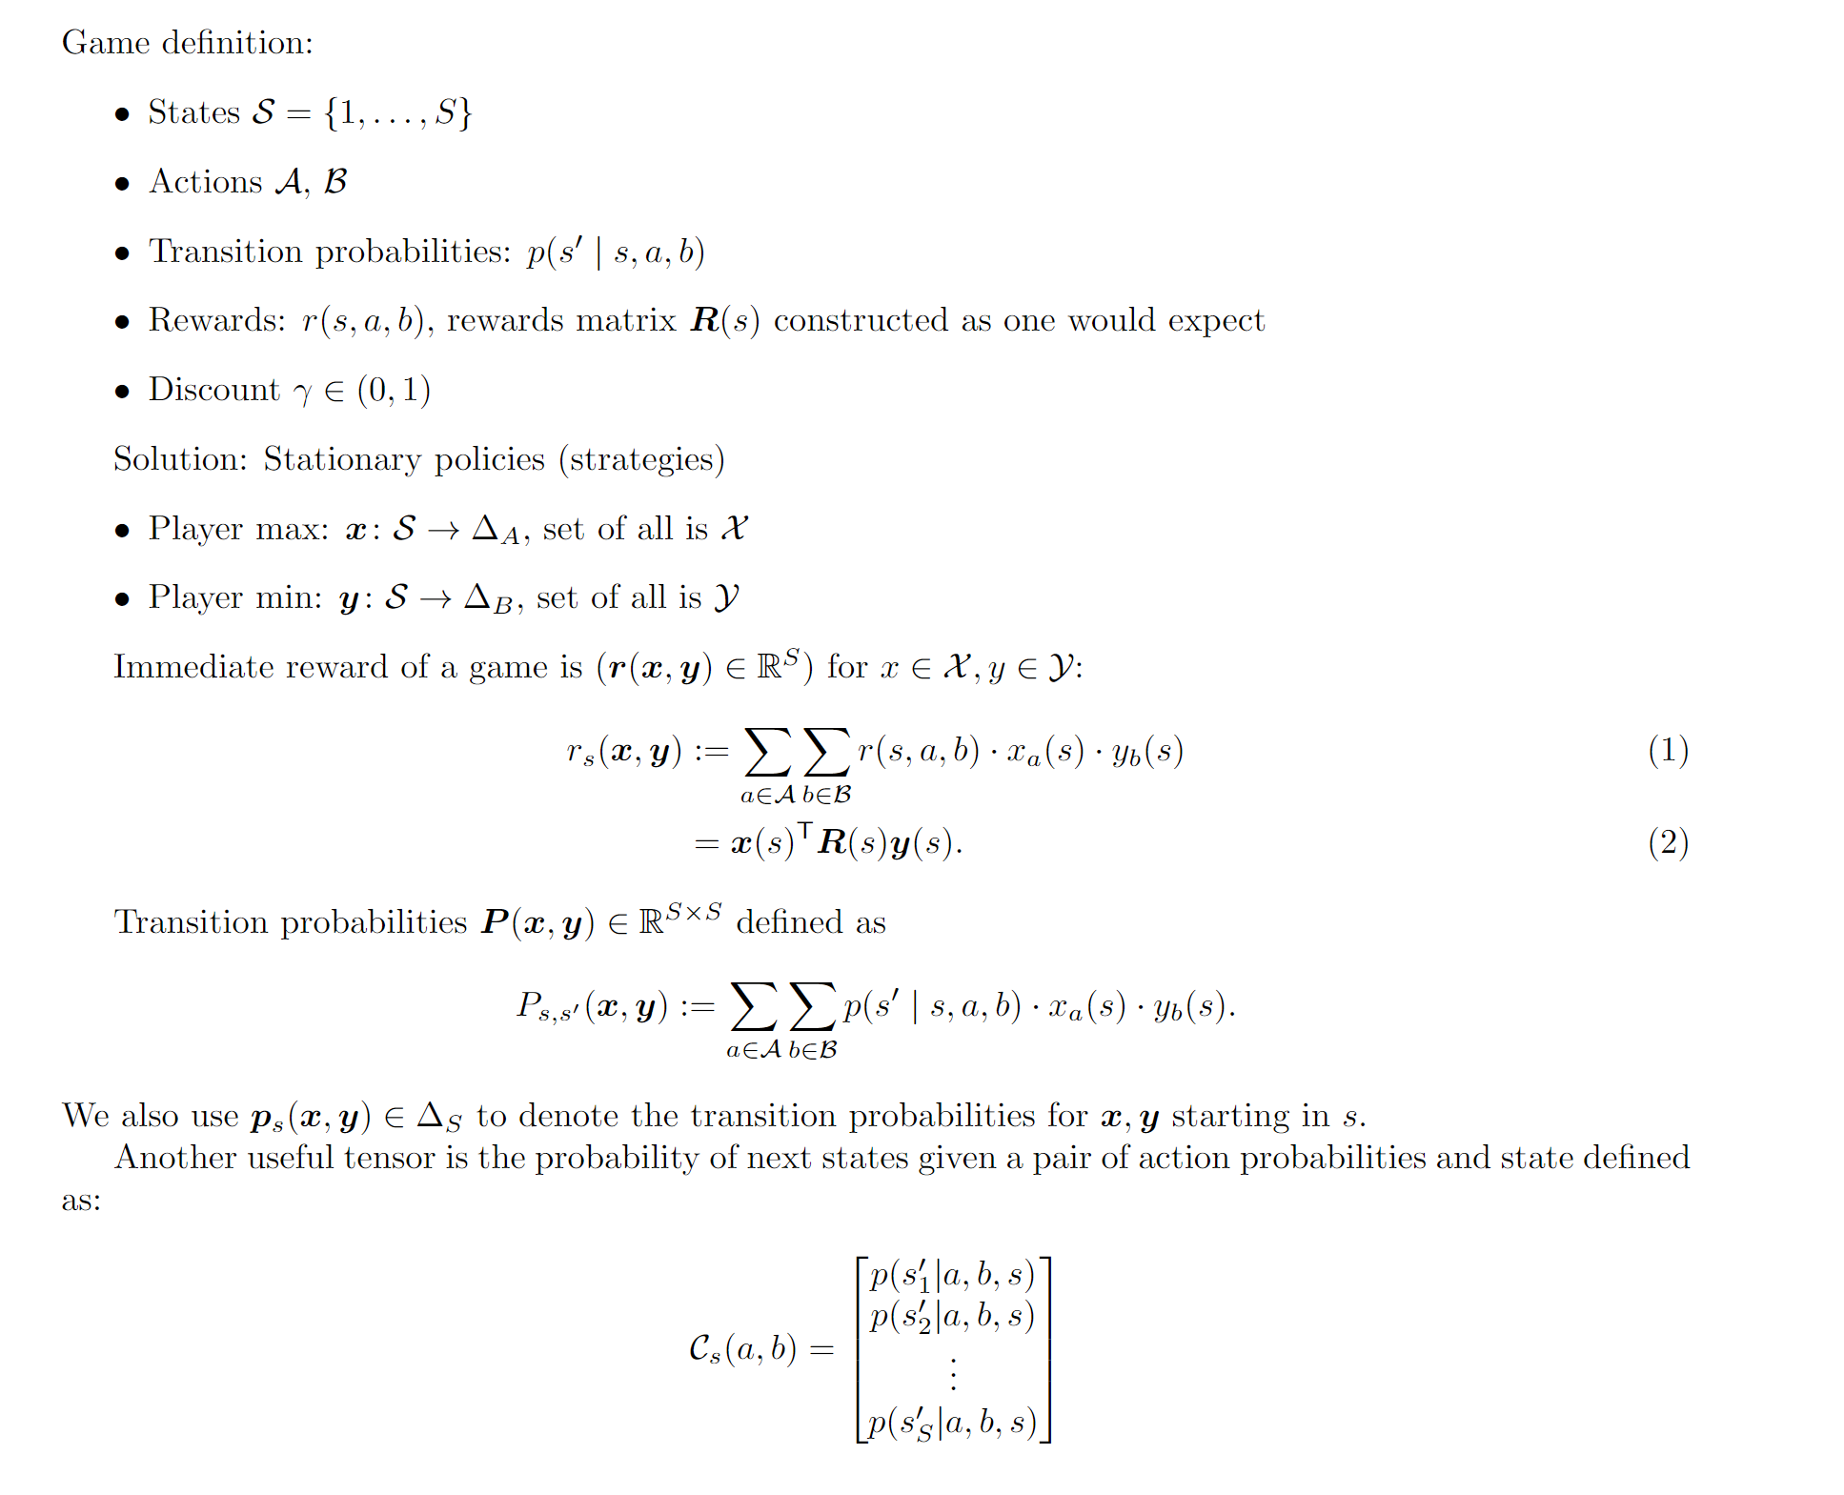
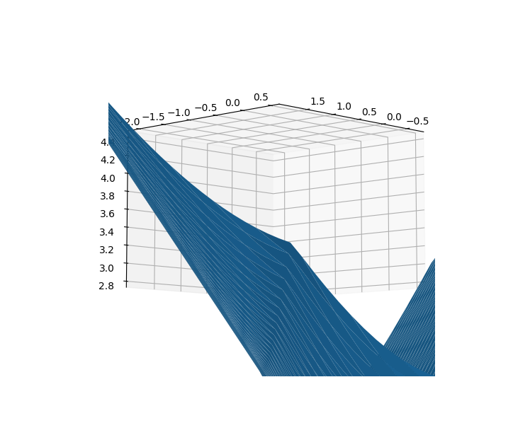
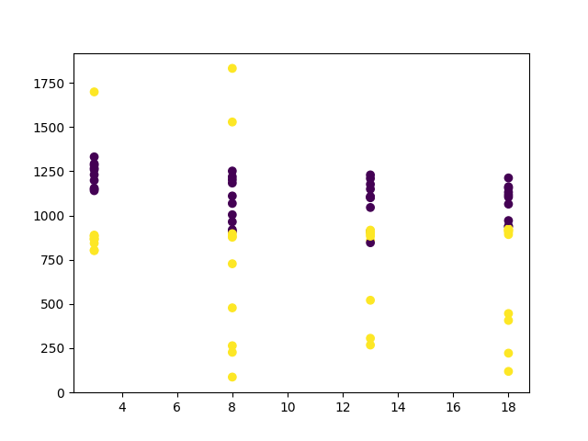
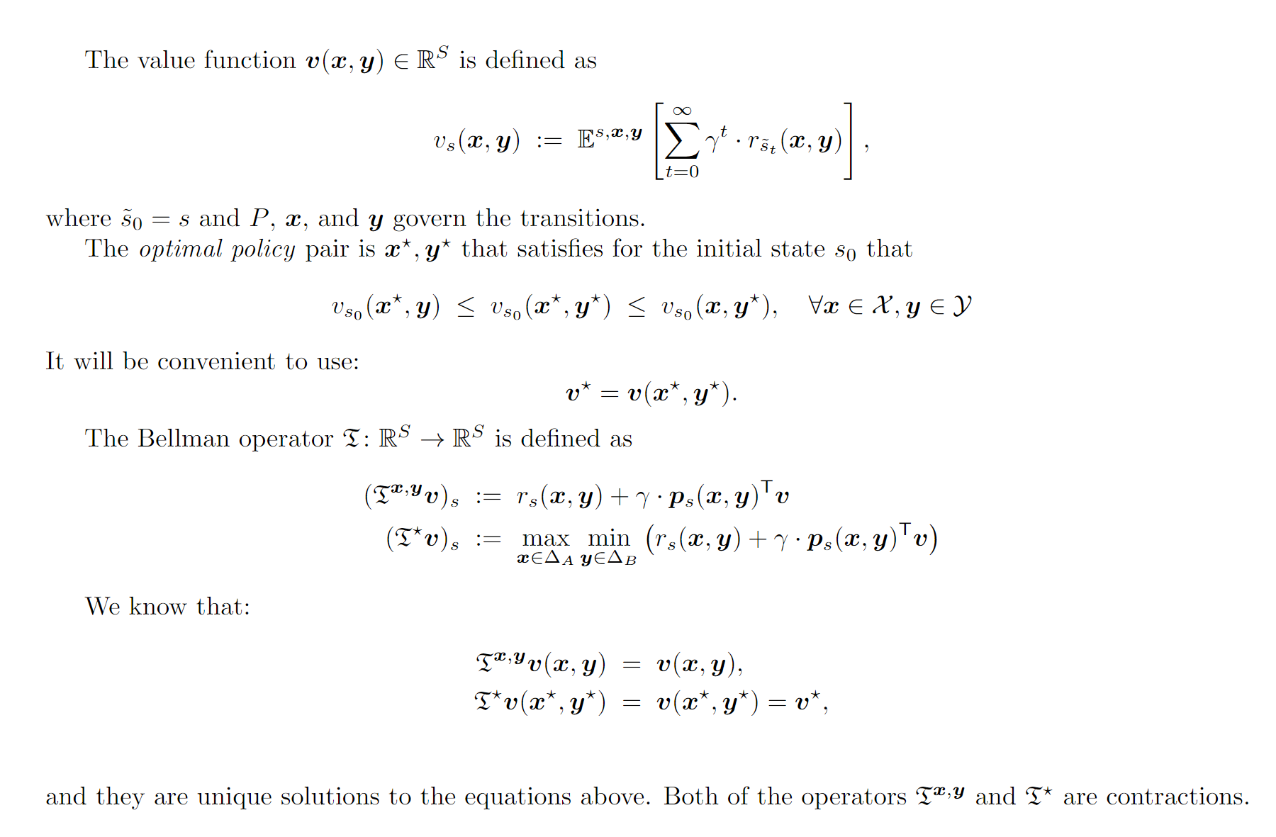
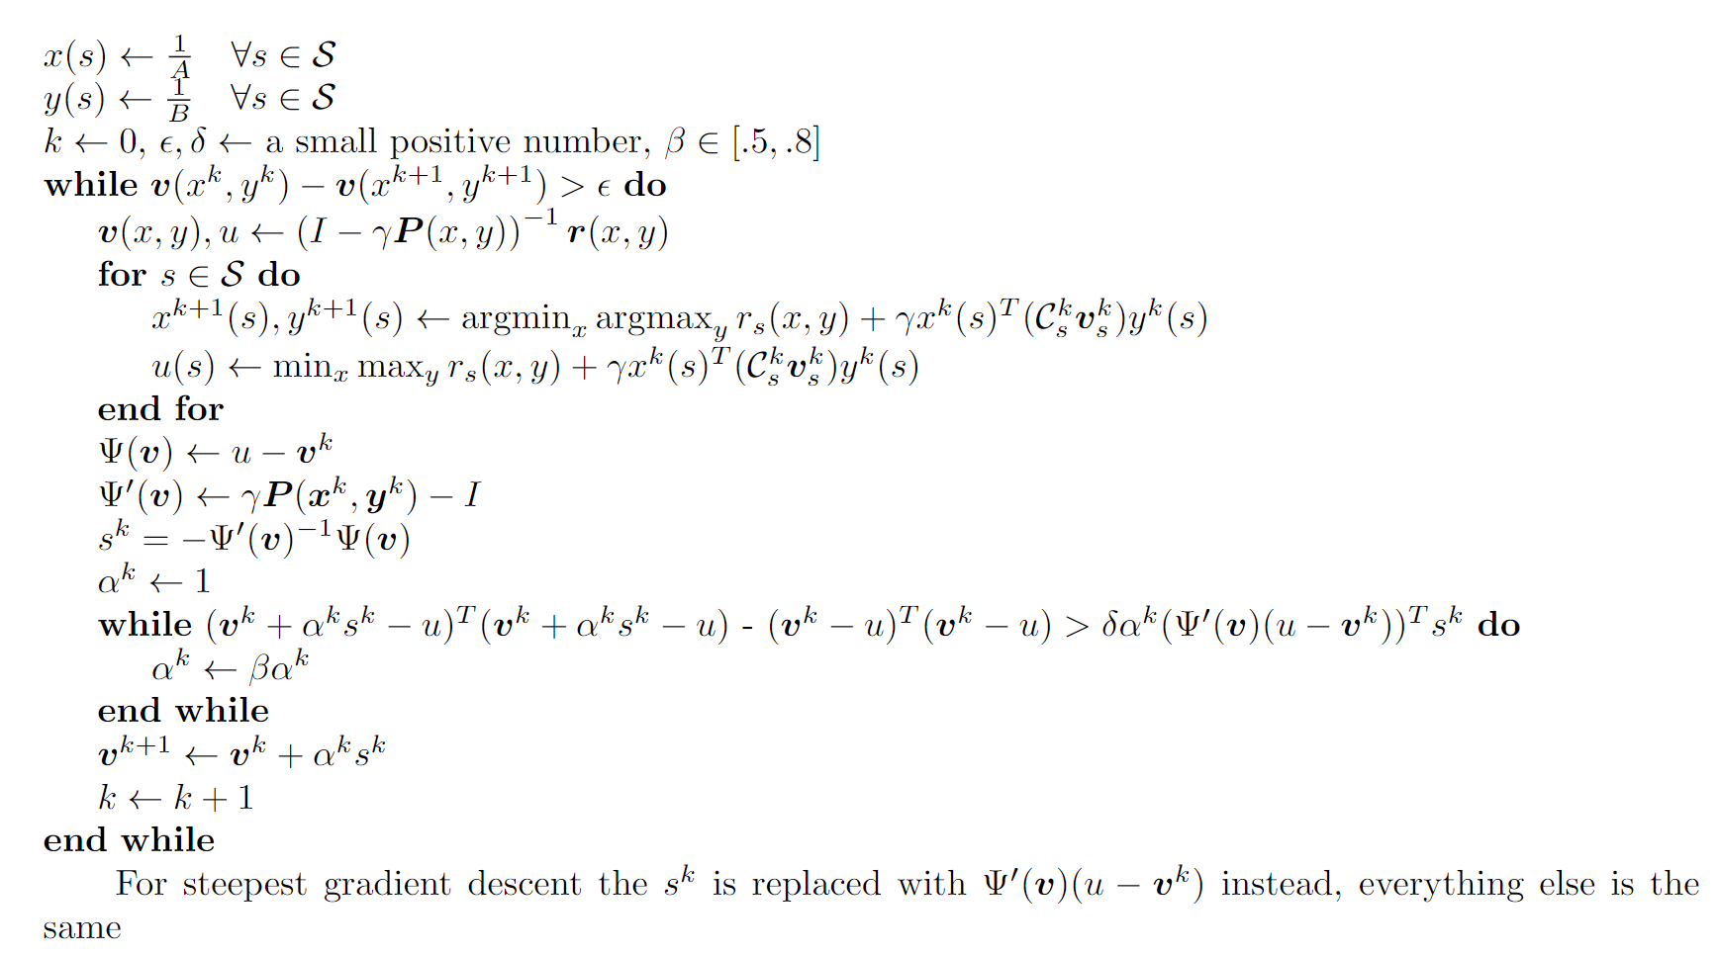
OBR Newton’s Method a Faster Solver for Markov Games Keith Badger Computer Science, University of New Hampshire, Durham, NH 03824
Introduction
Objective Function
Observations
Reinforcement Learning is a popular variant of machine learning that has cropped up as tasks given to AI have become more complex. It’s a framework that teaches a model to complete a task by trying it, and optimizing its decisions around the rewards it receives. In circumstances where there’s uncertainty about the dynamics of an environment it can be helpful to have an adversarial environment which seeks to make the uncertain dynamics of the environment as bad as possible to allow the model to find a safer solution with regard to the unknowns. A simple version of this concept is a Markov Game where the adversarial environment is just another agent whose rewards are the opposite of the original agent. When these two agents are at a stalemate the game is solved. A variety of methods for solving these games are explored and compared.
Example Minimization Objective
Example Contour
The Common algorithm has very stable numbers of iterations to convergence, even though it performs slower, with a few of the outlier points from our algorithm doing worse by a fair margin.
The performance gain of Newton’s OBR increases as the farsightedness parameter increases most likely from value iteration being sensitive to value initialization.
If points where objective is non differentiable are ignored, the objective can be shown to be gradient dominant, a condition which guarantees our algorithm works.
Bellman Residual (y) vs value of each state in 2 state game (x,z)
Contour Plot seems to show quasi-convex objective, although it’s unconfirmed
Notation
Performance
Conclusions
Non-Convex Point in Objective
Performance Comparison
Performs better than most common approaches
Suffers from lack of convexity in objective
Potentially solvable with smoothing term
Proof of convergence exists if non differentiable points are ignored
# of Iterations to Convergence
This is a problem for guaranteeing our algorithm will work
# of States
Purple is the Value Iteration, Yellow is OBR Newton’s
Notation Extended
sTAMD Simulations
Acknowledgements
Algorithm
I would like to thank Dr. Marek Petrik as well as Dr. Qi Zhang for their assistance advising me on this project.
References
Filar, J. A., & Tolwinski, B. (1991). On the algorithm of Pollatschek and Avi-ltzhak. In T. E. S. Raghavan, T. S. Ferguson, T. Parthasarathy, & O. J. Vrieze (Eds.), Stochastic Games And Related Topics: In Honor of Professor L. S. Shapley (pp. 59–70). Springer Netherlands. https://doi.org/10.1007/978-94-011-3760-7_6 Pérolat, J., Piot, B., Geist, M., Scherrer, B., & Pietquin, O. (2016). Softened Approximate Policy Iteration for Markov Games. Proceedings of The 33rd International Conference on Machine Learning, 1860–1868. https://proceedings.mlr.press/v48/perolat16.html

