Slide 1
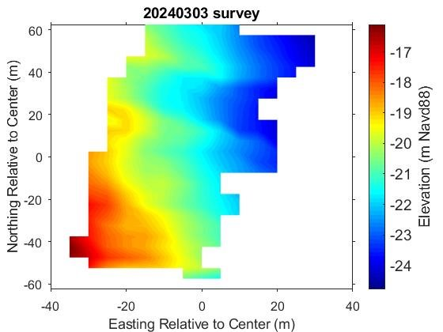
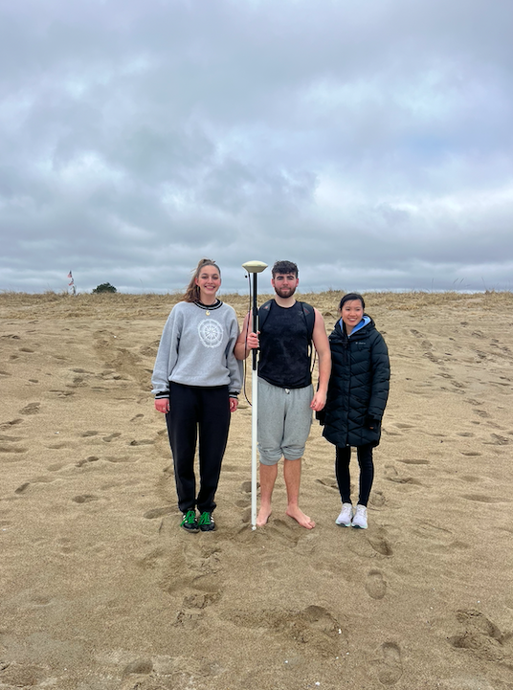
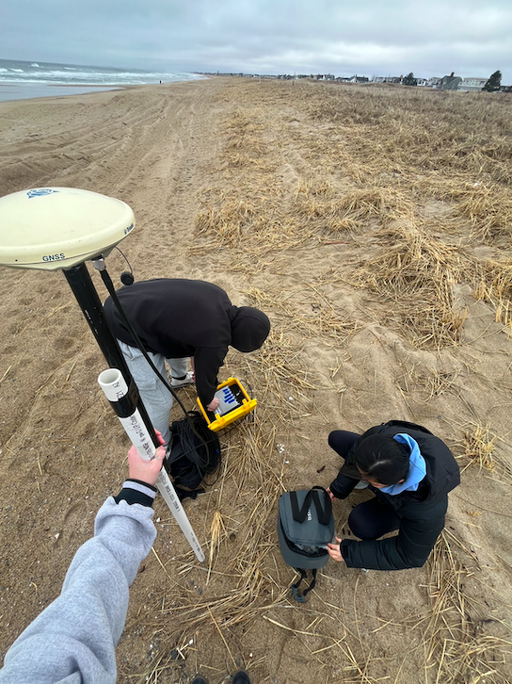
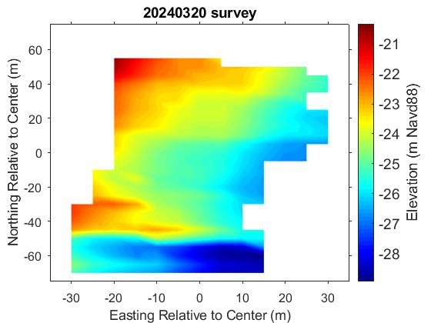
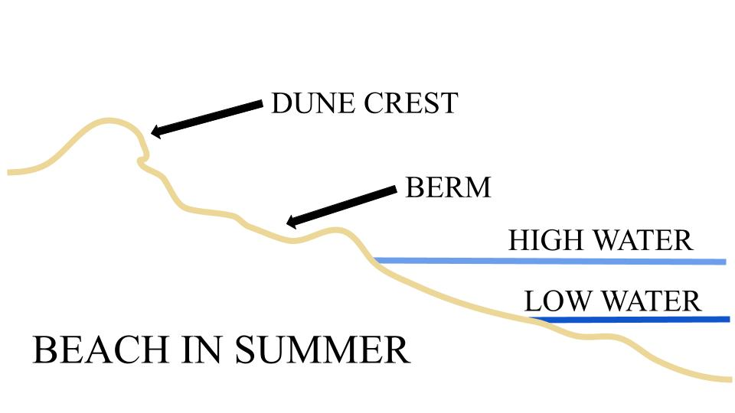
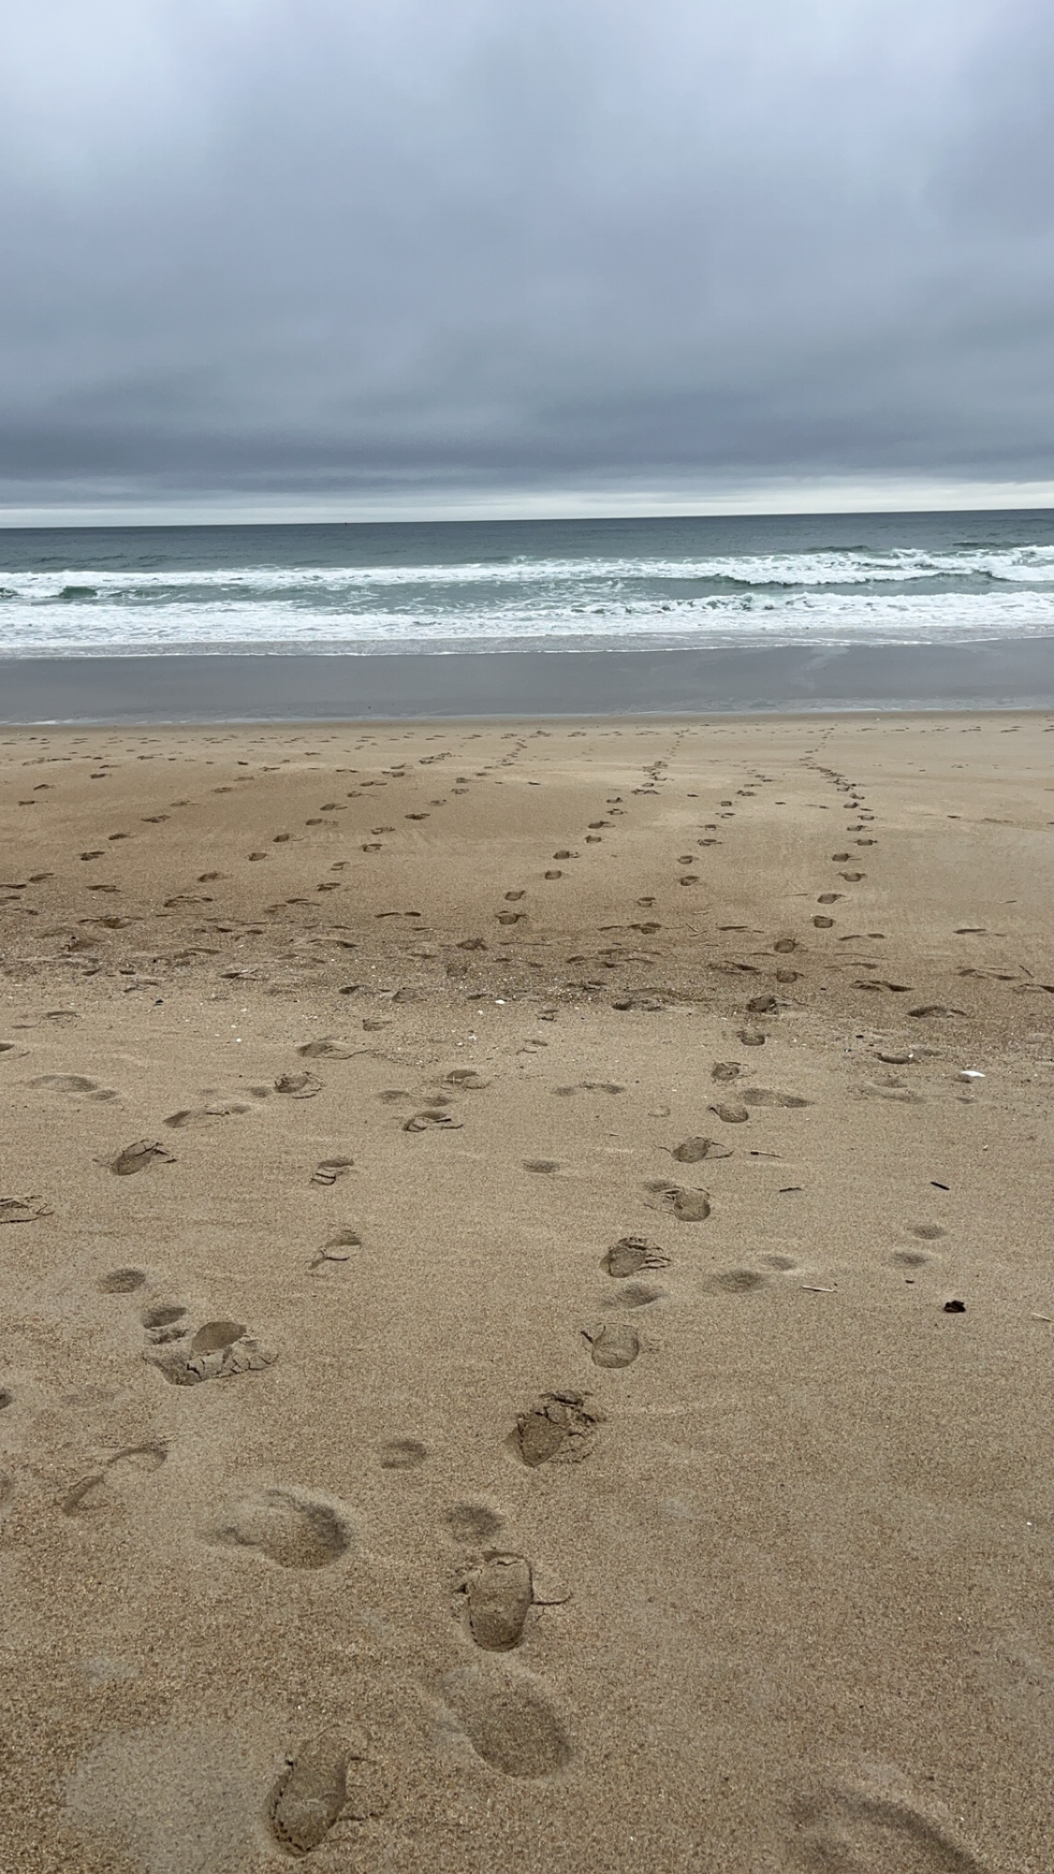
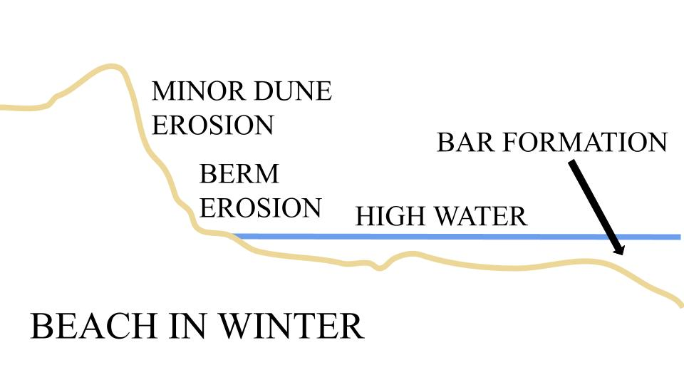
Change in New Hampshire Coastlines Over Time
Addie Murray, Rebecca Curley & Max Ballard
addie.murray@unh.edu, rebecca.curley@unh.edu, max.ballard@unh.edu
Innovation Scholars Ocean and Environmental Sensing
Introduction
Data
Solutions
Beach profiling is a survey technique to measure the contour of a beach
Used to decipher shoreline changes overtime, after storms, etc.
Real-time kinematics (RTK) provides accurate data while surveying
Global positioning system (GPS) uses additional data from a nearby base station
Ability to compare surveyed areas overtime to find trends, patterns, and predict future topography
Identify vulnerable areas and track changes
Information used in coastal management and decision-making to protect and stabilize coastlines
March 3rd, 2024
March 20th, 2024
Barriers help with coastal resilience for vulnerable communities
Smaller storm surge on land
Absorb energy from waves
Dunes, mangroves and seawalls protect fragile ecosystems
Why Do We Profile?
Increase in climate issues lead to sea level rise and exaggerated tide levels
Risk of more flooding
Erosion is damaging to coastal ecosystems
Wintertime has high-energy (storm) waves that pull sand offshore
Summertime has low-energy waves that deposits sand
Berm erosion and dune erosion due to bar formation and increased water levels
Takeaways
Implementing the use of a RTK instrument
Problem solving; processing data and code within MATLAB
Valuable insight from people with more experience
Effectively collaborating and working with deadlines
Data analysis
Results
Acknowledgements
Data is originally retrieved from RTK system in an unreadable format
Process data using various programs to analyze
Surveyed approximately 5200 m² (56000 ft²) on Seabrook beach
Visible change between the two surveying days
Left of graph is towards land; higher elevation
Right of graph is towards water; lower elevation
Elevation decreases the towards the water
A very special thanks to everyone that helped along the way including Matthew Florence for help with MATLAB, Melissa Marry for assistance with the GPS system, and the drone beach profiling group.
References
“Coastal Issues.” OzCoasts,ozcoasts.org.au
“Offshore Breakwaters & Beach Nourishment.” Virginia Institute of Marine Science,www.vims.edu/ccrm/

