Slide 1
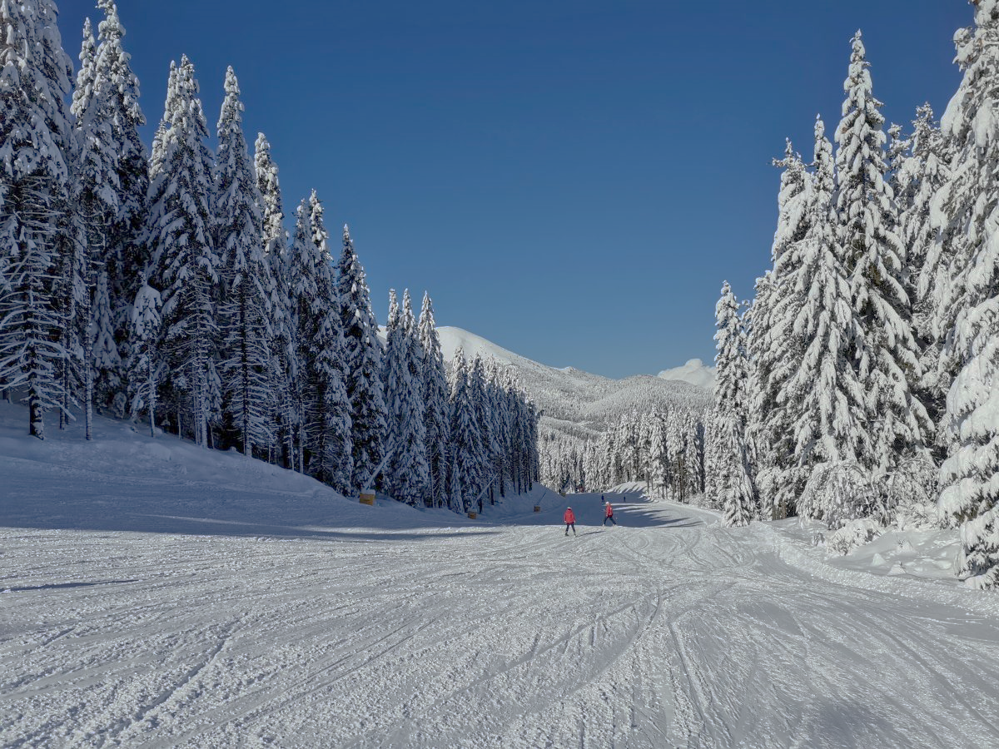
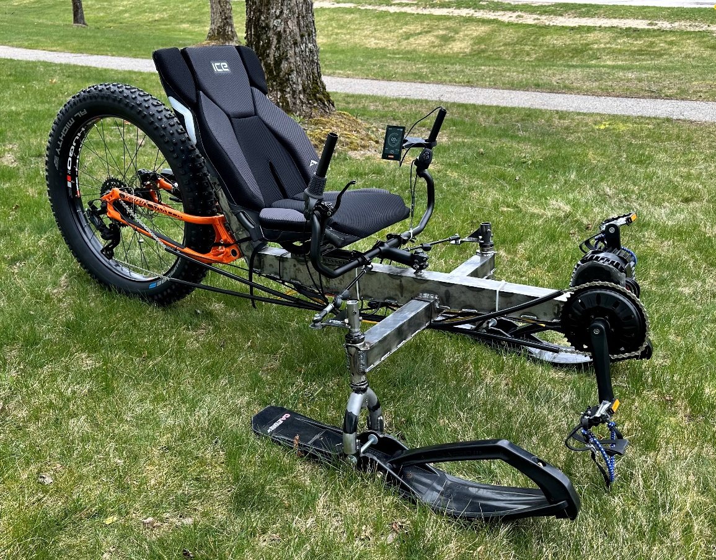
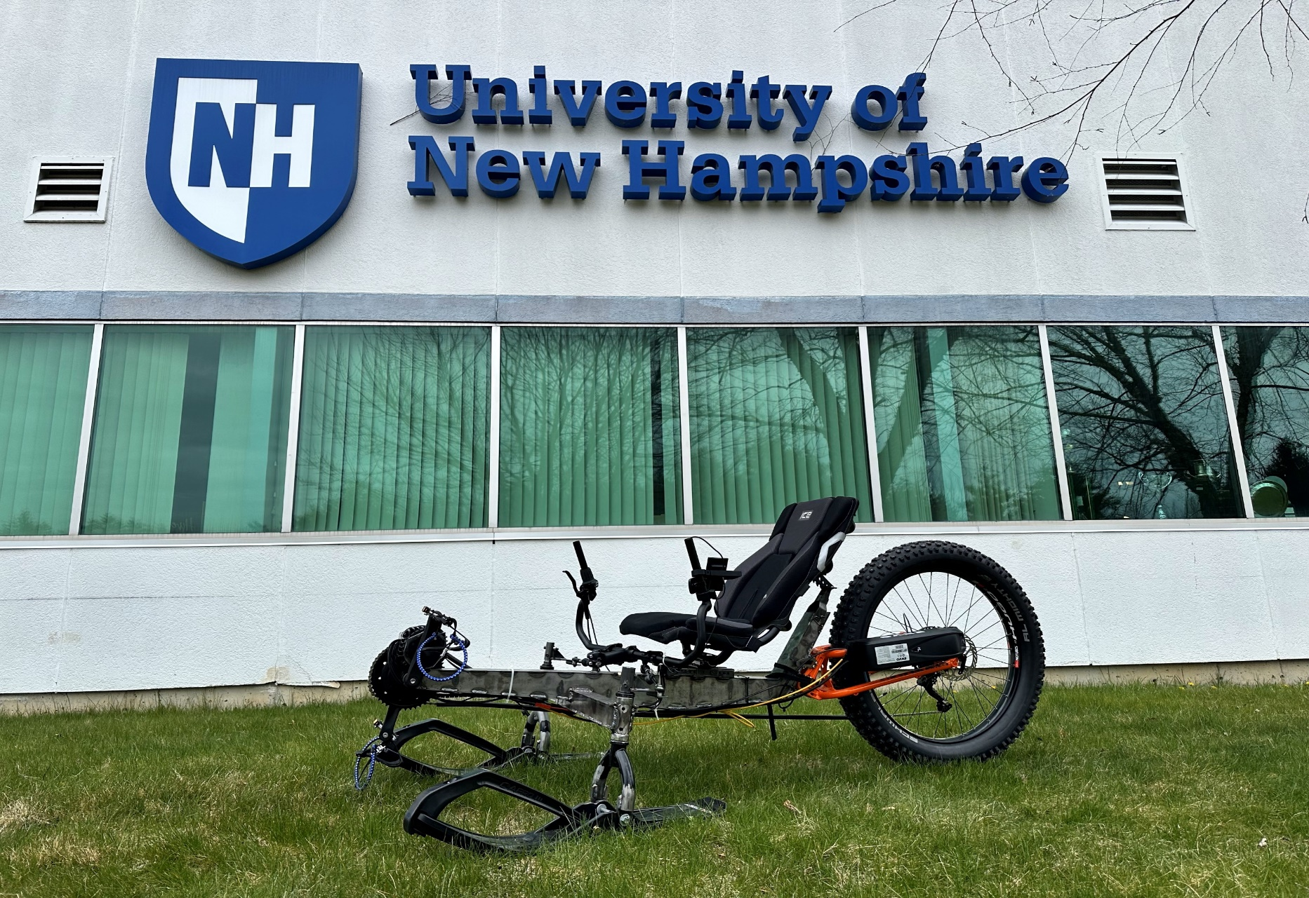
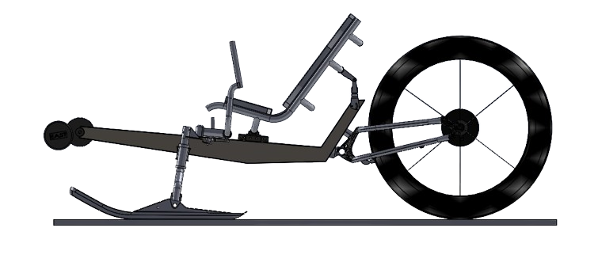
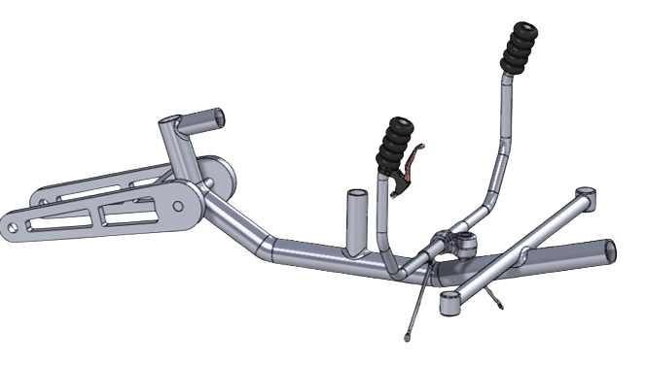
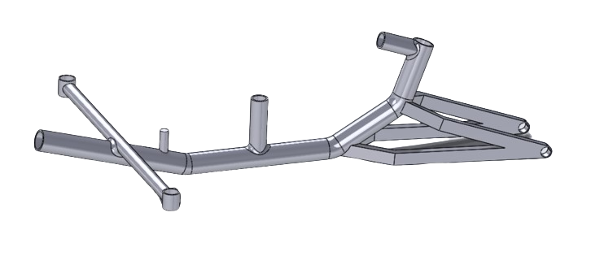
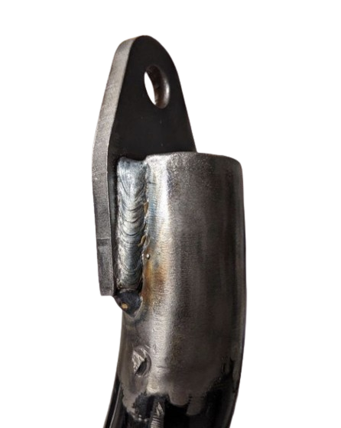
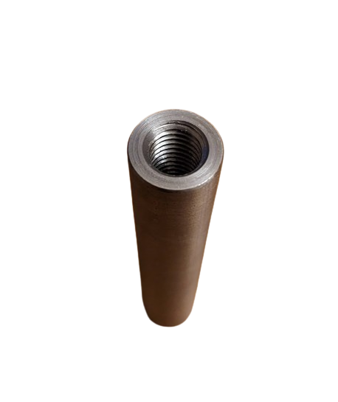
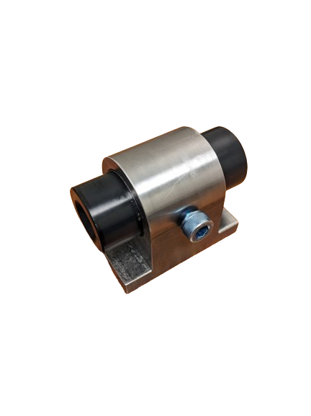
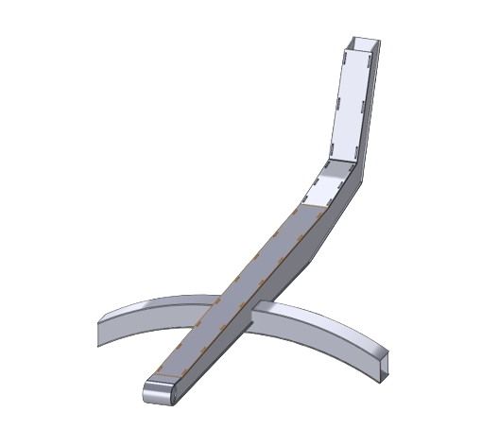
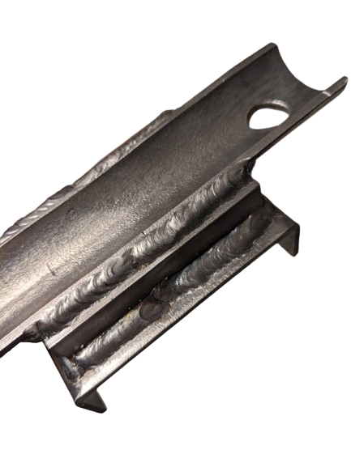
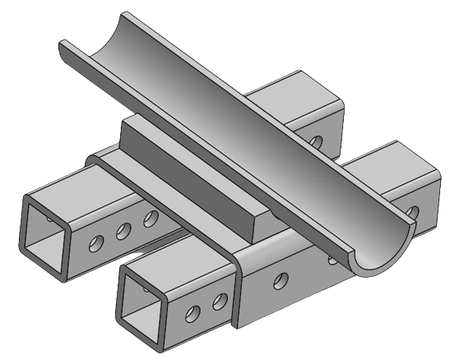
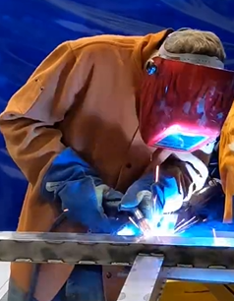
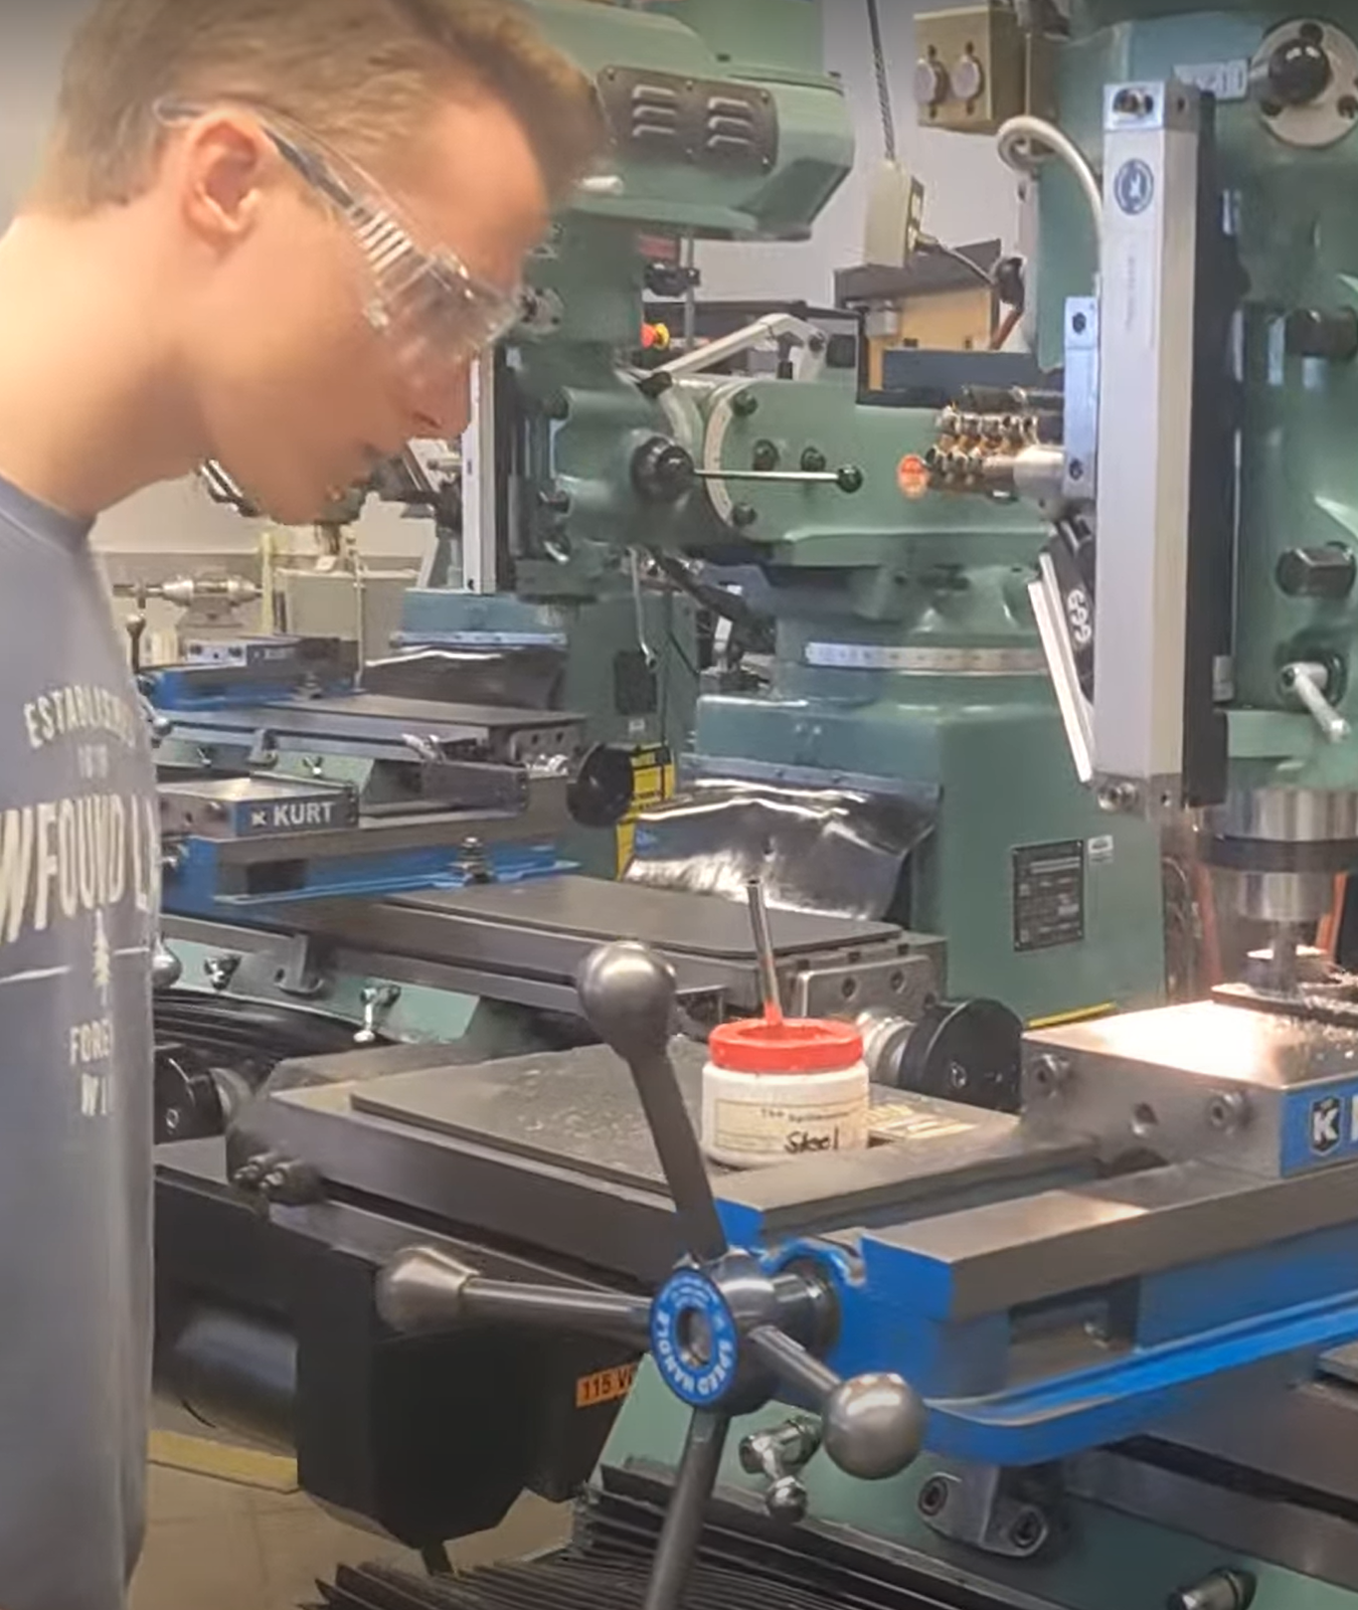
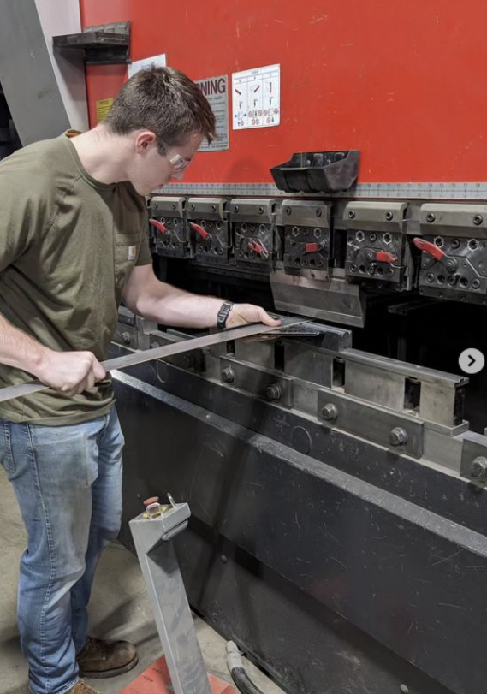
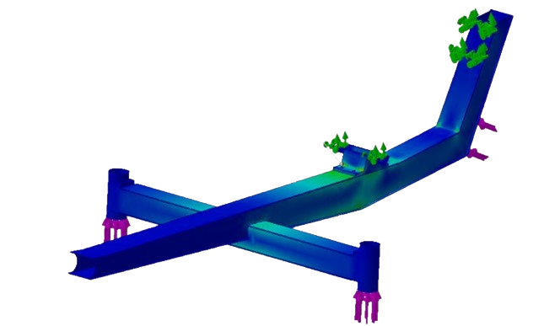
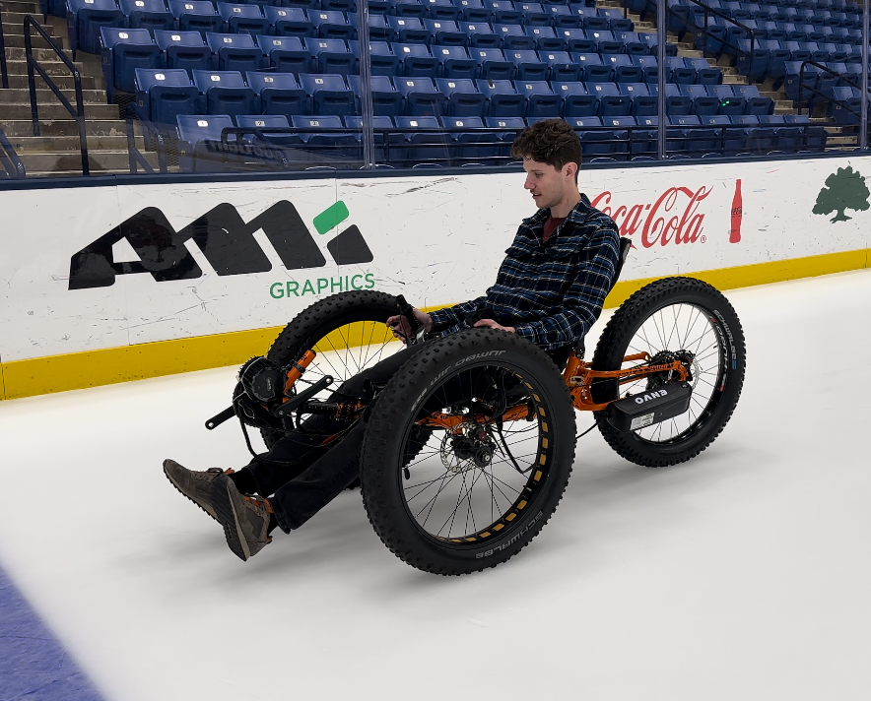
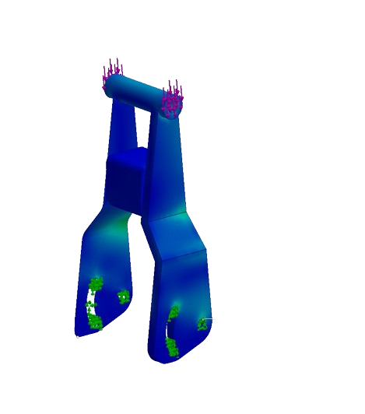
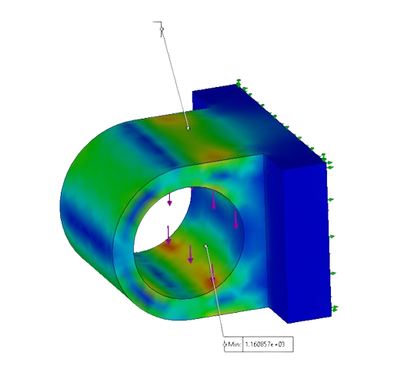
EAST: Electric Adaptive Ski Trike Reyer Bliss, Joseph Falk, Jared Hakala, Ethan Hardardt
UNH
Mechanical
Engineering
Advisors:
Dr. John T. Roth
Tye Thompson
INTRODUCTION
THE ELECTRIC ADAPTIVE SKI TRIKE
FUNDING
Wanted to make a positive impact
Client’s disability prevents her from enjoying winter sports
Device enables outside exercise with family
Northeast Passage partnership ensured client’s vision
Project Statement: Design and build a machine that allows our client to exercise on snowy trails.
Fat Bike
Continuous Outreach Ensured Project Feasibility
15 Sponsors Providing High-Quality Parts and Support
All Funds Raised During Academic Year
In-Kind Donations
$2,700
UNH $800
Cash Donations
$1,300
DESIGN AND ANALYSIS
Successful Completion of this Project Entails:
Transportable by Subaru Forester
Safe performance on groomed trails
Pedal operated
Variable electrical assistance
DESIGN PROCESS:
Transition to sheet metal from bent tube
Welding made simple with slot-and-tab design
Custom designed attachment points
Ensured all custom parts
integrated with donated
parts
ANALYSIS:
Minimum Safety Factor of 5
Maximum Weight Analyzed: 250 lbs
Maximum Deflection: <1 mm
1000W Mid-Drive Motor with Controller
Fat Bike Tire Ensures Traction in Icy Conditions
CHALLENGES
Mini Snowmobile Skis
No Resources From Legacy Project Work
New Advisors
Self-Taught Manufacturing Techniques
Lessons Learned
Project Management
Time Management
Resource Management
Client/Sponsor Relations
Advertising
Engineering Best Practices
Presentation Skills
MANUFACTURING
FABRICATION WELDING MACHINING FORMING
Seat Attachments
Rear Frame Mount
Motor Mount
Steering Attachment
Head Tubes
Ski-Arm
Ski Forks
Trike Frame
AKNOWLEDGEMENTS
A Special Thanks to Our Mentors, Supporters, and Advisors:
John Roth
Tye Thompson
Kyle Tierney
Jeremy Seiferth
Scott Campbell
Jonathan Dean
Brendan Reagan
Orrin Bliss
David Lee
All else who supported

