Slide 1
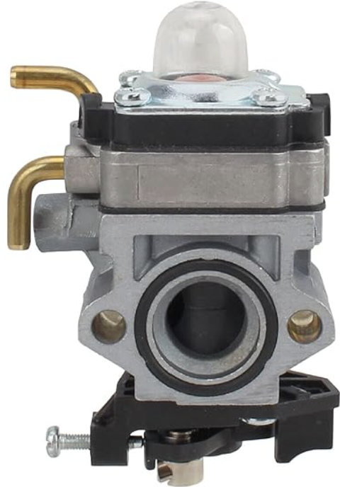
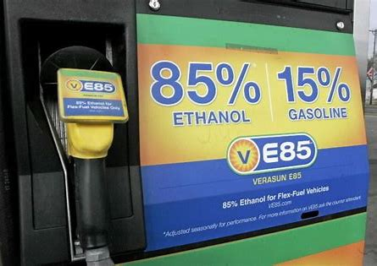
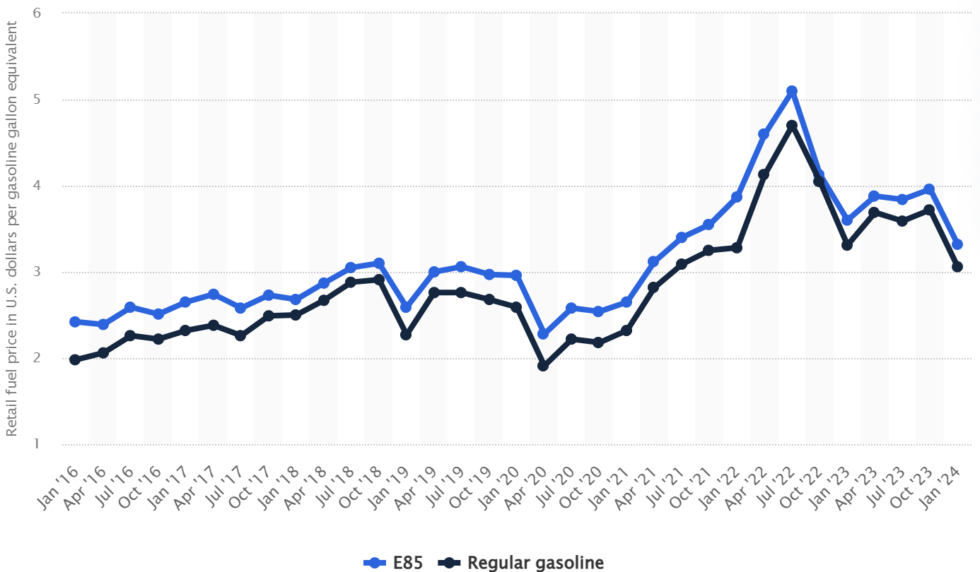
Leaf Blower - Gas to E85 Conversion Anthony Wilson & Evan DiChiara Department of CEPS, University of New Hampshire, Durham, NH 03824
Introduction
Data
For our project we converted a conventional 2 stroke gasoline leaf blower to run on E85 Ethanol fuel. This process required retuning the engine’s carburetor to provide more fuel. This is simple in theory but can be tricky to get right.
Gas Real World Data:
1/3 cup fuel ran for 2 minutes and 12 seconds at full throttle.
1.7 liter fuel tanks means 48 minutes total runtime
At idle could fill a 40 gallon bag in 1.79 seconds
Idle flow rate of 179 CFM
E85 Predicted Data *:
1/3 cup fuel would run for 1 minutes and 46 seconds
Full tank would last 38 minutes
Idle flow rate of 197 CFM
What is E85?
Conclusions
E85, also known as flex fuel, is a blend of gasoline and ethanol. It typically refers to an ethanol fuel blend of 85% ethanol fuel and 15% gasoline or other hydrocarbon by volume. This blend is used for vehicles equipped with specially designed engines. The percentage of ethanol depends on the geographical location and time of the year
Decline in overall fuel efficiency
Will increase the need to refill the tank
Increase in effective power
Increase in output volume
Ethanol has 44-52% lower greenhouse gas emissions than regular gasoline
So it requires 20% more fuel to burn but has a 50% reduced emissions?
- Yes, this means a net reduction of 30-40% less greenhouse gasses.
What’s the goal?
Determine whether or not e85 could be used as an effective fuel alternative in smaller 2-stroke engines.
Spread awareness of e85 in order to lower prices and expand availability.
Reduce emissions
Encourage environmentally friendly alternatives
Acknowledgements
Ethanol vs. Petroleum-Based Fuel Carbon Emissions | Department of Energy
Alternative Fuels Data Center: Ethanol Benefits and Considerations (energy.gov)
References
* Based off standing data that e85 produces 5-15% more power and has 25-30% less energy per gallon.
evan.dichiara@unh.edu
anthony.wilson@unh.edu

