Slide 1






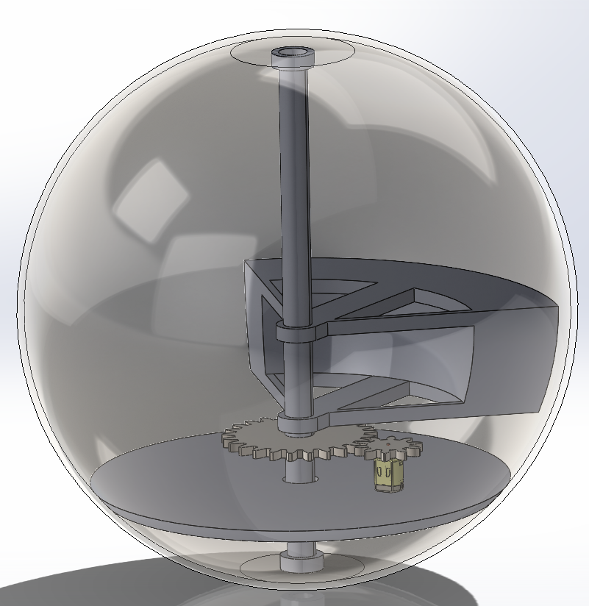
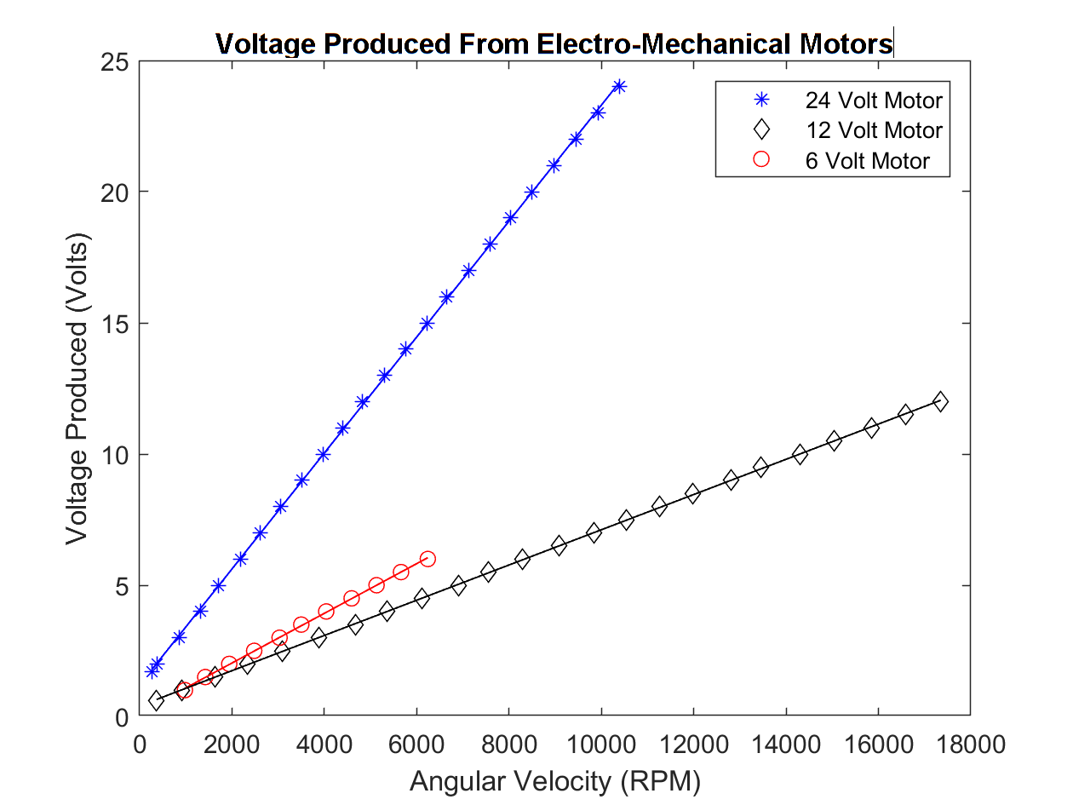
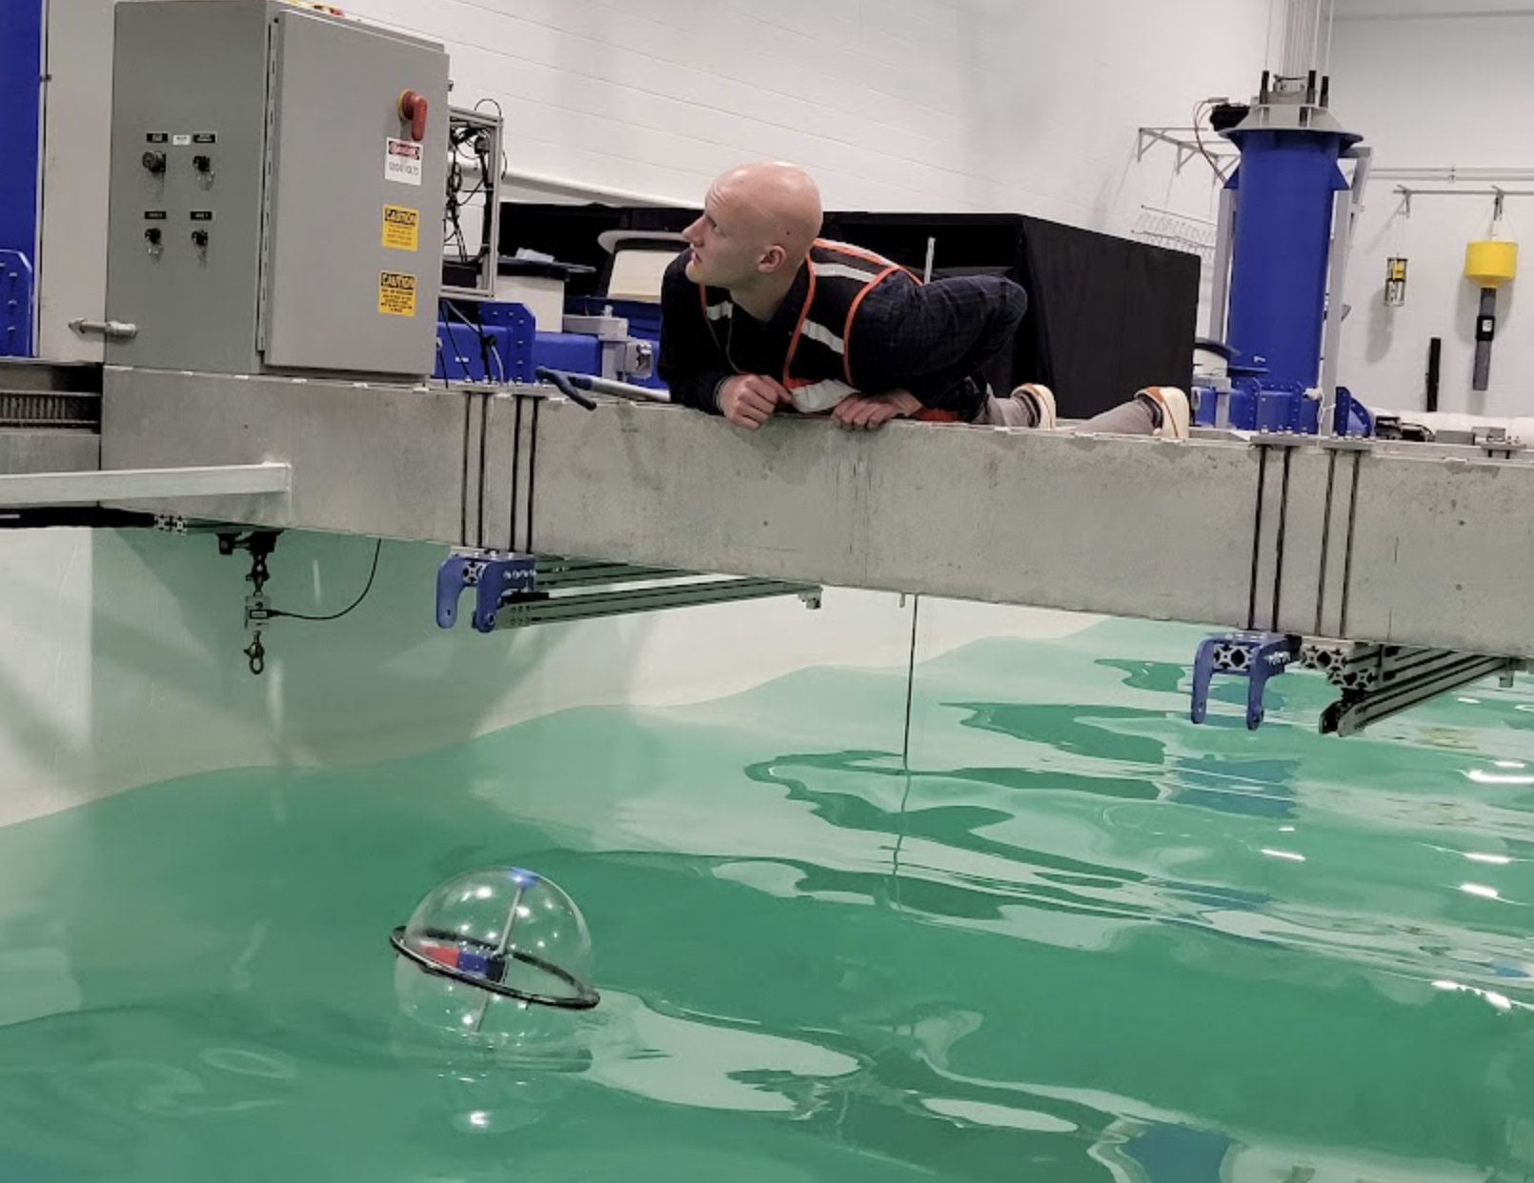
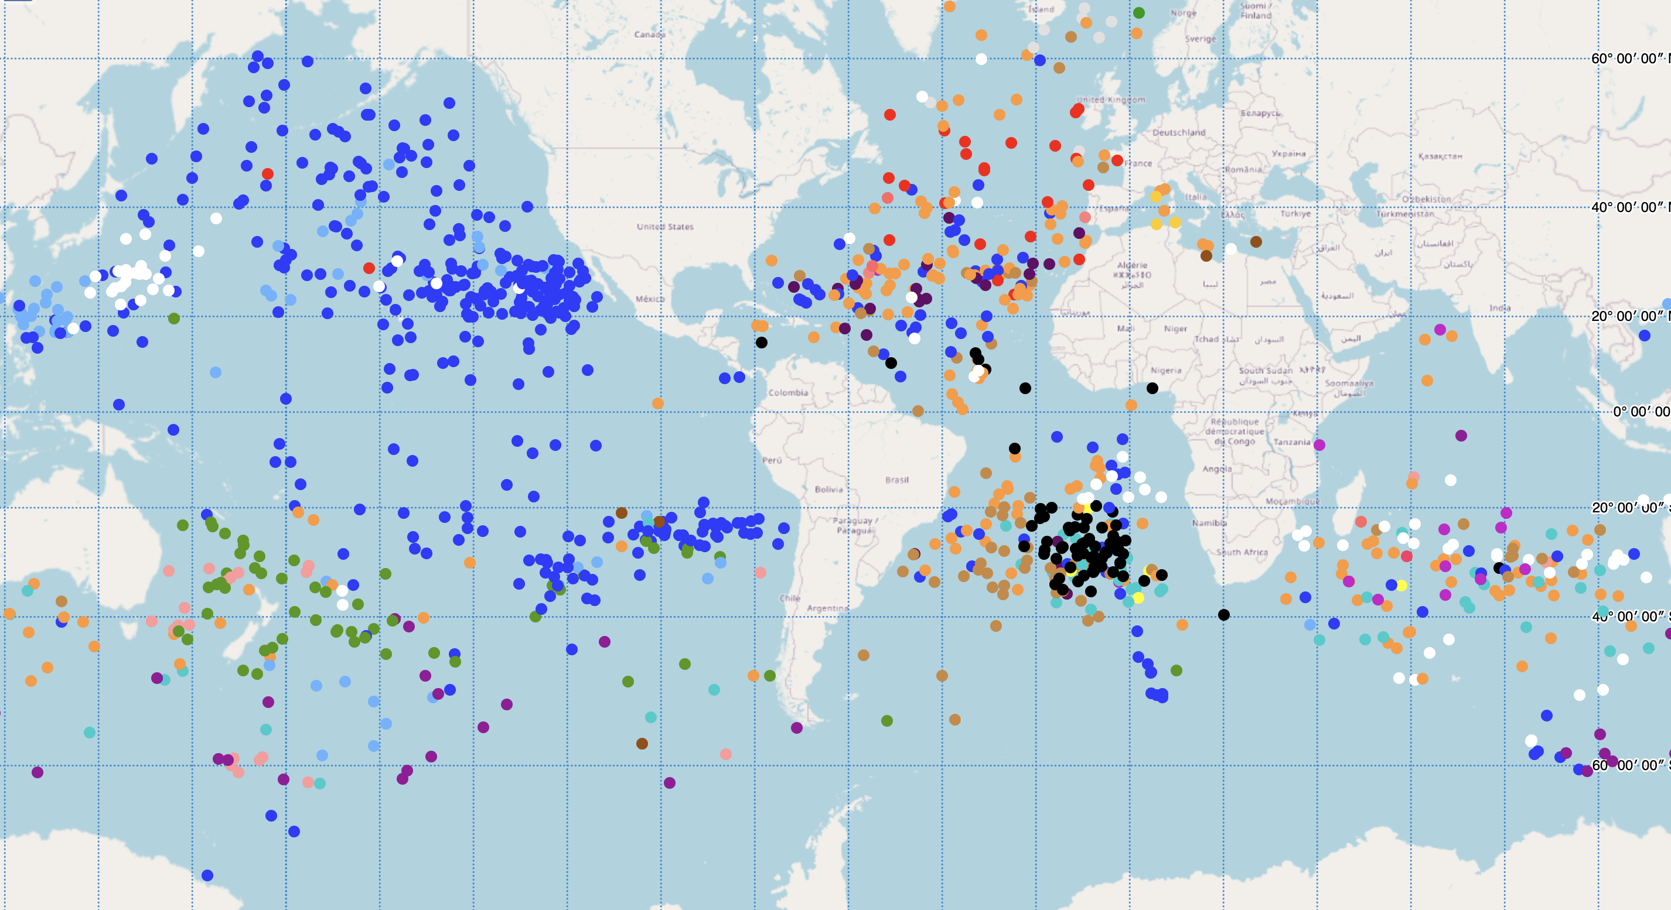
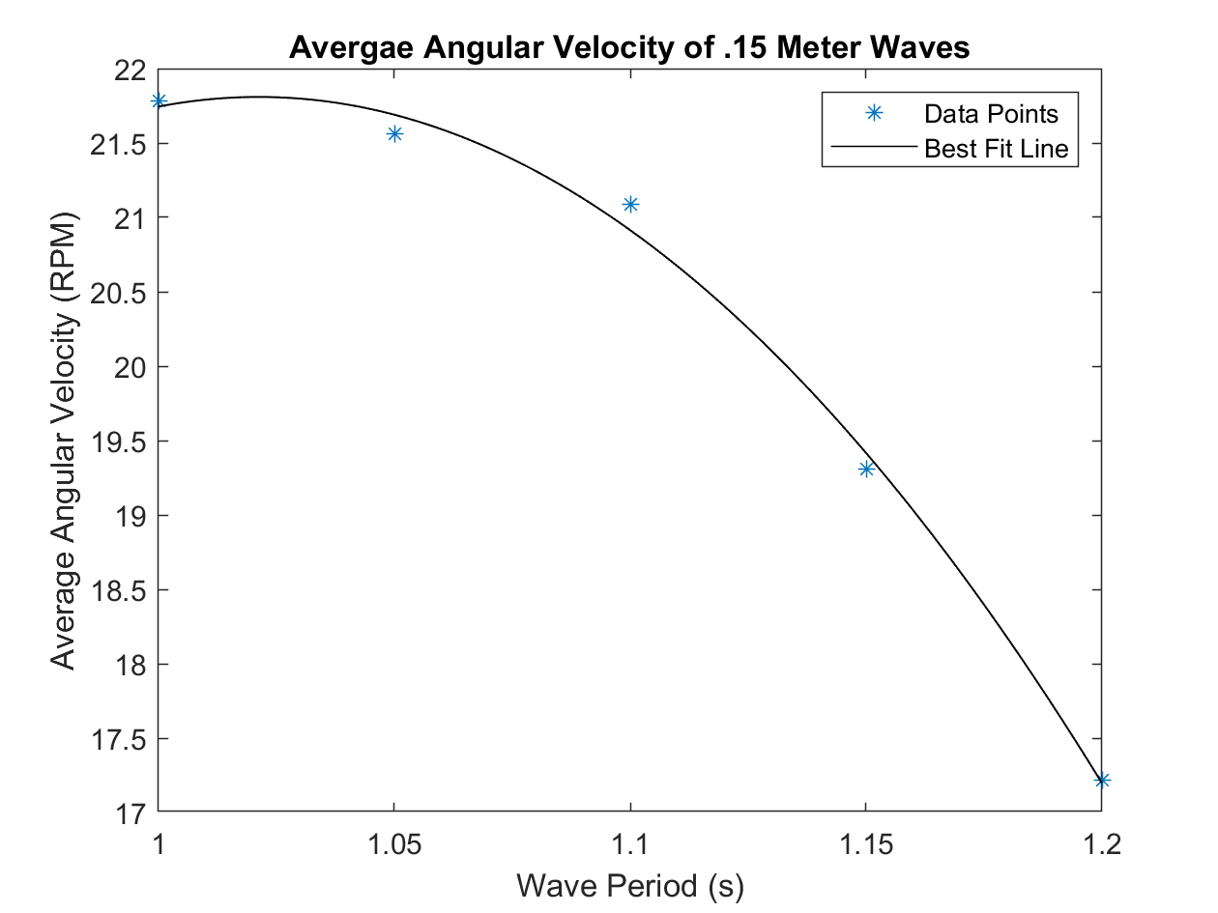
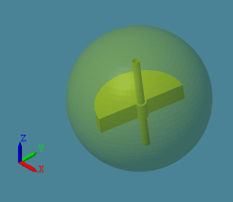
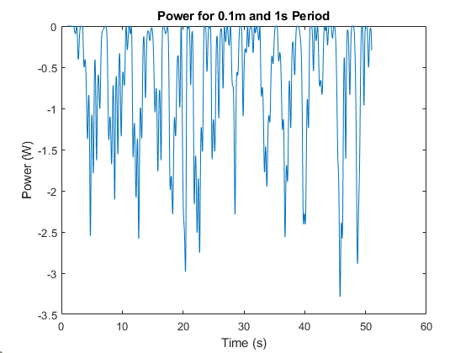

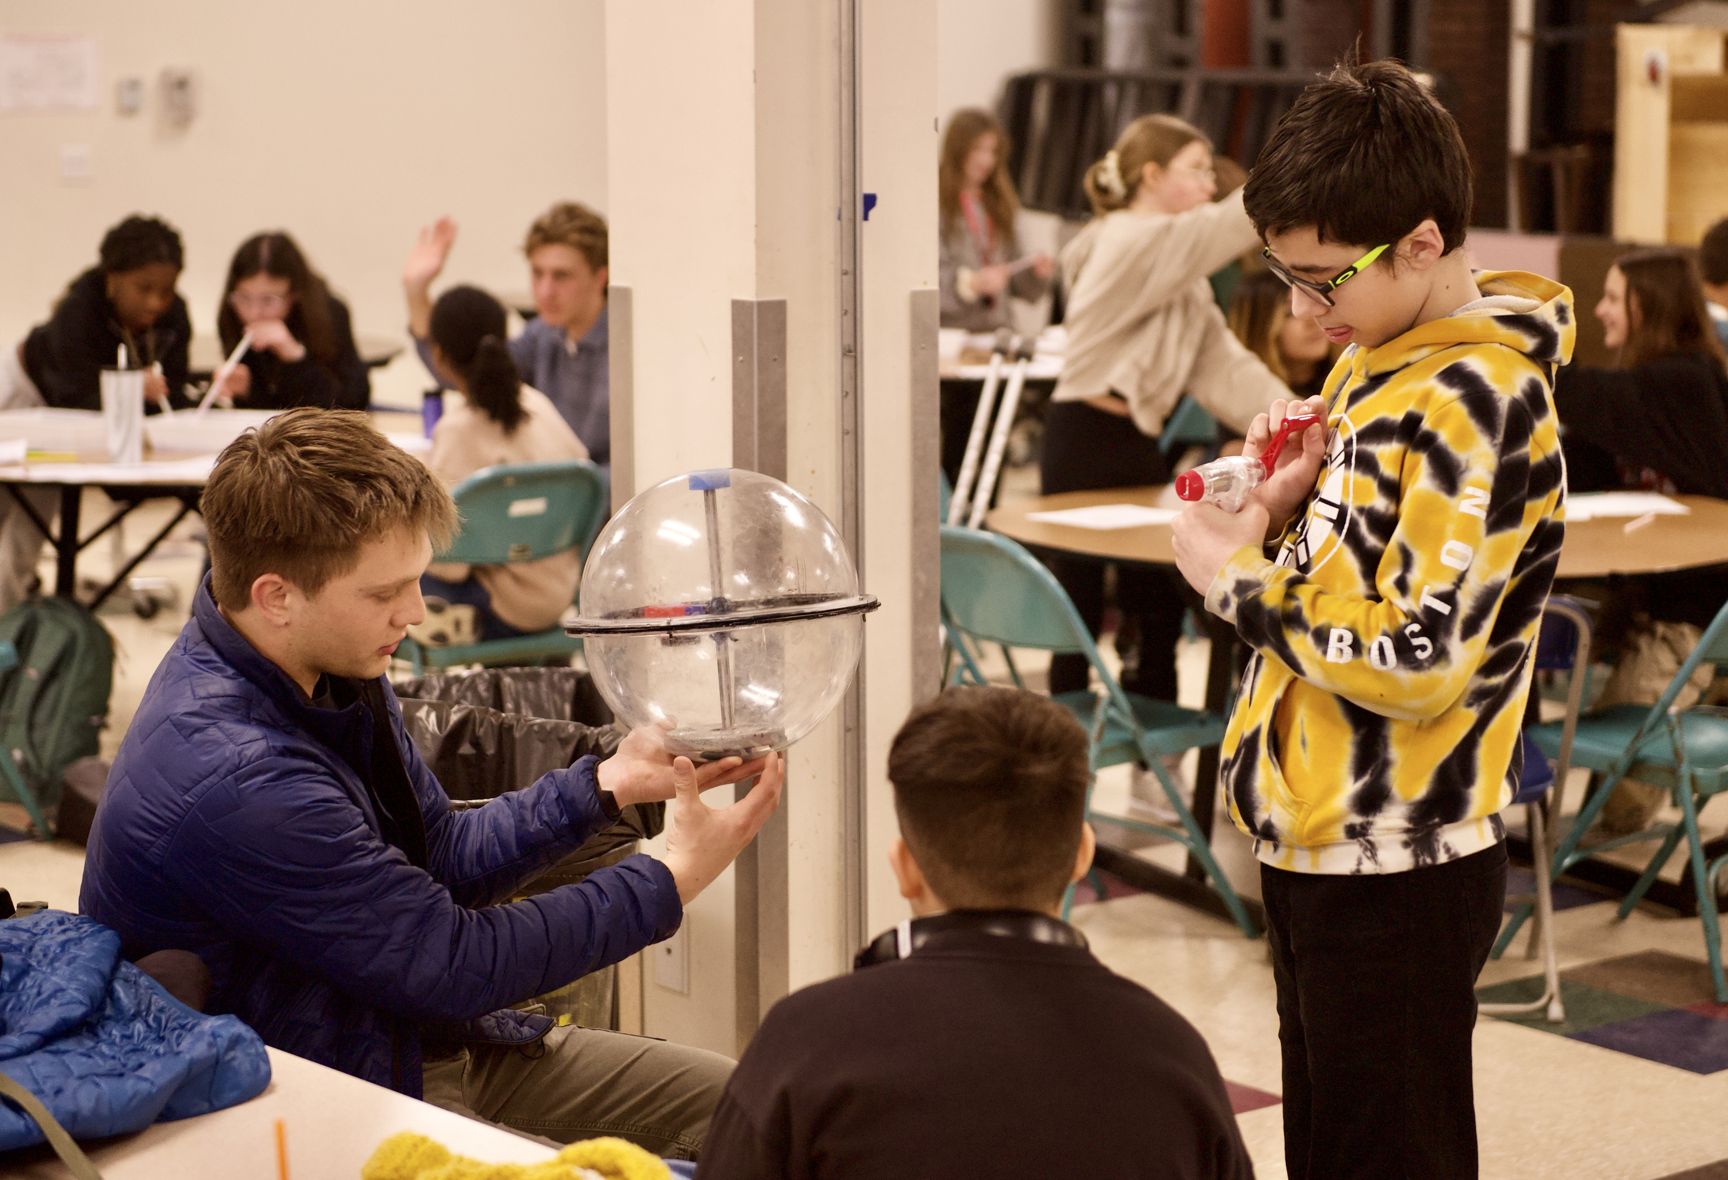
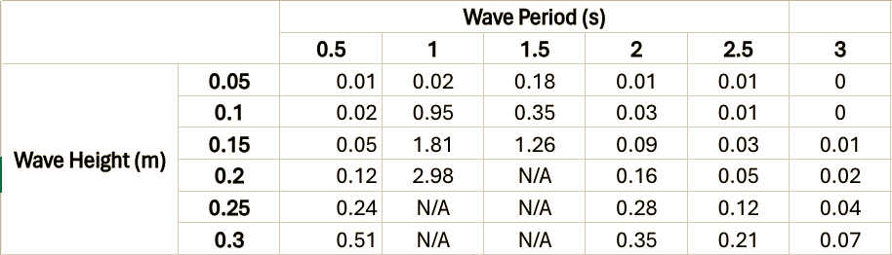
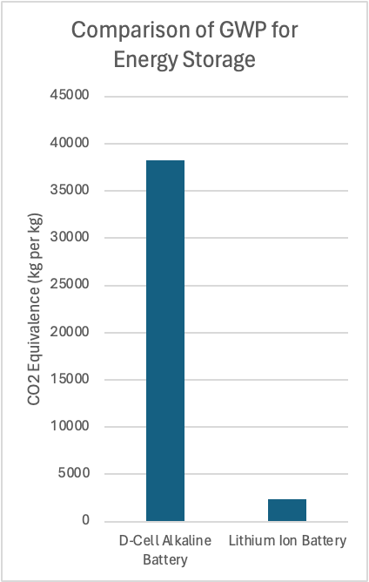

Drift-RMT: Powering Drifter Buoys with Wave Energy and Rotating Mass Technology
Matthew Carlson, Riley Desmarais, Nathaniel Hixon, William Lindsay, William Moore, Will Weete, Jack Kearning, Kara Wittmann, James Wood, Allison Kelley, Kevin Moriarty, Cameron Vose
Advisors: Dr. Martin Wosnik, Dr. Erin Bell (College of Engineering and Physical Sciences), Lisa Keslar (Paul College of Business)
Motivation
Device Design
Testing
Customer Discovery
The Marine Energy Collegiate Competition
Powering the Blue Economy (PBE) applications
Use marine renewable energy
NOAA Global Drifter Program
Collect data to improve weather forecasting
Over 1300 drifters deployed worldwide, goal: maintain a 5ºx5º grid
Powered by 30 D-Cell batteries
Problem
Unreliable, 68% stop transmitting before expected lifetime is reached
400 replaced annually – Remainder marine debris
Preliminary Design
General concept
Estimate sizing
material properties
Specifications
0.38m Diameter Spherical hull
3kg rotating mass
~170:1 Gear Ratio of Shaft to Motor
Generator testing
Goal: Develop the relationship between angular velocity and voltage produced for each motor
Three different sized motors
Target Government and Private Organizations
Interview conducted
Dr. Shaun Dolk, Manager of the Global Drifter Program, NOAA
Dr. Jake Kritzer, Executive Director, NERACOOS, Portsmouth, NH
Dr. Tom Coolbaugh, Operations Manager, Ohmsett Testing Facility, Leonardo, NJ
Peter Britz, Director of Planning and Sustainability, Portsmouth, NH
Evan Alders, MetOcean Telematics
Voltage Produced vs. Motor Speed
Wave tank testing:
Goal: Develop a relationship between angular velocity of the rotating mass mechanism and different wave characteristics
Conducted in Wave Tank in Chase Ocean Engineering Lab
Tested under 12 wave settings, varying wave height and period
SW Model of Drift-RMT Buoy
PTO Simulation
Community Outreach
WEC-Sim
Model used to generate data of heave response and power output for given waves
Simplified model used to reduce computation times
Will Weete Testing the Prototype
in the Wave Tank
Founder's Academy, Manchester, NH
3 interactive stations for 70 6th-grade student.
Demonstrated rotational energy generation, wind turbine mechanical energy, and surface current flow paths.
Global Drifter Map
Solution
Design
Wave energy converter (WEC)
Unbalanced rotating mass
Gearbox & electric-mechanical generator
2 rechargeable batteries
H-Bridge or similar circuity
Characteristics
Cannot inhibit drifter flow
Can survive different environments
Easily deployable
Lightweight
Angular Velocity vs. Wave Period
Given any combination of wave conditions and motor size, voltage production can be predicted
Motor selection depends on factors including gear ratios, operating range, and battery specifications
WEC-Sim Model
Instantaneous Power of Model
Team Members Working with Students
Seacoast School of Technology, Exeter, NH
Provided a tour for UNH marine energy testing facility and demonstrated design.
Presentations
Presented Drift-RMT design for clubs and organizations.
Social Media Presence
Active Instagram @unhmecc
Business Plan
Power Matrix in Watts of Simplified WEC-Sim Model
Financials
Sublicense design fee with multilevel drifter price scale based on instrumentation
Sales Price: $6,000 – $12,000 per unit
Cost of Sales: $0 (Outsourced Manufacturing)
Gross Profit Margin: 27% (Averaged)
Market Expansion
Increase current concentration to global 3ºx3º grid over five years
Expand current buoy networks for: weather prediction, climate mapping, disaster preparedness, shipping routes, fish population monitoring, oil concentration detection
Environmental Impact
Power Estimate
Concerns:
Noise disturbance
Marine toxicity
Marine debris of drifter
Solutions:
Insulated electronics
Encapsulated batteries
Retrievable via GPS tracking
Power Demanded
Sensors ping every hour on the hour and that data is transmitted to satellite
Average power draw ~0.06 watts
Power Produced - Theoretical
Future Efforts
Prototype Testing
Larger electrical loads
Test in wave tank under different conditions
WEC-Sim Model
Simulate more complex model
M – mass
g – gravity
r – hull radius
theta – buoy incline angle
n – generator efficiency
Global Warming Potential
Comparison

