Slide 1
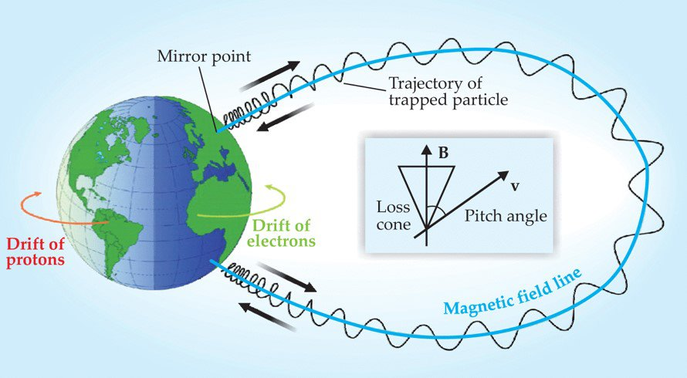
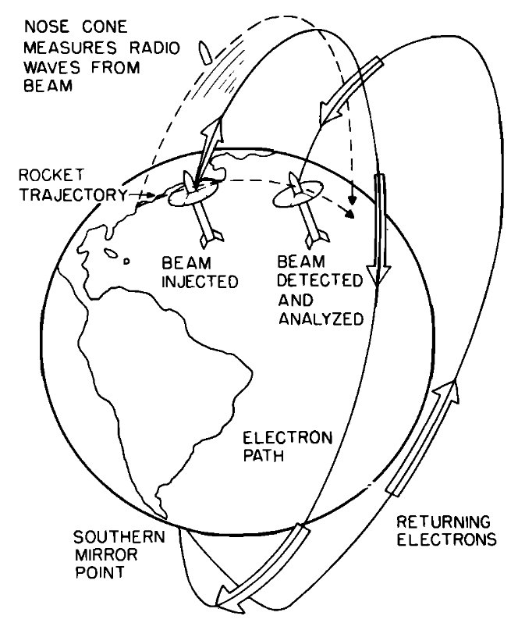
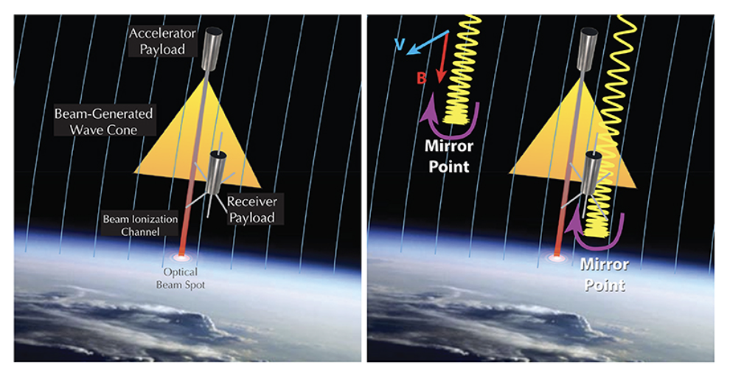
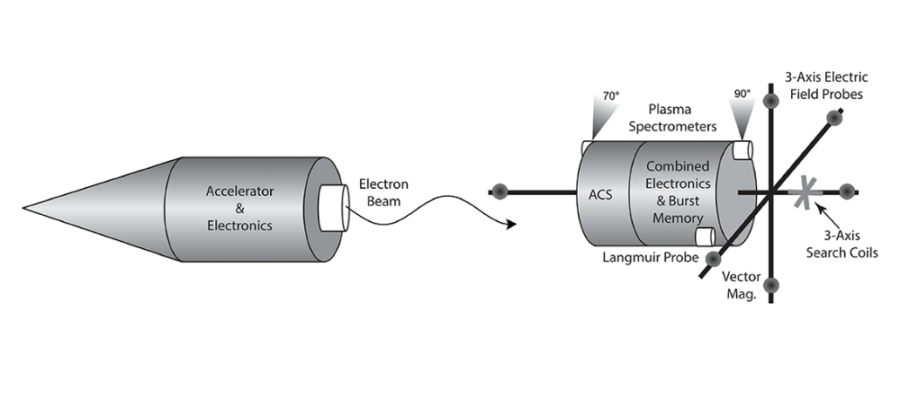
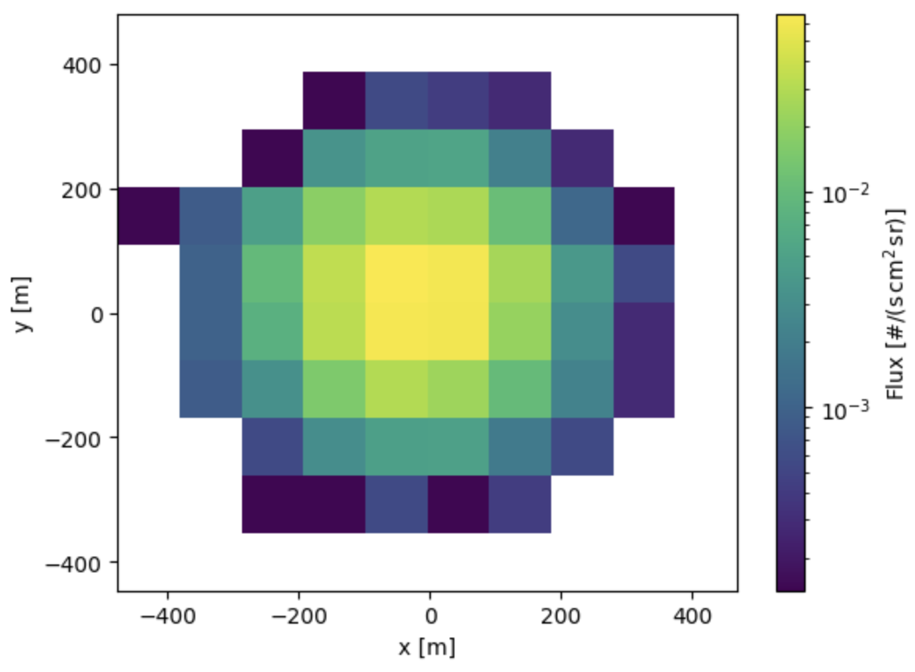
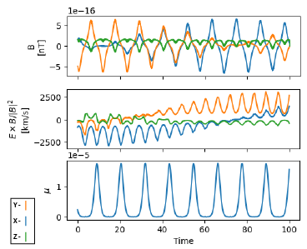
Beam Modeling for MICROBE Carly Cole, Christopher Oelerich, James Regan Computer Science, University of New Hampshire, Durham, NH 03824
Introduction
sTAMD Simulations
Implementation
Context
The objective of the Magnetosphere Ionosphere Coupling & Response Observed via Beam Echoes (MICROBE) project is to evaluate the effect of solar activity on earth by launching a particle accelerator and detector into a sub-orbital trajectory, emitting particles through the earth’s magnetic field, and measuring their return. The design of these instruments is reliant on an accurate simulation of the emitted particles. To support this, this project augments existing beam-modeling software to include an electric field model which will produce the data required to construct instrumentation.
In the beam tracing code, there are two principal systems: one for generating simulation data and the other for visualizing that data in different graphics. The simulation system uses functions based on the Boris particle pushing method, altering the velocity and position of a massive group of particles over a linear increment in time. The plotting system uses the data generated from these simulations to graph the characteristics of the beam and how it will be received based on the mission's defining parameters.
Figure 1: Graphic of a particle beam’s pathway along one of Earth’s magnetic field lines
Figure 2: Probe launch routine
Take-off | Emission | Reception | Landing
Requirements
Conclusions
Instrumentation
By adding to former developers' model of the magnetic field, we aimed to incorporate an electric field to improve the accuracy of the simulation. We were able to develop a physically accurate particle pushing method using a model containing both magnetic and electric forces, generating data to the benefit of the MICROBE instrumentation team. The improved model was thoroughly analyzed and validated. We were also able to produce parameter scans for instrumentation design by running the simulation on the supercomputer. Thus, we achieved ¾ of the requirements, with future steps including fully implementing the updated field model into the beam tracing code.
Update beam modeling code to implement the electric field in conjunction with the magnetic field.
Create methods for validating the electric field model by plotting flux and adiabatic invariants such as magnetic moment.
Create parameter scans for key variables.
Modify beam modeling code and run environment so it runs on a local supercomputer.
Testing and Results
We were able to develop an electric field model to be inserted into the simulation. We also adjusted the code to run on the supercomputer, allowing us to produce parameter scans more quickly. To validate the accuracy and reliability of our field model, we employed two primary methods:
Plotting Flux: We first plotted the flux distribution across the system, using data from the simulation. This enabled us to visualize the movement of the particles and confirm that it conformed to our theoretical expectations.
Plotting Magnetic Moment: Additionally, we were able to test the output from the electric field model by plotting magnetic moment. Our plots (figure 7) show that this remains largely constant, confirming that our implementation is accurate.
Figure 3: Graphic depicting how probe emits and receives particle beam
Figure 4: Design for probe. Contains 2 main segments: Accelerator (left) and Receiver (right)
Design
References
Sponsor: Matthew Argall
McEntire, R. W., R. A. Hendrickson, and J. R. Winckler (1974) – Context, Figure 2
Maynard and Chen (1975) – Volland-Stern electric field
Reeves, Geoffrey D., et al. “The Beam Plasma Interactions Experiment: An active experiment using puled electron beams.” Frontiers in Astronomy and Space Sciences, vol. 7 17 June 2020 – Instrumentation figures 5 and 6
Tasman, et al. (2019)
Zong (2022) -- Context, Figure 1
Figure 6: Spatial extent of the flux at a point in time
Figure 7: Time Series plots
Figure 5: Sequence diagram for simulation data generation

