Slide 1
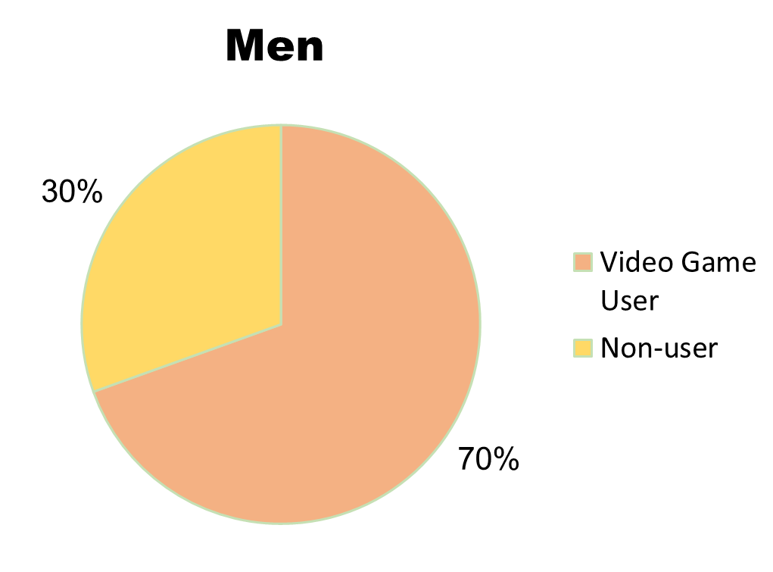
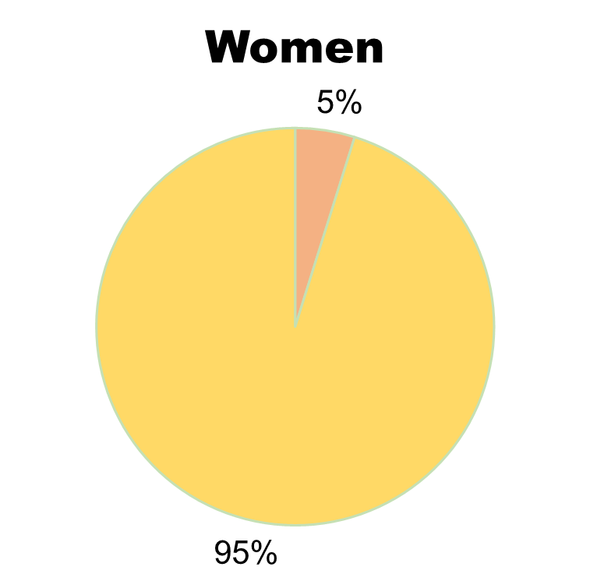
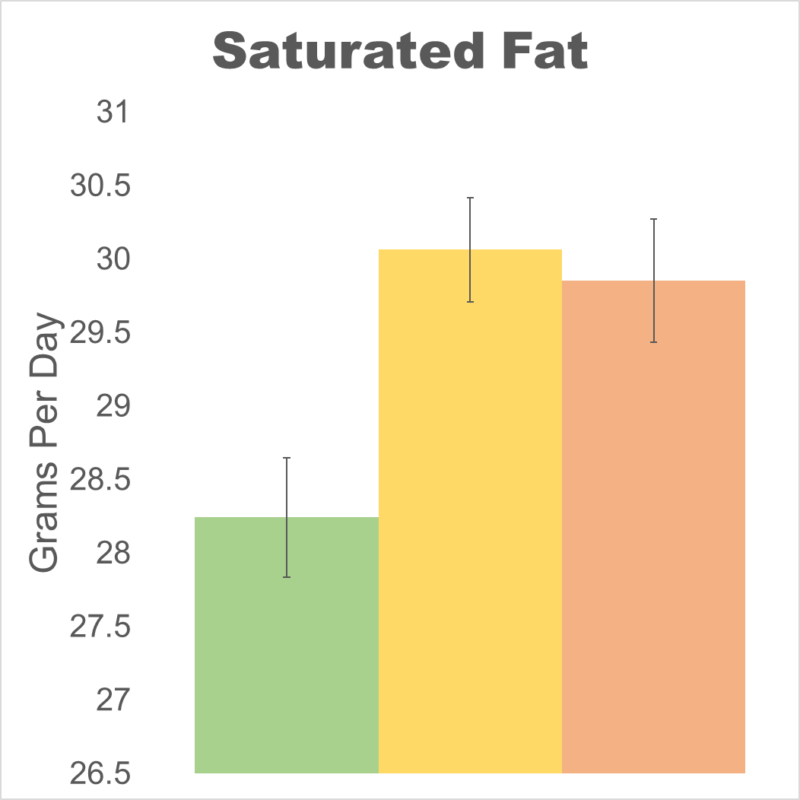
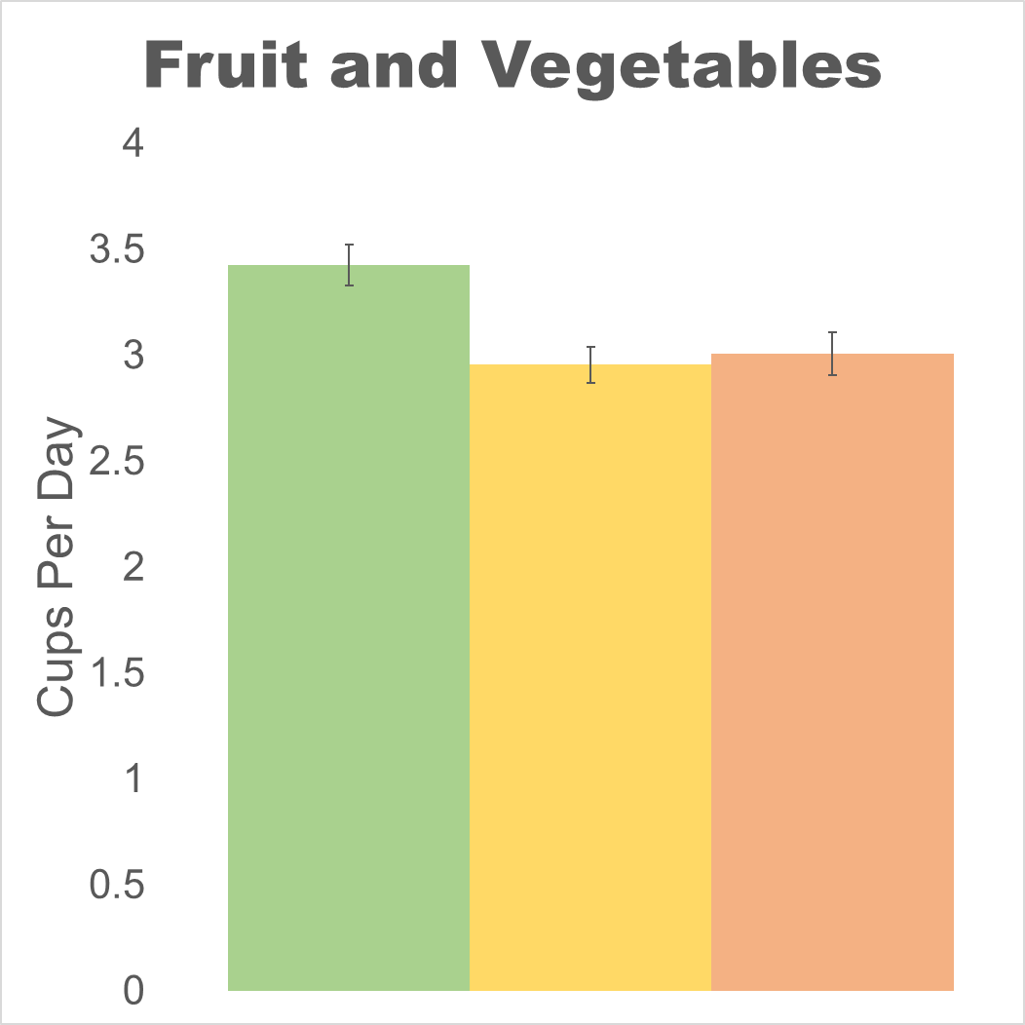
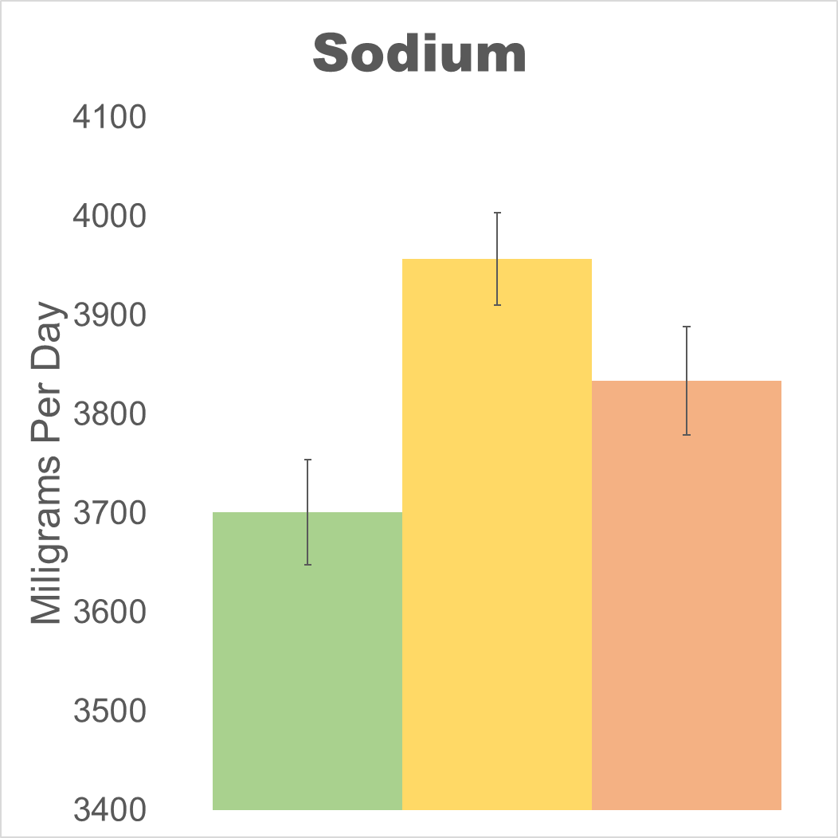
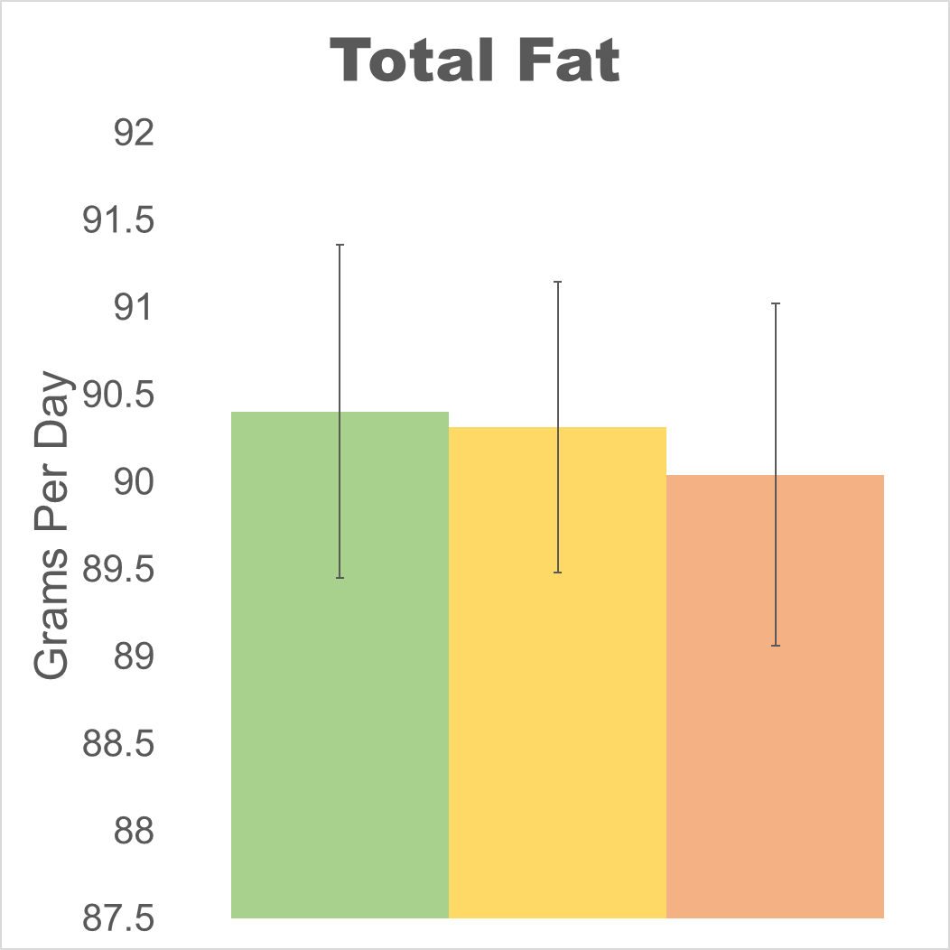
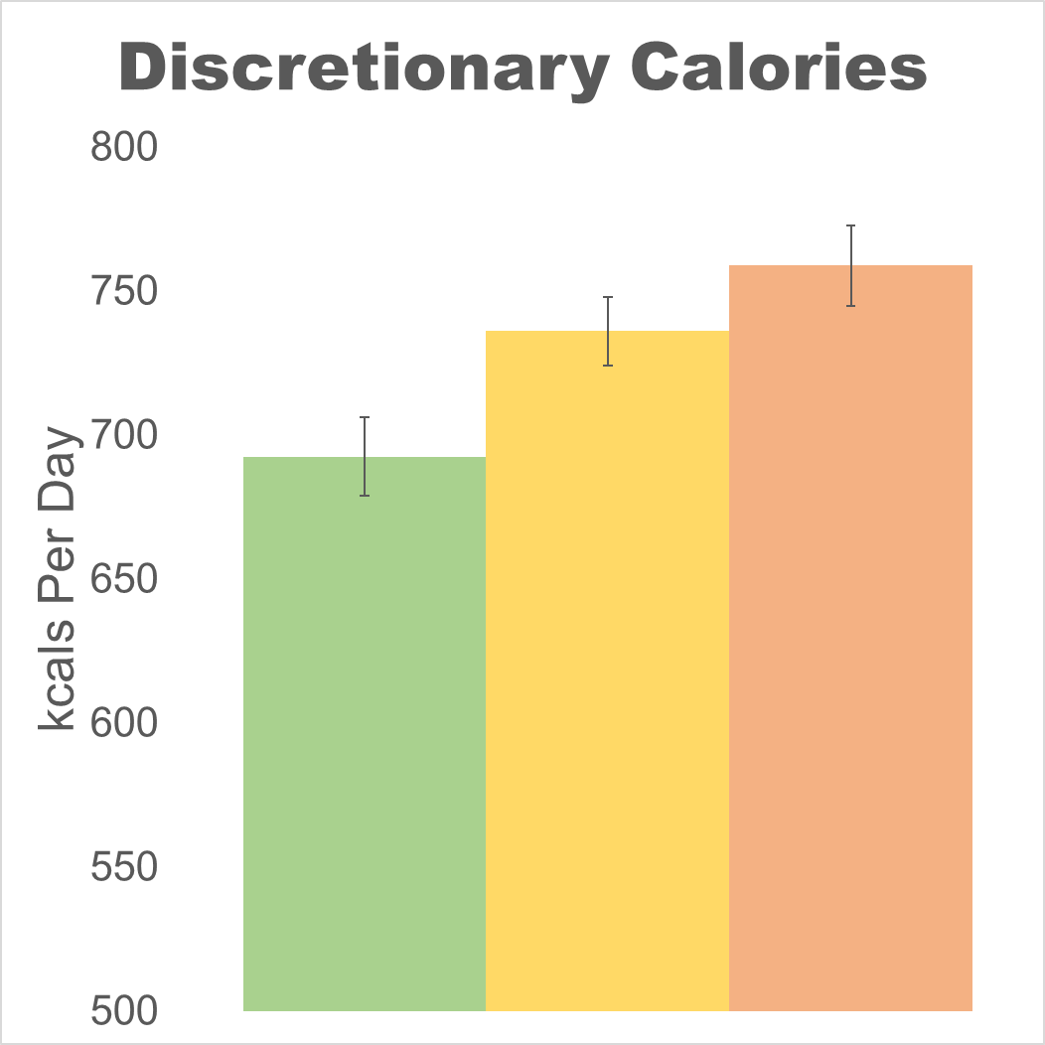
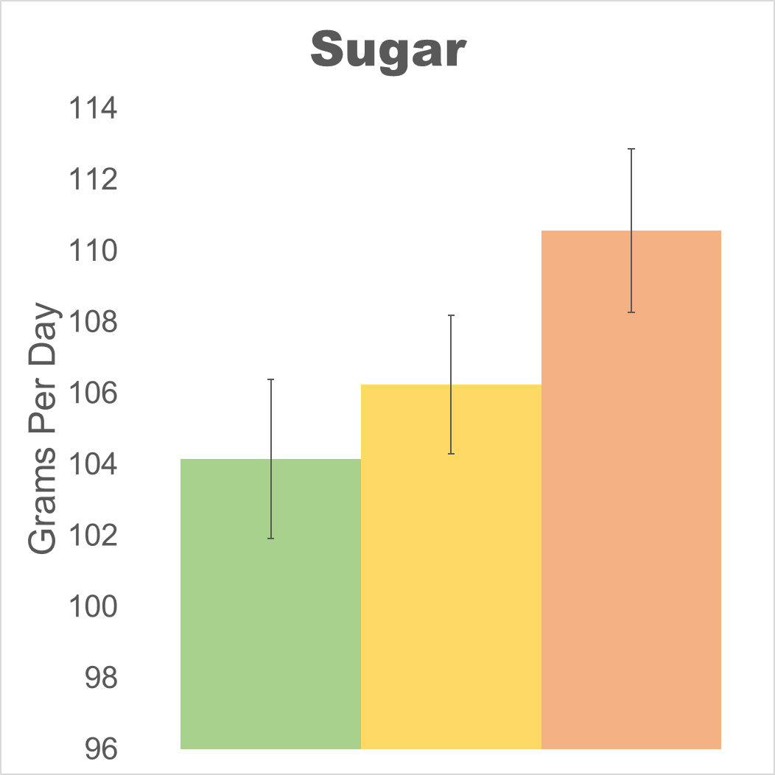
Do Dietary Patterns Differ with Video Game Usage in College Men?
Dustin Moore BS and Jesse Stabile Morrell PhD
University of New Hampshire:
Department of Agriculture, Nutrition, and Food Systems
Introduction;
Subject Characteristics;
Video Game Play by Gender;
The video game industry has exploded in the past 30 years.¹ It has grown nearly 10% from 2018-2019 and generated approximately $150 billion.² Engaging in seated video game play is considered a sedentary activity, which may contribute to positive energy balance, weight gain, and chronic disease.^{3,4} In addition, advertisements and mindless eating may contribute to the consumption of foods of low nutritional quality.^{5,6} The current literature provides evidence that video game usage is associated with poor diet, snacking, and less physical activity.^{7,8} The current evidence, however, does not examine college students or college aged adults. Because the video game industry has historically targeted young men, it is necessary to add to the current literature by exploring the associations of video game play and diet in college men.
Group (Video Game Usage) | Non-Users | < 1 hour/day Users | ≥ 1 hour/day Users
N Participants | 367(30.5%) | 477(39.4%) | 357(30.1%)
Age (years) | 19.3±0.1 | 19.1±0.1 | 19.2±0.1
% First-Year | 42.6% | 53.1% | 47.5%
Weight (kg) | 76.4±0.6 | 77.7±0.6 | 77.6±0.8
Height (cm) | 177.5±0.4 | 178.1±0.3 | 177.8±0.4
BMI (kg/m²) | 24.2±0.2 | 24.5±0.2 | 24.5±0.2
Body Fat % | 16.6±0.3 | 16.9±0.3 | 17.0±0.4
Iliac Waist Circumference (cm) | 82.4±0.5 | 84.2±0.5 | 84±0.6
Daily kcals (kcals/day) | 2598±45 | 2527±33 | 2363±37
Smoking Status | 9.7% | 10.1% | 9.3%
Daily Steps (steps/day) | 10037±186 | 9677±148 | 8422±148
Conclusions;
High and moderate video game usage is associated with:
Low fruit and vegetable intake
High saturated fat intake
High discretionary calorie intake
Moderate videogame usage is associated with higher sodium consumption compared to no usage.
Video game usage was not a predictor of total fat consumption, sugar consumption, or weight status (WC, BMI, and BF%)
Objective;
Results:
Nutrient Intake by Hours of Video Games Played
To assess the differences in fruit and vegetable (F/V), total dietary fat, saturated fat, sodium, sugar, and discretionary calorie consumption between high, moderate, and non-video game users in a sample of male college students.
Methods;
b
b
a
b
b
b
Strengths & Limitations;
Participants:
Participants consisted of 1201 male college students between the ages of 18-24.
Convenience sample from Nutrition Health and Wellbeing course at the University of New Hampshire.
Exclusion criteria: not 18-24 years old or have any medical condition that could prevent an individual from participating.
Study Design:
The College Health and Nutrition Assessment Survey (CHANAS): an ongoing cross-sectional study since 2005 at the University of New Hampshire.
Collects a variety of health-related information (i.e. anthropometric, diet, and behavioral).
Approved by University of New Hampshire IRB (#5524)
Measurements:
Video game usage using the question “On an AVERAGE SCHOOL DAY, how many hours do you play video games? Include activities such as Nintendo, Game Boy, Playstation, Xbox, etc.”
Diet information collected via 3-day food records and processed using Diet Analysis Plus version 10 (Cengage Learning)
WC, BMI, and BF% (via bioelectrical impedance) measured in duplicate by trained research assistants on calibrated machines.
Data Analysis:
ANCOVA to compare means between high, moderate, and non-video game users
Covariates: Freshman status, total energy intake, average daily steps
Analyses conducted using SPSS version 26
ab
Strengths:
Large sample size N=1201
Diet information collected using a 3-day food record
Anthropometric measurements are collected with validated instruments by trained research assistants
Limitations:
Cross-sectional studies cannot rule out reverse causation
Self-reported diet data can have varying accuracy
Results may not be generalizable to populations outside of male college students
a
a
Non-Users
< 1 Hour/Day Users
≥ 1 Hour/Day Users
b
b
Acknowledgments;
a
Thank you to the large cohort of undergraduate and graduate research assistants that aided in data collection, entry, and cleaning. Thank you to all support staff that organize and train students every year to maintain CHANAS. Thank you to Dr. Jesse Stabile Morrel for all the guidance and feedback in the execution of this study.
Funding Statement;
Broader Context;
Project funded by the New Hampshire Agriculture Experiment Station and the USDA National Institute of Food and Agriculture Hatch Project 1010738
Video game usage associations with diet in college men may allow for future education in university settings. With these novel results, universities across the U.S. and further can enact more focused educational campaigns within their dining halls and dormitories to increase nutrition literacy and healthy eating.
References;
1. Marchand A. J Interact Mark. 2013;27(3):141-157. 2. The Global Games Market Will Generate $152.1 Billion in 2019 as the U.S. Overtakes China as the Biggest Market. Newzoo. 3. Romieu I. Cancer Causes Control. 2017;28(3):247-258. 4. Guh DP. BMC Public Health. 2009;9:88. 5. Folkvord F. Appetite. 2018;129:245-251. 6. Harris JL. Health Psychol. 2009;28(4):404-413. 7. Siervo M. Appetite. 2018;120:100-108. 8. Chahal H. Pediatr Obes. 2013;8(1):42-51.

