Slide 1
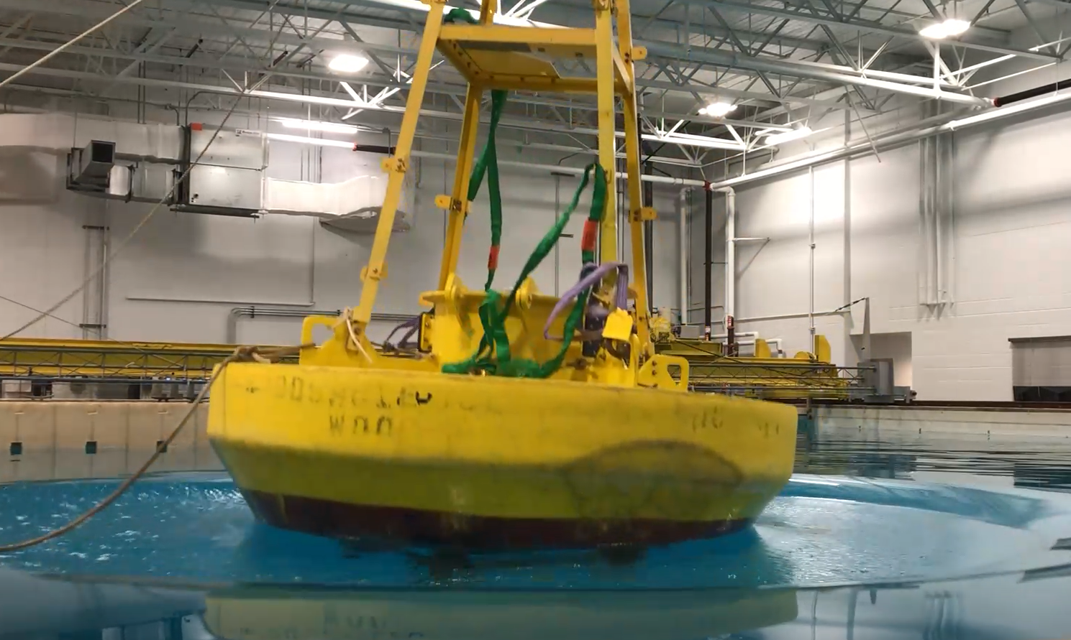
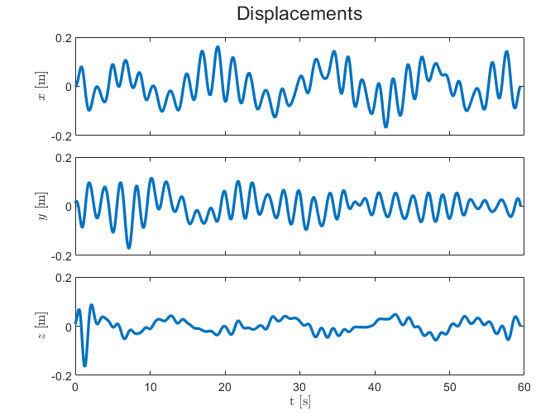
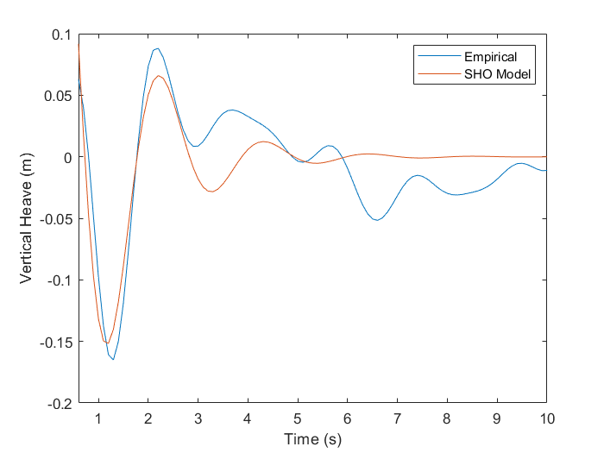
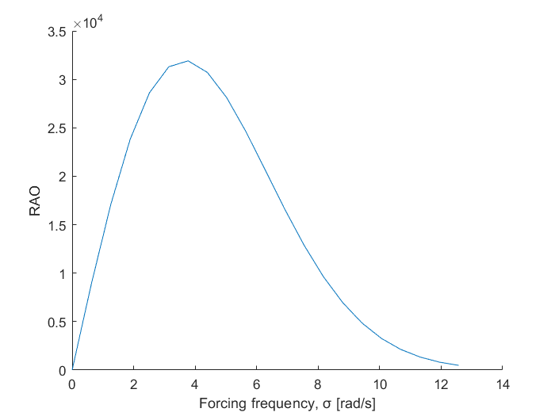
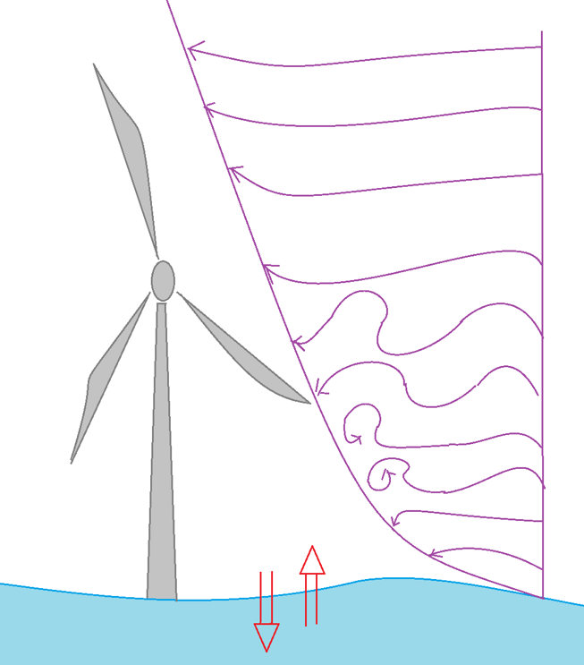
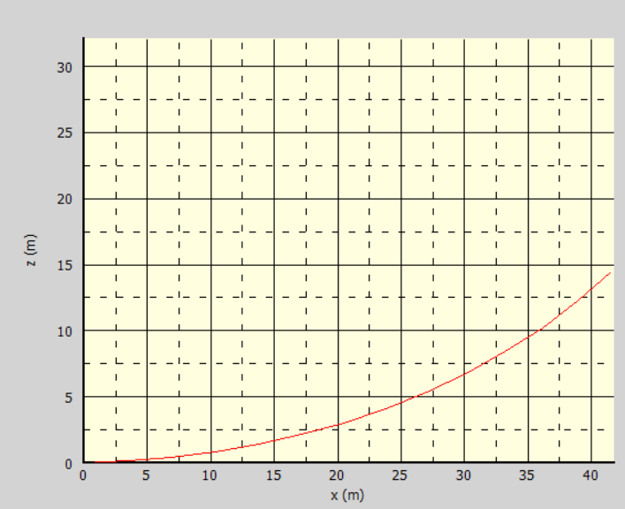
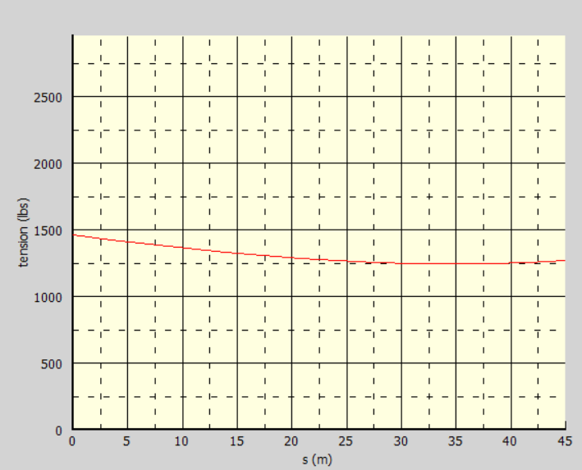
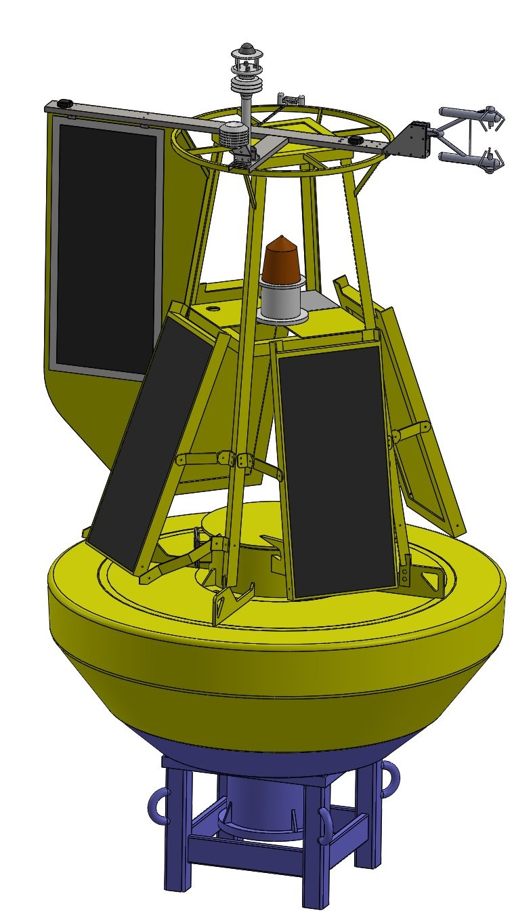
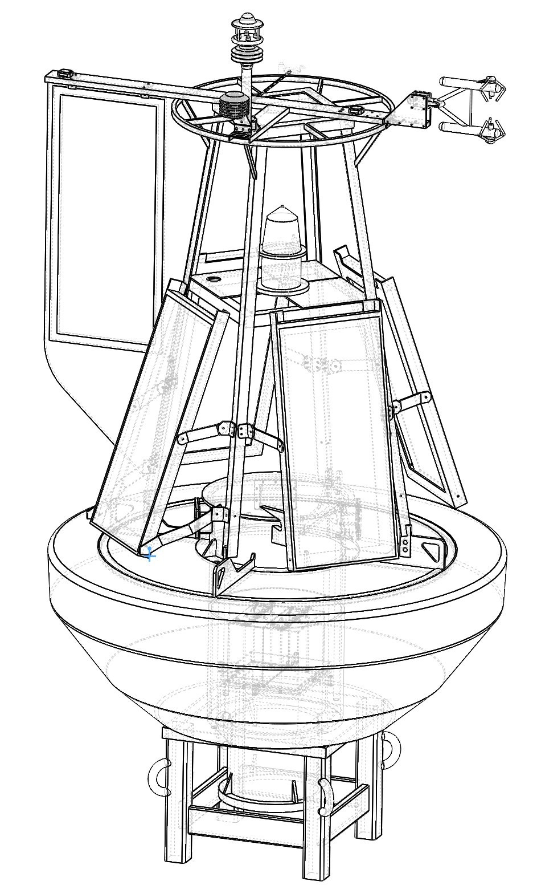
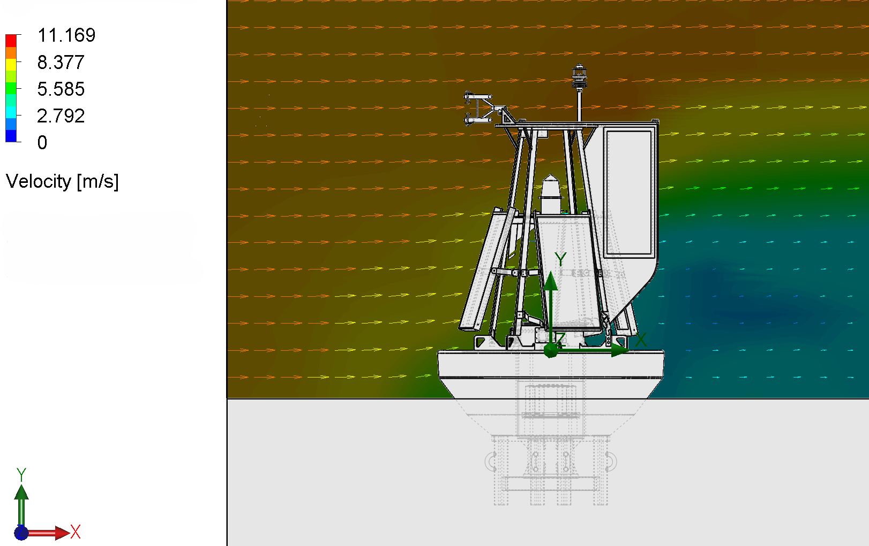
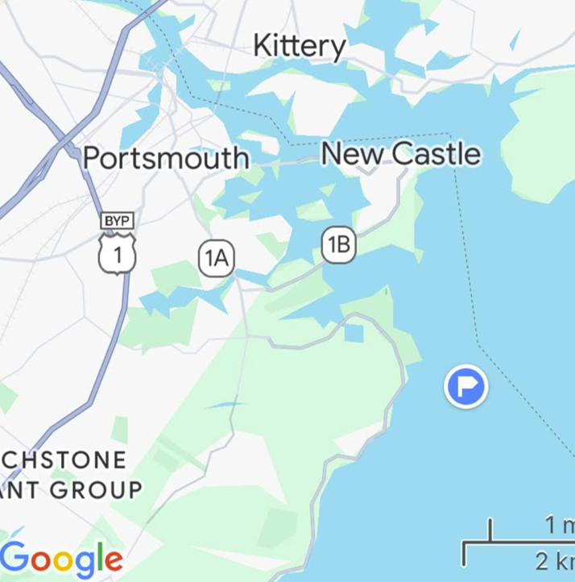
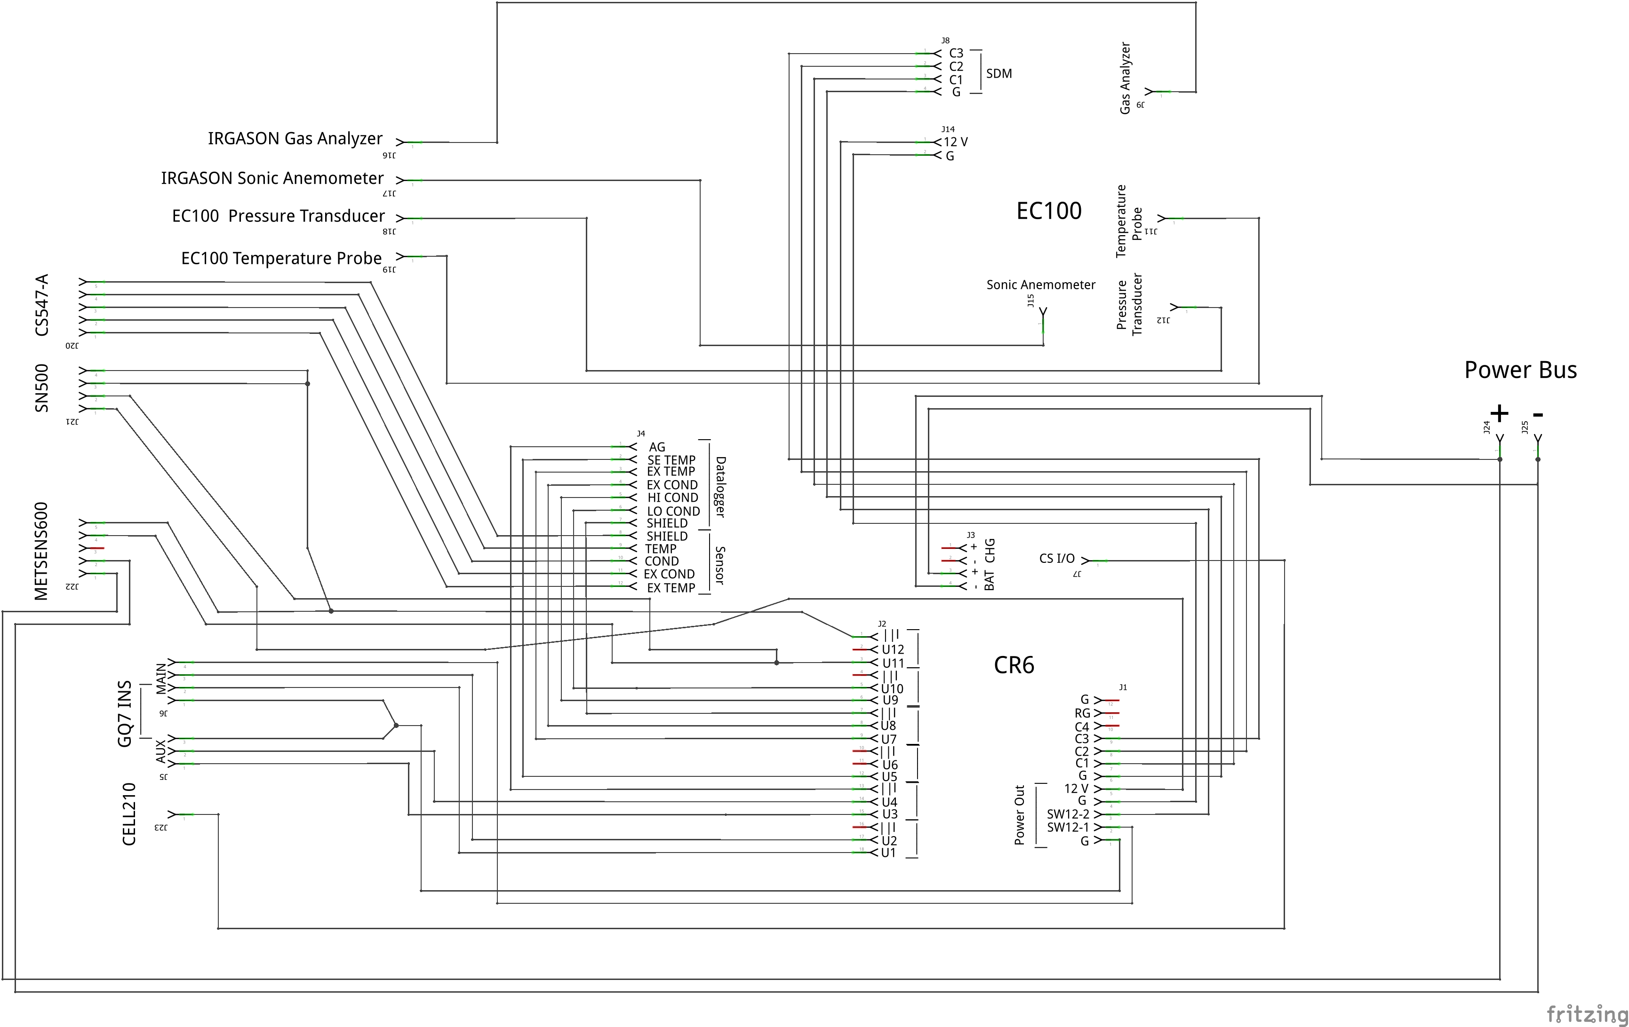
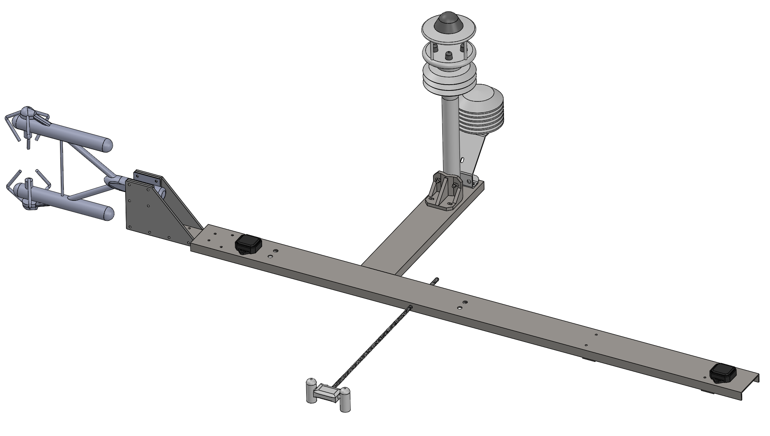
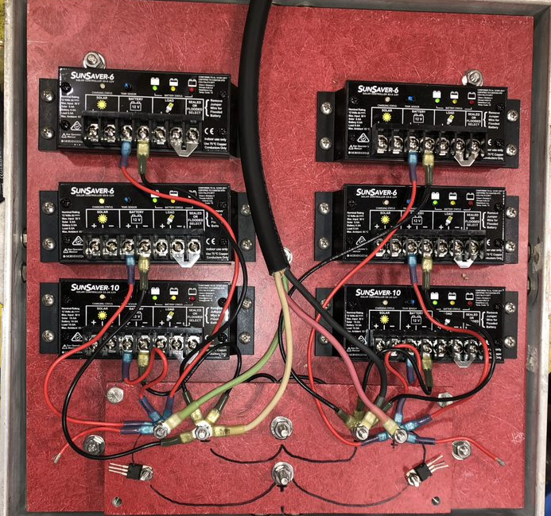
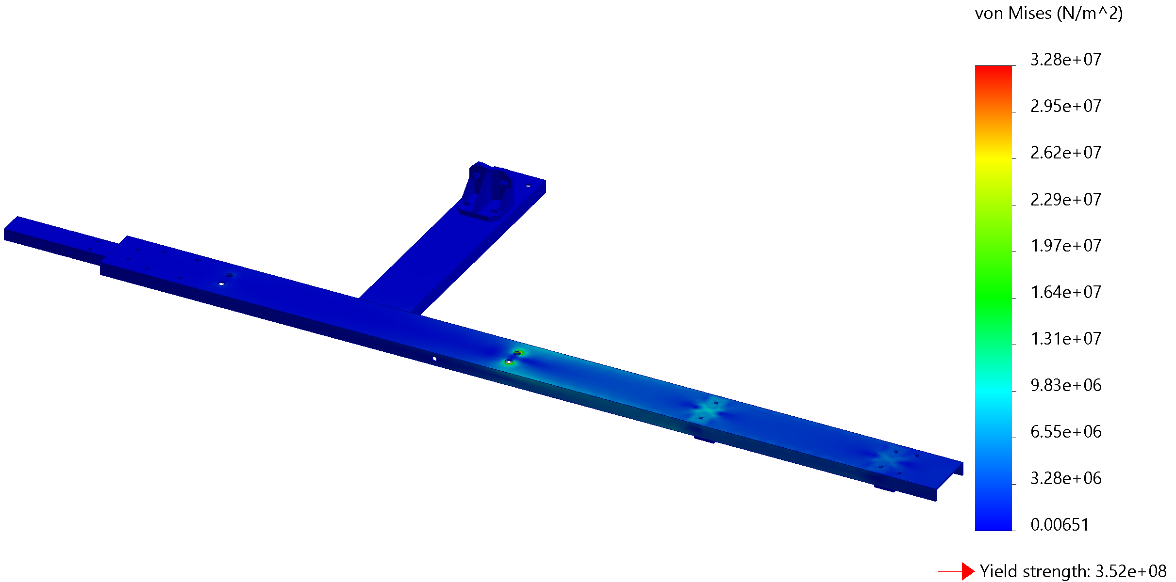
Development of the Air-Sea Flux Buoy Tristan Colby and Jane Schwadron Ocean Engineering, University of New Hampshire, 2024
Introduction
Modeling the Buoyancy and Roll Response
Mooring simulations
The Air-Sea Flux Buoy (ASFB) will measure meteorological parameters relating to the stability conditions of the turbulent air-sea boundary. These measurements will help researchers determine the momentum, moisture, and heat flux across the air-sea interface, along with the overall dynamics along the atmospheric boundary layer.
A drop test was performed to determine the 3-D displacement times series, natural vertical heave motion, and response amplitude operator (RAO) of the ASFB to characterize its nondimensional roll motion. Such knowledge helps isolate the velocities measured by the IRGASON during post processing.
The WHOI-cable software uses finite element analysis to model the nonlinear resultant forcing and displacement for a typical mooring (3:1 line-depth ratio, ¾ in. steel chain) in severe, random wave conditions (3 m sig. wave height, 10 second period, 3 m/s cross-shore current).
The ASFB project is part of a larger, ongoing project funded by the U.S. Department of Energy (DoE). The ASFB will be used alongside a meteorological drone to provide data for the development of offshore wind farms.
3D displacement time series
Modeled and empirical vertical heave motion
ASFB RAO vs external forcing frequency
CFD Modeling of External Flow Distortion
Resultant position of the catenary mooring line
Resultant forcing along the catenary mooring line
CAD Model (SolidWorks)
CFD External Flow (SolidWorks)
Deployment
Instrumentation
The completed Air-Sea Flux Buoy will be deployed off the New Hampshire coast Spring 2024. The buoy will be deployed by the R/V Gulf Challenger.
The mooring site is exposed to surf action and wind stress. It is close to shore for easy drone access from Odiorne Point.
IRGASON Sonic Anemometer & Gas Analyzer: 3-D wind velocity components, humidity, and CO2 concentration at a 20 Hz sampling rate
EC100 Temperature & EC100 Pressure Sensor
METSENS600: Wind velocity, air temperature, air pressure, & humidity
SN500: Upwelling and downwelling longwave and shortwave radiation fluxes
CS547: Water temperature and conductivity
GQ7 INS: Receives and transmits GNSS data to determine heading within 1 mm accuracy. Uses RTK corrections from a base station in New Castle
CELL210: A 4G LTE cellular modem sending data to a local server. Uses AT&T as the service provider.
Model includes buoy, vane, solar panels, nav light, top bracket, and instrumentation.
X-axis 9 m/s flow, with 30 deg vane offset. Note distortion of flow in buoy wake relative to instruments.
Location: 1 km off Rye NH
Depth: ~15 m
Date: Late May
Instrument Mounting Design
Power System
Acknowledgements
Secure instrument mounting ensures reliable data collection in the harsh conditions of the deployment site. The designed top mounting bracket is shown below. The bracket holds five instruments and mounts to the crows' nest and vane. The bracket keeps the IRGASON out of the buoy wake and the GNSS antennae unobstructed.
Power is provided to the main bus from two 12 VDC batteries charged by six 90-Watt solar panels.
Faculty Advisor: Nathan Laxague
Research Scientists: Shawn Shellito, Marc Emond
Undergraduates: Elani Daigle, Ethan Hickey
Machine Shops: Chase OE Lab, Olsen Center
Organizations: DOE, UNH, NH Sea Grant
References
Campbell Scientific. (2024). Gas Flux and Turbulence. Campbell Scientific. https://www.campbellsci.com/gas-flux-turbulence
Gobat, J. I., & Grosenbaugh, M. A. (2000). WHOI Cable v2.0: Time Domain Numerical Simulation of Moored and Towed Oceanographic Systems. Woods Hole Oceanographic Institution. https://iop.apl.washington.edu/~jgobat/cable.pdf
Monin, A. S. (1970). The Atmospheric Boundary Layer. Institute of Oceanology, Academy of Sciences.
Panofsky, H. A. (1974). The Atmospheric Boundary Layer Below 150 Meters. The Pennsylvania State University.
Tupper, E. (1996). Introduction to Naval Architecture (3rd ed.). Reed Educational and Professional Publishing Ltd.
Stress test simulating 10.5 m/s wind on vane.
One main bus powers all the instrumentation. Data logging and onboard processing occurs in the CR6. Data is telemetered to a local server onshore via the Cell210 and logged to an SD card.

