Slide 1
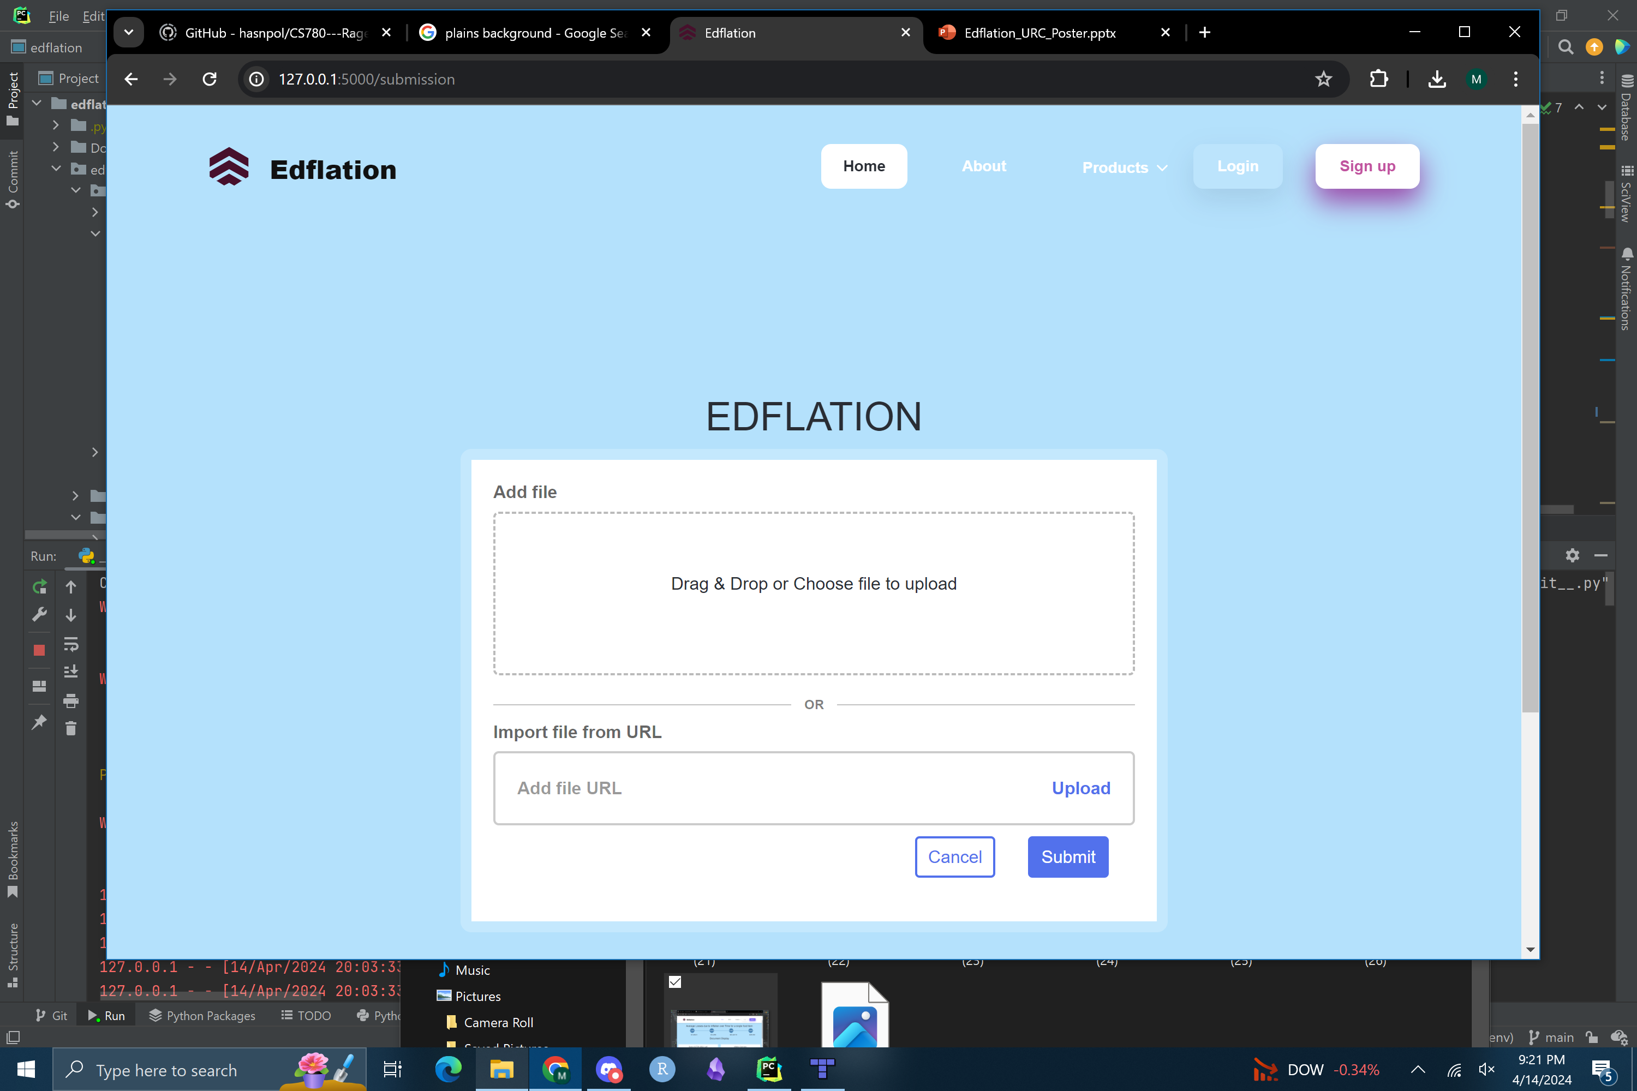
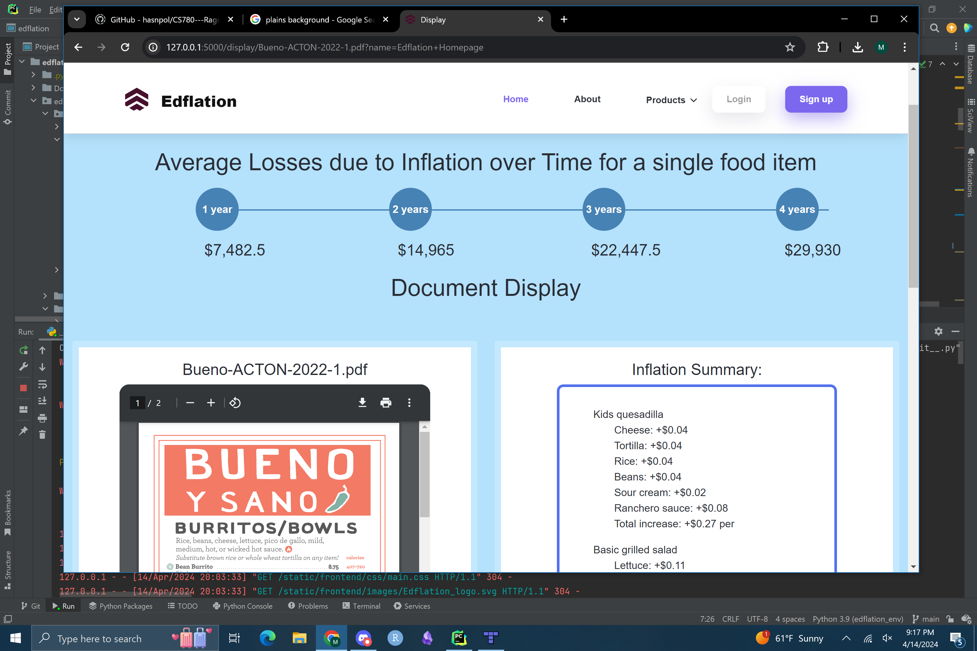
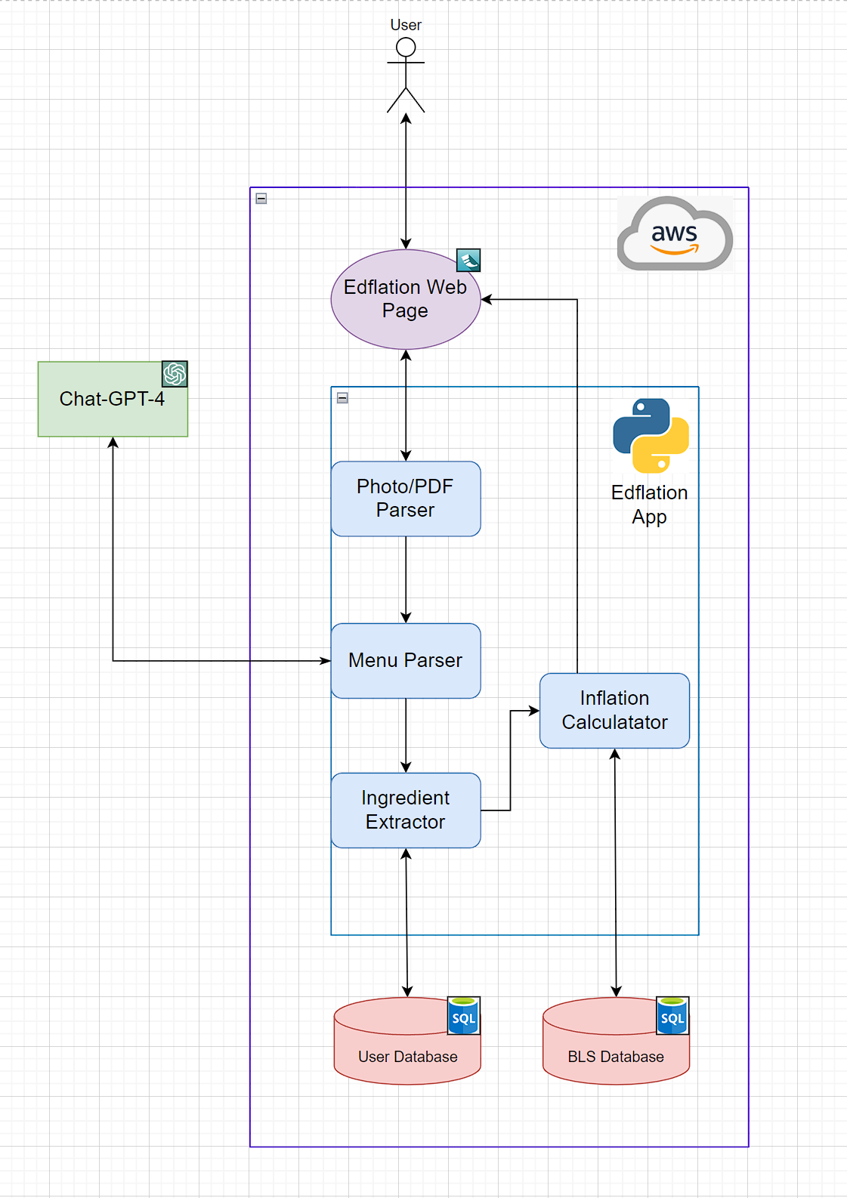
Edflation: Inflation Calculator for Restaurants Michael Crawley, Joseph Roussos, Lucas Melone, and Oliver Willis Department of Computer Science, Center for Business Analytics, University of New Hampshire
Introduction
Home Page
Summary Page
Edflation Design
Restaurant owners are losing money each year due to inflation. Our goal was to provide small restaurant owners the ability to easily produce summaries detailing the impact of inflation on their menus allowing them to better adapt to the ever-changing financial markets. We developed an ease-of-use web application hosted on AWS allowing restaurant owners to upload an image/pdf of their menus. Then using Chat-GPT-4 and data taken from the Bureau Of Labor Statistics, a summary of inflation is displayed on the webpage for the user to view the total $ increase in cost to produce a meal due to inflation.
Box for user to upload a menu.
Supports URL or file upload.
Supports PDF, PNG, JPG or DOCX files.
Displays aggregate inflation totals.
Displays menu submitted.
Displays in-depth breakdown by ingredient.
Requirements
Results
The user will be able to:
Create and login to an account
Upload their menu
The application will be able to:
Extract text from the uploaded menu
Identify menu items
Predict additional ingredients not listed
Additionally, Edflation must:
Have nearly 100% server uptime
Have an intuitive interface
Correctly identify 90% of the menu
Take no longer than a 30 seconds for the inflation summery to load.
After testing 50 different real restaurant menus:
Identified 93% of listed ingredients
Identified 57% of non-listed ingredients
Incorrectly identified 6% of ingredients
After 20 user trials, users reported:
Satisfactory ease of use
Low difficulty navigating the webpage
Edflation Web Page is a webpage hosted on an AWS Lightsail instance.
The User uploads their menu which is processed by the Photo/PDF Parser
The Menu Parser takes the menu and parses the text menu for raw text.
The Ingredient Extractor prompts Chat-GPT-4 to turn raw menu text into a JSON formatted collection of meal items, their prices, expected ingredients, and portion size for each ingredient.
The Inflation Calculator pulls from the BLS database, and computes inflation per meal.
Conclusions
Edflation's core functionality is robust. The menu uploading, parsing, inflation calculation, and display processes all meet expectations.
The largest hurdle lies in the ingredient identification accuracy. Our solution successfully identifies menu items that are listed. However, Ingredients that exist in the meal but aren’t listed directly on the menu occasionally cause misidentification of ingredients.
Through its simplicity, Edflation enables greater access to detailed inflation analysis for small business owners.
Contacts
Michael Crawley – Michael.Crawley@unh.edu​
Lucas Melone – Lucas.Melone@unh.edu
Joseph Roussos – Joseph.Roussos@unh.edu
Oliver Willis – Olvier.Willis@unh.edu
Acknowledgements
Andrew Mitchell – Andrew.Mitchell@unh.edu
UNH Business Analytics – CBAnalytics@unh.edu

