Slide 1
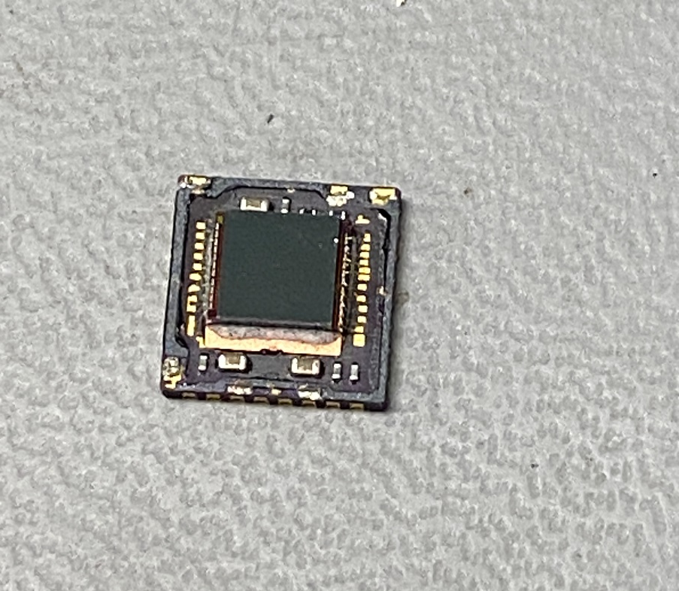
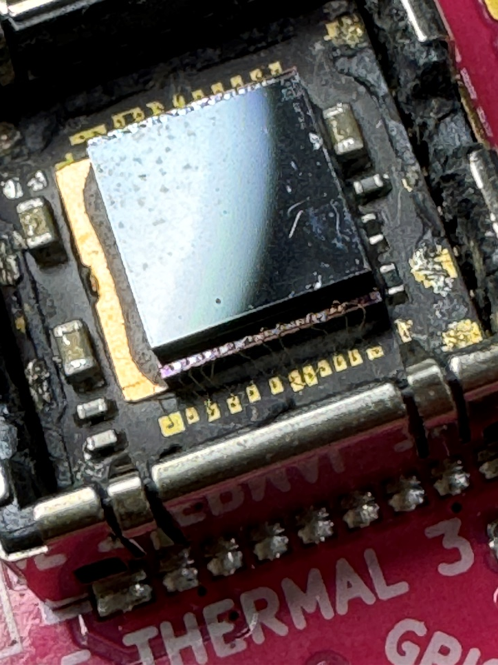
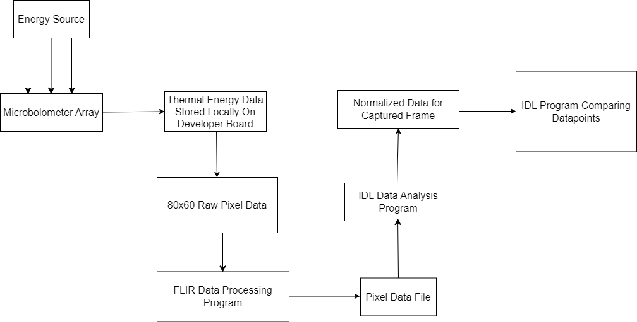
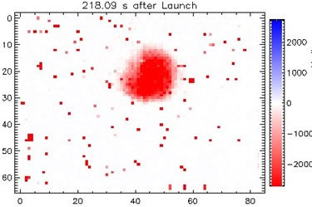
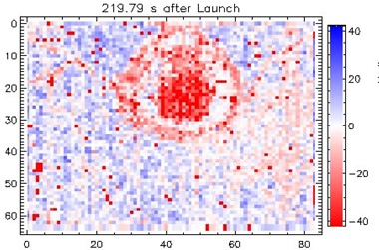
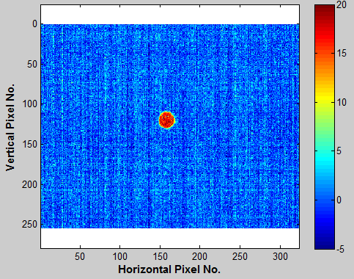
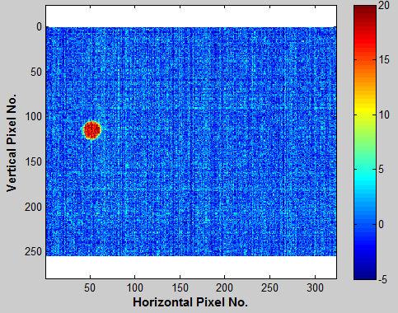
Advanced Development of the Thermospheric Winds Imager . Alec Mercer and Dr. James Clemmons Department of Physics & Astronomy, University of New Hampshire, Durham, NH 03824
Introduction
Equipment
Challenges
The Thermospheric Winds Imager (TWI) utilizes a novel concept to measure winds in the Earth’s Thermosphere. Characterizing the winds in this high-altitude region of the atmosphere is key to understanding the circulation and dynamics of this region.
The TWI has been flown previously but has yielded data that has proven difficult to interpret.
Prior flight results and preliminary lab testing shows promise in advancing the measurement technique of the TWI and obtaining quality data during its next flight.
For preliminary lab testing and calibration, multiple microbolometer arrays were procured. These detectors were smaller and cheaper than previous iterations of the TWI to test the viability of newer microbolometer arrays and determine feasibility of developing an instrument under a smaller footprint.
Depicted to the right are FLIR Lepton 3.5 Core Microbolometer arrays and a development board. These detectors have an 80x60 resolution, which is ¼ that of microbolometers used on prior missions.
Interfacing with the FLIR Lepton 3.5 through their proprietary development board and software development toolkit.
Obtaining clear documentation for the properties of the microbolometer arrays.
Removing the window of the microbolometer array, leading to destruction of the device.
FLIR Lepton 3.5 Core microbolometer array attached to development board
FLIR Lepton 3.5 Core microbolometer array with window attached
Destroyed Lepton 3.5 Microbolometer Array
Background
The TWI utilizes a microbolometer array, a detector that is sensitive to impinging energy, typically in the form of infrared radiation. In this application, this impinging energy is from the kinetic energy of an incident gas stream, such as encountered in space as a spacecraft flies through the Earth’s atmosphere.
Calibration Procedure
Future Work
To calibrate the microbolometers, an incandescent heat lamp was used as a constant thermal energy source. A computer program was used to interface with the Lepton 3.5 and capture incident heat flux on the detector. This data was processed and then plotted over the individual captures such that it varied with distance from the energy source. Variable distances were used, but consistent between tests to ensure consistent calibration.
Select microbolometer arrays for future experimental testing
Conduct experimental testing of microbolometer arrays in the molecular beam facility.
Determine the effects of the spacecraft’s thermal environment on TWI readings.
Develop 3D fluids simulations for the TWI and understand gas flow through the instrument.
B
D
3D Rendering of the TWI, depicting:
A – Aperture
B – Housing (transparent)
C – Windowless Microbolometer Array
D – Exhaust Vent
A
C
Previous Flight Data & Testing
Acknowledgements
DS2V Simulations
Special thanks to the ESRG team for supporting me during my research.
UNH Hamel Center for Undergraduate Research
UNH Space Science Center
Using results from flight data, multiple simulations were conducted to understand gas flow through the instrument and gain insight into how impinging gas can stimulate the detector. Simulations were conducted using DS2V, a computer program that uses a direct simulation Monte Carlo method to model axially-symmetric flows. These simulations were conducted using variable parameters, yielding similar depictions of gas flow through the instrument.
Example TWI images from the Auroral Jet sounding rocket flight at an altitude of about 300 km. Images are from two nearby data frames.
Gas Flow
References
Depicted, to the right, are results from DS2V Simulations of the TWI. Top figure is a depiction of the entire simulation plotting gas pressure. Gas flows from left to right. Black shape represents solid elements of the TWI. Bottom figure is a view of the aperture and detector. Light blue is gas that impinges on the detector (central 6mm of plot).
[1] Clemmons, J. H., B. B. Brady, J. L. Hall, and T. J. Curtiss, Windowless microbolometer array, US9851255B2, 2017.
[2] Bird, G. A., The DSMC method, version 1.2, ISBN 9781492112907, 300 pp., 2013.
A – Aperture
B –Windowless Microbolometer Array
Results from lab tests of the TWI using a molecular beam and two different angles of incidence. The different angles produce the relative displacement of the intense (red) spot, demonstrating the imaging capability.
A
B
Gas Flow

