Slide 1

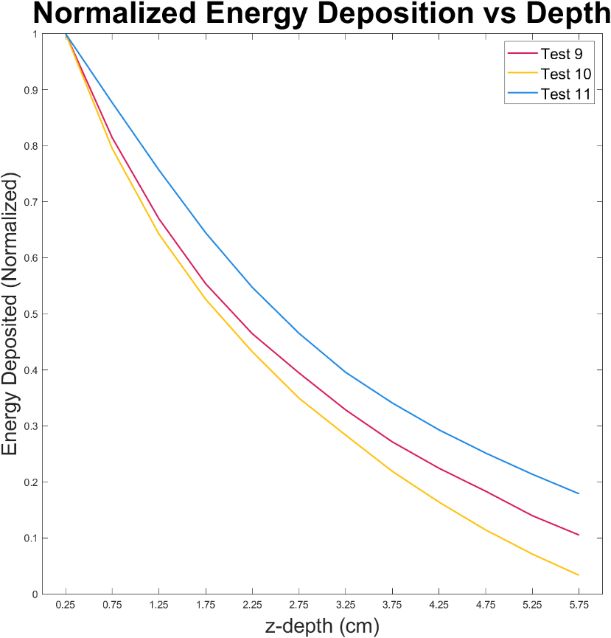
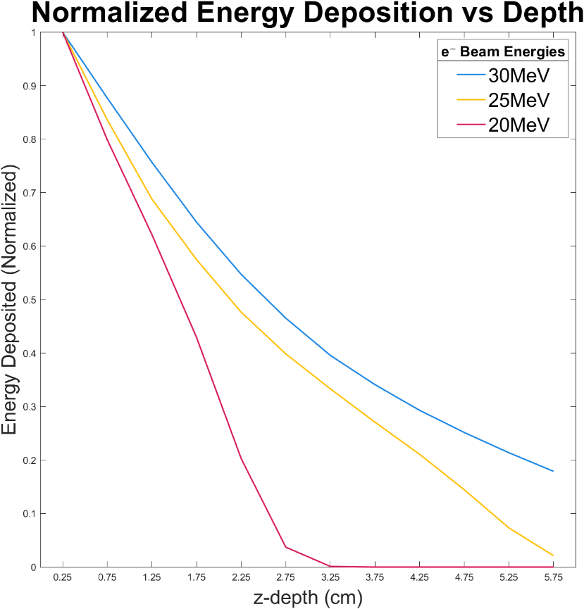
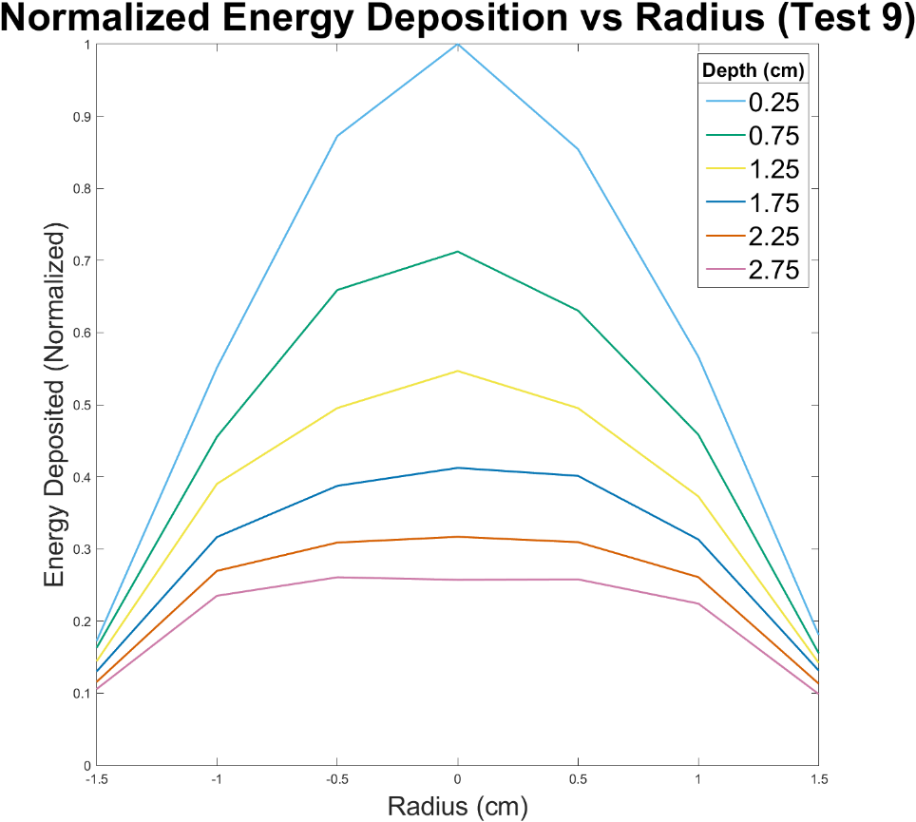
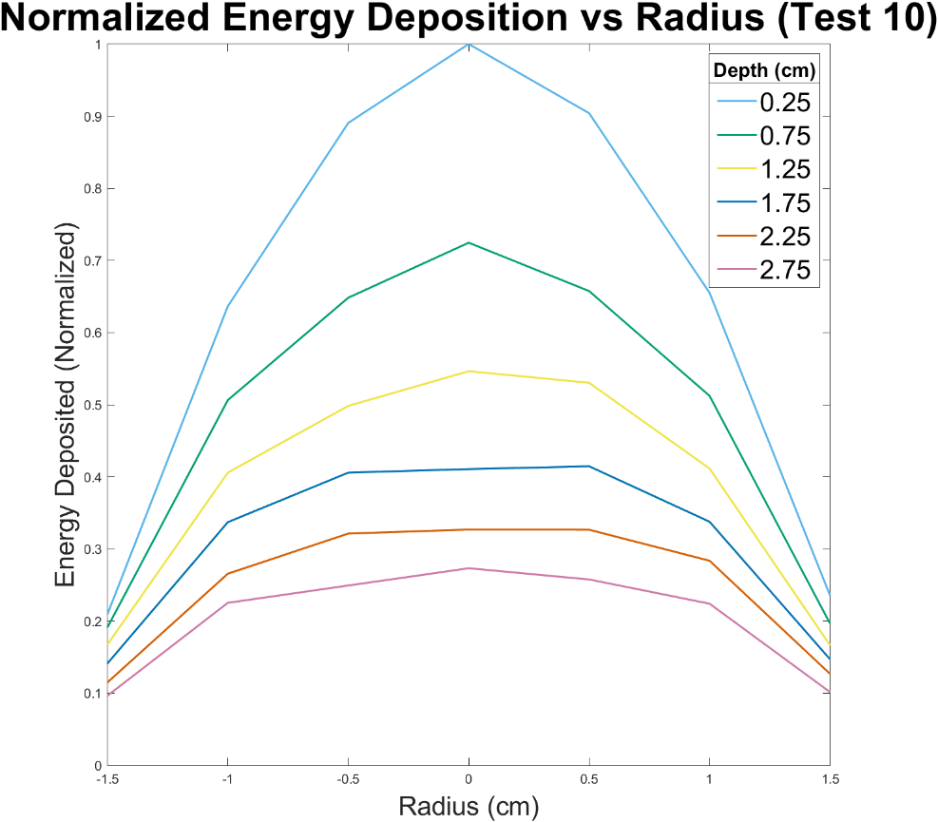
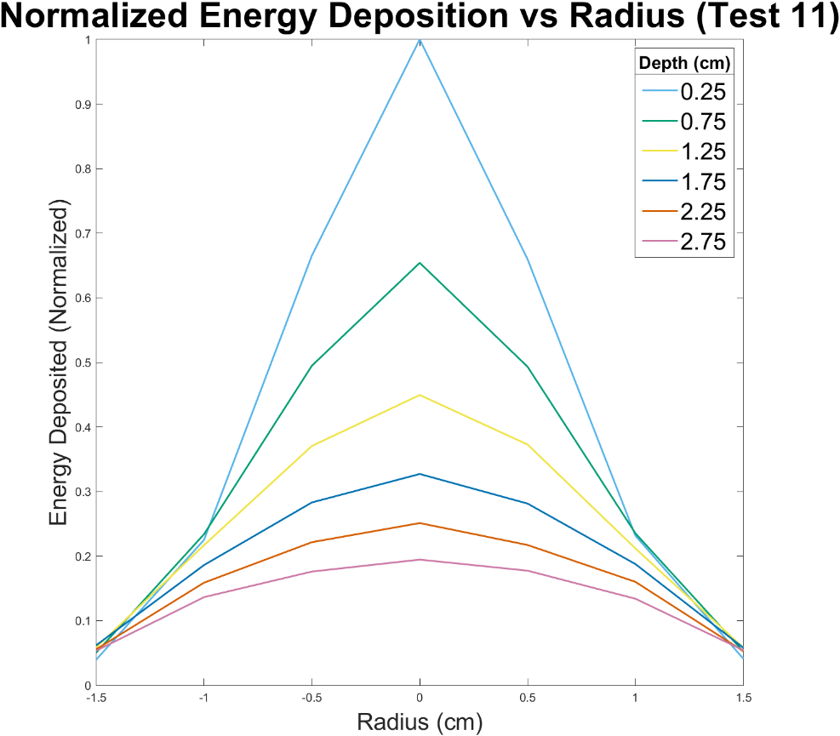
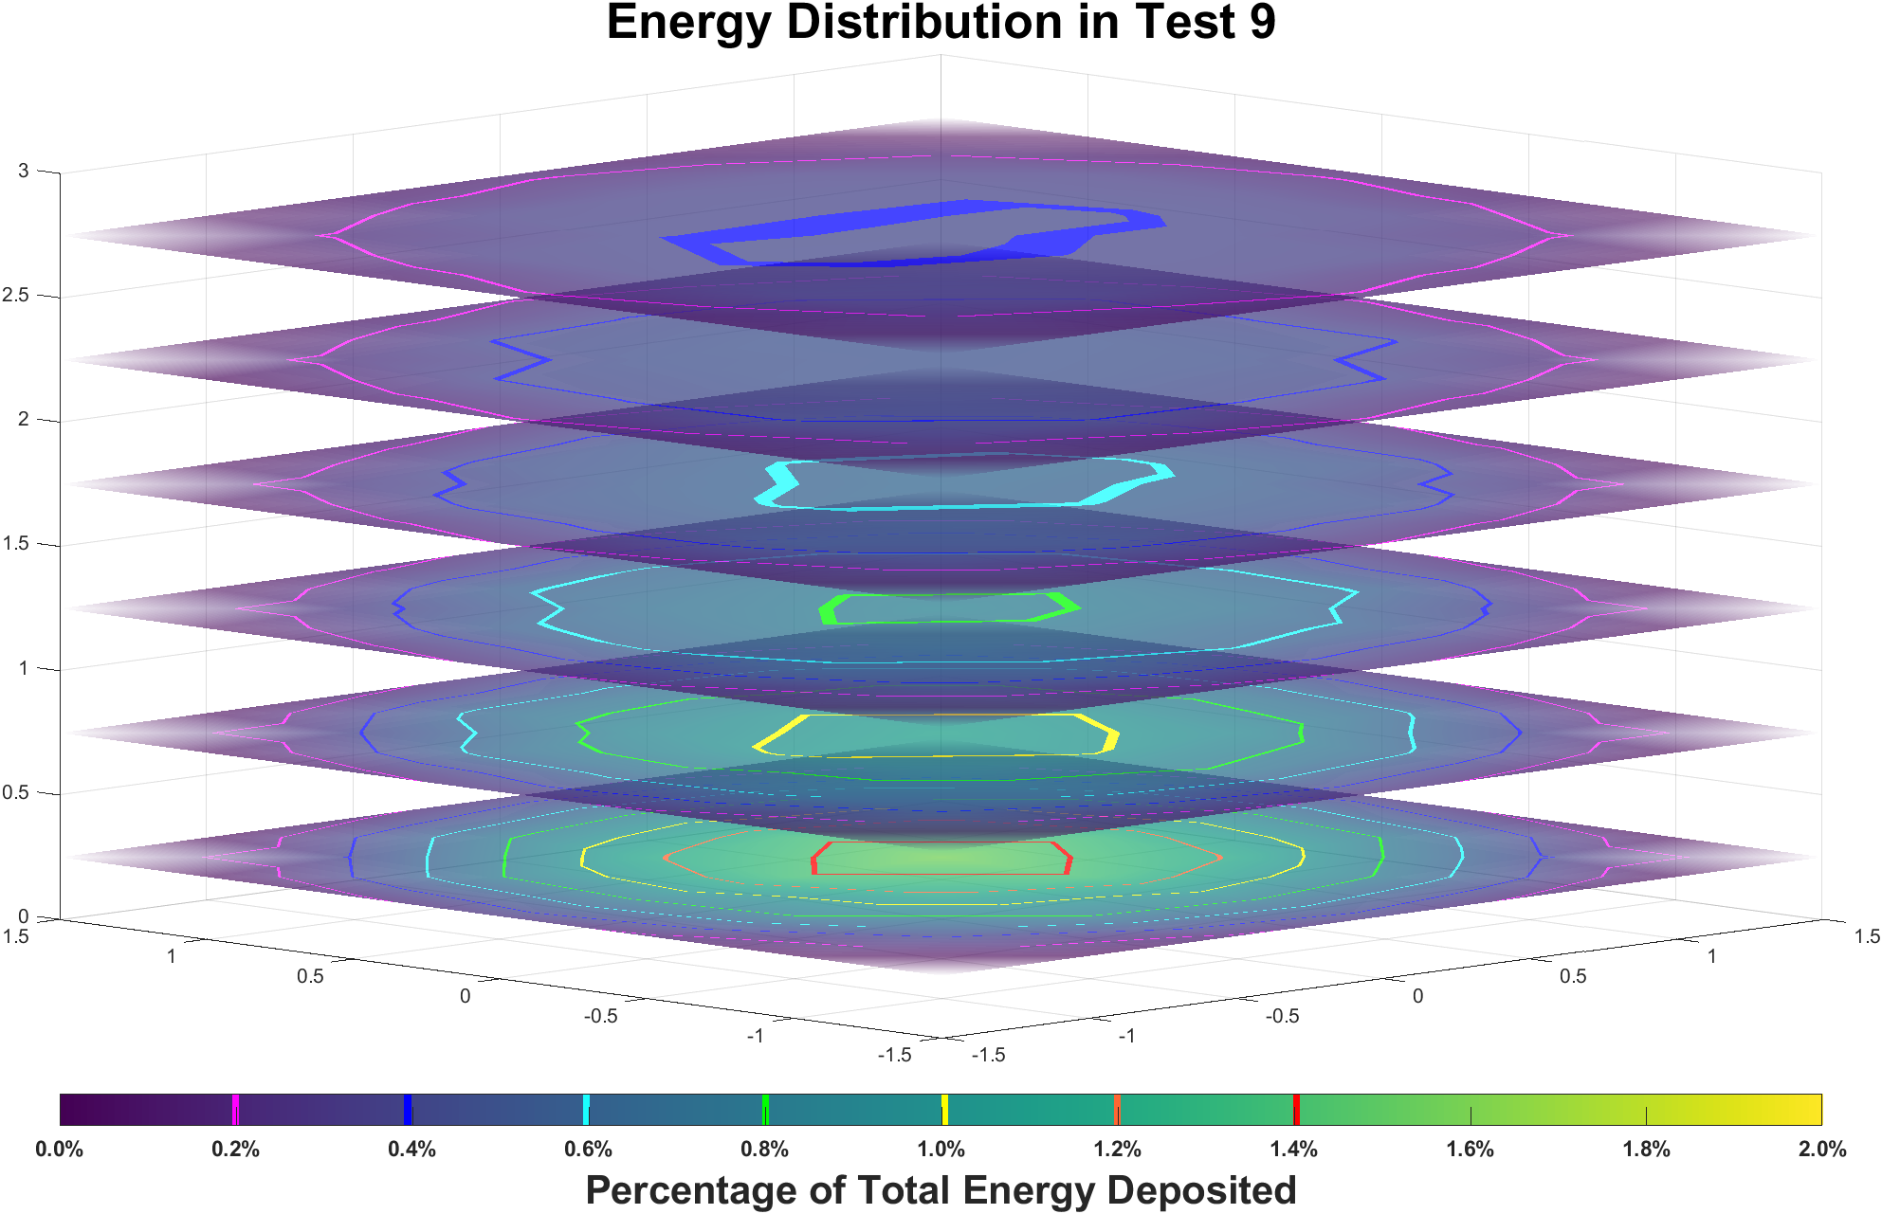
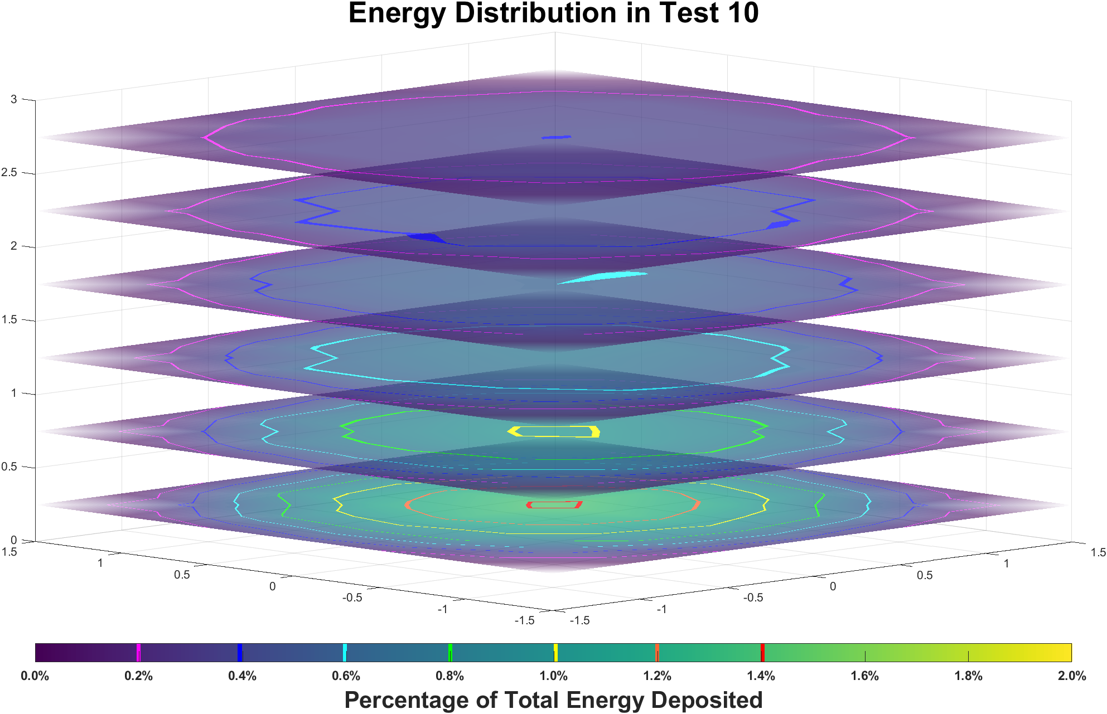
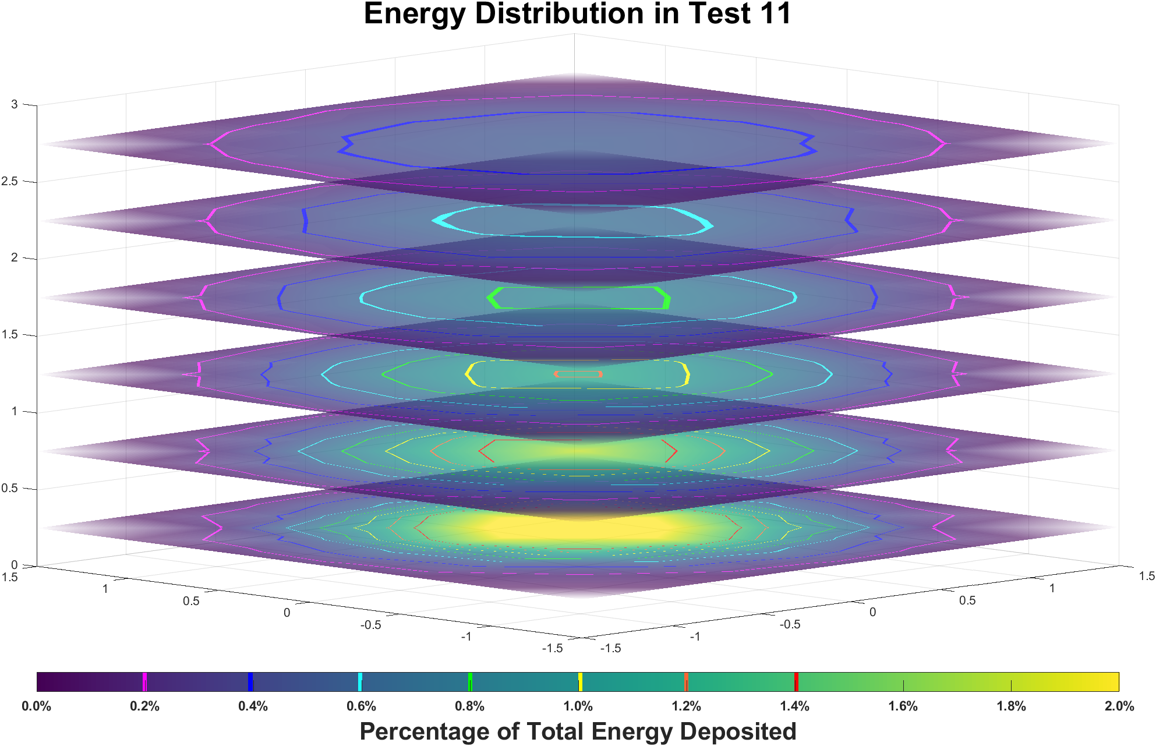
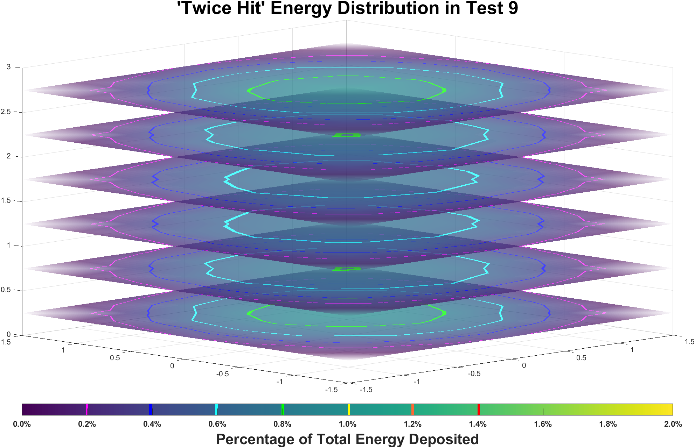
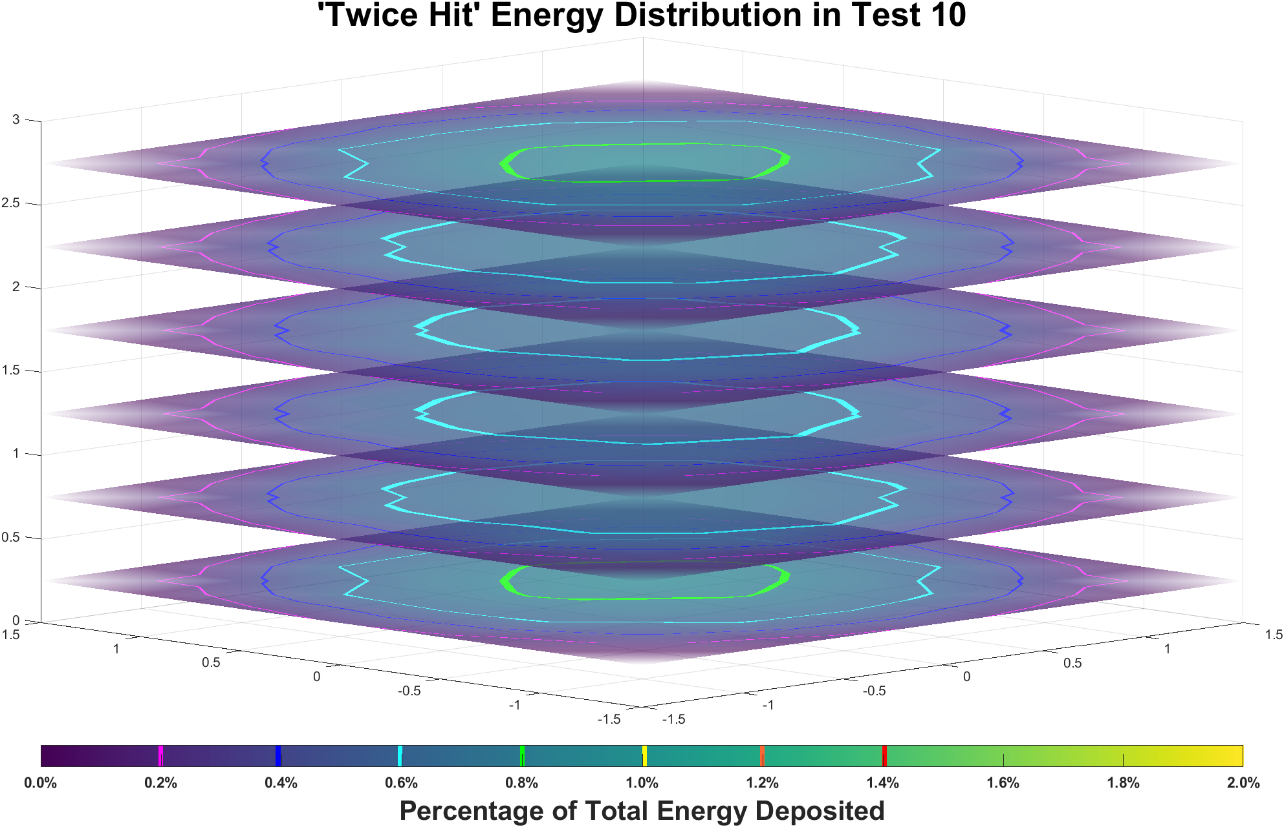
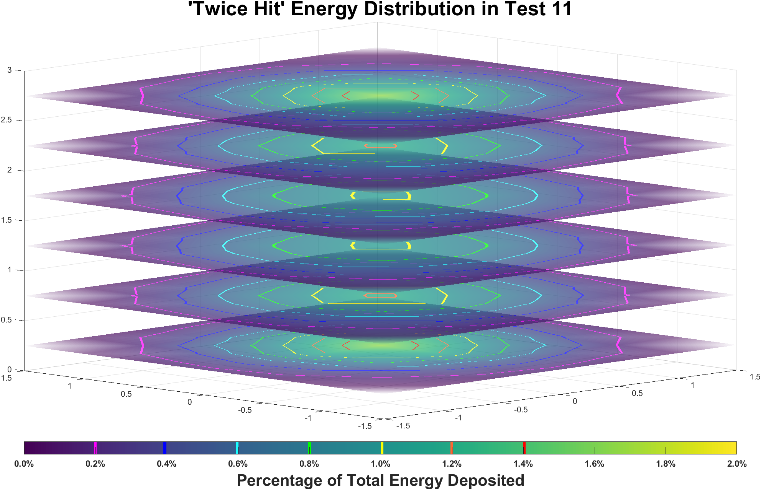
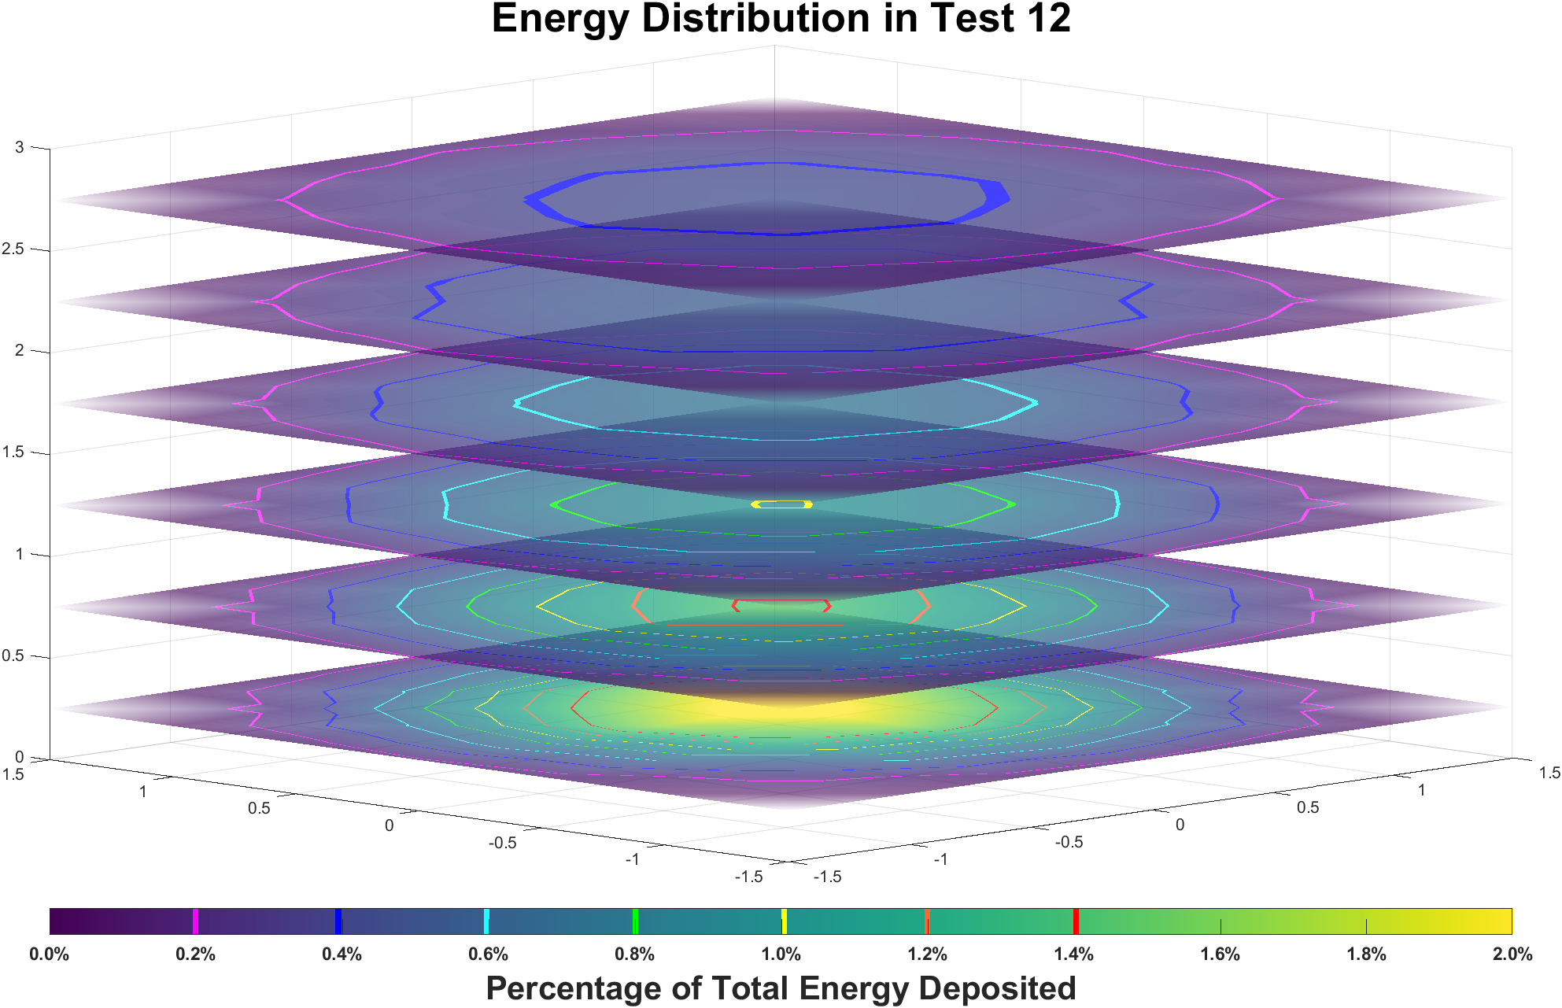
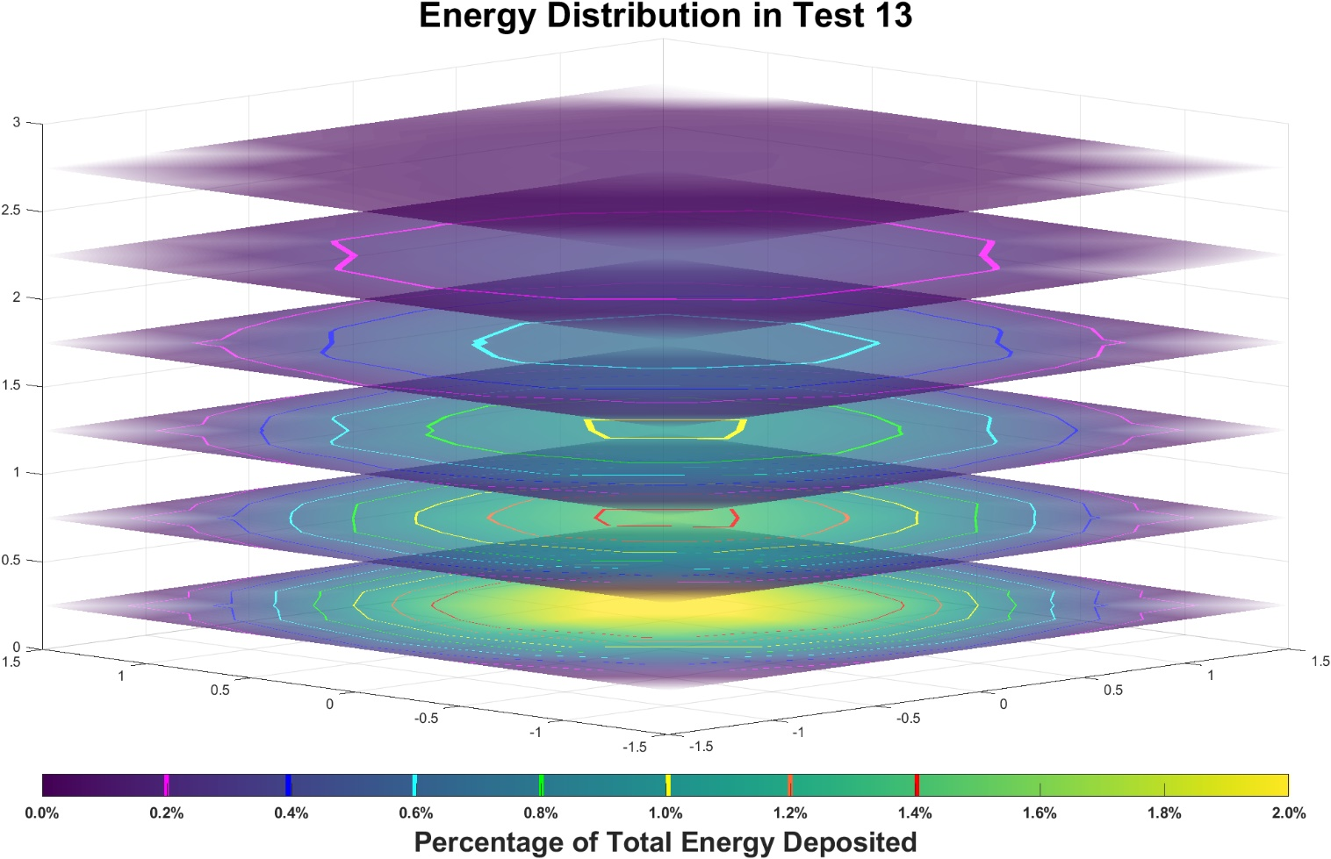
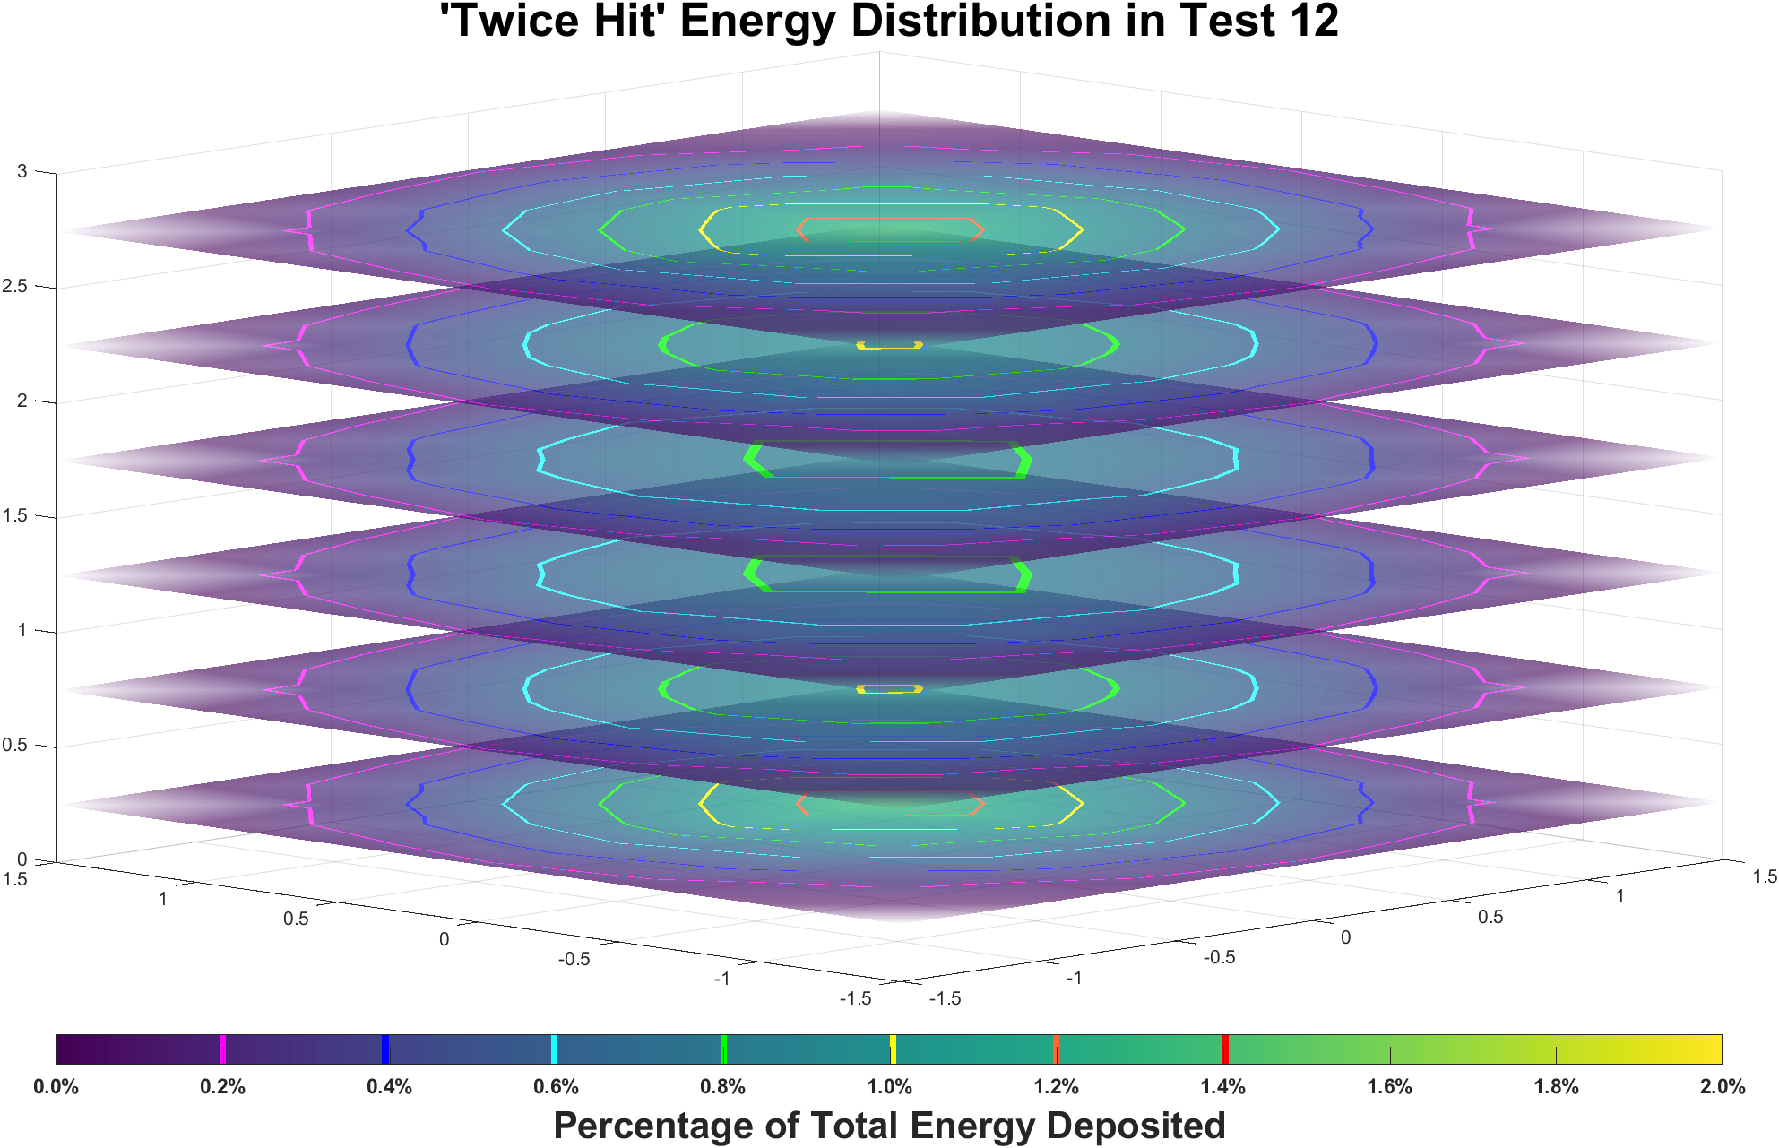
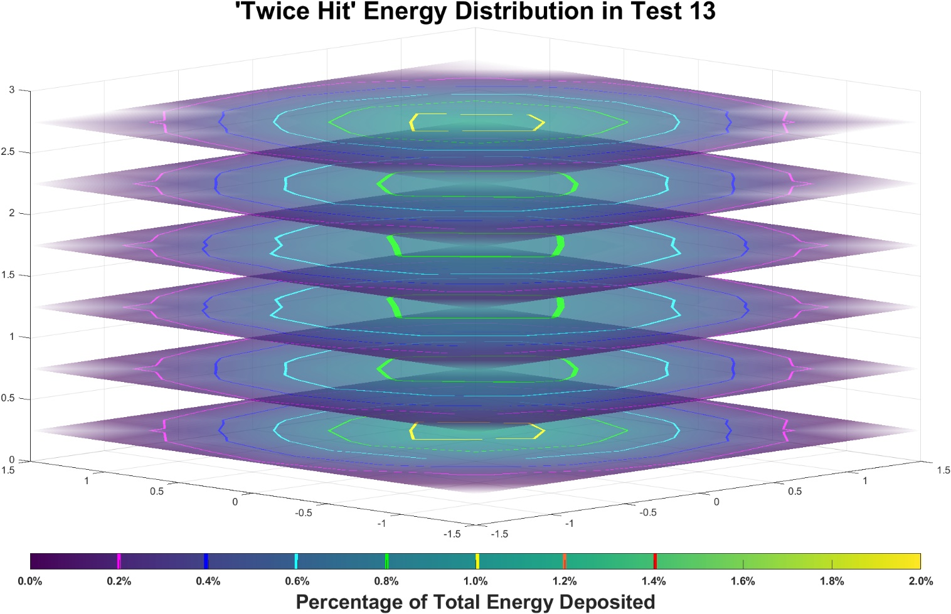
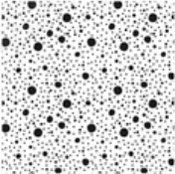

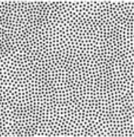

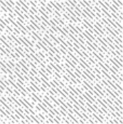
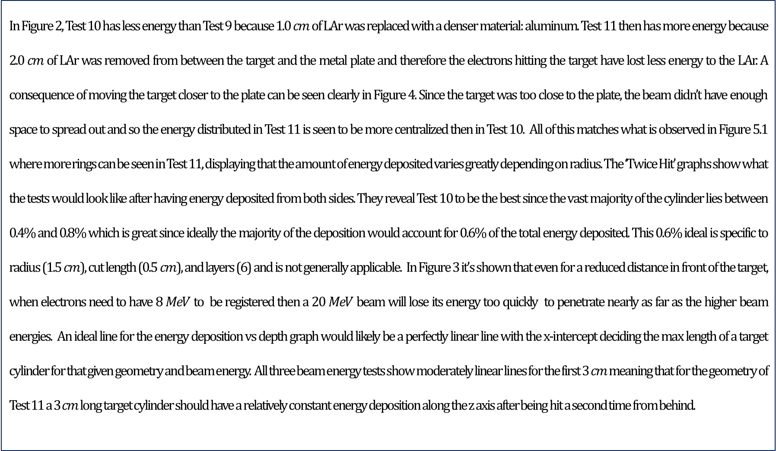
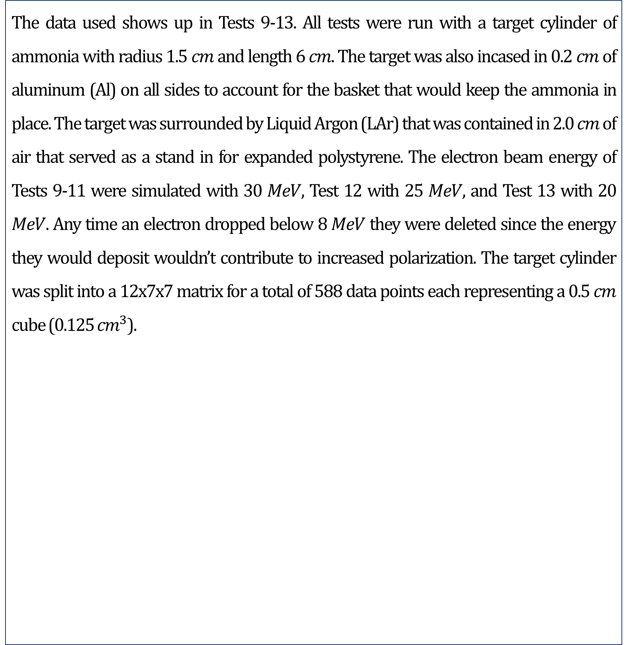
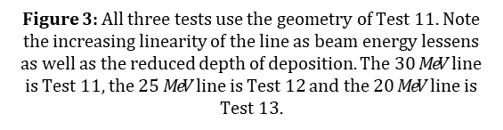
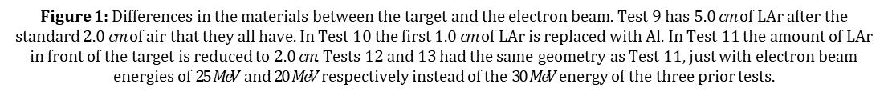
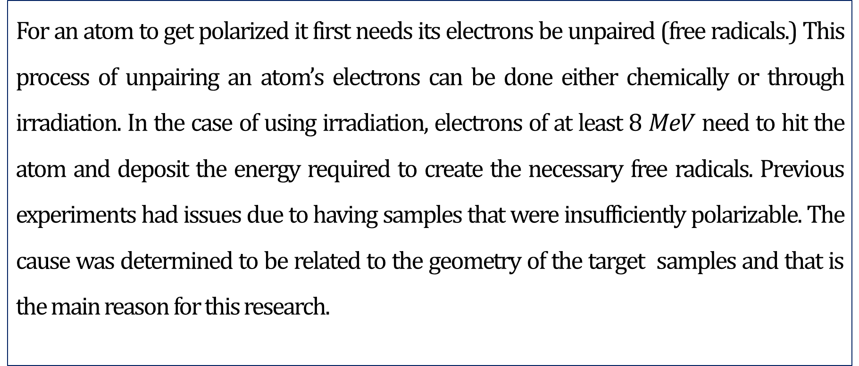
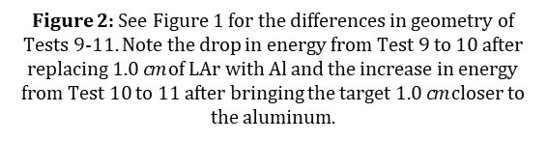
Simulating the Energy Deposited in Ammonia from a High Energy Electron Beam
Eli Phippard | Karl Slifer (Advisor)
Department of Physics, University of New Hampshire, Durham, NH 03824
12x12
Introduction
Energy Deposition in Depth and Radius
Analysis
Finding an ideal geometry for evenly depositing energy into a material such as solid ammonia is necessary to create a research sample that’s sufficiently polarizable to be used in Dynamic Nuclear Polarization (DNP) experiments. A Monte Carlo based software toolkit called EGSnrc was used to simulate the high energy electrons passing through the target material and the setup encasing it. There is a Goldilocks Zone of deposited energy that is required to achieve maximum polarization and therefore a completely even distribution of deposited energy is ideal. The geometries of the materials the electrons pass through prior to reaching the target changes the spread of deposited energy in the target. By using EGSnrc I was able to easily test various geometries and progress towards finding an ideal setup for making polarizable ammonia at NIST for later use in the Slifer Lab at UNH.
In Figure 2, Test 10 has less energy than Test 9 because 1.0 $cm$ of LAr was replaced with a denser material: aluminum. Test 11 then has more energy because 2.0 $cm$ of LAr was removed from between the target and the metal plate and therefore the electrons hitting the target have lost less energy to the LAr. A consequence of moving the target closer to the plate can be seen clearly in Figure 4. Since the target was too close to the plate, the beam didn’t have enough space to spread out and so the energy distributed in Test 11 is seen to be more centralized then in Test 10. All of this matches what is observed in Figure 5.1 where more rings can be seen in Test 11, displaying that the amount of energy deposited varies greatly depending on radius. The ‘Twice Hit’ graphs show what the tests would look like after having energy deposited from both sides. They reveal Test 10 to be the best since the vast majority of the cylinder lies between 0.4% and 0.8% which is great since ideally the majority of the deposition would account for 0.6% of the total energy deposited. This 0.6% ideal is specific to radius (1.5 $cm$), cut length (0.5 $cm$), and layers (6) and is not generally applicable. In Figure 3 it’s shown that even for a reduced distance in front of the target, when electrons need to have 8 $MeV$ to be registered then a 20 $MeV$ beam will lose its energy too quickly to penetrate nearly as far as the higher beam energies. An ideal line for the energy deposition vs depth graph would likely be a perfectly linear line with the x-intercept deciding the max length of a target cylinder for that given geometry and beam energy. All three beam energy tests show moderately linear lines for the first 3 $cm$ meaning that for the geometry of Test 11 a 3 $cm$ long target cylinder should have a relatively constant energy deposition along the z axis after being hit a second time from behind.
Figure 2: See Figure 1 for the differences in geometry of Tests 9-11. Note the drop in energy from Test 9 to 10 after replacing 1.0 $cm$ of LAr with Al and the increase in energy from Test 10 to 11 after bringing the target 1.0 $cm$ closer to the aluminum.
Figure 3: All three tests use the geometry of Test 11. Note the increasing linearity of the line as beam energy lessens as well as the reduced depth of deposition. The 30 $MeV$ line is Test 11, the 25 $MeV$ line is Test 12 and the 20 $MeV$ line is Test 13.
Figure 4: Radial distribution of energy deposition for three different geometries. See Figure 1 for the differences in geometry of Tests 9-11. Note the graph for Test 11 and the increase in concentration of deposited energy towards the center of the target cylinder. Also note the slightly wider distribution of Test 10 compared to Test 9.
3D Energy Deposition Distribution
Background Information
Conclusions
For an atom to get polarized it first needs its electrons be unpaired (free radicals.) This process of unpairing an atom’s electrons can be done either chemically or through irradiation. In the case of using irradiation, electrons of at least 8 $MeV$ need to hit the atom and deposit the energy required to create the necessary free radicals. Previous experiments had issues due to having samples that were insufficiently polarizable. The cause was determined to be related to the geometry of the target samples and that is the main reason for this research.
Adding an aluminum plate improves the radial distribution of energy. Decreasing the distance between the target and the metal plate reduces the radial distribution because the beam doesn’t have enough space to spread out. Decreasing the amount of dense material such as LAr between the target and the plate increases the depth of energy deposited. The beam energies have a large impact on how good a given geometry is, and a good geometry for one beam energy might be terrible for another beam energy. Test 10 was the best out of the three geometries tested.
Data
Future Work
The data used shows up in Tests 9-13. All tests were run with a target cylinder of ammonia with radius 1.5 $cm$ and length 6 $cm$. The target was also incased in 0.2 $cm$ of aluminum (Al) on all sides to account for the basket that would keep the ammonia in place. The target was surrounded by Liquid Argon (LAr) that was contained in 2.0 $cm$ of air that served as a stand in for expanded polystyrene. The electron beam energy of Tests 9-11 were simulated with 30 $MeV$, Test 12 with 25 $MeV$, and Test 13 with 20 $MeV$. Any time an electron dropped below 8 $MeV$ they were deleted since the energy they would deposit wouldn’t contribute to increased polarization. The target cylinder was split into a 12x7x7 matrix for a total of 588 data points each representing a 0.5 $cm$ cube (0.125 ${cm}^{3}$).
Figure 5.1: Percentage distribution of deposited energy in the first half of the target cylinder (3 $cm$). See Figure 1 for the differences in geometry of Tests 9-11. ‘Twice Hit’ energy distributions predict how the energy would be distributed if the same geometries were used but with a 3 $cm$ long target cylinder that was rotated to be hit a second time on the other face. Note the correlations between the graphs in this figure and Figure 4. Also note that 0.6% (cyan demarcation) is approximately the ideal percentage for the given geometry and data size of this target cylinder.
Look into using photons instead of electrons to create free radicals since it may be easier to get an even distribution of photons.
Look into using a plate that has either different density metals or different thicknesses at different radiuses.
Revisit Test 11 but move the aluminum plate to outside the Styrofoam to restore the distance from Test 10 but reduce the energy lost to LAr.
Revisit Tests 12 and 13 but with the geometry of Test 10.
Run new tests that have varying plate thickness but constant distance from the target to the plate.
Material Key
1 cm
Styrofoam
Test 9
TARGET
Liquid Argon
Acknowledgements
Aluminum
Test 10
TARGET
Solid Ammonia
I would like to thank:
My advisor Karl Slifer for helping me find which direction to work towards throughout the project.
My coworker Anchit Arora for helping me get material files for LAr and solid ammonia to be used in the simulations.
The maintainers of the EGSnrc GitHub repository for assisting me with issues I encountered with using the EGSnrc toolkit.
Further Reading:
Mellor, J. E. (2006). Studies and Measurements of Irradiated Solid Polarized Target Materials (Doctoral dissertation, University of Virginia).
Test 11-
-13
TARGET
Figure 1: Differences in the materials between the target and the electron beam. Test 9 has 5.0 $cm$ of LAr after the standard 2.0 $cm$ of air that they all have. In Test 10 the first 1.0 $cm$ of LAr is replaced with Al. In Test 11 the amount of LAr in front of the target is reduced to 2.0 $cm$. Tests 12 and 13 had the same geometry as Test 11, just with electron beam energies of 25 $MeV$ and 20 $MeV$ respectively instead of the 30 $MeV$ energy of the three prior tests.
Figure 5.2: ‘Twice Hit’ energy distributions predict how the energy would be distributed if the same geometries were used but with a 3 $cm$ long target cylinder that was rotated to be hit a second time on the other face. Note how the more linear each tests line was in Figure 3 the more consistency there is between each layer of the ‘Twice Hit’ graphs in this figure. Also note that 0.6% (cyan demarcation) is approximately the ideal percentage for the given geometry and data size of this target cylinder.
12x12

