Slide 1

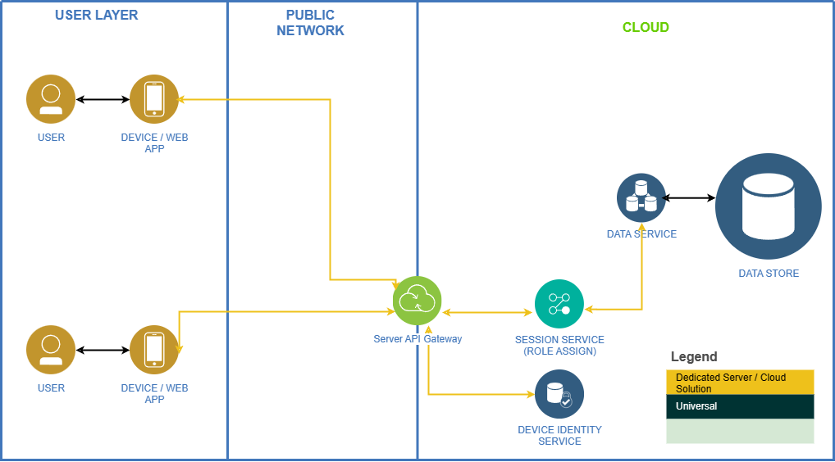
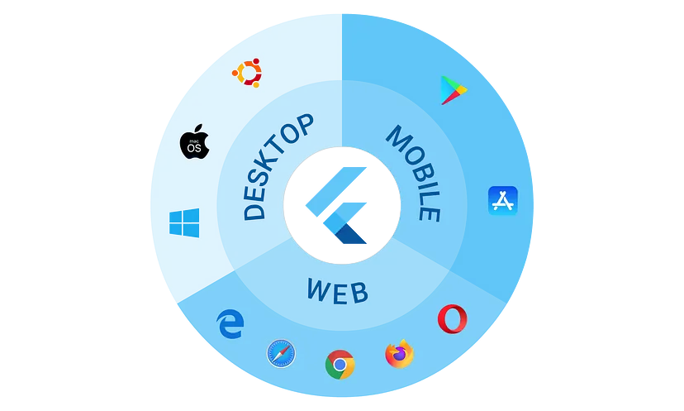


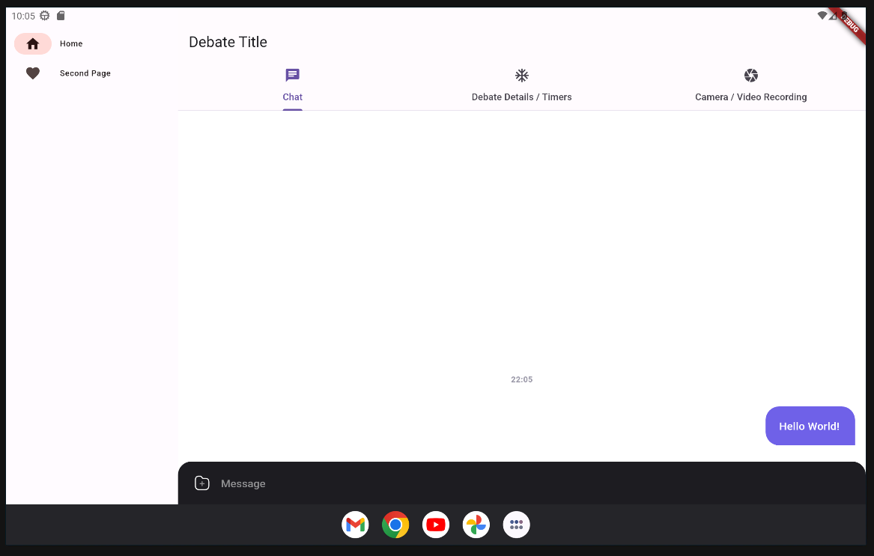
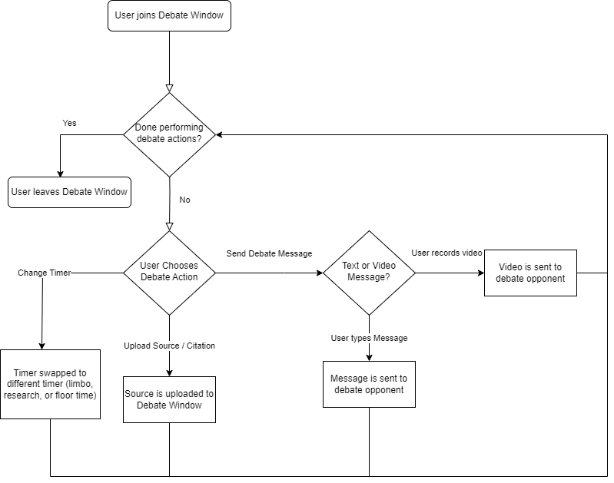
Debate Media System
Sam Palumbo, Cristian Colon, Rowland Ruto, Tian Guo, Daniel Shepard (Sponsor)
Department of Computer Science and Information Technology, University of New Hampshire
Contact Info: samuel.palumbo@unh.edu, cristian.colon@unh.edu, rowland.ruto@unh.edu, tian.guo@unh.edu
Introduction
Design / Implementation
Diagrams (continued)
Testing
Across the world, debates have a tendency to be uninformed, which can then spread misinformation across the internet.
Additionally, debates that escalate to uncontrollable levels can also cause interruptions between debaters, which not only makes the debate chaotic but also uninformative and confusing to listeners.
This project’s goal is to build an app that will allow users to debate with one another with timers, source citing, and video output for listeners, Allowing for more informed and less chaotic debates for all audiences.
The project is developed using Flutter, Google's renowned open-source SDK. Flutter's standout feature is its capability to enable the creation of cross-platform applications from a single codebase.
As for the backend, the server-side components of our project will be deployed on Microsoft Azure, a cloud computing service with which our team has prior experience.
Our development team employs GitLab for version control, a crucial aspect of our workflow.
Architecture Diagram:
Application testing throughout development consisted of unit testing and mocking using Mockito. We focused on creating unit tests for the core features of the debate window, and were able to use Mockito for features not currently implemented or completed.
Results
Architecture Diagram Information:
At this stage in the project, users can currently communicate via text or video messaging, view and post source citations, and view their debate timers. Due to the use of Flutter as our development framework, this application is accessible through iOS, Android, Windows, and Linux.
Users access our server through devices or a web app, with an API gateway directing requests to a session system that assigns roles and monitors activities. A data service manages and stores session information.
Requirements
Next Steps
Debate Window User Interface:
Create an application that allows users to host debates with others
Allow users to cite their sources when making an argument that then can be viewed by their opponent and the audience
Users are able to communicate through text or video messaging
Users can view the three timers of the debate: research time, limbo time, and debate (floor) time
Output a debate in video format for other users or audiences
Users can create accounts to view their current debates and search for debate topics
Formatting tools for the video end-product
Functionality for live audience participation and engagement
Integration of other media tools and social media apps
Continue development for the debate website that will support:
  Account creation / login
  Browsing feature to explore and search different debate topics
  Debate rooms for users to join prior to or during a debate
  Upload feature for users to upload the end result of a debate
Diagrams
Debate Window User Flow Chart:
UI Diagram Information:
The current version of the User Interface consists of multiple tabs. One contains the timer, and the other two allow both text and video messaging for response versatility.

