Slide 1




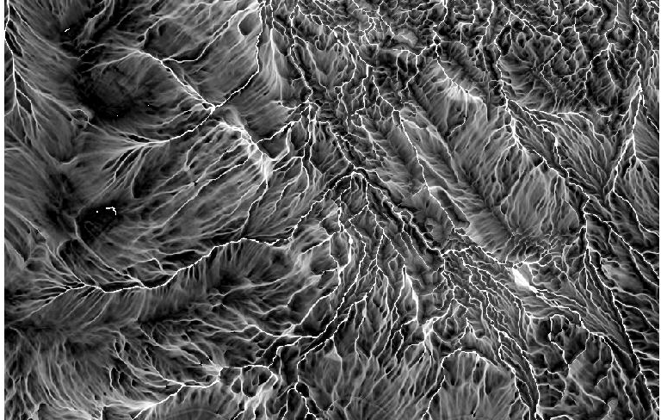
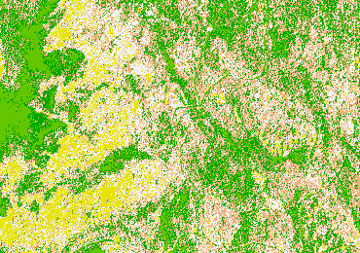
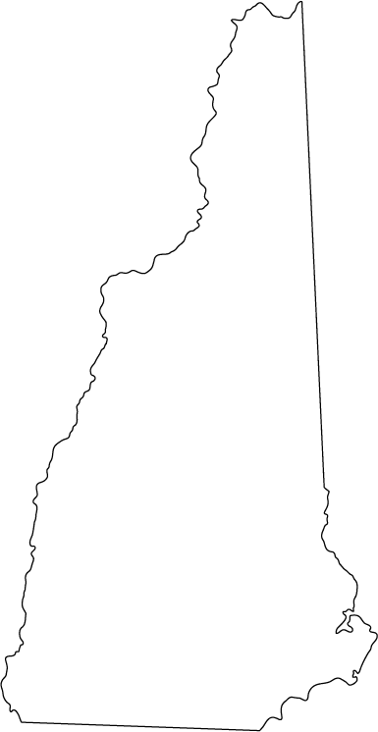
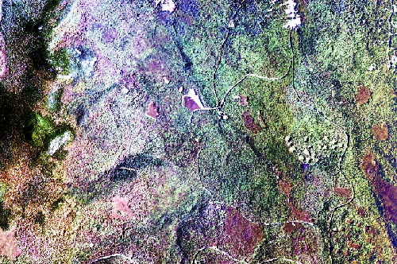
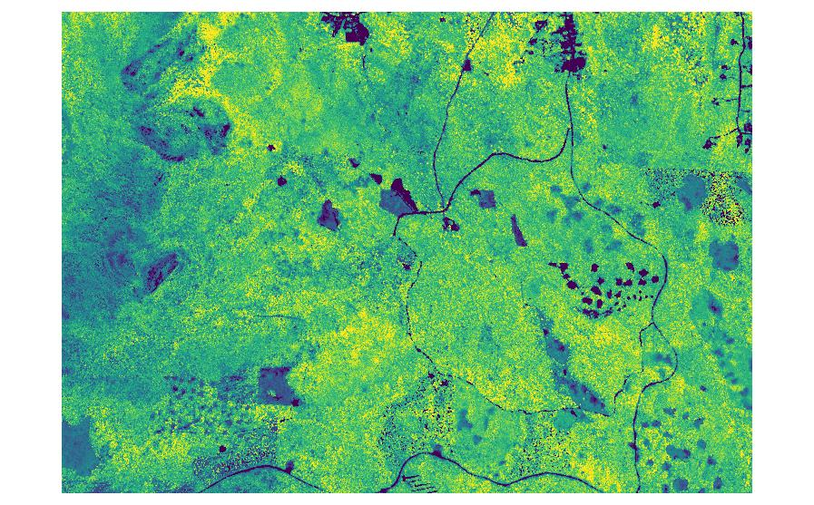
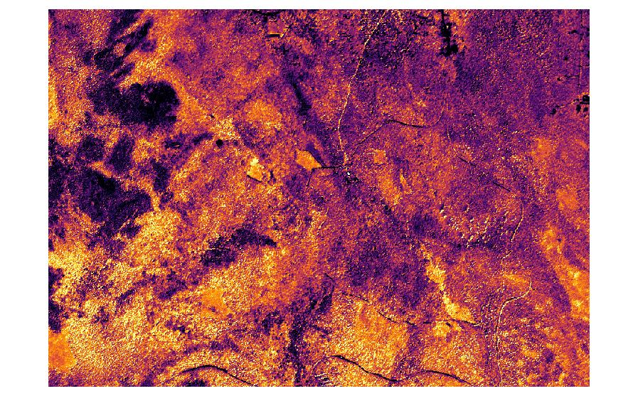
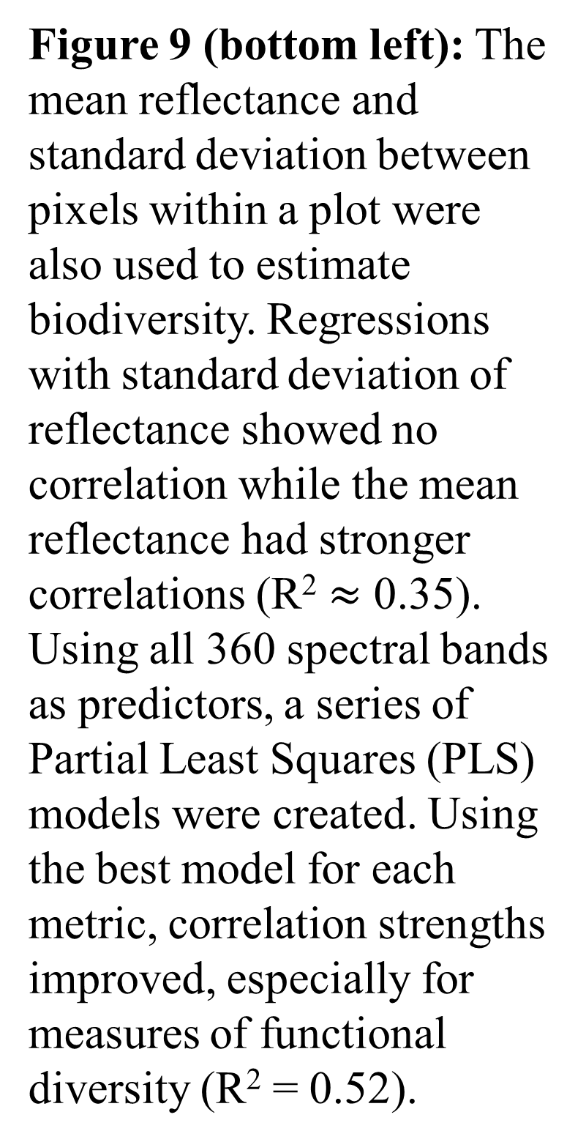
Accuracy of Remote Sensing Estimates of Multiple Forest Biodiversity Metrics
Kaitlyn Baillargeon (kab2014@wildcats.unh.edu)
Scott V. Ollinger, Andrew Ouimette, Rebecca Sanders-DeMott, Franklin Sullivan, Mary Martin, Olivia L. Fraser
Department of Natural Resources and the Environment, University of New Hampshire, Durham, NH
Institute for the Study of Earth, Oceans, and Space and Department of Earth Sciences, University of New Hampshire, Durham, NH
Introduction
Estimating Biodiversity
Estimating Biodiversity (cont.)
Forests support over 2/3rds of the Earth’s terrestrial biodiversity but is threatened by deforestation due to agriculture and urban development.
Biodiversity is most commonly measured by the number of species present (species richness) or variation between species (species diversity).
Other forms of biodiversity include variation of functional traits (functional diversity), genetic make up (phylogenetic diversity), and physical structure (structural diversity).
Remote sensing has been used in replacement of field measurements to estimate species diversity but less focus has been placed on estimating other forms of diversity remotely.
The objective of this study was to test how well different biodiversity metrics can be estimated using remote sensing.
Simple linear correlations were used to look at the relationship between remote sensing estimates and the field measured biodiversity metrics to determine if methods could be used to estimate diversity at a local level.
Every point of the graph represents one of the 400⁺ inventory plots.
Small coefficient of determination (R²) values (R² < 0.4) indicates poor estimation of biodiversity while higher values (R² > 0.5) indicates method may have some potential to be used as an estimate for biodiversity.
Figure 7 (right): A k-means, unsupervised classification was used to classify the hyperspectral image’s pixels into classes based on similarities. Spectral diversity were calculated using Shannon’s entropy index where each class represented one individual. This image is an example of a classification using 5 classes where class 1 is white, 2 is pink, 3 is yellow, 4 is yellow-green, and 5 is green.
Figure 3 (above): Topographic wetness index (TWID) where the white regions are considered to be wetter and the black regions are drier.
Figure 8 (top left): All correlations between the biodiversity metrics and spectral diversity were weakly correlated or showed no relationship. R² values were all less than 0.09. Number of classes used in classification did not have a significant influence on correlation strength.
R² = 0.05503
R² = 0.07267
Methods
Study Site
Bartlett Experimental Forest (BEF) (Figure 1)
1,052 hectare, northern-hardwood forest
Contains 400⁺, evenly spaced 32m x 32m inventory plots
Figure 1 (left): Approximate Location of BEF in New Hampshire
Figure 4 (left): All biodiversity metrics were weakly correlated to the topographic indices. As an example, correlations with TWID is shown. All R² values were less than 0.1.
R² = 0.000546
R² = 0.01204
Bartlett Experimental Forest
R² = 0.02738
R² = 0.009215
Figure 9 (bottom left): The mean reflectance and standard deviation between pixels within a plot were also used to estimate biodiversity. Regressions with standard deviation of reflectance showed no correlation while the mean reflectance had stronger correlations (R² $≈$ 0.35). Using all 360 spectral bands as predictors, a series of Partial Least Squares (PLS) models were created. Using the best model for each metric, correlation strengths improved, especially for measures of functional diversity (R² = 0.52).
Data Products
2001-2003 species inventory data of dominant canopy species with DBH > 3.8cm
SpecTIR hyperspectral imagery collected in 2014 containing 360 bands covering wavelengths between 400 to 2500nm and a spatial resolution of 5m.
2014 LiDAR collected from the National Ecological Observatory Network (NEON)
  1m Canopy Height Model
LiDAR from GRANIT
  5m Digital Elevation Model
R² = 0.01170
R² = 0.007578
Diversity of Spectral Classes
Figure 2 (right):
A) Hyperspectral image of BEF displayed in RGB. B) Canopy height model of BEF where yellow represents the highest peaks and dark purple is the lowest points
A
R² = 0.08683
R² = 0.5195
TWID
Figure 5 (right): Enhanced Vegetation Index (EVI) which measures for vegetation reflectance in the red and near infrared regions and accounts for influences from the blue region. Darker, purple colors represent lower values and yellow represent high values of reflectance.
B
R² = 0.09127
R² = 0.2097
Field Measured Biodiversity Indices
Species Diversity
  Shannon’s Index (H’), Richness, Peilou’s Evenness
Functional Diversity
  Richness, Evenness, Divergence, Dispersion, Rao’s Quadradic Entropy (RaoQ)
Phylogenetic Diversity
  Faith’s PD, Variability (PSV), Richness, Evenness, Clustering
Structural Diversity
  Inventory Based
    Standard deviation of DBH, Stand density (StanDen)
  LiDAR Based
    Rumple; Shannon Index of height profile, mean height, standard deviation of height
Figure 6 (left): Biodiversity metrics were regressed against multiple vegetation indices to look for correlations. Correlation strength between metrics and indices varied with the strongest R² being 0.31. On the right is an example using EVI to show what most correlations looked like.
R² = 0.004349
R² = 0.2425
Conclusion
Remote Sensing Analyses
Topography
  Slope (%), Aspect, Elevation, Topographic Wetness, Topographic Position, Bedrock
Vegetation Indices
  NDVI, EVI, etc.
Unsupervised Classification
  Shannon’s Entropy, Richness, and Peilou’ s Evenness of spectral classes
Reflectance
  Mean and Standard Deviation
Topographic and vegetation indices poor performance could be linked to the spatial scale of the field measured estimates. Indices might perform better on a regional scale (New England or the United States) rather than a local scale.
Lack of correlation between spectral and field measured diversity could be due to unaccounted for influences (tree structure, soil, shadows, sun angle, etc.)
The hyperspectral image was collected during the peak growing season. Images collected during this time are typically useful for estimating forest productivity which could explain why predictions of functional diversity were stronger than estimates of other diversity metrics.
Next steps would include adding a temporal aspect where multiple images are collected through out the year to look for seasonal changes. At different times of the year, it could be possible to estimate the other diversity metrics.
R² = 0.1751
R² = 0.1191
EVI
Acknowledgements: This material is based upon work supported by the National Science Foundation under Grant Number (1638688). Partial funding was also provided by the New Hampshire Agricultural Experiment Station, the Hubbard Brook Long Term Ecological Research program (NSF 1114804), the Harvard Forest Long Term Ecological Research program, and the University of New Hampshire graduate school. We also acknowledge the help and support of infrastructure and staff at Bartlett Experimental Forest. Inventory data of species compositions at BEF was collected by the University of New Hampshire. LiDAR data was obtained from the National Ecological Observatory Network and hyperspectral reflectance imagery was obtained from SpecTIR.

