Slide 1


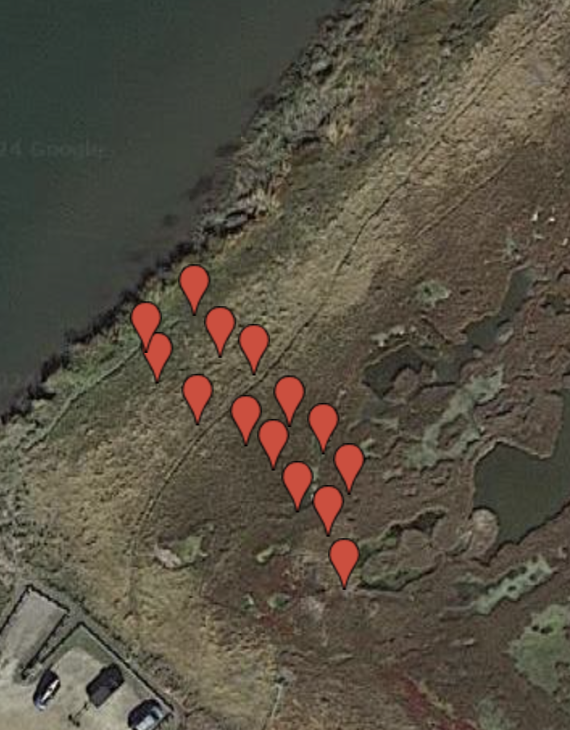
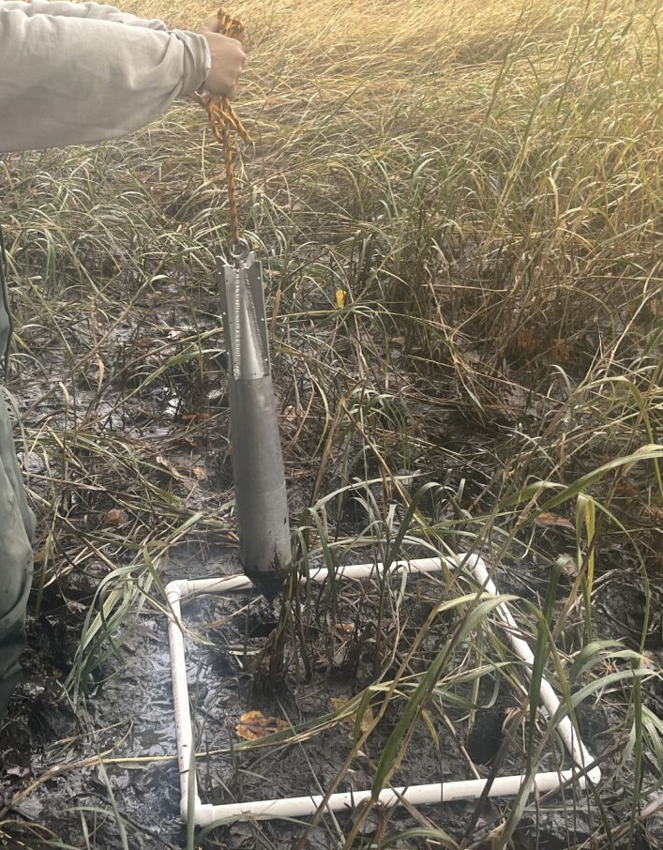
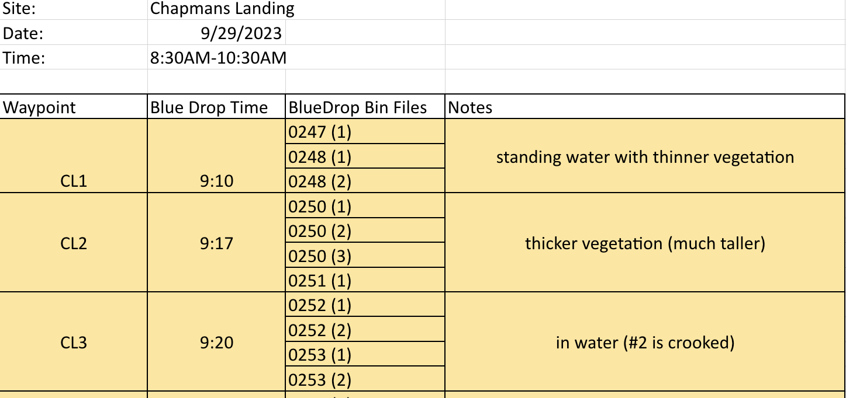
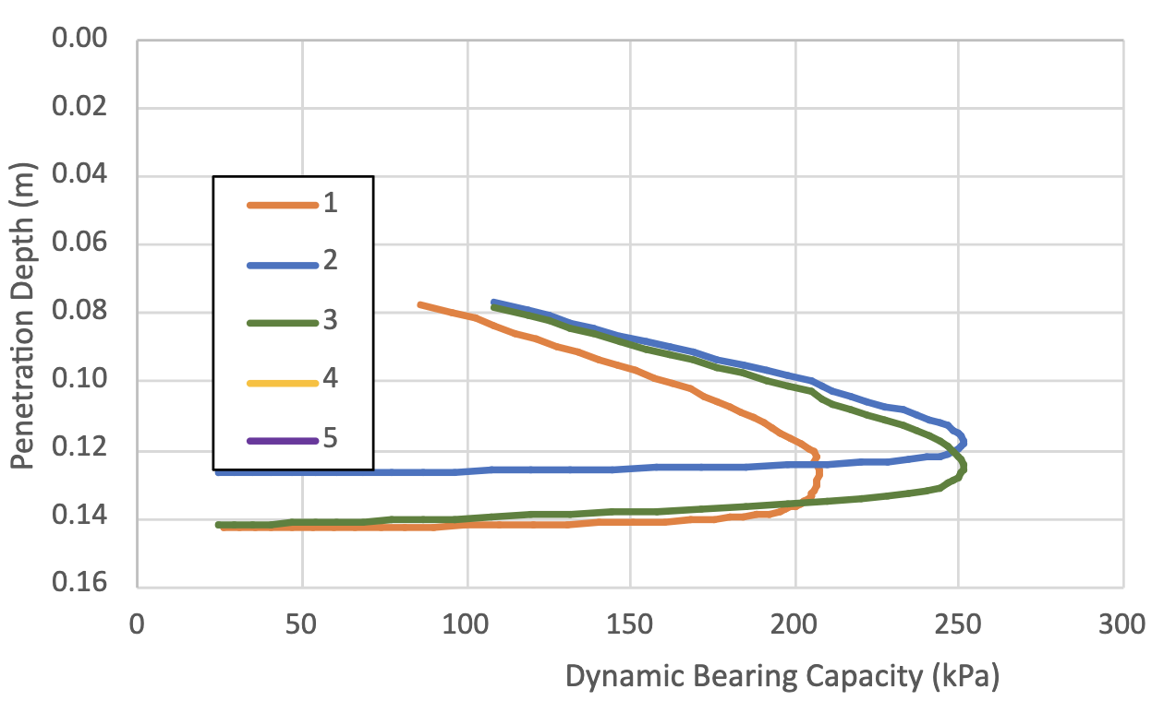
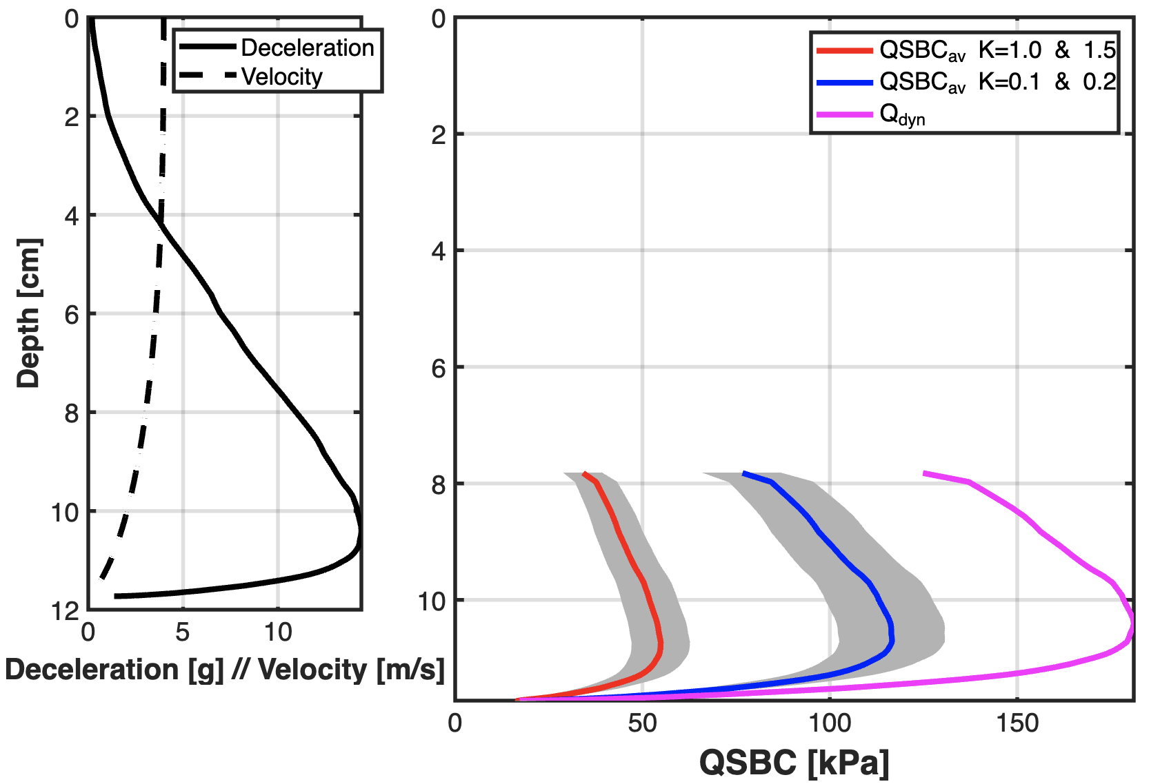
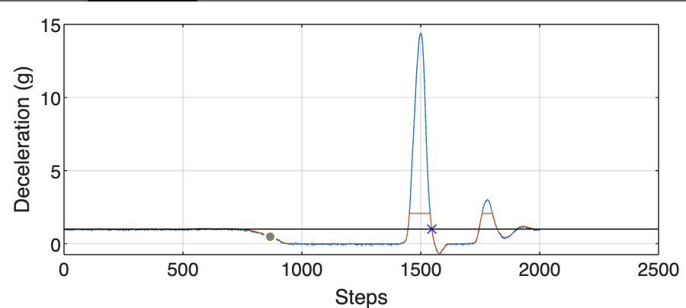
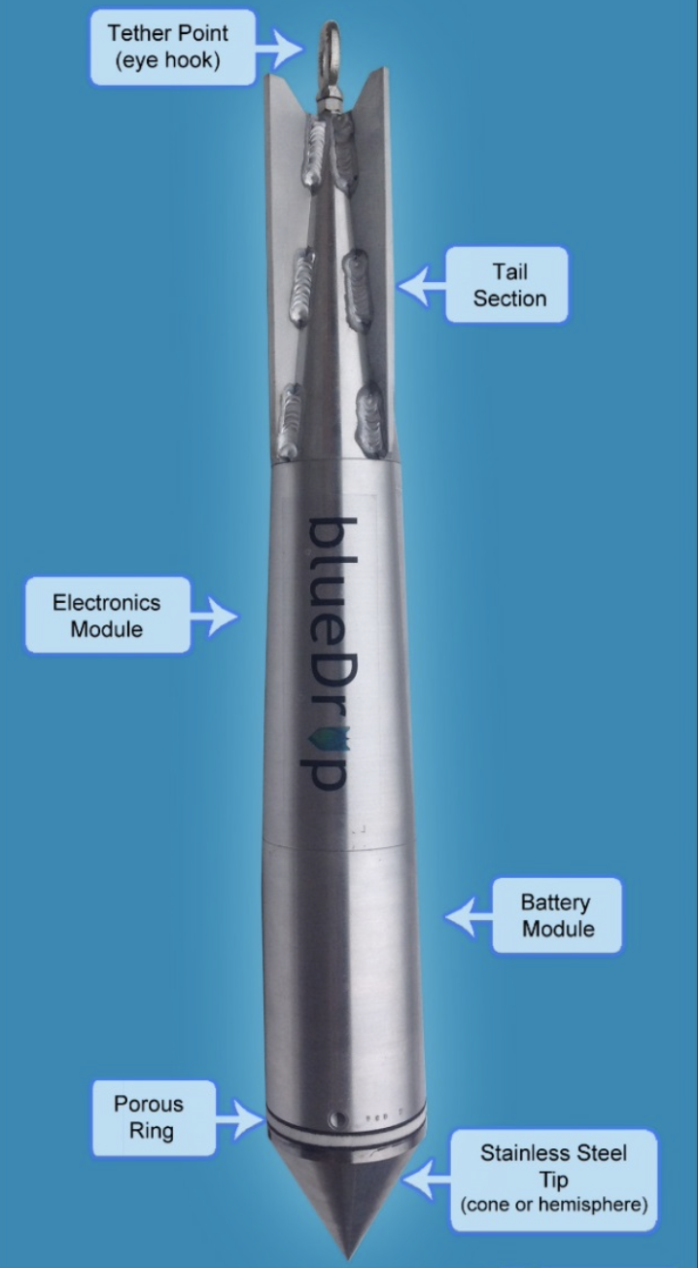
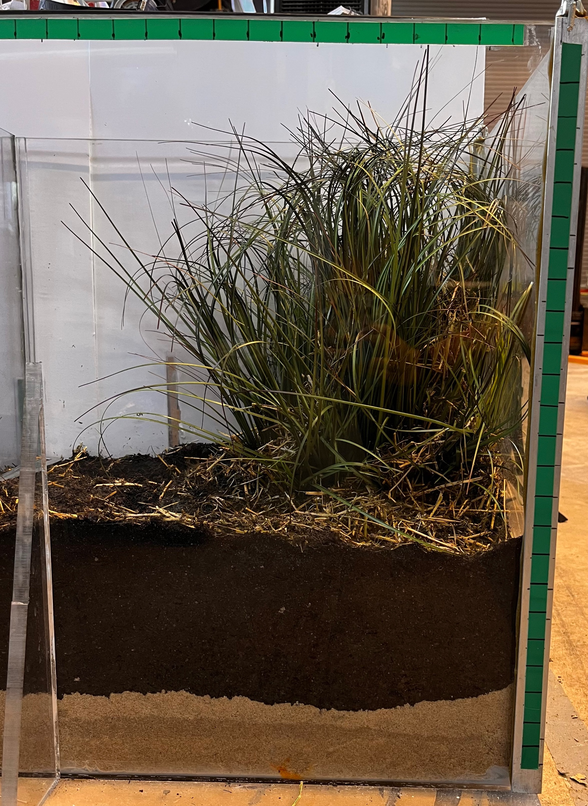
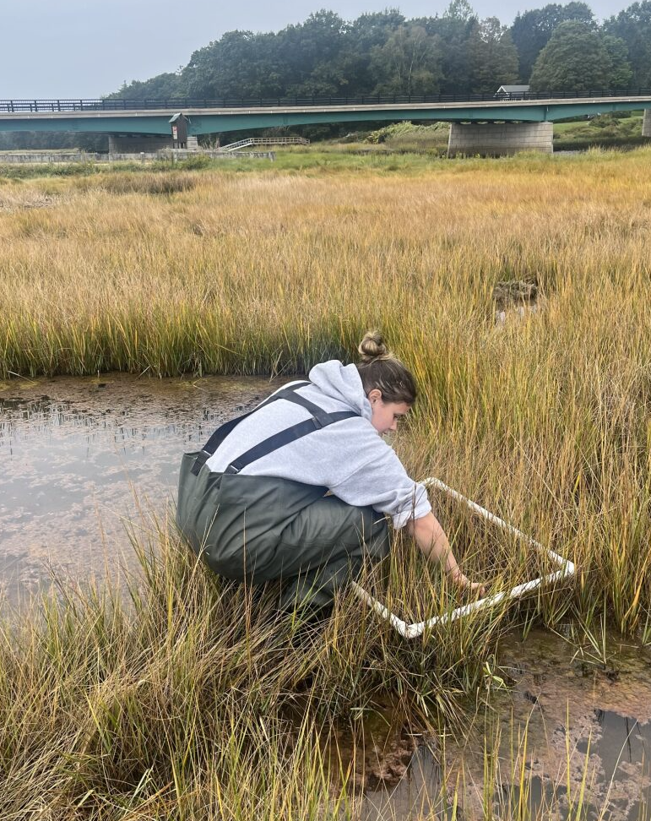
Geotechnical Characteristics of Salt Marshes in Continental Climates
Katie O’Brien, Julie Paprocki
Civil and Environmental Engineering Department, University of New Hampshire, Durham, NH
Background
Design
Results
Salt marshes provide many benefits to the coastline such as reducing erosion, supporting numerous wildlife species, protecting inland areas from storm surges and stabilizing shorelines. New England marsh losses have been significant due to their vulnerability to climate change and sea level rise. Currently, the Great Bay National Estuarine Research Reserve (GBNERR) provides insight on restoration efforts with a Habitat Prioritization Tool and a Marsh Prioritization Tool that uses crude metrics for soil information. At this time, unknown if geotechnical characteristics such as undrained shear strengths and consolidation characteristics can benefit this restoration process.
The data from each drop was entered into an excel sheet to calculate the average, maximum, and minimum qsbc. A graph was produced for each station to show the qsbc as a function of penetration depth. Ideally, the graph should present in a horizontal parabola.
1) Handheld GPS marked each drop location to visualize transects on site
2) Deployed 3 times in increments of about 10’ from inland to shoreline
3) Vegetation description was taken at drop locations and data collected was sorted into bin files to be processed in MATLAB
Objective
The purpose of this study was to determine if the use of a Portable Free Fall Penetrometer (PFFP) could be used to describe the geotechnical characteristics of saltmarshes. The field testing occurred in the Great Bay Estuary, New Hampshire using the PFFP blueDrop.
Deploy a PFFP in the Great Bay Estuary through multiple transects to derive:
in situ measurements of marsh soil strength
consolidation properties of the salt marsh
Conclusions
The sites that contained more saturated ground surface as well as denser vegetation coverage produced graphs with multiple “spike steps” showing two regions of impact as the blueDrop fell. This indicated that vegetation potentially is affecting the deceleration values as the penetrometer makes contact. The testing of vegetation effects is ongoing and is producing valuable data. If coherent data is able to be produced, then a correction factor can be applied to the original code to correct for soil resistance force on various vegetation types.
5) MATLAB then produces two plots to show qsbc (kPa) with 2 different strain rate correction factors
4) The initial ”spike step” of deceleration is inputted into MATLAB to indicate where the device made first contact with the soil
Data Collection
Testing the Effects of Vegetation Coverage on Deceleration
Acknowledgements
Electronics module houses:
5 (vertical) microelectromechanical system accelerometers (MEMs) to record deceleration at impact
2 (horizontal) MEMs to record inclination during release
Using the projected area of the conical tip, the ultimate dynamic bearing capacity (q_{dyn}) and equivalent bearing capacity can be calculated.
sTAMD Simulations
Mock Core with Vegetation Cover
Vegetation Counting Method
A Special Thanks to:
Academic Advisor: Dr. Julie Paprocki
NH Sea Grant for project funding
Great Bay National Estuarine Research and Reserve for site use
Julian Baldwin for assistance with lab experiments
Create a mock core with faux vegetation cover
Arrange GoPro Camera to record blueDrop impact on vegetation
Deploy blueDrop in mock core in soil, and on top of faux vegetation
Process drops in MATLAB
Compare lab tested results to field results
References
Paprocki, Julie. “Geotechnical Characterization of a Tidal Estuary Mudflat Using Portable Free Fall Penetrometers.”
Freidriches, Carl. “Tidal Flat Morphodynamics.”, Virginia Institute of Marine Science, Dec. 2011.
Bilici, Cagdas. “Development of a Sediment Sampling Free Fall Penetrometer Add-on Unit for Geotechnical Characterization of Seabed Surface Layers.”, University of Virginia Polytechnic Institute and State University, May 2018.

