Slide 1


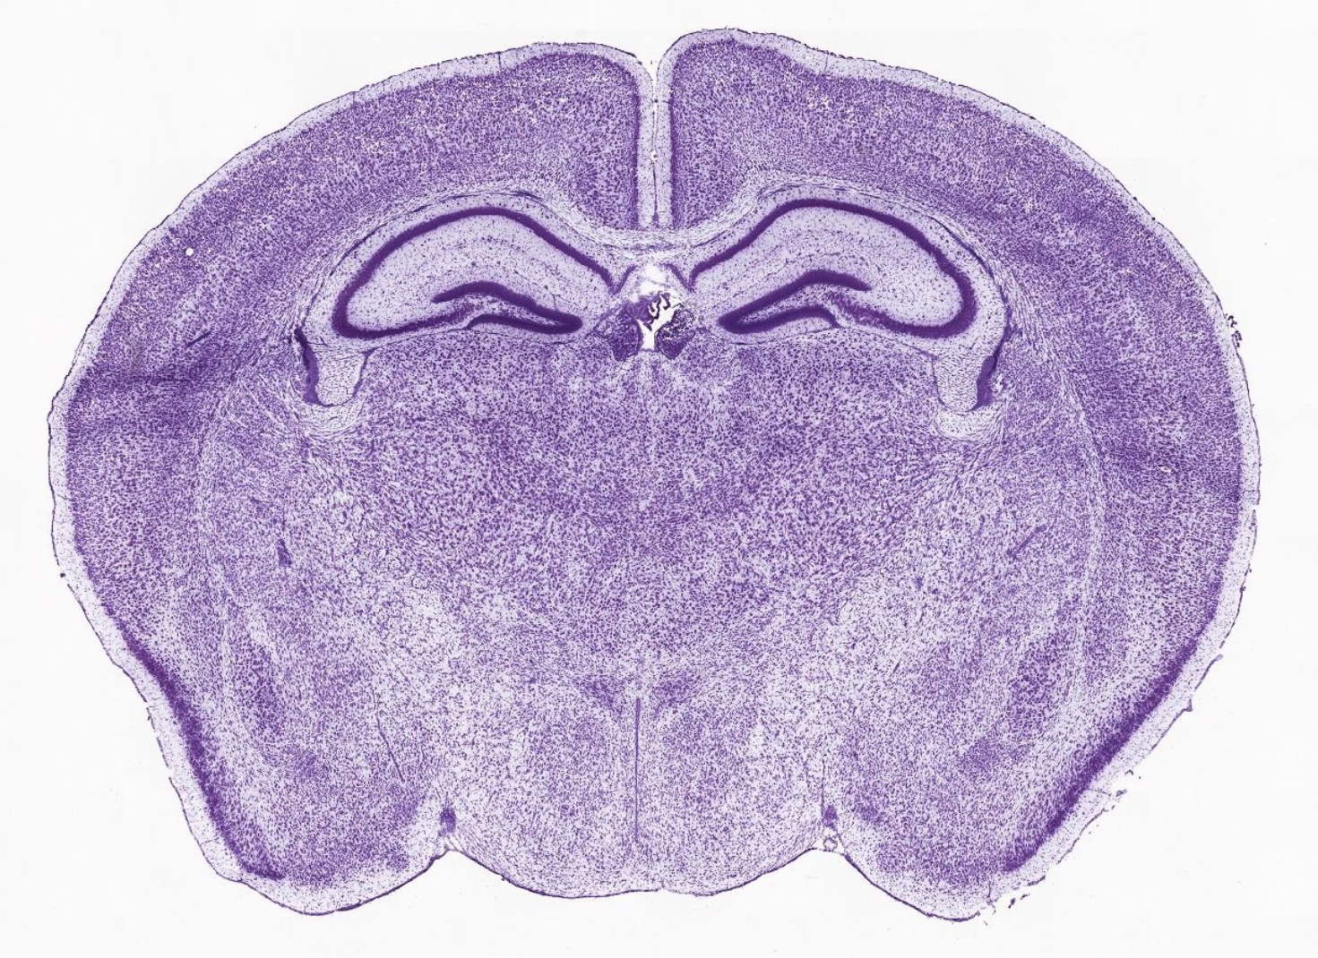
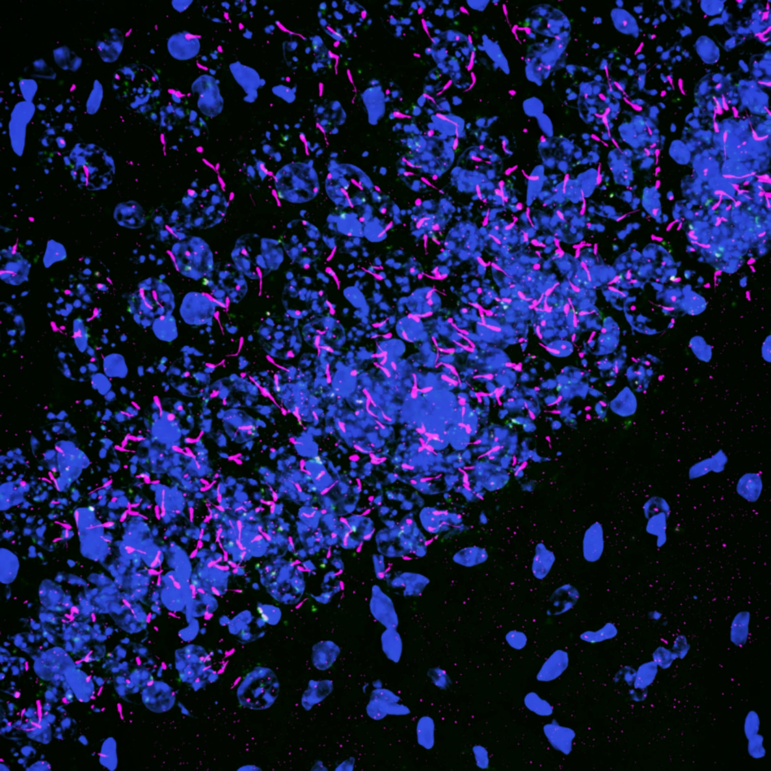
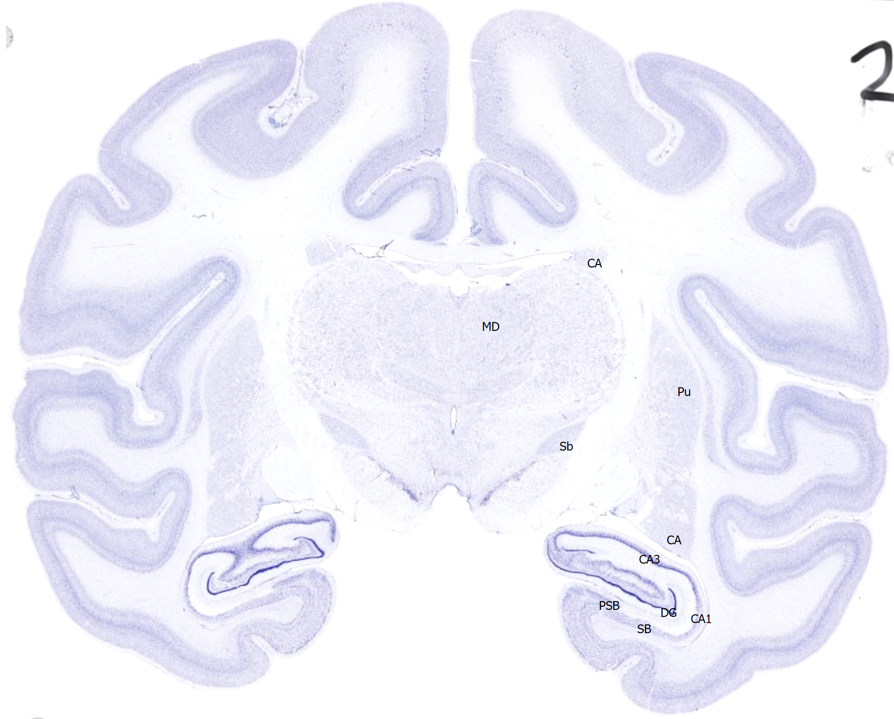
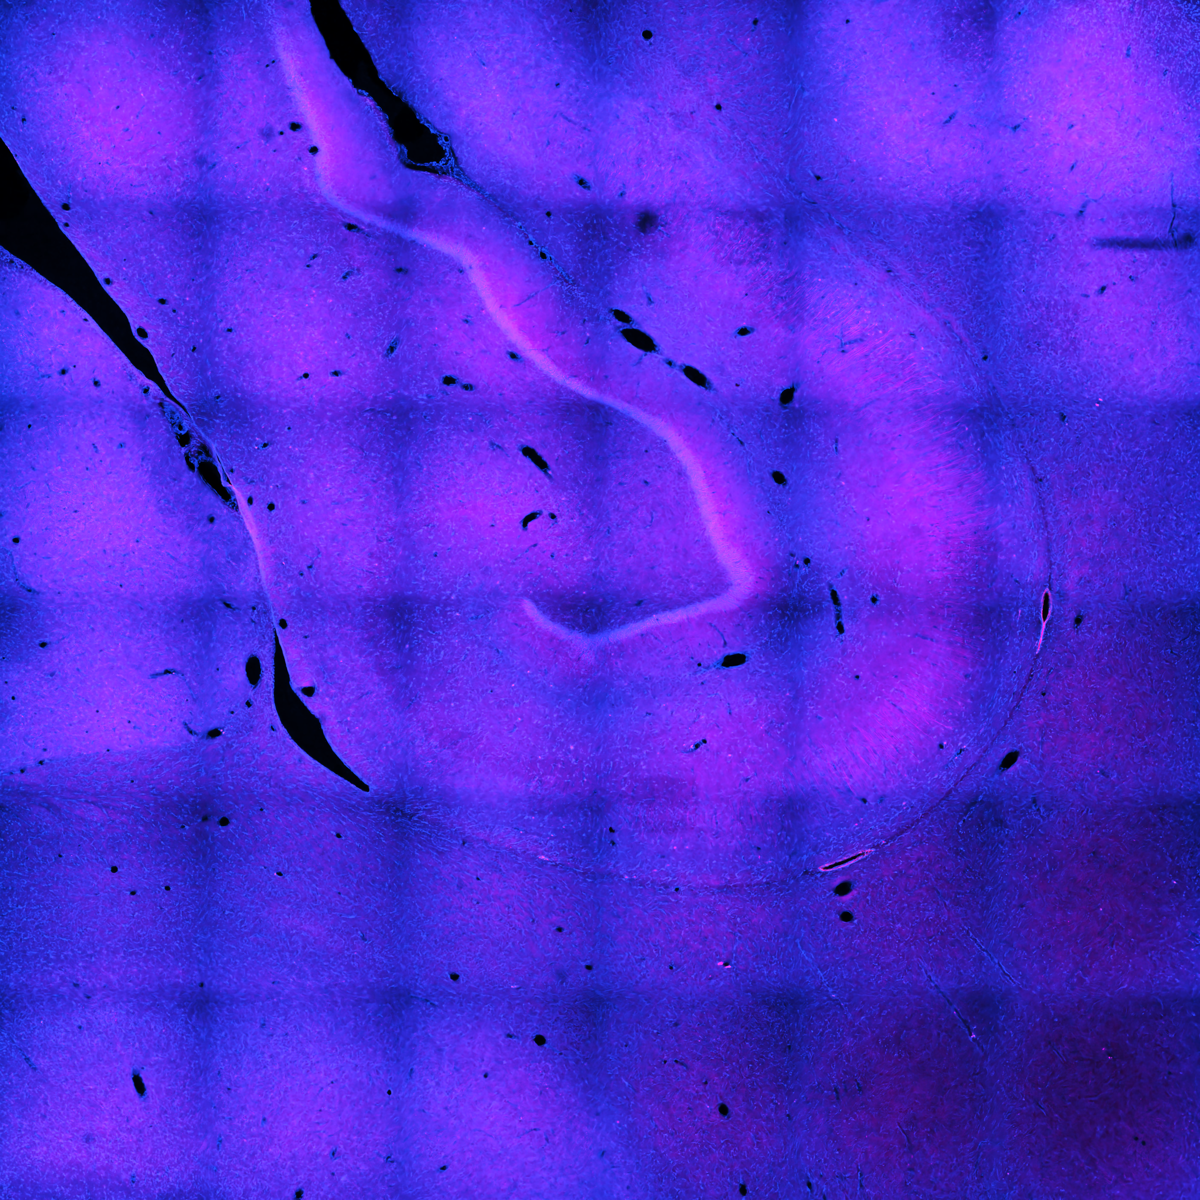
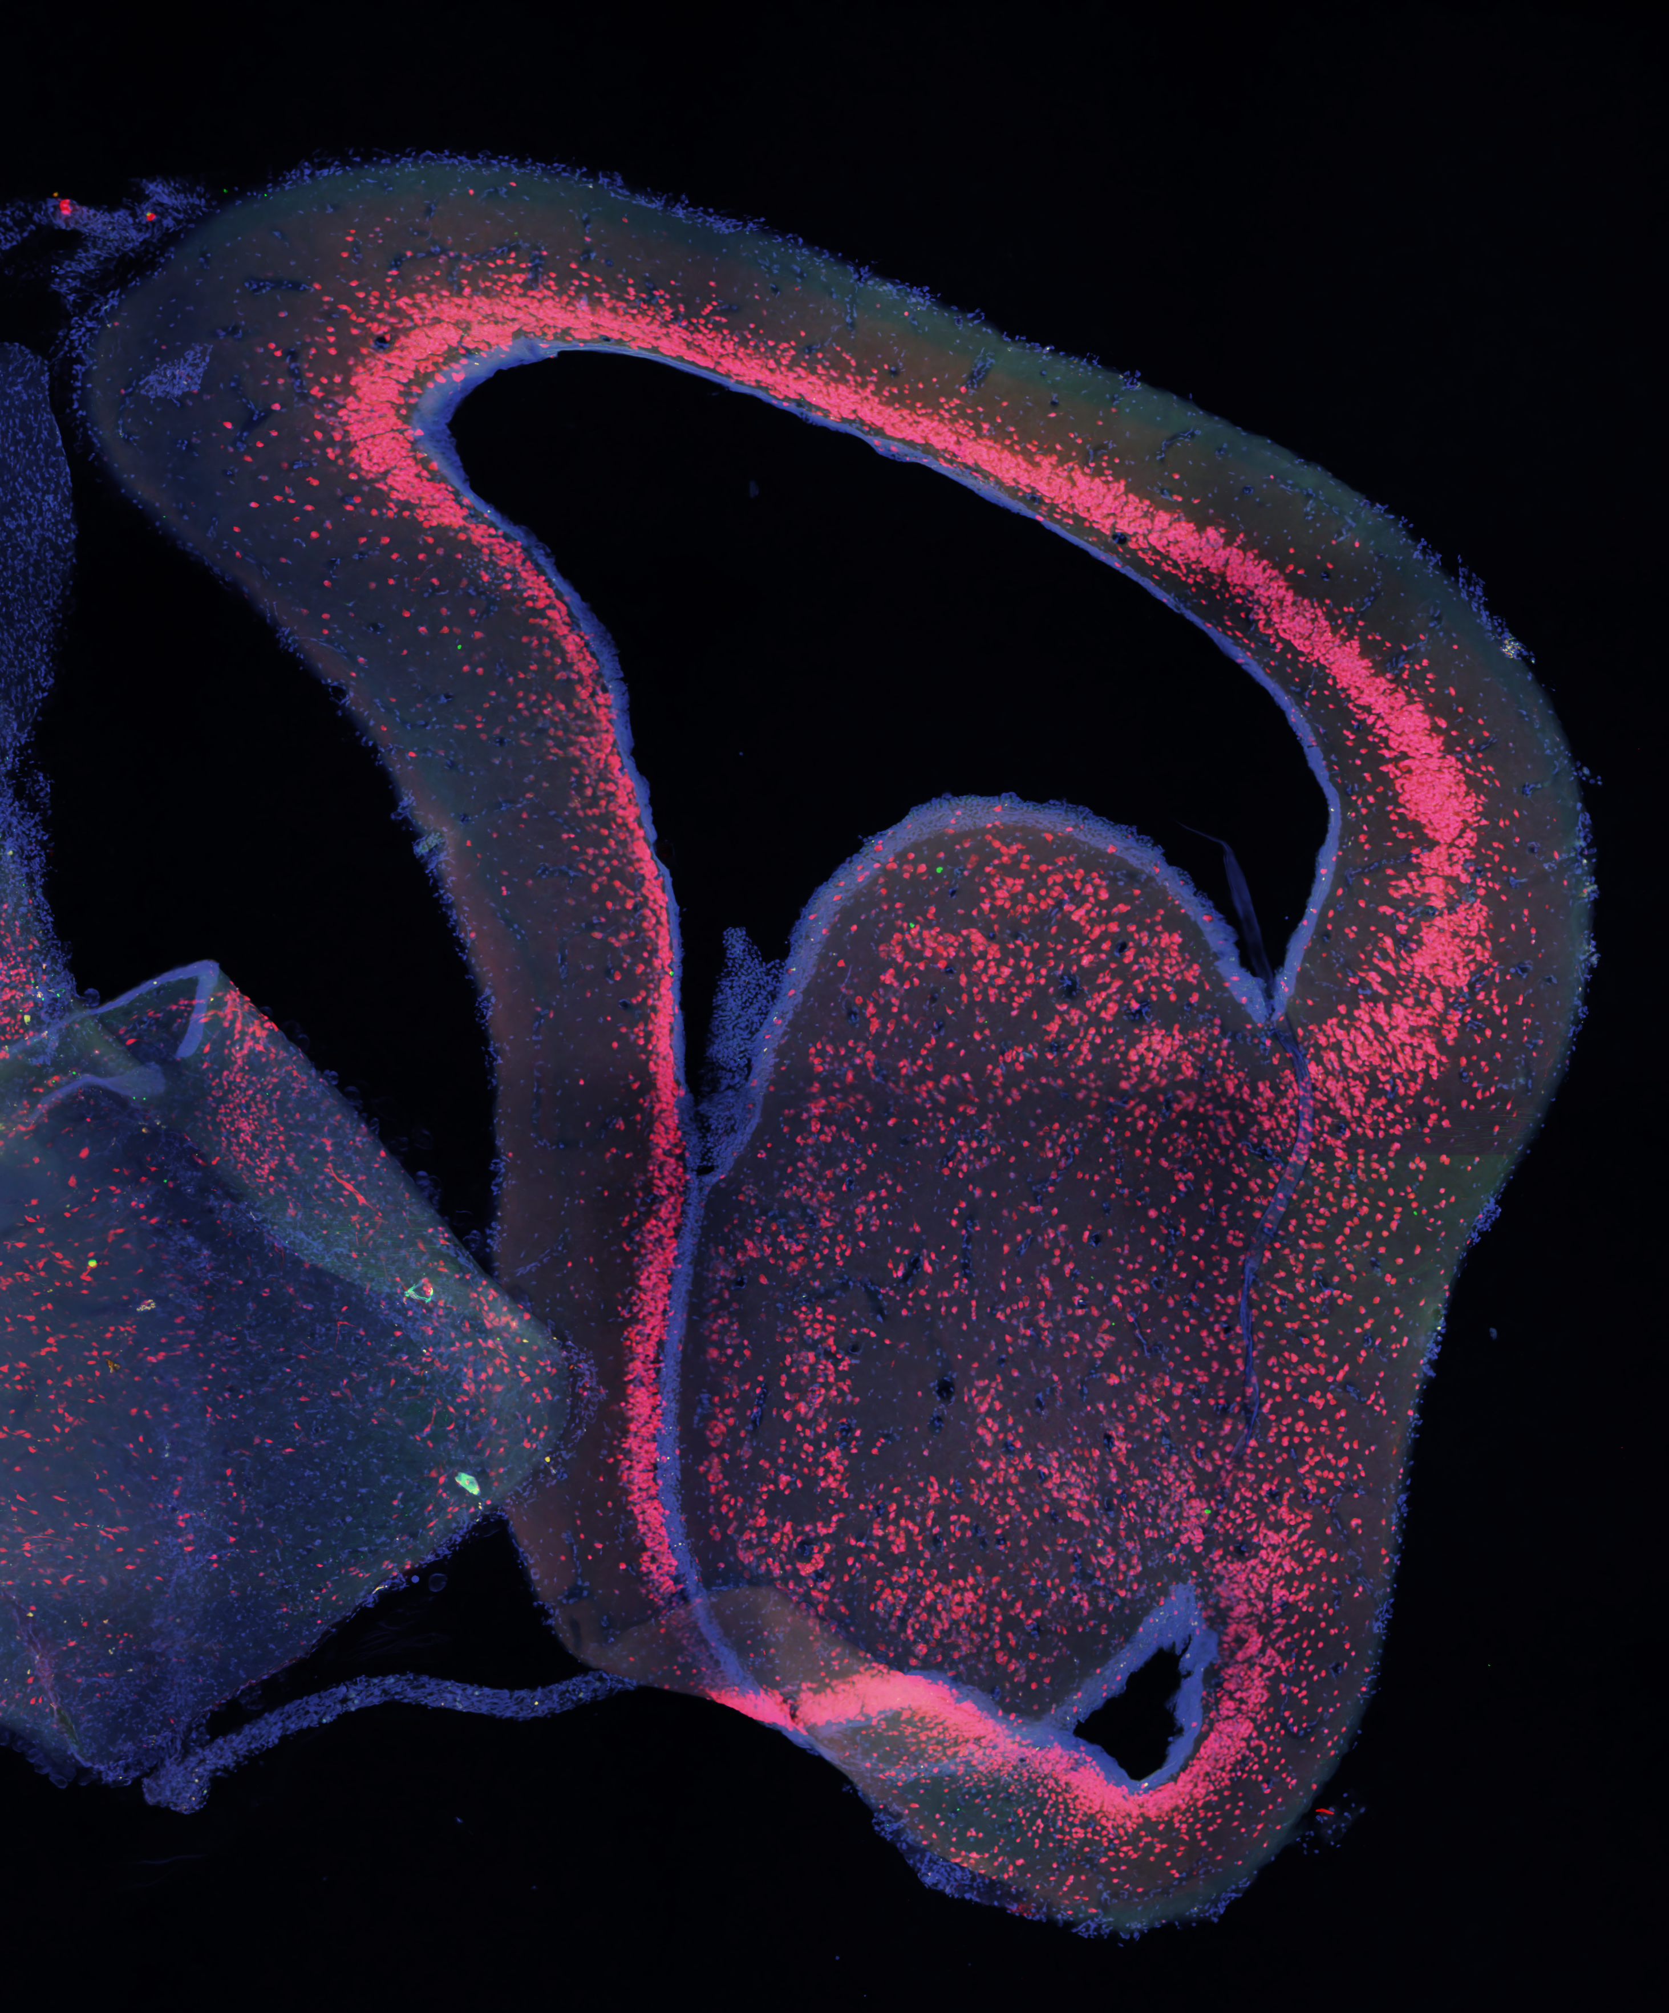
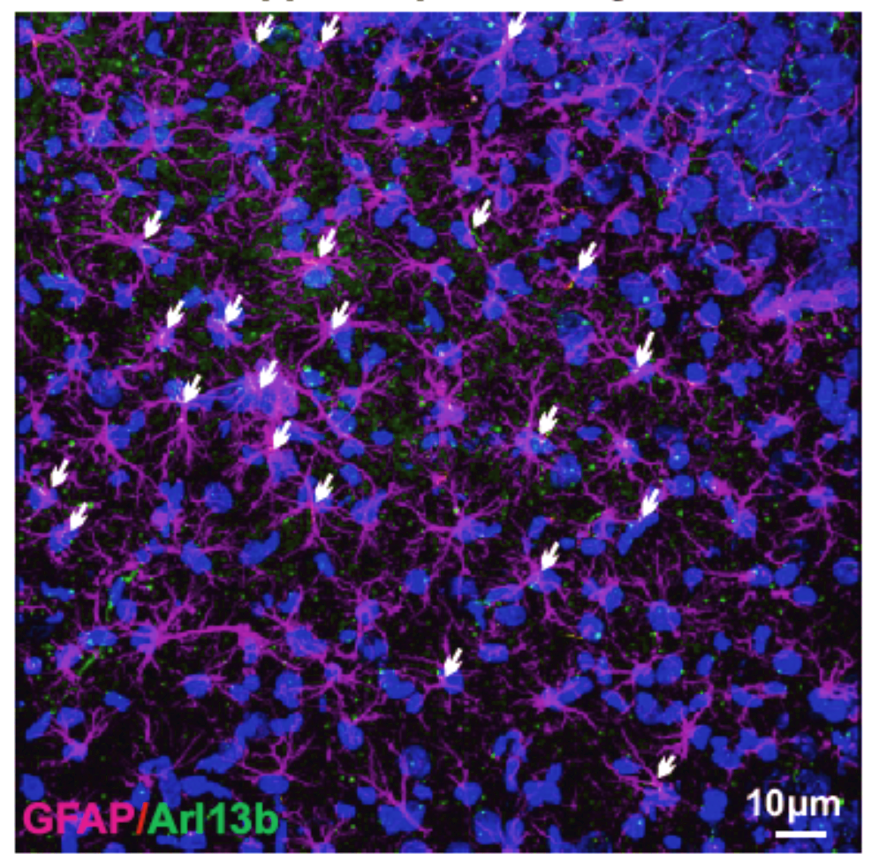
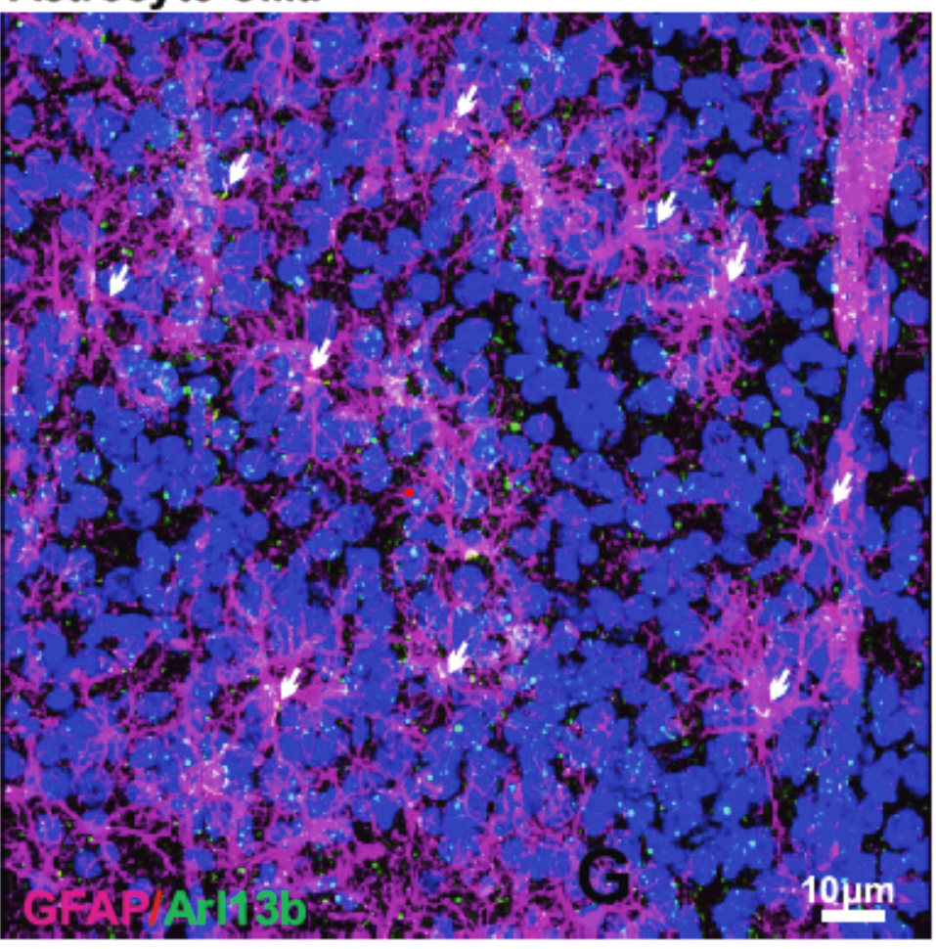
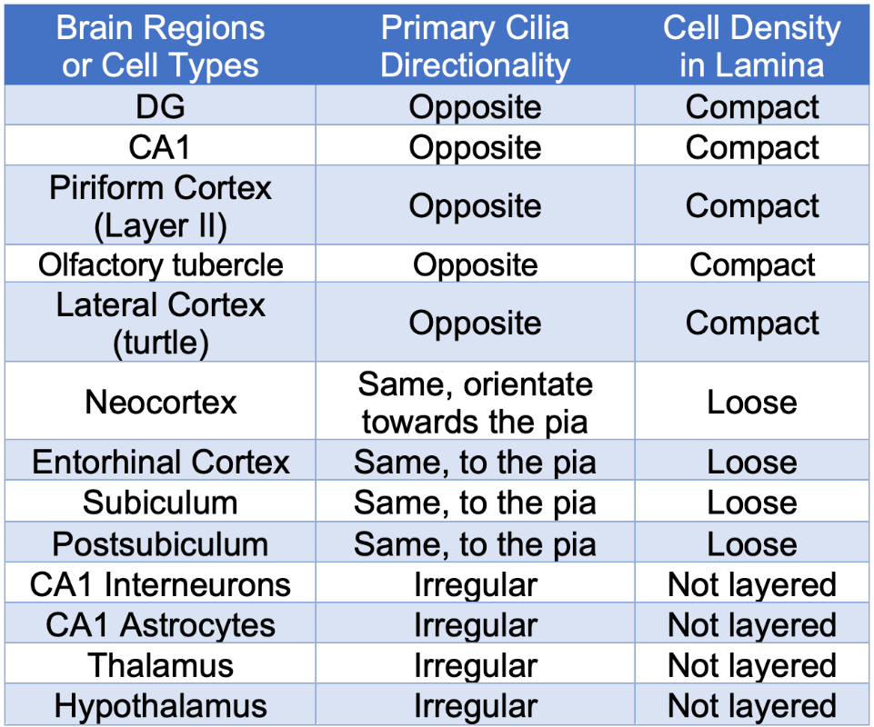
Comparative Primary Cilia Directionality Analysis in Cortical Regions of
Turtles, Mice, and Monkeys
Soheila Mirhosseini¹, Liyan Qiu¹, and Xuanmao Chen^{1,*}
¹Department of Molecular, Cellular, and Biomedical Sciences, University of New Hampshire, Durham, NH 03824
Abstract
Fig. 2 Cilia Orientations in Cortical Regions of Mouse
Fig. 5 Cilia Length in Cortical Regions
Primary cilia serve as cell antennae in most vertebrate cells including neurons. It is known that primary cilia regulate embryonic neurodevelopment, but little is known about their roles in postnatal neurodevelopment. The mammal brain's 6-layered neocortex is homologous to the dorsal cortex in reptiles. The 3-layered allocortex (old cortex) includes the olfactory cortex and hippocampus in mammals, equivalent to the lateral and medial cortex in reptiles, respectively. The mouse hippocampal CA1-CA3 are condensed into one highly dense lamina. In contrast, the neocortex of monkeys is highly expanded, evolved, and has gyrifications. Furthermore, the CA1 region in monkeys are loosely layered. We have discovered that primary cilia in loosely layered cortical regions including mouse neocortex point in the same direction; however, cilia in the dense laminated regions such as mouse hippocampus manifest opposite directionality. This work will advance our understanding of how primary cilia regulate postnatal neurodevelopment and cortical evolution.
A
Hippocampus:
3 layers, allocortex
B
AC3/DAPI
Piriform cortex: 3 layers, allocortex
Neocortex:
6 layers
C
Layer III
AC3/DAPI
Fig. 2
A: Neocortex, piriform cortex (allocortex), and hippocampus (allocortex) are shown in the coronal mouse brain section (adapted from https://developingmouse.brain-map.org).
B: Polar plot shows the cilia orientation in layers II/ III and layer V (not shown here) of the entorhinal cortex in mice point to one direction (Immunofluorescence staining of primary cilia is shown on top).
C: The cilia orientation in layer II of the piriform cortex in mice is opposite based on the polar plot (Immunofluorescence staining of primary cilia is shown on bottom).
Layers II/III
Layer I
Pia surface
10 μm
Layer II
Layer I
Fig. 5 Cilia length in different cortical regions of Mice, Turtles, and Monkeys.
10 μm
Fig. 3 Cilia Orientations in Cortical Regions of Monkey
Conclusions
Methodology
A
Hippocampus
C
CA1
AC3/DAPI
Loose cortical layers including Layer III piriform cortex, neocortex, entorhinal, and perirhinal cortexes in mice, subiculum, CA1 region, sulcus and gyrus (parts of cortex) in monkeys have the same cilia directionality and they point to the pia surface.
Compact allocortical layers such as Layer II piriform cortex, Olfactory tubercle (OT), CA1, CA3, and DG regions (parts of hippocampus) in mice, lateral, medial, ventral, and dorsal cortexes in turtles, DG, and CA3 regions in monkeys showed opposite cilia orientation.
Cilia on the astrocytes in the hippocampus and neocortex layers have random directionality.
Cilia frequency in compact cortical regions are higher than that of loose cortical region.
This study will uncover the role of primary cilia in cortical evolution.
In the long term, this line of research will provide useful clues to understand how vertebrate brains evolve from the 3 layered allocortices to the 6 layered neocortices to acquire higher intelligence.
Brain tissues from turtles, mice, and monkeys will be collected and sliced.
Immunofluorescence staining, and confocal microscope were used to take images from different cortical regions of the brain.
The morphology of cilia was analyzed.
Cilia orientation measurement, analysis of the data, and drawing of different plots were performed.
Cilia can be marked by antibodies of cilia-specific proteins, such as type 3 adenylyl cyclase (AC3) and ADP-ribosylation factor-like protein 13B (Arl13 B).
Data analysis was done using ImageJ software.
Custom MATLAB polar plot codes were used to make histograms and polar plots.
Subiculum
Sulcus
Gyrus
CA3
DG
B
AC3/DAPI
CA1
10 μm
Pia Surface
Fig. 3
A: Coronal section of monkey brain (Hippocampus is magnified).
B: The cilia orientation of Dentate Gyrus (DG) in monkey is opposite (Immunofluorescence staining of primary cilia is shown here).
C: The cilia orientation of CA1 region in monkey point to one direction (Immunofluorescence staining of primary cilia is shown here).
DG
10 μm
10 μm
Fig. 1 Cilia Orientations in Cortical Regions of Turtle
sTAMD Simulations
Fig. 4 Cilia Directionality in Different Cell Types and Brain Regions
A
AC3/NeuN/DAPI
Dorsal cortex: 3 layers, allocortex
Astrocytes
Astrocytes
Table. 1 Cilia directionality and lamina compactness in different brain regions and cell types.
Acknowledgements
Medial cortex: 3 layers, allocortex
This study was supported by UIC and the National Institutes of Health Grants MH105746, GM113131, AG054729, MH126317, MH125305, UNH COLE Awards, and UNH CoRE grants.
Hippocampus
Layer V, Neocortex
Lateral cortex: 3 layers, allocortex
References
B
AC3/NeuN/DAPI
Lateral cortex
Yang, J.; Mirhosseiniardakani, S.; Qiu, L.; Bicja, K.; Gel Greco, A.; Jungkai Lin, K.; Chen, X., Primary Cilia Directionality Reveals a Slow Reverse Movement of Principal Neurons for Postnatal Positioning and Lamina Refinement in the Cerebral Cortex. bioRxiv 2021.
Chen, X.; Luo, J.; Leng, Y.; Yang, Y.; Zweifel, L. S.; Palmiter, R. D.; Storm, D. R., Ablation of type iii adenylyl cyclase in mice causes reduced neuronal activity, altered sleep pattern, and depression-like phenotypes. Biological Psychiatry 2016, 80 (11), 836-848.
10 μm
Fig. 1
A: The lateral, dorsal, and medial cortexes (all allocortex) in the turtle brain section (Immunofluorescence staining of primary cilia in turtle brain section)
B: The polar plot of lateral cortex shows the opposite cilia direction (preliminary data).
10 μm
Fig. 4 Polar plots of astrocytes cilia in mouse hippocampus and layer V neocortex show they have random directionality.

