Slide 1


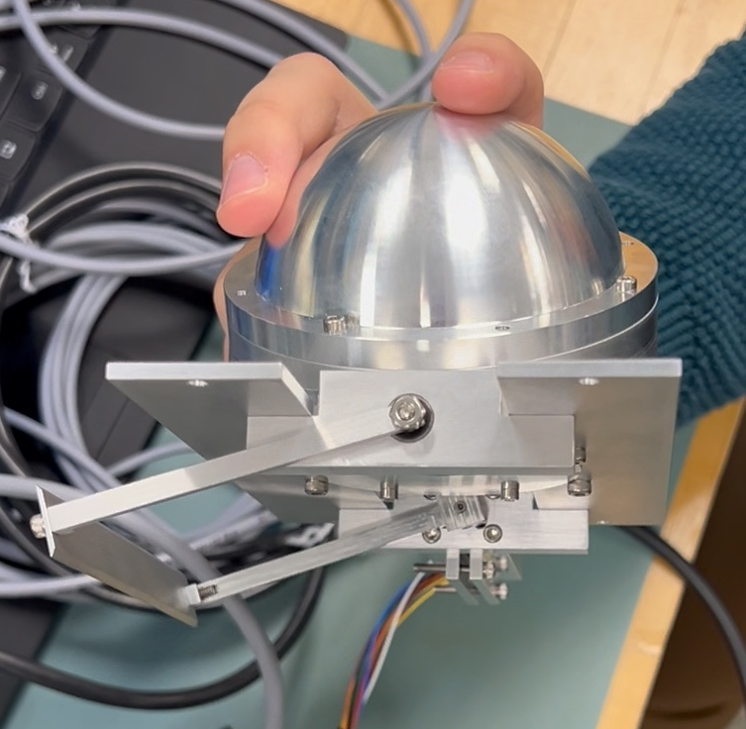
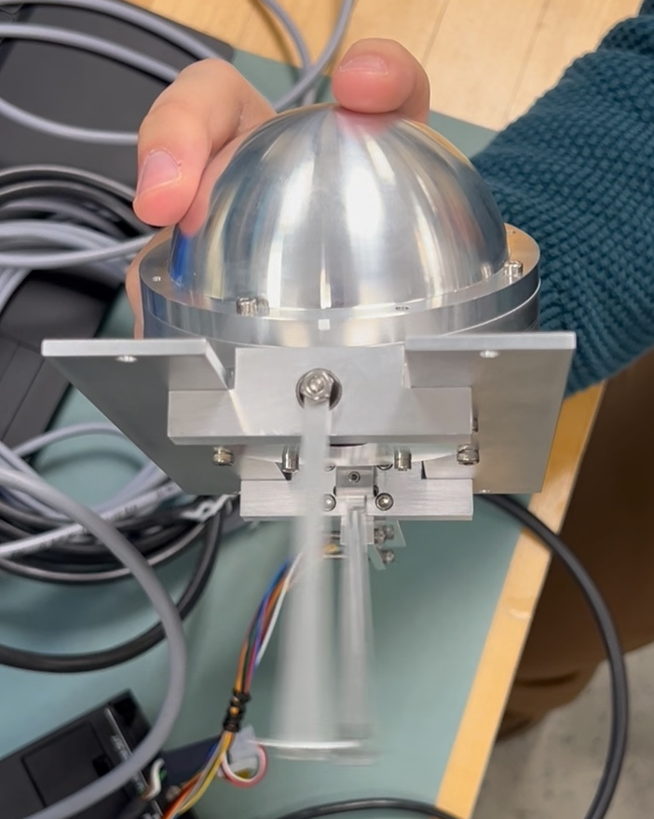
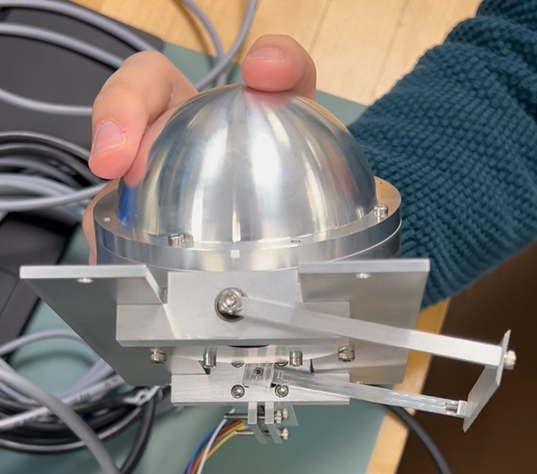
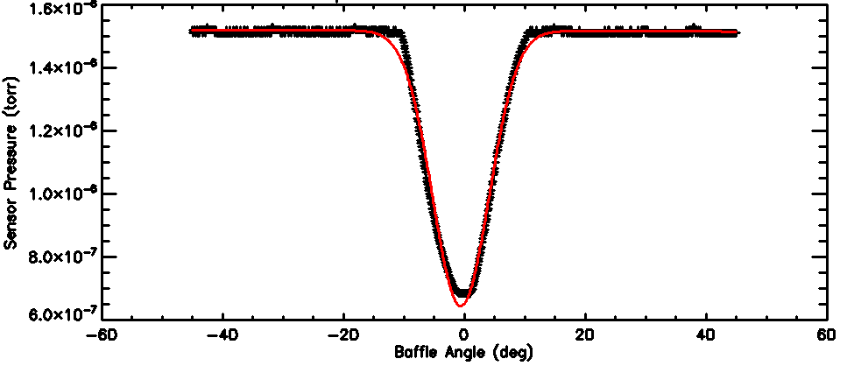
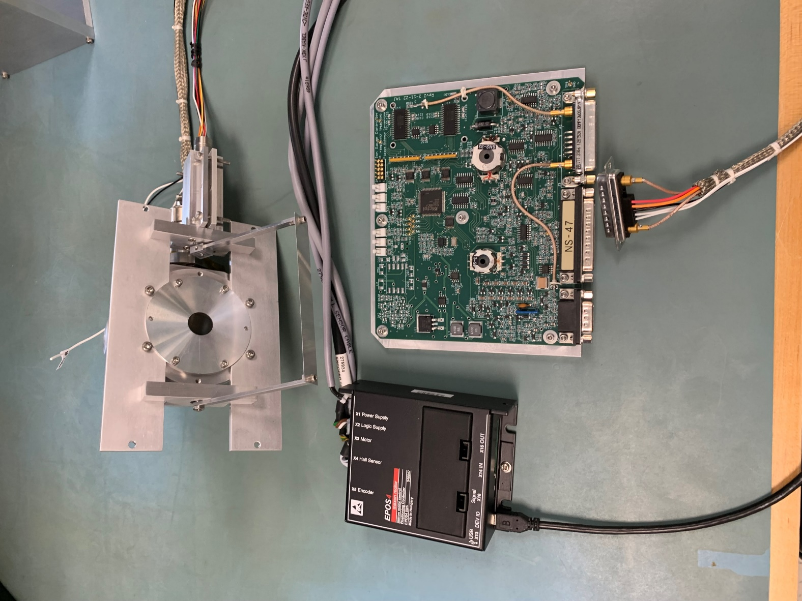
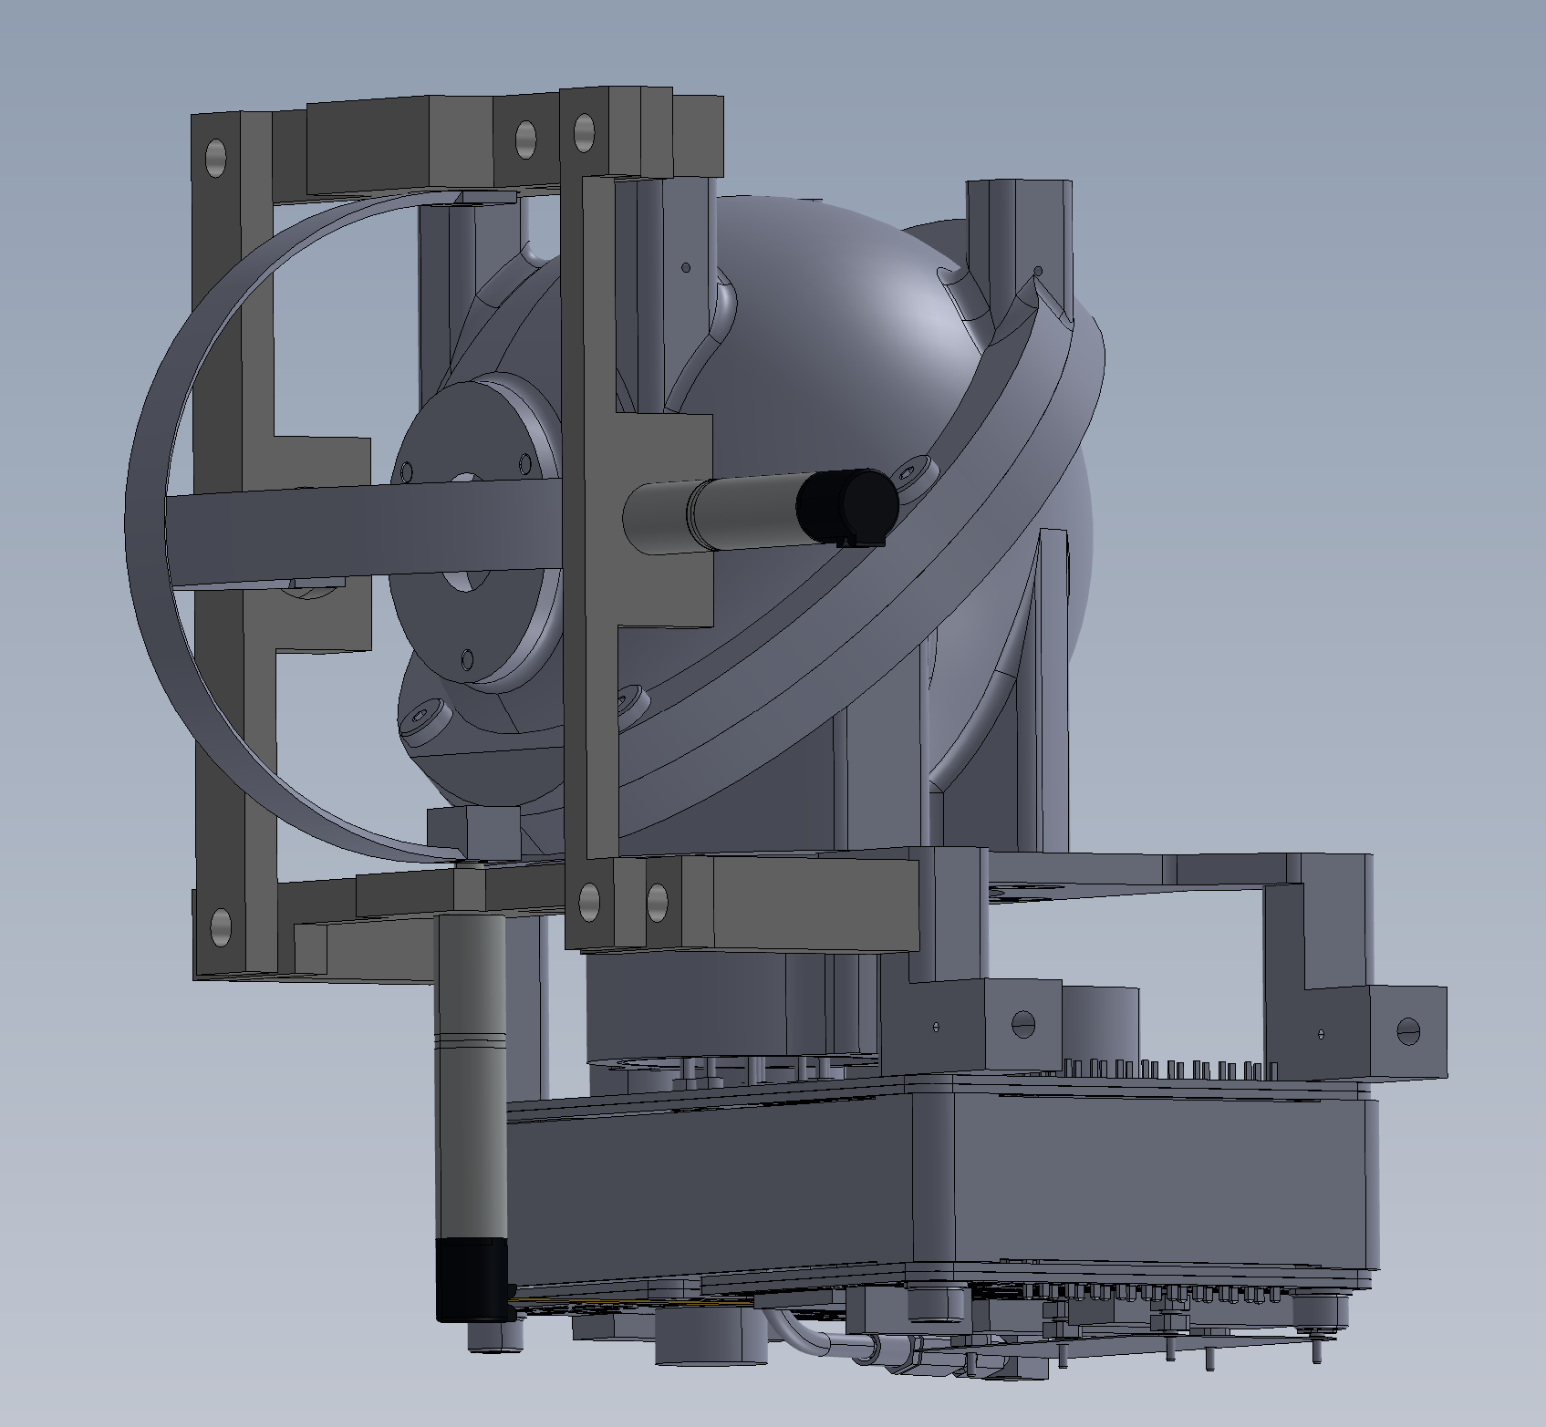
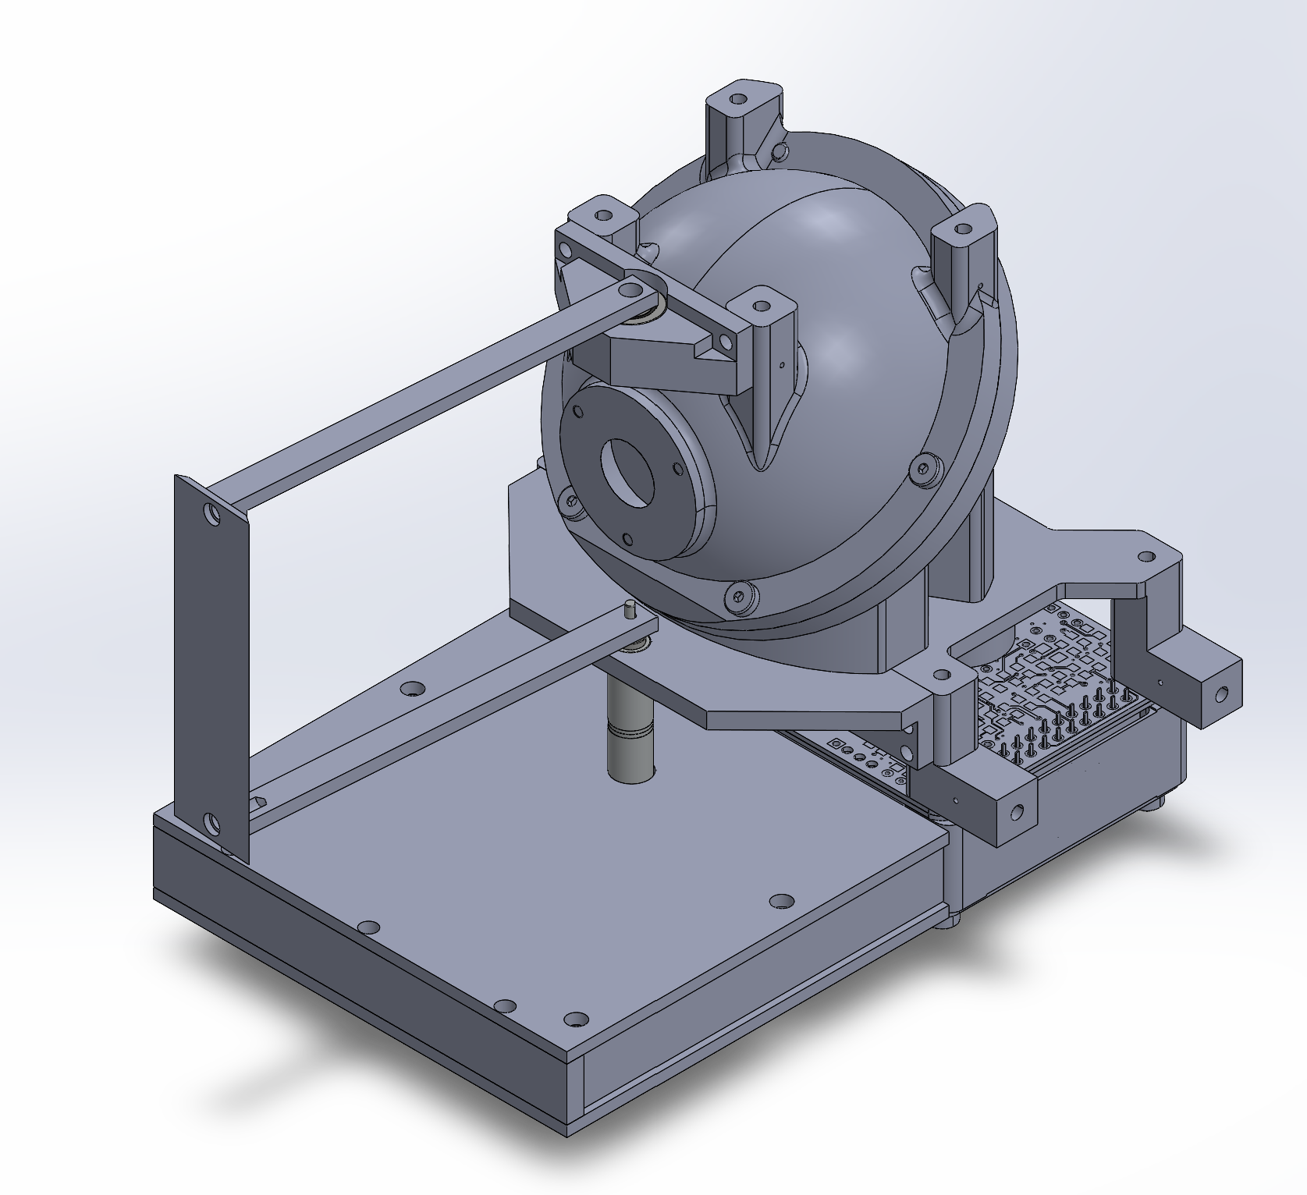
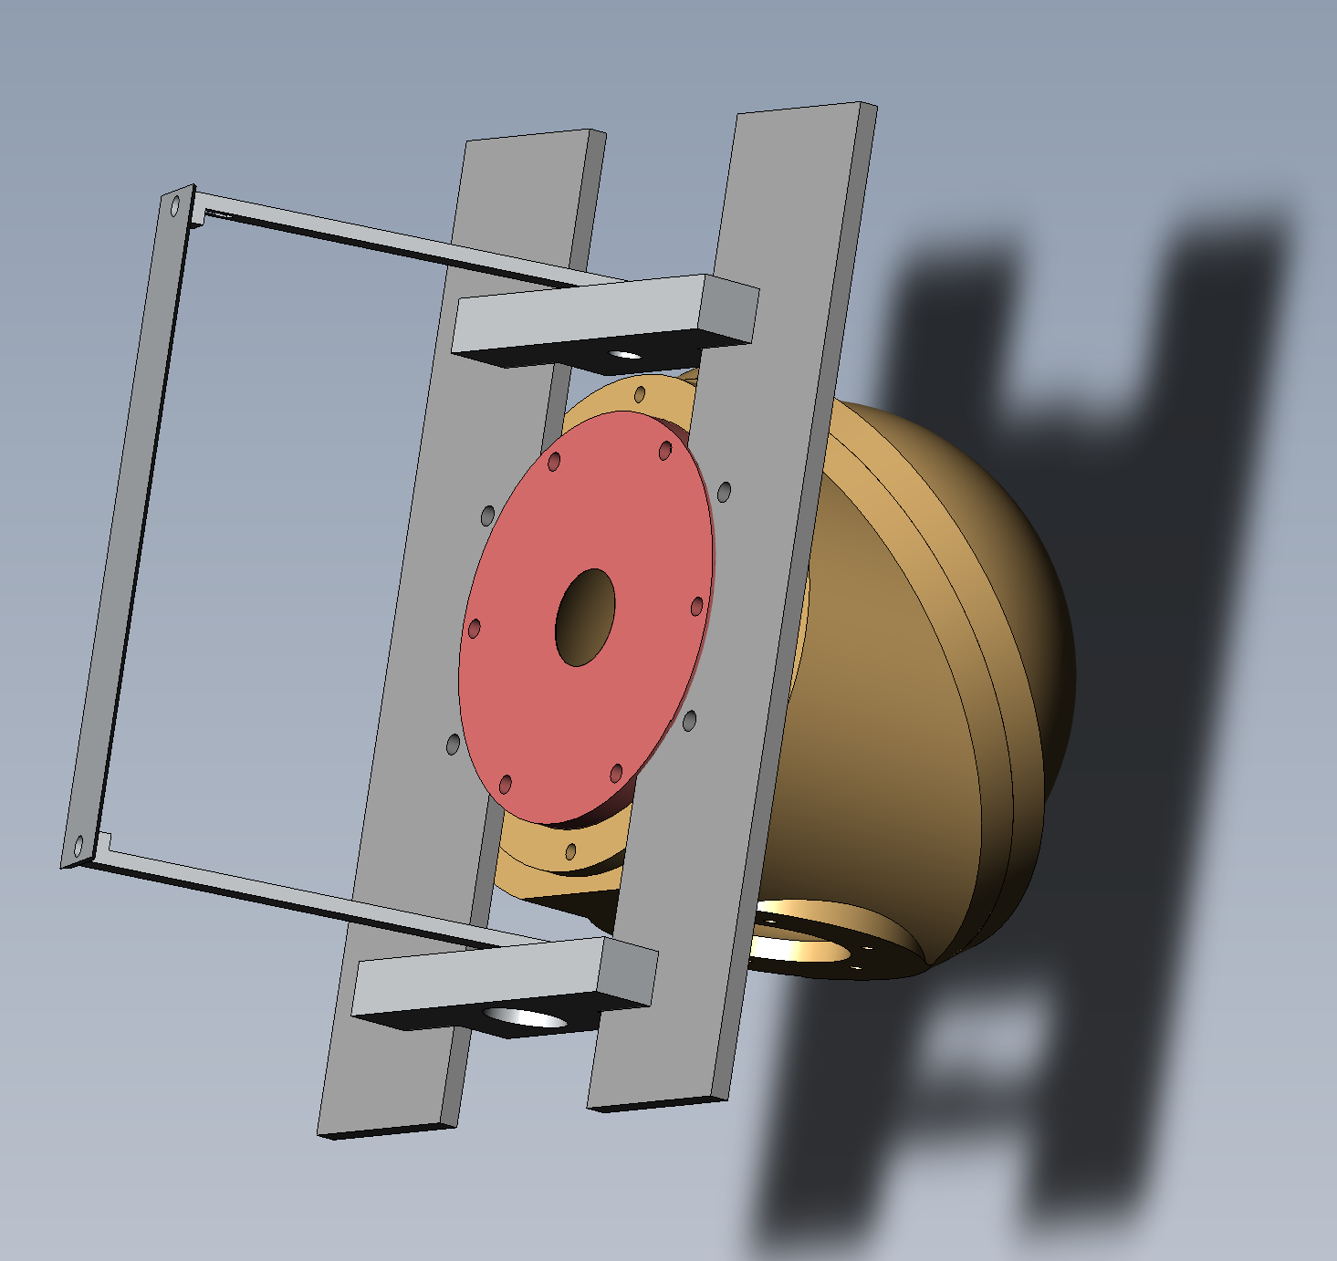
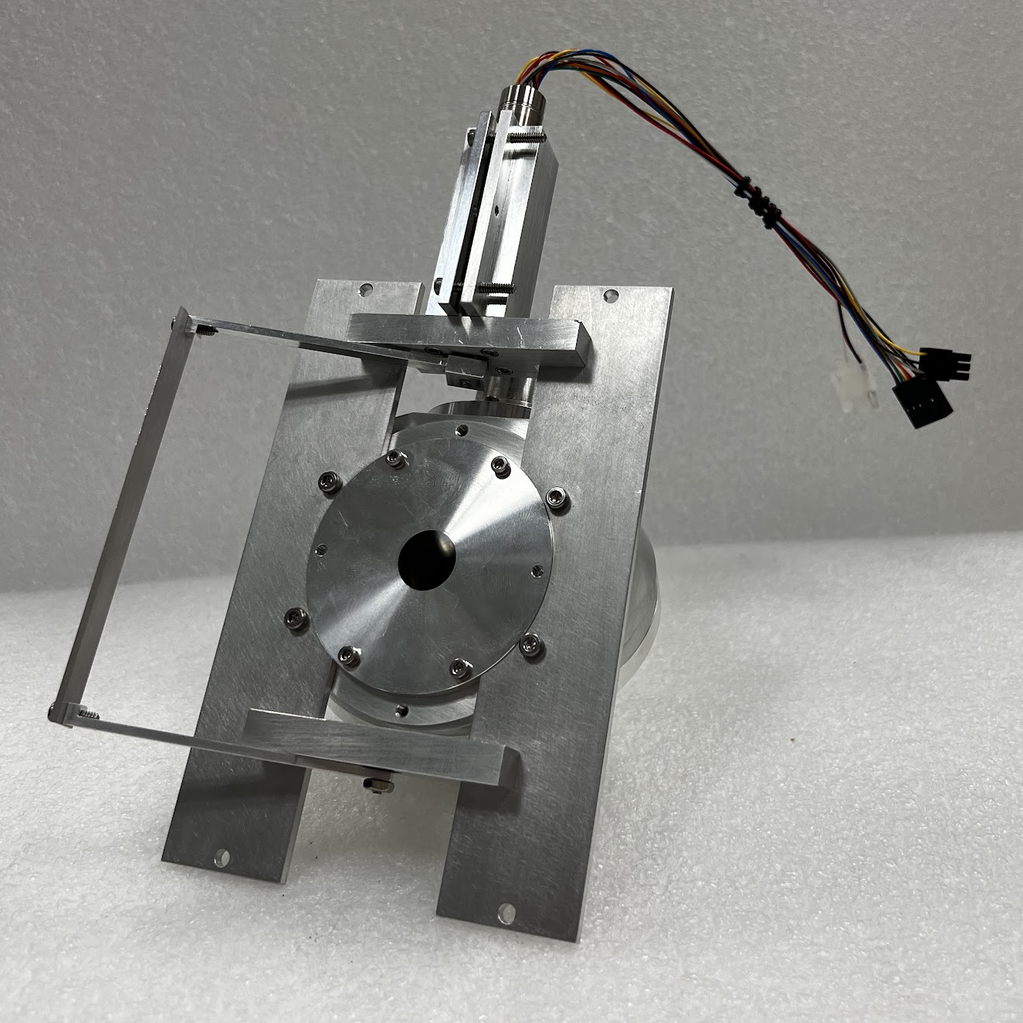
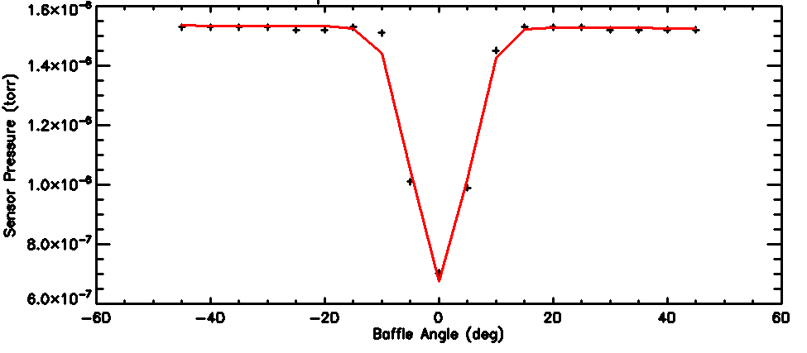
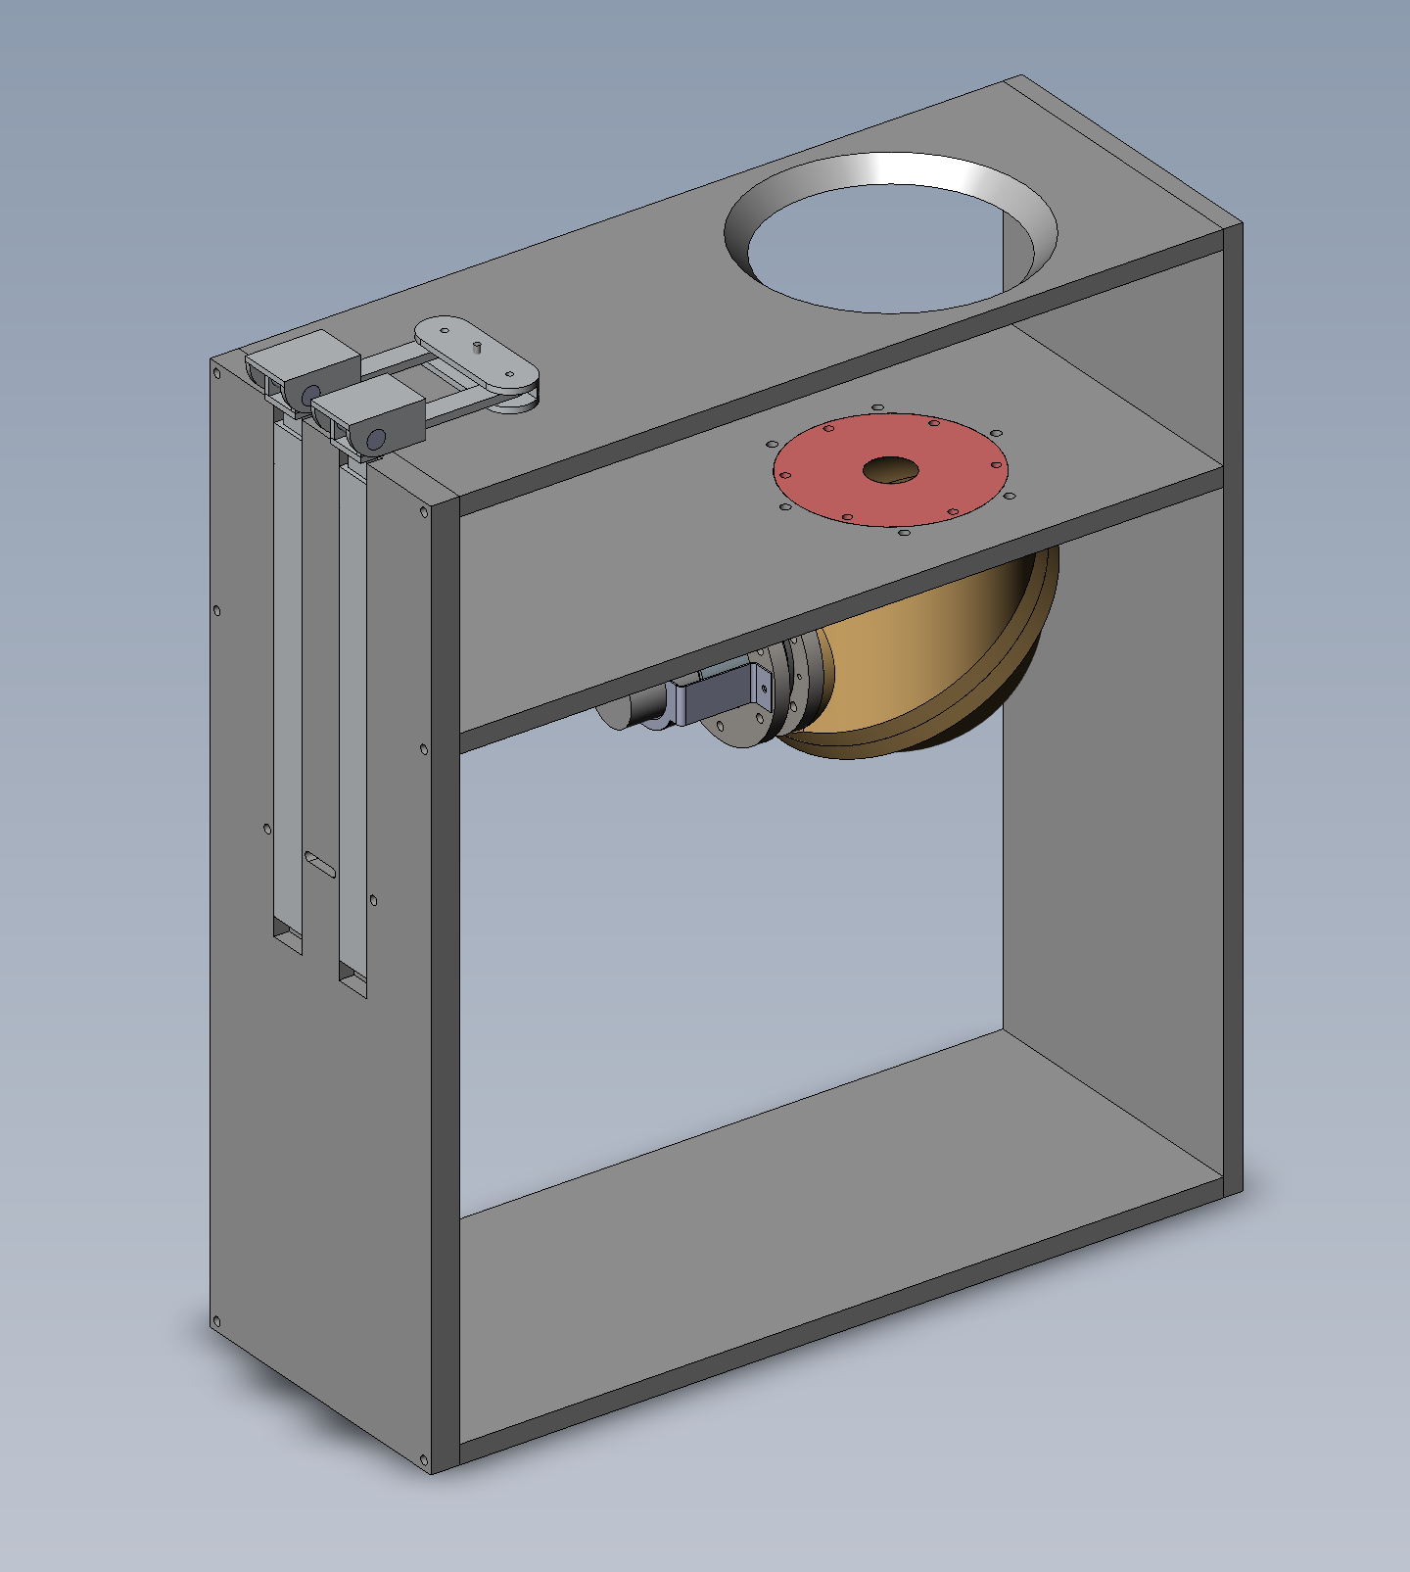
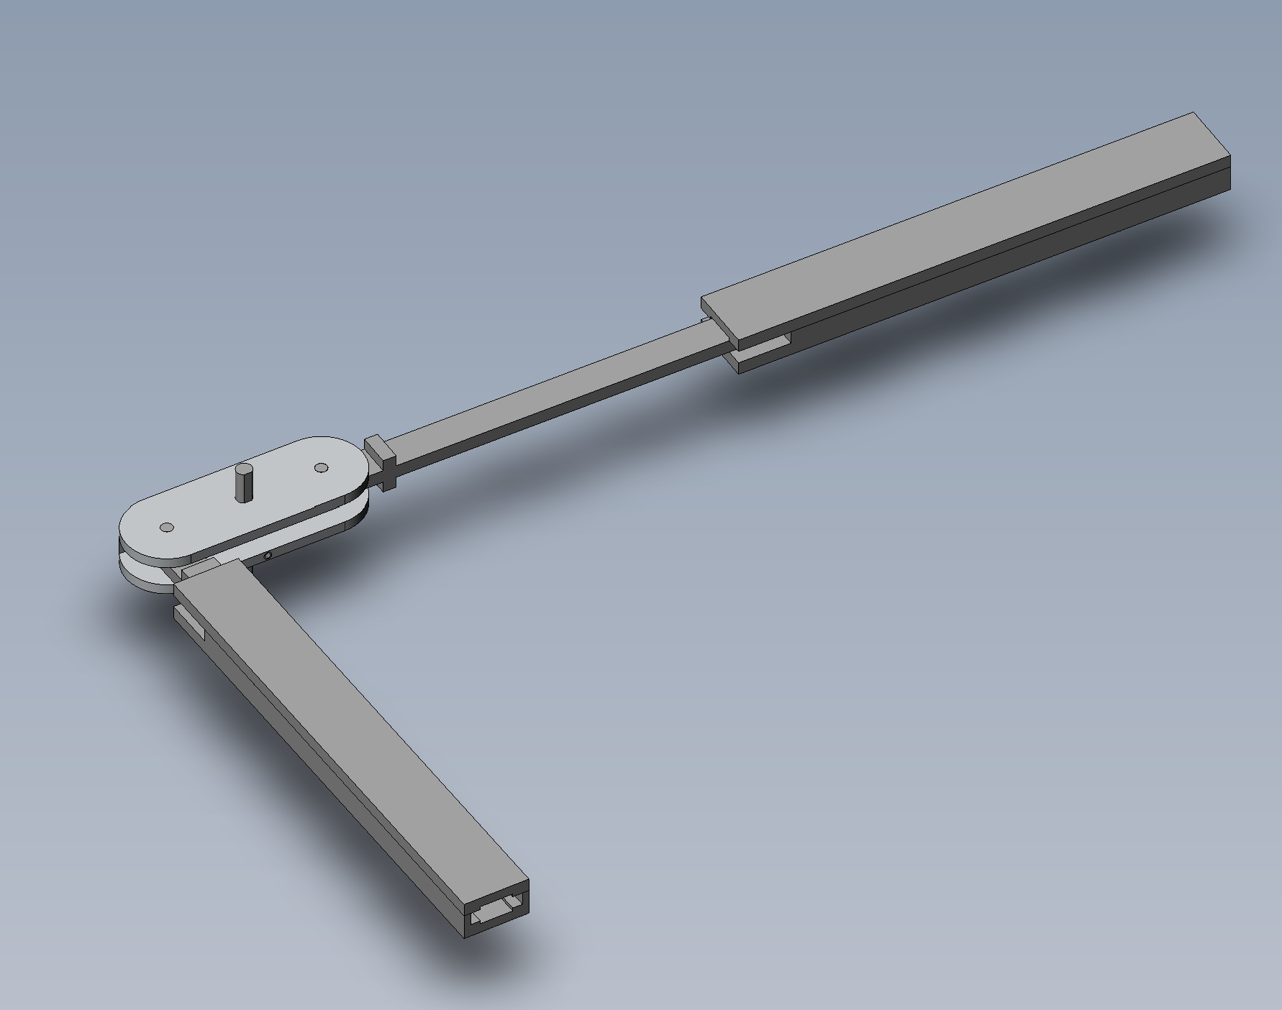
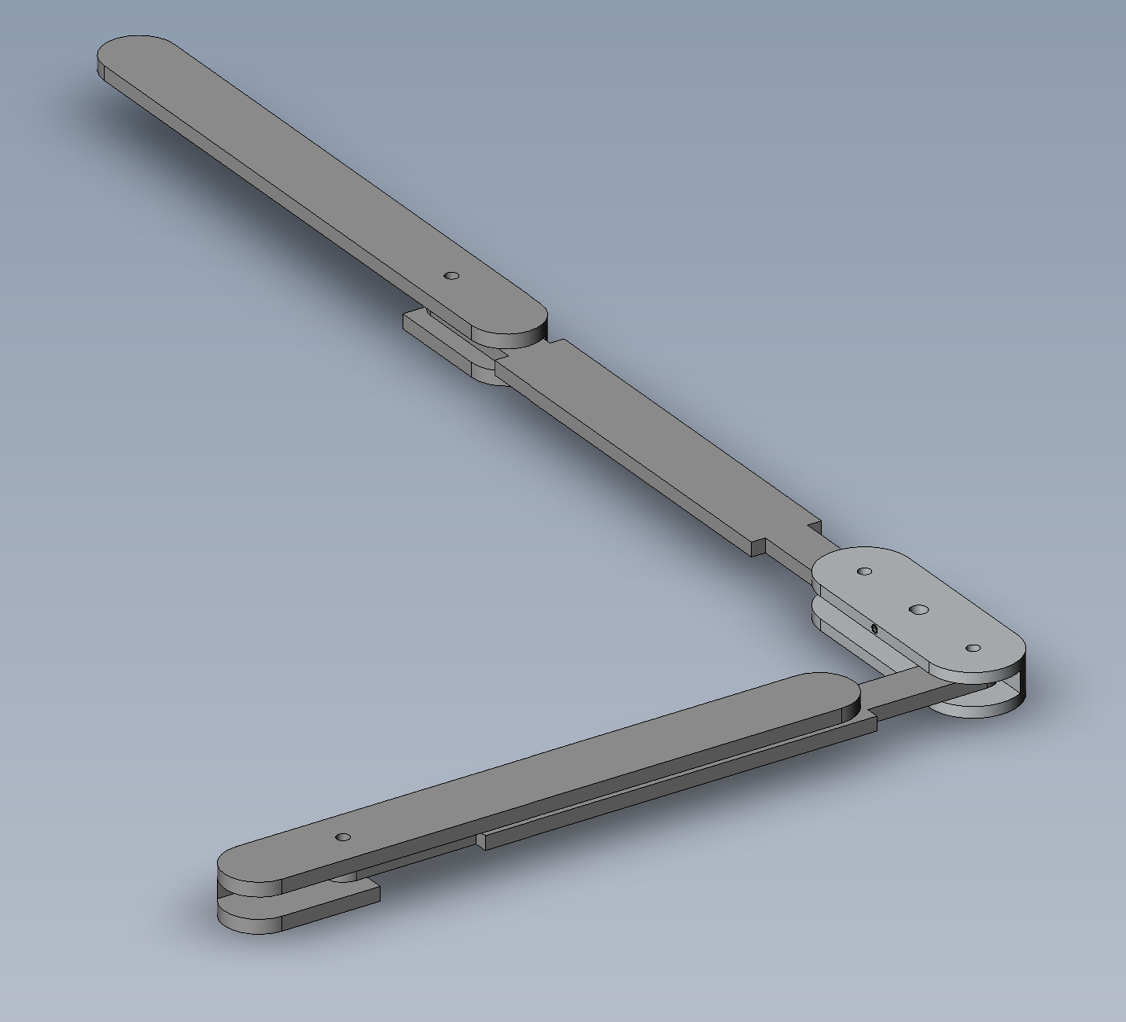
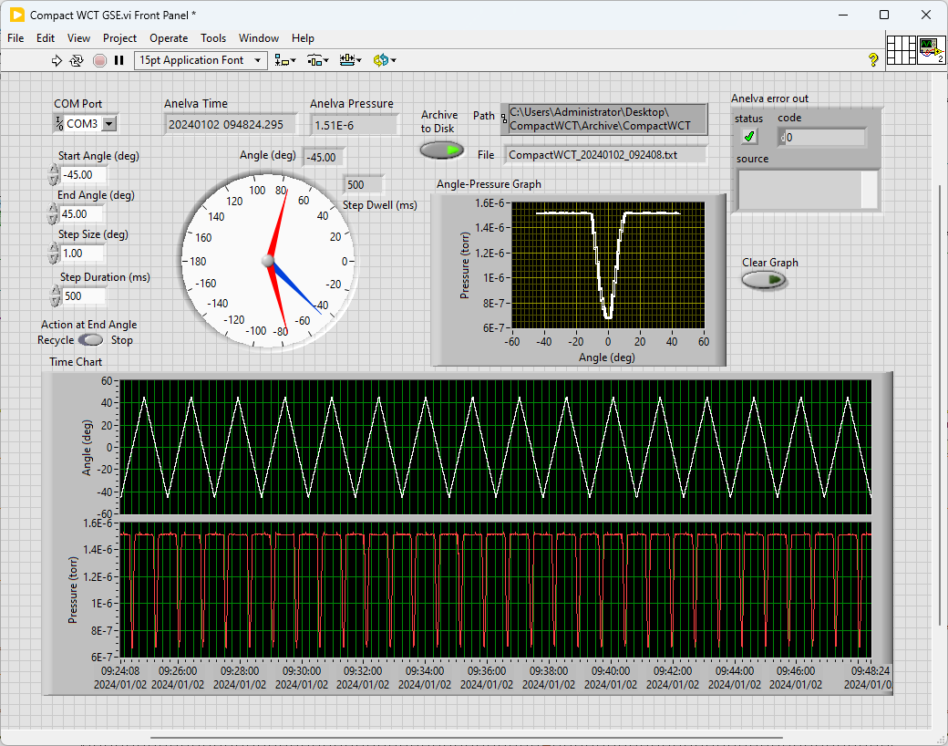
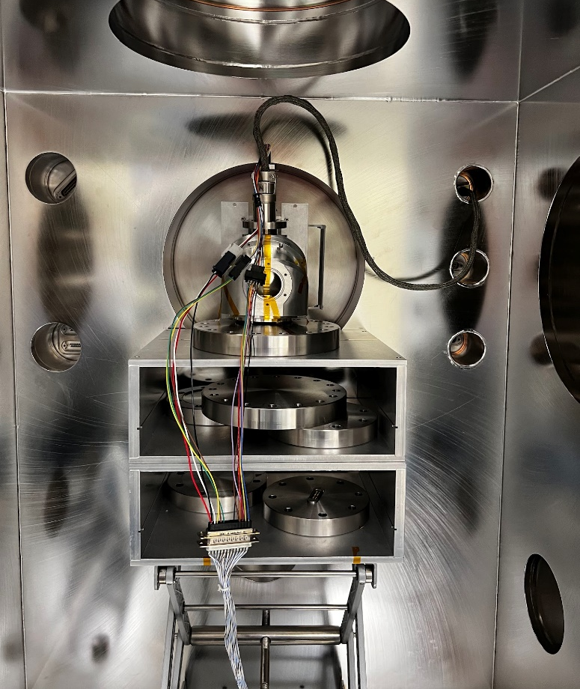
Developing CubeSat Instruments to Measure Upper Atmospheric Winds
Jackson Scheele, University of New Hampshire Physics Department
Advisor: Dr. James Clemmons
Motivation
Mechanics
Conclusions
The upper atmosphere hosts fascinating physical phenomena including “space weather” which refers to the atmospheric conditions in the thermosphere and ionosphere
Presently, the dynamics of this space is not well understood largely due to a lack of thermospheric winds measurements
These winds dictate much of the dynamics of the upper atmosphere including how it circulates, how it responds to energy input from deeper space, and how turbulent structures are set up within the upper atmosphere
This situation motivates us to develop improved and easier-to-fly instrumentation that will allow better measurements of winds in the thermosphere
The Ion Gauge measures pressure data which can be used to determine atmospheric winds by monitoring their flow into the accommodation chamber
The Aperture plate controls the size of the passage for atmospheric winds to travel into the accommodation chamber
The Baffle rotates around an axis the runs through the center of the aperture plate and travels in a 90-degree arc with its center directly covering the chamber aperture
The particle shadow cast by the baffle onto the accommodation chamber controls the flow of material into the instrument.
Design performed as expected and proved efficacy for flight applications
Prototype performed extremely well at low speeds, but error rose significantly as speed was increased to realistic speeds
Sampling rate was severely limited by the Anelva controller which likely impacted poor performance as oscillatory speed was increased
Next Steps
Objective
Replace Anelva controller with flight controller to improve sampling rate from 4 samples/second to 1000 samples/second
Add second baffle with an axis of rotation perpendicular to existing baffle to accommodate winds coming from above and below chamber aperture
Simulate two-baffle prototype geometry with IDL scripts to establish optimal dimensions and predict performance for flight sized instrument
Consider prototyping the other seven design concepts originally discarded at the beginning of the project
Previous attempts to measure upper-atmospheric winds and temperatures are sparse and have been performed with significant error. This project aims to develop instrumentation to perform highly accurate measurements of atmospheric winds
Process
Considered eight potential design concepts believed to progress from poor data collection systems to more accurate and efficient instruments
Chose rotating baffle arm system to encourage finite chunks of atmospheric winds into accommodation chamber for sample analysis
Adjusted solid model design to fit existing parts available in the lab to test design efficacy
Wrote software to control baffle motor, record data, and combine accommodation chamber data with baffle position data for analysis
Tested prototype in vacuum chamber by aligning instrument aperture with Nitrogen particle beam to act as atmospheric wind stream.
Slow Oscillatory Motion
136 seconds/oscillation
0.1 degree motor steps
Dwell of 240ms
Center: -0.556 deg → -74.7 m/s
Center sigma: 0.0083 deg → 1.1 m/s
Width sigma: 0.0088 deg → 2.3 K
Flight board (bottom right) can collect data much better than Anelva controller used for initial data collection
Two Baffle system adds complexity to instrument, but delivers a more accurate data collection method
Fast Oscillatory Motion
19 seconds/oscillation
5.0 degree motor steps
Dwell of 500ms
Center: 0.173 deg → 23.3 m/s
Center sigma: 0.15 deg → 20 m/s
Width sigma: 0.16 deg → 42 K
Telescoping Arm Deployment
Spring Loaded Deployment
Swinging Arm Deployment
Other design concepts (pictured above) have yet to be manufactured but show promise. The ability to stow blades in a compact position until measurements need to be taken are suitable for the small nature of CubeSat missions.

