Slide 1
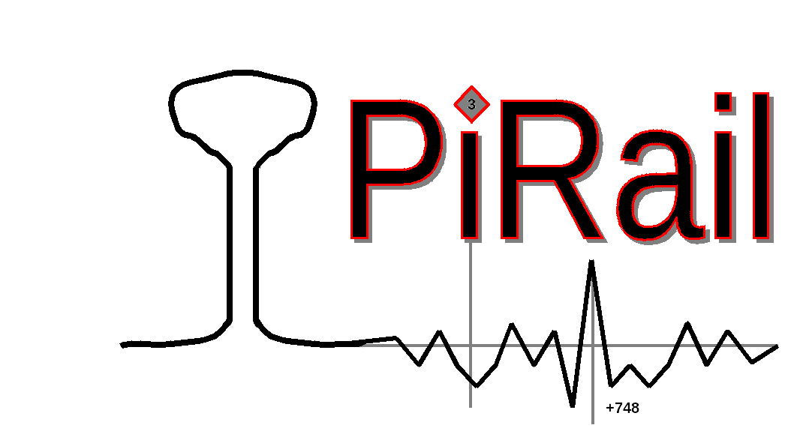
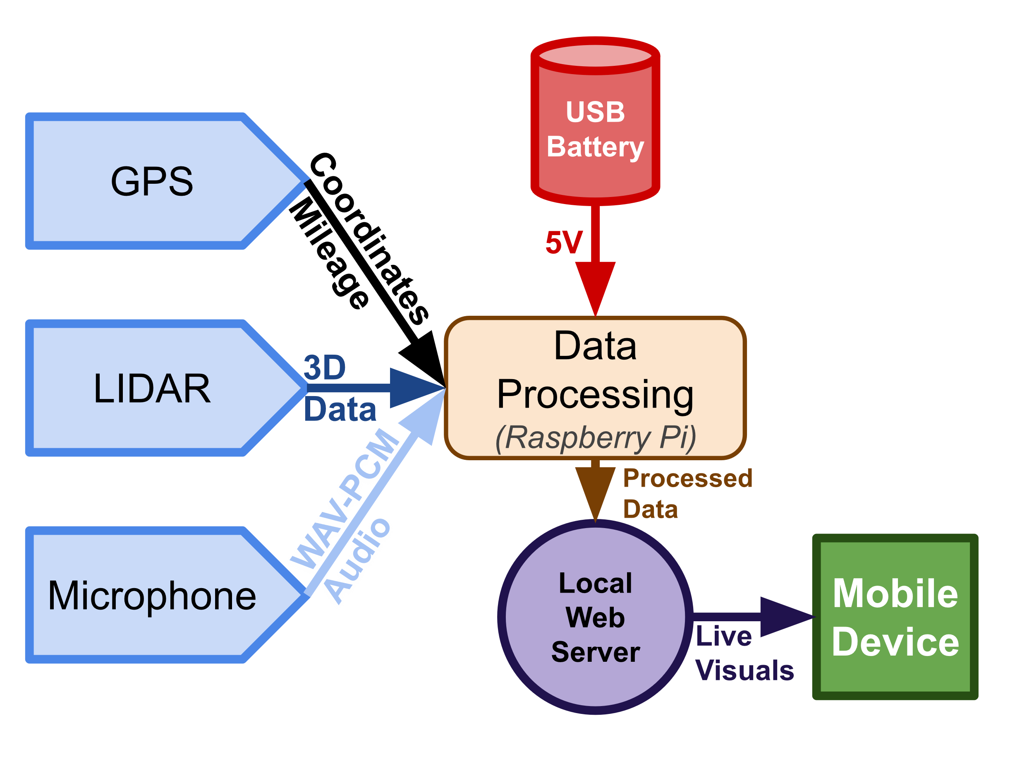
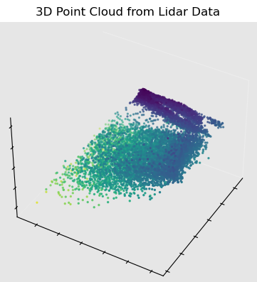
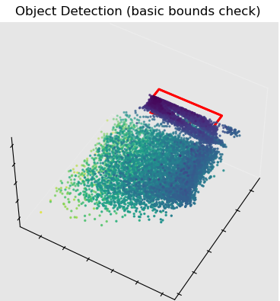
PiRail Members: Will Morong, Theo DiMambro, Jay Bazenas Project Sponsor: Jon Miner Department of Computer Science, University of New Hampshire
Introduction
This Year’s Work
Figure 3
Design diagram for the PiRail hardware and intended mobile client when used for data collection on-track
PiRail is a hobbyist toolkit consisting of data-collection and analysis software built for use with low-cost commodity hardware, ex. A Raspberry Pi. By making modern technology more accessible to everyone in the railroad industry, tons of time can be saved by avoiding potential hazards, and new innovations can be found and applied.
Discussion
Methods/Requirements
The primary goal of the project is to promote student research and innovation, especially in an underserved industry like the railroad industry. The hope is that modern technology and innovative new practices will help bring in a new generation of students and reinvigorate the field.
Other Railroad companies like Amtrak and RailPod have created similar products, showing that there is a real demand for this and there is a ton of room for growth for next years group.
We collected data live from the railroad, using the existing PiRail hardware and access to a railroad with help from our project sponsor, Jon. The type of data is stored in flat ASCII files, transferred in a modified JSON format, and it is initially stored based on the date, and then processed by using the Geo-location algorithm, which makes known locations via the longitude and latitude and railroad mileage. Then Points of interest, or POIs are created, and they contain the mileage, longitude and latitude, and pieces of metadata that help define these points.
Figure 1
Figure 2
Cleaned point-cloud from raw lidar data with all error points removed
Visualization of a frame of LIDAR data with object detection bounds
LIDAR-based 3D Object Detection
Our focus this year was on designing and implementing a method of data analysis using commodity LIDAR sensors available online for pointcloud-based object detection. In the Fall we collected real-world 3D LIDAR data taken on a railcar running on a recreational railroad. We set up obstacles on the track and took sensor readings for later work. Later, we created analysis software in Python using the custom-made PiRail data storage formats created in previous years. The visualization and analysis software was created by us this year.
TensorFlow-Accelerated AI Object Detection
We also began work on an accelerated AI pipeline for object detection in the hope that it could, in the future, run real-time on a single-board computer with a Google Coral USB TPU accelerator equipped. If this could be paired with the current local webserver, it would be possible to receive object detection information live with very little delay. Many different approaches to object detection were attempted in our research using the existing data we had. In the future, we hope that this work is expanded upon.
Conclusions
Basic Object Detection
The Basic Object detection has been our main goal this semester with the LIDAR being able to detect objects on/near the track.
Making software to help determine types of objects such as bushes or solid objects is the primary objective after.
Web Service
Use of the web service should make it easy to display data provided by the LIDAR and object detection.
Allows for live data reading with a phone for easy modification and verification.
The project success criteria will be when during testing PiRail system detects all the objects we place in front of it as well as it not producing any false positives (detecting an object that isn’t there) or at least improve upon the accuracy of the previous iteration of PiRail.
We would also like to give a huge acknowledgement to the help and knowledge we got from our project sponsor, Jon Miner. This would not have been able to be possible without his help.
.

Slide 2
This poster template provided courtesy of
UNH ESRC Poster Printing Services
Trust us to make your poster look GREAT!
Website: http://posters.unh.edu
Poster Guide: http://goo.gl/1E7TJY
DELETE THIS SLIDE BEFORE PRINTING

