Slide 1
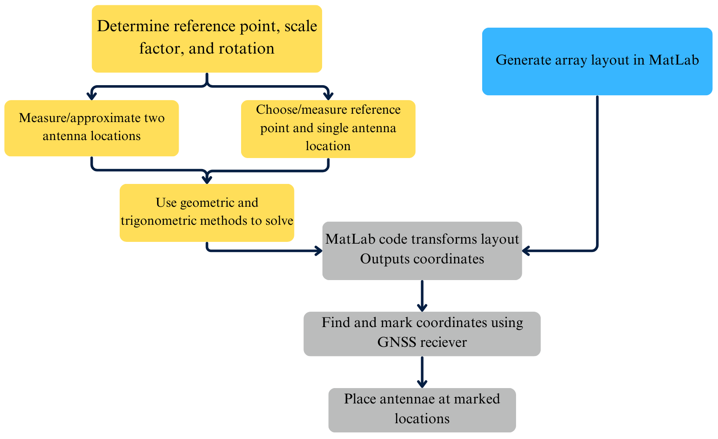
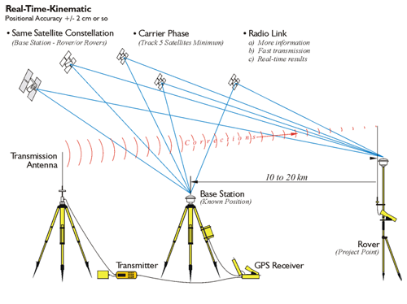
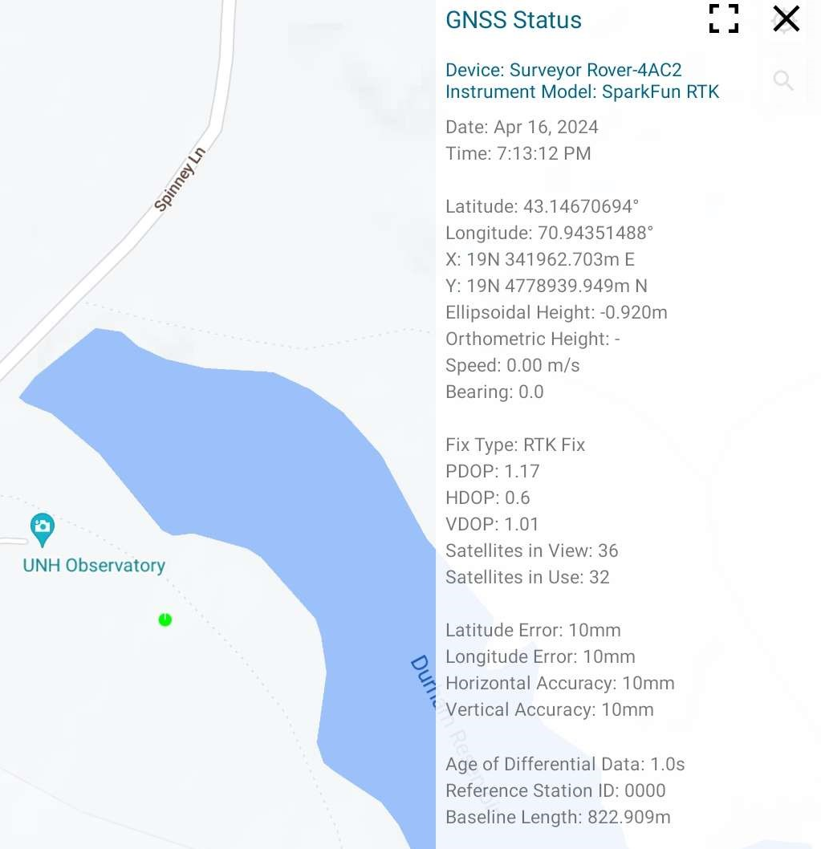
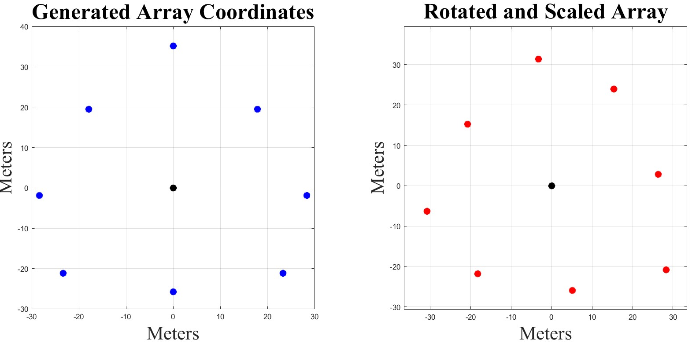
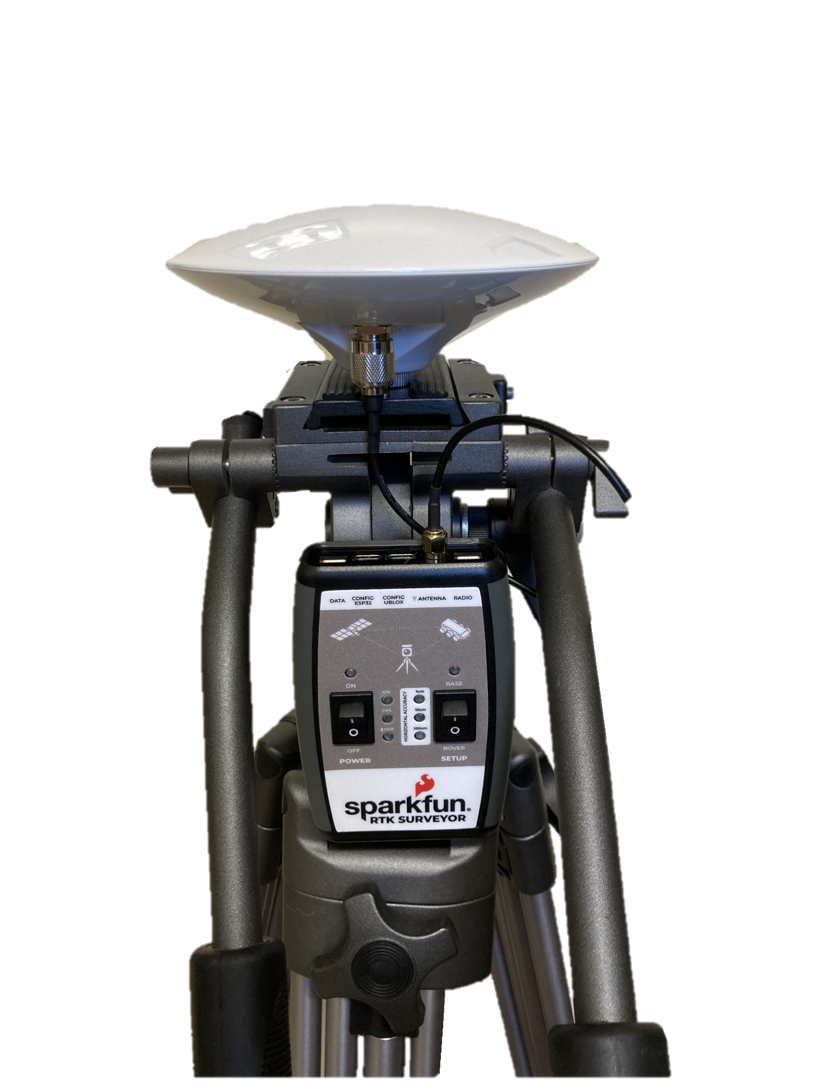
Precise Positioning an Antenna Array for Lightning Imaging
Angus Kirkpatrick, Dr. Ningyu Liu (Faculty Advisor)
Department of Physics and Astronomy, University of New Hampshire
background
methods
Results
The Radio Interferometer for Thunderstorm Studies (RIFTS) technique uses an array of eight broadband antennae to create images of lightning by analyzing the electromagnetic waves produced from ionizing the air around a lightning strike.
The positioning of these antennae is a critical factor in the resolution of the images. Both the shape and size of the array affect the resulting image. Our antennae are currently in a modified Reuleaux triangle formation, which uniformly covers the UV spectrum.
A Global Network Satellite System (GNSS) receiver with Real Time Kinematics (RTK) allows for ±0.01m horizontal accuracy in ideal conditions (Fig. 1). Our device is the SparkFun Surveyor, with an L1/L2/L5 surveying antenna (Fig. 2). RTK requires a source of positional correction data, provided by the reference station operated by the University of New Hampshire.
Using a GNSS receiver we measure a reference point/origin coordinate for the array and leading antenna direction.
The array layout is generated by a MatLab script specific to the geometry.
Using MatLab and initial measurements, we scale and rotate the array (Fig. 4), outputting cartesian coordinates (Fig. 5).
These coordinates can then be located using the GNSS receiver and marked before moving the antennae
Placing the antennae in the correct positions went smoothly, with only a few minor inconveniences. The entire process took about 1.5-2 hours including correcting errors and troubleshooting.
The absolute theoretical precision is ±0.01m in either direction, or ${10}^{−4}$ $m^{2}$, it would take several times longer to achieve. The antennae are placed within 0.01 $m^{2}$, well within our required precision.
While placing the array, the following issues were encountered:
Due to a typo, the coordinates were not exact, though only in the obsolete digits.
Physical constraints in the field resulted in the need to shift the entire array 5m west from the theoretical figure.
Mistakes in the field, resulting in the need to place some antennae multiple times.
Fig. 3. Flow chart outlining the methodology to position the methods
Fig. 1. A diagram depicting the principles of RTK by Dr. Jan Van Sickle
Materials
Fig. 4. MatLab generated Reuleaux array and rotated array.
SparkFun RTK Surveyor
L1/L2/L5 Multiband Surveying Antenna
Tripod with mounting plate and threading adaptor
Source of Radio Technical Commission for Maritime (RTCM) correction data
Mapping software (SW Maps)
Field Markers
Discussion and conclusions
The methodology is simple, cost effective, and repeatable
However, there is certainly the capacity for improvement. Primarily in finding the correct positions of the antennae.
Requires estimated locations of antennae, or measuring two locations beforehand
Could be improved by mapping the field and a grid, placing two antennae on the intersections, or computational method to automatically find maximum geometry
Bluetooth compatibility issues restrict devices to Android
Fig. 5. A screenshot of the mapping software (SW Maps) at antenna #4.
Resources
Sickle, Jan Van. Real-Time Kinematic. 2023. RTK and the Federal Communications Commission (FCC), The Pennsylvania State University, https://www.e-education.psu.edu/geog862/node/1845. Accessed 12 Apr. 2024.
Google (2024) UNH Observatory adjacent field. Available at https://www.google.com/maps. Accessed 12 Apr. 2024.
Fig. 2. SparkFun RTK Surveyor Device

