Slide 1
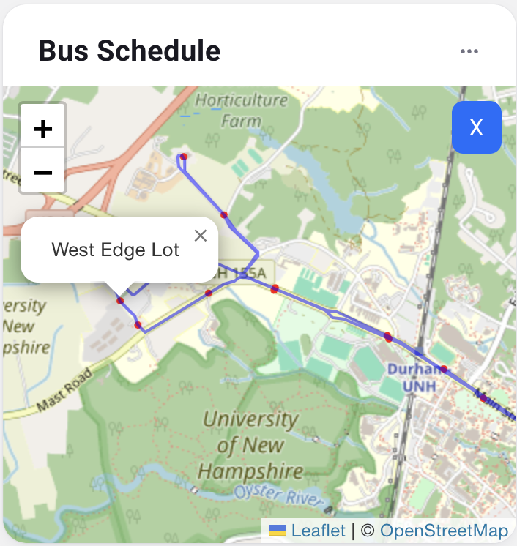
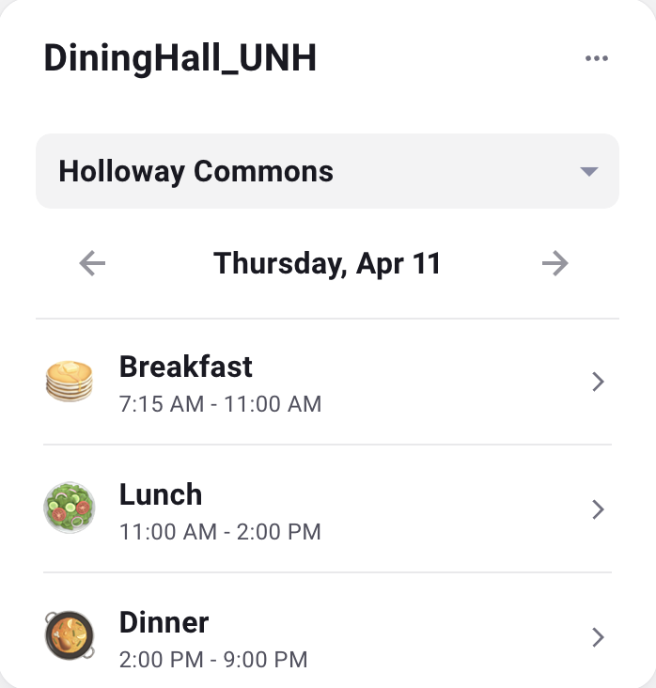
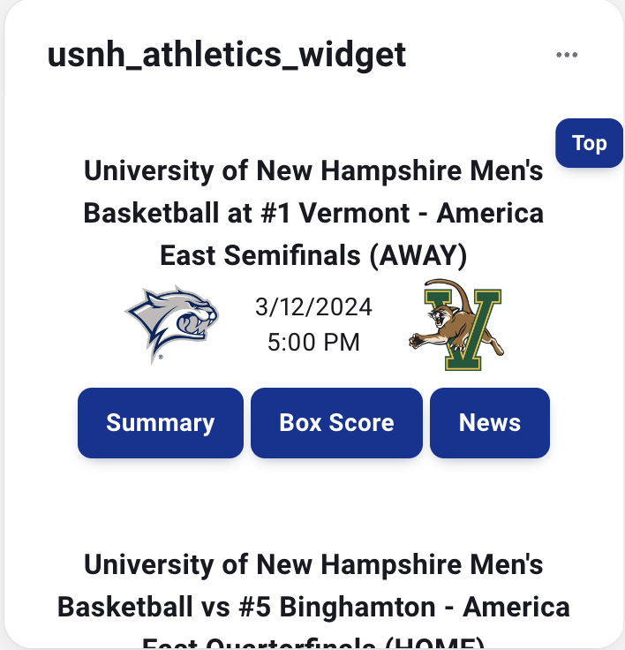
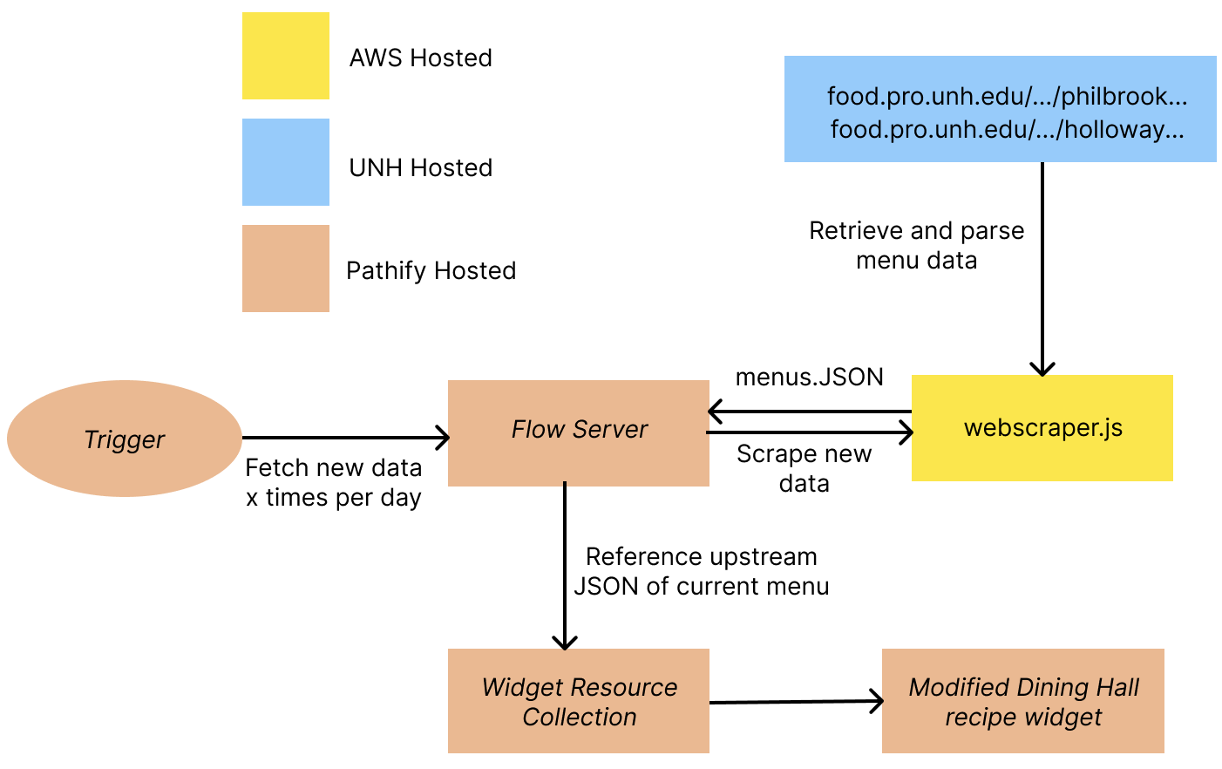
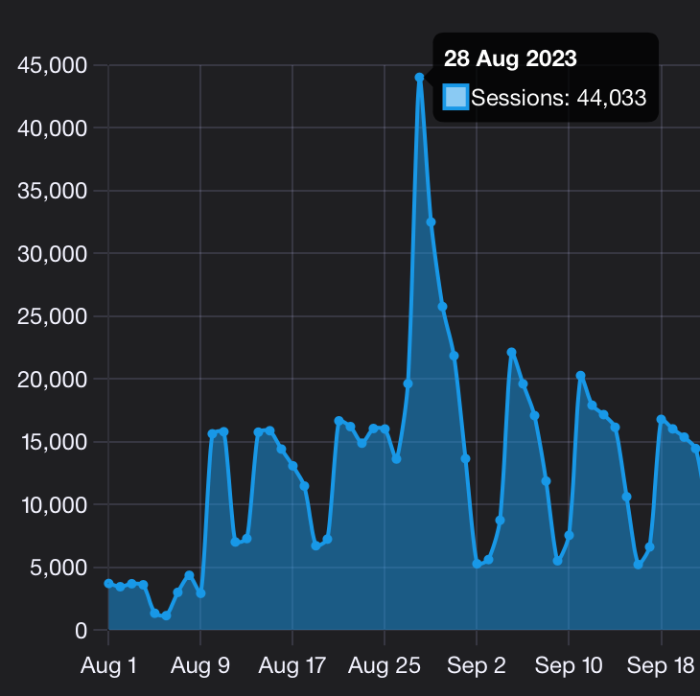
USNH myPortal Widget Development Rahul Chalumuri, Abhinav Sharma, Kaleb Crowther, Patrick O’Neil, Zach MacKenzie Department of Computer Science, University of New Hampshire, Durham, NH 03824
Introduction
UI Diagrams
Testing/Results
The USNH myPortal (“portal”) is a virtual hub for USNH students, staff, and faculty. The portal displays relevant information to users like their email and a list of “myCourses” in customizable widgets.
Our project focuses on developing new, helpful, and fun widgets for community members to engage with. Displaying this information as widgets in one central location saves users’ time and effort from having to manually access these data sources separately to obtain the same information. Data is pulled from a variety of sources, cached, and used by widgets to display the relevant information.
The developed widgets are UNH Dining, UNH Wildcat Transit, UNH Athletics, WPCR, and WKNH.
Testing was conducted on USNH’s QA portal environment and locally.
Feedback surveys will collect information from users to evaluate success of released widgets and provide the next team with important insights.
Once in production, success will be determined by the user engagement which can be quantified using traffic patterns.
The Bus Schedule Widget displays real-time bus route information from Wildcat Transit.
The Dining Hall Widget displays meal options for Holloway Commons and Philbrook.
The UNH Athletics Schedules displays the schedules of both men's and women's sports.
Requirements
Dining Hall Widget Architecture Diagram
Conclusions
Functional Requirements
Customization: Allow users to select bus routes and dining halls.
Display: Show daily dining menu, live bus location, and live sports scores/schedules.
Non-Functional Requirements
Integration: Widgets must communicate with their respective data source via API, RSS feed, or web scraper.
Security: Widgets employ authentication and authorization through Pathify.
Documentation: Create documentation to assist future students and developers.
Pathify’s “Flow Server” is where retrieved data is cached and accessed by widgets.
The Dining Widget uses AWS to execute the collection and parsing of the current day’s menus.
The Flow Server uses a custom API to retrieve this information to be called by the widget to populate its data fields.
The “resource collection” is the repository of the front-end.
The project team was divided into four groups to tackle the four development areas.
There we no security concerns and all the widgets developed maintained high quality standards.
The impact of the project was determined by the number of widgets that we were able to complete.
Future work will involve creating more sophisticated widgets and repeating developed widgets for other USNH institutions.
Overview
Measuring Value
Limitations/Challenges
Tools Used
In order to implement the requirements, we decided to create 4 distinct widgets in the form of a:
Media player which will play the radio stations from all 3 schools.
Bus widget which will grab the data from UNH’s Wildcat Transit and display a real-time map and schedule.
Dining hall menu which will display a menu for breakfast, lunch, and dinner at all 3 schools, starting with UNH.
Athletics widget which will display live scores and schedules for games.
The production environment of the myPortal can only track user sessions rather than clicks per widget making success criteria hard to analyze.
Unfamiliar technology platforms like Pathify created a steep learning curve in the development process.
Gaining access to resources from third-party vendors for data collection was slow and limited development capabilities.
Each USNH institution uses different technologies for identical services, making repeatability difficult.
Acknowledgments
Thank you to our advisor, Professor David Benedetto, our sponsors Blaise Masse and David Blezard from USNH, as well as Pathify’s technical support team.
Portal traffic can partly be used to measure project success. While success cannot be measured yet, as widgets rollout in the future, success can be gauged by increased engagement.

