Slide 1
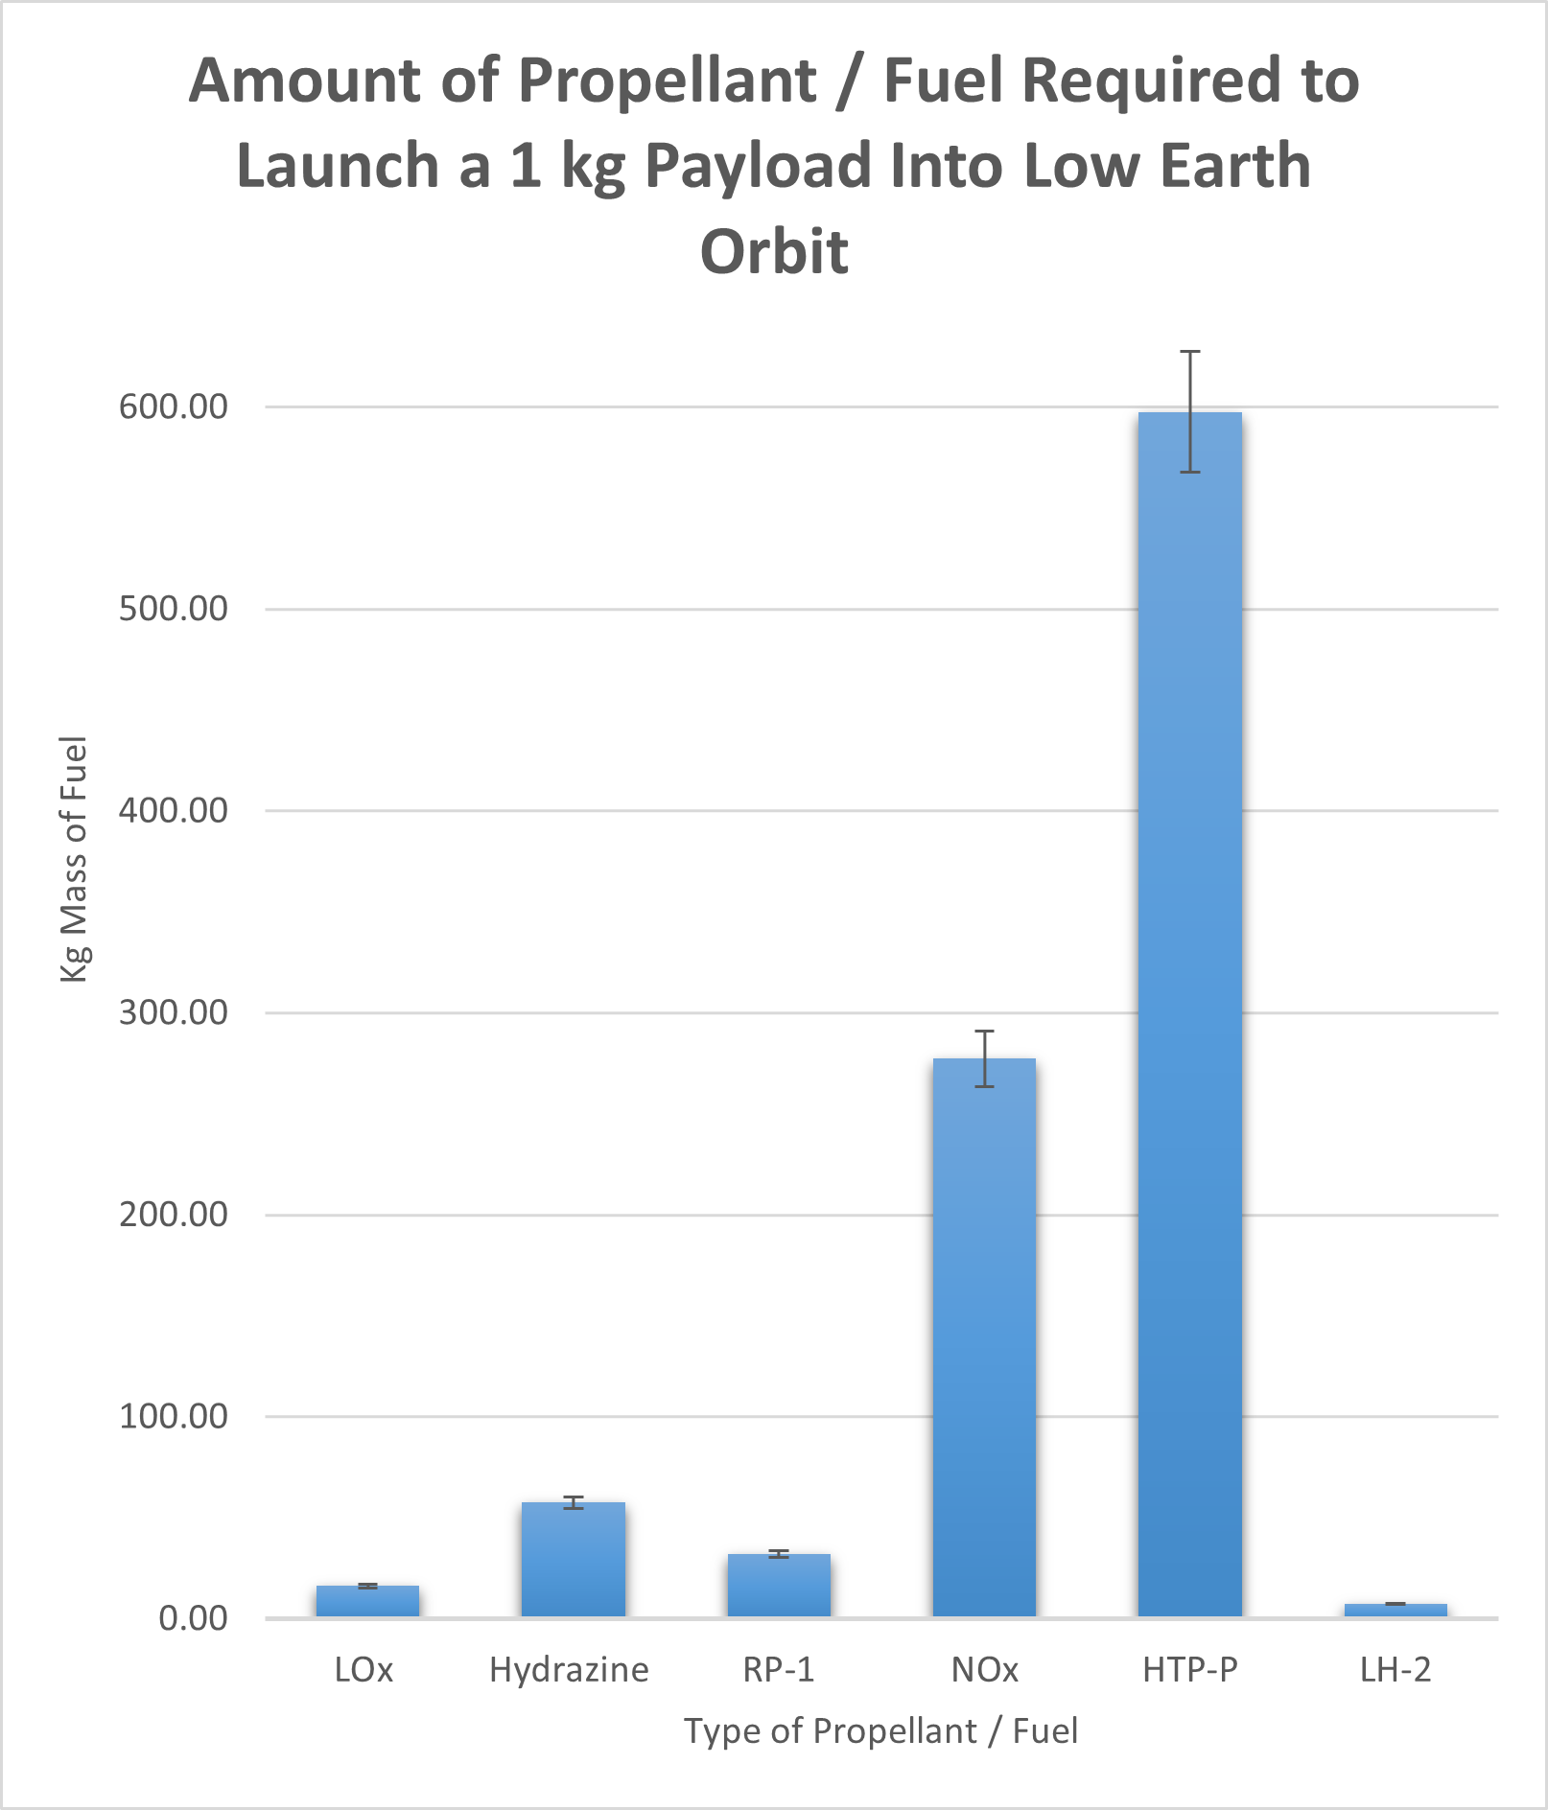
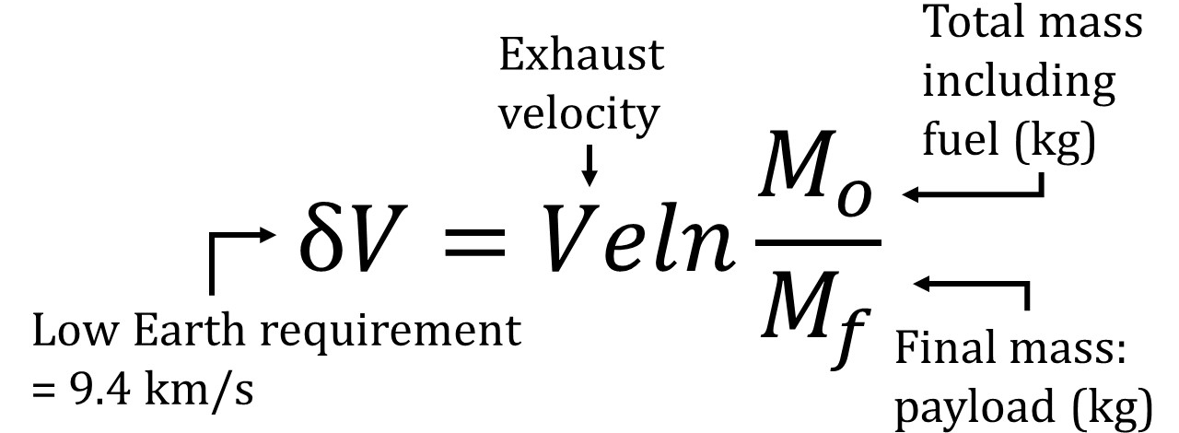
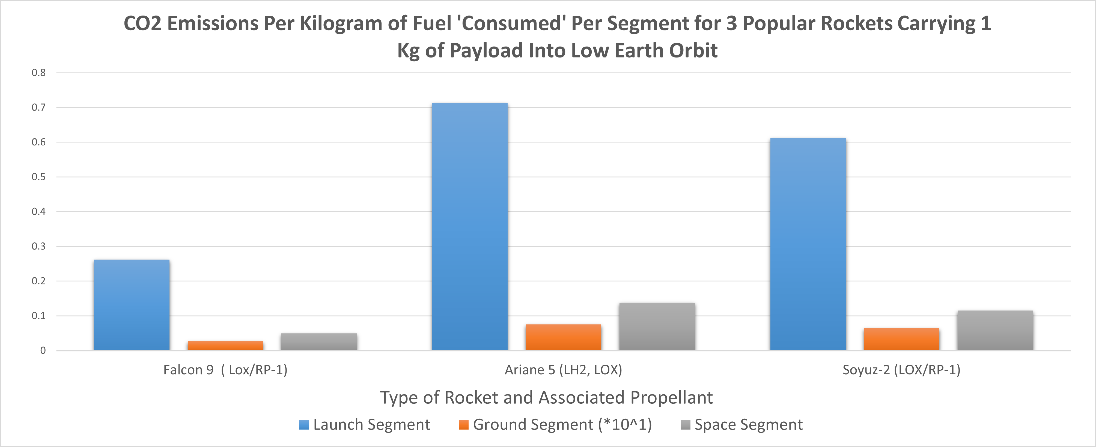
LCA of Space Missions’ Global Warming Potential Devanee Gurugé, Dr. Weiwei Mo (Faculty Advisor) Department of Physics & Astronomy, University of New Hampshire, Durham, NH 03824
Introduction
System Boundary
Propellant Emissions
Results
With an increase in space missions during the last 20 years & a growing awareness about factors that contribute to global warming it was found that space missions have minimal global warming impacts. However, within a space mission there are several factors that massively contribute to global warming, the goal was to complete a Life Cycle Analysis (LCA) of space missions and their global warming potential by investigating the following:
Use of different propellants
Factoring in all segments, from ‘cradle to grave’
Greatest global warming potential factor from each segment
The launch segment contributes the greatest to the global warming potential of space missions.
Burning of propellant during launch, creating emissions of nitrogen oxides, methane, and black carbon
84.90% of climate change potential comes from production and manufacturing of spacecraft, launcher components, and propellants.
Upon reentry into the atmosphere an average of 4.28 kg CO₂ eq are emitted per kg of initial fuel
NO_{X} is assumed the primary emission
Two fuels have the largest impact overall
RP-1 – Aerospace kerosene
LO_{X} – Liquid oxygen
Methodology
Conclusions
Completion of an LCA focusing on global warming factors in the space sector through the following steps:
Literature review
44 papers reviewed, 31 with relevant data
Detailed summary
System boundary creation
Constructed consistent definitions of mission segments (launch, space, ground) to apply across literature review
Statement of the functional unit
Serves as a basis for impact assessment calculations, in this LCA: To place a payload of 1 kg into low Earth orbit
Data analysis of emissions
Breakdown of emissions produced during launch, space, and ground segments
Conversion of emissions into CO₂ equivalents using the rocket equation
Investigation of CO₂ emissions of three popular rocket vehicles based on the segment
Calculated for base weight of rocket plus amount of fuel needed for a 1kg payload
Total global CO₂ emissions of space missions are relatively small
0.01% in 2018 based on 114 launches per year
Estimated to be 0.21% based on 750 launches per year as access to space becomes more attainable
Studies and calculations show the launch segment has the greatest impact on global warming potential on average due to burning of propellants. For the space segment, manufacturing carries the highest impact.
Spots of under-represented data points that need further investigation are the ground segment emissions during end-of-life operations.
Unit | Description | Kg CO₂ eq
Kg | Carbon Dioxide (CO₂) | 1
Kg | _{Black Carbon (BC)} | 2.38
Kg | Nitrous Oxide (NO_{X}) | 298
Kg | Carbon Monoxide (CO) | 2 – 5.3
Kg | Liquid Water (H₂0) | 0.002
Kg | Organic Carbon | -69
Kg | Methane (CH₄) | 25
sTAMD Simulations
Acknowledgements
CO₂ Emissions Combined Per Segment
A special thanks to my project advisor, Dr. Weiwei Mo for guiding & supporting me through my research, and my friends and family for their support in my educational journey.
References
Wilson , A. R. (2019). Advanced Methods of Life Cycle Assessment for Space Systems (thesis).
Neumann, S. S. (2018). (thesis). Environmental life cycle assessment of commercial space transportation activities in the United States.
Wilson, A. R., et al. (2022). Ecospheric life cycle impacts of annual global space activities. Science of The Total Environment, 834. https://doi.org/10.1016/j.scitotenv.2022.155305

