Slide 1

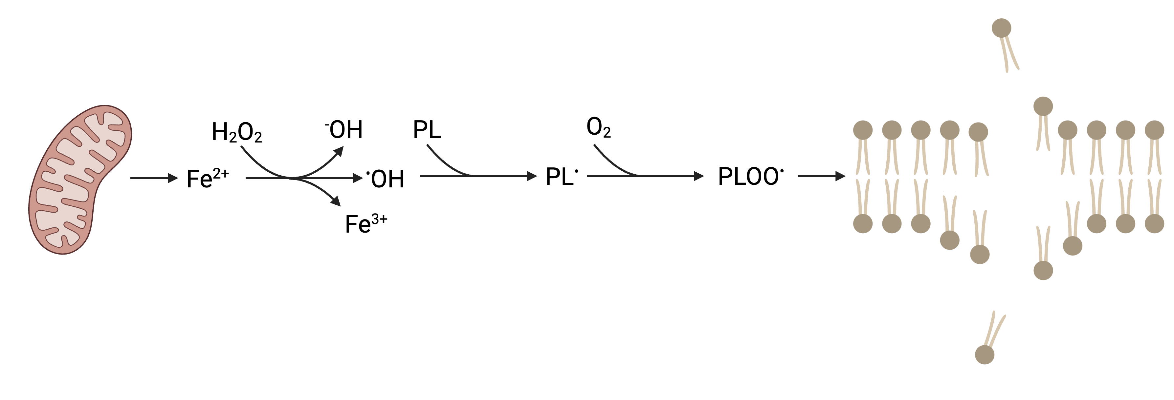
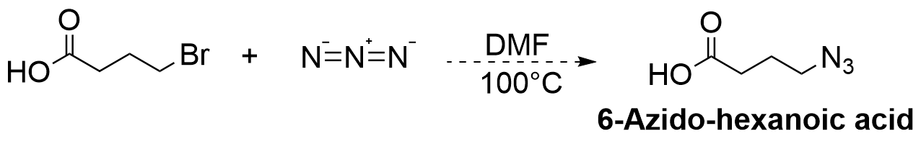
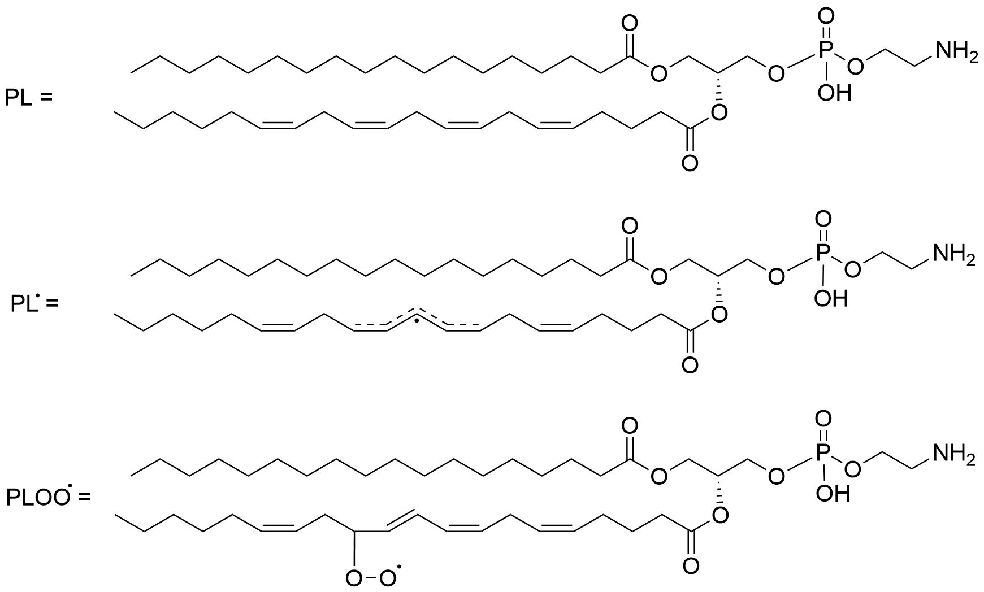
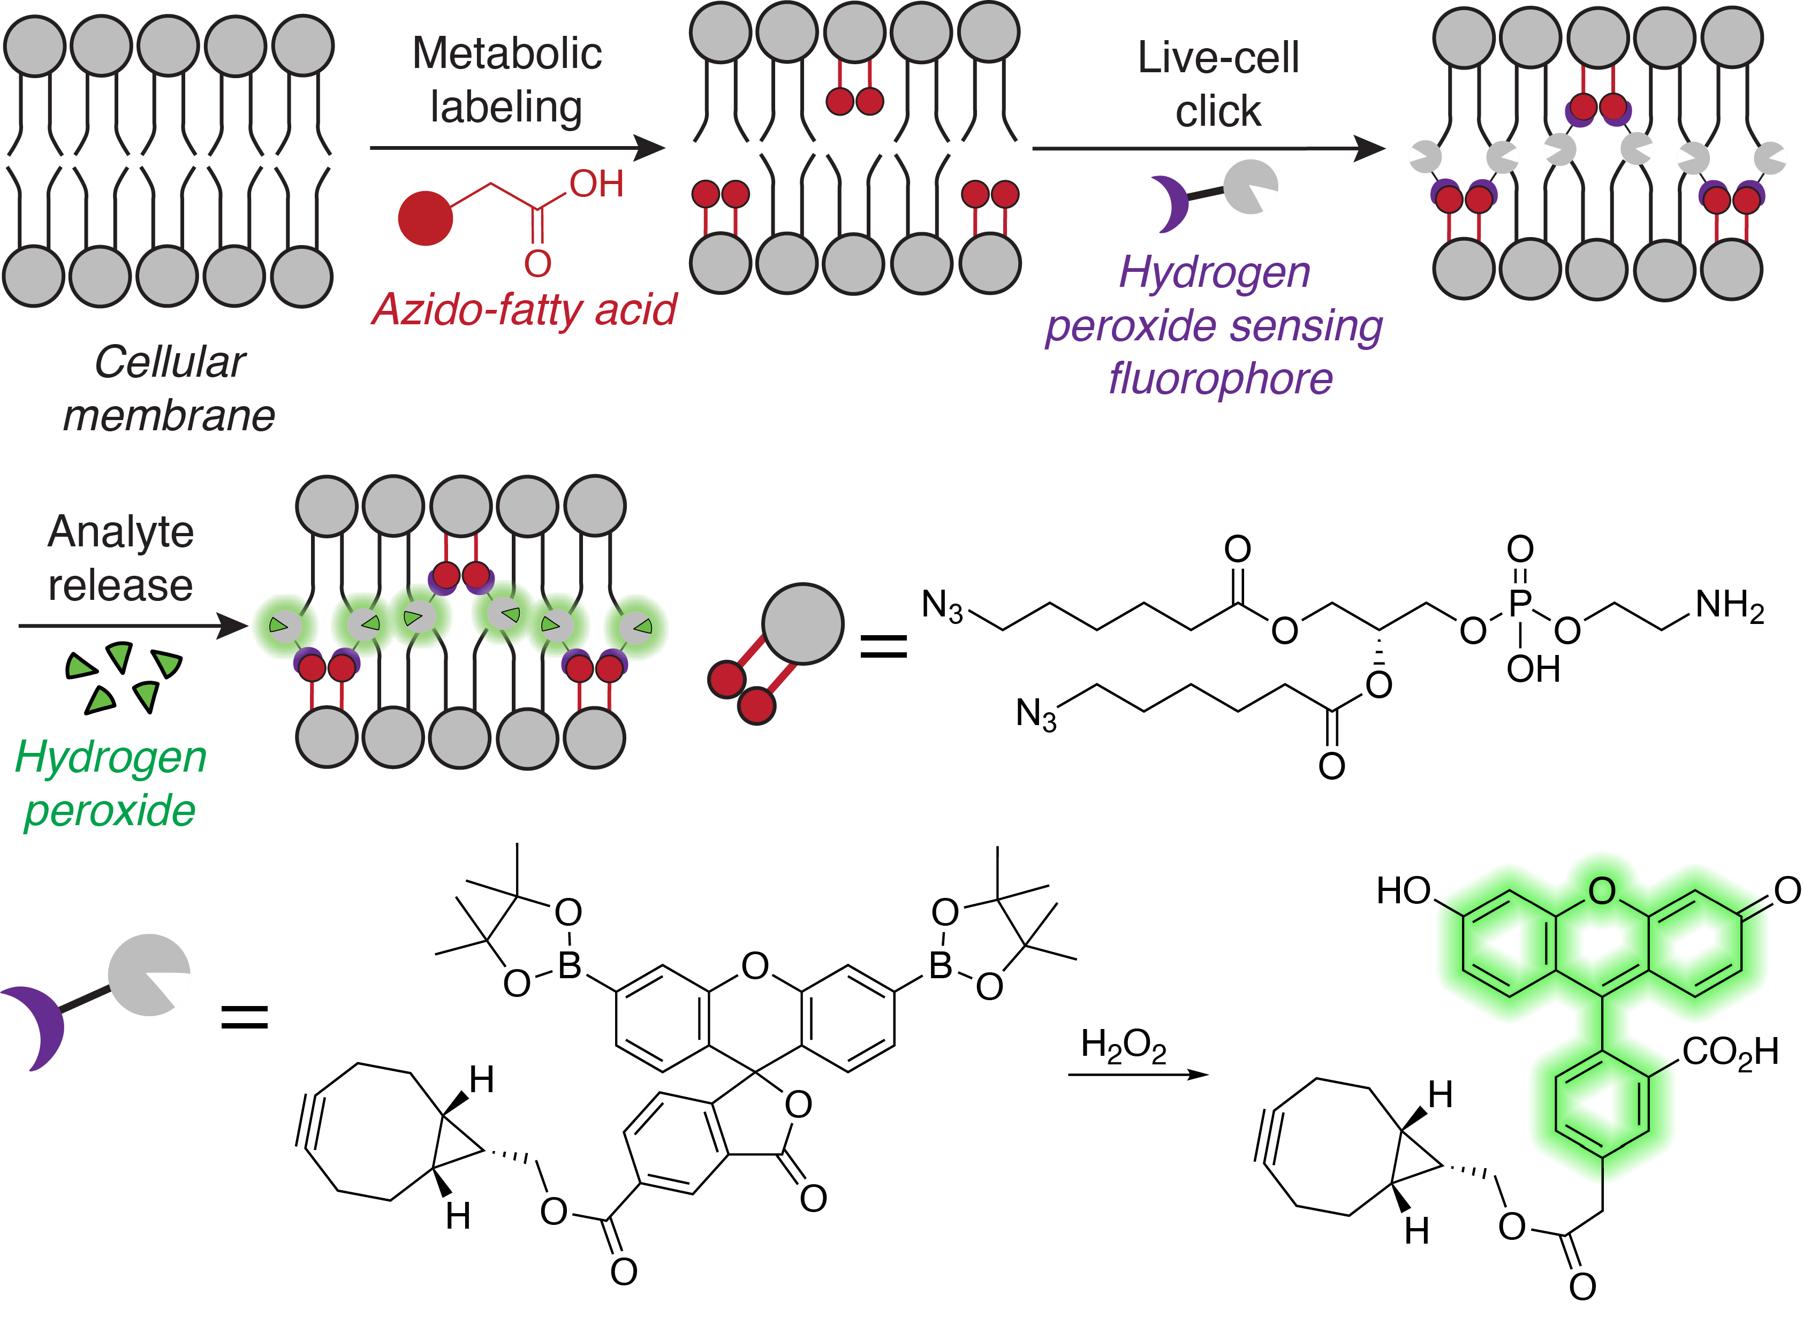

Development of a Clickable Probe for Imaging
Hydrogen Peroxide in the Bilayer
Erin E. McCarthy, Brittany White-Mathieu
Department of Chemistry, University of New Hampshire
Background
Methodology
Applications
Ferroptosis is a complex mode of cell death. Ferroptosis is triggered when reactive oxygen species (ROS) react with iron released from mitochondria.
During ferroptosis, phospholipids are destroyed resulting in membrane damage. The destruction of membrane-bound structures, including organelles, leads to cell death.
Despite its importance to cellular and organismal health, ferroptosis isn’t well understood, and more research is needed to understand the role of membranes in this form of cell death.
Organic Synthesis
6-Azido-hexanoic acid will be synthesized from 6-bromohexanoic acid and sodium azide in DMF.
Mixture will be heated to 100°C and left to run for ~16 hours at inert pressure.
The resulting organic layer will be collected, dried over sodium sulfate, and concentrated using a rotary evaporator.
Incorporation Into Cells and Imaging
6-azido-hexanoic acid will be incorporated into the membranes of HeLa cells.
Compound will be fed to cells and will be incorporated into membranes via the cells’ natural membrane building processes.
A fluorophore that fluoresces in the presence of hydrogen peroxide will be introduced and will bind to the anchor via click chemistry.
Hydrogen peroxide and a ferroptosis initiator will be added, and confocal microscopy will be used to image the cell.
  The origin and movement of hydrogen peroxide will be imaged, as well as any morphological changes in the cells’ membranes.
This foundational research will provide insight into the fundamental mechanism of ferroptosis.
  Investigational research is invaluable to our medical systems and our understanding of life.
  This research will provide a scaffold for countless further probes and investigations.
If ferroptosis is left unchecked, it can be a devastating cellular killer.
  Literature suggests that the ferroptosis pathway plays a role in diseases like Dementia, Alzheimer’s, and cancers, opening doorways for further investigation of treatments.
This research will provide insight into membrane structure and how the environment may differ inside the bilayer.
Chemical probes and fluorescent tags are essential tools in research because they allow for the tracking and visualization of molecules of interest.
  This technique is not limited to sensing analytes involved in ferroptosis; the method developed in this research will provide an improved tool for tracking a variety of analytes.
References
Chen, X.; Comish, P. B.; Tang, D.; Kang, R. Characteristics and Biomarkers of Ferroptosis. Front. Cell Dev. Biol. 2021, 9, 637162.
Dixon, S. J.; Lemberg, K. M.; Lamprecht, M. R.; Skouta, R.; Zaitsev, E. M.; Gleason, C. E.; Patel, D. N.; Bauer, A. J.; Cantley, A. M.; Yang, W. S.; Morrison, B.; Stockwell, B. R. Ferroptosis: An Iron-Dependent Form of Nonapoptotic Cell Death. Cell 2012, 149 (5), 1060–1072.
Jiang, X.; Stockwell, B. R.; et. al. Ferroptosis: Mechanisms, Biology and Role in Disease. Nat. Rev. Mol. Cell Biol. 2021, 22 (4), 266–282.
Lorendana, V.; Rita, D.S; Maria, M. F.; Giuseppe, G.; Maurizio, T.; Valentina, F.; Elena, P. HDAC Inhibitors-Based Antibody Drug Conjugates (ADCS) and Use in Therapy. Italy WO2018178060 A1, 2018.
Chang, M. C. Y.; Pralle, A.; Isacoff, E. Y.; Chang, C. J. A Selective, Cell-Permeable Optical Probe for Hydrogen Peroxide in Living Cells. J. Am. Chem. Soc. 2004, 126 (47), 15392–15393. https://doi.org/10.1021/ja0441716.
Devaraj, N. K.; Finn, M. G. Introduction: Click Chemistry. Chem. Rev. 2021, 121 (12), 6697–6698. https://doi.org/10.1021/acs.chemrev.1c00469.
Lee, C. Not So Basic Research: The Unrecognized Importance of Fundamental Scientific Discoveries. Harvard Graduate School of Arts and Sciences, SITN, 2019.
Project Introduction
The White-Mathieu Lab is developing chemical tools that shed light on the regulatory functions of membranes in ferroptosis.
This project aims to synthesize a compound that will serve as an anchor to attach a fluorophore to the inside of lipid bilayers, where ROS react with phospholipids.
Goal: Investigate the role of membranes in ferroptosis by visualizing membranes when hydrogen peroxide is produced.
Aim 1: Synthesize a molecule that can anchor a fluorophore to membranes.
Aim 2: Use the fluorescence to track production of H₂O₂ and to observe changes in membrane morphology.
Acknowledgements
The White-Mathieu lab
Dr. Brittany White-Mathieu
Paige Ring
Saghar Jarollahi
Nicholas Mixon
Taylor Stock
Kylie Armor
Funding

