Slide 1



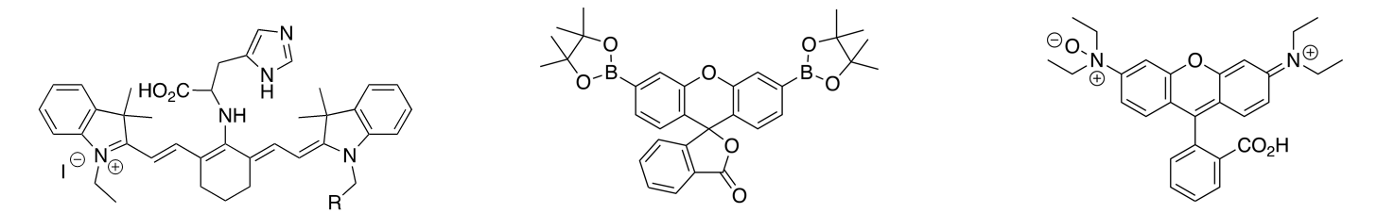
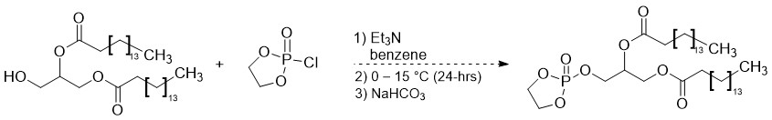

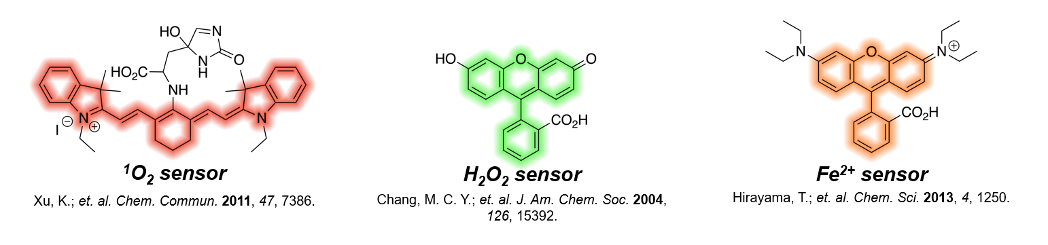
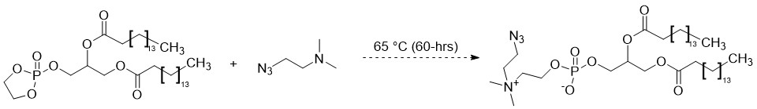
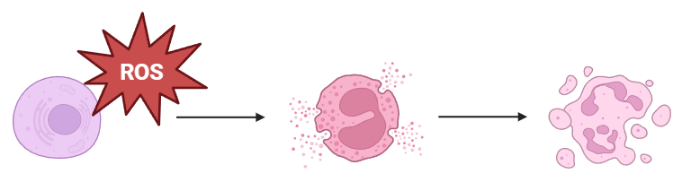
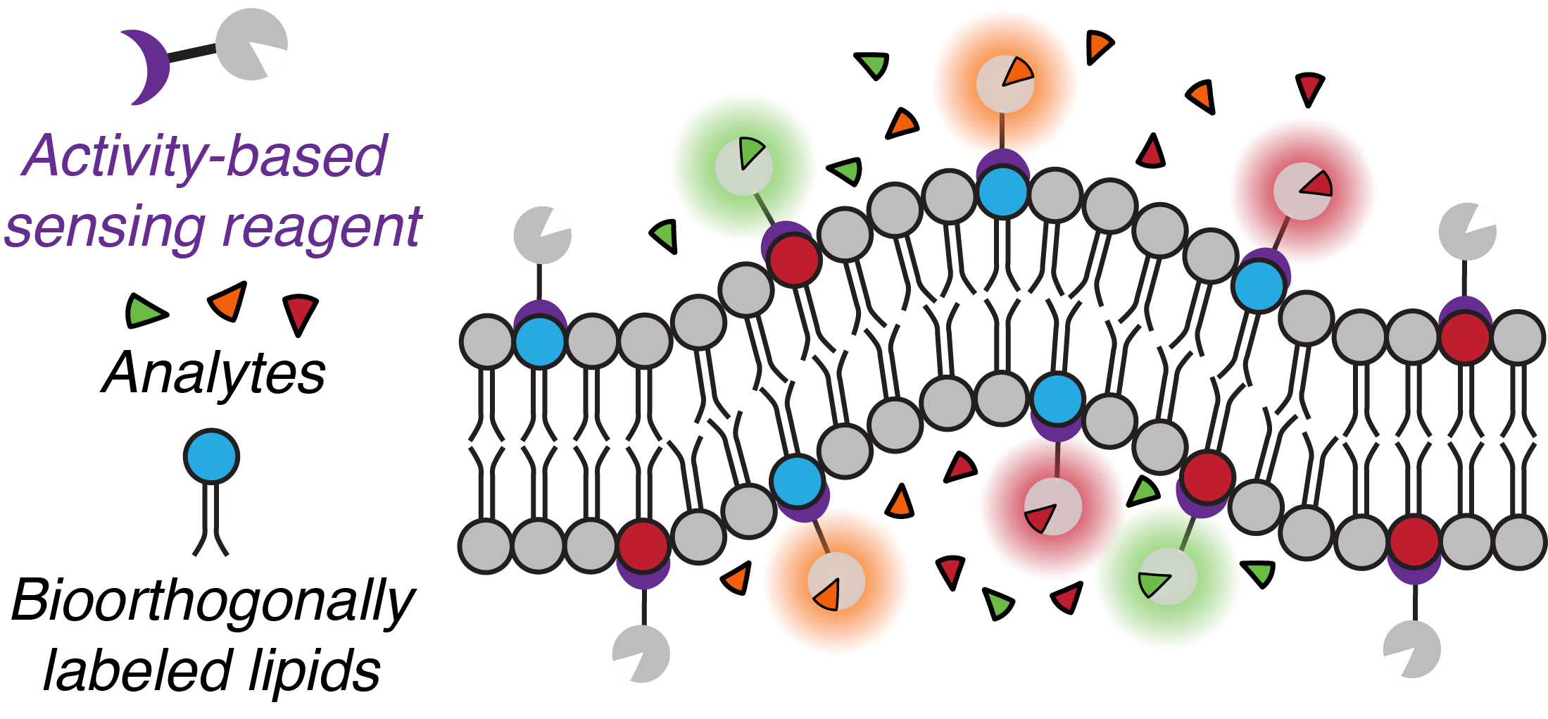
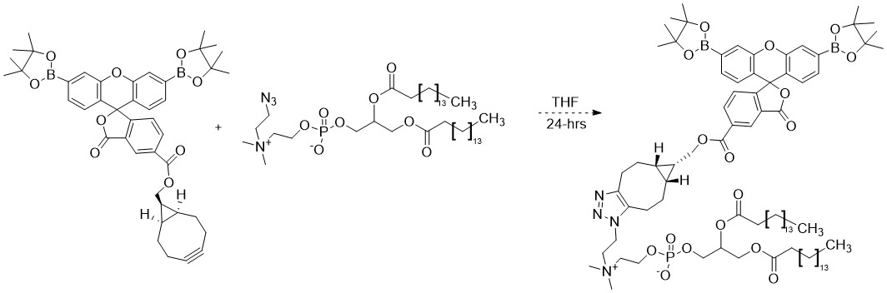
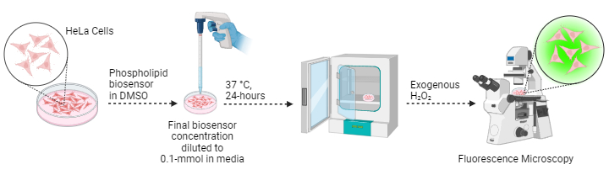
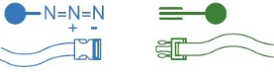
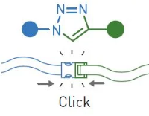

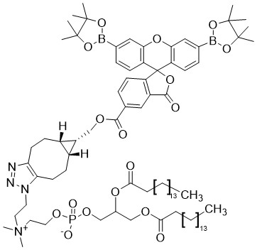
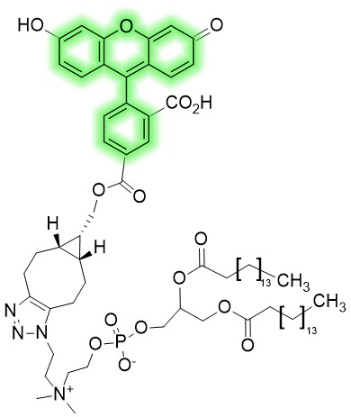
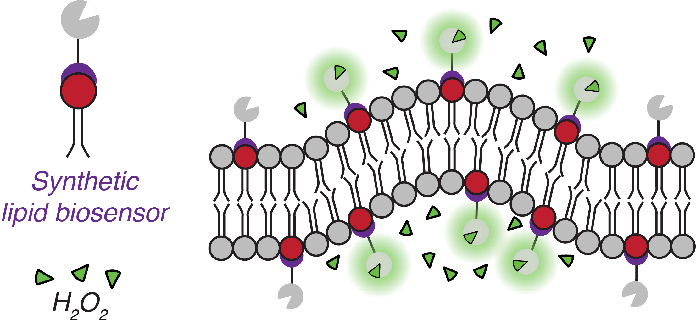

Exogenous Clickable Phospholipids for Imaging Hydrogen Peroxide
Nicholas Mixon*, Brittany White-Mathieu
Chemistry Department, University of New Hampshire, Durham, NH 03824
Nicholas.Mixon@unh.edu
Introduction
Methods^{[6-8]}
Aims
Fluorescent biosensors: molecules that undergo structural modification in the presence of an analyte of interest that enables the molecule to fluoresce.
Stage 1: Synthesis of phospholipid and azido-amine.
Characterization of fluorescent profile
- Ensure visibility.
- Observe incorporation with organelle markers with fluorescence microscopy
- Record changes in membrane structure during ROS degradation events.
Determine optimal cell delivery parameters
- Incubation time.
- Ideal sensor concentration.
- Loading mechanisms.
Stage 2: Synthesis of azide functionalized phospholipid.
Compare synthetic phospholipid biosensor to alternative azido-choline digestion method
- Quantify fluorescence.
- Determine localization.
Future Directions
  Reactive oxygen species (ROS), such as H₂O₂, degrade cellular membranes and result in eventual cell death.
Incorporation
of various sensors for characterizing membrane degradation.
Stage 3: SPAAC “click” reaction of biosensor and synthetic phospholipid.
[4.]
Oxidative damage caused by H₂O₂,and other ROS are connected to:
Aging
Cancer
Cardiovascular Disorders
& Neurodegenerative Diseases
[2.]
Characterization of membrane degradation events is of fundamental importance for understanding disease.
Extensive lipid peroxidation induces cell death by Ferroptosis. Iron (III) serves as an oxidant for the conversion of hydrogen peroxide to a hydroxyl radical, thus, becoming reduced to Fe²⁺. The subsequent oxidation of this reduced species then drives peroxidation of polyunsaturated fatty acids (PUFAs), degrading membranes cell-wide. [9.]
Fluorescent biosensors are uniquely poised to achieve both detection of hazardous substrates and characterization of membrane structure by illuminating areas where the analyte is present.
Stage 4: Biosensor integration into HeLa cells, subsequent exogenous H₂O₂ activation, & characterization.
We aim to characterize membrane decomposition with the use of these anchored fluorescent biosensors.
Acknowledgments
White-Mathieu Lab:
Paige Ring
Saghar Jarollahi
Erin McCarthy
Taylor Stock
Nicholas Mixon
Brittany White-Mathieu
Funding Generously Provided By…
Special thanks to:
Nayanthara Krishnan
&
Charles Wilson for their help in understanding key concepts.
[5.]
[4.]
Recent advances in biorthogonal click chemistry enable us to affix biosensors directly to individual phospholipids through strain promoted azide-alkyne cycloaddition (SPAAC). These phospholipids can then be incorporated into the membranes of live cells. [6-7]
&
Synthetic lipid biosensors integrate with natural phospholipid membranes
& await contact with the species of interest.
References
[1.] Hirayama, T.; Okuda, K.; Nagasawa, H. Chem. Sci. 2013, 4 (3), 1250. https://doi.org/10.1039/c2sc21649c.
[2.] Chang, M. C. Y.; Pralle, A.; Isacoff, E. Y.; Chang, C. J. J. Am. Chem. Soc. 2004, 126 (47), 15392–15393. https://doi.org/10.1021/ja0441716
[3.] Xu, K.; Wang, L.; Qiang, M.; Wang, L.; Li, P.; Tang, B. Chem. Commun. 2011, 47 (26), 7386. https://doi.org/10.1039/c1cc12473k.
[4.] Biorender. https://www.biorender.com
[5.] Nobel Prize, Chemistry 2022. https://www.nobelprize.org/prizes/chemistry/2022/popular-information/
[6.] Alamudi, S. H.; Satapathy, R.; Kim, J.; Su, D.; Ren, H.; Das, R.; Hu, L.; Alvarado-Martínez, E.; Lee, J. Y.; Hoppmann, C.; Peña-Cabrera, E.; Ha, H.-H.; Park, H.-S.; Wang, L.; Chang, Y.-T. Nat Commun 2016, 7 (1), 11964. https://doi.org/10.1038/ncomms11964..
[7.] Gutierrez, B.; Aggarwal, T.; Erguven, H.; Stone, M. R. L.; Guo, C.; Bellomo, A.; Abramova, E.; Stevenson, E. R.; Laskin, D. L.; Gow, A. J.; Izgu, E. C. iScience 2023, 26 (12), 108567. https://doi.org/10.1016/j.isci.2023.108567.
[8.] Jao, C. Y.; Roth, M.; Welti, R.; Salic, A. EuChemS, ChemBioChem, Volume 16 (3), pp. 472-476, January 13 2015. https://doi.org/10.1002/cbic.201402149.
[9.] Jiang, X.; Stockwell, B. R.; Conrad, M. Nat Rev Mol Cell Biol 2021, 22 (4), 266–282. https://doi.org/10.1038/s41580-020-00324-8.
Reactivity results in Fluorescence.
Reaction of the boronate and peroxide results in a structural change of the sensor, wherein, conjugation is increased resulting in a fluorescent emission in the 500 to 550-nm range which may be detected via fluorescence microscopy.

