Slide 1


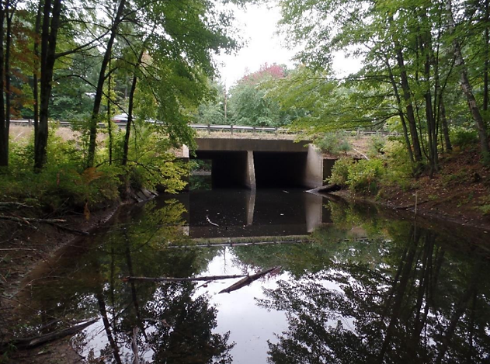
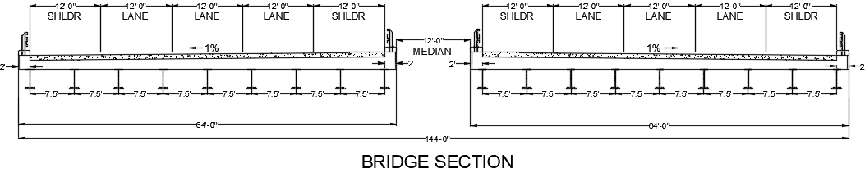
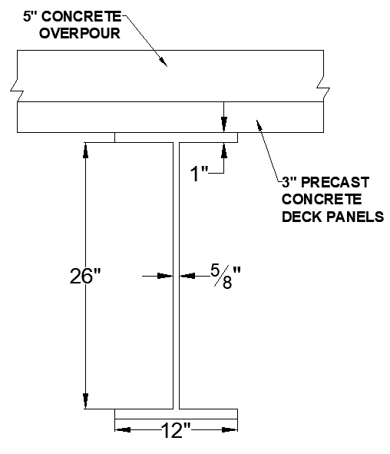
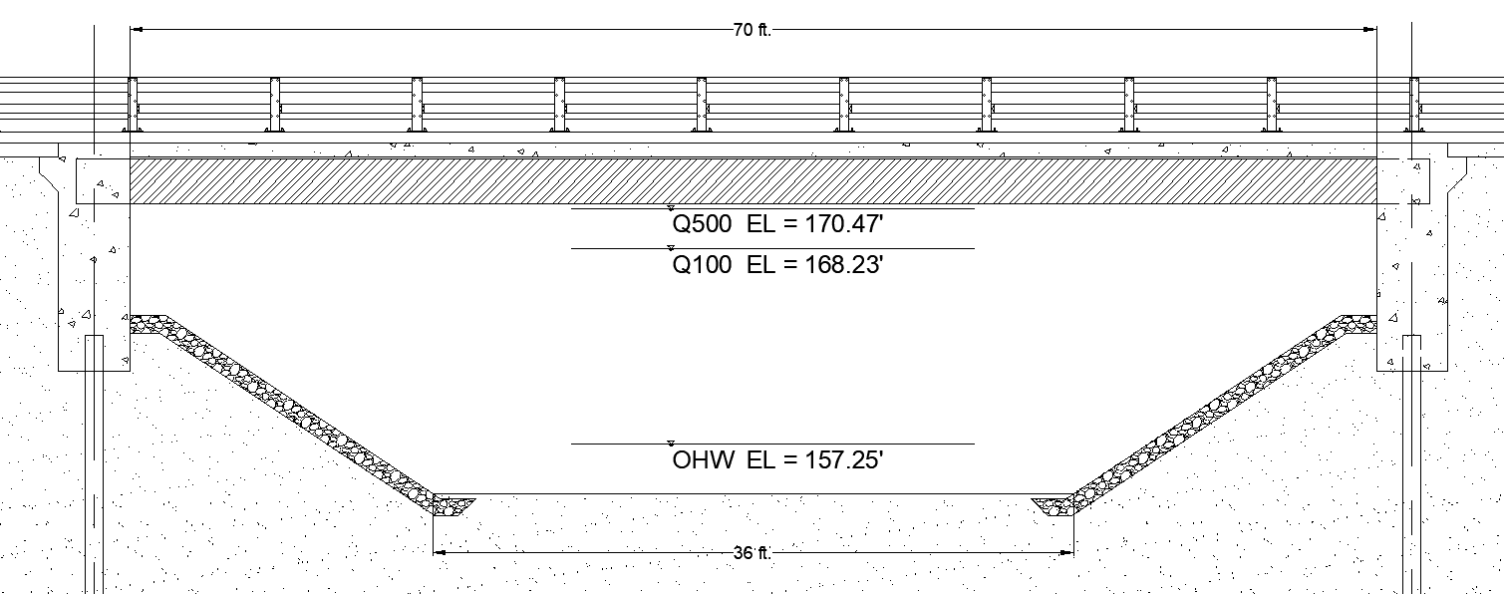
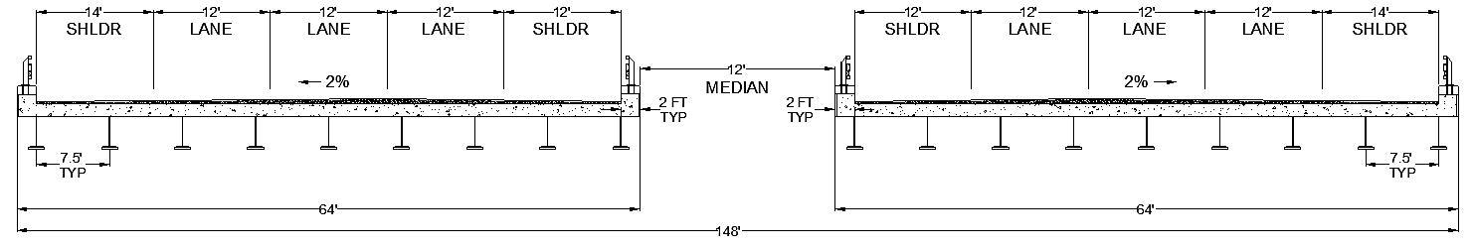
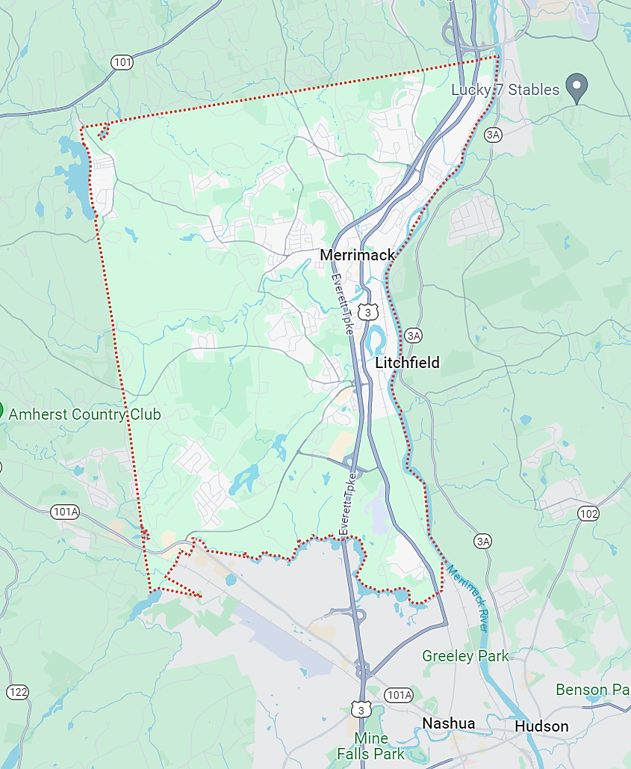
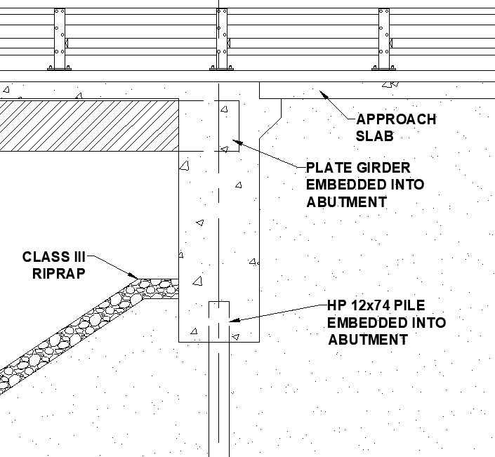
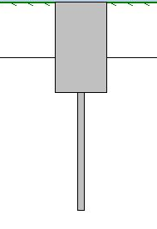
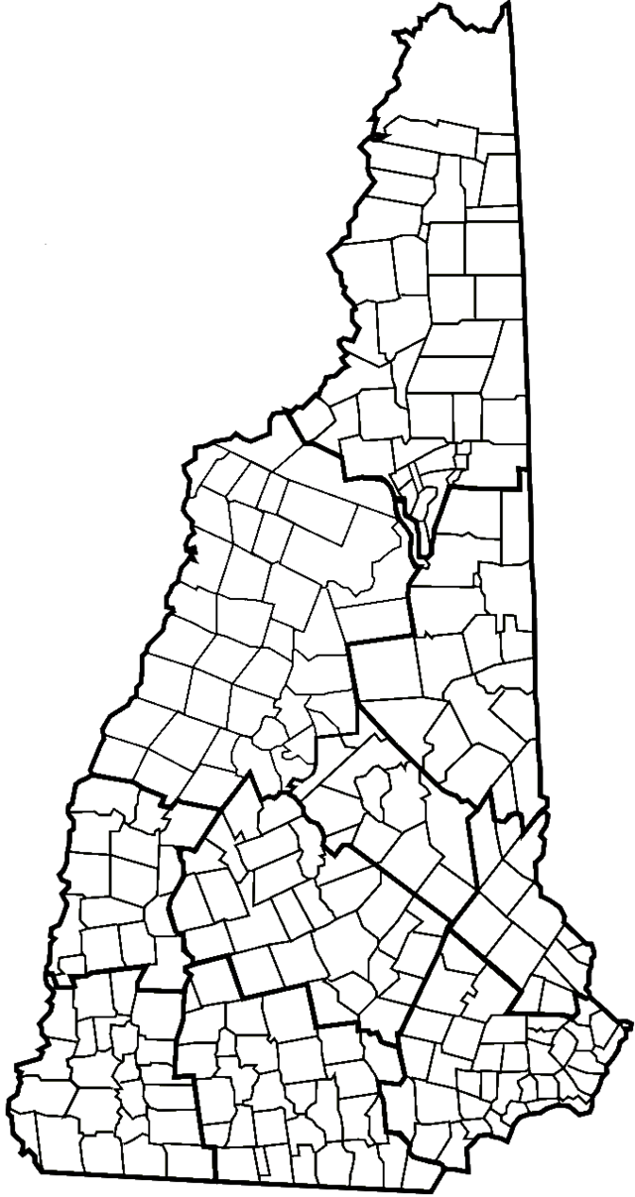

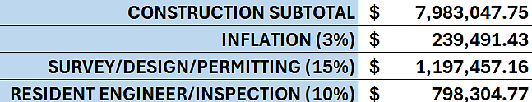
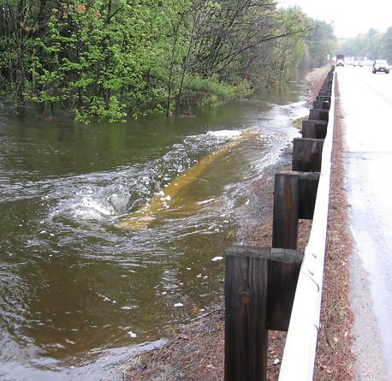
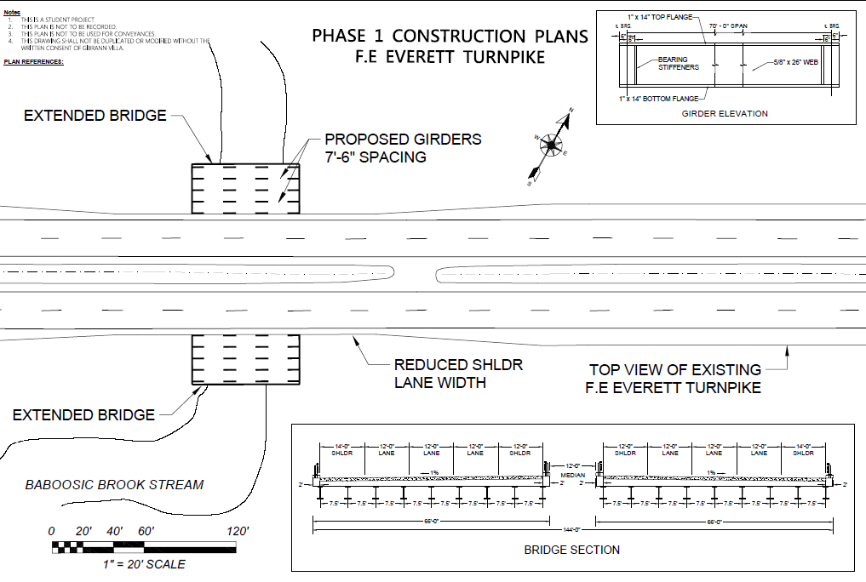
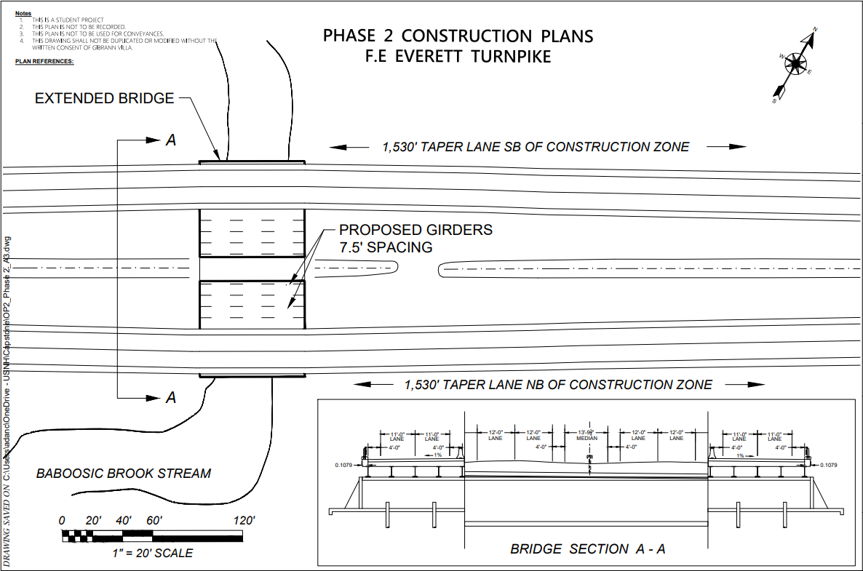
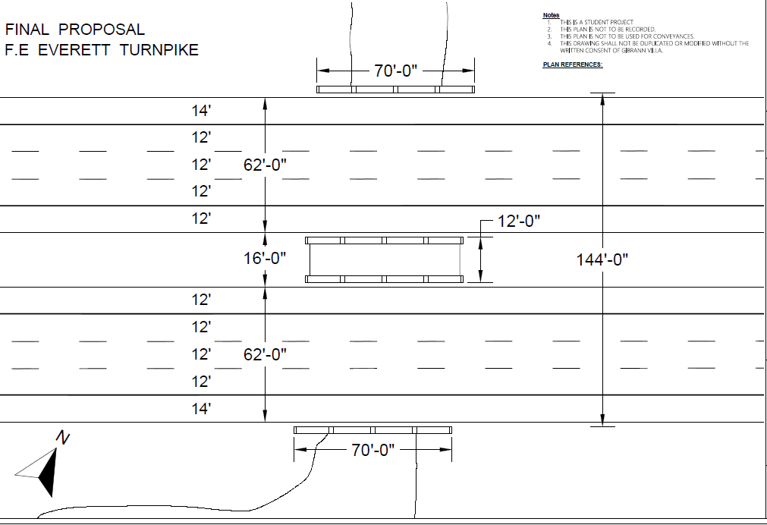
l.
Bridge Replacement of the F.E. Everett Turnpike Over Baboosic Brook
Austin Leborgne, Ryan Miller, Gibrann Villa, Ellie Massie
Civil and Environmental Engineering Department
University of New Hampshire, Durham, NH 03824
Project Background
Composite Welded-Steel Plate Girder
Hydraulic Analysis
Existing Structure
Located in Merrimack, NH over Baboosic Brook
Carries Four Lanes of Travel on the Everett Turnpike
Twin Cell Box Culvert
30 ft Span
Constructed in 1954
Condition Rating – 7
Figure 4 – Cross-section of Proposed Bridge
Design Results
Twin Bridges for management of 70,000 ADT
Composite Deck for adequate strength over 70 ft span
Composite Section Capacity – 2824 k-ft > 2402 k-ft Moment Demand
Plate girders were selected because of their flexibility of construction, durability, and longevity. The ability to minimize web depth was critical in minimizing any increase in roadway grade and meeting hydraulic capacity requirements.
Figure 11 – Proposed Hydraulic Opening
Figure 1 – Downstream of F.E.E.T. Culvert
USGS StreamStats determined bankfull width (w_{b})
NH Stream Crossing Guidelines determined minimum required bridge width
Passes 100 and 500-year flood capacity and freeboard requirements
Area_{Proposed} = 980 ft.²
The existing culvert must be replaced with a larger bridge that supports the flow of Baboosic Brook. As part of a larger effort to widen the F.E. Everett Turnpike in NH, the proposed bridge must also support three lanes of traffic in each direction.
Figure 5 – Deck and Girder Section
Site Location
Integral Abutment/Steel H-Pile Foundation
Preliminary Cost Estimate
Manchester
Why Use Integral Abutments?
Does Not Require Bridge Joints
Reduces Future Maintenance Costs
Greater Durability
An integral abutment is a fixed connection between the supporting members of the superstructure and a pile supported substructure. The girder ends are encased into the abutment to create the connection. The abutment is supported by a single row of piles extending down to the designed depth.
$ 1,330,508
Project
Location
Figure 12 – Pie Graph of Construction Costs by Category
Nashua
Table 1 – Total Estimated Construction Costs
Figure 2 – Locus Map of Project Location
Figure 6 – Elevation View of Proposed Integral Abutment
Figure 7 – L-Pile Output
Deliverables/Constraints
Traffic Control - Phased Construction
Acknowledgements
Deliverables
Design hydraulic opening that supports flow of Baboosic Brook
Redesign roadway to support three lanes of traffic in each direction
Superstructure Design
Substructure Design
Traffic Control Analysis
Preliminary Cost Estimate
We would like to thank our Sponsor, McFarland Johnson, and specifically Chris Gagne, PE for their time and assistance during every step of the project. Faculty Advisors Dr. Erin Bell, PE and Matthew Low, PE contributed greatly with their guidance and expertise on bridge and roadway design. In addition, we would like to express our gratitude to Dr. Fei Han for his counsel on pile foundation design.
References
Figure 8 - Phase I Traffic Diversion
Figure 9 - Phase II Traffic Diversion
Figure 10 - Proposed Final Roadway
AASHTO LFRD Bridge Design Specifications (7th ed.). (2014). American Association of State Highway and Transportation Officials.
State of New Hampshire. (2018). Chapter 2 Bridge Selection. Department of Transportation Bridge Design Manual.
Figure 3 – Overtopping of Culvert
Phase I
Construct outer three bridge lanes
Traffic uses existing lanes
Existing shoulder will be reduced for construction
Phase II
Taper existing lanes onto newly constructed bridge
Construct inner two lanes
Finished Bridge
3 lanes in north/southbound directions
144 ft out-to-out
Two lanes of traffic must remain open during construction and any raising of existing roadway grade must be limited to avoid additional highway reconstruction costs.

