Slide 1
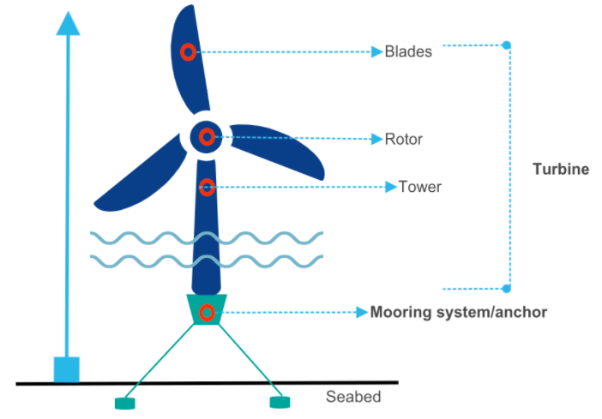
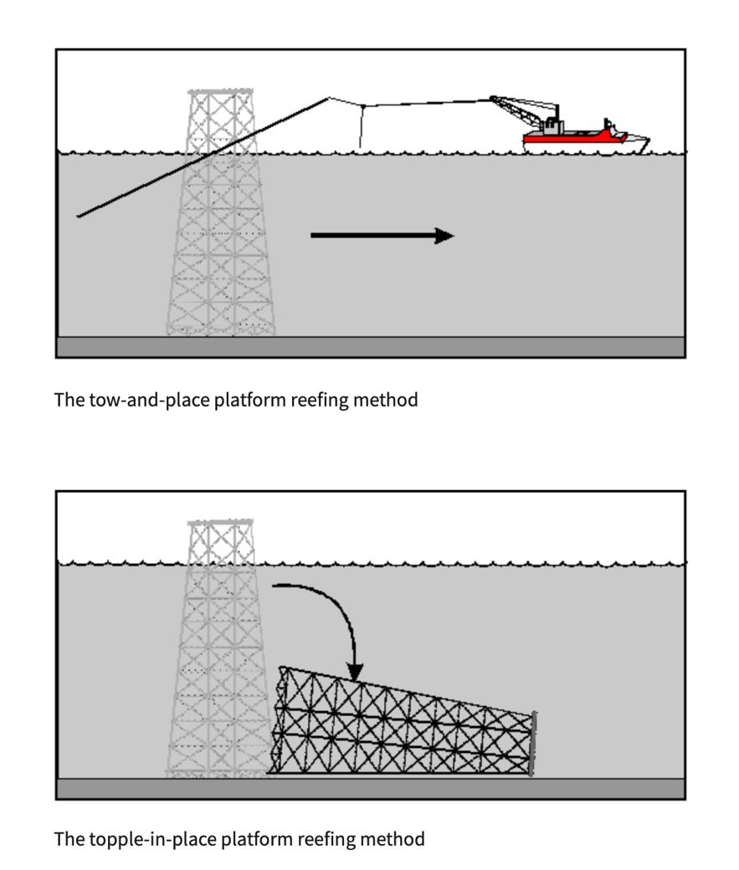
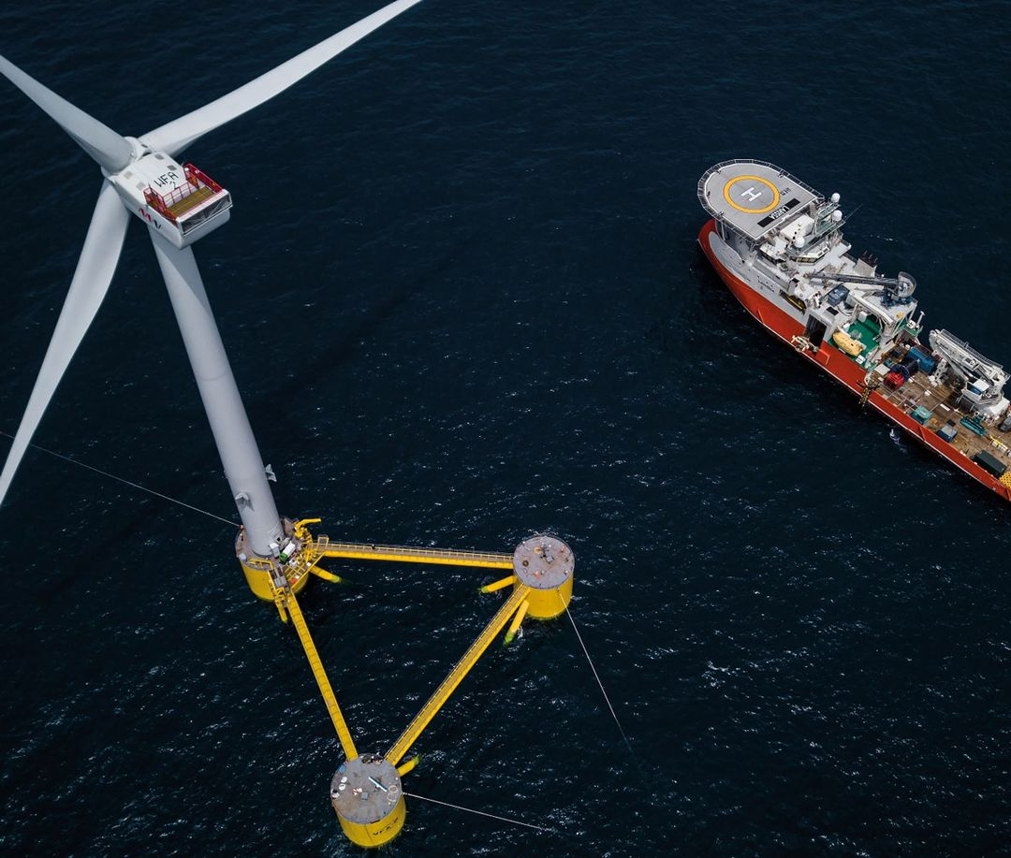
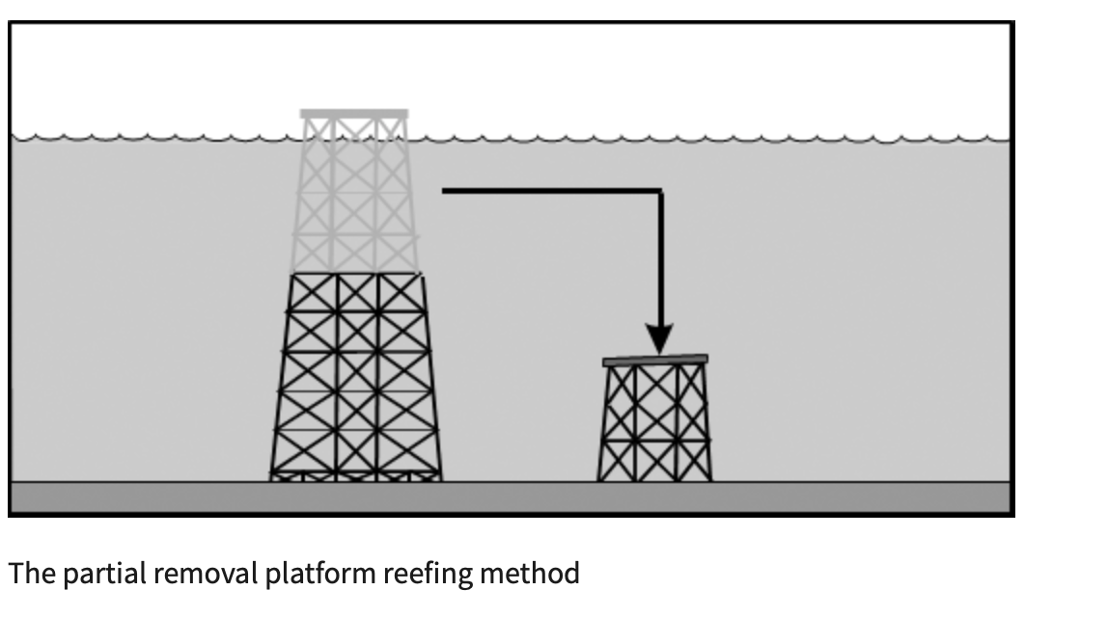
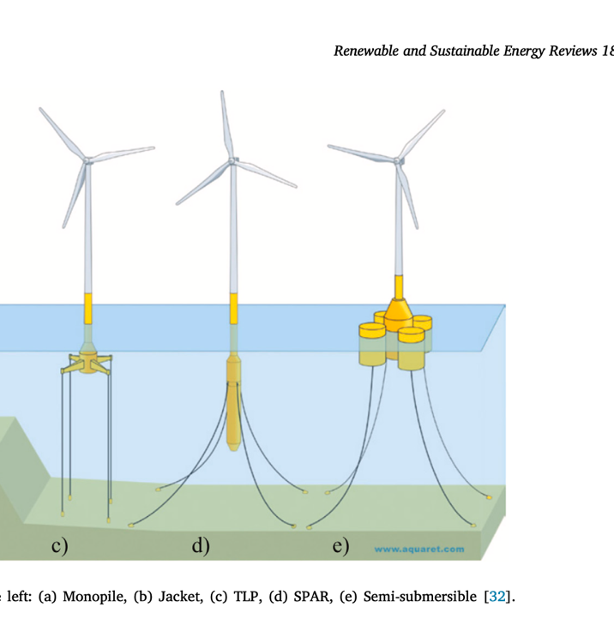
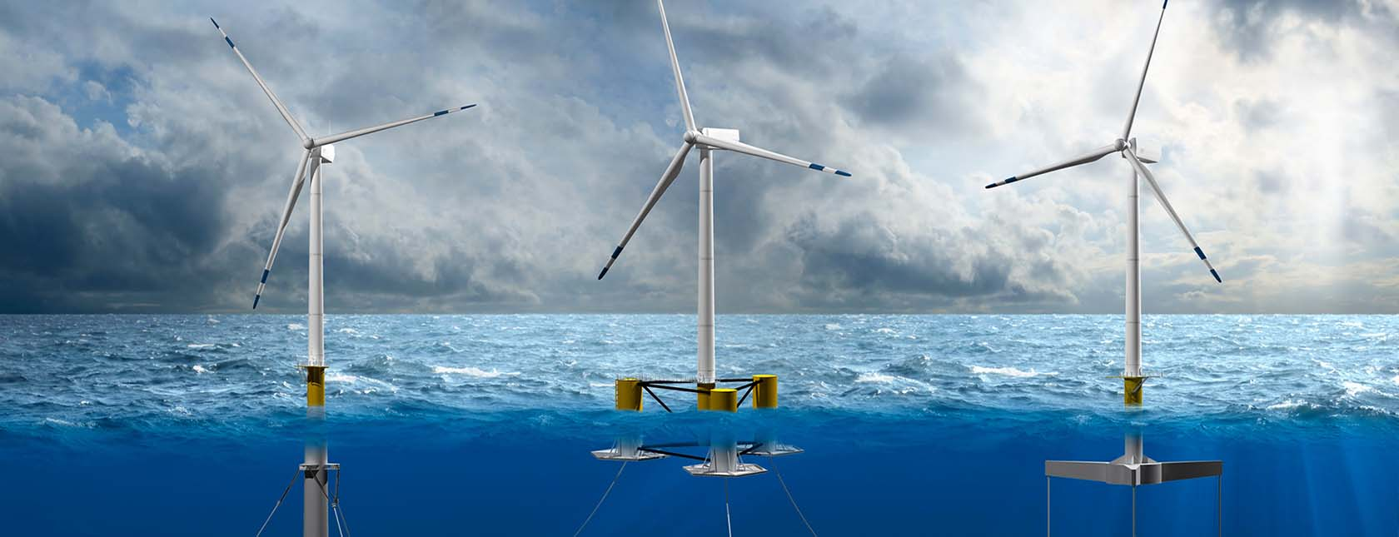
Floating Offshore Wind Turbine Analysis
Payton Maddaloni, Department of Engineering and Physical Science, University of New Hampshire
Introduction
Types of Traditional Platforms
Operating Consideration
End of Life Consideration
More Discussion Text….
The floating offshore wind turbine (FOWT) industry is making strides across the globe. Considerations in different life cycle phases are either addressed or have the potential to be optimized
Tension Leg
Benefits | Challenges
Light weight | Complex mooring system
Construability off or on shore | More expensive
Small seabed footprint | High operational risk
End of their operational life has been seen as an issue for the long term. Many end-of-life scenarios have not been realistically tested but can follow a similar approach to the oil and gas industry
Due to the remoteness, rough sea conditions, and logistic challenges, O&M takes up 20-35% of lifecycle costs
Maintenance
Rigs to Reefs
Platforms may be sunk in approved places by the Regional Supervisor to create an artificial reef for marine life
Trans Costs:
Transportation
Labor
Spare Parts
Invisible Costs:
Production losses (PL)
Spar System
Benefits | Challenges
Low operational risk | High installation cost
Simple fabrication process | Specialized vessel required
Handle severe sea conditions | Large seabed footprint
PL Study
Background
Cradle to Gate Limitations
27 4MW turbines
Eleven turbines must be repaired within the next 3 days
2 vessels and 19 technicians can be used to perform the maintenance
Obtaining a Permit
Semi-Submersible
Benefits | Challenges
Minimal risk to operation | Non-industrialized manufacturing
Heave plates limit overturning | Built in one piece requiring additional facility
Insensitive to soil conditions | Long lead times
State legislators are putting laws in place to suppress the federal permission
A study in the spring of 2023 from Columbia University’s Sabin Center for Climate Change found a 35 percent increase in local ordinances restricting renewable energy development
Cases
Proposed Method: considering PL, prioritizing most damaged
Method One: PL not considered
Method Two: considering PL, two vessels separated to service each cluster
Workforce
Construction requires tradesman looking to develop a new craft within a niche market
ReVision Energy offers apprenticeships for new employees, encouraging them to get their electrician license
Currently, there are 515 platforms converted into reefs in the Gulf of Mexico. This method can be translated over into floating offshore wind farms. Rigs to Reefs has the potential to minimize labor and transportation costs. Overall, lowering the global warming potential and levelized cost of energy
Result and Conclusions
Supply Chain
Competition with the electric car market for materials
Massive wait times for critical items like panel boards and disconnect switches
United States is attempting to gain independence back from China, limiting the amount of growth
PL is a large portion of the overall efficiency of a wind farm. The proposed method was the cheapest due to the routes of the vessels and technicians being properly planned by observing the data of each turbine. In conclusion, PL is a variable within O&M that must be considered and tested when building a new offshore wind farm
References
Feng, J., Car, H., Liu., & Lee, J. (2021). A Systematic Framework for Maintenance Scheduling and Routing for Off-Shore Wind Farms by Minimizing Predictive Production Loss. E3S Web Conf., 233. https://www.e3s-conferences.org/articles/e3sconf/abs/2021/09/e3sconf_iaecst20_01063/e3sconf_iaecst20_01063.html
Ojo, A., Collu, M., & Coraddu, A. (2023). Preliminary Techno-Economic Study of Optimzed Floating Offshore Wind Turbinee Substructure. Wind Energ. Sci Disucss (preprint). https://wes.copernicus.org/preprints/wes-2023-96/
Decommissioning. Bureau of Safety and Environmental Enforcement. In U.S. Department of the Interior. https://www.bsee.gov/decommissioning
From left to right: Tension Leg, Spar, Semi-Submersible

