Slide 1


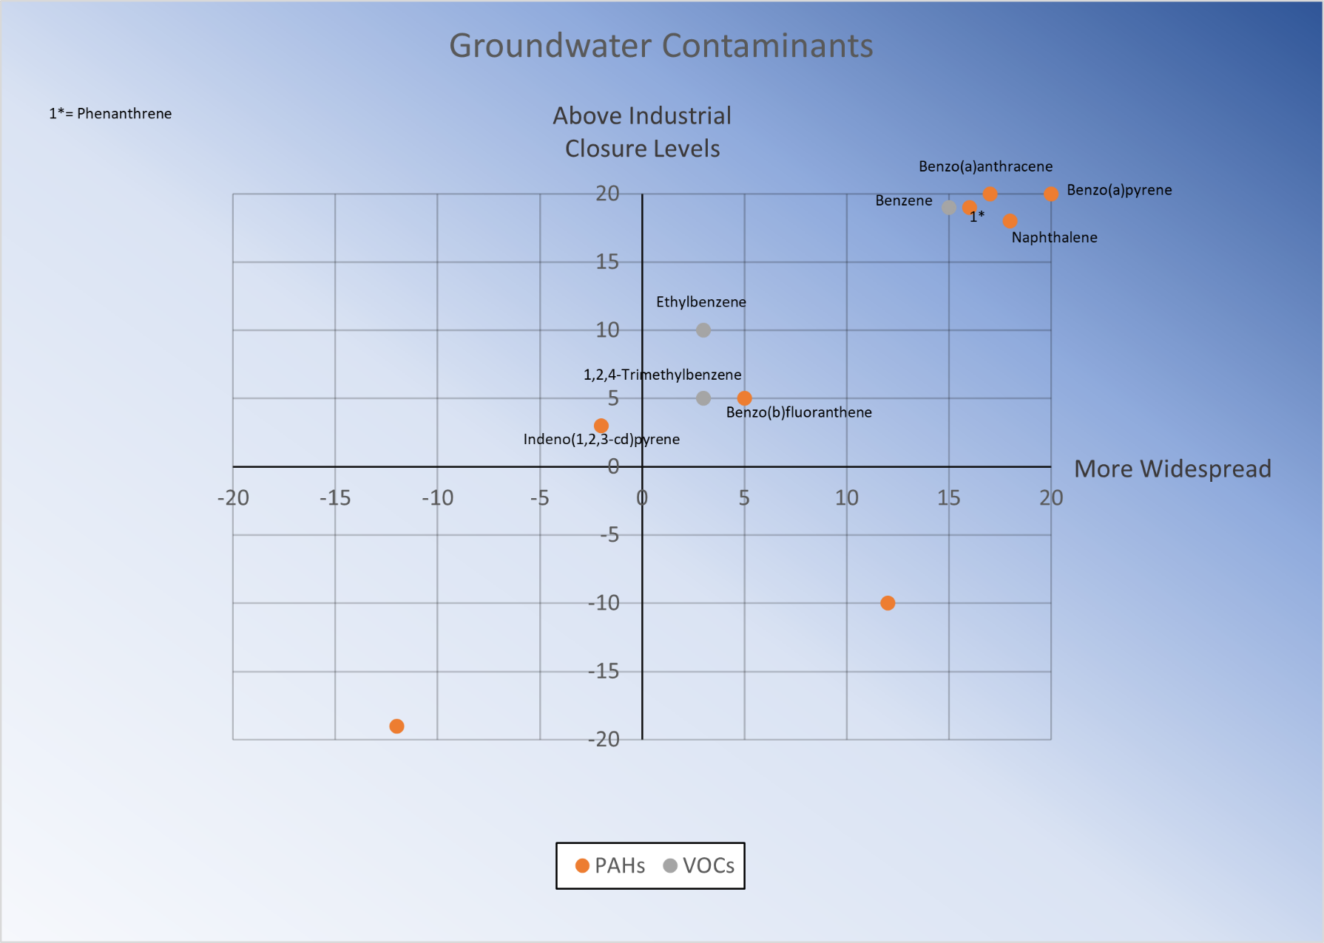
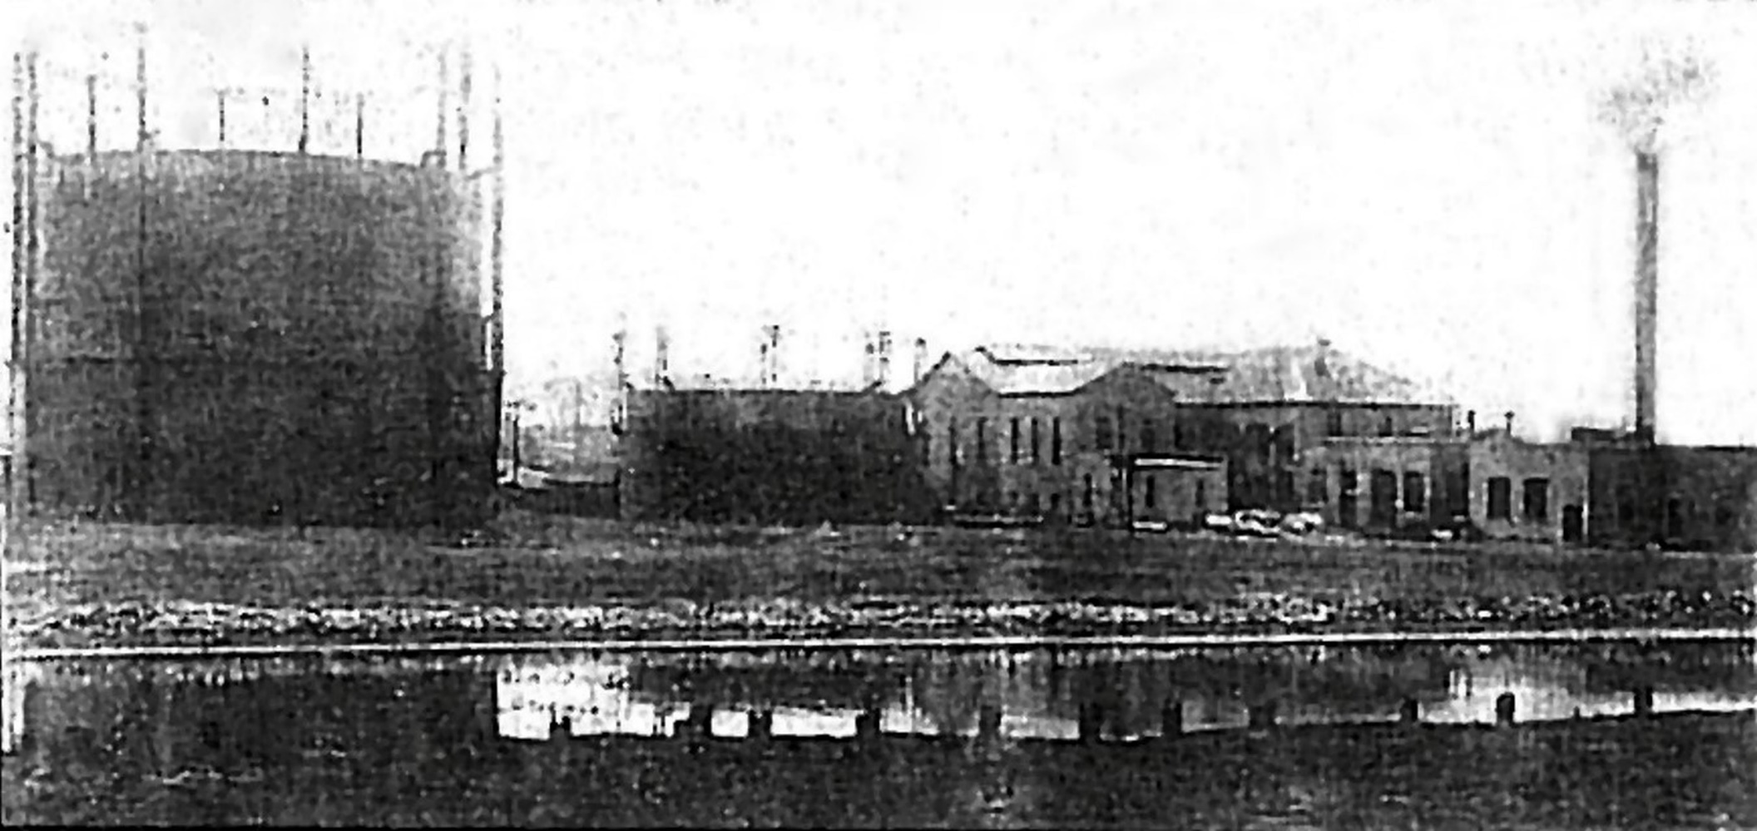
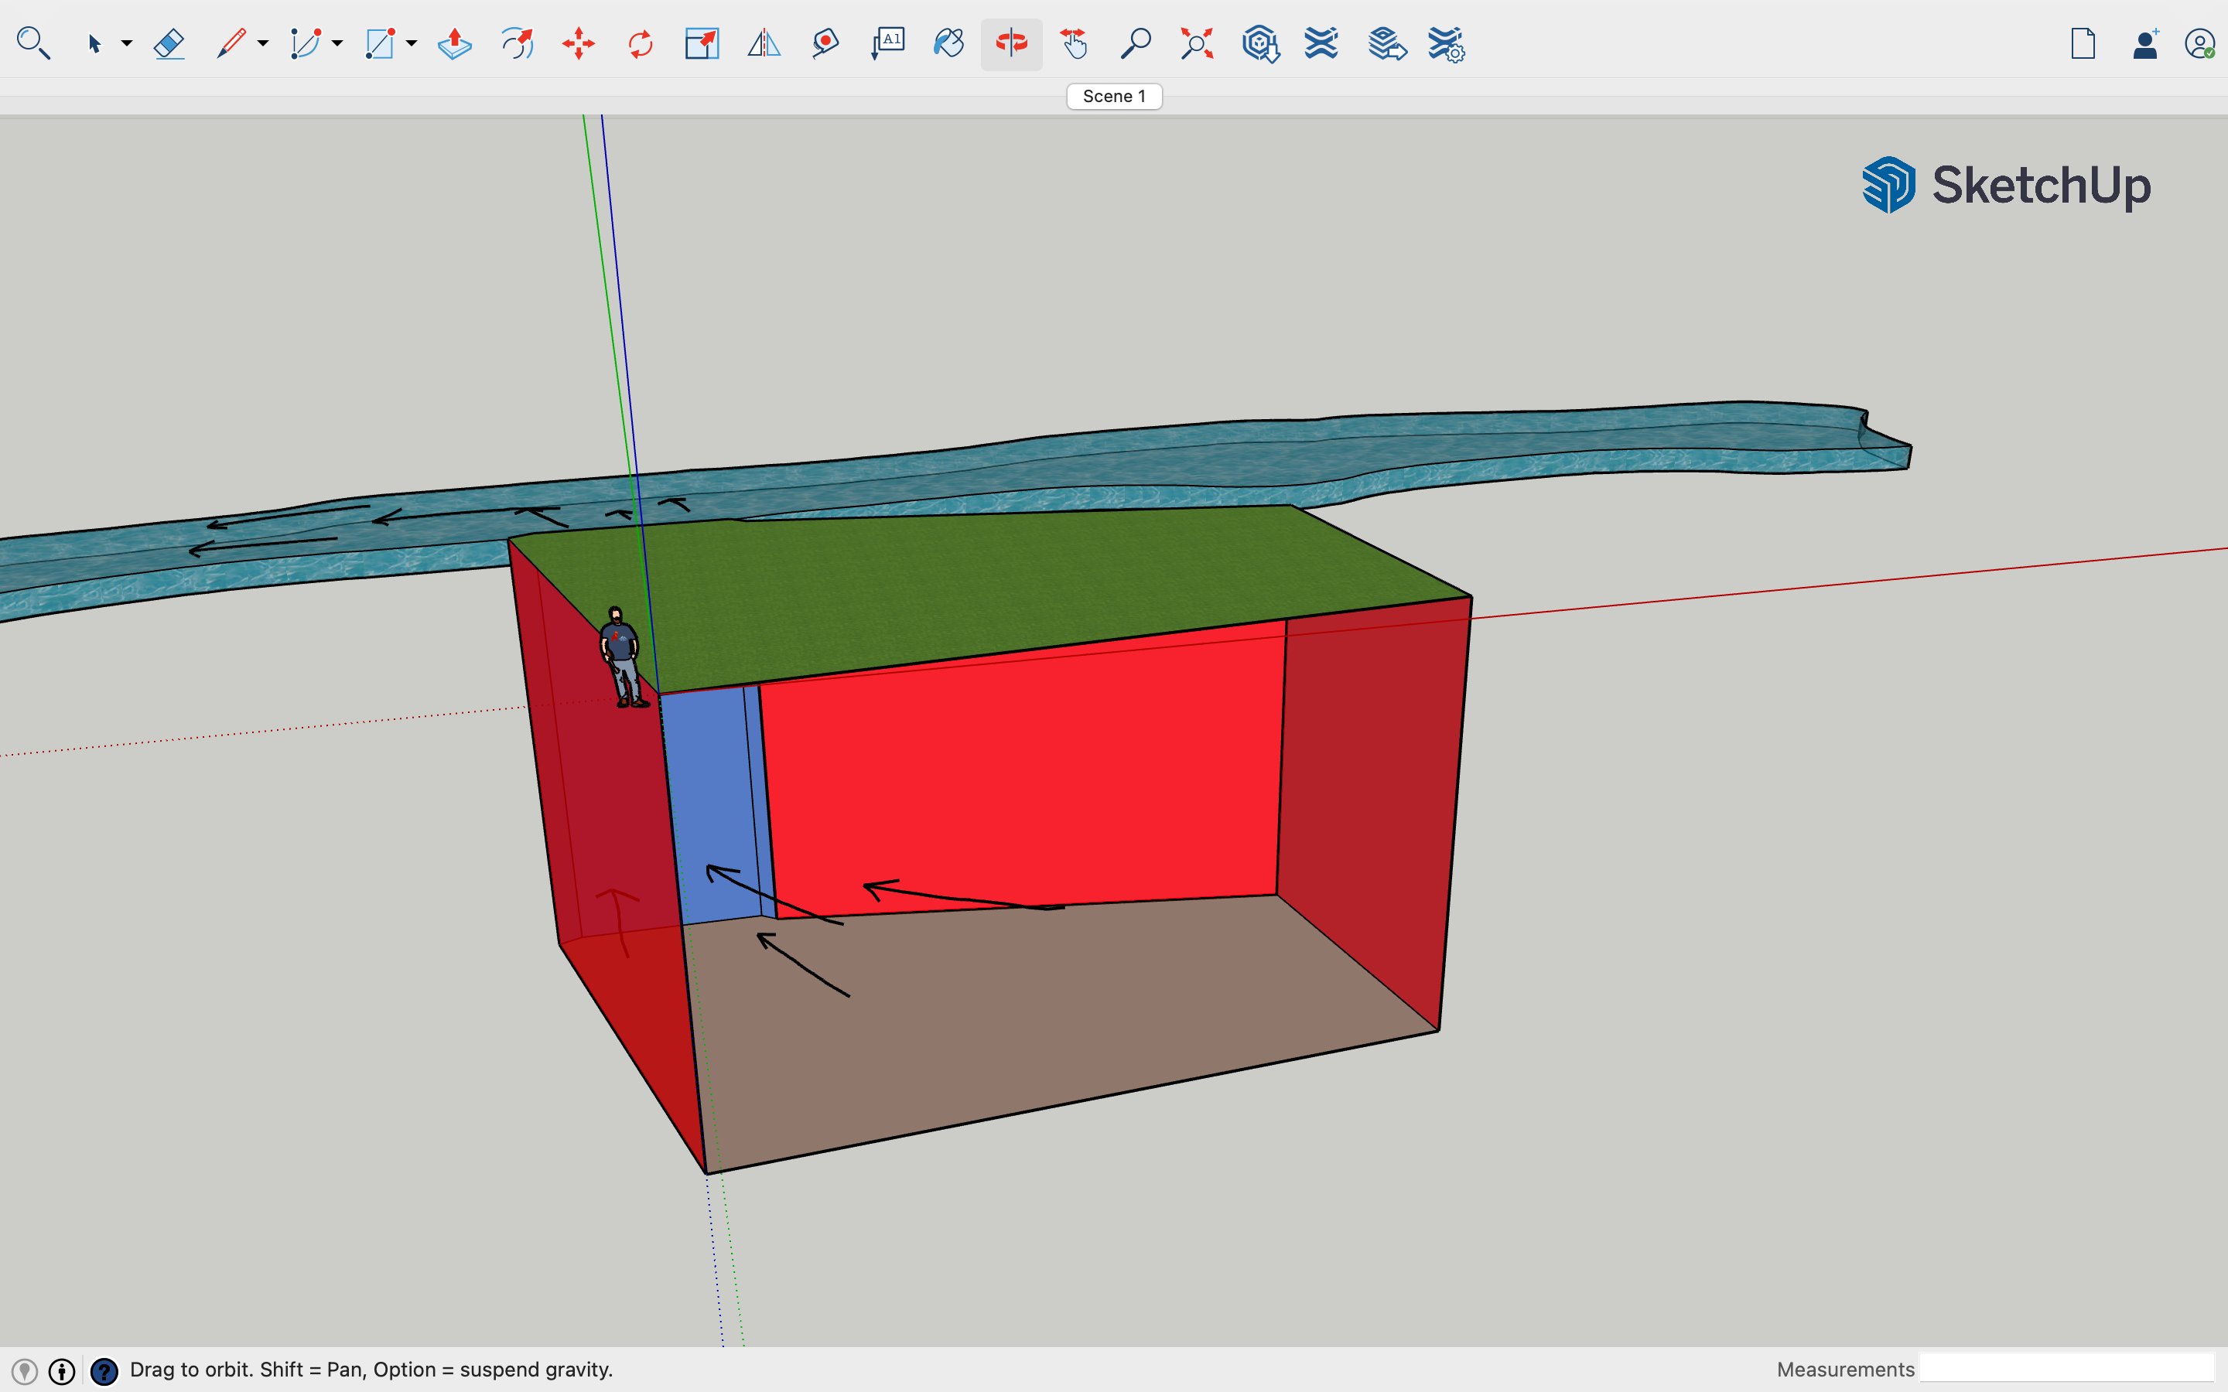
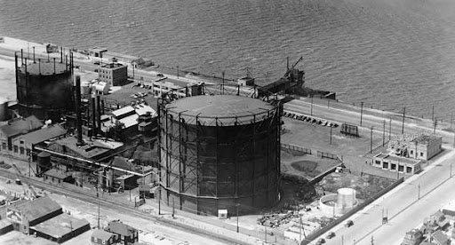
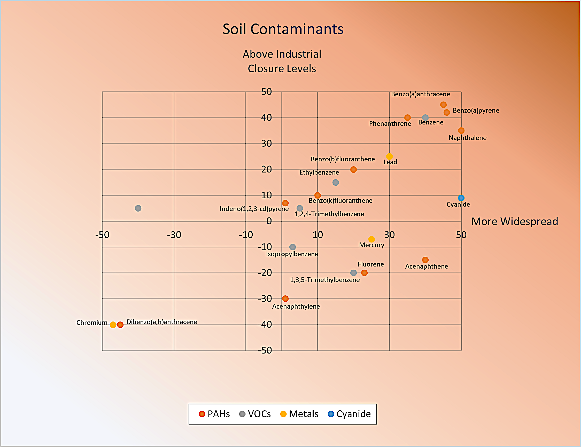

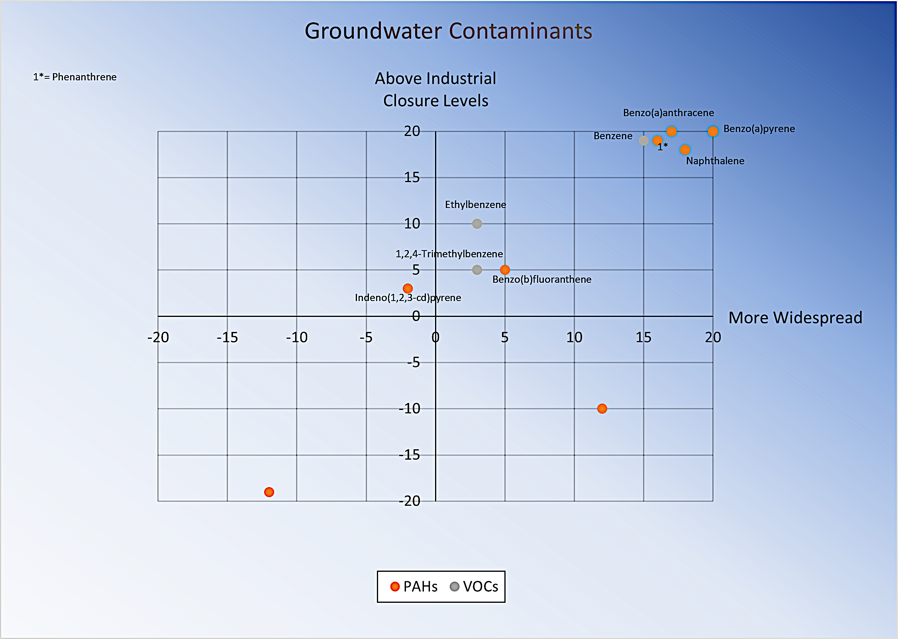
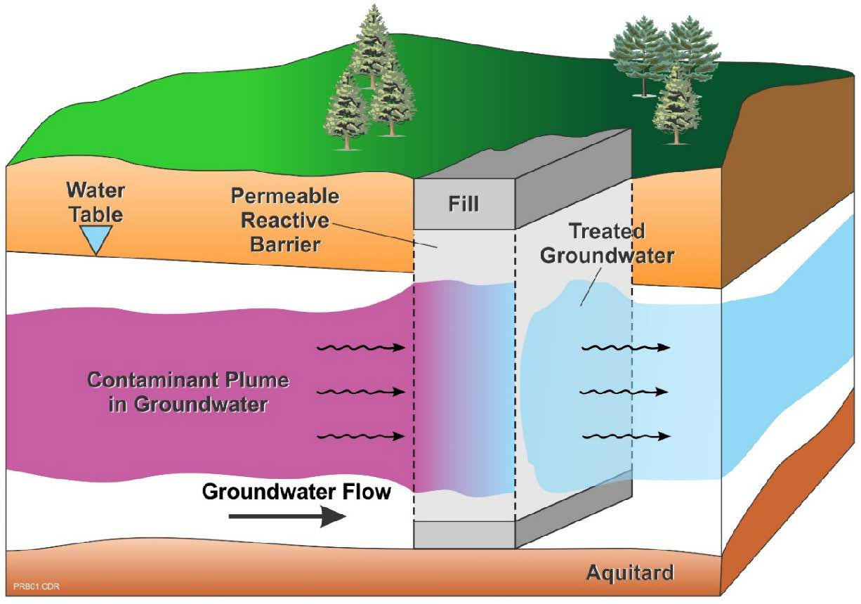
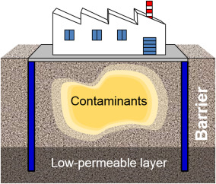
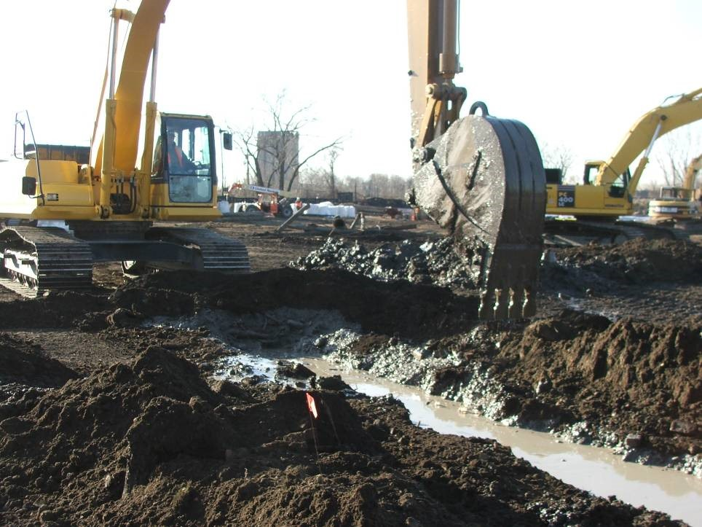
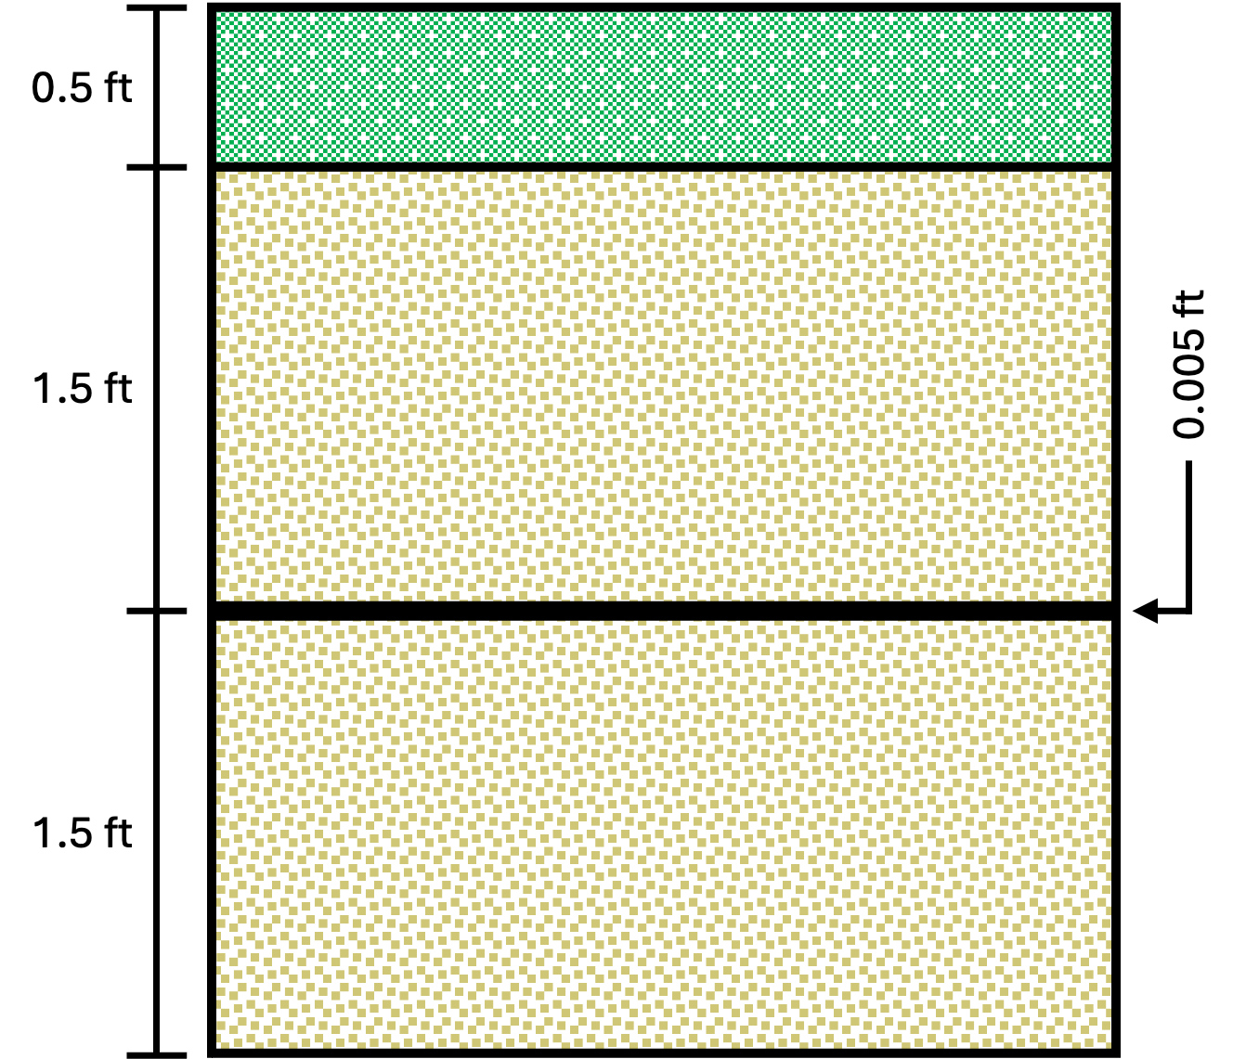
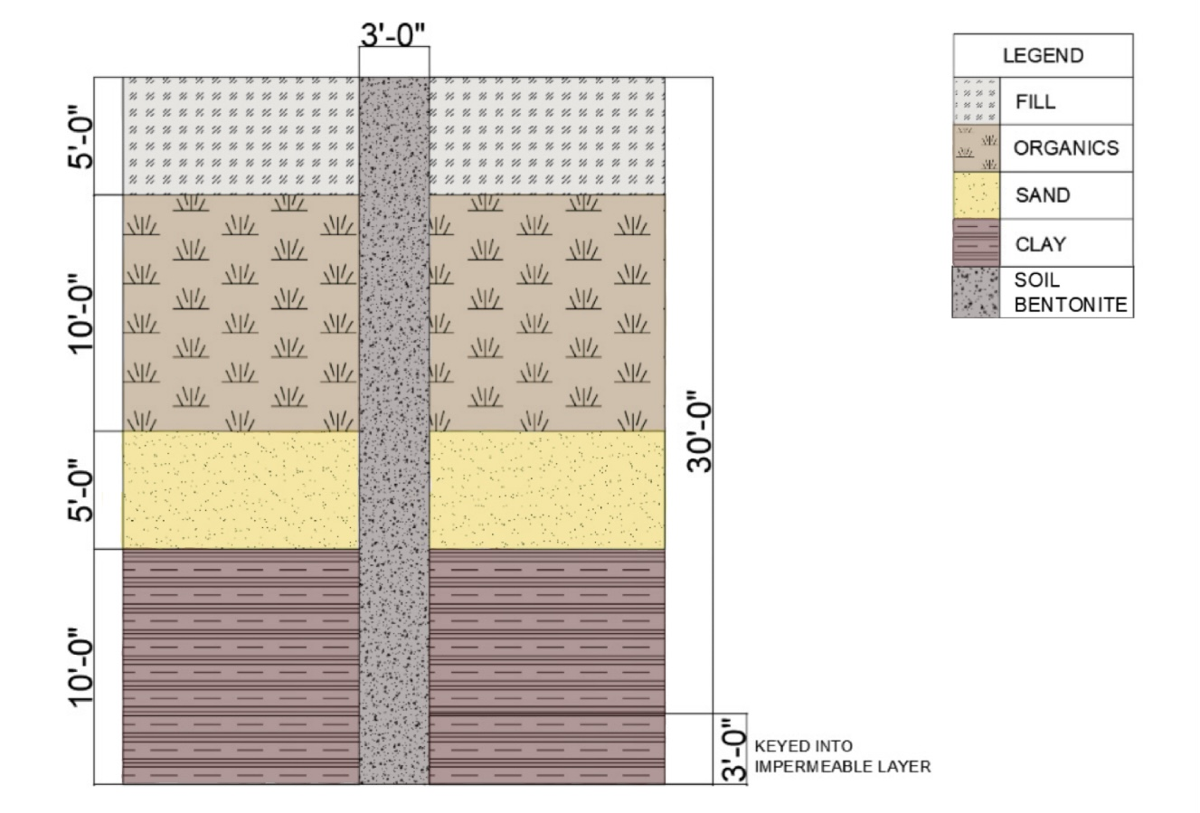
Former Manufactured Gas Plant Remediation - Great Lakes Region
Alexis Eaton, Kelsey Glass, Katie O'Brien, Sarah Nadeau, Sydney Norris
UNH Civil and Environmental Engineering, University of New Hampshire, Durham, NH 03824
Introduction
MPG Site Design
Cost Assessment
Haley & Aldrich, Inc. has been retained by an unknown client to design and implement a remediation system for a parcel of contaminated land near a former manufactured gas plant in an undisclosed, urban location in the state of Indiana.
What is a manufactured gas plant? Before natural gas pipelines became commonly available during the 1960’s, manufactured gas plant facilities were used to generate gas that could be used as an energy source by the gasification of coal or oil.
While these industrial facilities are no longer utilized in the United States, contamination of groundwater, soil, and surface waters caused by manufactured gas plant operations still persists.
Services to be Provided:
Manufactured Gas Plant
Design Schematic
Project Component | Considerations | Total Cost
Slurry Walls | -Western SB Slurry -Eastern SB Slurry -Northern SB Slurry | $2,817,000.00
PRB | -GAC -Bentonite -Geomembrane | $493,000.00
Cap | -Geomembrane -Drainage Sand -Vegetation -Soil | $430,000.00
Cumulative Cost (Materials Only): $3,740,000.00
Identification of contaminants present​
Design of a groundwater treatment system
Design of a soil treatment system
Cost estimate
Triple bottom line assessment
Site model
Manufactured gas plants were used before natural gas pipelines were created to provide communities with energy. This photo shows the 1915 gas plant when it was in use.
The red represents the slurry walls while the purple represents the PRB. Groundwater will flow through the PRB into the river. Green represents the cap and vegetative cover.
Methodology
Charts
TBL Assessment
Groundwater and soil remediation technologies were researched, and pros and cons of each option were weighed. The team then chose the most suitable treatment methods.
Groundwater Contaminant Analysis
Soil Contaminant Analysis
Key Takeaways:
Environmental: the PRB will have a small carbon footprint because pumping isn’t required
Economic: the selected slurry wall material is the cheapest option
Social: the cap and vegetative cover will create green space
Groundwater Treatment Technologies Researched:
Phytoremediation
Pump and treat
Permeable reactive barriers (PRBs)
Soil Treatment Technologies Researched:
Soil biopiles
In situ chemical oxidation/reduction
Soil vapor extraction/air sparging
Stabilization and solidification
Slurry walls
Capping
VOCs and PAHs are present in groundwater on the site. The contaminants in Quadrant I are of the most concern.
More contaminants are present in the soil than groundwater. VOCs, PAHs, cyanide, and metals are present on the site.
Groundwater Treatment Design
sTAMD Simulations
Soil Treatment Design
References
Trenching Excavation for PRB
A permeable reactive barrier (PRB) will be used treat contaminants using a funnel and gate system created by the orientation of the slurry walls. The PRB will span 300 ft along the river and be 3 ft wide and 25 ft deep. The trench will be lined with a geomembrane and filled with a 50/50 mix of GAC and bentonite. The top 3 ft will be capped.
Site Cap Design
Ground Conditions & Slurry Wall Design
Community guide to vertical engineered barriers - US EPA. (n.d.-c). https://semspub.epa.gov/work/HQ/401627.pdf
“Kempisty, D. M., Summers, R. S., Abulikemu, G., Deshpande, N. V., Rebholz, J. A., Roberts, K., &amp; Pressman, J. G. (2020, March 8). Granular activated carbon adsorption of carcinogenic volatile organic compounds at low influent concentrations. Journal - American Water Works Association. https://www.ncbi.nlm.nih.gov/pmc/articles/PMC7077425/
Safety Data Sheet - Urbans Aqua. (n.d.). https://www.urbansaqua.com/wp-content/uploads/2017/09/FILTRASORB-400-13134-sdsEN-1.pdf
Soil-Cement-Bentonite» Slurry Walls» Geo-Solutions | Soil and Groundwater Problems Solved.” Geo-Solutions, 2022, www.geo-solutions.com/services/slurry-walls/soil-cement-bentonite/
Acknowledgments
Special Thanks To:
Jim Malley (Ph.D., P.E.), Shannen Cisneros, William Haswell (P.E.), Jeff Miller (P.E.), Lisa Damiano (P.E.), Fei Han (Ph.D., P.E.), Majid Ghayoomi (Ph.D., P.E.)
The site cap will be placed directly on top of the existing grade. A total of 3 ft of sand will surround a 60 mil (0.005 ft) geomembrane, and a 0.5 ft vegetative layer will be placed on top of the upper sand layer. The site cap will prevent contaminant volatilization.
The soil bentonite slurry walls will be located downgradient of contamination, with two walls along the east and west perimeters of the site and the third wall running along north perimeter where it will join into the permeable reactive barrier.

