Slide 1
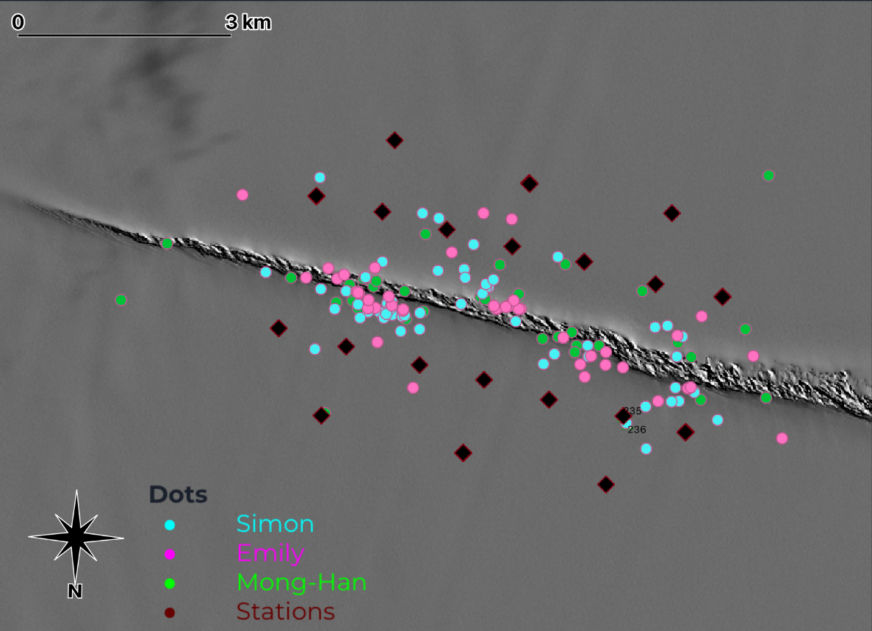
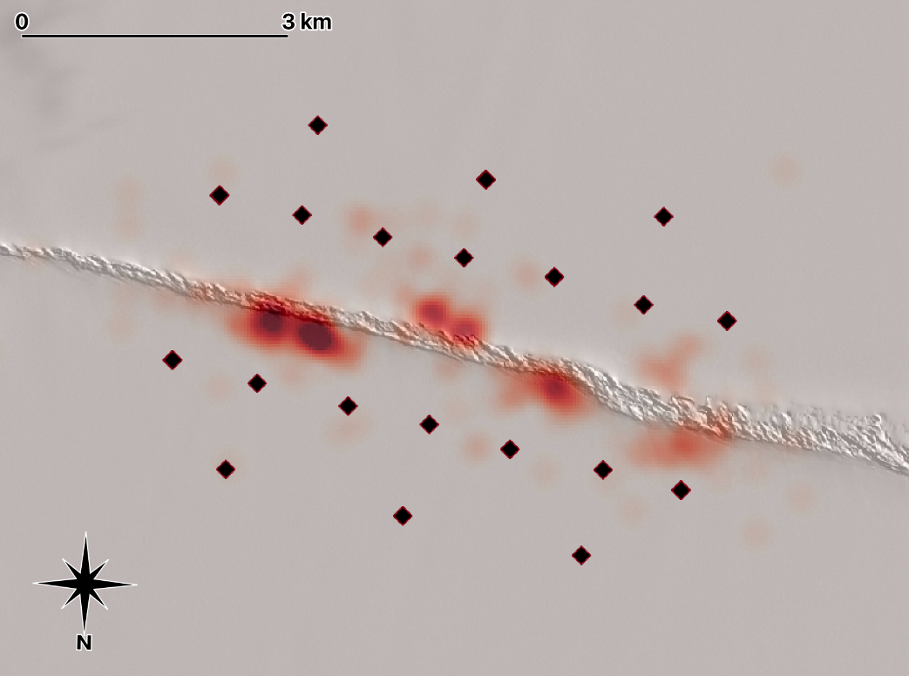
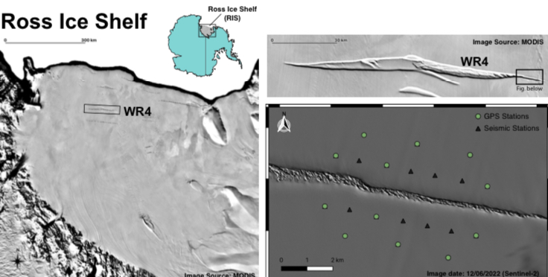
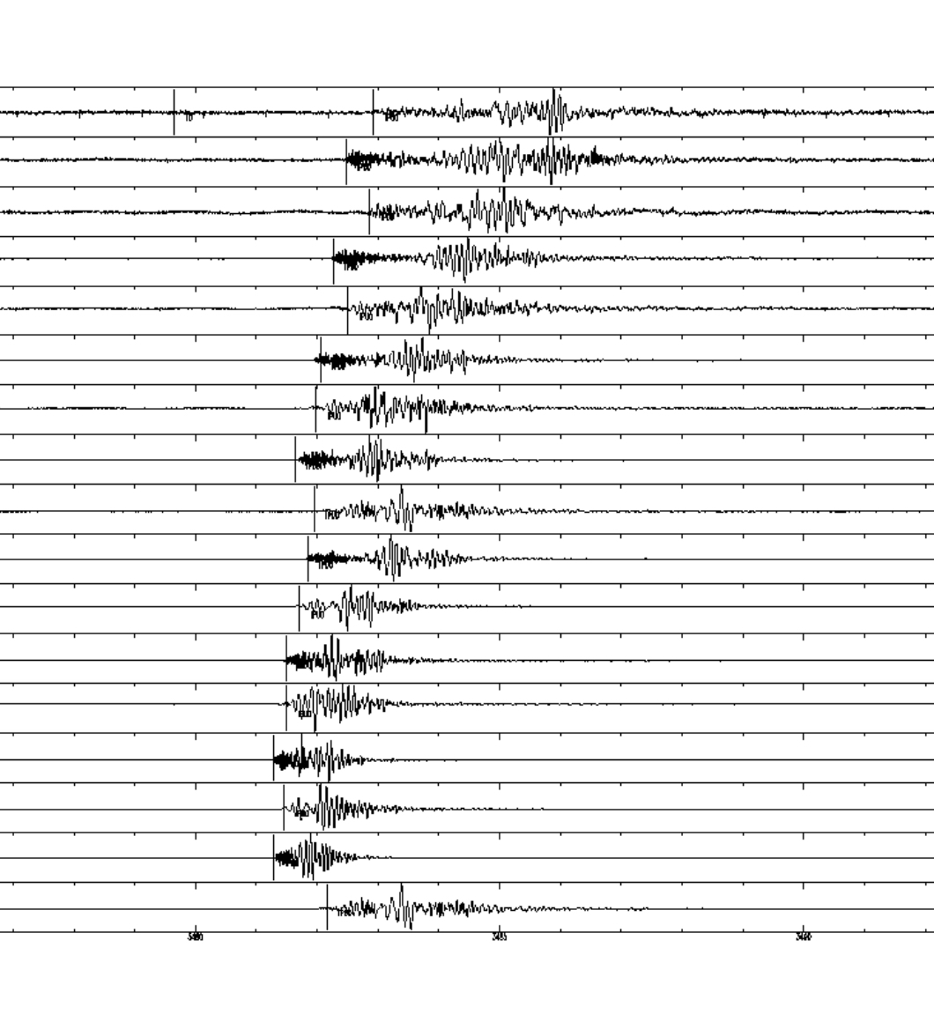
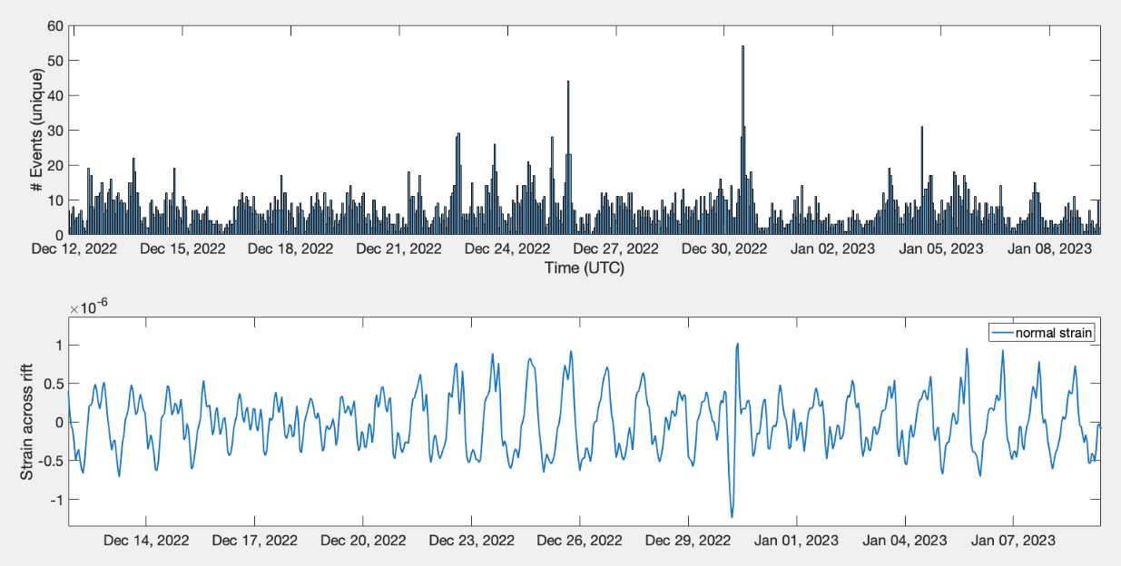
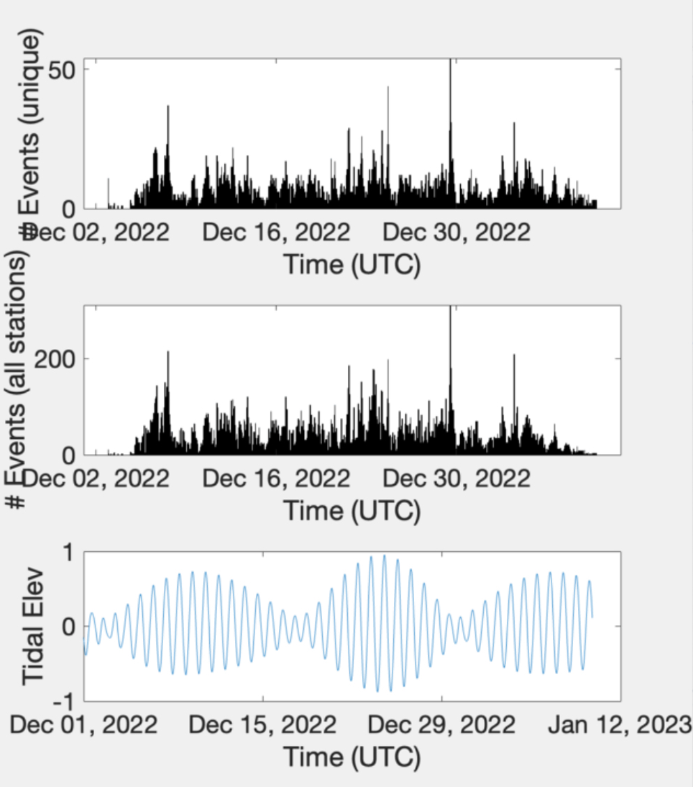
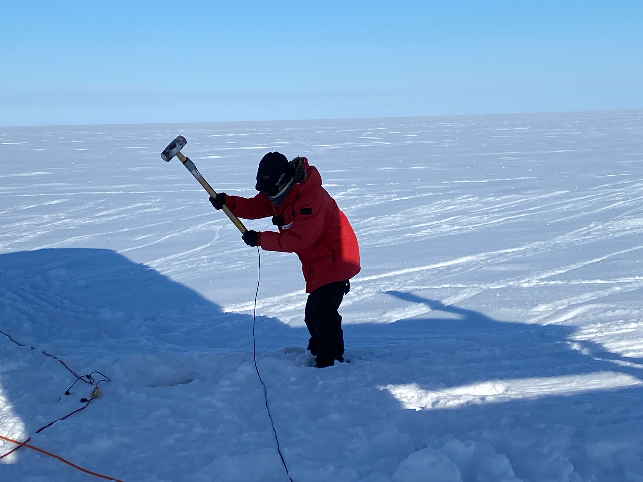
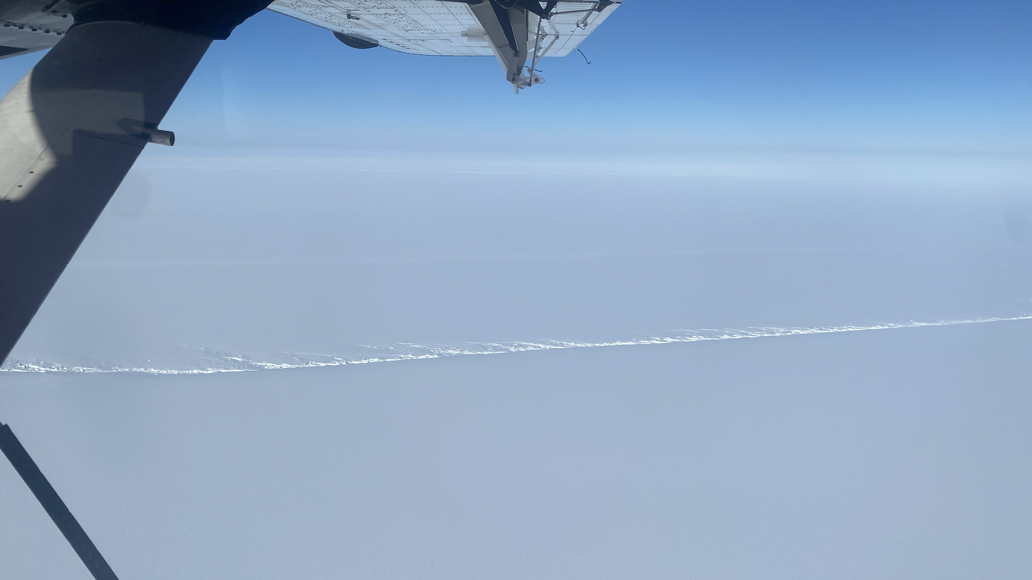
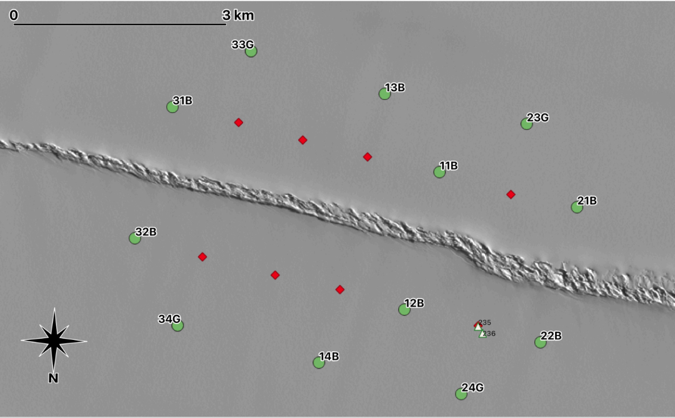
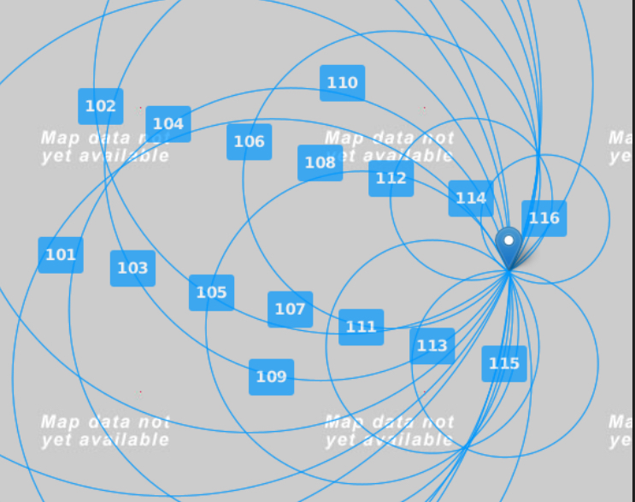
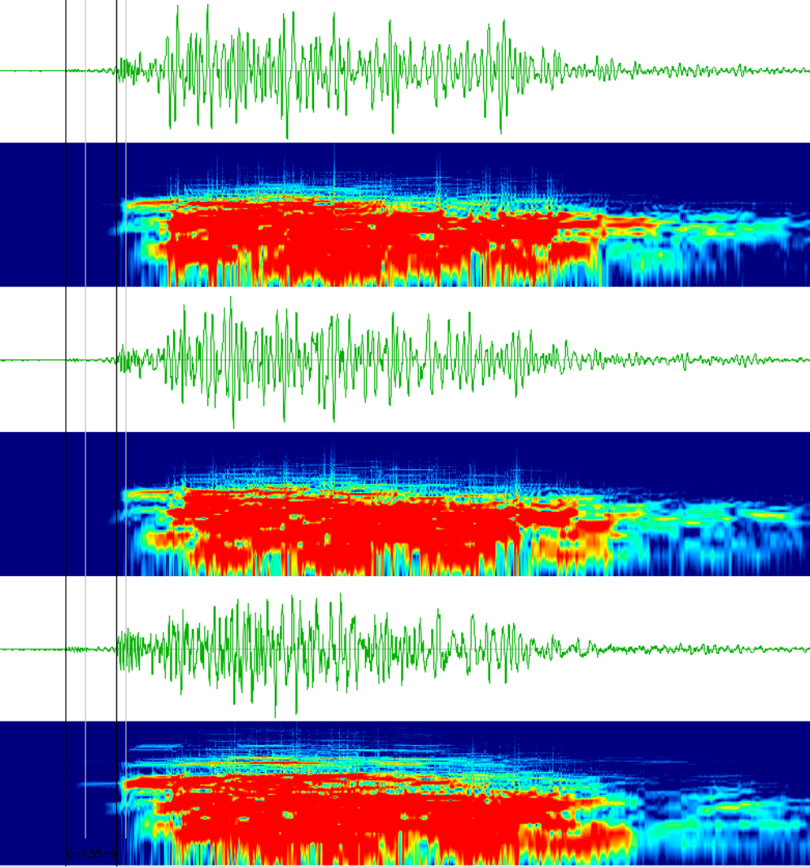
Cataloging and Locating Icequakes on the Ross Ice Shelf to Determine Long-Term Rift Behavior
Simon Eisl¹, Nicholas C. Schmerr² , Mong-Han Huang², Katherine Udell-Lopez², Emily Harkleroad³, Mariam Naseem², Terry Hurford⁴
¹ University of New Hampshire Department of Physics, ²University of Maryland Department of Geology, ³University of Maryland Department of Astronomy, ⁴NASA Goddard Space Flight Center
ARROW Project Overview
Located Events and Icequake Modality
Ice shelves are a critical buffer zone where ice melt from interior Antarctica flows, forming large masses of floating ice that remain attached to mainland Antarctica
Does not directly effect sea level, but impacts stability of ice mass flux
Rift zones, like WR4 (see image), within these ice shelves form and stand as precursors toward iceberg calving
These rifts continuously grow in random and rapid fashion, with seemingly sudden growth happening after a period of minimal change
As these rifts continue to deform, these deformations can cause vibrations within the shelf, referred to as icequakes
In December of 2023, 12 GPS stations and 16 seismometers were deployed around a section of a major rift zone (WR4)
ARROW team is attempting to
answer the following:
What is the mechanism of
the icequakes?
What is the long- and short-
term deformation of the rift
zones?
Is rift deformation associated with diurnal tides?
Cataloging the Events
In total, 465 events were located using WAVES
There are clear hotspots of icequake activity; main hotspot is located roughly 3 km from WR4’s westernmost edge on the northern side
Further locating of events will be using Double-Difference Hypocenter Location (hypo-DD) software to check the accuracy of WAVES’s locating algorithm and locate events more efficiently
When looking at the number of events occurring that day and comparing to both tidal elevation and the strain rate across the rift yields possible correlation between diurnal tidal motion and icequake occurrences
Peaks in the strain across the rift line up with
spikes in the number of events, being seen
most evidently on December 31st
Similarly, higher tide elevation also shows
possible correlation to a rise in the number of events
After all of the data was gathered, the data had to be downloaded from IRIS, an online database run by the NSF where our collected seismic data was stored
IRIS stores all 24 hours of data in 3 separate parts so these files had to be merged and de-trended in order to pick a full day’s worth of events at once more easily
After processing the data, rough estimates for P- and S-wave arrival times were selected and cataloged for future analysis and locating
Picks were made using seismic analysis code (SAC)
6136 unique events were identified across the ~35 day window
After creating the catalog, the events were separated and organized by signal-to-noise ratio (SNR) for locating
Each event was given a 20-second window; 5 seconds before P-wave arrival time and 15 seconds after
Signal used in the SNR
was the maximum in
the last 15 seconds
and noise was the
maximum from first
5 seconds
Data Collection
16 Fairfield Zland 3-C nodal seismometers were deployed across WR4
8 were placed on either side, spaced 1 km apart from each other; 14 located 1 km from the rift zone and 2 located 2 km
Each recorded ~35 days of seismic data with a 500 Hz sampling rate
12 CGPS stations were also deployed
8 of the 12 were collocated with a seismometer
Each recorded 40 days of data with a 0.033 Hz sampling rate
Data was collected from December 2nd 2022 to January 9th 2023 alongside one active source seismic survey
Locating the Events
After separating out the events and organizing them by SNR, the events with the highest SNR were located using WAVES analysis software
Every events P- and S-wave arrival time was re-picked more precisely than the initial cataloging process
The model was edited to fit the Ross Ice Shelf’s P- and S-wave propagation rates with the assumption that each icequake was occurring on the surface (0 km)
Layer | Depth (km) | P-Wave Velocity (km/s) | S-Wave Velocity (km/s)
1 (Ice) | 0.3 | 3.7 | 1.85
2 (Water) | 0.8 | 1.5 | 0
3 (Crust) | 30 | 6 | 3.4
4 (Upper Mantle) | 120 | 8.05 | 4.5
Main Takeaways
Rift zones such as WR4 are regions of particularly high seismic activity with over 6000 events detected over a ~35 day period along this 7 km stretch
Icequake origins appear to be found more frequently near the outermost edges of rift zones and occur as shelf fractures incrementally
There is evidence of correlation between the strain across the rift, diurnal tides beneath the shelf, and icequake events
Further locating of events using hypo-DD should give a better understanding of short- and long-term rift zone behavior
Acknowledgements
This work was supported by the NASA Grant: 80NSSC23K0881 and through the NSF Antarctica Program (Event: C-530). We would like to thank UNAVCO and PASCAL for supporting instrumentation, and Nico Bayou (UNAVCO) and Susan Stanford (PASCAL) for downloading GPS and seismic data.
Notes:
Abstract # 5524

