Slide 1

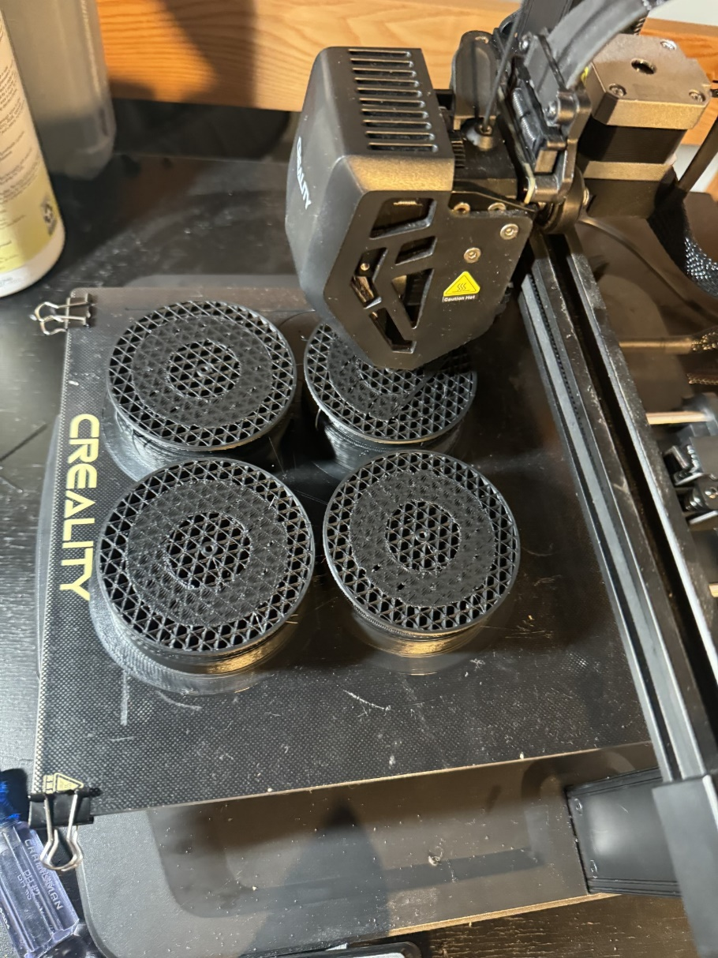
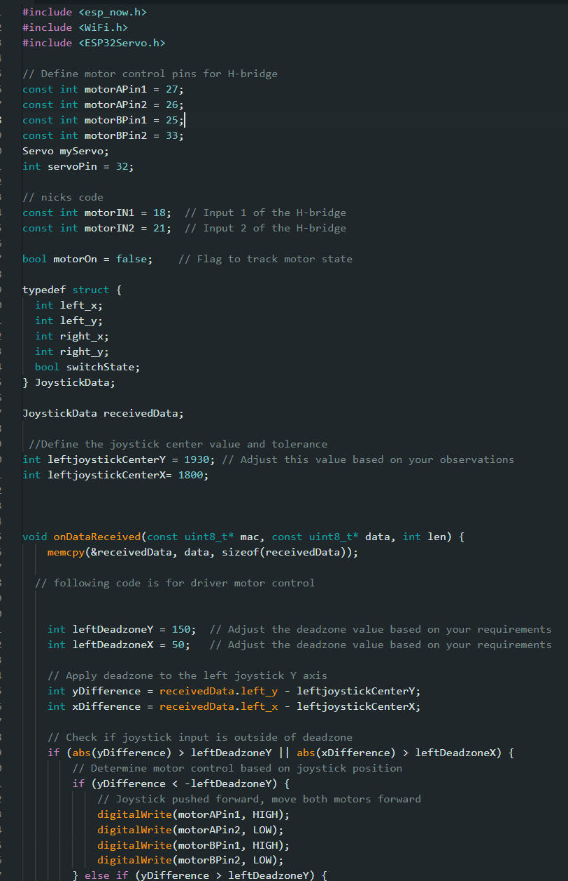
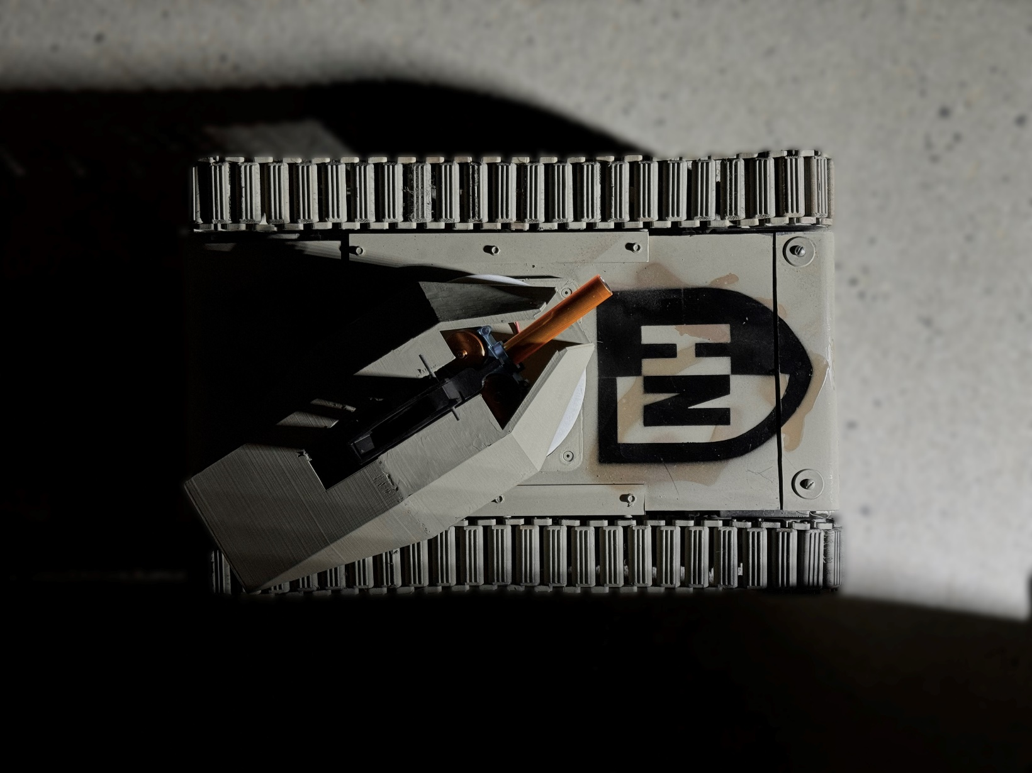
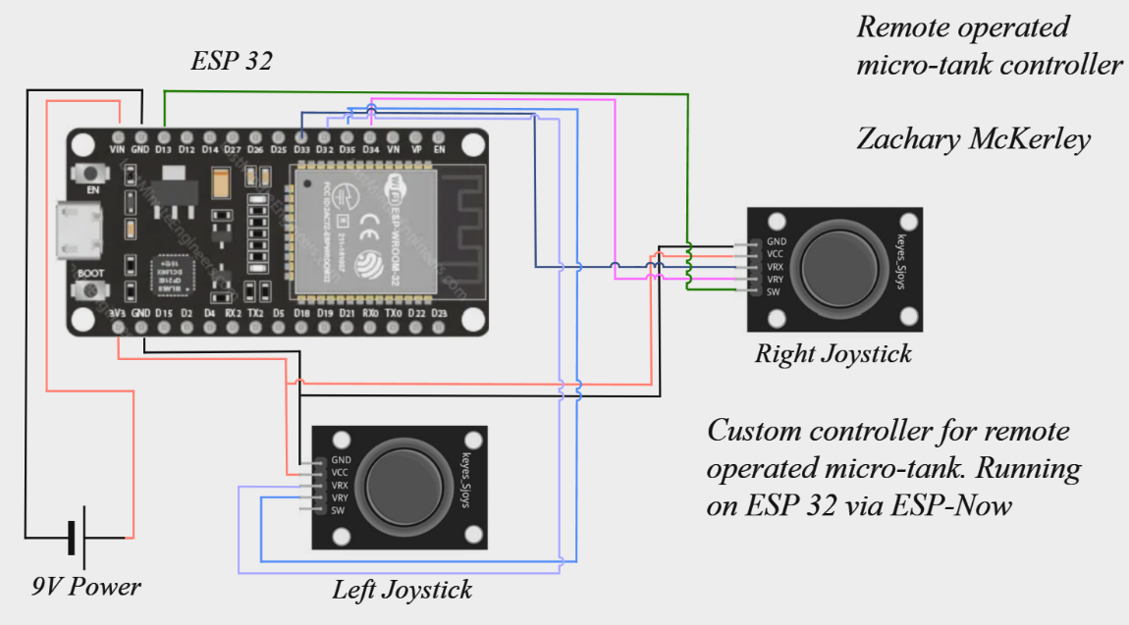
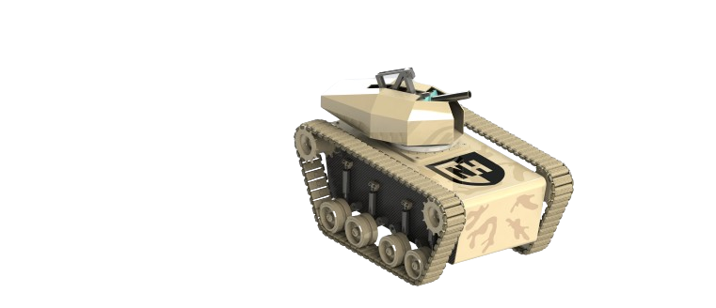
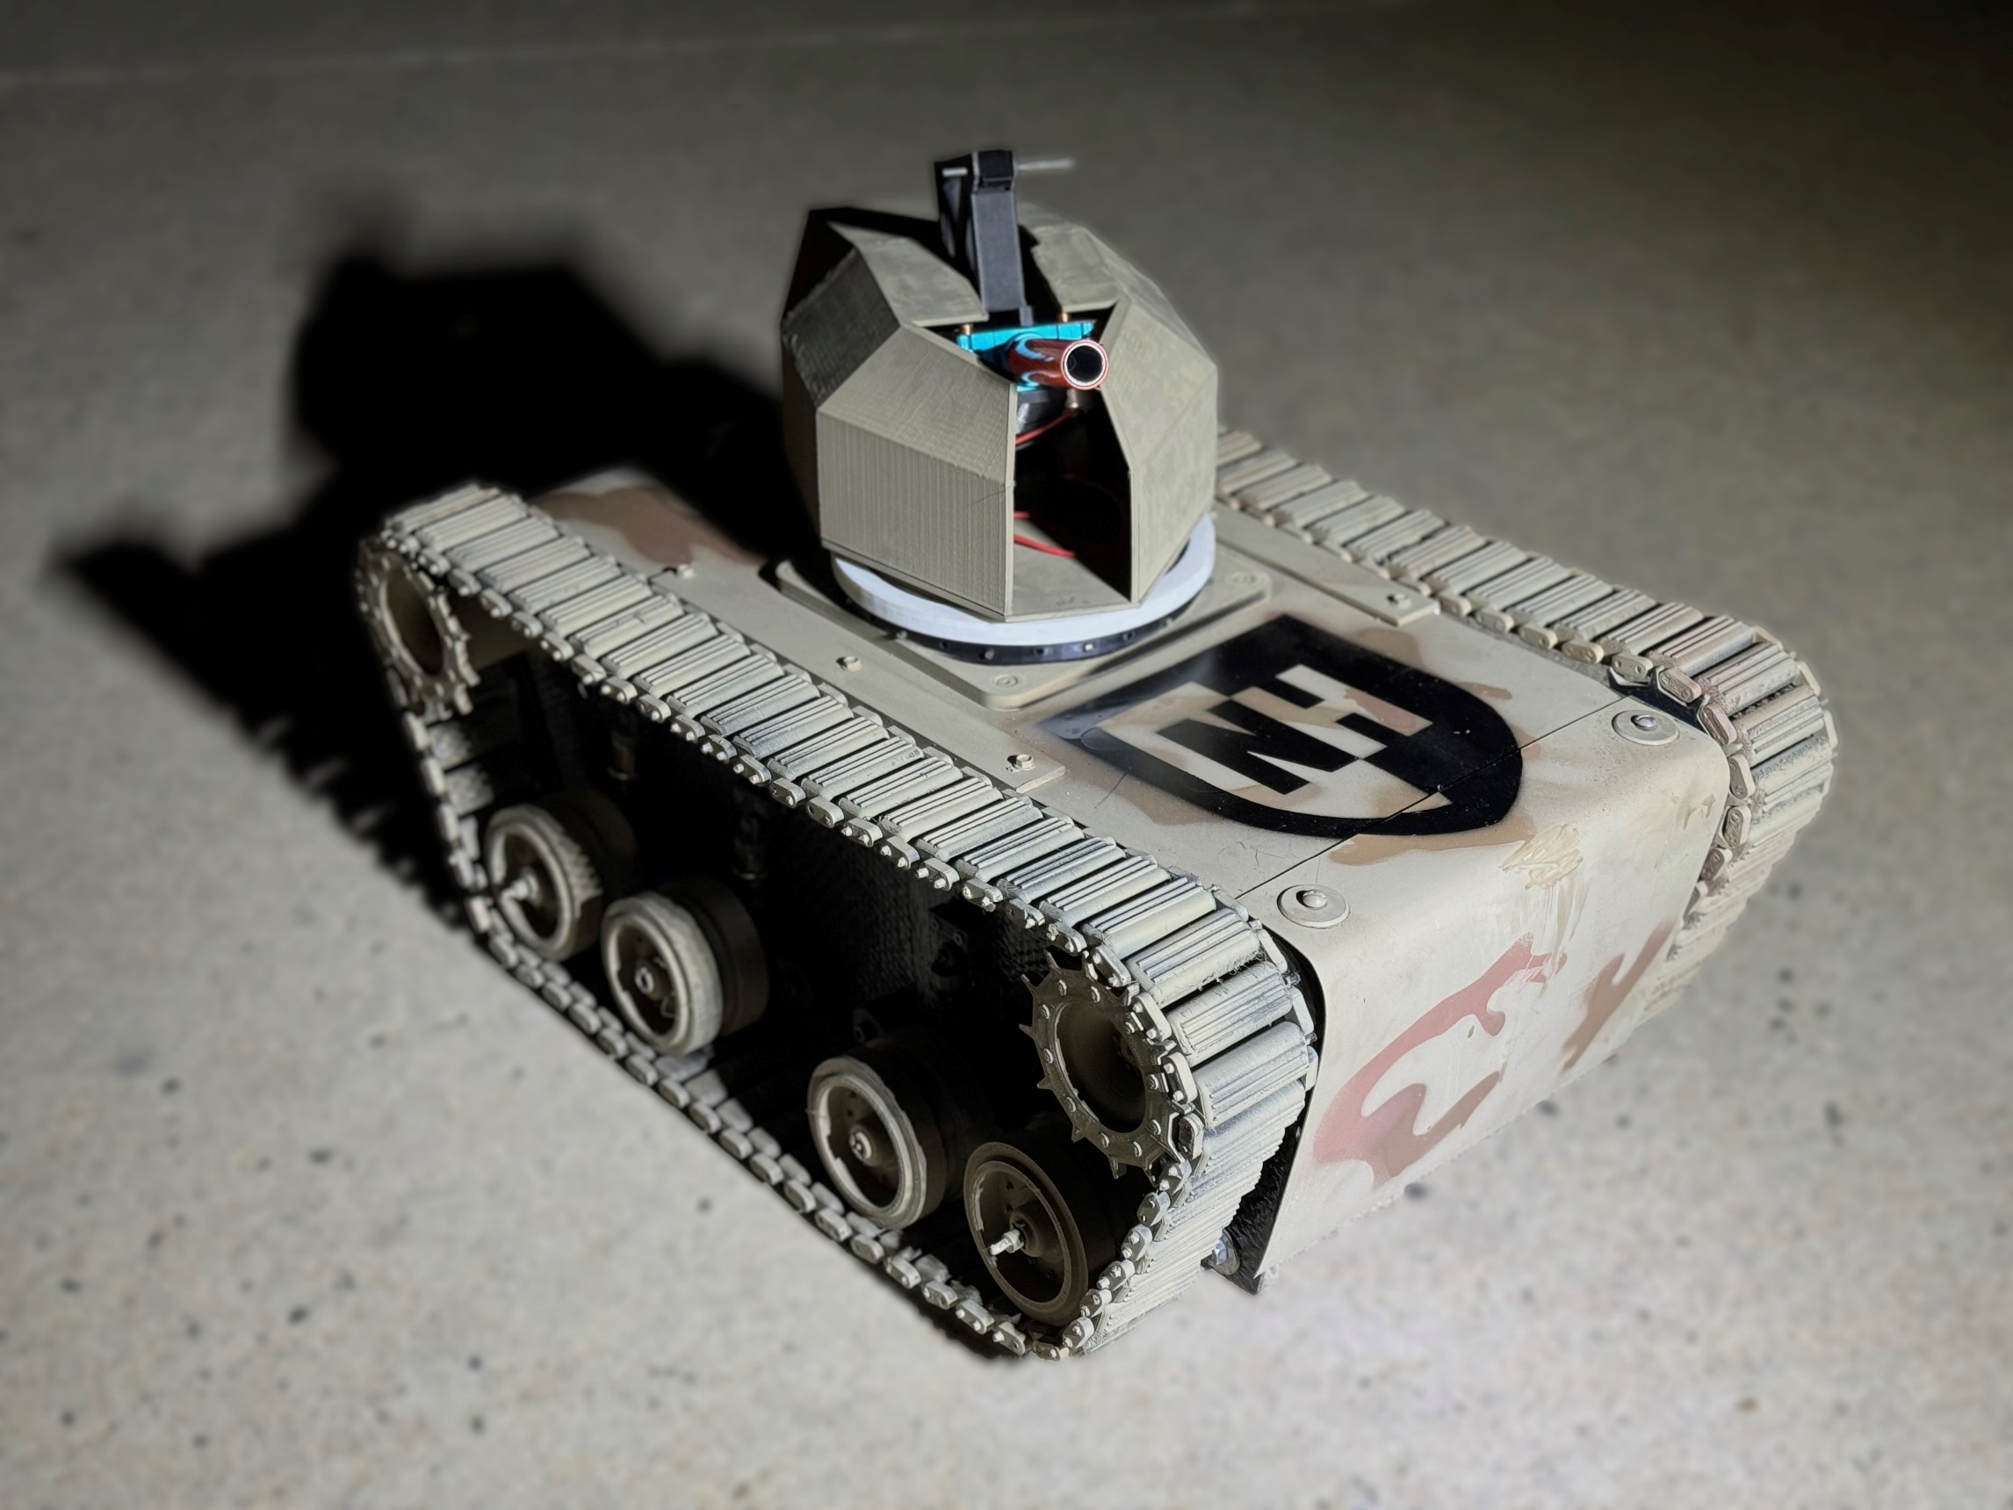

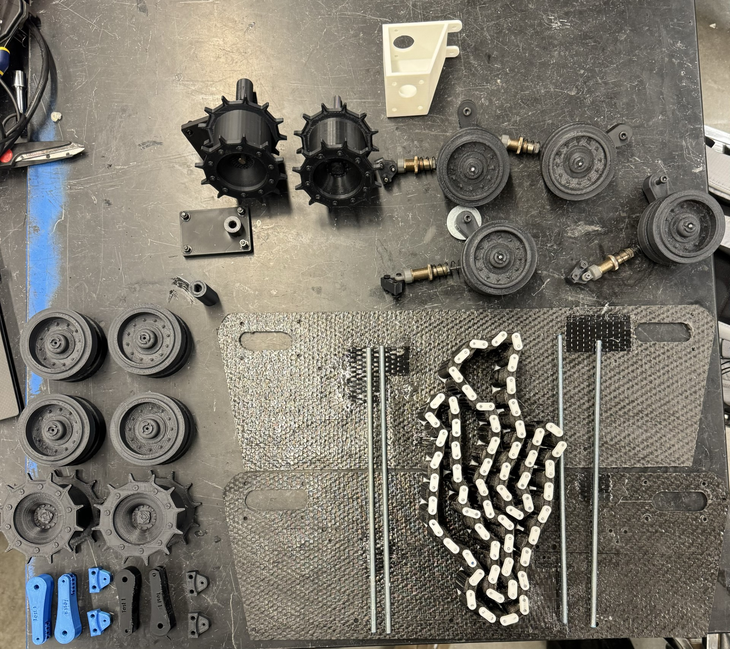
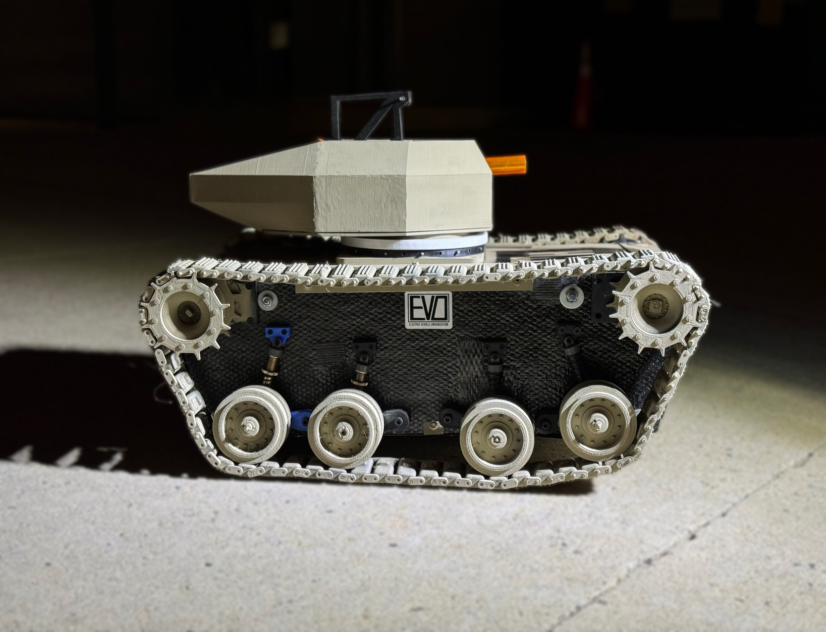
Investigating Rapid Prototyping by Making an RC Tank
Jonathan Gosselin, Rowan Baptista, Nicholas Niedzielski, Trent LaRose, Zachary McKerley | Tech 412 | University of New Hampshire
Objectives
Methods
Results
Conclusions
3D printing (CURA) (PLA/TPU)
Over 2.5 kg of PLA
1kg of TPU
About 64 hours of total printing time
Working driver motors, turret stepper motors, gun servos for angle of fire, and gun flywheel motors
Wireless remote operation of all the tank components
Over 350 lines of code
3D printing allows creatives the ability to quickly make designs come to life
3D printers are as cheap as $150 compared to costly mills
3D printing can be used as a proof of concept before a more polished product is manufactured
Microcontrollers allow for code to be rapidly compiled and applied to receptacles such as servos, motors, or steppers
Potential uses for this type of rapid prototyping: startups, test products for large companies, or just the average DYI enthusiast
Investigate rapid prototyping by designing a models of the various parts of a rc tank
3D Print designs for Final Production
Make a quick and easy microcontroller to wirelessly operate electrical components
Piece mechanical and electrical components together into an operational micro tank
Coding (C++)
Completed Tank:
Introduction
3D printing:
3D printing is a form of additive manufacturing using filament spools
3D printing is fast and cheap
It is the way of the future as it can create baseline products of models made in a CAD software
Coding/Microcontrollers:
An ESP32 offers built-in Wi-Fi/Bluetooth and a robust processor, facilitating fast prototyping with platforms like Arduino.
Almost all pins on the ESP32 offer GPIO which allow for easy integration of various sensors and actuators, accelerating the prototyping process.
Circuitry:
Allows for quick iterations and modifications, enabling designers to experiment with various electronic configurations and functionalities easily
Using actual electronic components in prototypes facilitates the early testing of the electrical performance and interaction of a product
Circuitry
Background Questions
Computer Aided Design (SolidWorks)
What is 3D printing?
Why isn’t 3D printing used currently in manufacturing?
What does a microcontroller do?
Idea to Creation
Isometric Full Tank Assembly
Contacts
Rowan Baptista: Rowan.Baptista@unh.edu
Jonathan Gosselin: jjg1099@unh.edu
Zachary McKerley: Zachary.McKerley@unh.edu
Nicholas Niedzielski: Nicholas.Niedzielski@unh.edu
Trent LaRose: Trent.LaRose@unh.edu

