Slide 1
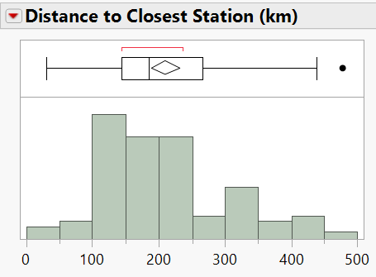
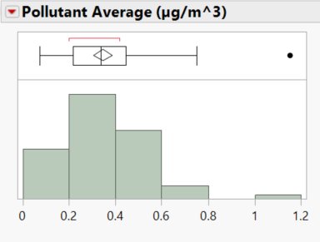
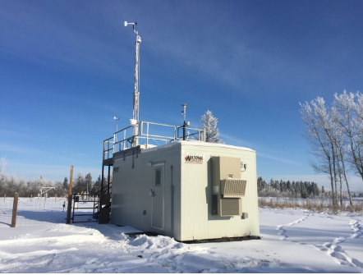
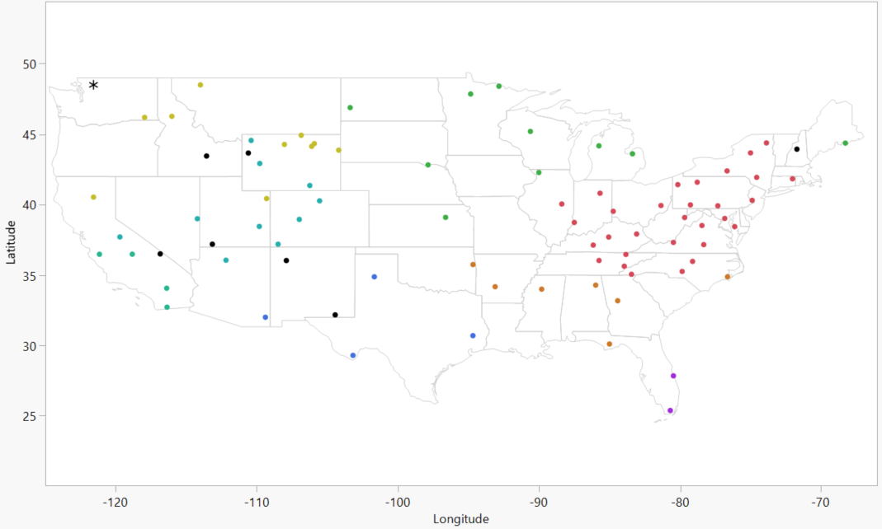
Optimization of Air Quality Monitoring
Payson Hornbeck - Mathematics and Statistics - University of New Hampshire
background
Hypothesis
Results and Conclusions
The Clean Air Status and Trends Network (CASTNET) is a system of air quality monitoring sites located throughout the United States, with a few additional stations in Canada. Each site collects weekly data on various pollutant levels in the area.
By utilizing CASTNET’s data, scientists can make insightful decisions on steps they can take to combat air pollution in order to heal ecosystems and the populations within them.
The goal of this project is to spatially analyze the site locations, in order to eventually suggest one or multiple locations for new sites that are statistically optimized, while also being in a place where the pollutant levels would be of desirable measurements.
Noticeable trends include pollutant average increasing with decreases in elevation as well as latitude.
For a location recommendation, the desirability criteria of maximizing distance to closest station and minimizing pollutant average is used first. The new location is naturally bound by the latitudinal and longitudinal extremes of the sites already in the CASTNET system.
Figure 1 shows the site locations included in the analysis, color coded by their assigned hierarchical cluster. The asterisk in Washington state represents the suggested new location.
Initially, the average distance between adjacent stations is 210.36 kilometers. With this station included, that distance is increased to 213.51 kilometers.
Initially, the station that is the most isolated is in Chiricahua, Arizona, suggesting that this area could use an additional station. The shortest distance between sites occurs in Wyoming, suggesting this area has adequate and possibly redundant coverage.
Taking note of the high outlier of Pollutant Average (Indian River Lagoon, Florida), the data seems to be slightly right skewed, suggesting an optimization function for a new location may want to capture lower, more regular pollutant values.
Methods
The software JMP was used primarily as an exploratory tool. From CASTNET, variables latitude, longitude, elevation, are gathered and imputed, as well as concentrations for numerous pollutants, which are eventually conglomerated into a more useful pollutant average variable.
A python script is written to calculate the distance to the next closest station for each respective site. This variable, which can be thought of similarly to ‘coverage’, acts as the primary response for any models.
In addition to exploratory techniques such as outlier identification and multicollinearity analysis, methods such as hierarchical clustering and optimization techniques are also utilized.
Improvements and Next steps
More subject matter knowledge would be needed to set model desirability to more accurately represent what industry scientists would want to capture with new sites.
As opposed to an approximated Euclidean distance calculation, the Haversine formula could be used to compute the distances to the closest station.
Sources
U.S. Environmental Protection Agency Clean Air Status and Trends Network (CASTNET) www.epa.gov/castnet
T. Li et al. (2017)
M. Fuentes et al. (2005)
Figure 1

