Slide 1
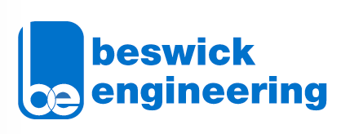
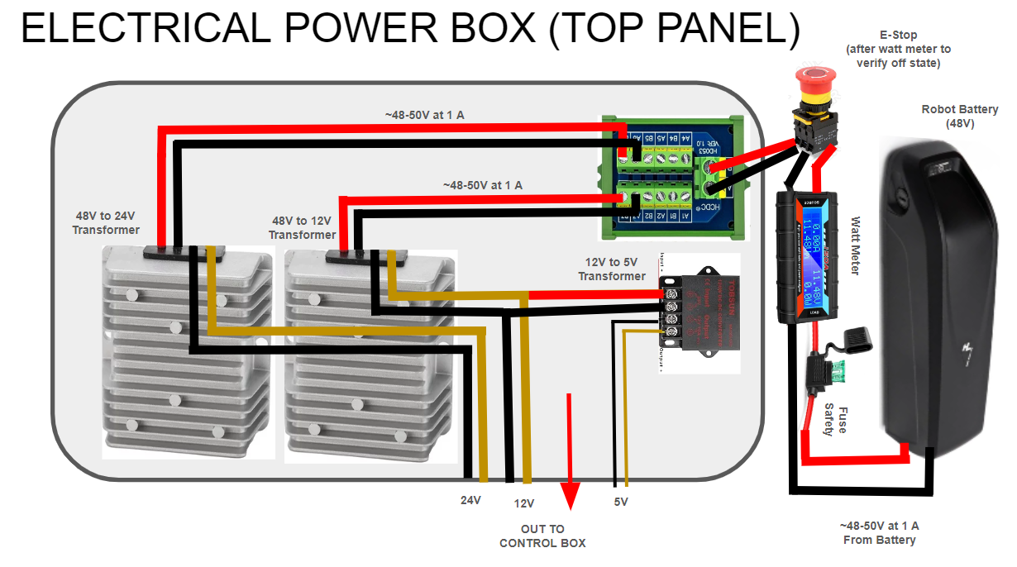
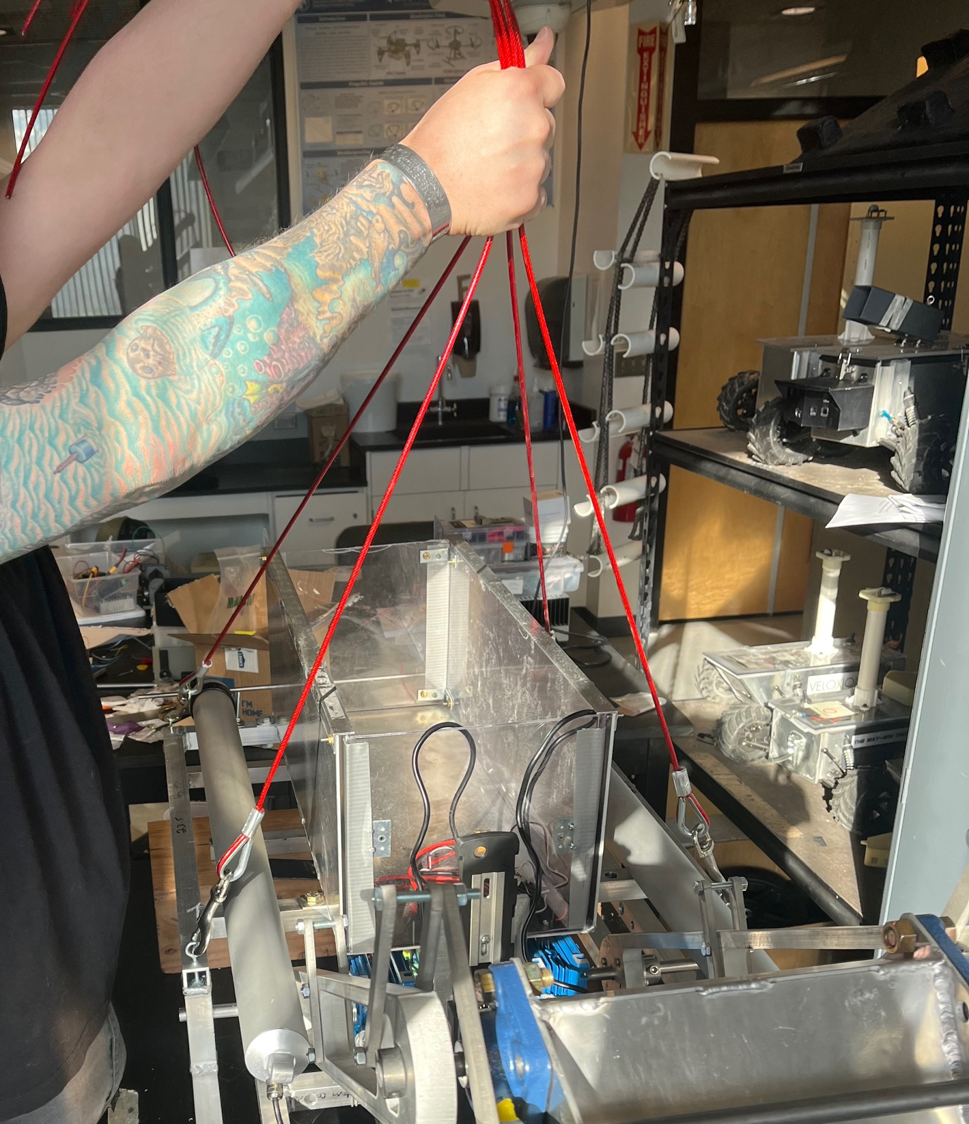
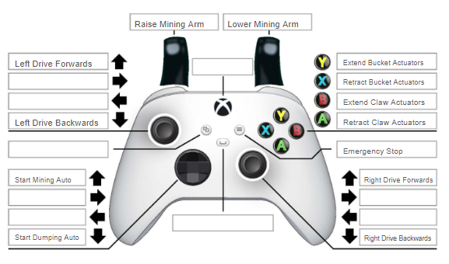
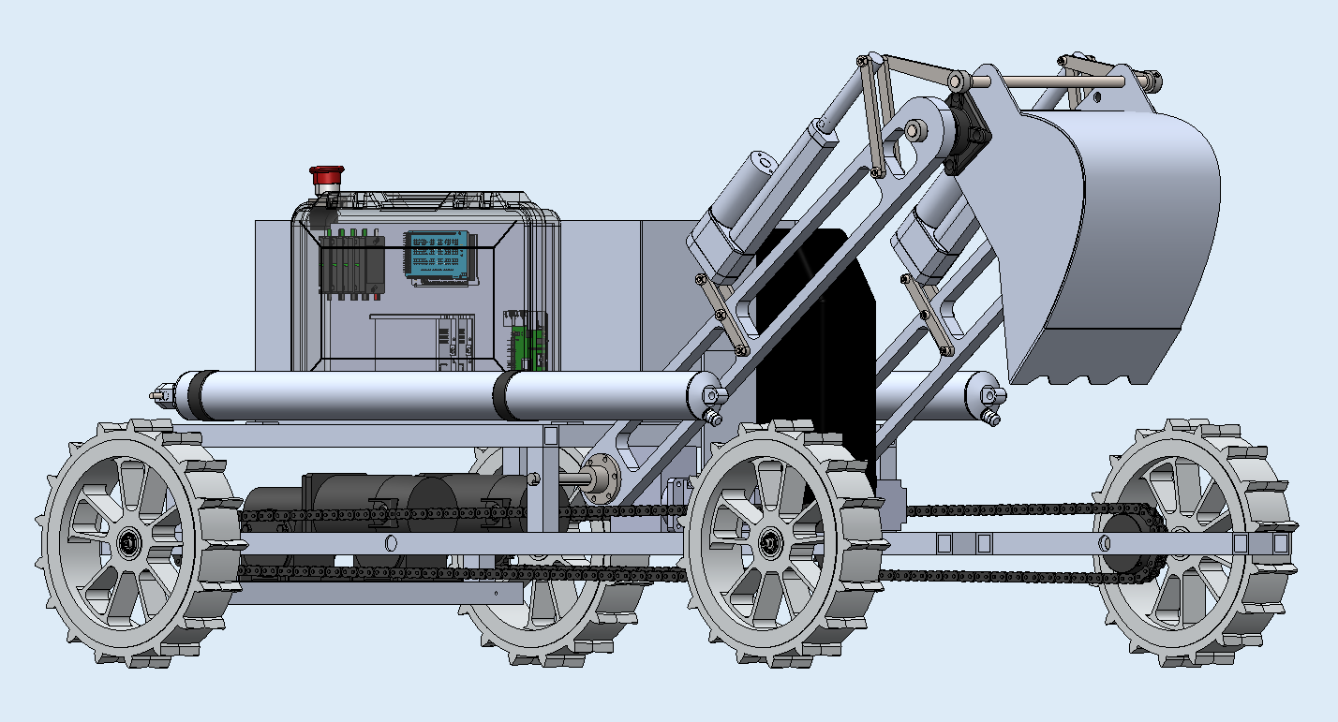
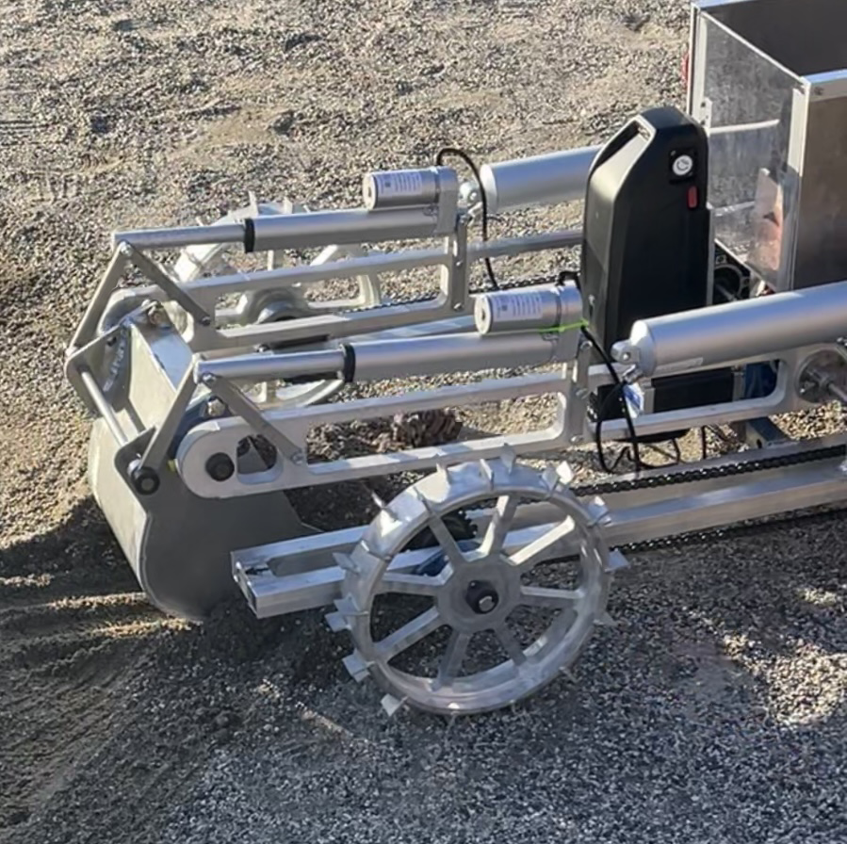
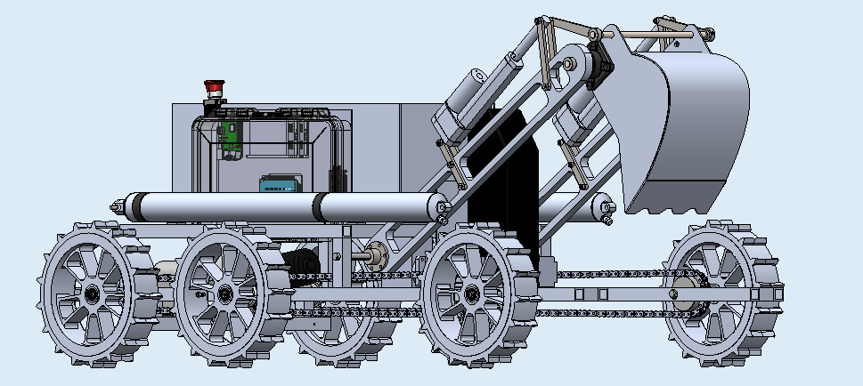
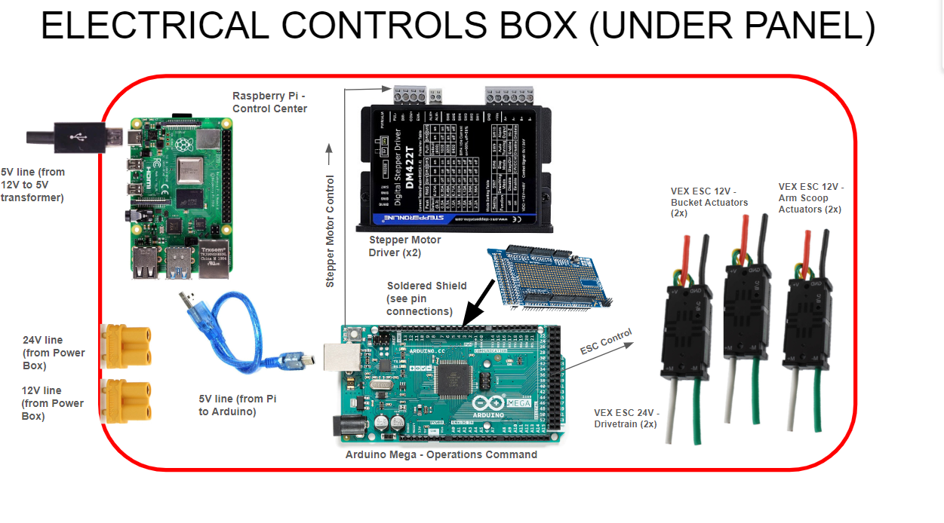
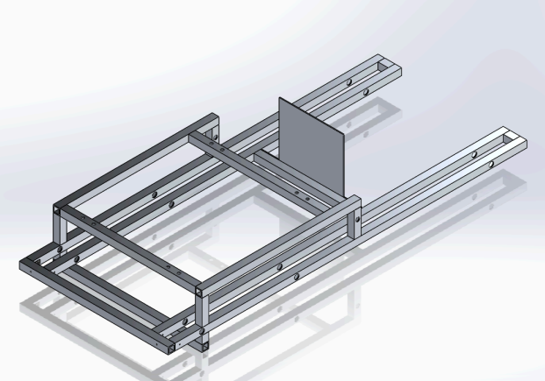
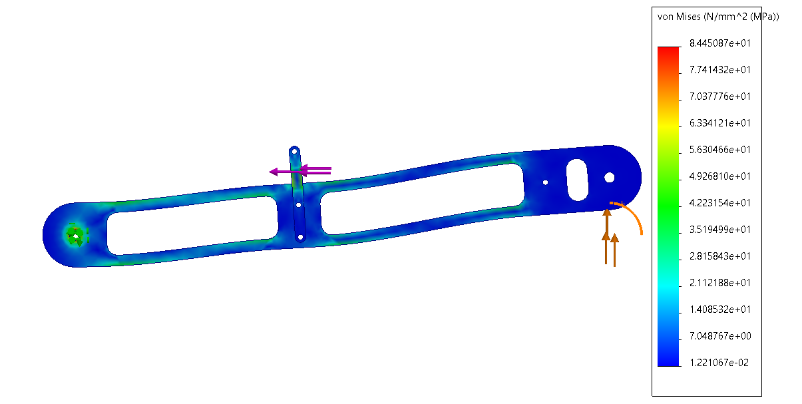
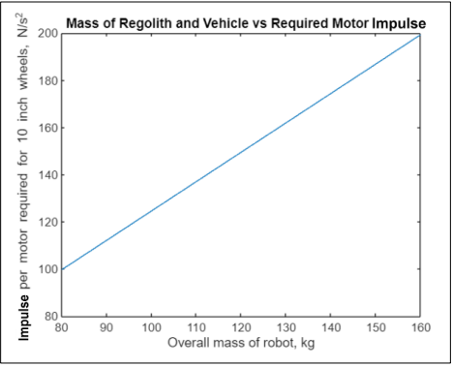
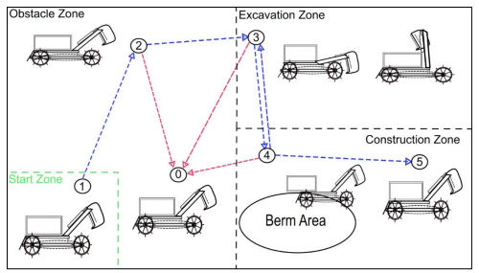
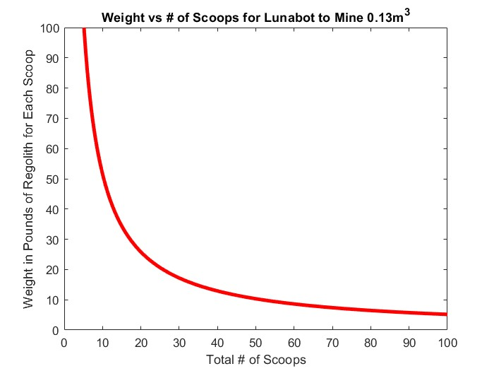
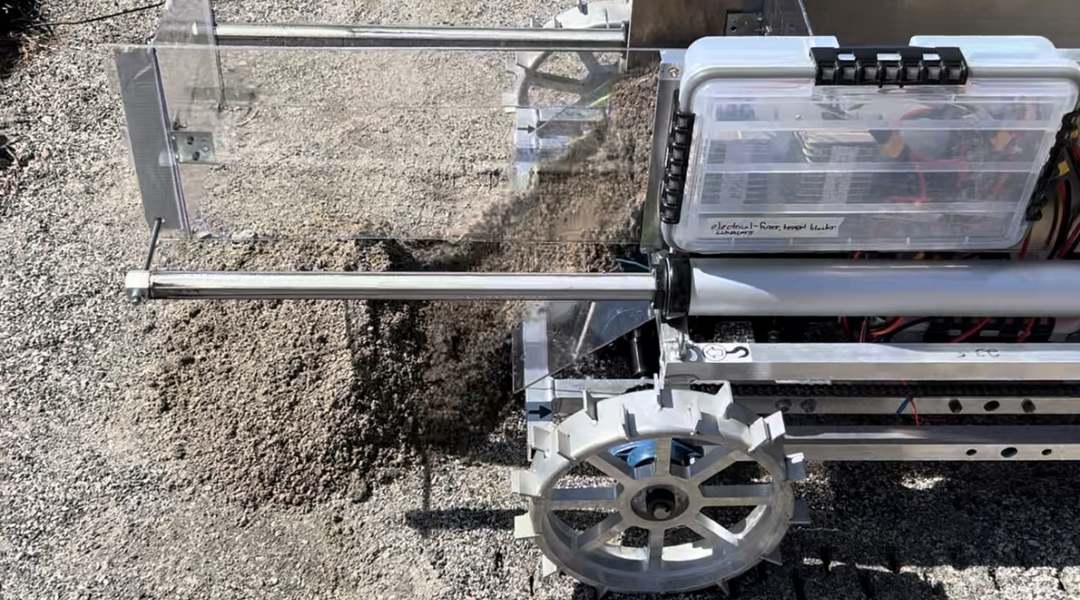
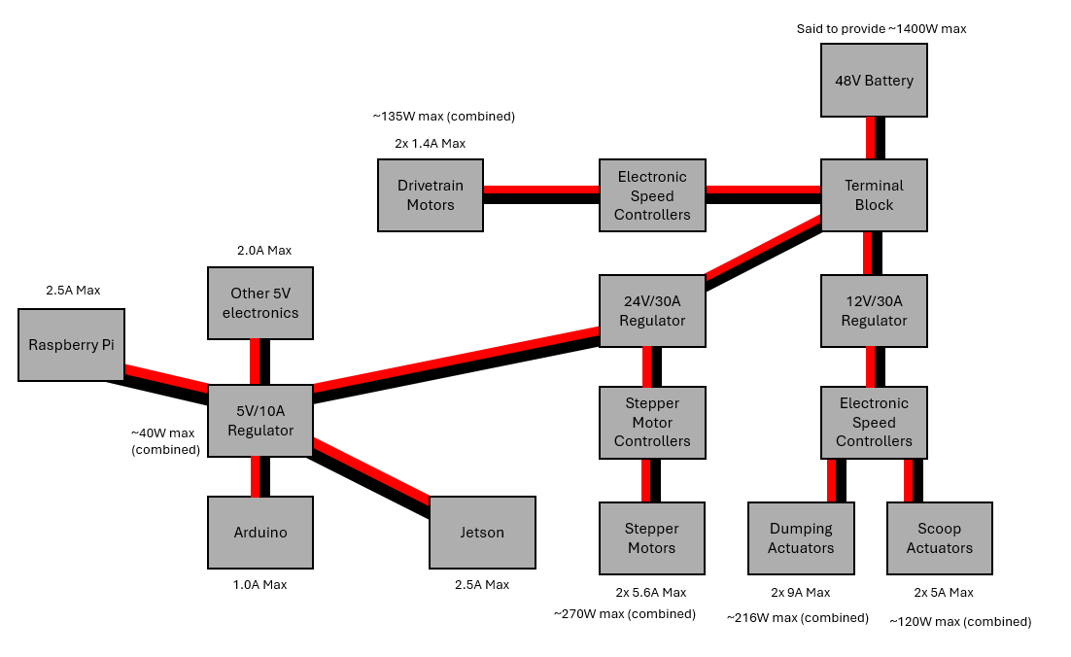
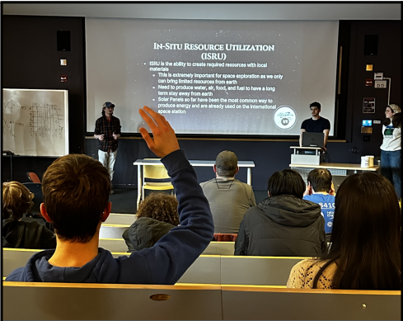
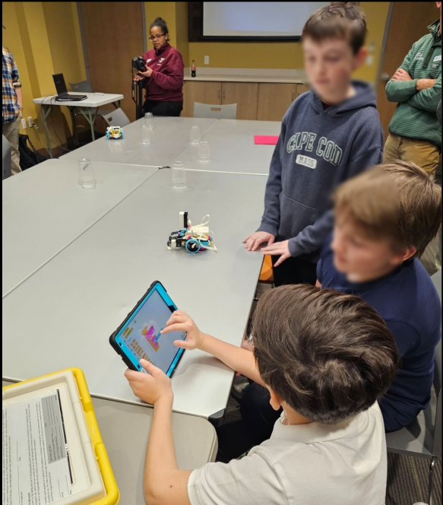
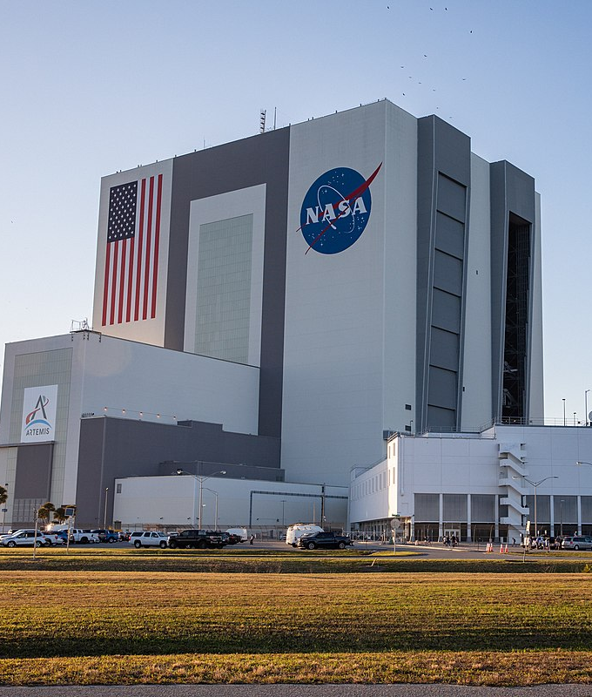
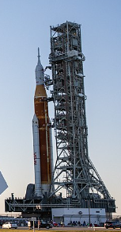
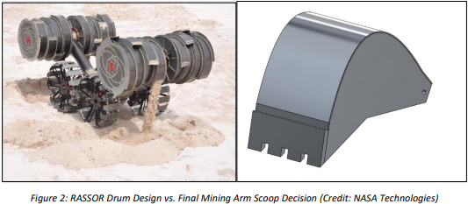
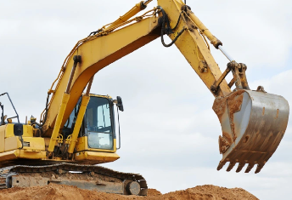
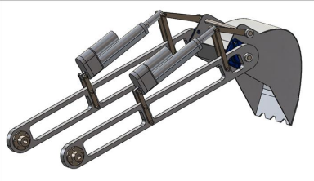
UNH LunaCats | NASA Robotic Mining Team Weston Bartlett, Kaiden Bedell, Christopher Brunet, Anthony Comte, Ethan Costa, Kenneth Fazio, Steven Gallopo, Tyler Jagentenfl, Sean Manning, Cody McBride, Joy Planchet, Noah Simard, and Matt Toppi Advisors: Professor May-Win Thein, ChanLing Beswick University of New Hampshire Department of Mechanical Engineering
Project Overview
Crane Hoist Points
Robotic Mining Arm
Control: Software and Hardware
NASA Lunabotics Competition
(University of Central Florida, Kennedy Space Center)
National college-level lunar rover mining competition held in Florida, hosted by Caterpillar with a $10,000 prize pool.
Interdisciplinary design teams bring robots to compete in a lunar simulant (BP-1 and LHS-1 sandpit) arena.
As part of NASA’s Artemis mission, teams are given material and performance specifications, NASA Deliverables challenge each team in systems engineering and design.
Mounting eyebolts merge above robot’s center of gravity, allowing the robot to be dropped into the competition arena.
Toothed scoop designed for mining lunar regolith and collecting material for berm construction.
Systems Controls & Operation
The robot is controlled via a client-server system in which a laptop is connected to an onboard Raspberry Pi through an external router.
Raspberry Pi communicates with Arduino to send motion commands to different parts of the robot through remote operation.
LiDAR and autonomous run cycles are team goals, granting extra competition points.
Electrical/Control Boxes
Competition Scoring
Competition points can be earned based on performance in many categories including weight, power requirements, & autonomy with a focus on building berms of lunar material on the moon.
House Arduino and Raspberry Pi for motor controls, which draw power from the 48V battery. “Brain” communicates with actuators & motors using electric speed controllers.
Software Design
Mechanical Analysis
Competition Strategy
FEA & Material Selection
The mining arm was optimized using FEA to reduce weight and increase mining strength.
Torque and load analysis in SolidWorks aided in our selection of mining arm and drivetrain motors.
Material strength analysis led to the selection of 6061-T6 Aluminum
Client
The client is run on a local computer using Python, which is connected to the robot via a boosted router setup.
The client was designed for ease of use. The client should be easy to launch and set up, with intuitive driving controls.
Server
The server is run on a Raspberry Pi located on the robot, which sends commands to the Arduino which controls the individual elements of the robot.
The server was designed with consistency in mind. It runs for long driving sessions without crashing and quickly receives and passes on input commands.
Team Performance & Operation Strategy
Analysis was run on payload weight and mining effectiveness.
Our strategy is to make up for lost points in the power and weight categories by designating parts of the robot as “dust-free” features and protecting them from regolith.
Extra points are earned by mining and constructing larger berms.
Vehicle Frame
Welded Al 6061 frame designed to support the load and bear weight of our lunar robot. Mounting considerations and drivetrain influenced its design.
Dumping & Berm Construction
Material is pushed out the back of the robot using two high-speed linear actuators. The dumping bucket was constructed out of plexiglass to keep it lightweight.
Each team is scored based on berm volume and structure, making analysis of this crucial in our strategy.
Drivetrain & Locomotion
A chain-driven motor system utilizes individual motor control for arena navigation. Paddled wheels allow for more wheel surface area in the soft sand-like material.
Server-Client Router Connection Scheme
“Exolith” Arena Competition Movement Strategy (left),
Expected Weight vs Number of Scoops to Meet Volume Goal (0.13 cubic meters, right)
Electrical Analysis
Safety and Effective Design
Our subsystems work on multiple voltage channels (5V-48V).
Voltage regulators step down the battery for our on-board controls.
Ensure design follows competition power guidelines.
Metrics & Project Requirements
Material Analysis
Mechanical Systems Design
The 2024 Lunabotics competition objective, unlike other years, involves the construction of a high-volume berm. Last year’s auger drill was retired for a new mining solution.
FEA & Material Selection
Mining, Dumping, and Frame Design
Our design process involved FEA considerations & mining research that aligned with our competition goals.
A push system was favored over a dump truck dumping mechanism to reduce power and space requirements.
Mining Arm Design
The excavating arm rotates via two stepper motors, turning a shaft using a 40:1 gear ratio to meet torque requirements.
A drum mining system was considered due to the success of the NASA RASSOR robot. An excavator scoop was chosen instead due to our limited accessibility to drum information.
Linear actuators mounted on the arms and the H-link linkage, found on most excavators, allow the serrated scoop to push through hard-packed material.
The mining arm was optimized using FEA to reduce weight and increase mining strength.
Torque and load analysis in SolidWorks aided in our selection of mining arm and drivetrain motors.
Material strength analysis led us to choose strength-to-weight efficient Aluminum 6061-T6 for the robot’s frame, bucket, and mining arm.
Competition Requirements
Robot mass cannot exceed 80kg
Maximum dimensions are 1.5x0.75x0.75 meters
Must function in a lunar environment (no air-filled tires, pneumatics, etc.)
Robot must have an emergency kill switch
Robot must provide its own onboard power
Team Metrics
Robot must mine and displace 0.13 cubic meters of material in 15 minutes to qualify for finals
Material must be displaced in 4 trips from the mining area to the dumping area
Weight budget created to ensure robot did not exceed 155lbs (70kg)
Movement performance tests allow for informed modification of the current drivetrain
Vehicle fits within dimension specs
STEM Engagement (Outreach)
NASA Kennedy Space Center, Cape Canaveral, FL
Community & ARTEMIS
Students were invited to learn about robotics and NASA’s STEM Gateway Competitions.
Exeter YMCA and ORHSR events were held with our team.
Acknowledgments
References
Professor May-Win Thein Project Advisor
Beswick Eng, ChanLing Beswick Business Sponsor
NASA Lunabotics Department, CAT Competition Hosts
White Birch Armory Hardware Support
CEPS and ME Dept Grant & Funding
NASA RASSOR Mining Robot Design Consideration vs. Excavating Scoop

