Slide 1
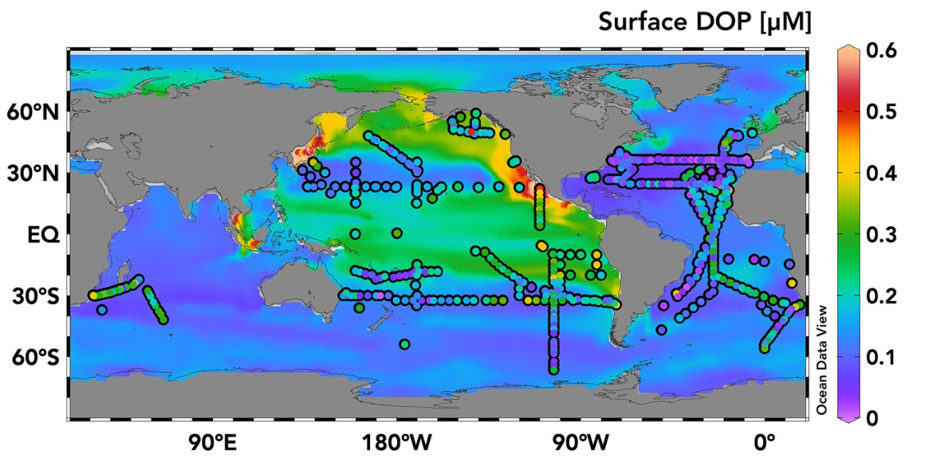
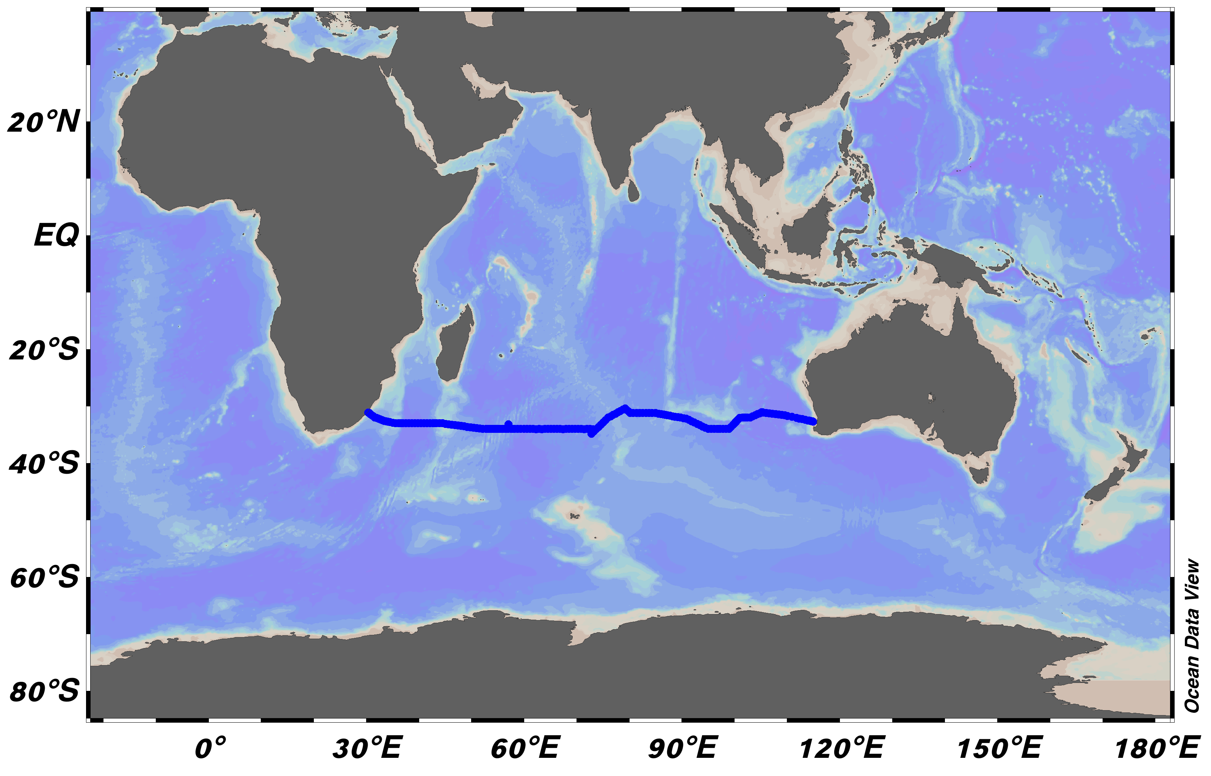
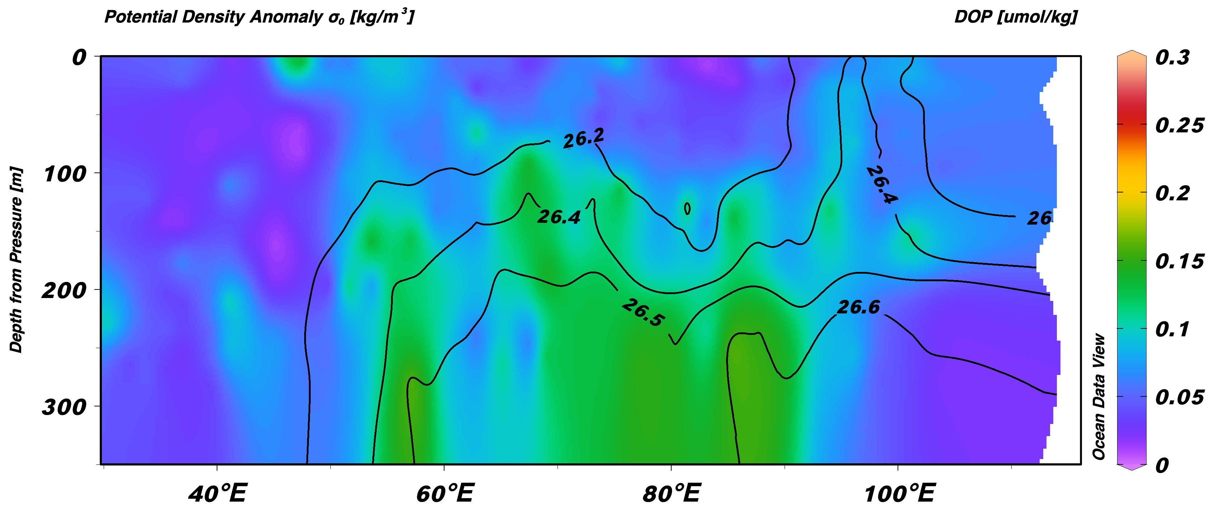
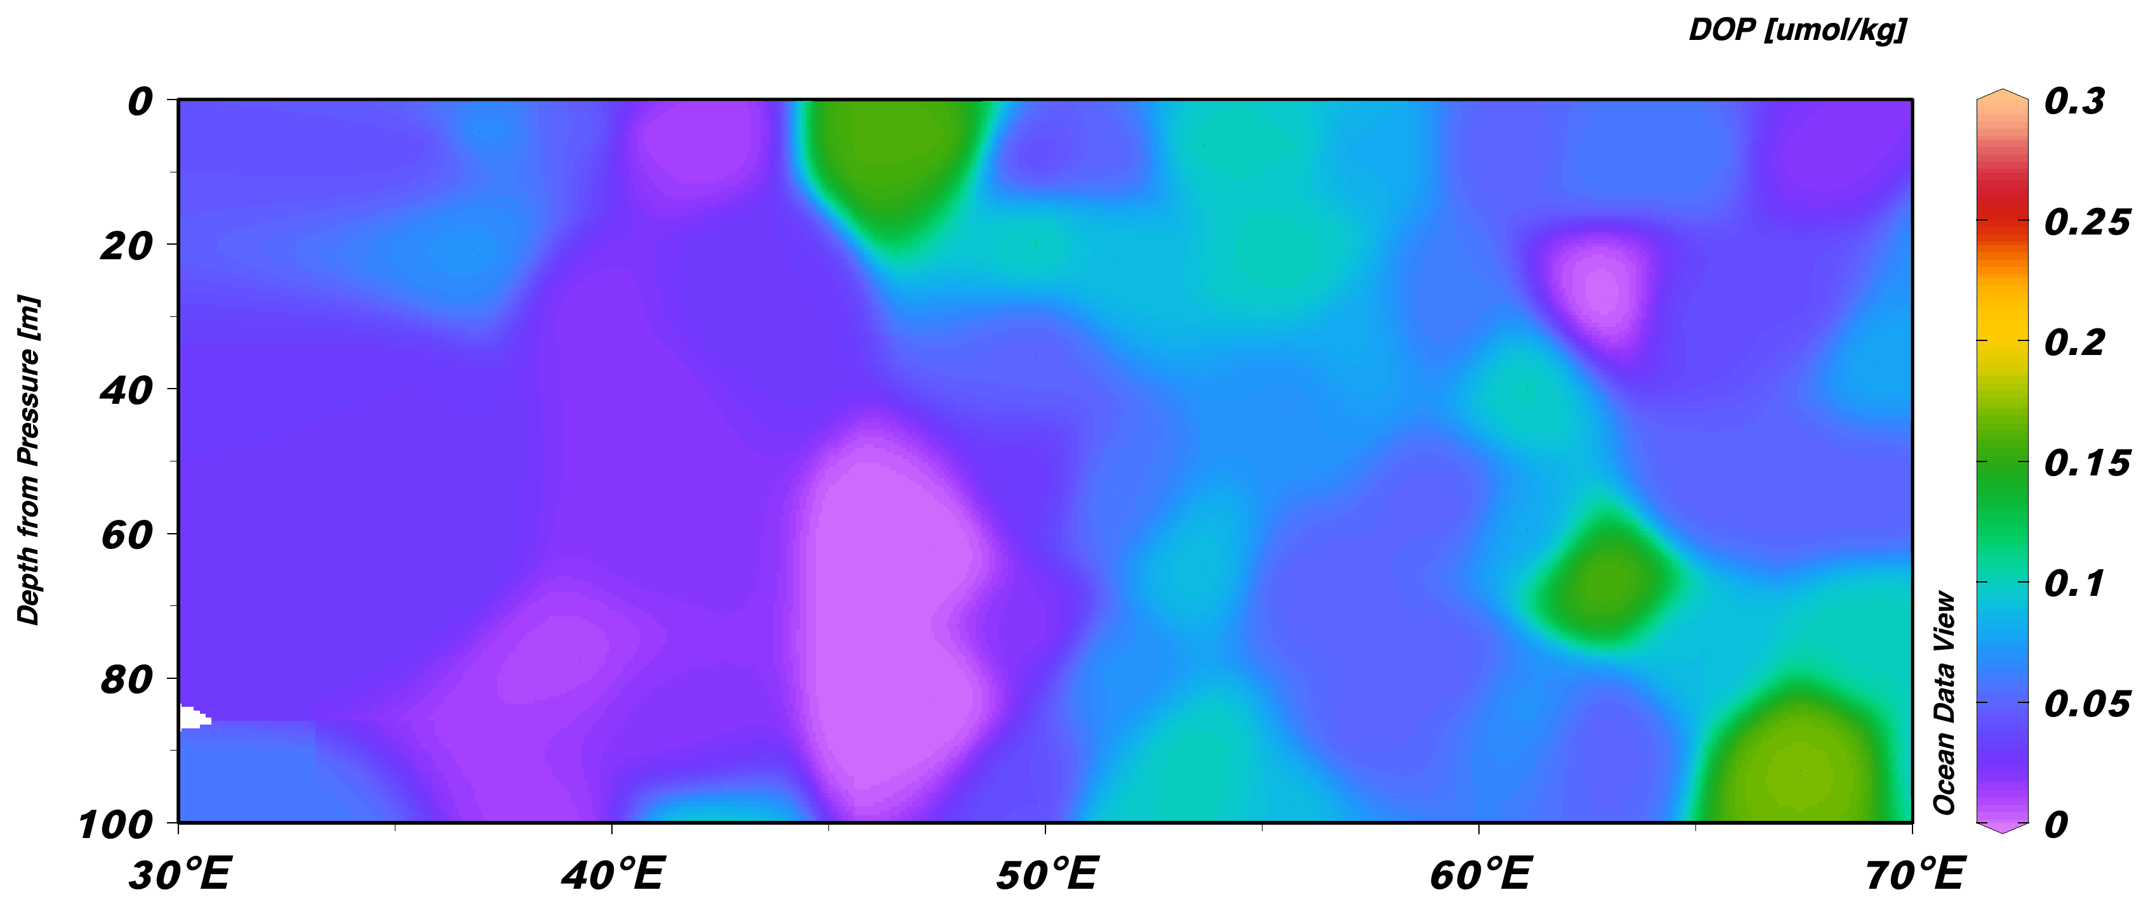
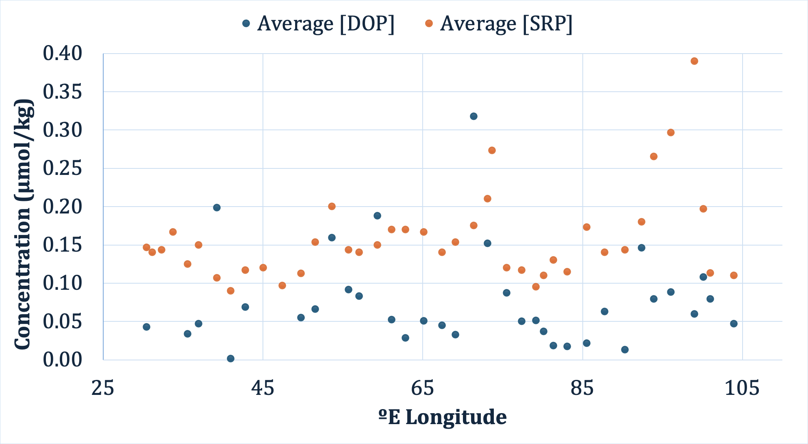
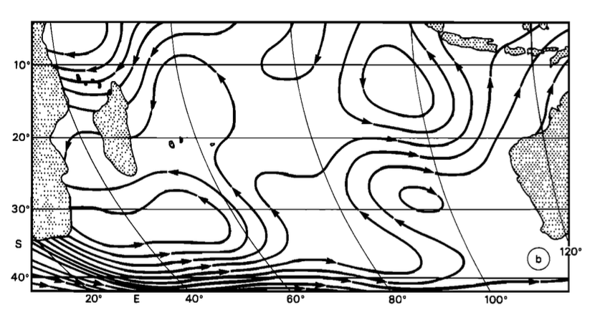
Supply and Consumption of Dissolved Organic Phosphorus Across the Subtropical Indian Ocean Author: Corinne Richard | Advisor: Dr. Robert Letscher Earth Sciences, University of New Hampshire, Durham, NH 03824
Introduction
The Indian Ocean: an understudied region for marine DOP
Results/Discussion
Marine autotrophs (phytoplankton) form the basis of the ocean’s food chain. Phytoplankton rely on ocean nutrients, such as phosphorus and nitrogen, to grow and survive.
Phytoplankton preferentially use inorganic nutrient forms because inorganic P and N molecules are small. Organic P and N molecules are larger and require enzymatic activity (e.g. alkaline phosphatase) to be taken up (Whitney and Lomas 2018).
Models of biological productivity within subtropical oligotrophic (low nutrient) gyres indicate dissolved organic phosphorus (DOP) may be used in place of inorganic phosphorus (PO₄³⁻) by marine autotrophs (Letscher et al 2016; 2022).
One model study estimates DOP contributes 14% of the required P in the global ocean for sustained marine phytoplankton growth (Letscher et al. 2022). To date, field studies of these processes to test the models are dominated in the Atlantic and Pacific Oceans. Here we investigate the DOP distribution and consumption across the Indian Ocean from the I05 US GO-SHIP Cruise (2023) across ~33ºS latitude.
Indian Ocean circulation does not follow the same patterns as other ocean basins. Strong current diversions in the subtropics result in recirculation in the western and central regions of the basin (Stramma and Lutjeharms 1997). Diverging recirculations are observed at 65º and 95ºE (Stramma and Lutjeharms, 1997).
Higher PO₄³⁻ stress leads to higher DOP consumption rates (Liang et al 2022), which has been largely unstudied in the Indian Ocean.
Previous DOP Measurements
I05 Sample Region
Higher [DOP] at the western gyre’s edge @ 52ºE (~ 0.085 ± 0.03 µmol/kg) compared to the gyre’s center @ 40ºE (~0.026 ± 0.015 µmol/kg) suggests biological (autotrophic) consumption:
DOP_{cons} = (∆DOP)(D_{Ek}) / T_{52º–40ºE}
∆DOP = 0.06 mmol m⁻³, D_{ek} = 50 m, T_{52º–40ºE} = 2.2 yr
DOP_{cons} = 1.4 ± 0.05 mmol m⁻² yr⁻¹
E to W flow estimated from drifter velocity to be ~1.64 cm/s (Laurindo et al. 2017).
Mean [DOP] gradient (ΔDOP) in upper 50m = 0.06 µmol/kg
Low PO₄³⁻ concentrations in the upper 50 m (mostly <300nM)
Recirculation and diverging current activity at ~95ºE (Stramma and Lutjeharms 1997) could explain higher nutrient concentration and surface-directed flow in this area
Unused DOP reserves at the surface at ~95ºE due to higher [PO₄³⁻] flow down the 26.2 and 26.4 kg/m³ isopycnals and to the west
Elevated concentrations between the 26.5 and 26.6 kg/m³ isopycnals could be supply from Subantarctic Mode Water (SAMW) flowing northward
→ Sallée et al 2006 estimate SAMW in this region to have a density of 26.65-26.7, but the warming climate in the 19 years since could be enough to influence these measurements ~0.1-0.2 kg/m³
Generally, [DOP] tends to be higher near and along the flow of circulating currents and lower in between (i.e. the gyres)
Upper 50m: longitudinal variability of [DOP] and [PO₄³⁻] follow a similar fluctuation pattern
Figure 1 Courtesy of Letscher et al 2022 (Figure 2). Surface [DOP] estimated from a model output containing DOPv2021 database observations (overlain circles). The large red circle indicates our study region: the Indian Ocean with very few previous DOP observations.
Figure 2 (Blue line) I05 US GO-SHIP cruise transect collected from July 22, 2023 to September 14, 2023 spanning from Fremantle, Australia to Cape Town, South Africa. The nominal latitude is 33ºS.
DOP Distribution
Conclusions
Questions/Motivation
Figure 3 [DOP] in µmol/kg interpolated over 350m depth at ~33ºS in the Indian Ocean from ~30ºE – 105ºE. Green indicates higher concentrations (~0.15 µmol/kg), where blue/purple indicates lowest concentrations (~0.05 µmol/kg to undetectable). Smooth black lines indicate relevant potential densities in σ_{θ} [kg/m³] (isopycnals).
Previous studies using models to estimate autotropic DOP uptake in this region predict DOP_{cons} = 0.49±0.07 mmol m⁻²yr⁻¹ (Letscher et al 2022) → our estimates are almost 3 times higher
→ This model also predicted the fraction of the biological pump supported by DOP to be ~14%; our higher value could indicate DOP to be more important
As the ocean changes with the climate and nutrient availability becomes more unpredictable, the fate of phytoplankton might be more optimistic than previously assumed since DOP concentrations are comparable to PO₄³⁻
The ability of phytoplankton to utilize DOP in place of PO₄³⁻ shows a resilience that could be critical for sustaining ocean ecosystems.
Further research should evaluate the role of iron stress in the Indian Ocean on the utilization of DOP as a photosynthetic nutrient since current research concludes this variable to be an important factor in other ocean basins (Liang et al 2022).
This research is aimed to:
Fill in gaps in knowledge about the phosphorus biogeochemistry of the Indian Ocean.
Answer: What is the longitudinal variability of DOP in the Indian Ocean?
Answer: Is the distribution of DOP concentrations indicative of DOP consumption by marine autotrophs as an organic nutrient?
Answer: What is the rate of autotrophic DOP consumption from Indian Ocean surface waters?
Methods
Methods
Water samples were collected in the Indian Ocean from July 22, 2023 to September 14, 2023 on the I05 US GO-SHIP Cruise spanning from Fremantle, Australia to Cape Town, South Africa
DOP is computed as the difference of total dissolved phosphorus (TDP) and soluble reactive phosphorus (SRP) using
[DOP] = [TDP] – [SRP]
Soluble reactive phosphorus is the inorganic phosphorus, or phosphate (PO₄³⁻)
Nutrient analysts aboard the cruise determined SRP values photometrically using the molybdenum blue method.
TDP measurements were made at UNH from acidified and refrigerated samples using a SEAL Analytical AQ300 Discrete Analyzer system.
Samples are digested prior to analysis with an oxidizing acidic potassium persulfate reagent (POR). Digestion converts all organic phosphorus forms to PO₄³⁻.
After digestion, the same colorimetric method is used via the AQ300. Deeper blues (higher absorbances) indicate higher phosphorus content. TDP values are adjusted to the POR blank using
[TDP]_{samp} = ([PO₄³⁻]_{meas}*5.4 mL – [PO₄³⁻]_{POR}*0.4 mL)/ 5 mL
The uncertainty on DOP concentration determinations is ~5-10% or 0.002 to 0.02 µmol/kg
sTAMD Simulations
Physical Supply & Autotrophic Consumption from the upper 50 meters
Average [DOP] and [PO₄³⁻] in upper 50 m
DOP consumption
Acknowledgements
Thank you to Dr. Robert Letscher and Caroline Anderson for substantial support, guidance, and assistance.
Thank you to the UNH Earth Sciences department.
Thank you to the 2023 I05 US GO-SHIP crew.
References
Laurindo, L., A. Mariano, and R. Lumpkin, 2017: An improved near-surface velocity climatology for the global ocean from
drifter observations Deep-Sea Res. I, 124, pp.73-92, doi:10.1016/j.dsr.2017.04.009
Letscher, R. T., Primeau, F., & Moore, J. K. (2016). Nutrient budgets in the subtropical ocean gyres dominated by lateral
transport. Nature Geoscience, 9(11), 815–819.https://doi.org/10.1038/ngeo2812
Letscher, R. T., Wang, W., Liang, Z., & Knapp, A. N. (2022). Regionally variable contribution of dissolved organic phosphorus
to Marine Annual Net Community production. Global Biogeochemical Cycles, 36(12).
https://doi.org/10.1029/2022gb007354
Liang, Z., Letscher, R. T., & Knapp, A. N. (2022). Dissolved organic phosphorus concentrations in the surface ocean controlled
by both phosphate and iron stress. Nature Geoscience, 15(8), 651–657. https://doi.org/10.1038/s41561-022-00988-1
Sallée, J.-B., Wienders, N., Speer, K., & Morrow, R. (2006). Formation of subantarctic mode water in the southeastern Indian
Ocean. Ocean Dynamics, 56(5–6), 525–542. https://doi.org/10.1007/s10236-005-0054-x
Stramma, L., & Lutjeharms, J. R. (1997). The flow field of the subtropical gyre of the South Indian Ocean. Journal of
Geophysical Research: Oceans, 102(C3), 5513–5530. https://doi.org/10.1029/96jc03455
Whitney, L.P., & Lomas, M. W. (2018). Phosphonate utilization by eukaryotic phytoplankton. Limnology and Oceanography
Letters, 4(1), 18-24. https://dio.org/10.1001/lol2.10100
Above: Interpolated [DOP]in the Indian Ocean at ~33ºS. The red star indicates an area of higher concentration at the edge of the gyre; the yellow star indicates a region of lower concentration in the gyre's center. The arrow indicates the direction of DOP consumption.
Below: Indian Ocean circulation courtesy of Stramma and Lutjeharms 1997. Stars correspond with the figure above.
Figure 4 Average [DOP] and [PO₄³⁻] in the upper 50m of the Indian Ocean at ~33ºS from ~30ºE – 105ºE. Blue circles indicate [DOP]; orange circles indicate [SRP], or [PO₄³⁻]. Low [PO₄³⁻] is considered to be ~10-300 nM (Letscher et al 2022). [0.20 µmol/kg = 200nM].
Image courtesy of Stramma and Lutjeharms 1997

