Slide 1
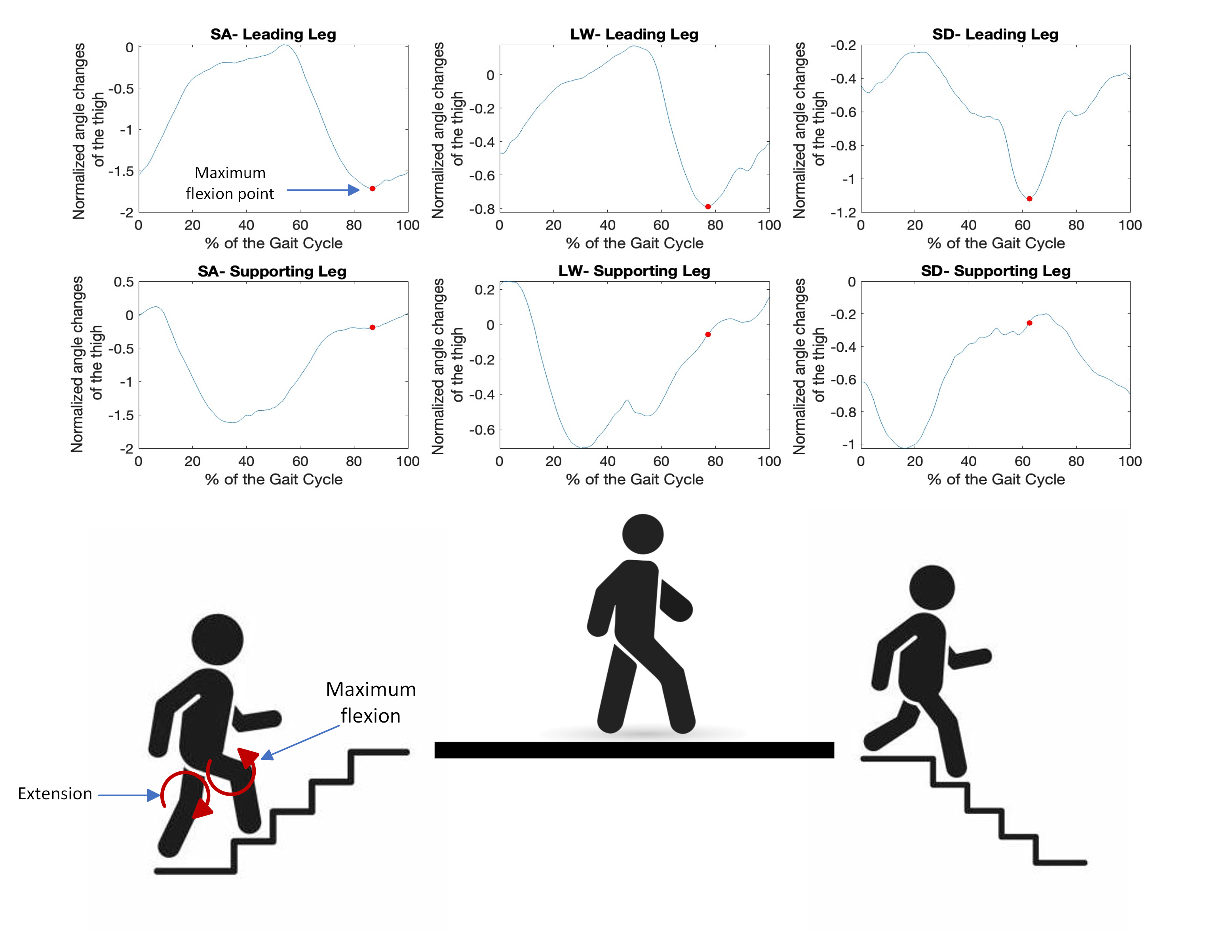
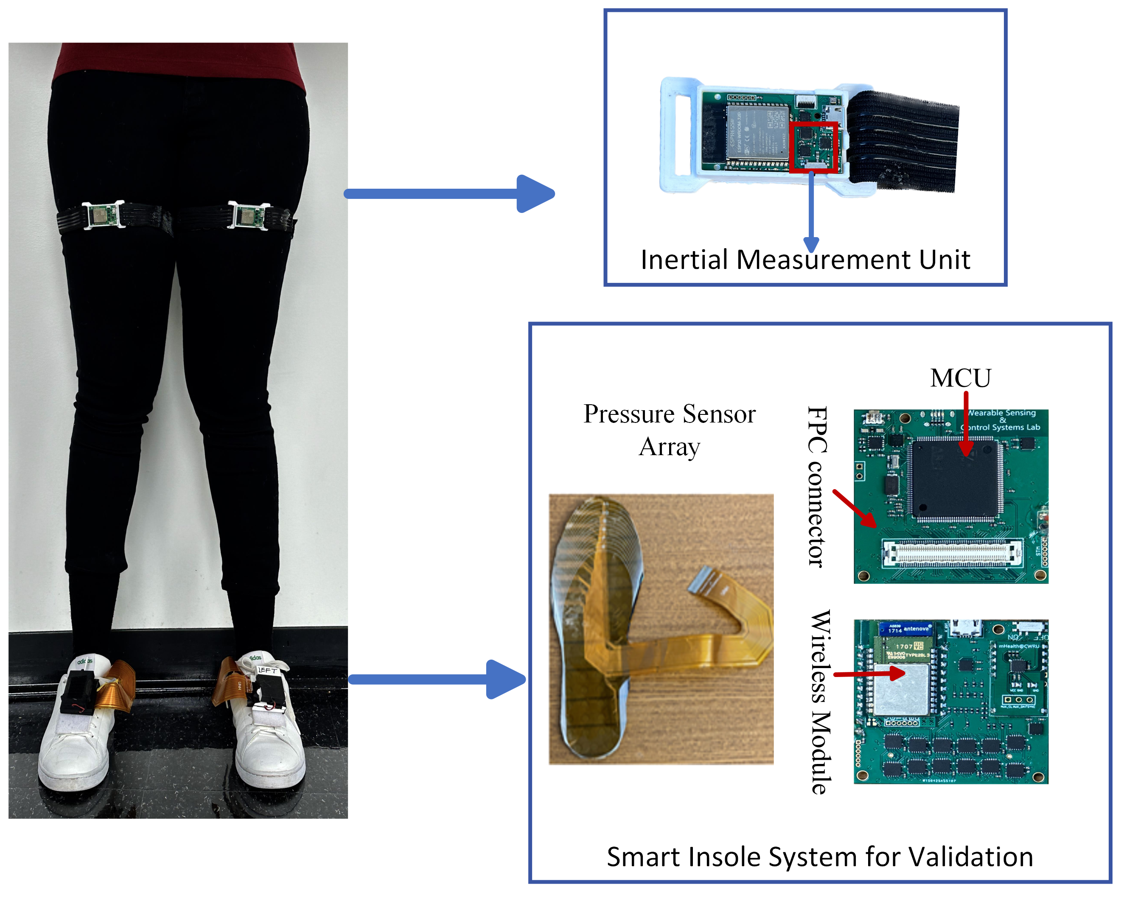
Human Motion Intention Recognition with Thigh-Mounted IMUs Stella Ansah, Diliang Chen, and Se Young Yoon. Department of Electrical and Computer Engineering, University of New Hampshire.
Introduction
Methods
Assistive devices such as powered prostheses have the potential to help people with amputations by restoring mobility and contributing to their independence. The ability to recognize human intentions and preceding actions is critical to the smooth and safe interaction between a user and the powered prosthesis. Although many methods have been proposed to recognize the user's intended motion, most methods rely on multiple sensors placed on various body segments, making them impractical for many real-world applications. In addition, sliding-window-based methods are typically employed for analysis and feature extraction. However, the inability to adapt the window size to varying walking speeds limits the performance of most existing methods in real applications.
To address these challenges, this study proposes a novel intention recognition approach based solely on thigh-mounted inertial measurement units (IMUs) and an event-based feature extraction approach that achieved a good generalization performance across different speeds and subjects. The system achieves an accuracy greater than 99% for all test subjects in the Leave-One-Subject-Out validation. The activities were recognized between 150.63 to 724.32 milliseconds before the next foot contact event. These results demonstrate the potential of the proposed method in recognizing the motion intention of a user to enable optimized control of the powered prosthesis in time.
Two IMUs nine-axis Inertial Measurement Units (IMUs) mounted on both thighs were used for motion intention recognition.
A smart insole system made up of 96 pressure sensors was used to evaluate the performance of the proposed method.
Participants completed repetitions of a circuit that involving level-ground walking, stair ascent, and stair descent activities, along with the transitions between these activities.
A total of ten healthy subjects, aged between 22 and 32, with a mean age of 28 and a standard deviation of 3, participated in the study.
To recognize activity transitions, changes in thigh angle resulting from hip flexion and extension were extracted from the IMU times series data and used to train a weighted K-Nearest Neighbor (KNN) machine learning model.
Results
Table 1: Leave-One Subject Out Validation: True Positive Rates for the different Activities.
Table 2 : Average prediction times for different activities as a percentage of the entire gait cycle and actual prediction time in milliseconds.
Future Work
\ | LW | LW-SA | LW-SD | SA | SA-LW | SD | SD-LW
1 | 100% | 100% | 93.8% | 100% | 100% | 99.6% | 100%
2 | 97.6% | 100% | 100% | 100% | 100% | 100% | 100%
3 | 100% | 100% | 86.1% | 100% | 100% | 100% | 100%
4 | 100% | 100% | 95.1% | 100% | 100% | 100% | 100%
5 | 100% | 100% | 81.6% | 100% | 100% | 100% | 100%
6 | 100% | 100% | 100% | 100% | 100% | 100% | 100%
7 | 100% | 100% | 100% | 100% | 100% | 100% | 100%
8 | 100% | 100% | 100% | 100% | 100% | 100% | 100%
9 | 100% | 100% | 91.2% | 100% | 100% | 100% | 100%
10 | 99.9% | 97.3% | 91.7% | 100% | 100% | 100% | 100%
Average | 99.76% | 99.73% | 93.95% | 100% | 100% | 99.96% | 100%
Activity | Prediction time-Slow (ms) | Prediction time-Normal (ms) | Prediction time-Fast (ms) | Percentage of the Gait Cycle – Slow | Percentage of the Gait Cycle – Normal | Percentage of the Gait Cycle – Fast
LW | 370.98 | 324.19 | 260.22 | 20.06% | 22.98% | 22.53%
LW-SA | 391.43 | 285.45 | 165.83 | 17.64% | 18.55% | 15.07%
SA | 275.31 | 172.50 | 150.63 | 11.61% | 10.30% | 12.70%
SA-LW | 299.29 | 238.18 | 255.83 | 13.19% | 13.71% | 18.81%
LG-SD | 661.33 | 529.09 | 428.00 | 29.30% | 32.88% | 34.22%
SD | 724.32 | 525.47 | 385.43 | 32.49% | 34.49% | 34.39%
SD-LG | 478.57 | 359.00 | 289.17 | 24.16% | 25.31% | 25.62%
Towards a more practical motion intention recognition system.
Less obtrusive
User friendly
Ideal for foot ankle prosthesis
Less number of sensors
References
.
D.Chen,Y.Cai,andM.-C.Huang,“Customizable pressure sensor array: Design and evaluation,” IEEE Sensors Journal, vol. 18, no. 15, pp. 6337– 6344, 2018.
S. Ansah and D. Chen, “Wearable-gait-analysis-based activity recogni- tion: A review,” International Journal on Smart Sensing and Intelligent Systems, vol. 15, p. 20220021, 01 2023.
B. Hu, E. Rouse, and L. Hargrove, “Fusion of bilateral lower-limb neuromechanical signals improves prediction of locomotor activities,” Frontiers in Robotics and AI, vol. 5, 2018. [Online]. Available: https://www.frontiersin.org/articles/10.3389/frobt.2018.00078
D. Chen, Y. Cai, X. Qian, R. Ansari, W. Xu, K.-C. Chu, and M.- C. Huang, “Bring gait lab to everyday life: Gait analysis in terms of activities of daily living,” IEEE Internet of Things Journal, vol. 7, no. 2, pp. 1298–1312, 2020.
LW: Level Ground Walking, LW-SA : Level Ground Walking to Stairs Ascend, LW-SD : Level Ground Walking to Stairs Descend, SA: Stairs Ascend, SA-LW : Stairs Ascend to Level Ground Walking , SD: Stairs Descend, SD-LW : Stairs Descend to Level Ground Walking.

