Slide 1


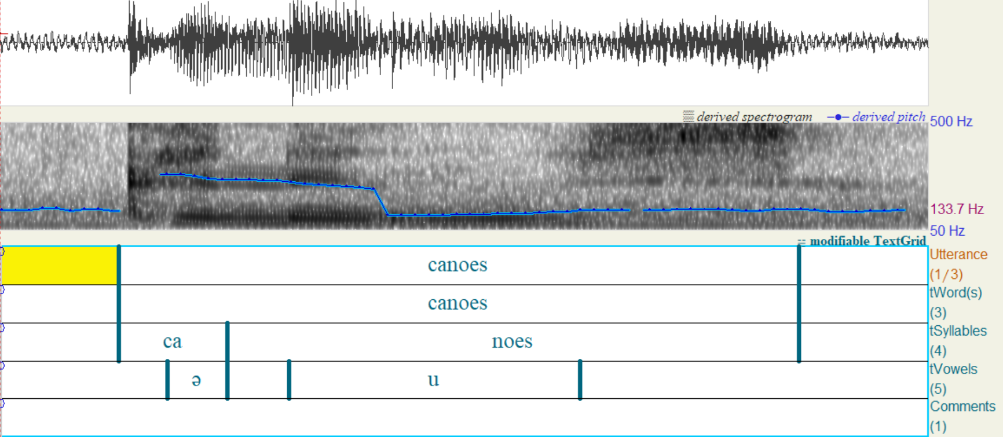
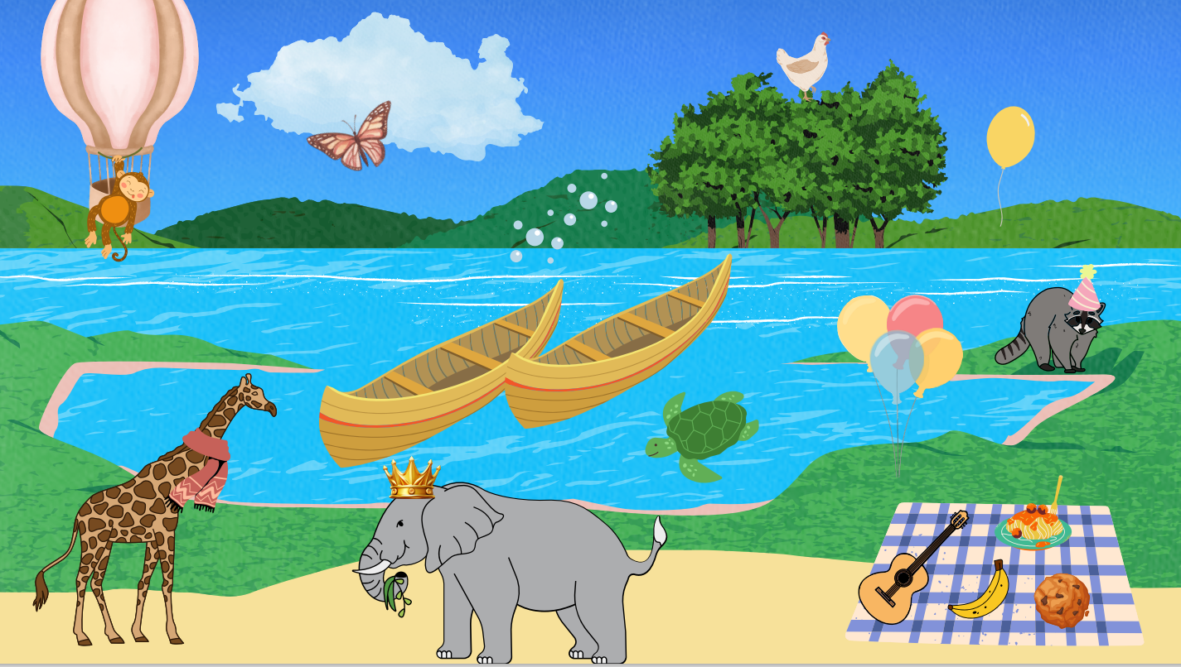


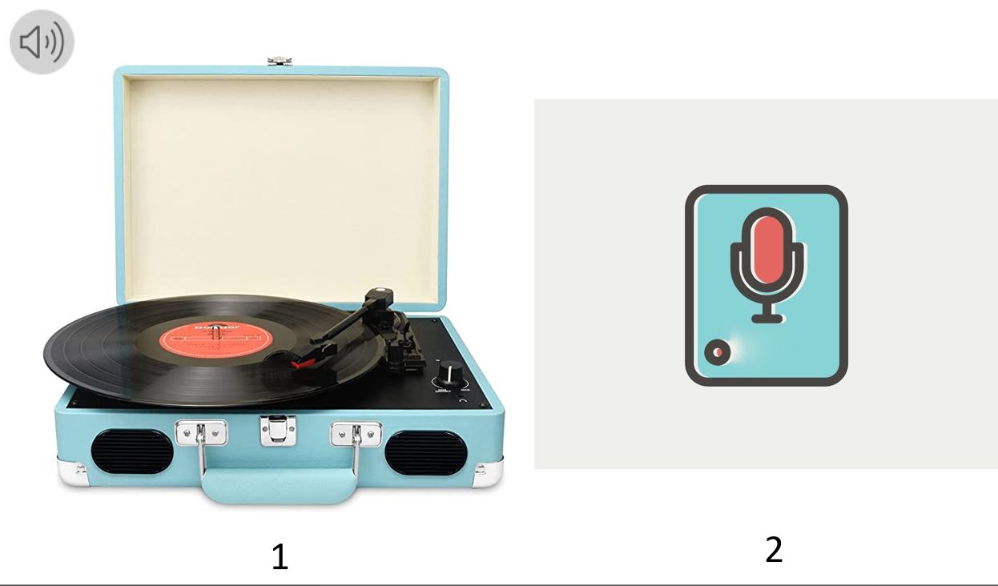
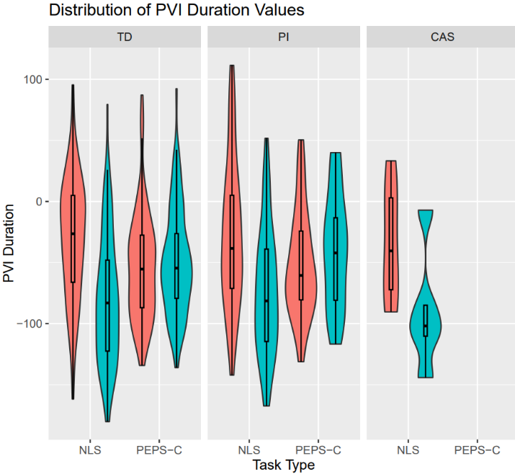
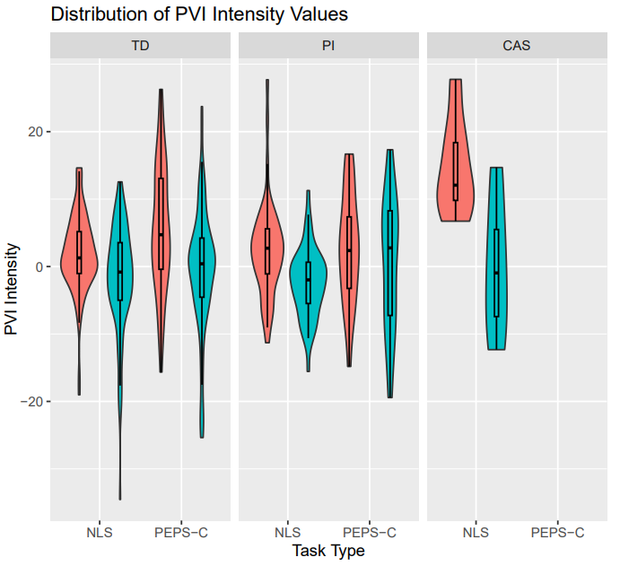
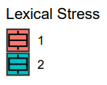
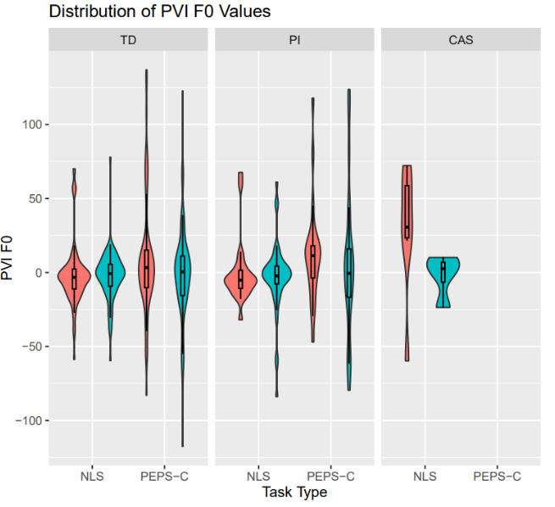
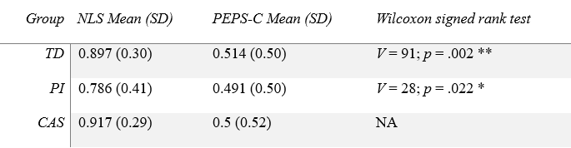
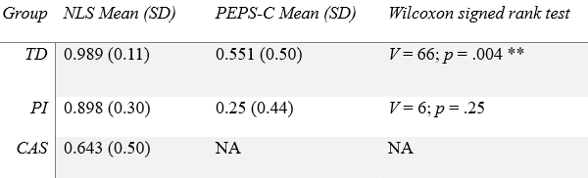
Melody of Speech Assessment in Children
Rachel Courter
Masters Thesis Advisor: Dr. Jill Thorson
Department of Communication Sciences and Disorders, CHHS
Communication, Acquisition, and Translational Studies Lab
Introduction
Methods
Discussion
Prosody is the melody and rhythm of speech and is vital in understanding language and diagnosing speech disorders ([1], [2])
Strong need for a clinical tool to analyze prosodic features which are critical in determining delay or disorder ([3])
Support Speech Language Pathologists’ (SLPs’) ability to diagnose speech-language disorders with diagnostic prosodic features ([4], [5])
Few prosodic assessments exist:
  PVSP & PROP: limited normative data & lack receptive analysis ([6], [7]), PPAT for hearing loss ([8])
Profiling Elements of Prosody in Speech-Communication (PEPS-C) ([9])
  Assesses 7 prosodic abilities (receptive & expressive)
  Populations studied: children & adults who are typically developing (TD), and those with ASD, Williams syndrome, SLI/DLD, and other communication difficulties ([10], [11])
Development of assessment considerations: Elicitation of target
Naturalistic (spontaneous - produce target within conversation) vs. structured (produce isolated target sentence/word)
Development of Naturalistic Lexical Stress (NLS) tasks
  Previous study: higher lexical stress accuracy when assessed in a naturalistic & spontaneous interaction ([12])
Analysis considerations: Perceptual & acoustic measures ([13])
Perceptual correlates: length, loudness, pitch
  Accuracy based on examiner skill & knowledge
Acoustic correlates: duration, intensity, fundamental frequency (f0)
  Normalized Pairwise Variability Index: ([14])
  Previous study: nPVI_dur & nPVI_int significant predictors of stress ([12])
Study Aims
Aim 1: Make improvements to NLS receptive & expressive tasks to better control for factors including sentence position, phrase final lengthening, & uncertainty contour
  Hypothesis 1: Improvements will allow for additional acoustic comparisons of expressive responses across participants
Aim 2: Examine expressive & receptive prosodic abilities of children aged 5- to 11-years-old who are TD, diagnosed with childhood apraxia of speech (CAS), or a phonological impairment (PI) after completing eight PEPS-C subtests & two NLS tasks
  Hypothesis 2: Participants will perform better on the NLS subtests due to the naturalistic elicitation of the target words
Participants
Children aged 5- to 11-years-old
21 participants (13f, 8m); 3 groups (13 TD, 7 PI, 1 CAS)
Inclusion: native speaker of US English, normal vision, hearing, and IQ, no other neurologic, developmental, or genetic disorder, score within 1SD of language screener
Procedure
Consent, assent, & demographic forms
Audiogram & vision screening
Language screening: CELF-5 Screener ([15])
PEPS-C (v2015) administration
  Vocabulary & image check
  8 tasks (4 understanding, 4 expression)
NLS (updated) administration
  Vocab Check & NLS Receptive task
  Vocab Check & NLS Expressive task
Analysis
NLS & PEPS-C receptive tasks automatically scored
Audio recorded for acoustic analysis & reliability
Expression tasks spliced and labeled in Praat acoustic software (utterance, word, syllable, vowel) ([16])
Perceptual & acoustic analyses (nPVI_dur, nPVI_int, nPVI_dur)
Improved lexical stress performance of TD and PI groups in a more natural and spontaneous interaction
In agreement with earlier findings, duration and intensity are significant acoustic predictors of lexical stress
Higher accuracy for NLS over PEPS-C tasks
Improved internal consistency of NLS expressive task from previous study ([12])
Future work:
Continue recruitment to increase sample size
Develop naturalistic contrastive stress receptive & expressive task
Limitations: Sample size, testing environment
Broader Clinical Impact: Importance for continued development of a comprehensive naturalistic prosodic assessment as it captures a more accurate representation of receptive & expressive ability
Feature | Definition
Affect | Emotion, like or dislike, sarcasm, irony
Phrasing | Creates units within spoken language
Rhythm | Timing, syllables, and stress
Tempo | Speed & rate of speech
Speech Melody | Intonation (e.g., rising & falling pitch)
Lexical Stress | Emphasis placed on a particular syllable
Example of Praat coding
Example PEPS-C Task
Example NLS Task
Acknowledgements & References
PEPS-C Lexical Stress Task
NLS Receptive Task
Special thanks to my advisor, Dr. Jill Thorson, and my committee members Prof. Amy Plante, Dr. Don Robin, and Dr. Edwin Maas. Thanks to the members of the CAT Lab at UNH for their help with data coding and analysis.
[1] Thorson, J. C. (2019). Prosody. The SAGE Encyclopedia of Human Communication Sciences and Disorders, 1489–1491. [2] Fernald, A., & Hurtado, N. (2006). Names in frames: Infants interpret words in sentence frames faster than words in isolation. Developmental Science, 9(3), F33-F40. [3] McSweeny, J. L., & Shriberg, L. D. (2001). Clinical research with the prosody-voice screening profile. Clinical Linguistics & Phonetics, 15(7), . [4] Hawthorne, K., & Fischer, S. (2020). Speech-language pathologists and 505–528prosody: Clinical practices and barriers. Journal of Communication Disorders, 87. https://doi-org.unh.idm.oclc.org/10.1016/j.jcomdis.2020.106024. [5] Randazzo, M. (2019). A survey of clinicians with specialization in childhood apraxia of speech. American Journal of Speech-Language Pathology, 28(4), 1659–1672. https://doi-org.unh.idm.oclc.org/10.1044/2019_AJSLP-19-0034. [6] Diehl, J. J., & Paul, R. (2009). The assessment and treatment of prosodic disorders and neurological theories of prosody. International Journal of Speech-Language Pathology, 11(4), 287–292. [7] Crystal, D. (1982). Profiling linguistic disability. E. Arnold. [8] Klieve, S. A. (1998). Perception of prosodic features by children with cochlear implants. Is it sufficient for understanding meaning differences in language (Unpublished master’s thesis). University of Melbourne, Australia. . [9] Peppé, S. (2015). PEPS-C: a test of prosodic ability. PEPS-C. http://www.peps-c.com/peps-c-2015.html. [10] Peppé, S., & McCann, J. (2003). Assessing intonation and prosody in children with atypical language development: The PEPS-C test and the revised version. Clinical Linguistics & Phonetics, 17(4–5), 345–354. [11] Wells, B., & Peppe, S. (2003). Intonation abilities of children with speech and language impairments. Journal of Speech, Language, and Hearing Research, 46(1), 5–20. [12] Dempsey, O., & Thorson, J. C. (2023). Prosodic assessment of language and speech. Presented at the American Speech Hearing Association Convention. Boston, MA. [13] Shattuck-Hufnagel, S., & Turk, A. E. (1996). A prosody tutorial for investigators of auditory sentence processing. Journal of Psycholinguistic Research, 25(2), 193–247. https://doi.org/10.1007/BF01708572. [14] Grabe, E., & Low, E. (2002). Durational Variability in Speech and the Rhythm Class Hypothesis. In C. Gussenhoven & N. Warner (Eds.), Papers in Laboratory Phonology 7. Cambridge: Cambridge University Press. [15] Wiig, E. H., Semel, E., & Secord, W. A. (2013). Clinical evaluation of language fundamentals–fifth edition (CELF-5). Journal of Psychoeducational Assessment, 33(5), 495–500. [16] Boersma, P., & Weenink, D. (2023). Praat: doing phonetics by computer [Computer program]. Version 6.1.39, retrieved 26 February 2023 from http://www.praat.org/
IMprint (noun) or imPRINT (verb)
NLS Expressive Task
Results
Acoustic Analyses
Generalized linear model (GLM) implemented to investigate expressive task with nPVI_dur, nPVI_f0, and nPVI_int as predictor variables for stress pattern
TD group
nPVI_dur (β = -0.011, p < 0.001) and nPVI_int (β = -0.081, p < 0.001) significantly predict stress
nPVI_f0 was not a significant predictor (β = 0.002, p = 0.741)
PI group
nPVI_dur (β = -0.009, p < 0.001) and nPVI_int (β = -0.062, p < 0.05) significantly predict stress
nPVI_f0 was not a significant predictor (β = 0.02, p = 0.742)
Accuracy
Wilcoxon signed rank tests used to compare accuracy between group & task
TD group performed significantly better on NLS expressive (V = 66; p = .004) and receptive subtests (V = 91; p = .002)
PI group performed significantly better on NLS receptive subtest (V = 28; p = .022); expressive accuracy was not significantly different (V = 6; p = .25), but NLS mean was higher
Generalized linear mixed effects model (GLMM) indicated task (PEPS-C vs. NLS) significantly impacted receptive accuracy (β = -1.45, p < 0.001)
nPVI = 100 x [d_{k} – d_{k+1})/( d_{k} + d_{k+1})/2]
Acoustic Correlate | Measurement
f0 | Maximum, minimum, and range - Calculate nPVI_f0
Duration | Measured in milliseconds (ms) - Calculate nPVI_dur
Intensity | Maximum vocal intensity for vowels within weak and strong syllables - Calculate nPVI_int
Trochaic (SW)
Iambic (WS)
Reliability
25% of expressive tasks randomly selected
  intra-rater: κ = .974
  inter-rater: κ = .895
Both near perfect agreement (p <.001)
Internal Consistency
Kudar-Richardson Formula 20 (KR-20)
α = .599 for NLS expressive
α = .388 for NLS receptive
Mean accuracy by group across receptive tasks
Mean accuracy by group across expressive tasks
Notes:
of

