Slide 1
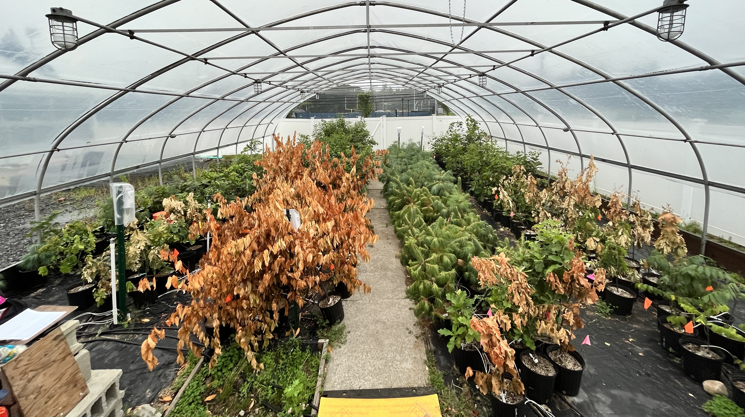
Assisted migration and drought in the Northeast U.S.
Sam Zuckerman, PhD Candidate
Natural Resources and Earth Systems Science

Slide 2
Forest cover in the U.S.
Notes:
This is a map of woody biomass in the continental U.S.
Take a close look at where we are in the northeast.

Slide 3
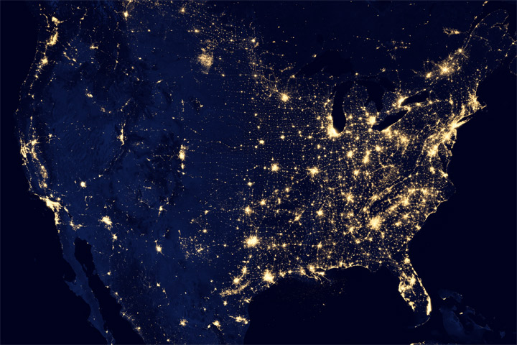
Night sky in the U.S.
Notes:
This is a map of the night sky, with the lights showing population hotspots.
Again, take a look at the Northeast.

Slide 4
The NE is…heavily forested AND densely populated!
Notes:
If we compare these maps side by side, we can see that the northeast is the most heavily forested and densely populated region in the country.

Slide 5
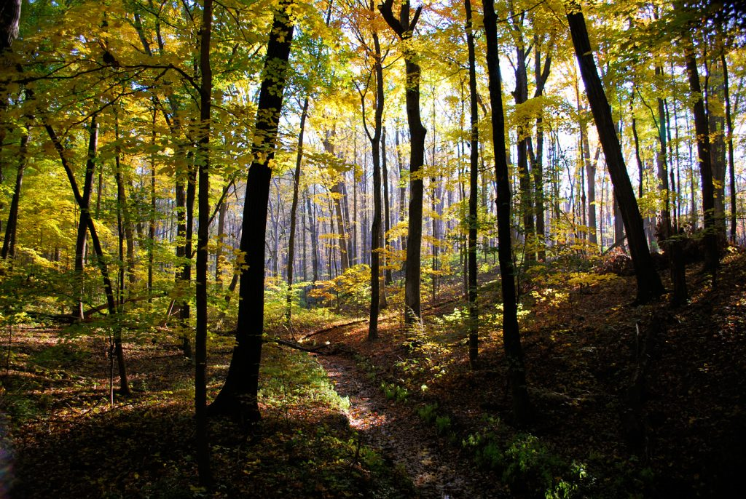
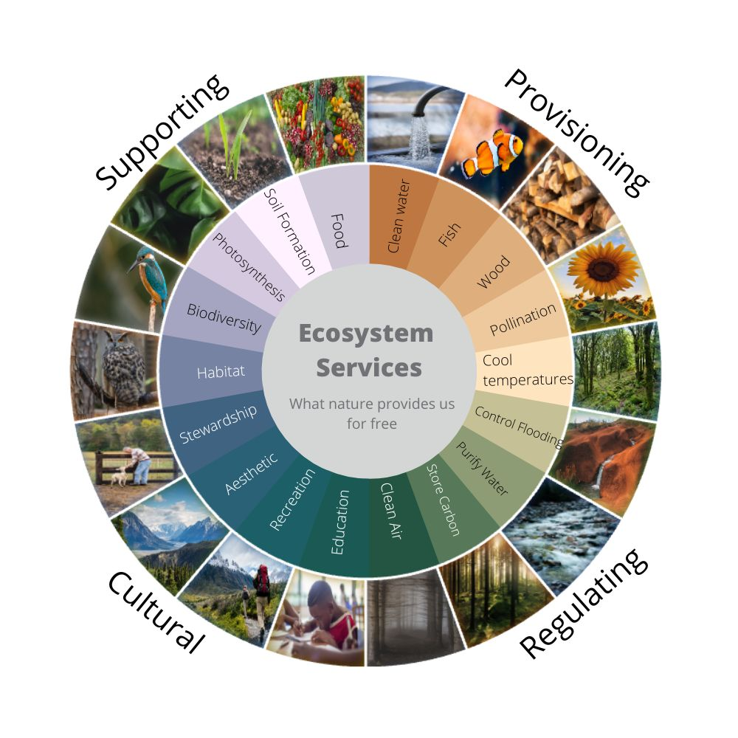
PC: Greg Immel
©Visionlearning - Inspired by graphic from TEEB Europe
Notes:
In this region, millions of people rely on the sustainable management of forest ecosystems for timber production, carbon sequestration, erosion control, recreation, cultural goods and much more. And when we manage forests sustainably, we always get co-benefits, that is timber production AND wildlife habitat, carbon sequestration AND recreation potential.

Slide 6
“protect, restore, and promote the sustainable use of terrestrial ecosystems, sustainably manage forests…”
PC: Greg Immel
©Visionlearning - Inspired by graphic from TEEB Europe
Notes:
Acknowledging the importance of forests to the global population, the United Nations created the goal to protect, restore, and promote the sustainable use of terrestrial ecosystems. They highlight sustainably managing forests as a key mechanism to achieving this goal.

Slide 7
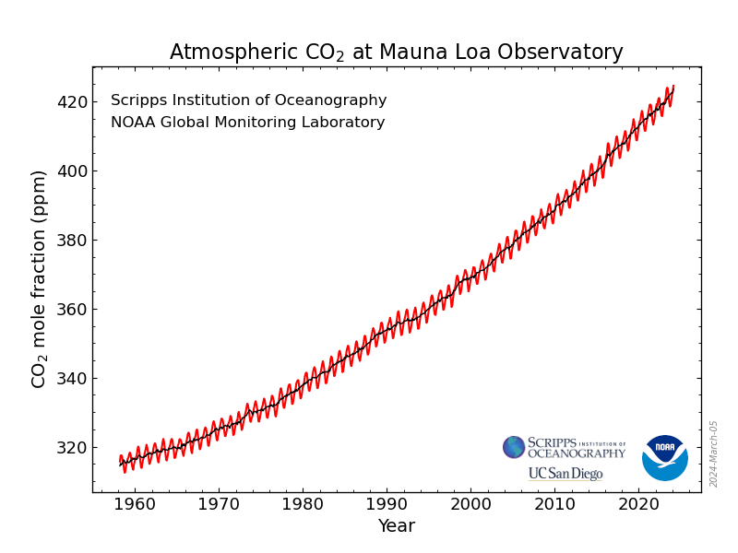
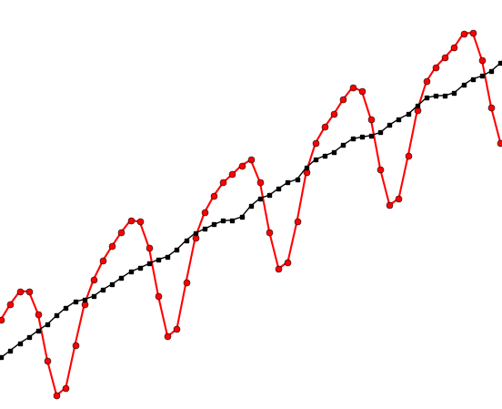
CO2
O2
C
Carbon uptake
Notes:
To illustrate one reason trees are so important for humanity, we can look at the monthly carbon dioxide trends over the last 60 years. The peaks here represent the winter months when CO2 is more abundant in the atmosphere and the valleys represent the summer months when trees are sucking CO2 out of the atmosphere and storing it as carbon

Slide 8
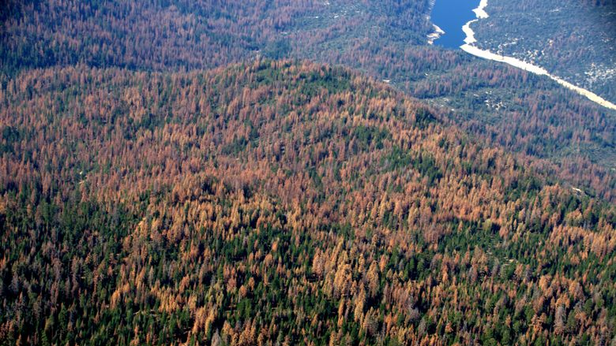
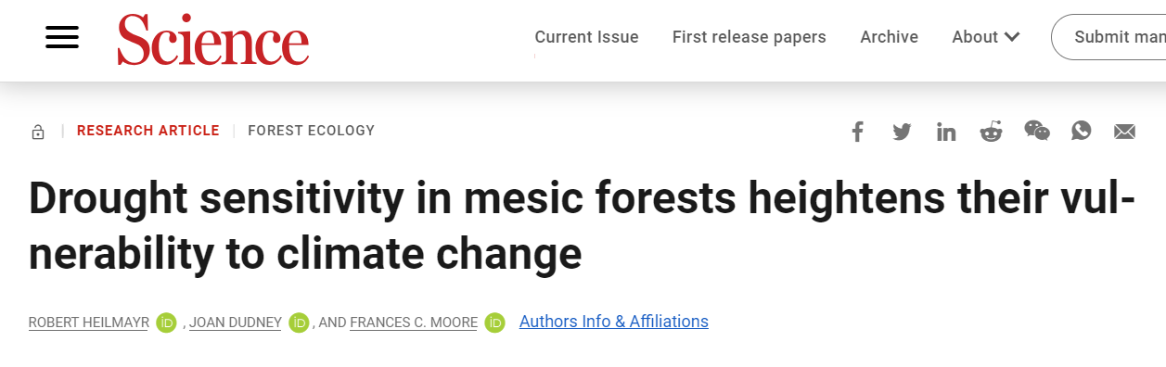
Climate change threats and opportunities
↑ tree mortality
↓ carbon sequestration
Improved forest management is an important land-related adaptation action with co-benefits
Intergovernmental Panel on Climate Change
Notes:
However, climate change threatens forests worldwide and recent studies have shown that trees adapted to wetter climates, such as the northeast u.s., may actually be more vulnerable to the negative impacts of climate change since they are not adapted to heat and drought.

Slide 9
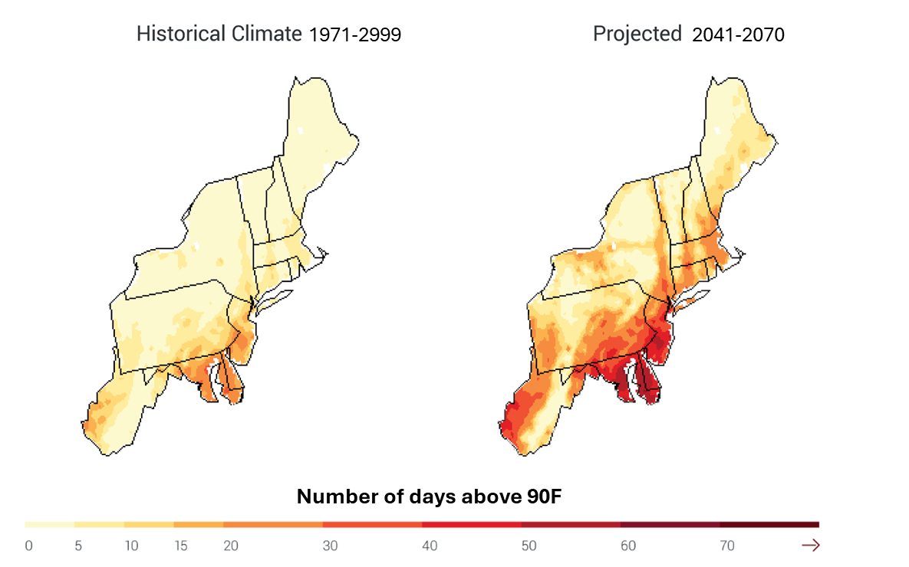
Temperature → hotter
↑ soil evaporation
↑ atmospheric demand for water
Source: National Climate Assessment, globalchange.gov

Slide 10
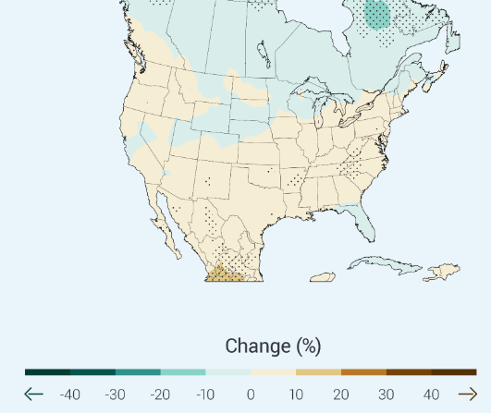
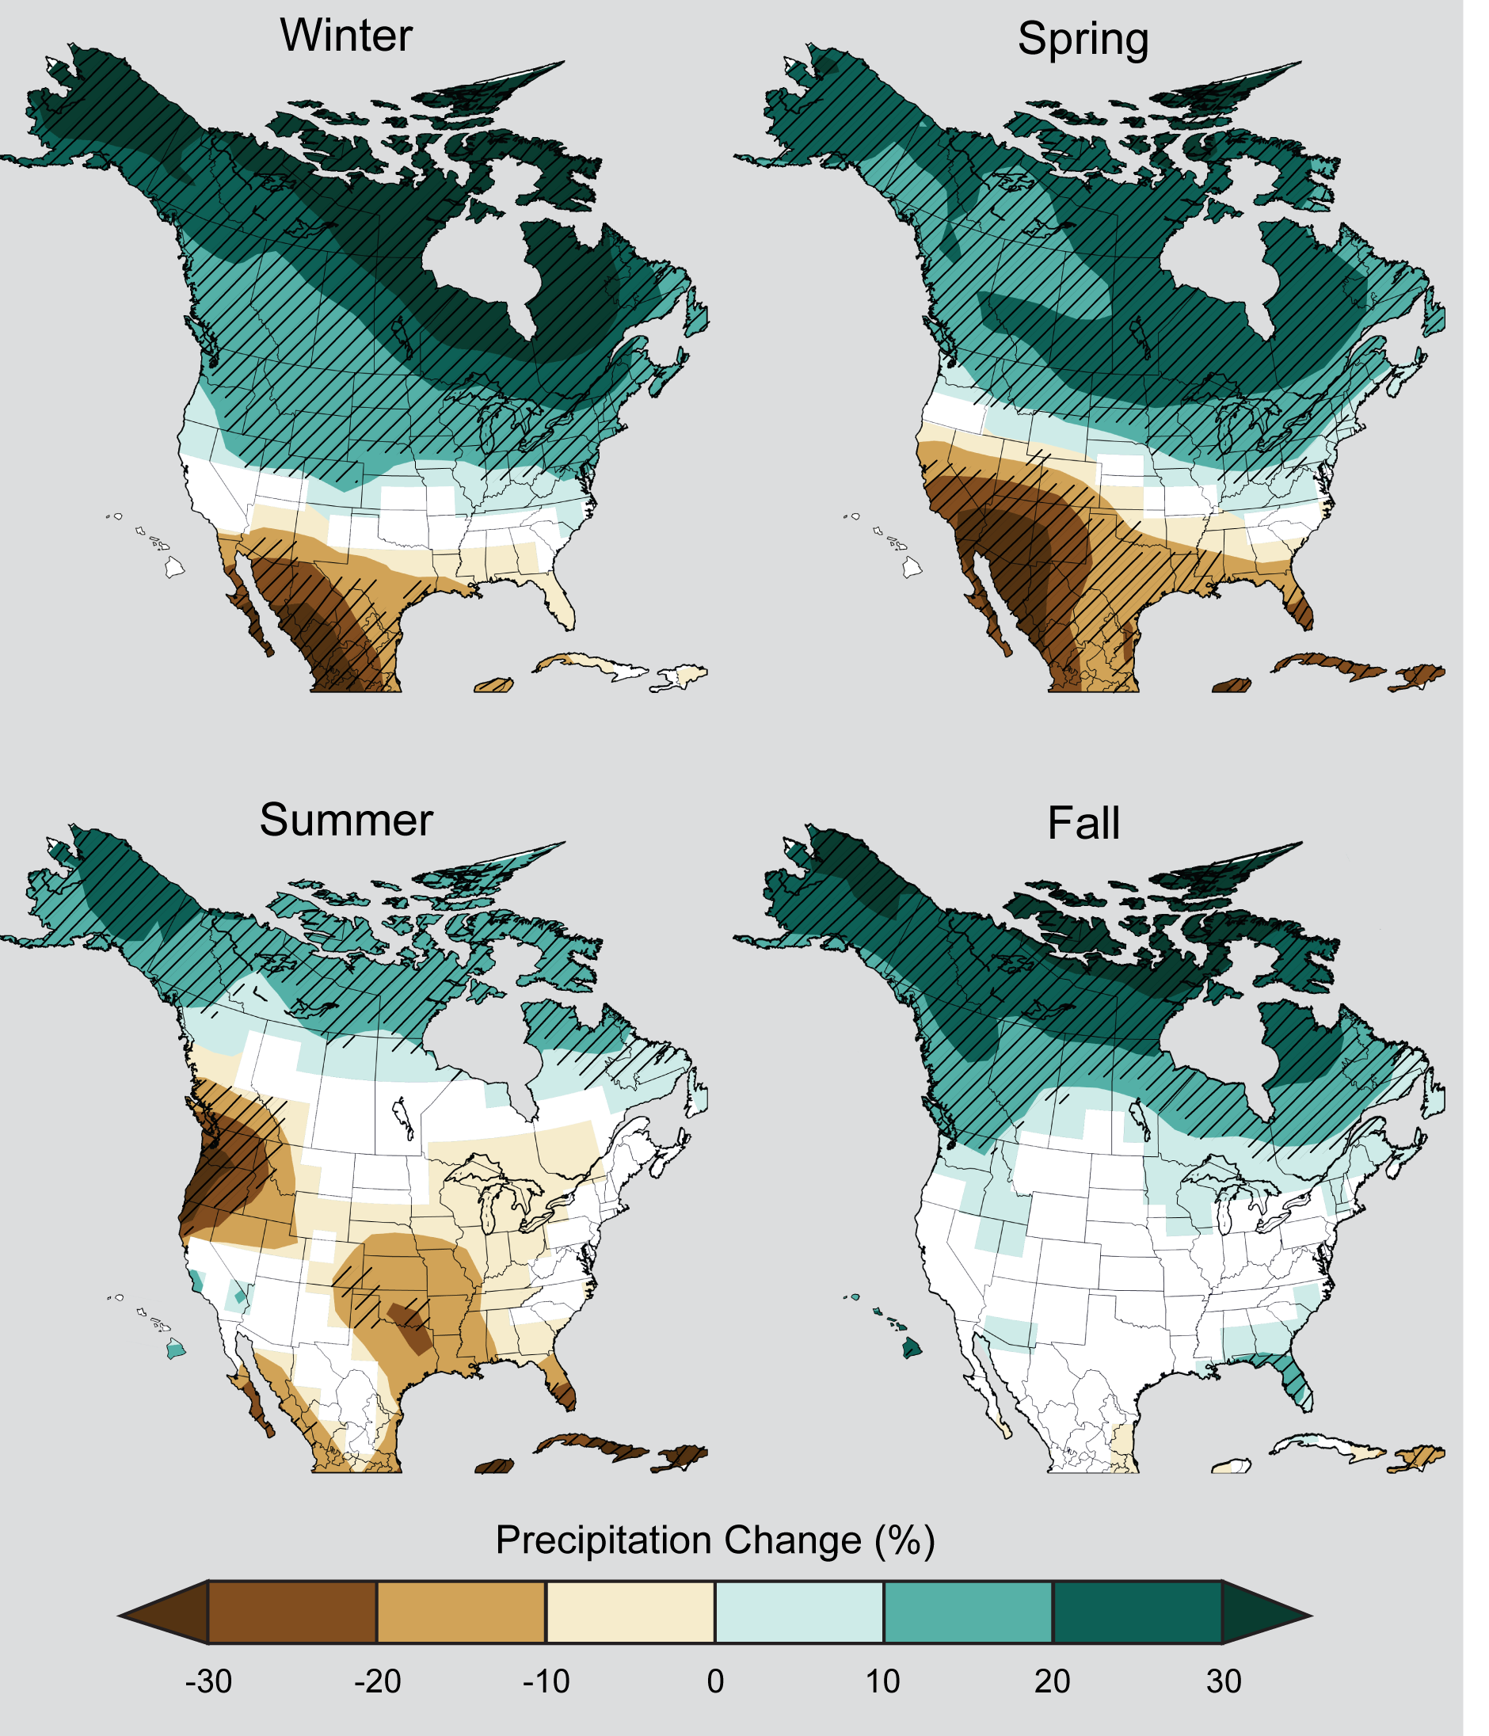
Precipitation → wetter*
…but more variable, and little/no increase during growing season
Changes in consecutive dry days
Projected precipitation increase by season
Source: National Climate Assessment, globalchange.gov

Slide 11
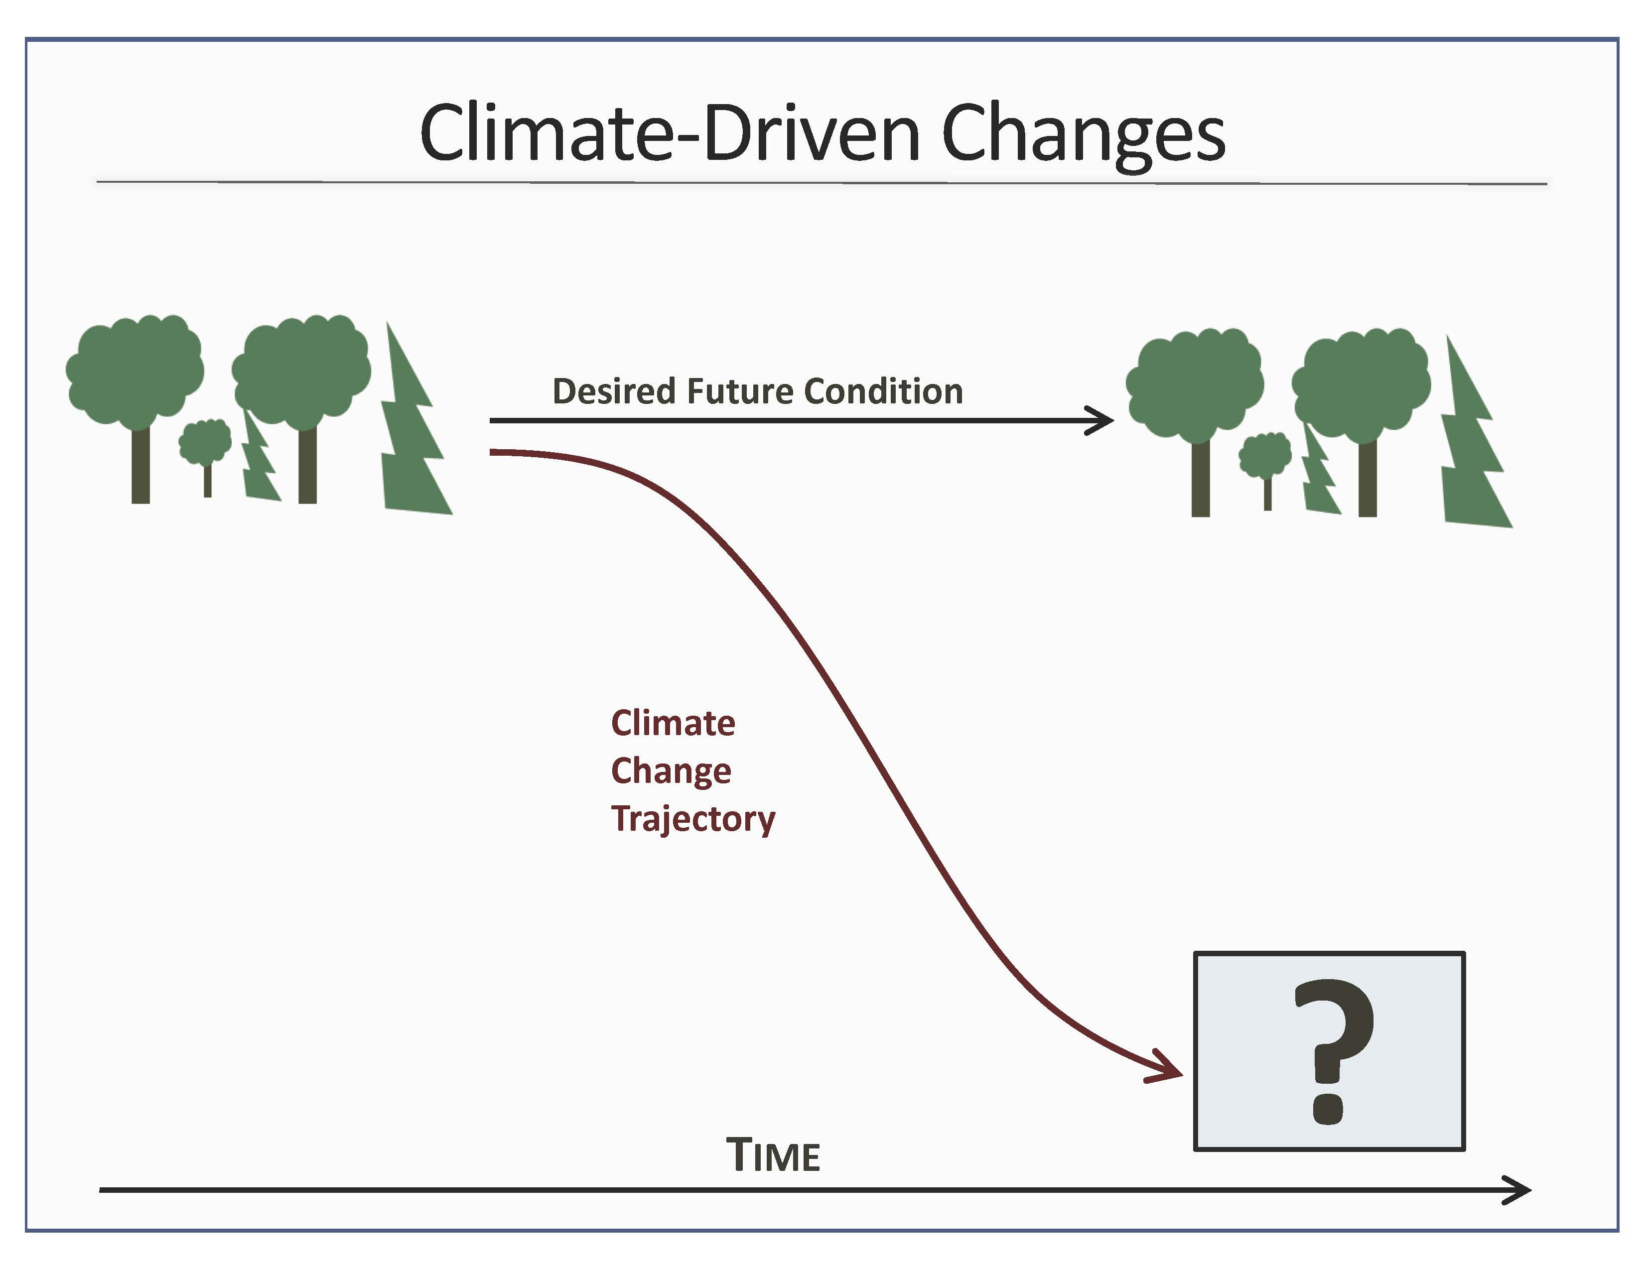
Carbon sink
Wildlife habitat
Timber value
Recreation
Cultural value
Water filtration
Carbon source
Poor habitat
No timber
Recreation
Source: adapted from Adaptive Silviculture for Climate Change
Notes:
Because of this changing climate, the forests of the future may look very different than they do today. If not sustainably managed, forests could become a carbon source, poor habitat for wildlife, etc.
But, what if we could anticipate climate change and cultivate forests that maintain the benefits of a healthy forest? That is the premise of…(next slide)
https://www.adaptivesilviculture.org/silviculture-climate-adaptation

Slide 12
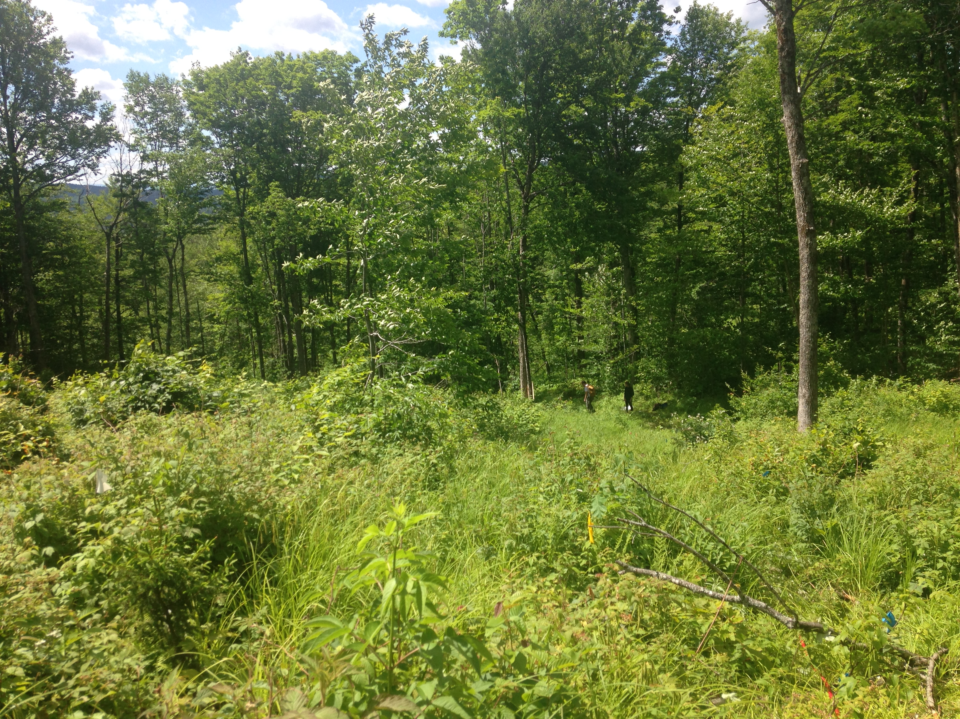
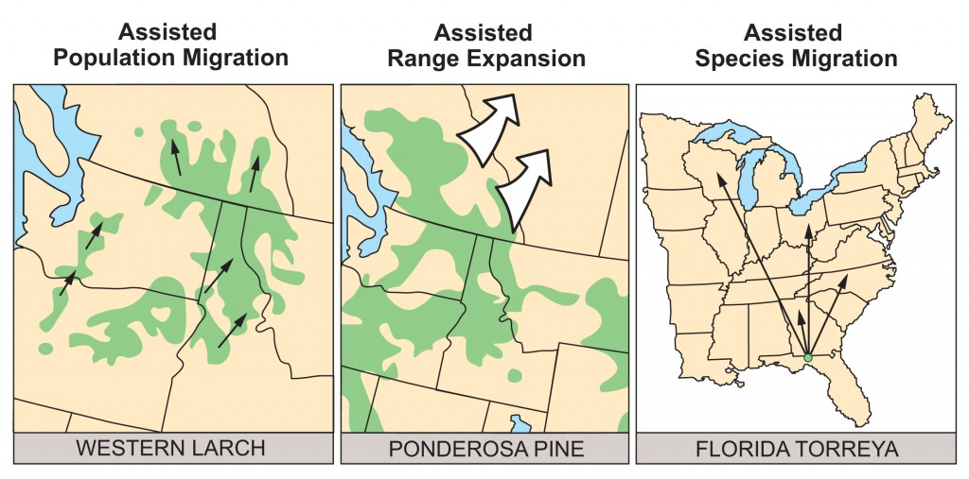
What is assisted migration?
Transplanting species or populations adapted to the future climate of a region
Proactive approach to cultivate climate-resilient forests and mitigate climate change

Slide 13
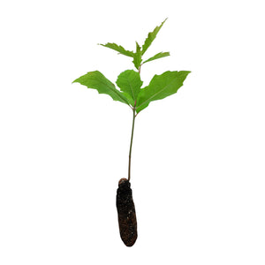
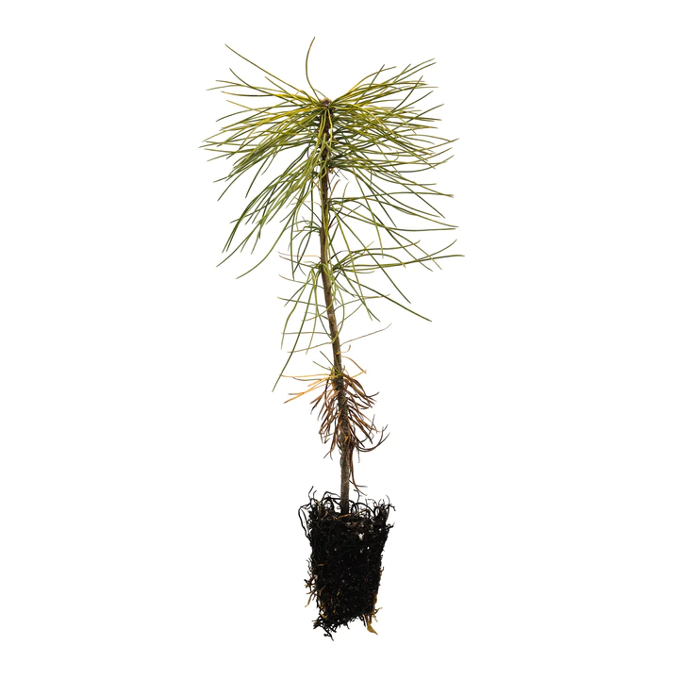
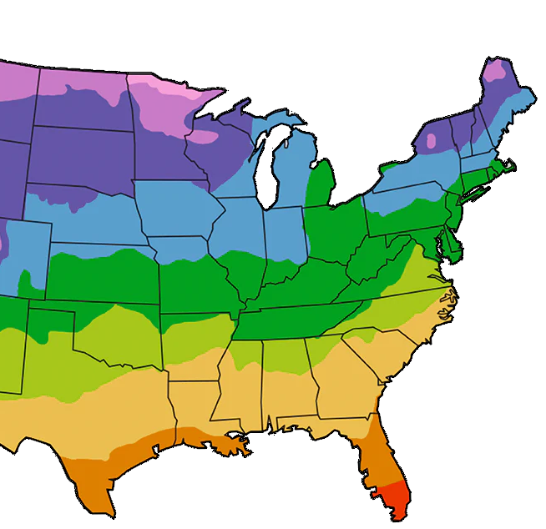
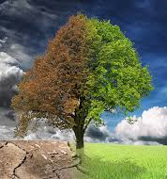
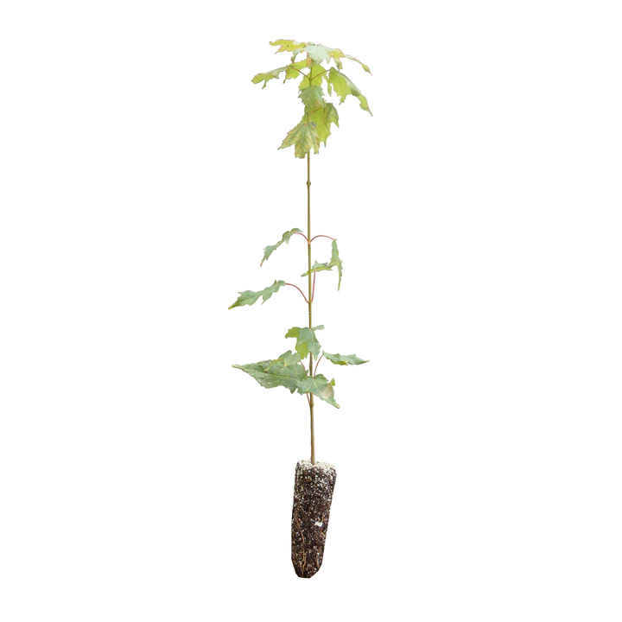
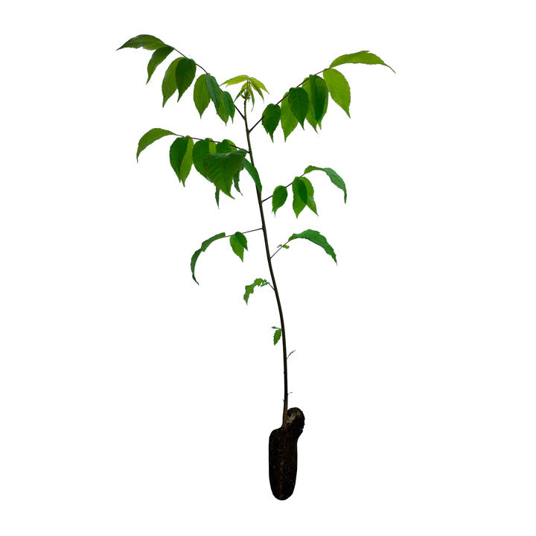
Missing pieces
Which species?
From where?
Drought resilience?

Slide 14
Greenhouse experiment

Slide 15
Species
Sugar maple
Black walnut
Eastern white pine
Black cherry
White oak
Southern red oak
Northern red oak
Experimental treatments
2022
2023
Control
maintain field capacity
Control
maintain field capacity
Moderate drought
3 weeks 5% VWC → rewatered
Drought
3 weeks no water
Ecotypes
Virginia
Michigan
New Hampshire
Severe drought
Water withheld indefinitely

Slide 16
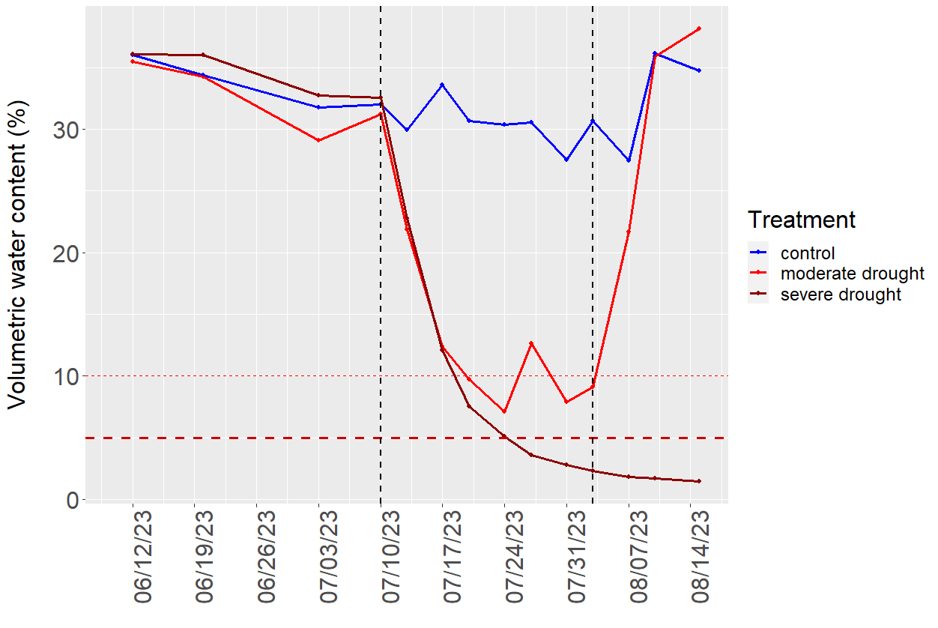
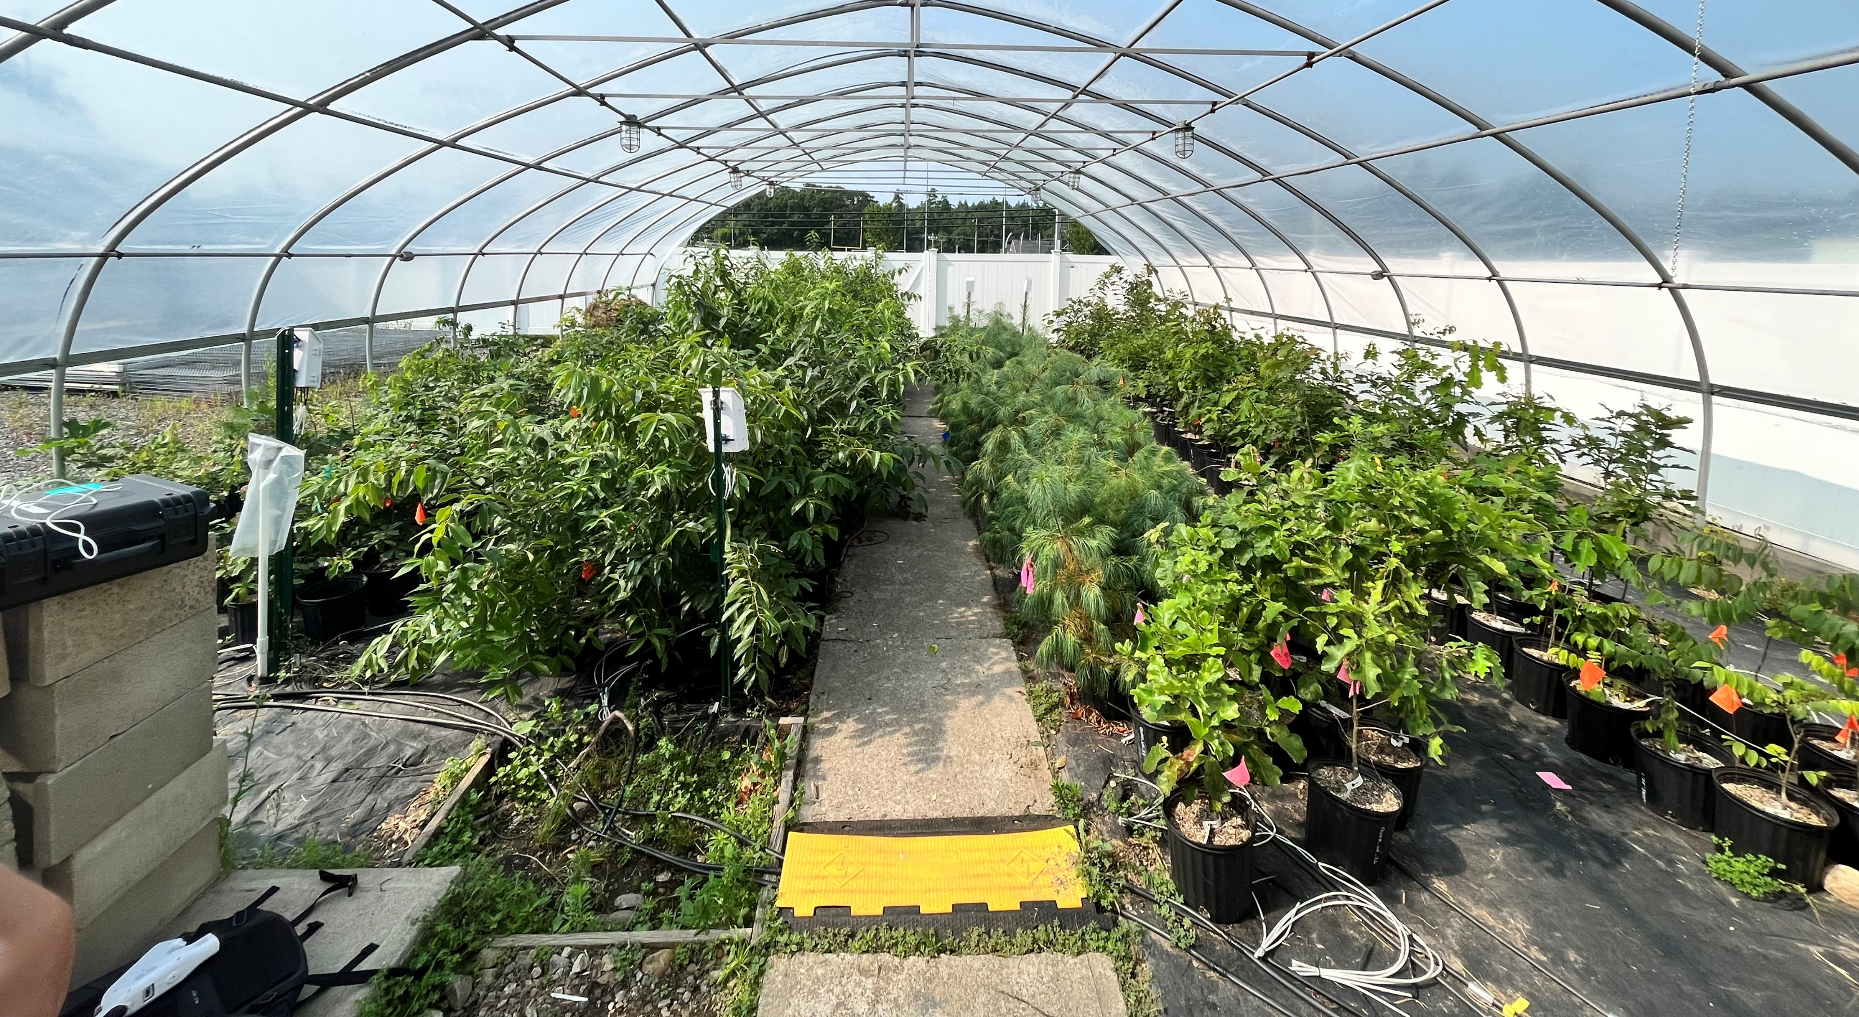
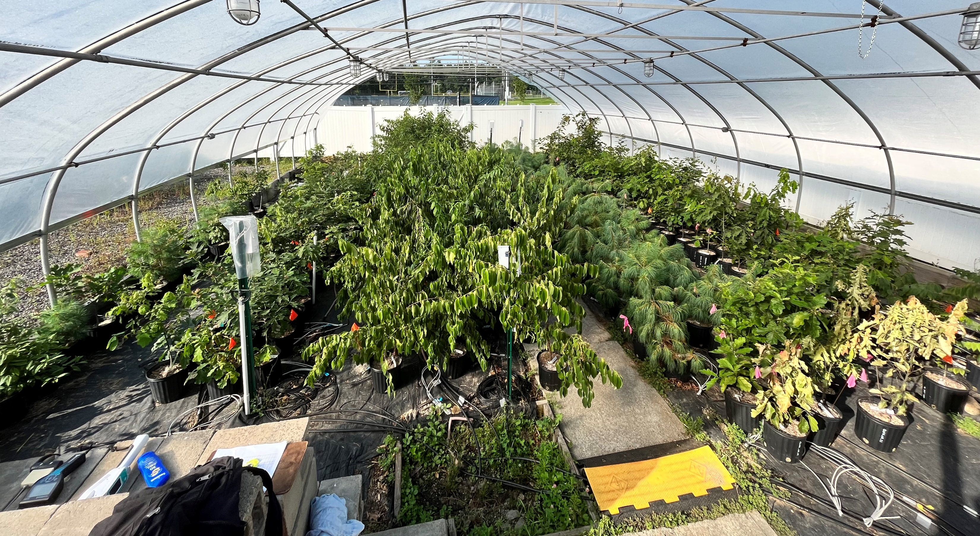
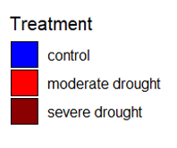
2023 soil moisture averaged by species
Visual signs of drought stress
1 week
2 weeks
4 weeks

Slide 17
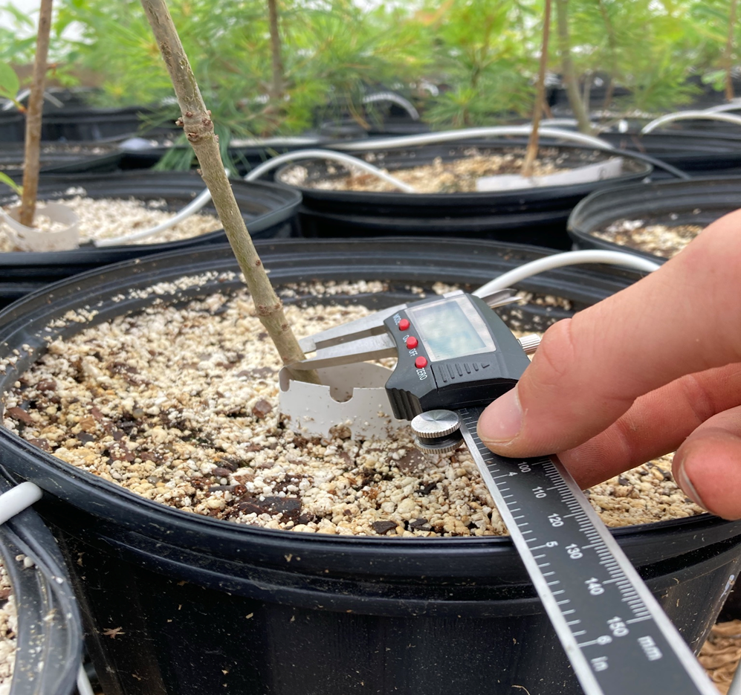
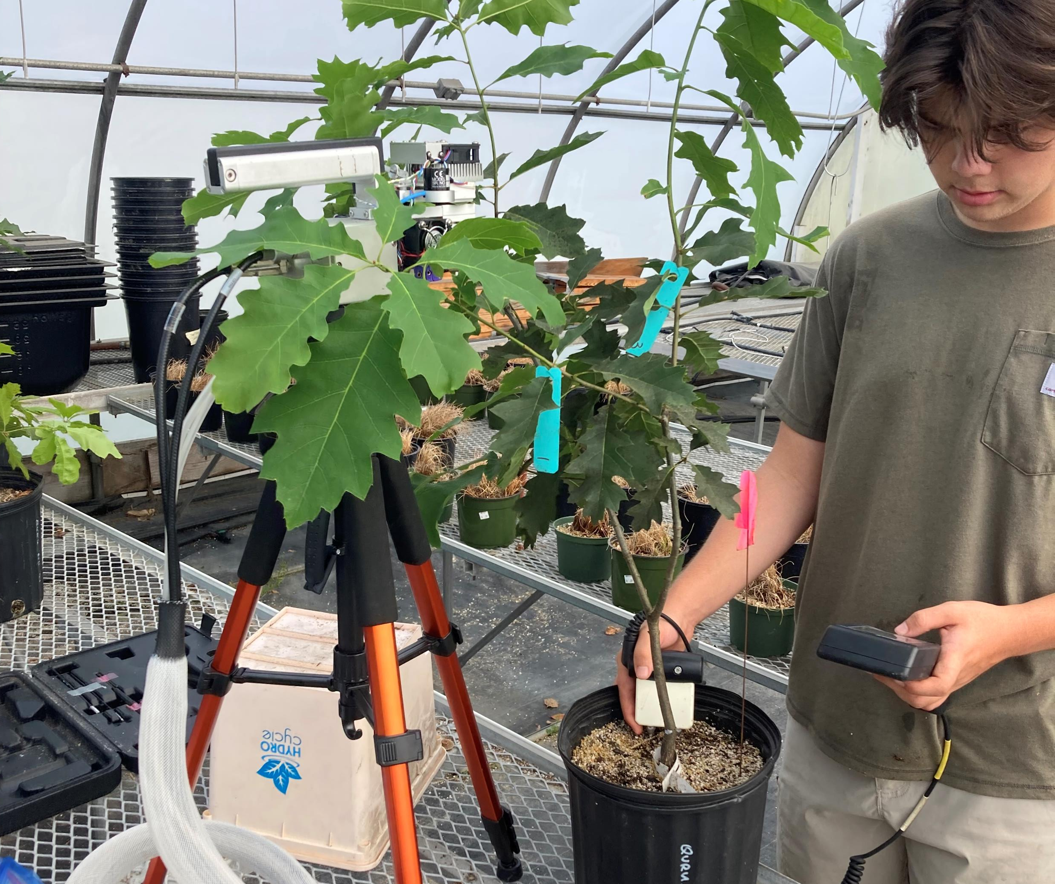
 | Measurement | 2022 | 2023
Growth | Height * | X | X
 | Diameter | X | X
 | Biomass (roots + shoots) * |  | X
Physiology | Photosynthetic rate | X | X
 | Stomatal conductance rate | X | X
 | Predawn/midday water potential | X | X
 | Turgor loss point |  | X
 | Chlorophyll fluorescence |  | X
 | Native embolism/hydraulic conductance |  | X
 | Phenology |  | X
 | Leaf carbon/nitrogen content | X | X
Anatomy | Specific leaf area |  | X
 | Stomatal size and density |  | X

Slide 18
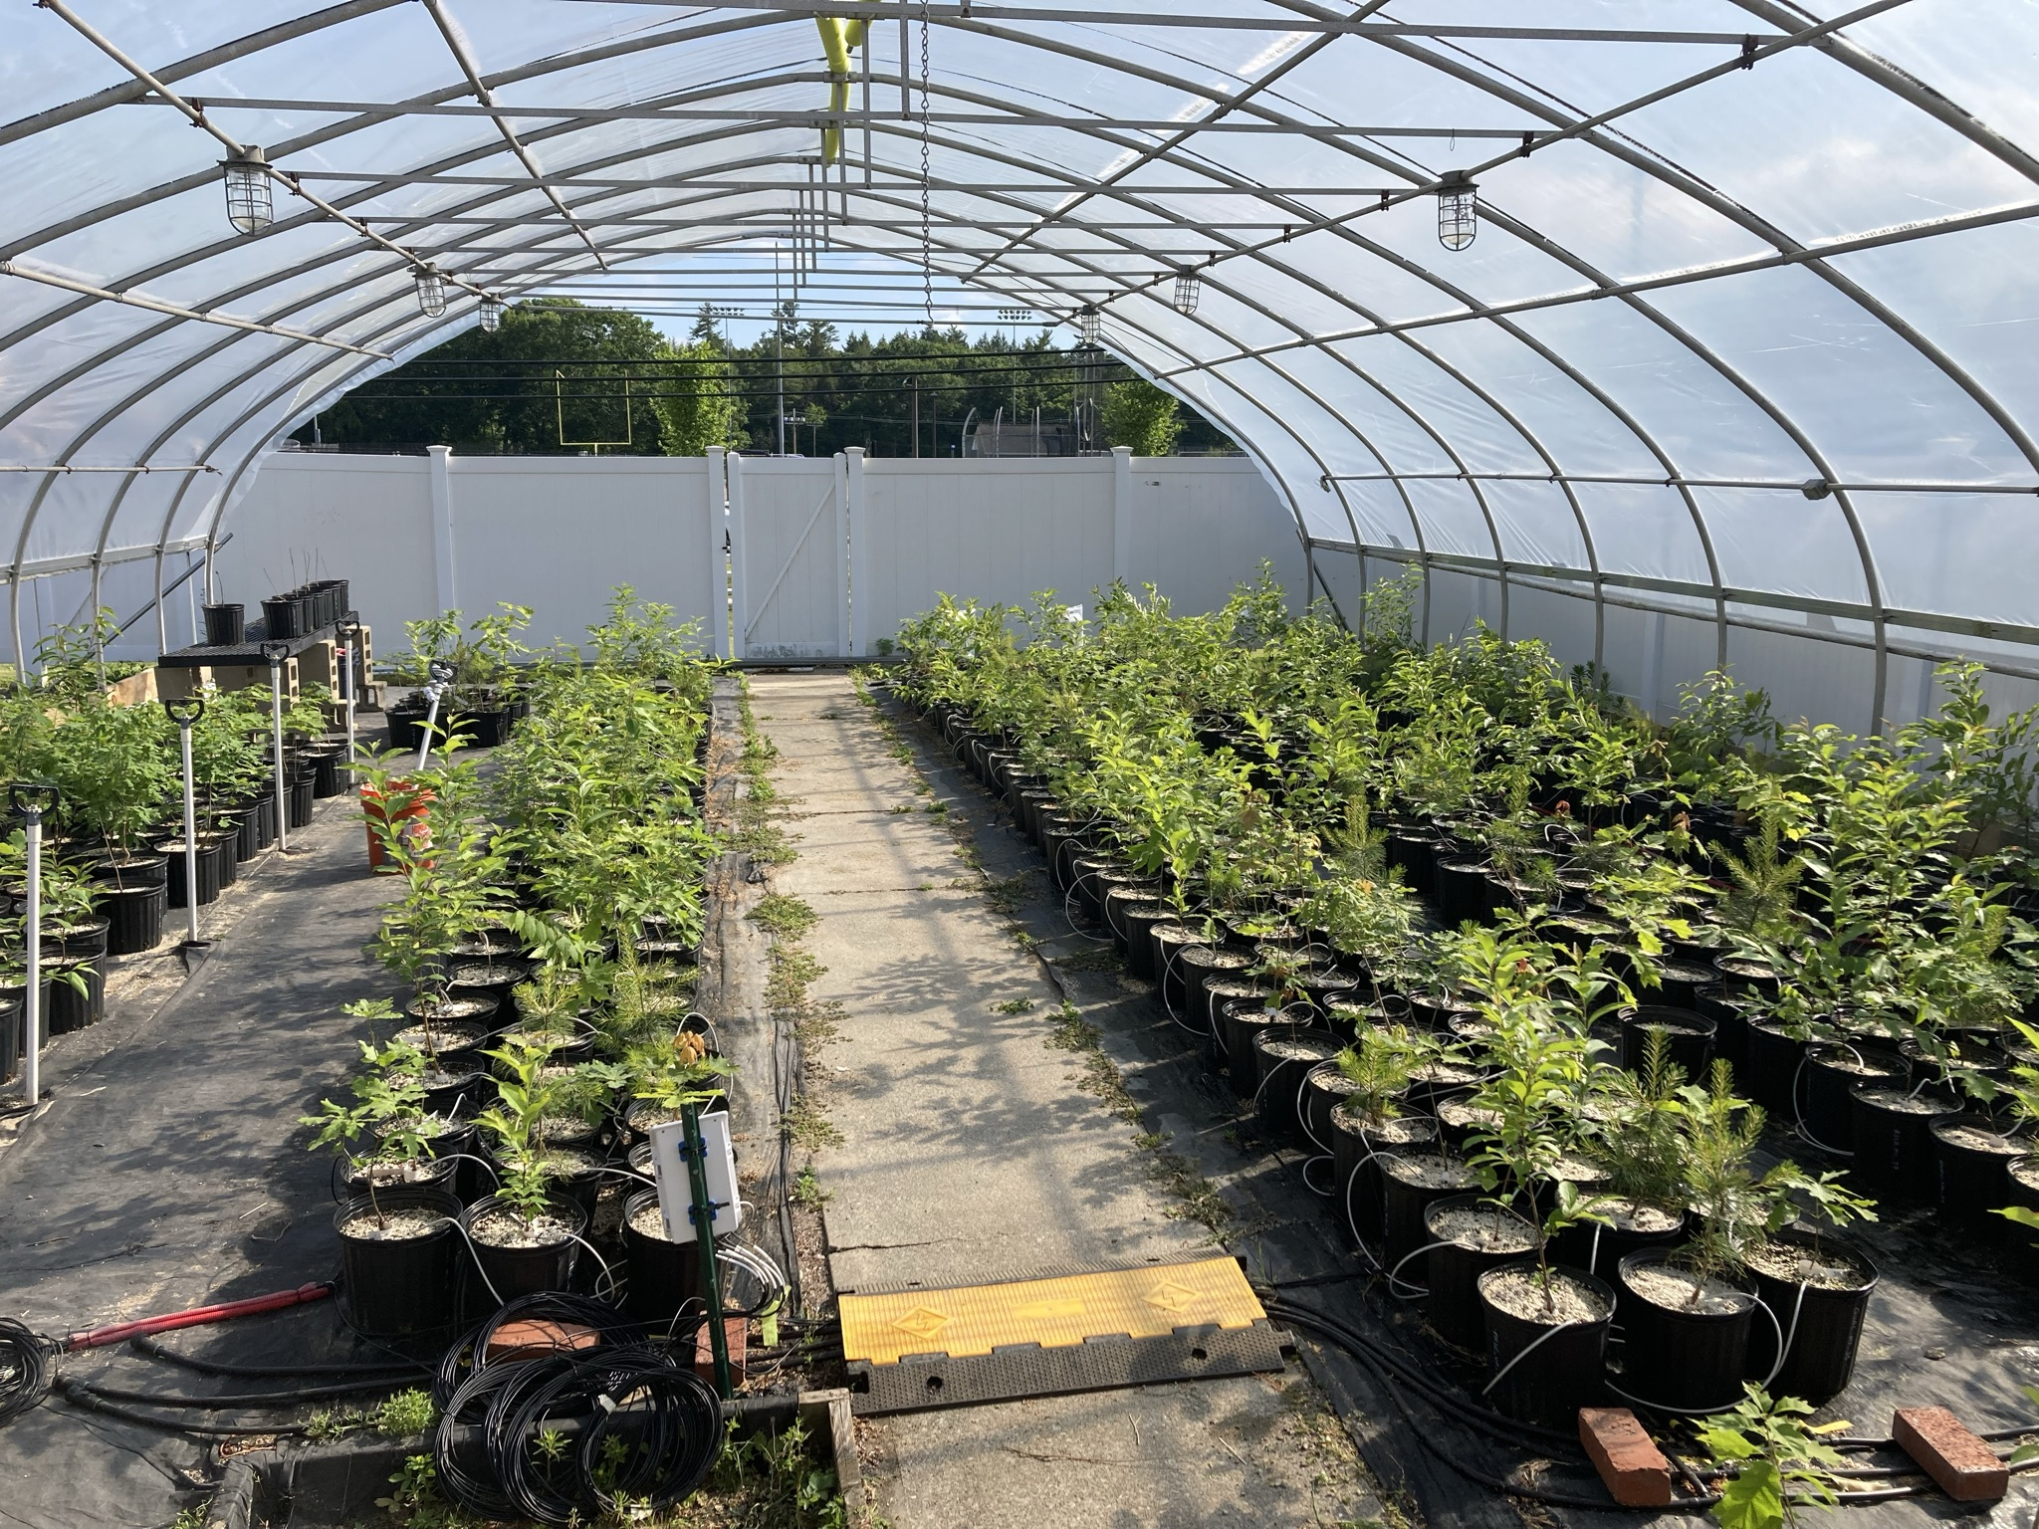
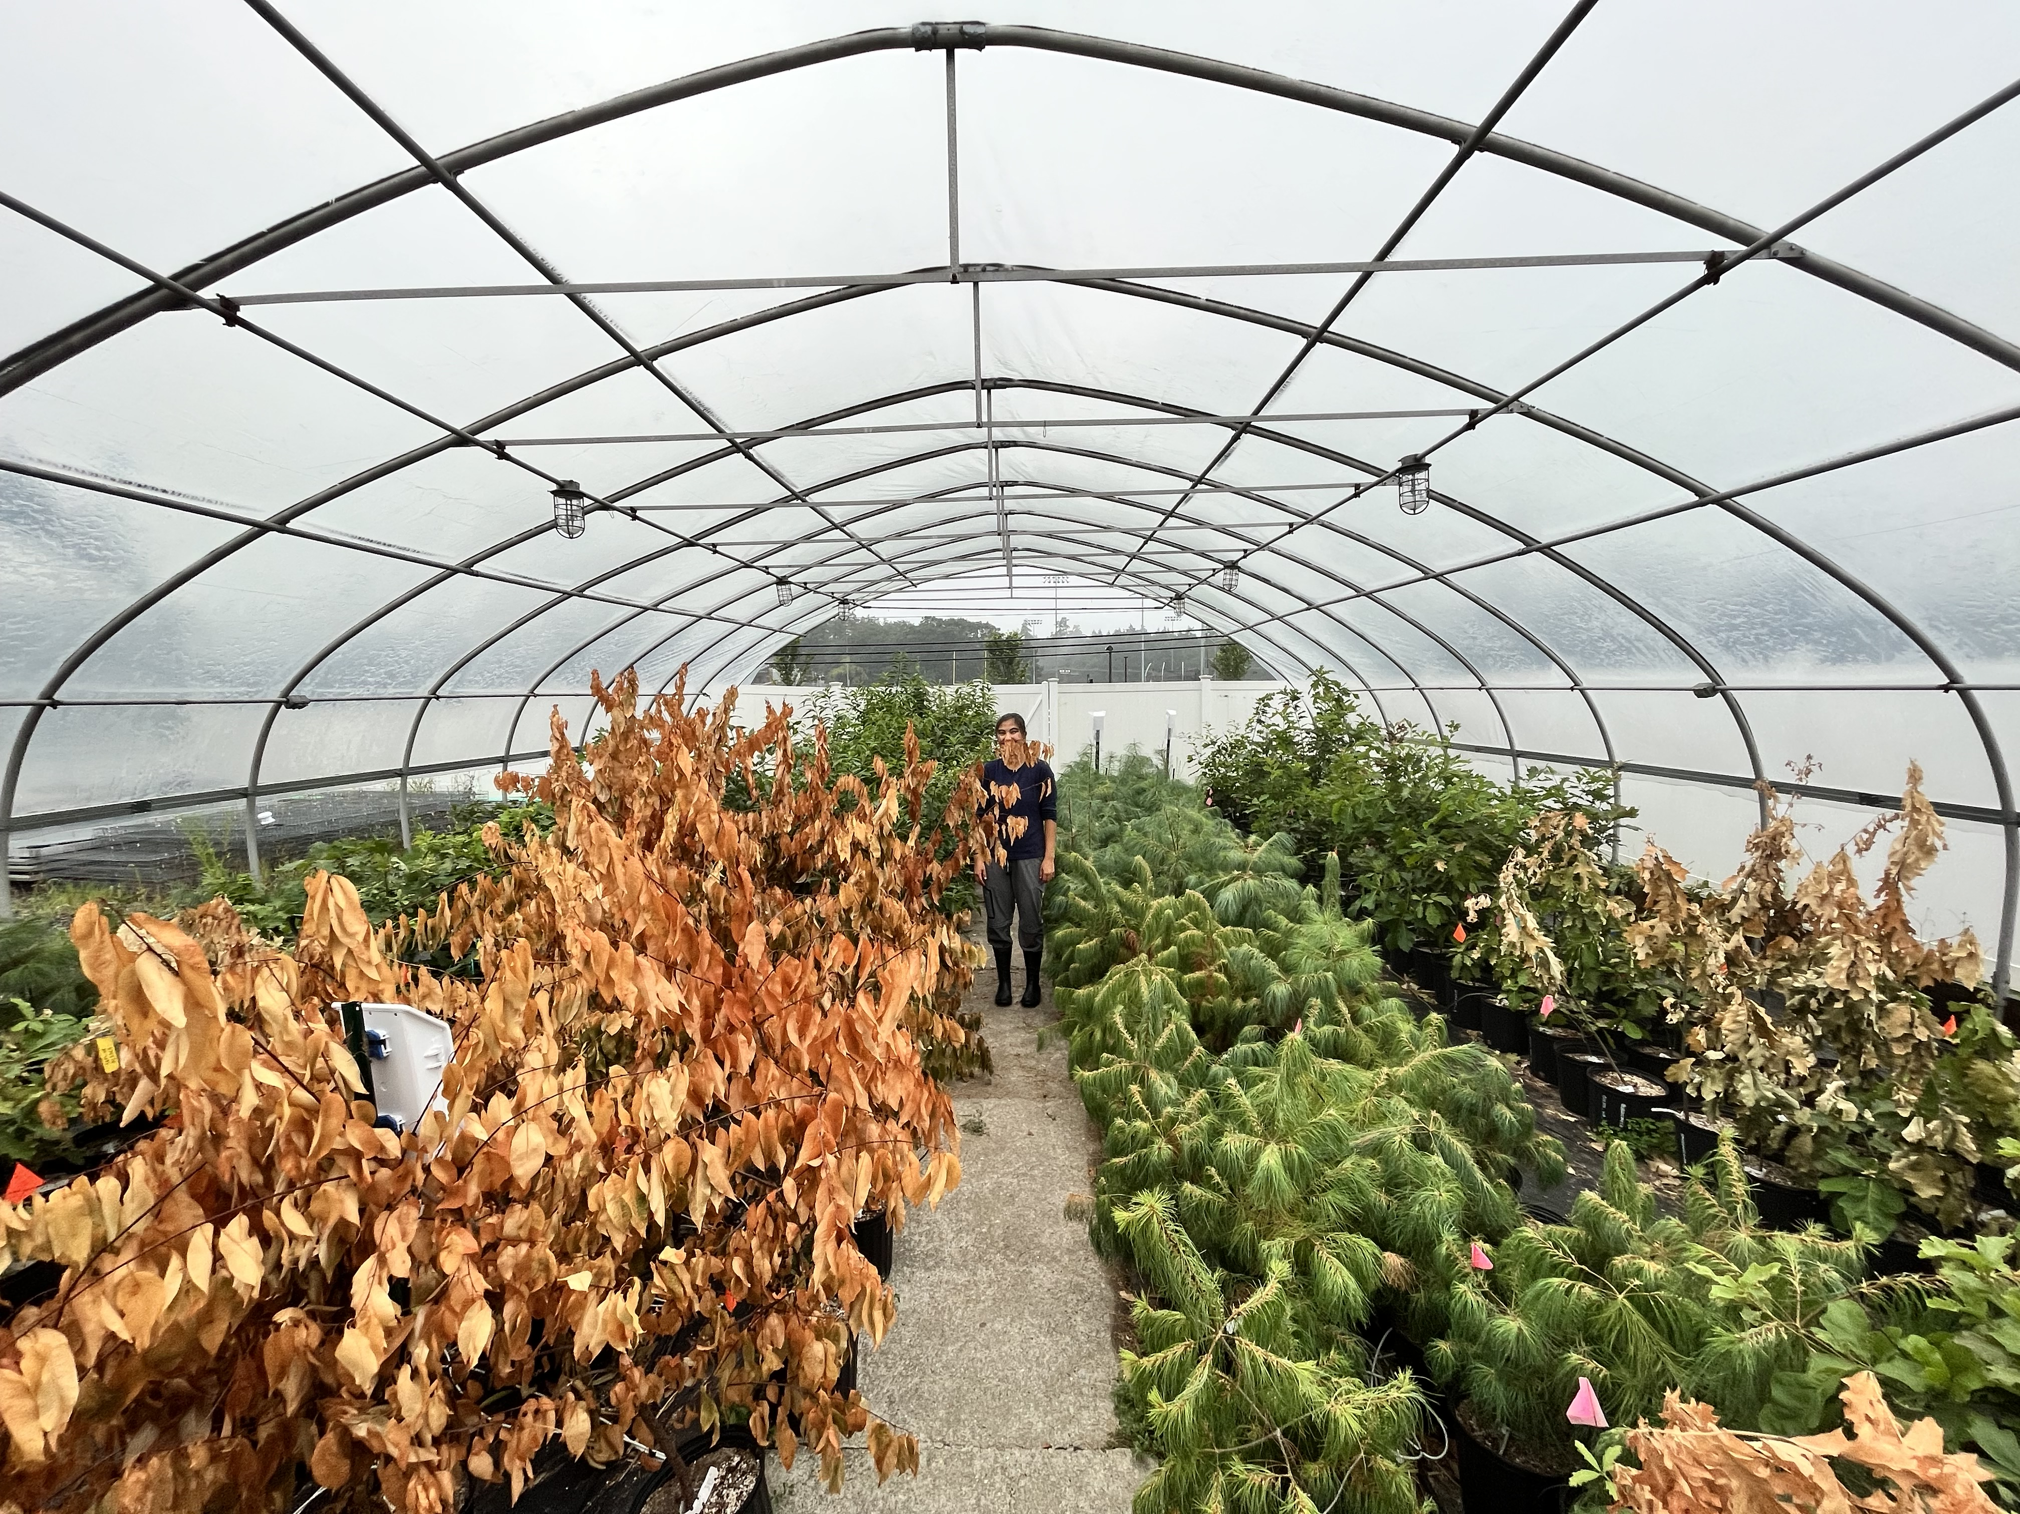
They grow up so fast
Notes:
Over the 2 year experiment, some of these trees grew a lot

Slide 19
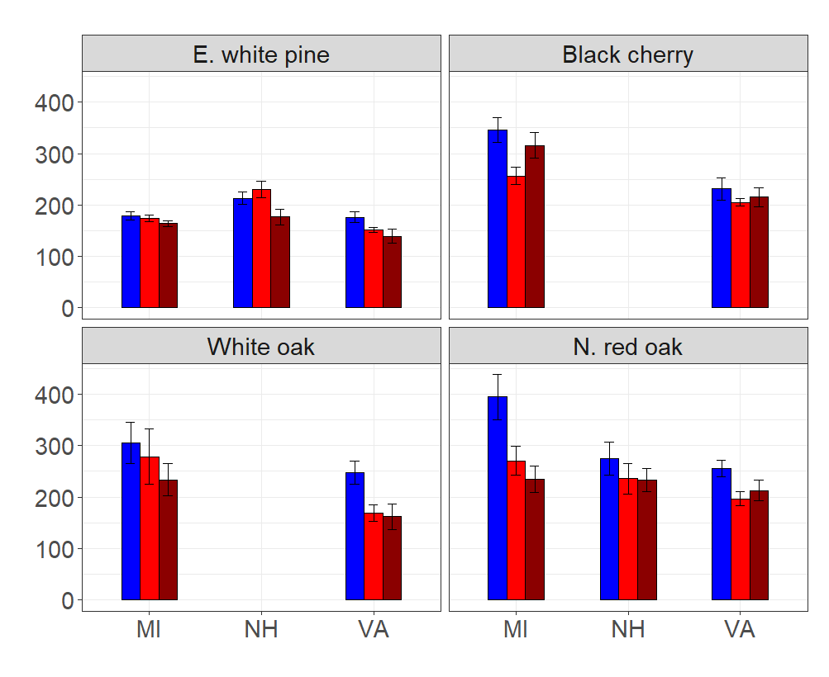
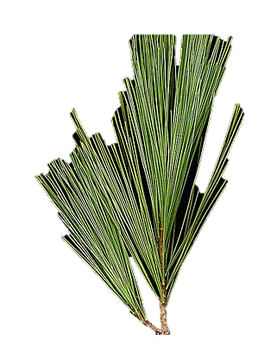
Percent height increase
Height growth (% of initial)

Slide 20
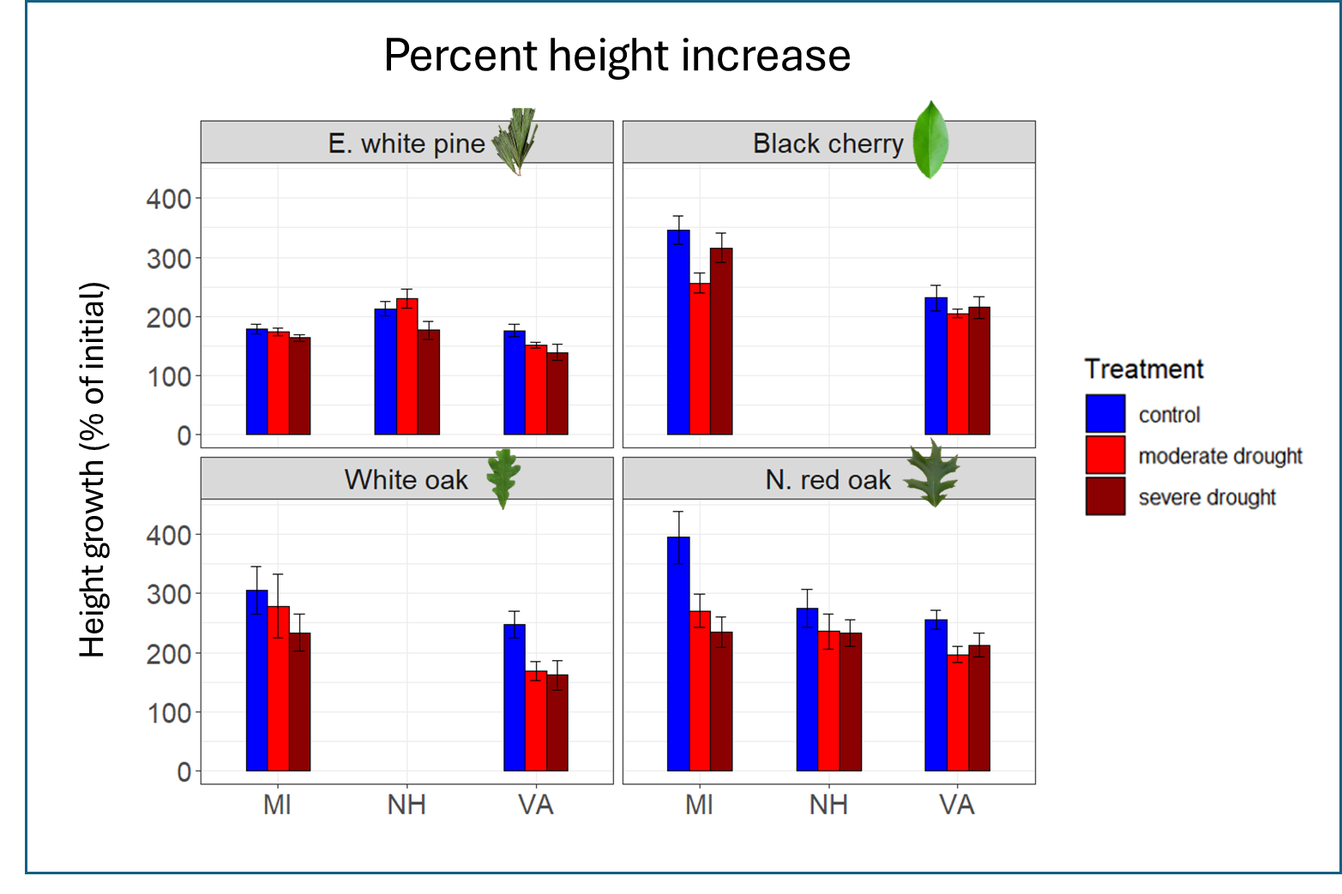
Northern red oak and black cherry grew the most
These species also had the largest ecotype differences
Notes:
We can infer that faster growing trees have the largest differences amongst ecotypes

Slide 21
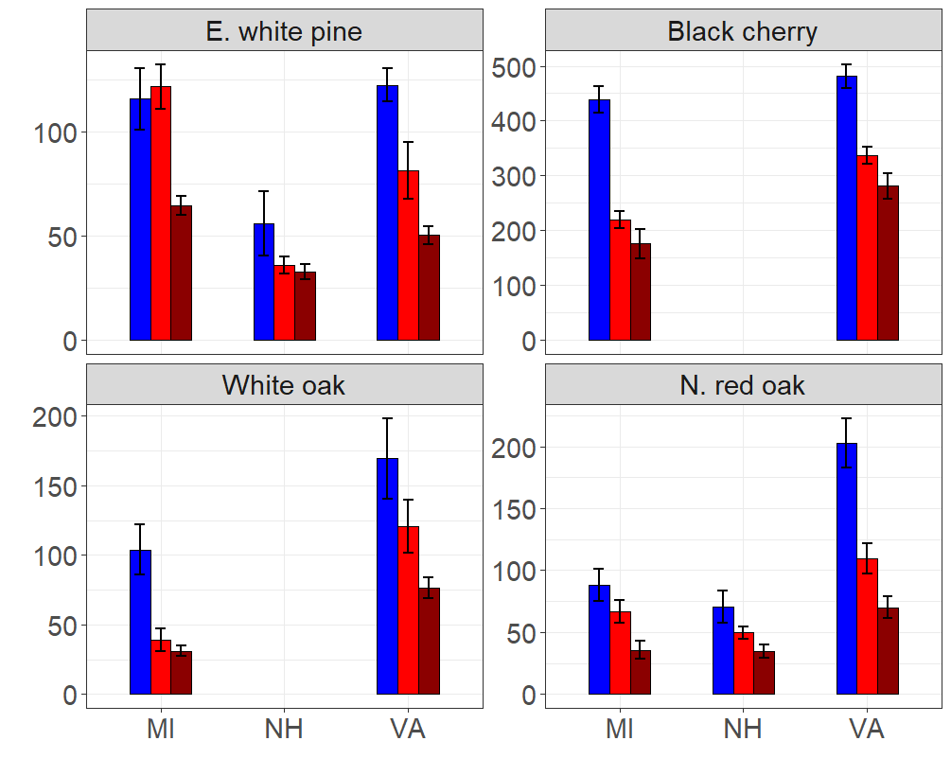
Total biomass
Weight (g)
Notes:
Another way we can look at growth is through biomass which accounts for all the aboveground stem material and the belowground root material.

Slide 22
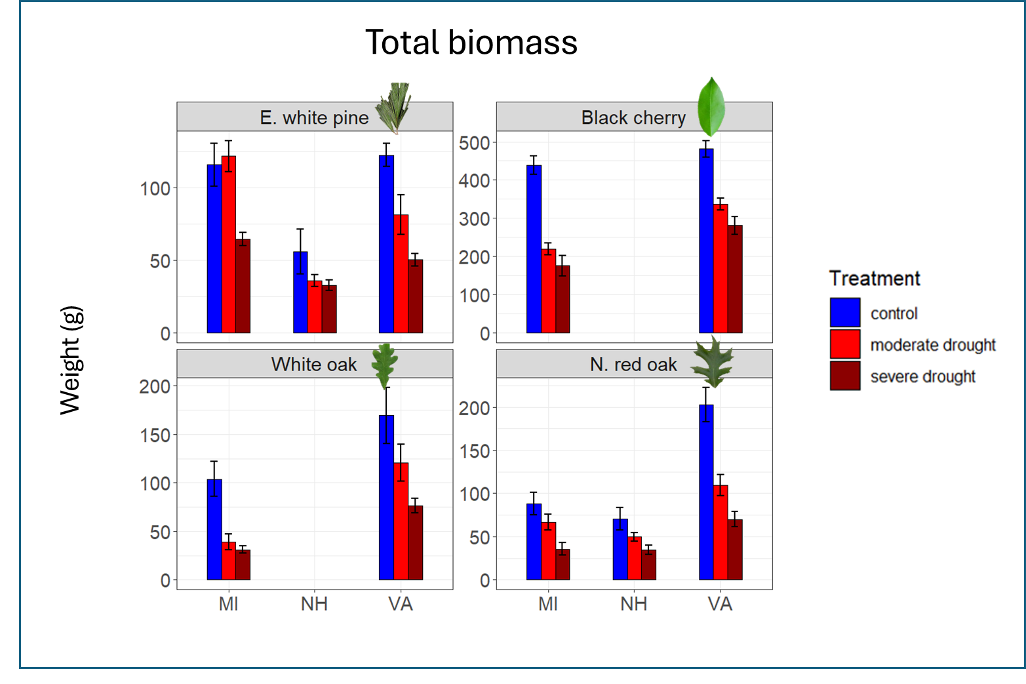
Black cherry acquired the most biomass
However, ecotype effects more pronounced in oaks

Slide 23
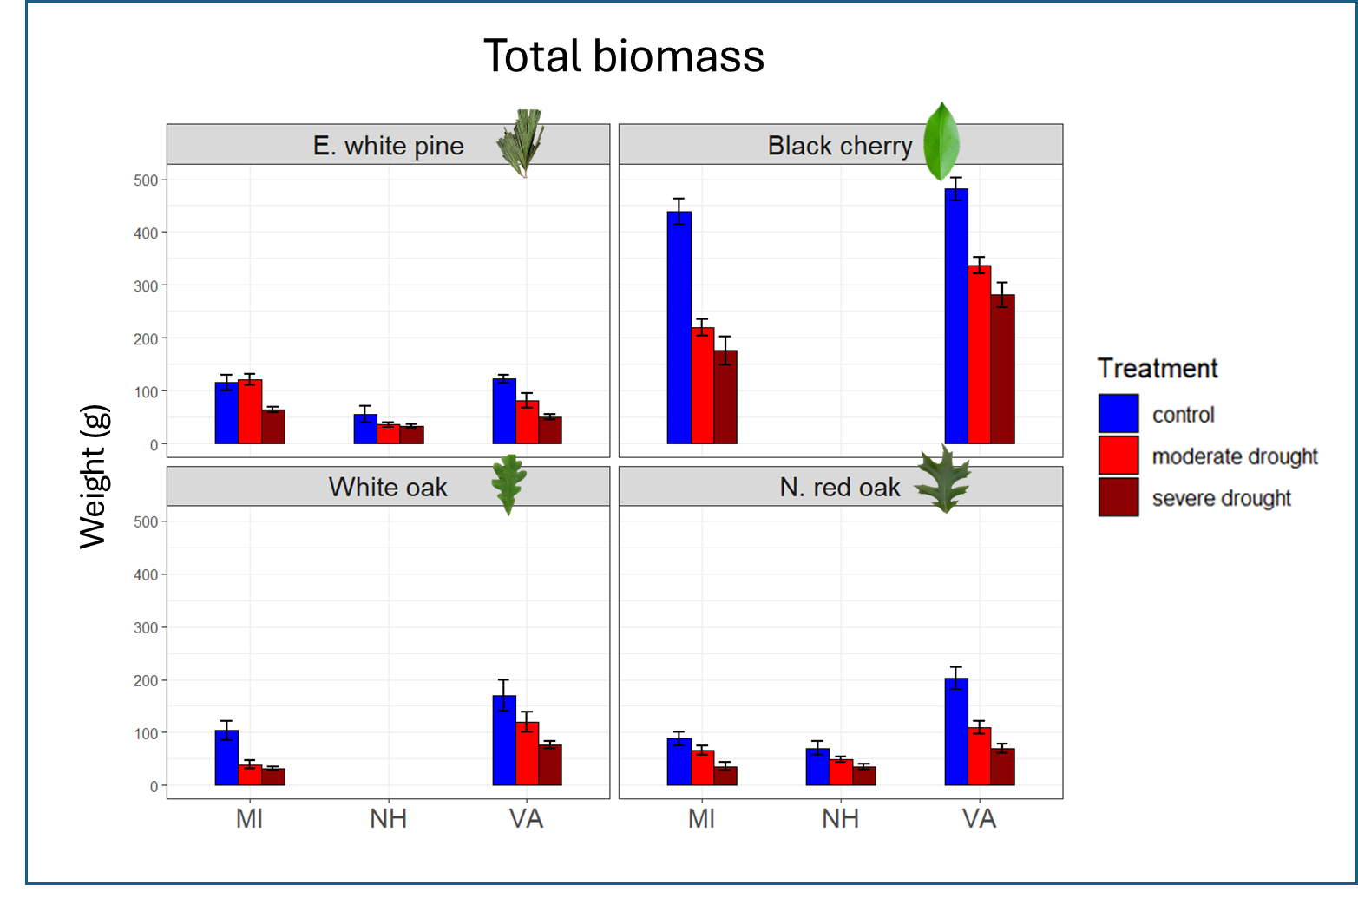
Black cherry acquired the most biomass
However, ecotype effects more pronounced in oaks

Slide 24
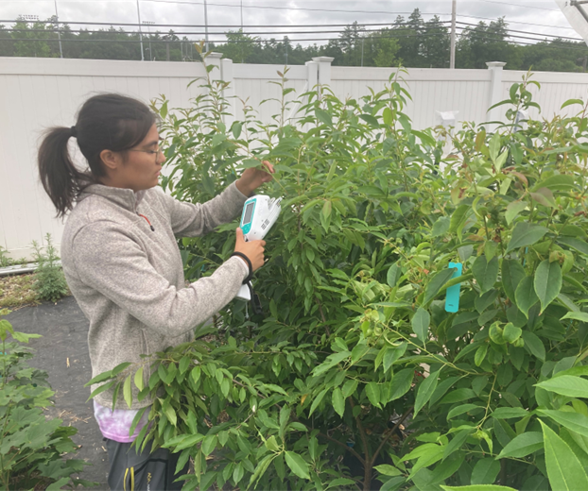
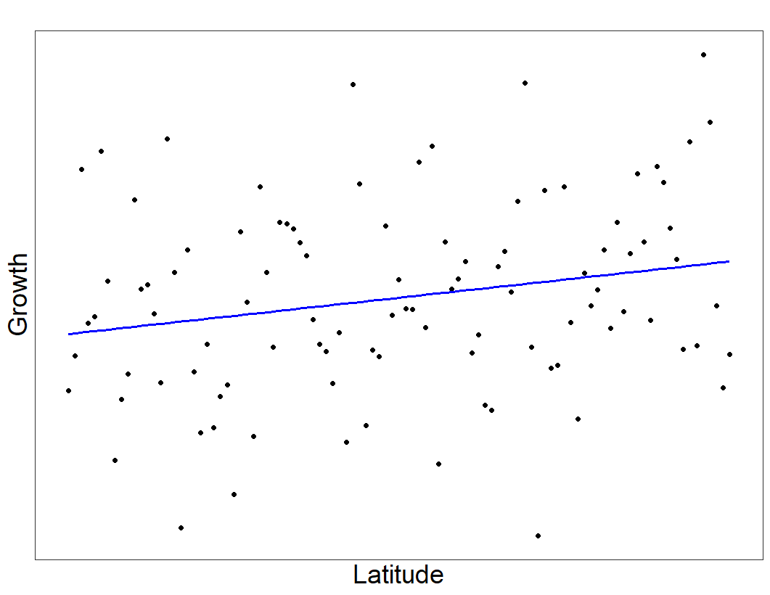
Bringing it home…
Forest Service illustration by Savannah Halleaux
Species > Ecotype responses
Physiology may tell a clearer story
Other studies show slight relationships between origin and performance
Notes:
Given the greater coordination of species level responses compared to ecotype level responses, it appears that species selection is still of foremost importance when choosing which trees to plant.
However, other studies examining the performance of just one species across many more ecotypes have seen that origin may provide slight advantages in early tree growth. This suggests that it could be possible to leverage the power of ecotypes.
And with that, I would like to acknowledge a fantastic group of collaborators and take any questions you may have

Slide 25
Acknowledgements
Jackson Ehmett
Katie Johnstone
Zach Hooper
Dakota Mako
Nicholas Forestell
Aileen Auclair
Matthew Rozinski
Jack Hastings
Jason Demers
Jess Gersony/PLACE lab
Emma Flaherty
David Moore
Tanner Frost
Emily Anders
Matt Biondi
Luke Hydock
Heidi Asbjornsen--UNH
Cameron McIntire--USFS
Jay Wason--UMaine
Tony D’Amato--UVM
Matthew Vadeboncoeur--UNH
Shannon Rogers—sustainability coach

Slide 27
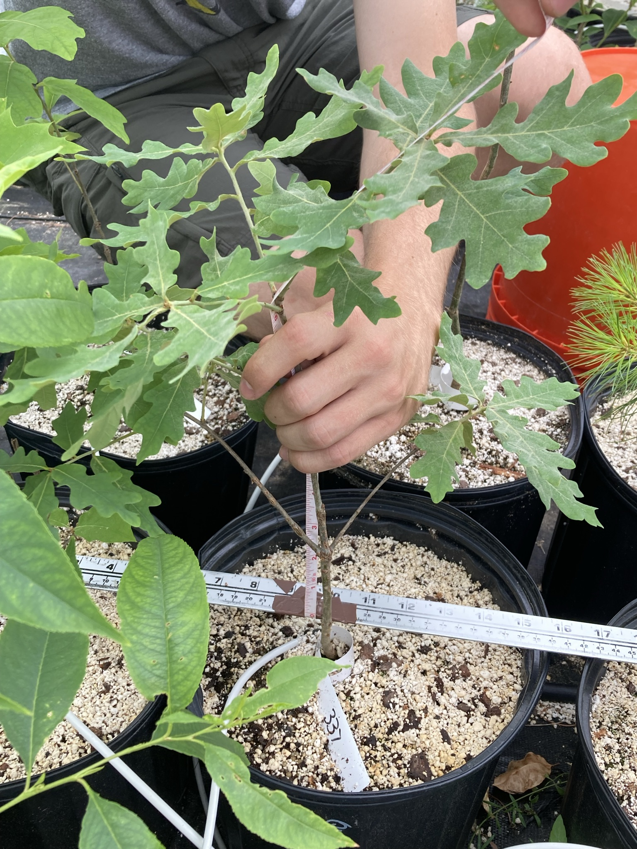
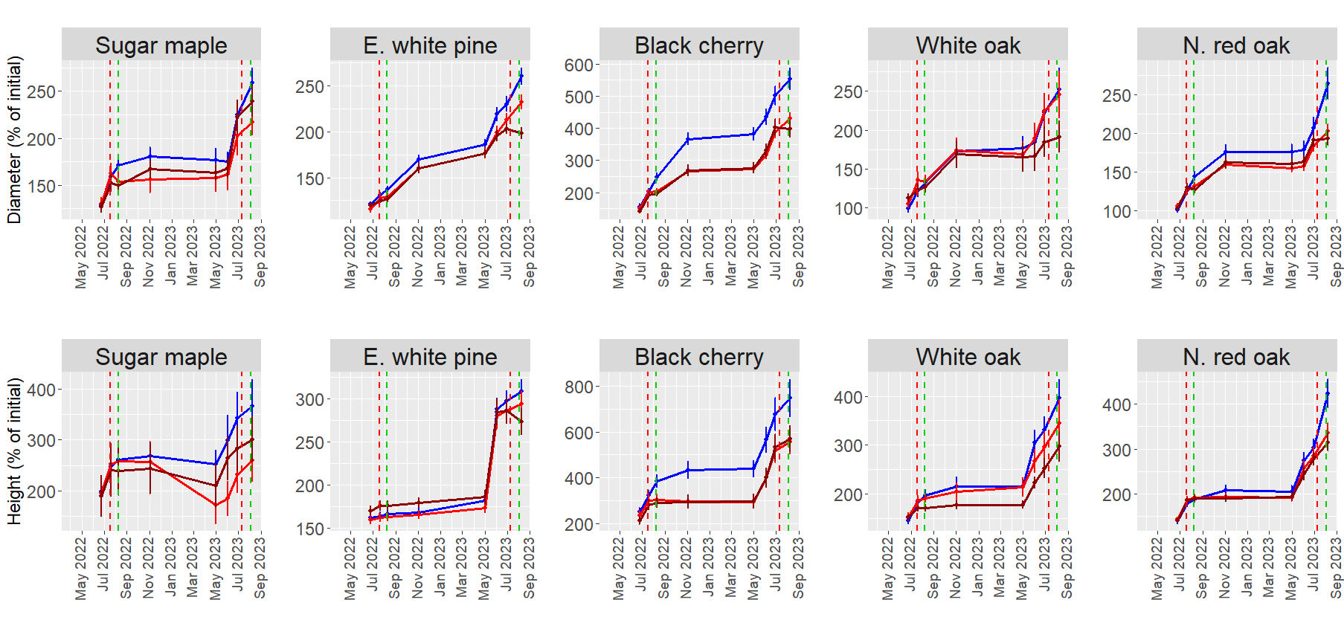
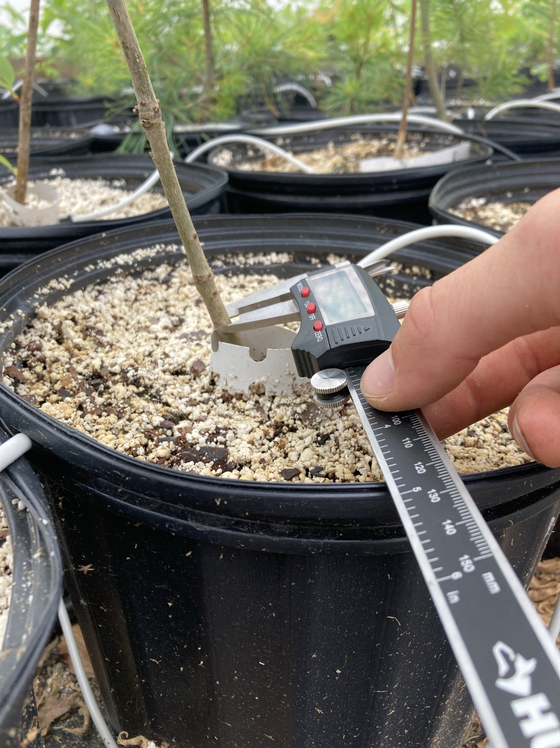
Results
Notes:
Emphasize importance of seedling height

Slide 28
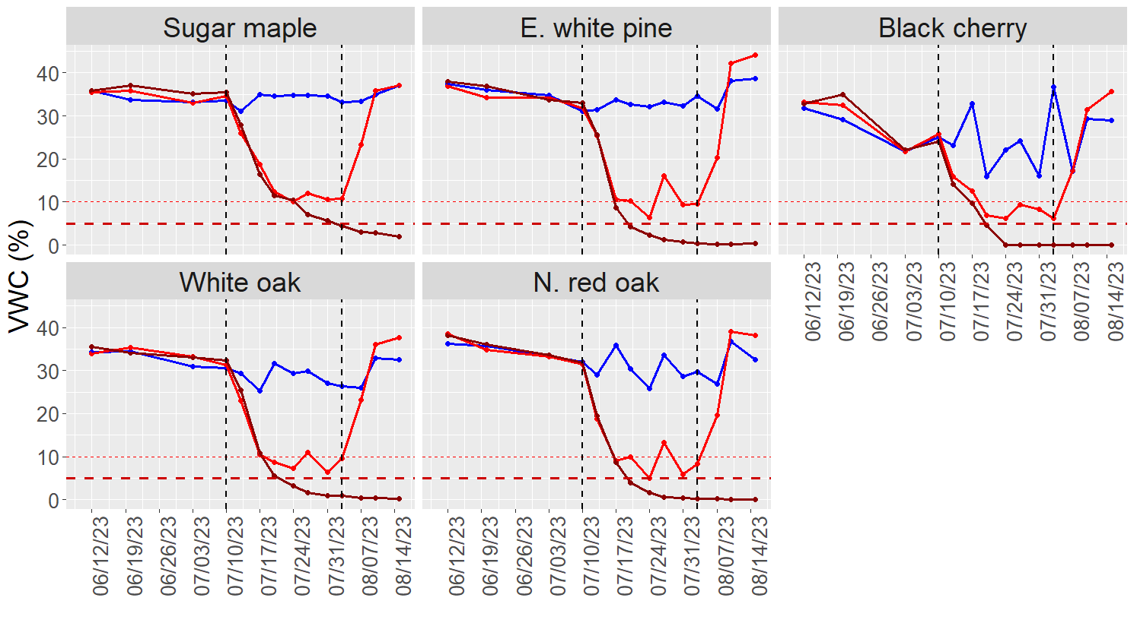
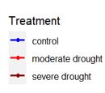
Soil moisture varied by species

Slide 29
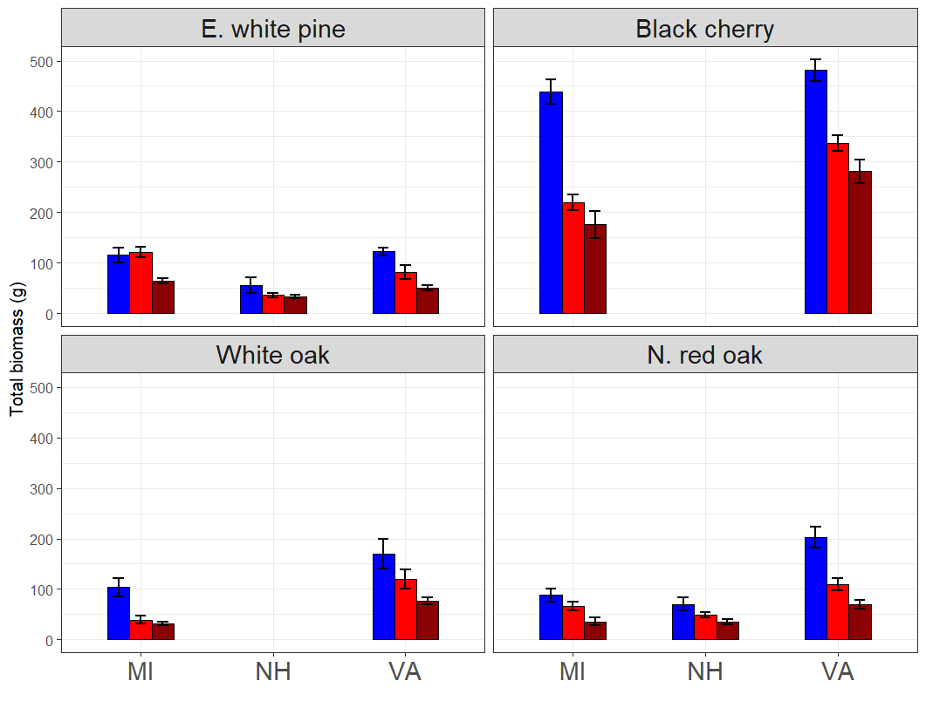
Total biomass
Weight (g)

