Slide 1
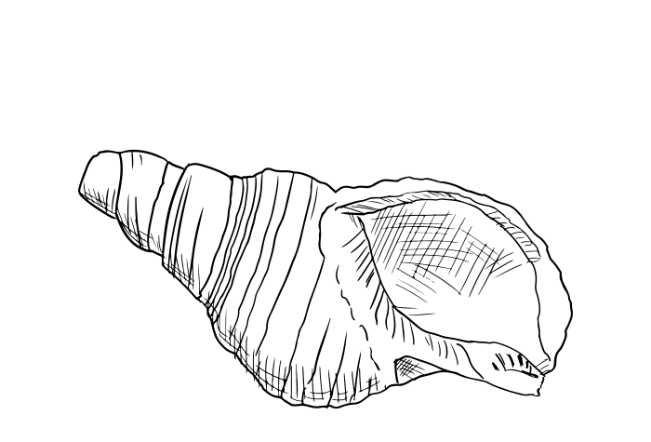
(Possibly)
Good Vibrations
Low Frequency Anthropogenic Sound and Mussel Settlement and Survival Patterns
Kyrie Newby, UNH Department of Biological Sciences
Dr. Brittany Jellison, Associate Professor at UNH
Dr. Michelle Fournet, Associate Professor at UNH
Dr. Mike Coogan, Postdoctoral Fellow at UNH

Slide 2
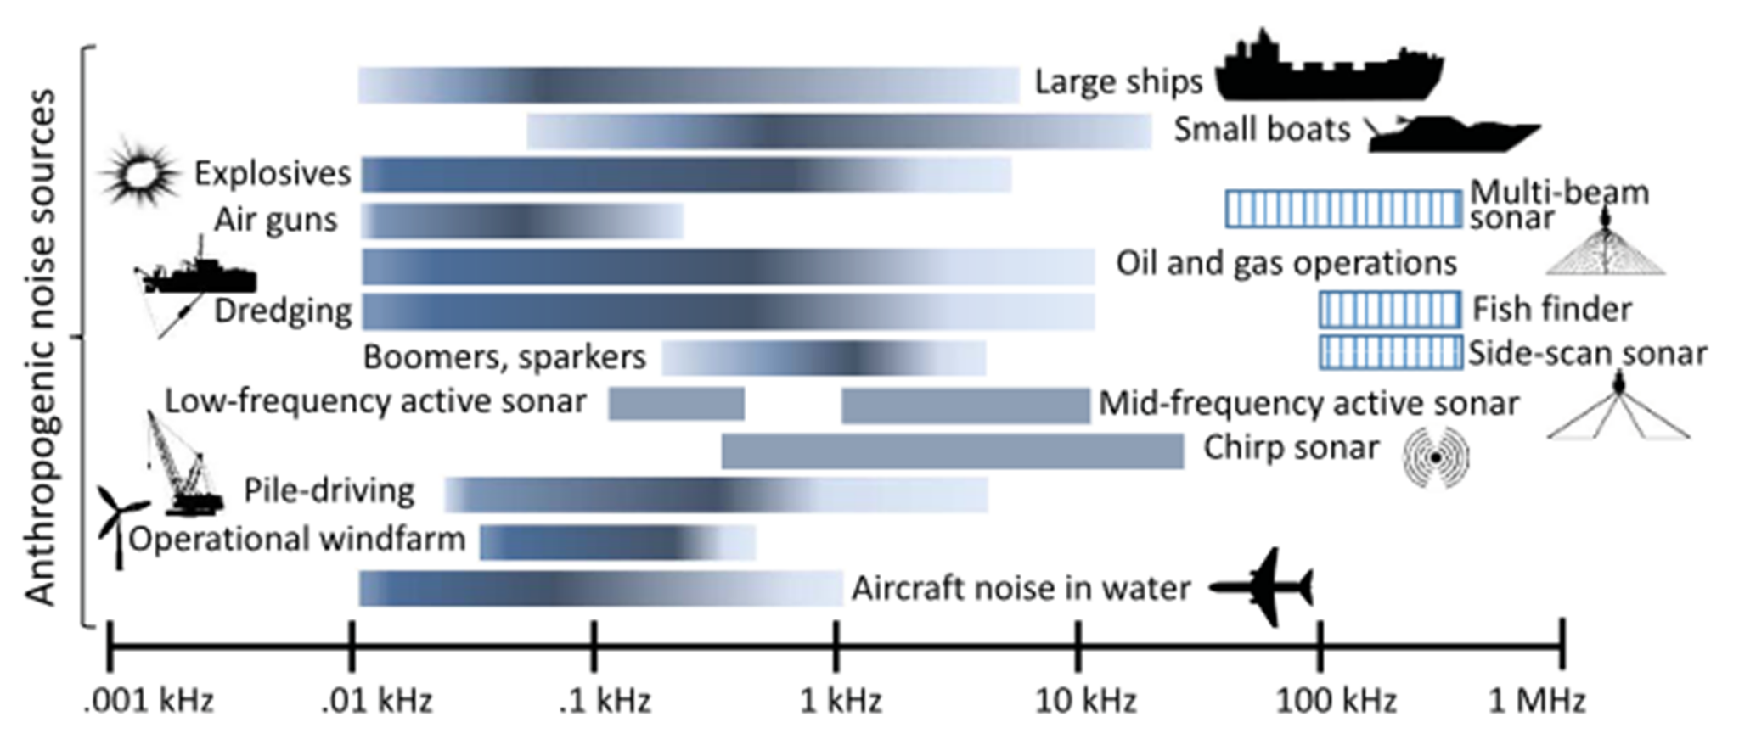
Anthrophony in the Ocean
Duarte et al 2021

Slide 3
Anthrophony in the Ocean
Duarte et al 2021

Slide 4
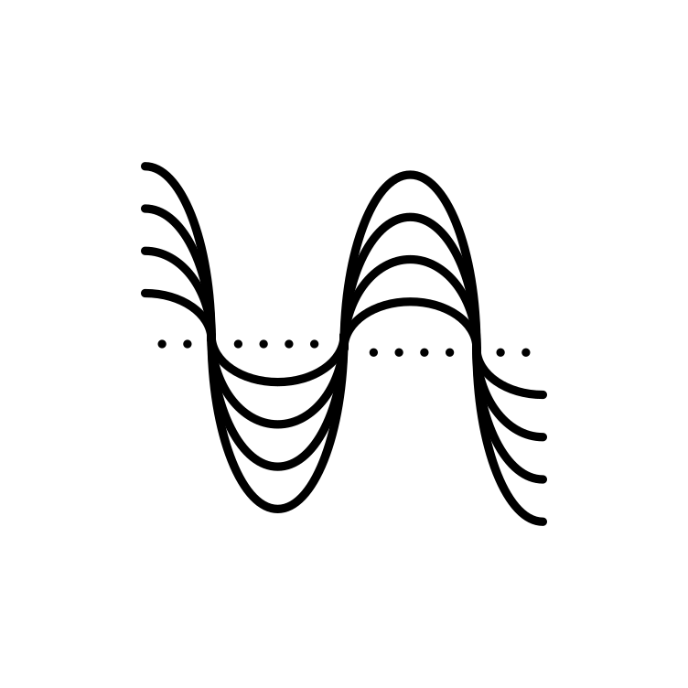
Components of Sound
Sonic Energy
Sound Waves
Particle Motion
Pressure
Detection by Mammals*
Detection by Fish
Detection by Invertebrates

Slide 5
Components of Sound
Sonic Energy
Sound Waves
Particle Motion
Pressure
Detection by Mammals*
Detection by Fish
Detection by Invertebrates

Slide 6
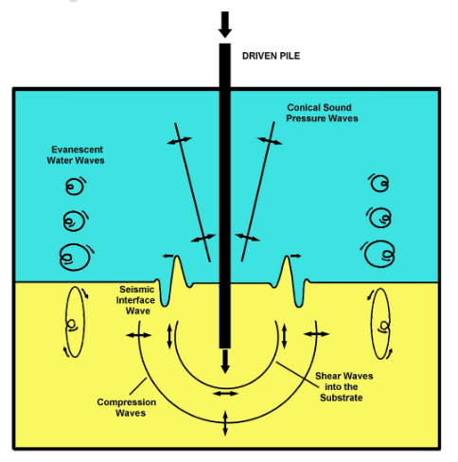
Components of Sound
Hawkins et al. 2021
Sonic Energy
Sound Waves
Particle Motion
Pressure
Detection by Mammals*
Detection by Fish
Detection by Invertebrates

Slide 7
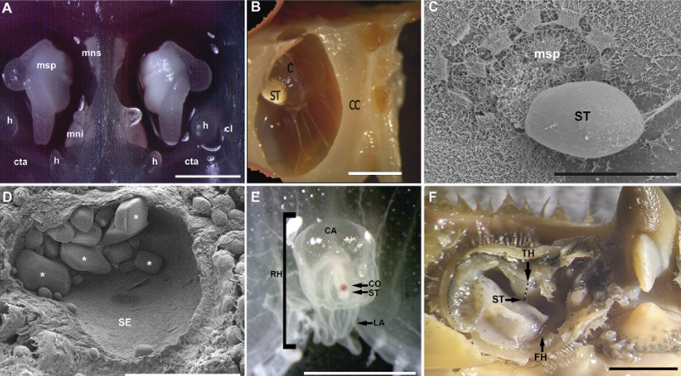
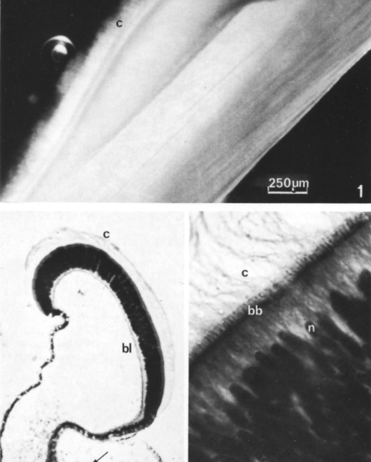
Mechanism for sound reception by particle movement: statocysts and the abdominal sense organ (ASO)
Statocyst microscopy, Sole et al 2023: A–C: Cephalopods
D: Gastropods. E: Cnidarians F: Crustaceans
ASO microscopy, Moir 1977
Notes:
The bivalve abdominal sense organ (ASO) is highly sensitive to waterborn vibration in the range 20–1500 Hz

Slide 8
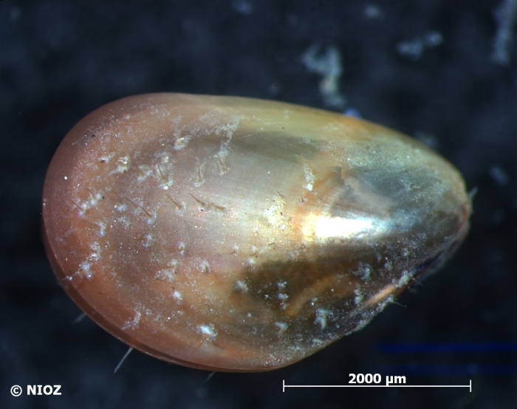
The Blue Mussel Mytilus edulis
Habitat creation and improvement in the Gulf of Maine
Water filtration
Coastal protection
Cultural importance
Economic value
World Register of Marine Species

Slide 9
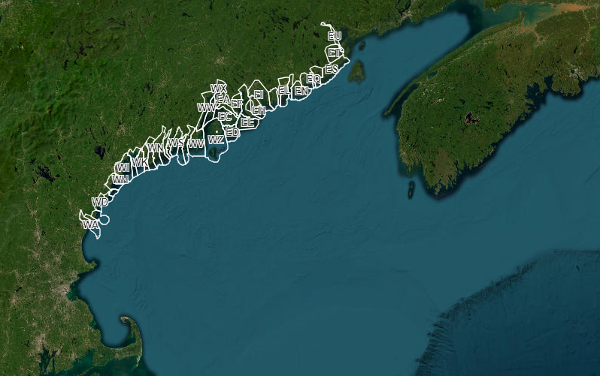
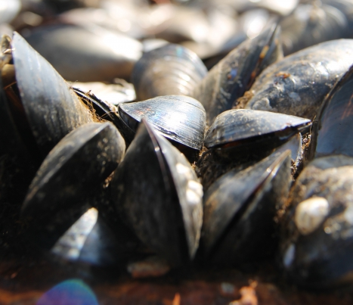
Maine Department of Marine Resources - Marine Shellfish Closures & Monitoring Data
World Register of Marine Species
Mussel Collection Areas: Maine, USA
Industry worth $4.3 million in Maine as of 2021

Slide 10
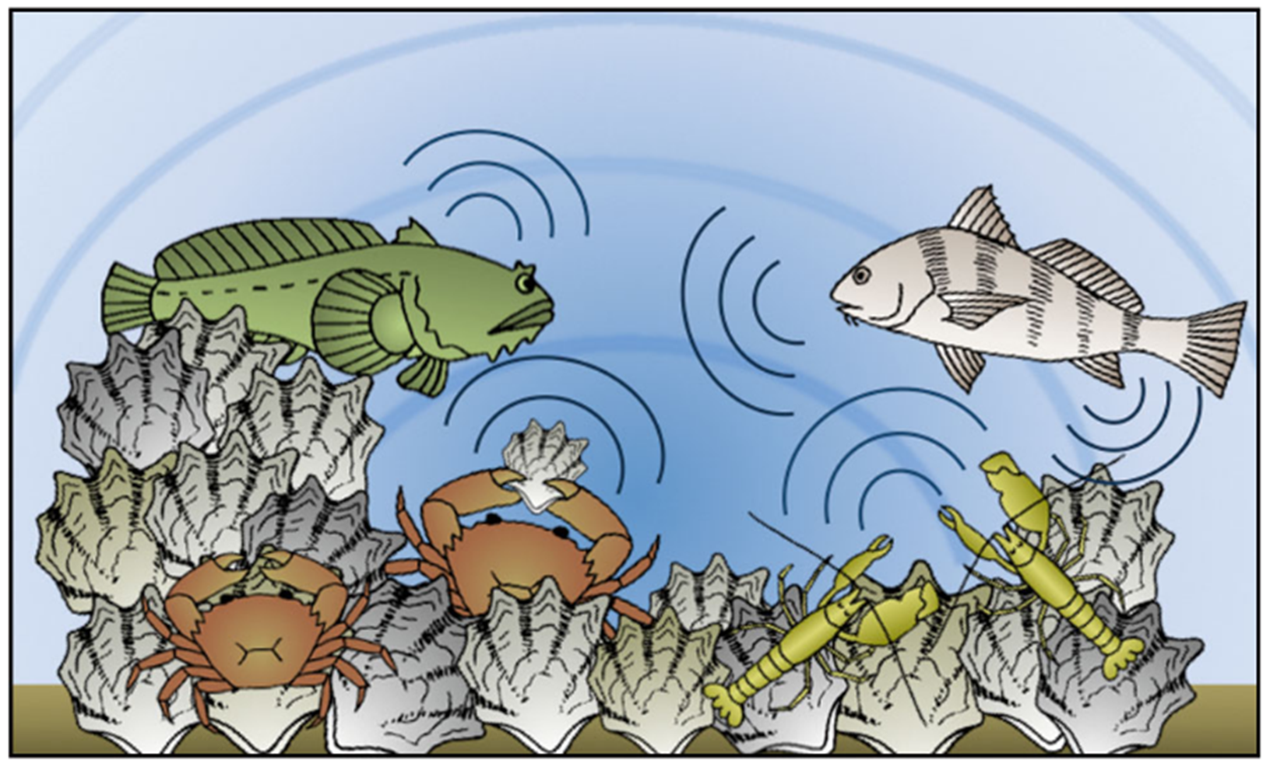
Positive Effects: Natural sound as a larval cue
Lillis et al. 2014

Slide 11
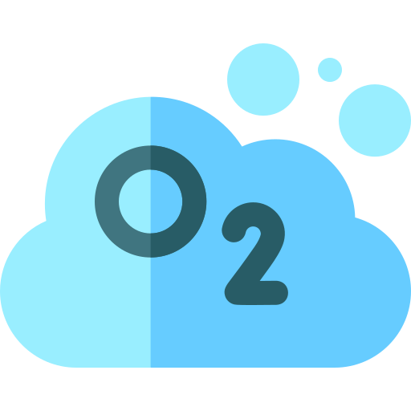
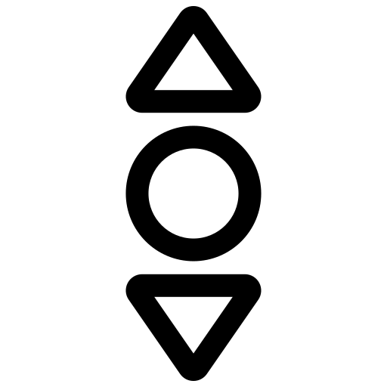
Negative effects: Anthropogenic sound as a physiological stressor
Higher breaks in DNA
Higher oxygen consumption
Increased valve movement
Sole et al 2023
Notes:
turn this into diagram

Slide 12
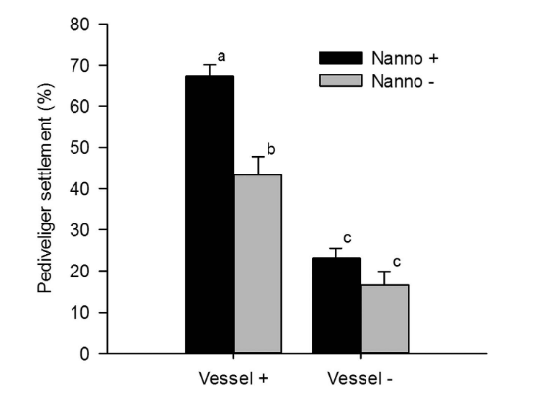
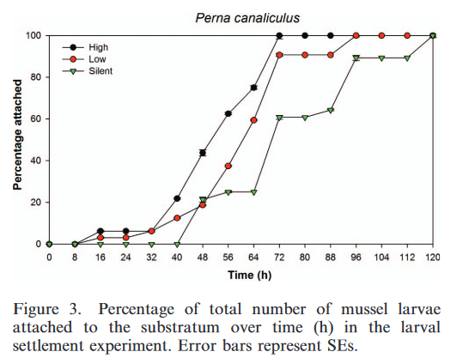
Positive effect (?) : Ship noise as a larval cue
Ship noise
Faster settlement (Wilkens et al. 2012)
Increased settlement (Jolivet et al. 2016)
loud
quiet
silent

Slide 13
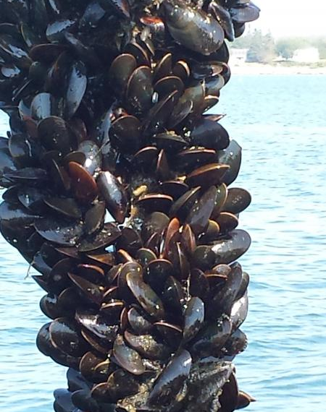
Wiscasset Newspaper
Question:
How do low frequency noise levels affect both the settlement and the adult survival and fitness of the blue mussel?

Slide 14
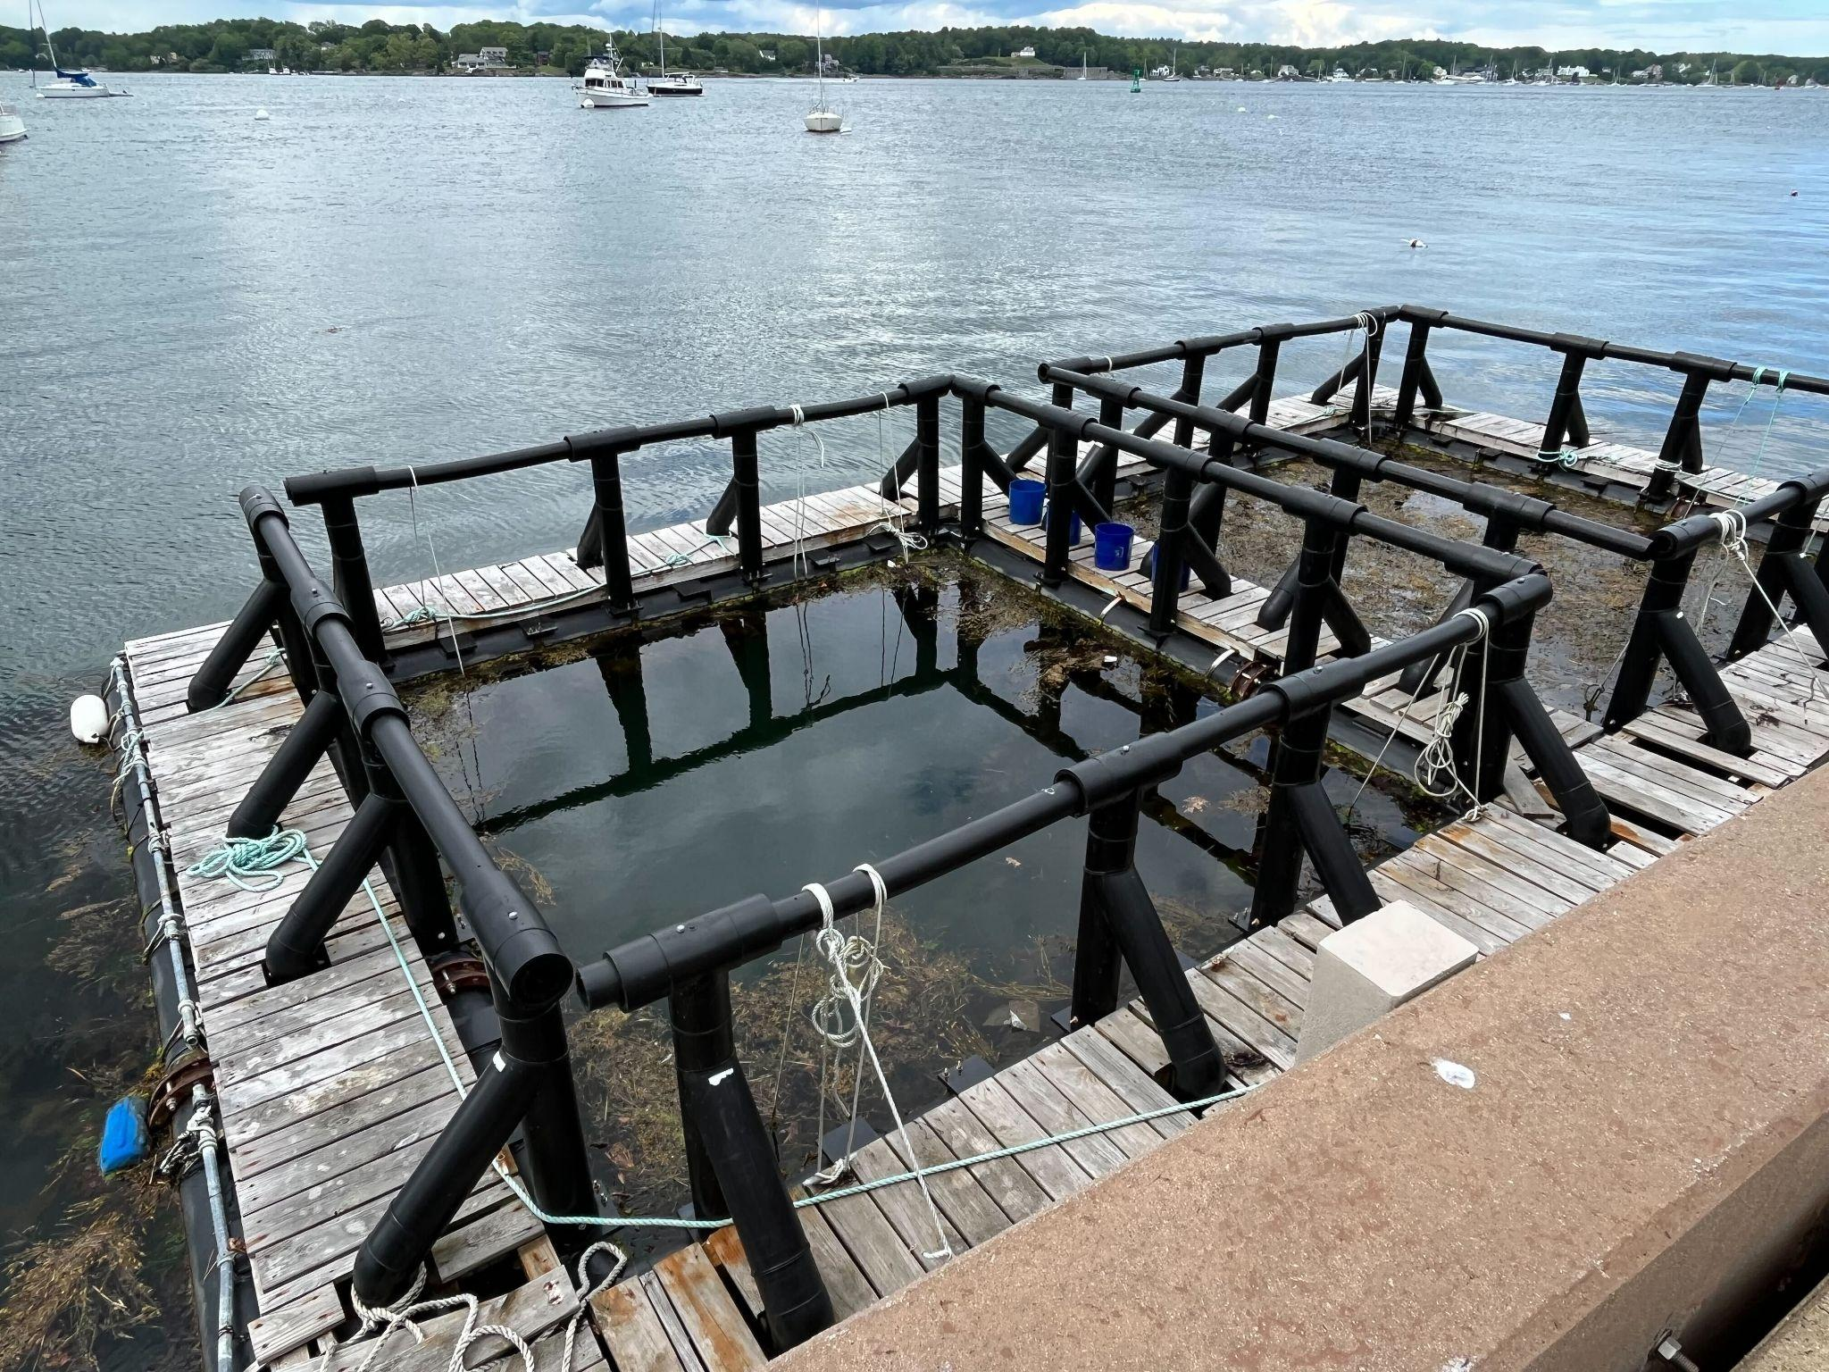
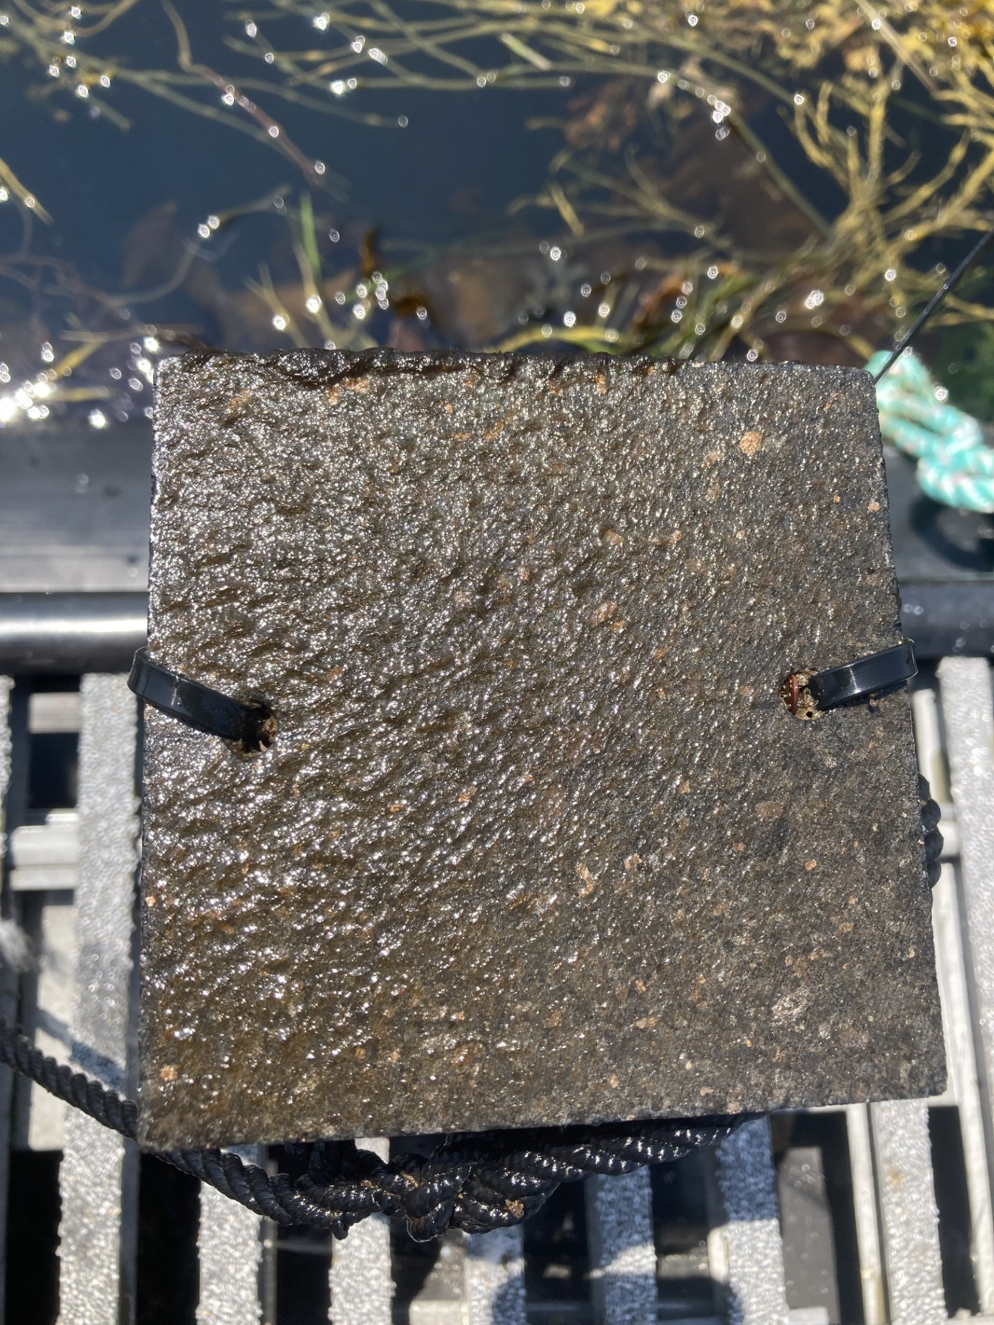
Recruitment of new mussels on settlement plates
UNH Coastal Marine Lab
Newcastle Beach

Slide 15
Amplitude of sounds 10-5000 Hz measured with hydrophones on each floating dock
Medium sized Boat
Discovery of Sound in the Sea (DOSITS)
Sound Trap 500 (ST500), Ocean Instruments
Notes:
June 4 9:30pm boats!

Slide 16
What we’re looking for:
How rates of settlement and amplitude of low frequency sound energy relate to each other
Differences in adult mussels from both sites (respirometry, morphology)
Number of new mussels present on plates from week to week

Slide 17
What we’re looking for:
How rates of settlement and amplitude of low frequency sound energy relate to each other
Differences in adult mussels from both sites (respirometry, morphology)
Number of new mussels present on plates from week to week

Slide 18
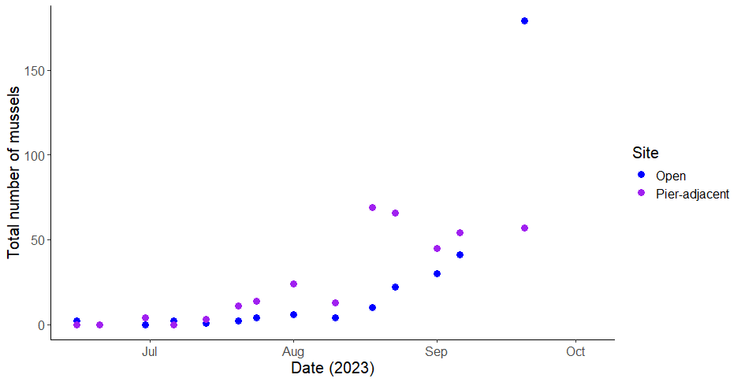
New mussel population numbers increased over time in two main waves (as expected)

Slide 19
New mussel population numbers increased over time in two main waves (as expected)
First wave

Slide 20
New mussel population numbers increased over time in two main waves (as expected)
Second wave
First wave

Slide 21
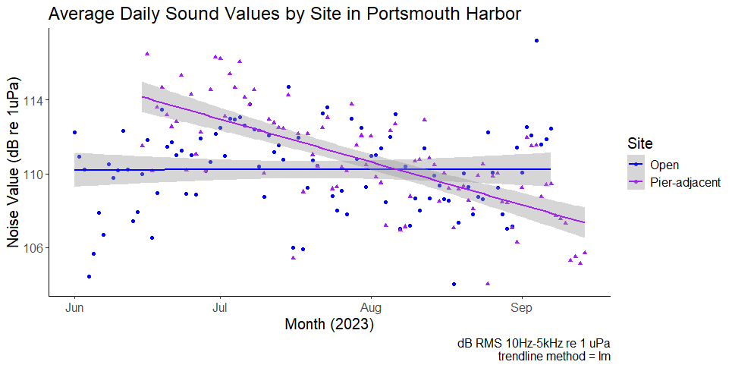
Average daily sound amplitude levels decreased at the pier site over time, although there was high variability at both sites
Noise Value as an interaction of site and time (date)
estimate = -0.07506 dB re 1uPa
p < .0001
Notes:
results - sound

Slide 22
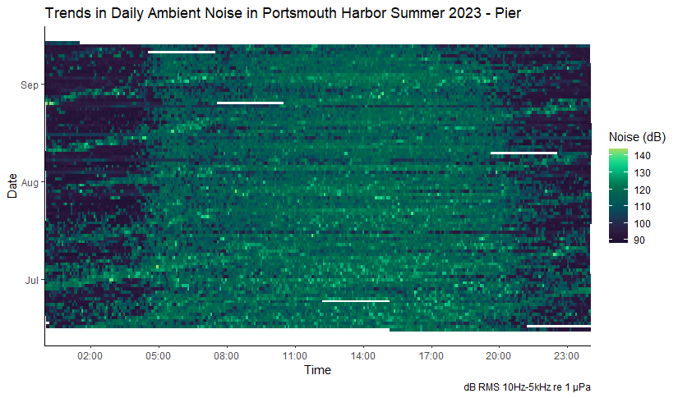
Daily trends were seen at both sites, including tidal flow noise and increased noise during daylight hours (5am-8pm)

Slide 23
Daily trends were seen at both sites, including tidal flow noise and increased noise during daylight hours (5am-8pm)
Tidal flow
Daylight hours

Slide 24
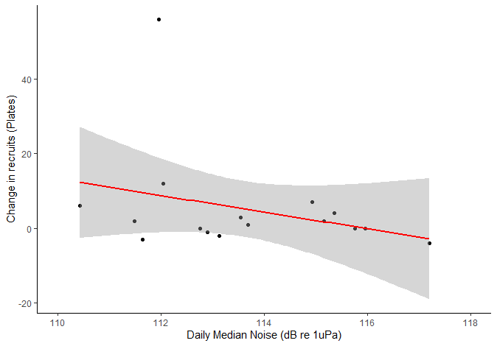
In a field setting, blue mussel recruitment was negatively correlated with low frequency sound amplitude (loudness of low sounds)
Change in recruits as a function of noise value, all points considered (estimate = -9.1, p = 0.04)

Slide 25
Conclusions
Sound amplitude from 10-5000 Hz differed between the two sites through time
Blue mussel settlement differed in magnitude and peak settlement time between the two sites
Preliminary models show that mussel recruitment decreases were associated with increasing ambient low sound (primarily vessel noise)

Slide 26
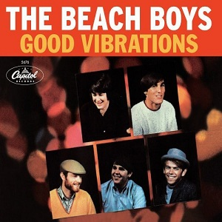
Conclusions
Sound amplitude from 10-5000 Hz differed between the two sites through time
Blue mussel settlement differed in magnitude and peak settlement time between the two sites
Preliminary models show that mussel recruitment decreases were associated with increasing ambient low sound (primarily vessel noise)
Wikipedia

Slide 27
Conclusions
Sound amplitude from 10-5000 Hz differed between the two sites through time
Blue mussel settlement differed in magnitude and peak settlement time between the two sites
Preliminary models show that mussel recruitment decreases were associated with increasing ambient low sound (primarily vessel noise)
X
Wikipedia

Slide 28
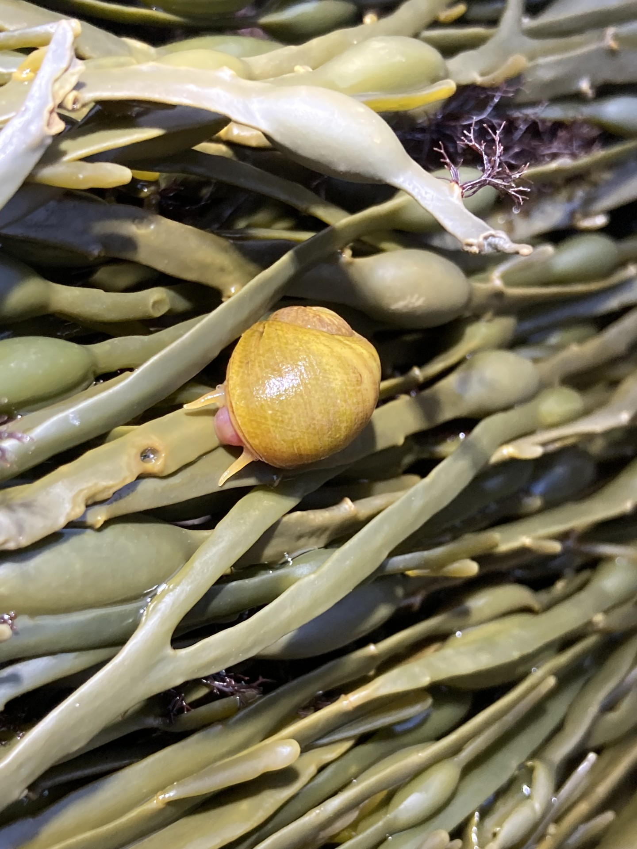
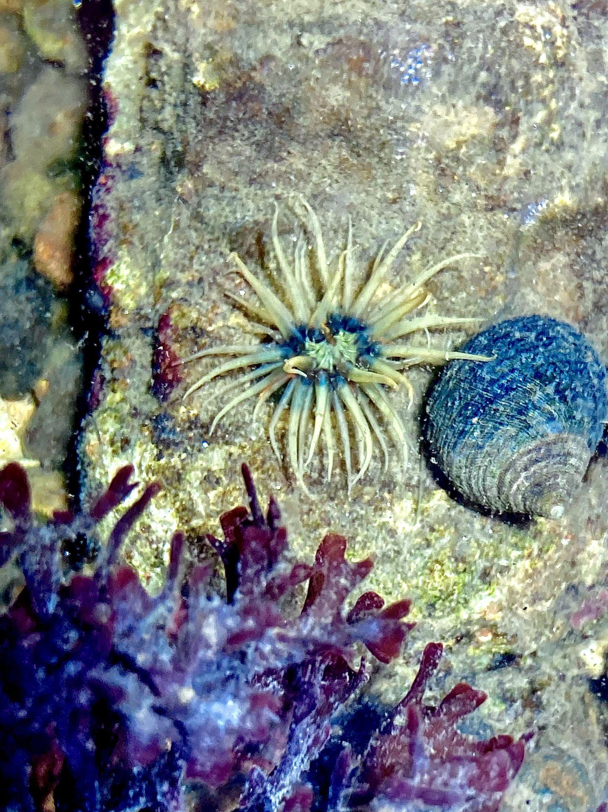
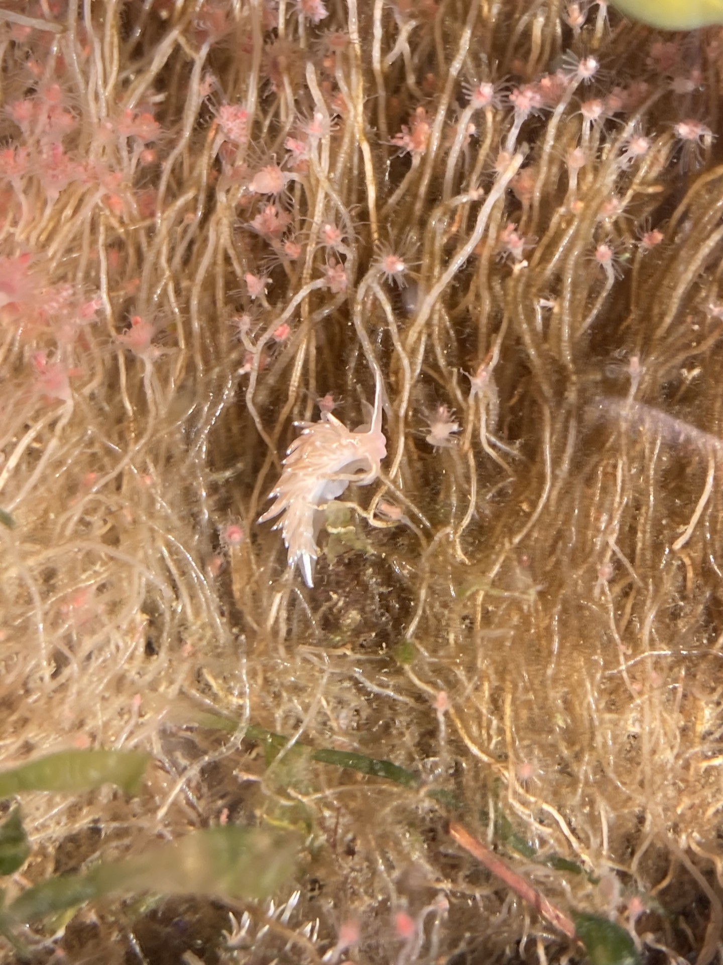
Acknowledgements
Dr. Liz Harvey
Dr. Jen Miksis-Olds
Maddie Wilson
Todd Stelling
Michaela Edwards

Slide 29
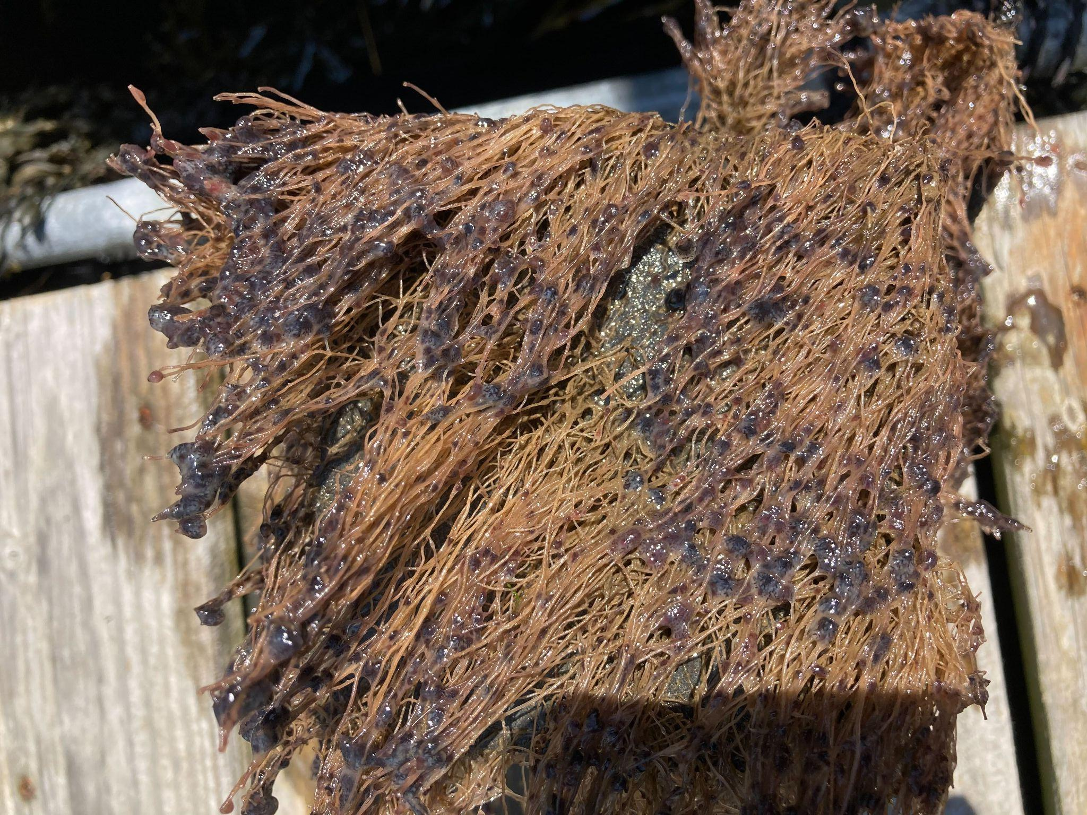
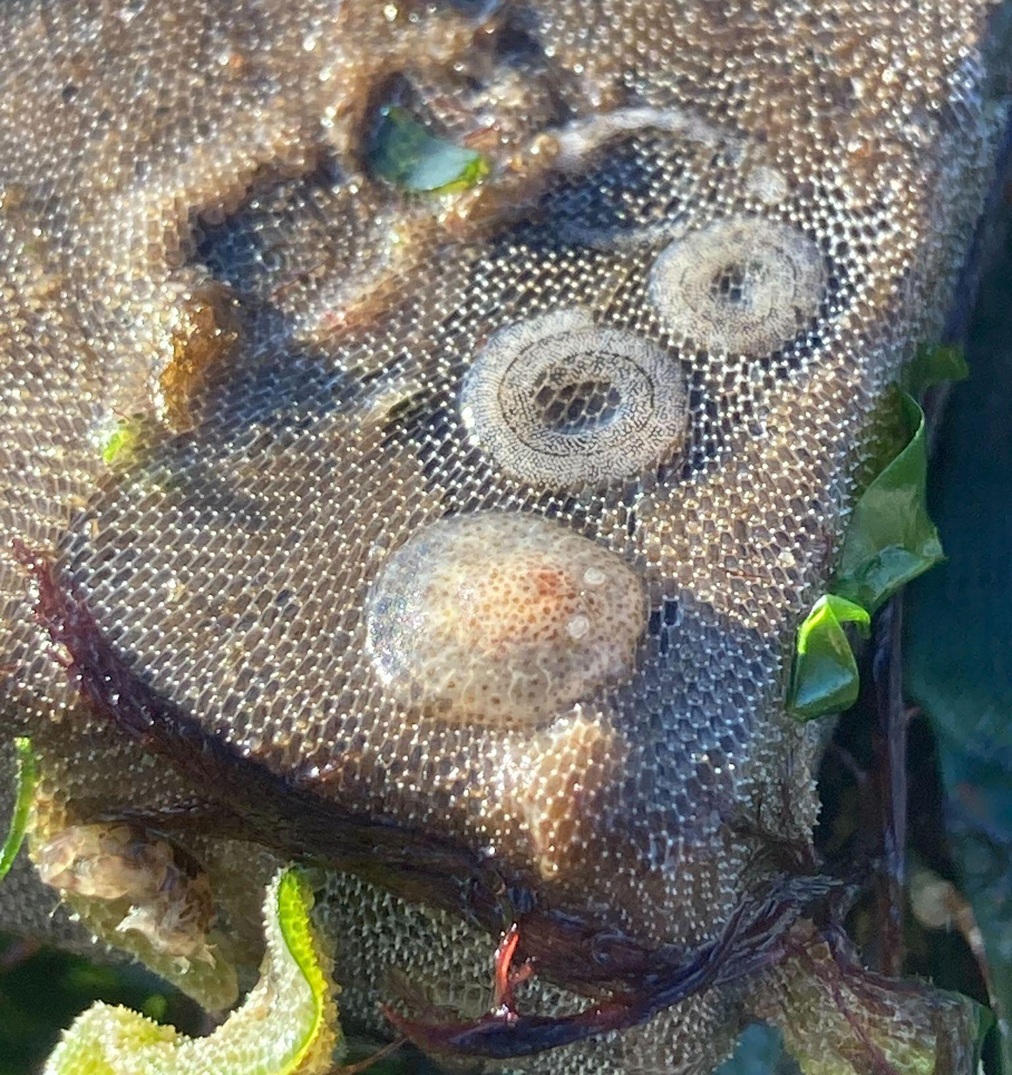
Questions?

Slide 30
References
Duarte, Carlos M., Lucille Chapuis, Shaun P. Collin, Daniel P. Costa, Reny P. Devassy, Victor M. Eguiluz, Christine Erbe, et al. “The Soundscape of the Anthropocene Ocean.” Science 371, no. 6529 (February 5, 2021): eaba4658. https://doi.org/10.1126/science.aba4658.
Hawkins, Anthony D., Richard A. Hazelwood, Arthur N. Popper, and Patrick C. Macey. “Substrate Vibrations and Their Potential Effects upon Fishes and Invertebrates.” The Journal of the Acoustical Society of America 149, no. 4 (April 2021): 2782–90. https://doi.org/10.1121/10.0004773.
Jolivet, Aurélie, Rejean Tremblay, Fréderic Olivier, Cédric Gervaise, Rémi Sonier, Bertrand Genard, and Laurent Chauvaud. “Validation of Trophic and Anthropic Underwater Noise as Settlement Trigger in Blue Mussels.” Scientific Reports 6, no. 1 (September 20, 2016): 33829. https://doi.org/10.1038/srep33829.
Lillis, A, Db Eggleston, and Dr Bohnenstiehl. “Soundscape Variation from a Larval Perspective: The Case for Habitat-Associated Sound as a Settlement Cue for Weakly Swimming Estuarine Larvae.” Marine Ecology Progress Series 509 (August 27, 2014): 57–70. https://doi.org/10.3354/meps10917.
Lillis, Ashlee, DelWayne R. Bohnenstiehl, and David B. Eggleston. “Soundscape Manipulation Enhances Larval Recruitment of a Reef-Building Mollusk.” PeerJ 3 (June 4, 2015): e999. https://doi.org/10.7717/peerj.999.
Lillis, Ashlee, David B. Eggleston, and DelWayne R. Bohnenstiehl. “Correction: Oyster Larvae Settle in Response to Habitat-Associated Underwater Sounds.” Edited by Simon Thrush. PLoS ONE 9, no. 1 (January 6, 2014). https://doi.org/10.1371/annotation/b04bc087-808a-4edc-ae2a-08932bff360c.
Moir, A.J.G. “On the Ultrastructure of the Abdominal Sense Organ of the Giant Scallop, Placopecten Magellanicus (Gmelin).” Cell and Tissue Research 184, no. 3 (November 1977). https://doi.org/10.1007/BF00219896.
Solé, Marta, Kenzo Kaifu, T. Aran Mooney, Sophie L. Nedelec, Frédéric Olivier, Andrew N. Radford, Mirella Vazzana, et al. “Marine Invertebrates and Noise.” Frontiers in Marine Science 10 (March 7, 2023): 1129057. https://doi.org/10.3389/fmars.2023.1129057.
“SoundTrap ST500 STD – Long Term Recorder.” Accessed April 8, 2024. https://www.oceaninstruments.co.nz/product/soundtrap-st500-std/.
Wilkens, S.L., J.A. Stanley, and A.G. Jeffs. “Induction of Settlement in Mussel ( Perna Canaliculus ) Larvae by Vessel Noise.” Biofouling 28, no. 1 (January 2012): 65–72. https://doi.org/10.1080/08927014.2011.651717.
Wiscasset Newspaper. “Maine Mussels: Not on the Rocks.” Accessed November 2, 2023. https://www.wiscassetnewspaper.com/node/78120.
“WoRMS - World Register of Marine Species - Mytilus Edulis Linnaeus, 1758.” Accessed November 2, 2023. https://www.marinespecies.org/aphia.php?p=taxdetails&id=140480#images.

