Slide 1
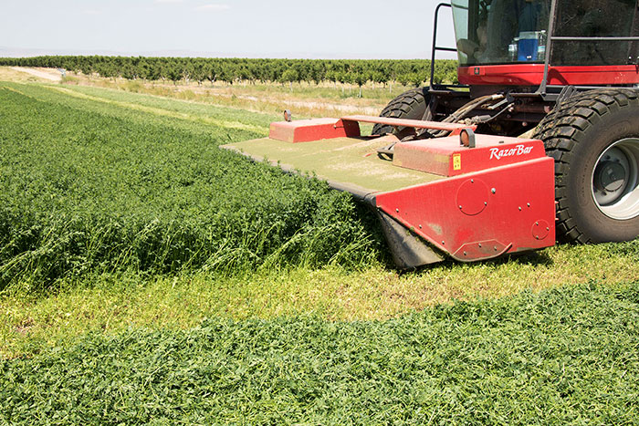
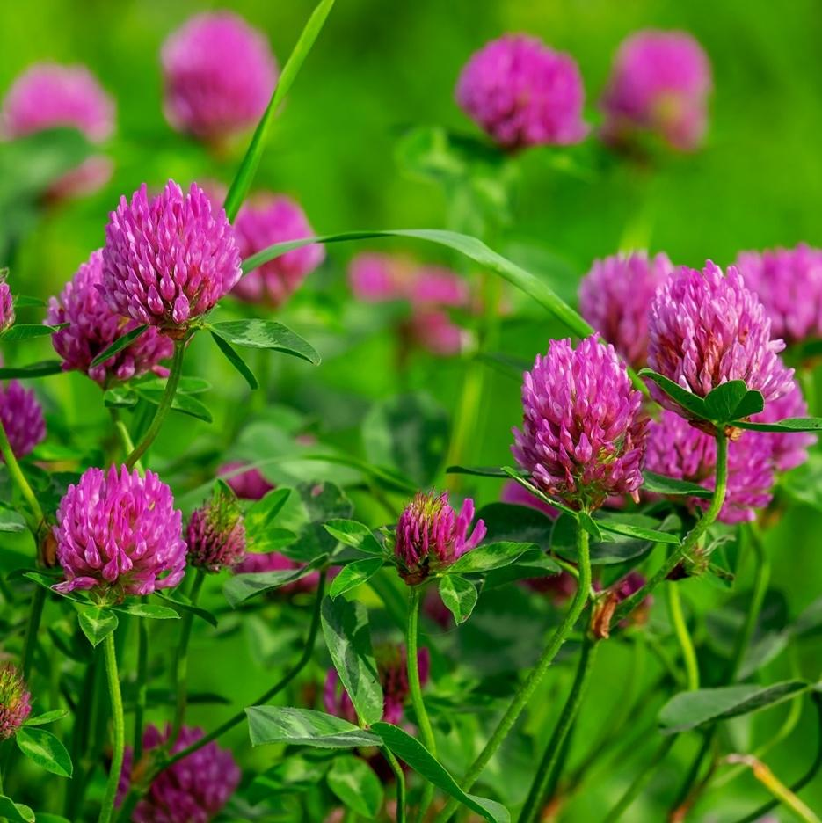
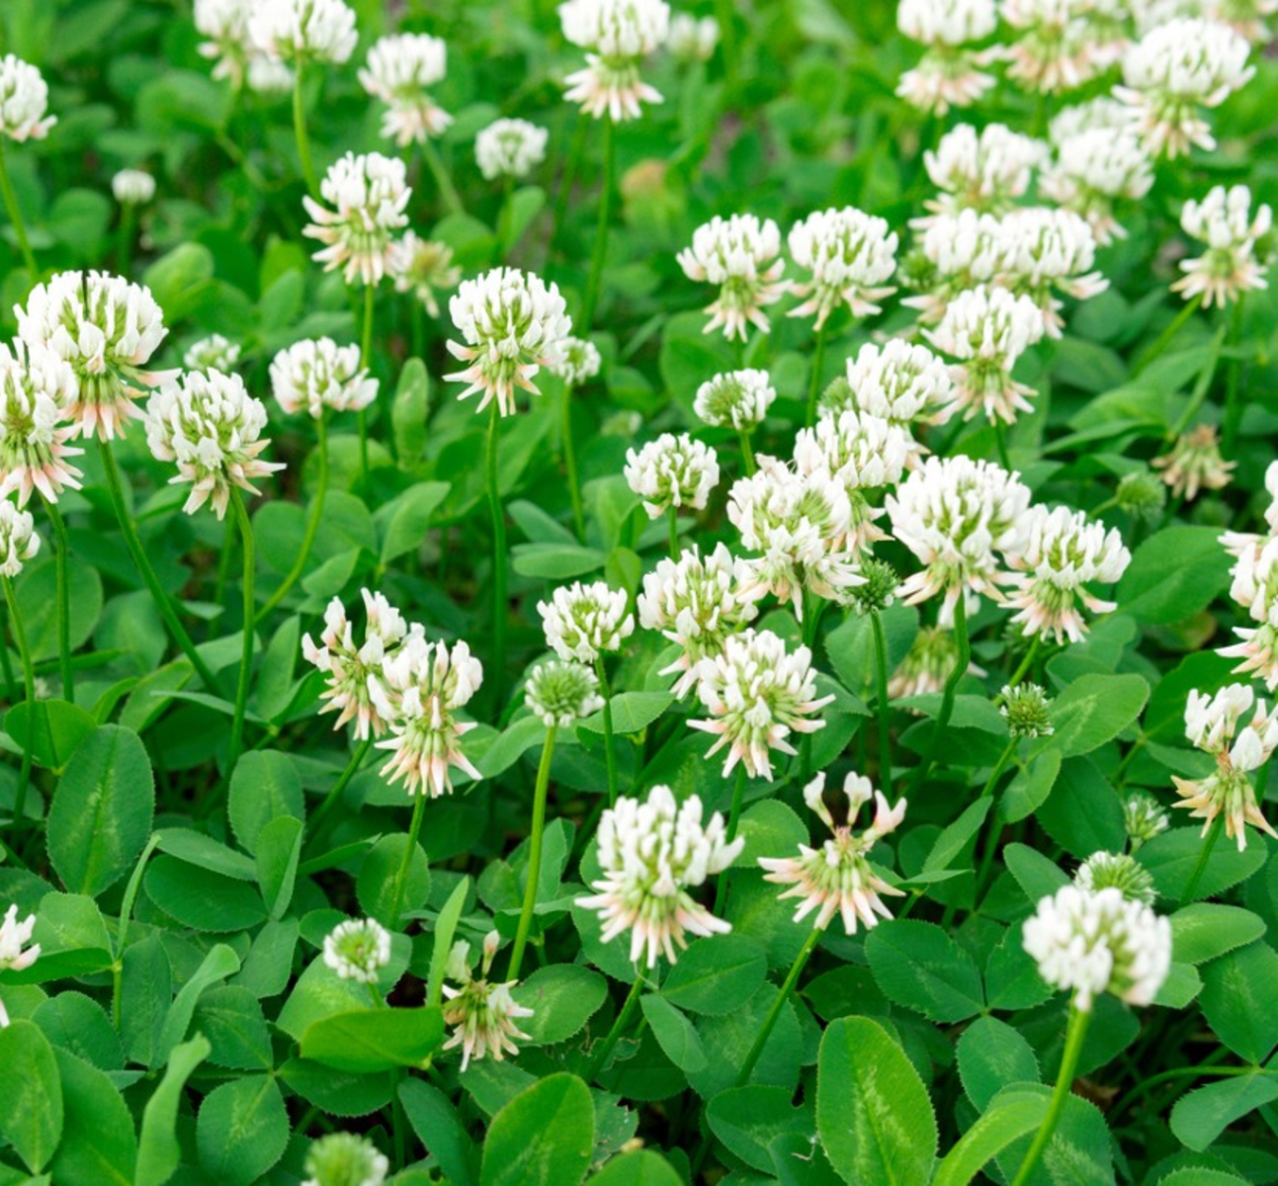

Influence of Defoliation Frequency and Severity on Phytoestrogen Concentrations in Red Clover and White Clover
Palash Mandal¹, Nicholas D. Warren², Marta R. M. Lima³, Andre F. Brito¹, Richard G. Smith²
¹Department of Agriculture, Nutrition and Food Systems, UNH, NH; ²Department of Natural Resources and the Environment, UNH, NH; ³School of Plant and Environmental Sciences, Virginia Tech, VA
Graduate Research Conference, UNH
April 15, 2024

Slide 2

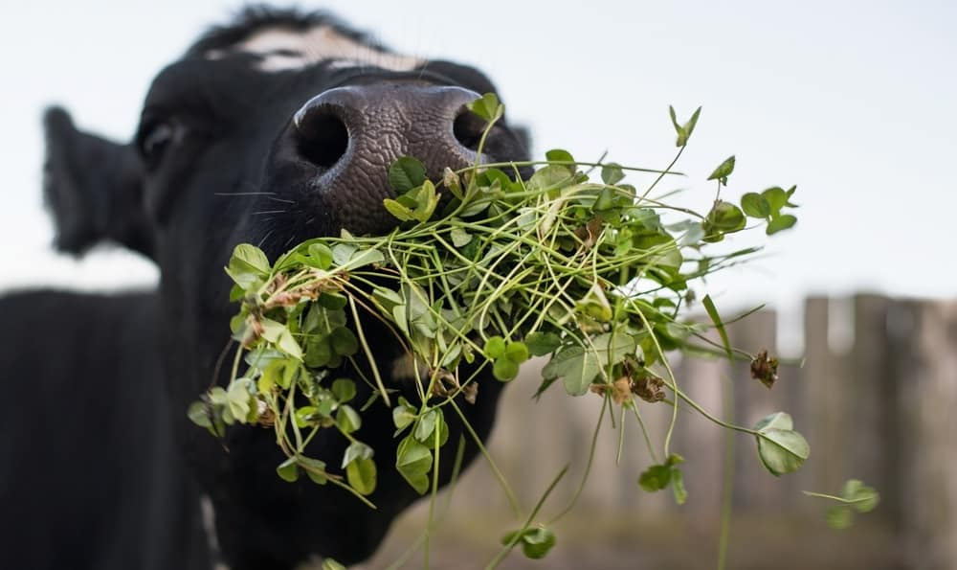
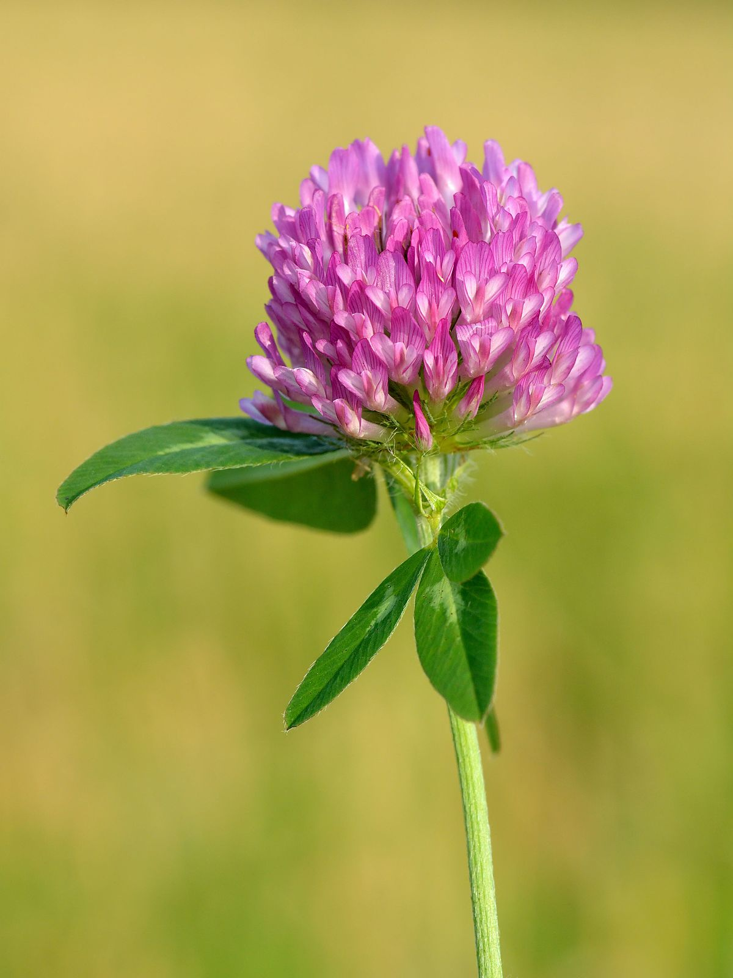
Benefits of clovers (forage legumes)
Environmental benefits of legumes
Reduce N fertilizer use
Fix atmos.
N₂
Reduce N₂O emission
Clover
Supports natural enemies
Reduce NO₃- leaching
Reduce enteric CH₄ emission
(Paulson et al. 2008; Aguirre-Villegas, 2017; Brito et al. 2020)
Notes:
On average, cropping systems with legumes reduced nitrous oxide emissions by 18 and 33% and N fertilizer use by 24 and 38% in arable and forage systems, respectively, compared to systems without legumes
Nitrate leaching was similar with and without legumes in arable systems and reduced by 22% in forage systems.
Soil microbes known as rhizobia supply much-needed nitrogen to legumes such as clover (Trifolium species). In return, legumes shelter the rhizobia in nodules on their roots and provide them with carbon.

Slide 3
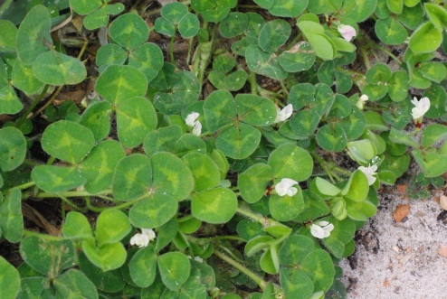
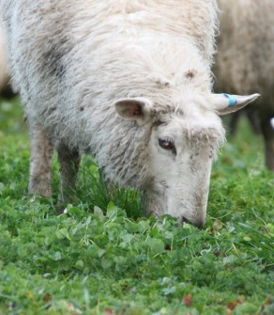
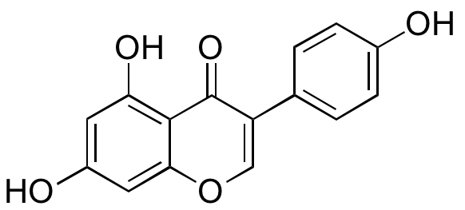
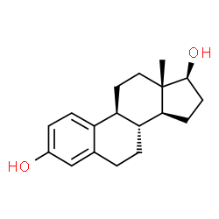
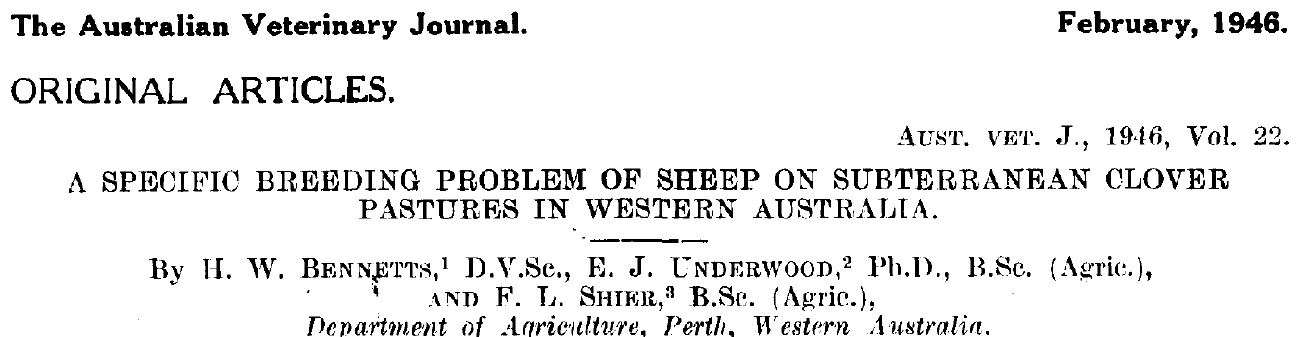
Potential problem
Environmental benefits of legumes
Phytoestrogens are compounds that occur naturally in some legume plants
1946: infertility occurred in female sheep grazing subterranean clover
Phytoestrogens structurally and/or functionally similar to mammalian estrogens
“Clover disease”
Genistein
Estrogen

Slide 4
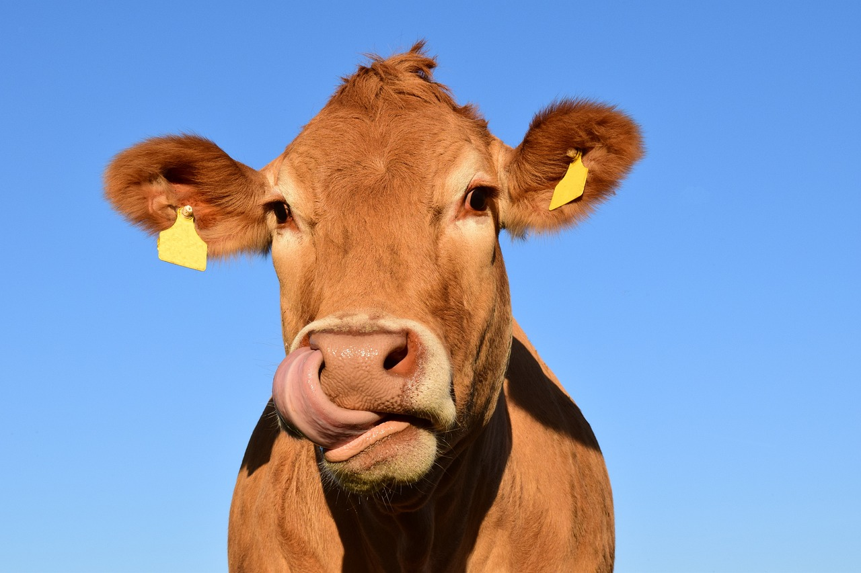
Impact of phytoestrogens on dairy cattle
Environmental benefits of legumes
Reduces the corpus luteum function
Reduces fertility and conception rate
Transfer to milk
Mandal et al. (in prep.)

Slide 5
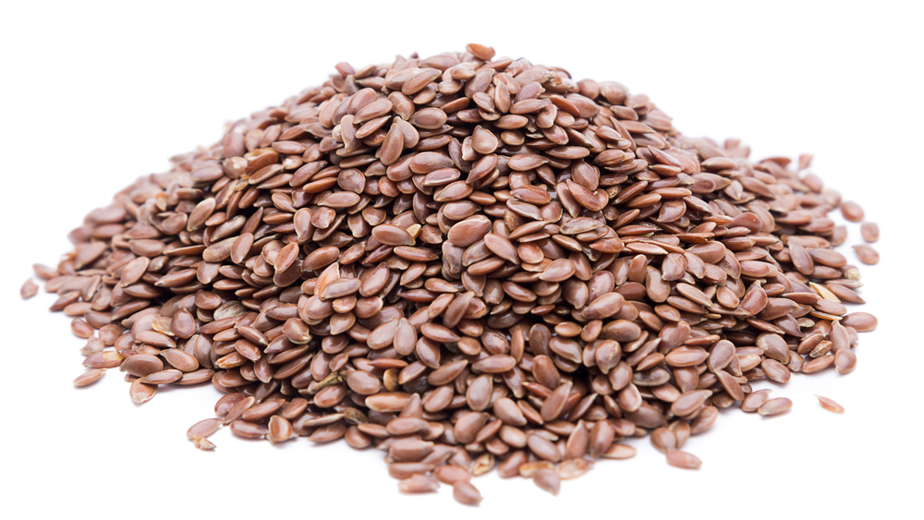
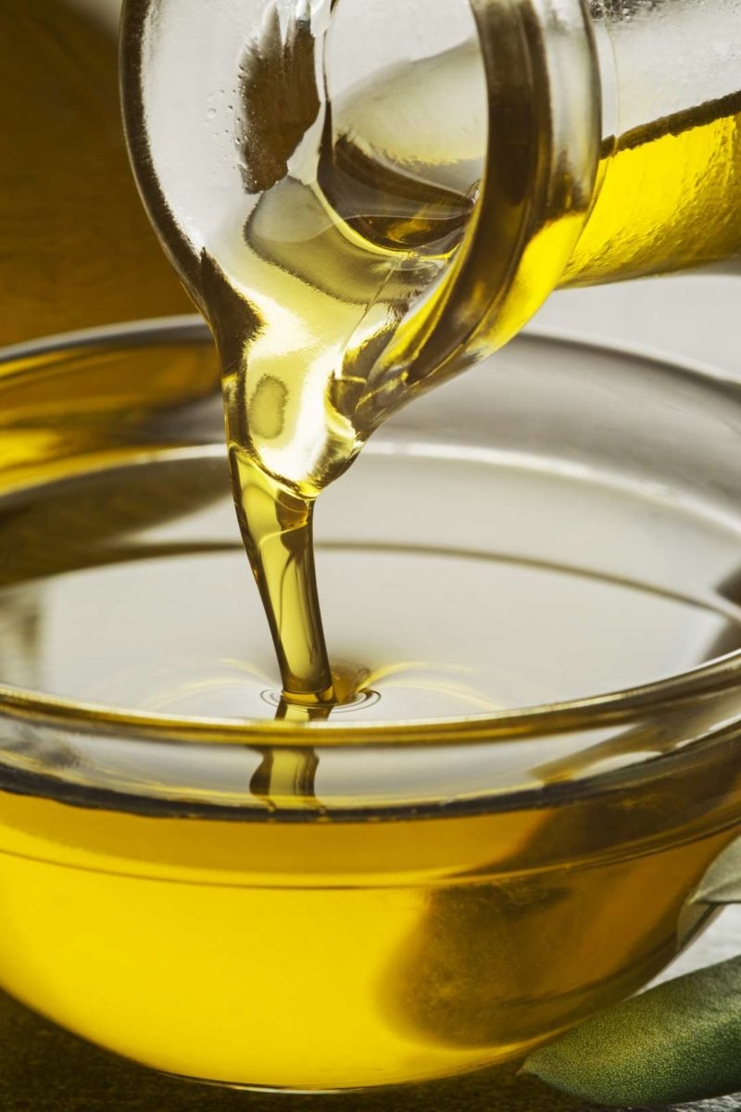
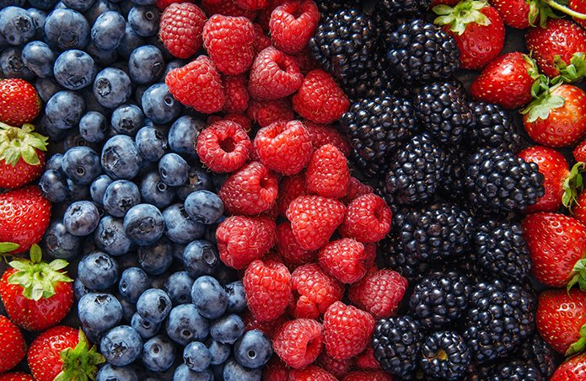
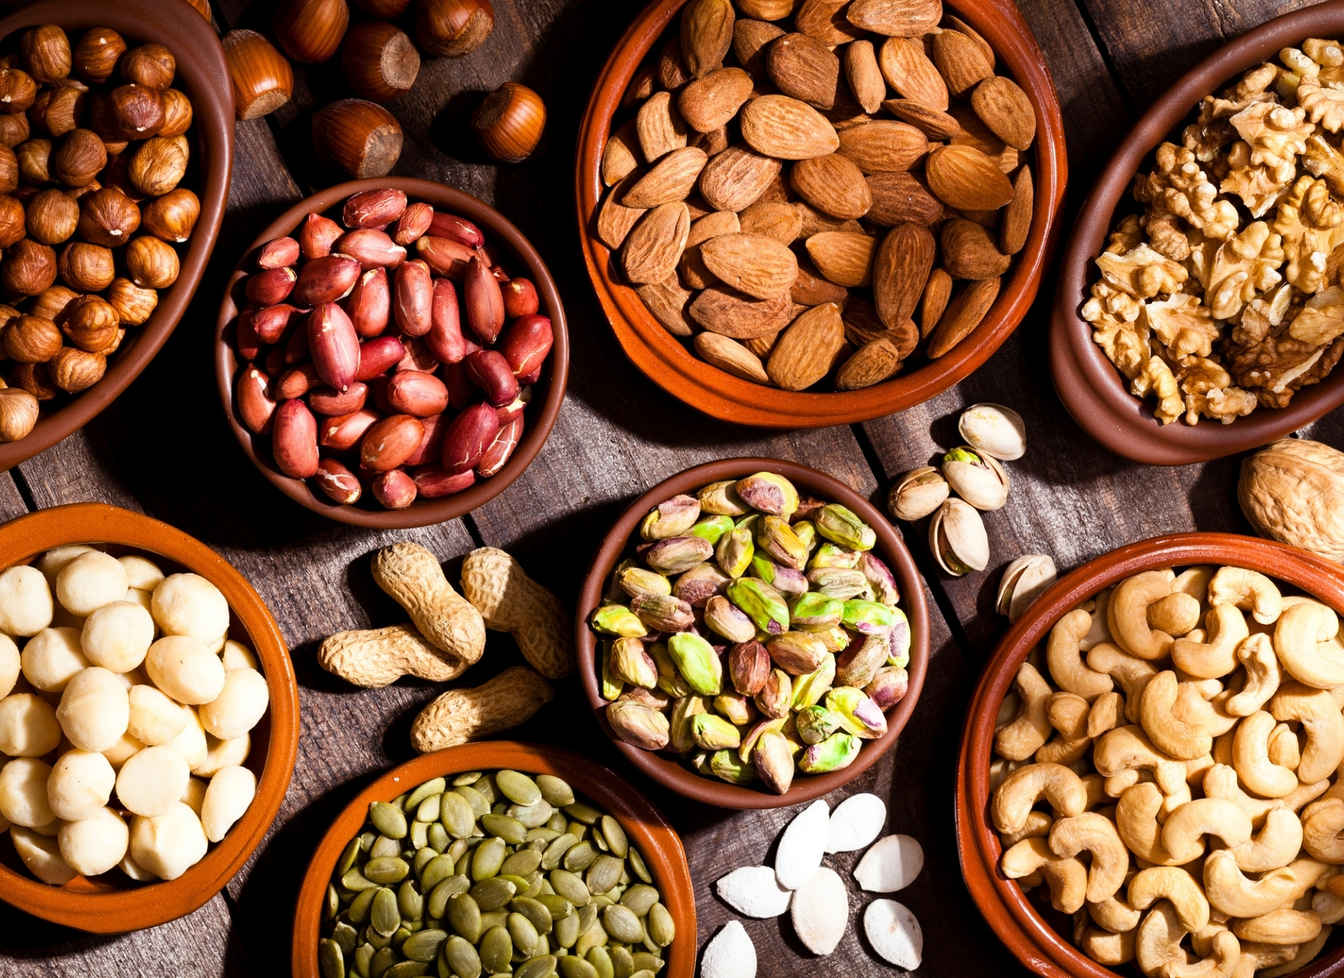
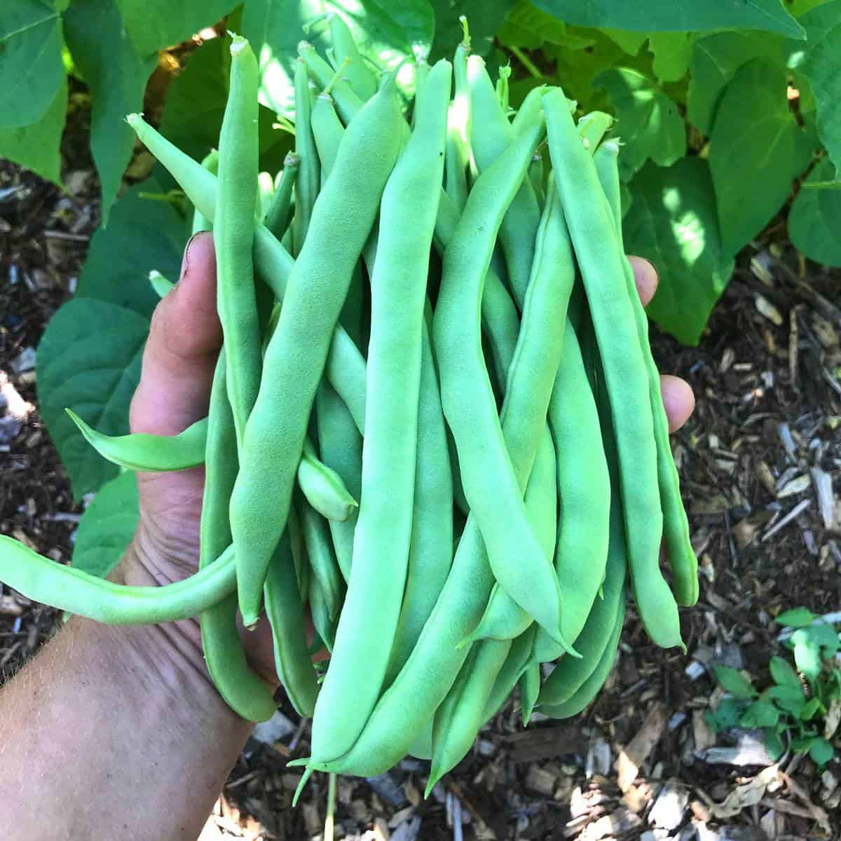

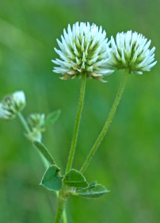
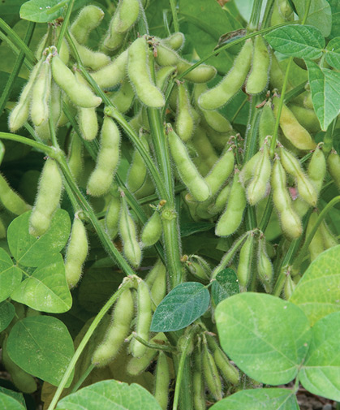
Classification of phytoestrogens
Environmental benefits of legumes
Phytoestrogens
Flavonoids
Isoflavones
Biochanin A
Formononetin
Genistein
Daidzein
Glycetin
Prunetin
Coumestans
Coumestrol
Lignans
Stilbenes

Slide 6
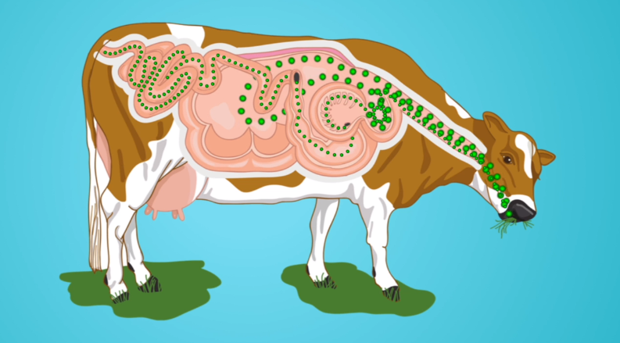



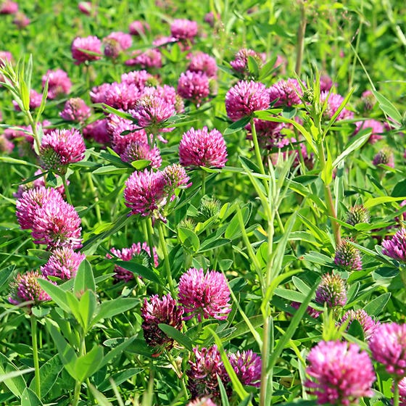

Formononetin daidzein equol biotransformation
Phytoestrogen +
Equol
Phytoestrogen
(Kalač 2018)
Notes:
Animal feed does not content equal, formononetin is demethylated into daidzein and large extent of these are subsequently reduced into equol by rumen microorganisms and transfer to the milk

Slide 7
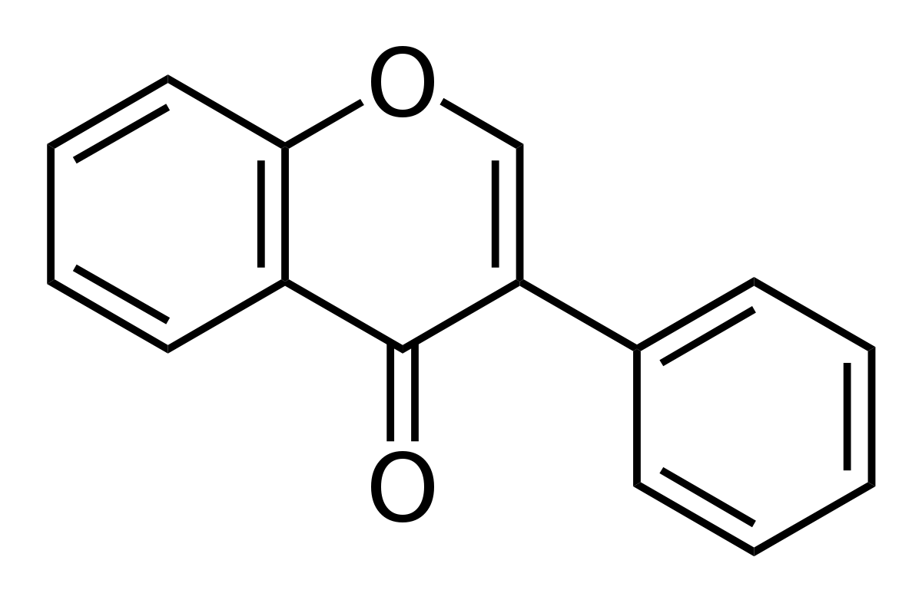
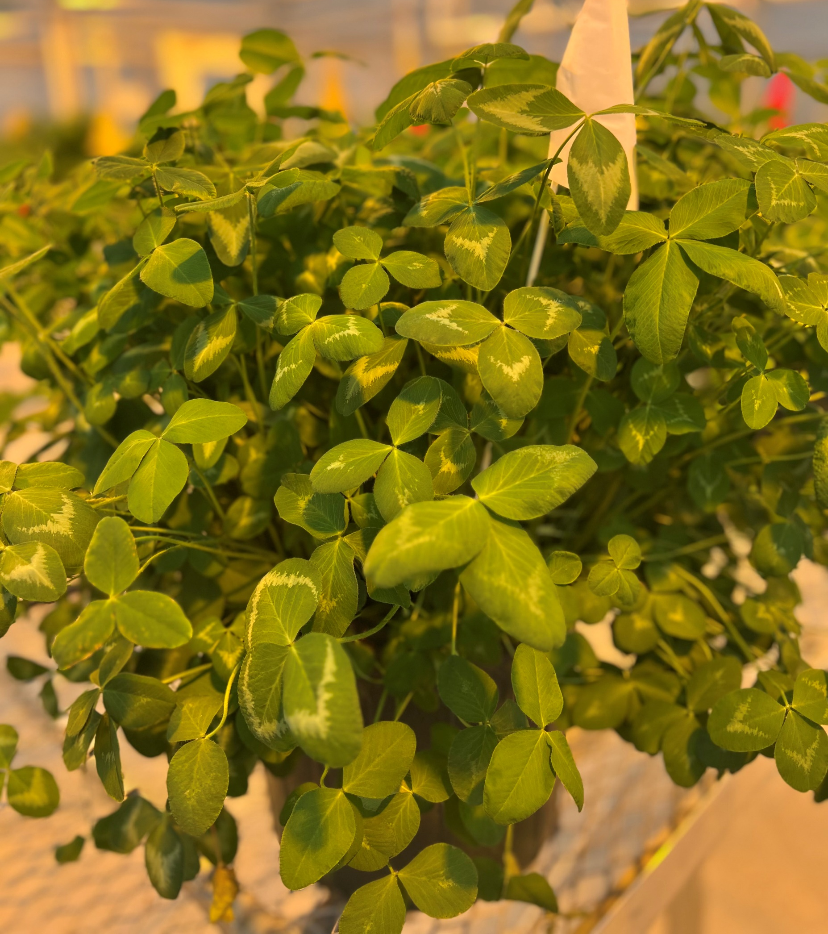


Plant and animal agriculture are interlinked
Environmental benefits of legumes
Forage Legumes
Animal Reproductive Health
Human Health
(Comerford et al. 2021)
7
Notes:
The complementary roles for plant-source and animal-source foods in sustainable healthy diets

Slide 8










Drivers of phytoestrogen concentration
Environmental benefits of legumes
Abiotic stress
Biotic stress
Management factors
Mandal et al. 2024; Mandal et al. (in prep.)
Notes:
According to previous research, different environmental and management factors could influence phytoestrogen accumulation. For example, in one of our study increased 100% phytoestrogen concentration in red clover. However, we do not know how management practices such as defoliation frequency and defoliation height influence the phytoestrogen concentration.

Slide 9
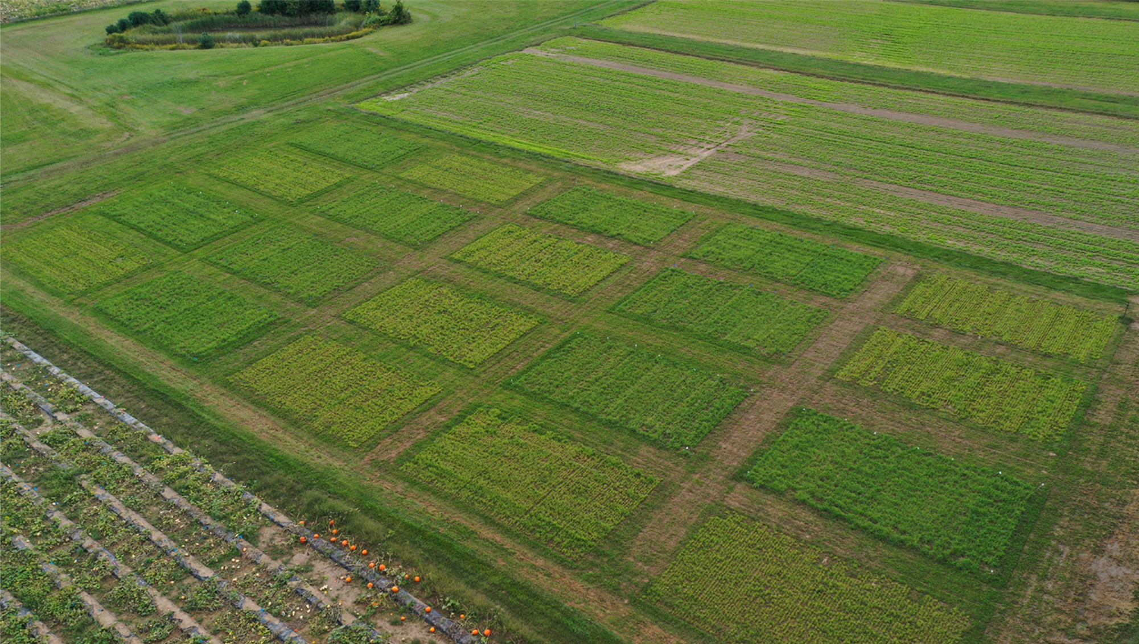
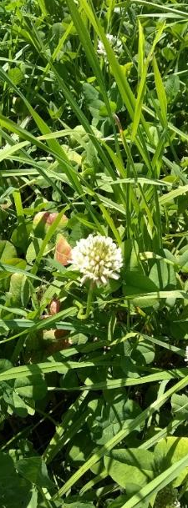
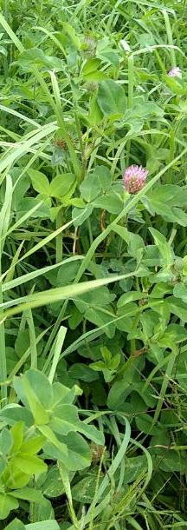
Experimentation
Environmental benefits of legumes
Objectives: to investigate phytoestrogen concentrations in red clover and white clover in response to defoliation frequency and defoliation severity
W. clover ‘Alice’
R. clover ‘Freedom’
Location: UNH Kingman Research Farm (Madbury, NH)
Orchardgrass ‘Latar’
Design: RCBD Split plot design

Slide 10
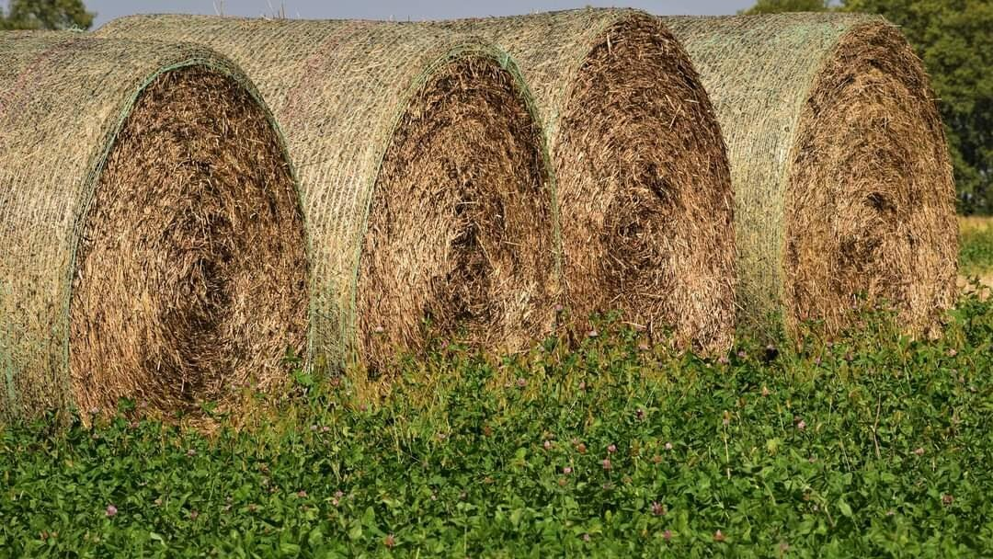


Defoliation frequency and severity
Environmental benefits of legumes
23rd May
26th July
27th September
3 Defoliation/Season (3X)
Defoliation frequency
(Per Season)
23rd May
22nd June
20th July
23rd August
27th September
5 Defoliation/Season (5X)
10 cm
5 cm
Defoliation severity/
residual height
Notes:
The defoliation frequency of forage legumes depends on the length of the growing season and the purpose of growing forages. In this New England region usually farmers defoliate 2-6 times. In our study we considered 3 times and 5 times defoliation which was done in 2022 started from May until September maintain 5 cm and 10 cm defoliation severity.

Slide 11
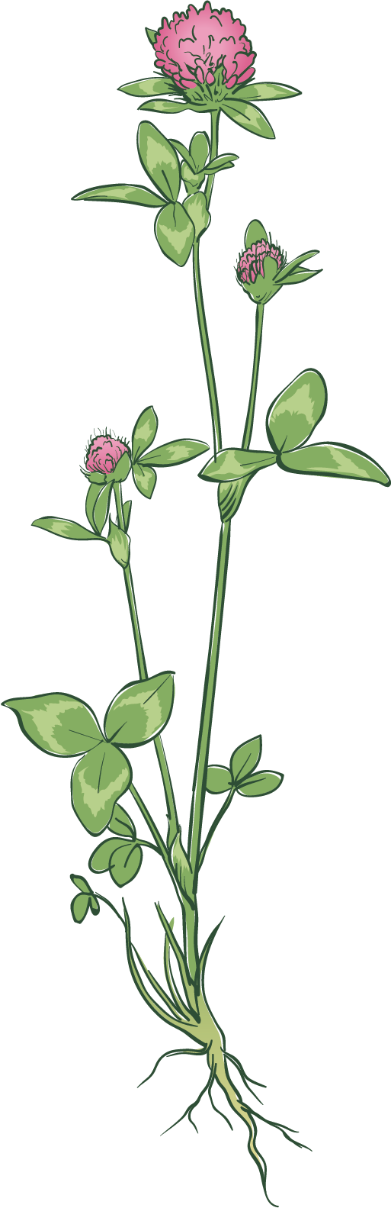
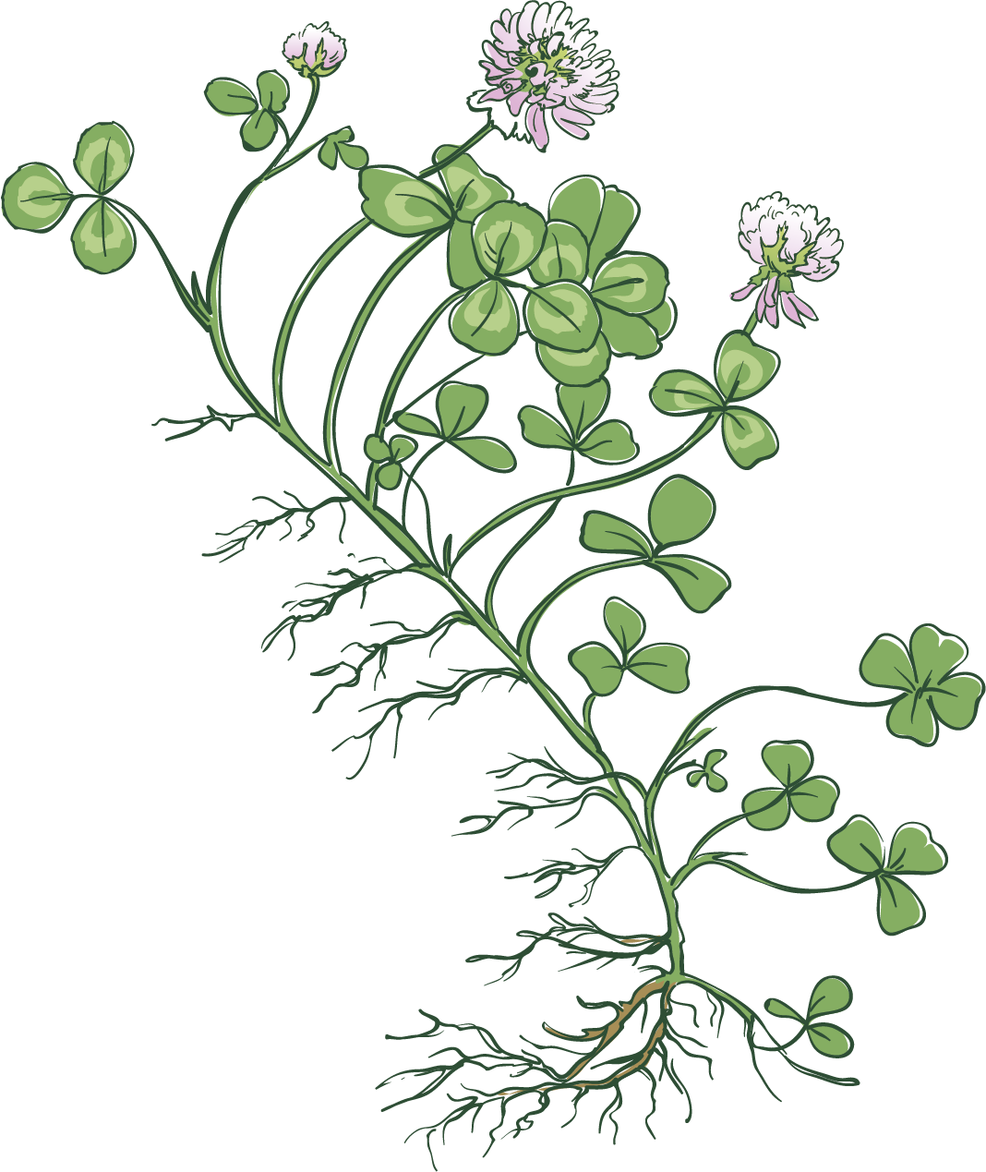
Defoliation frequency and severity
Environmental benefits of legumes
Red Clover
White Clover
Severe defoliation
10 cm
5 cm

Slide 12
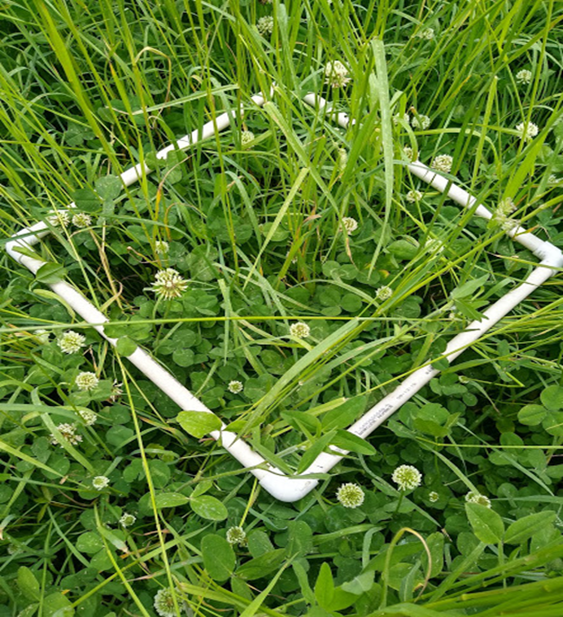
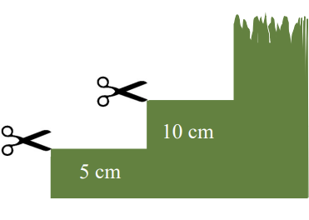
Experimentation
Environmental benefits of legumes
High-Performance Liquid Chromatography (HPLC)
Formononetin
Biochanin A
Genistein
Daidzein
Prunetin
Glycitein
Coumestrol (white clover only)

Slide 13
Total phytoestrogens accumulation
Environmental benefits of legumes
Red Clover
White Clover
7.0
Frequency (F): p<0.05
Severity (S): p = 0.69
F× S: p = 0.76
0.05
Frequency (F): p = 0.06; Severity (S): p = 0.17; F× S: p = 0.09
a
6.0
0.04
NS
5.0
b
4.0
0.03
Total phytoestrogens (mg g⁻¹)
Total phytoestrogens (mg g⁻¹)
3.0
0.02
2.0
0.01
1.0
0
3X
5X
0
3X
5X
Defoliation frequency
Defoliation frequency
Total phytoestrogens = Formononetin + Biochanin A + Genistein + Daidzein + Glycitein + Prunetin + Coumestrol (for white clover only)

Slide 14
Environmental benefits of legumes
Relative abundance of phytoestrogens

Slide 15
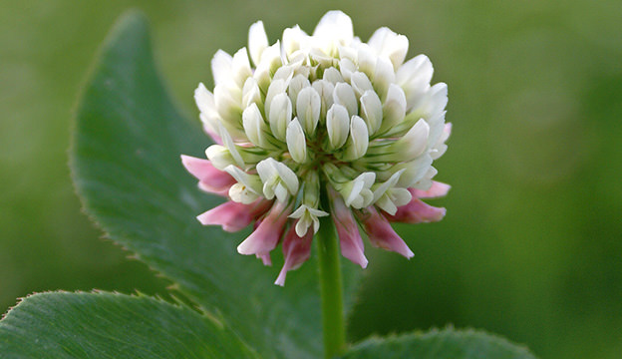
Summary
Environmental benefits of legumes
Total Phytoestrogen
> (140 times)
White clover
Red clover
> (34.5%)
Red clover
No significant effect
White clover
10 cm
5 cm
No significant effect
Red clover
White clover

Slide 16



Thank you for listening!
Environmental benefits of legumes
UNH-Agroecology Lab
Contact: Palash.Mandal@unh.edu
Richard.Smith@unh.edu
USDA NIFA OREI
(Project: 2020-51300-32196)
Graduate Research Grant (GNE22-289)

