Slide 1
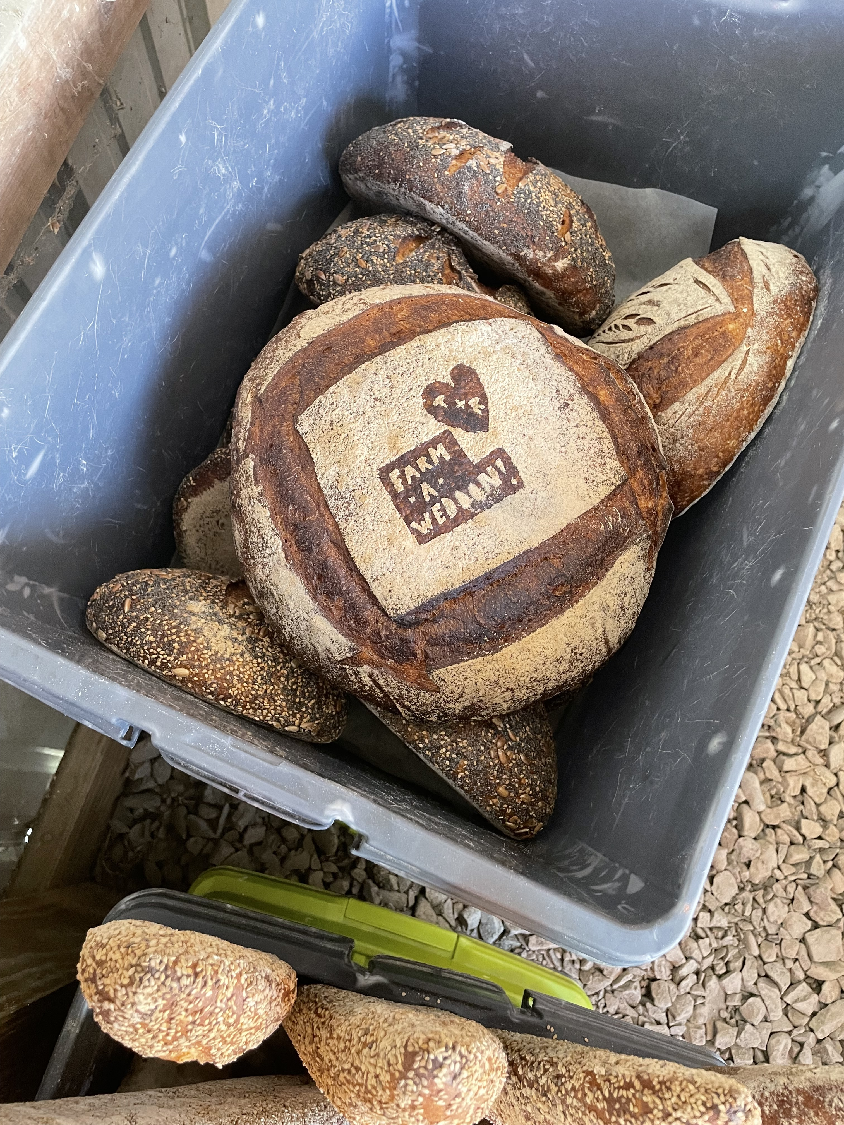
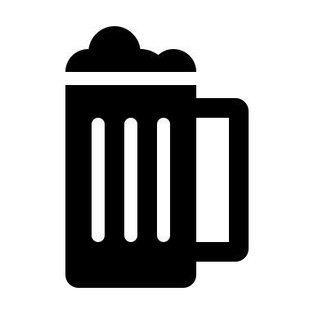
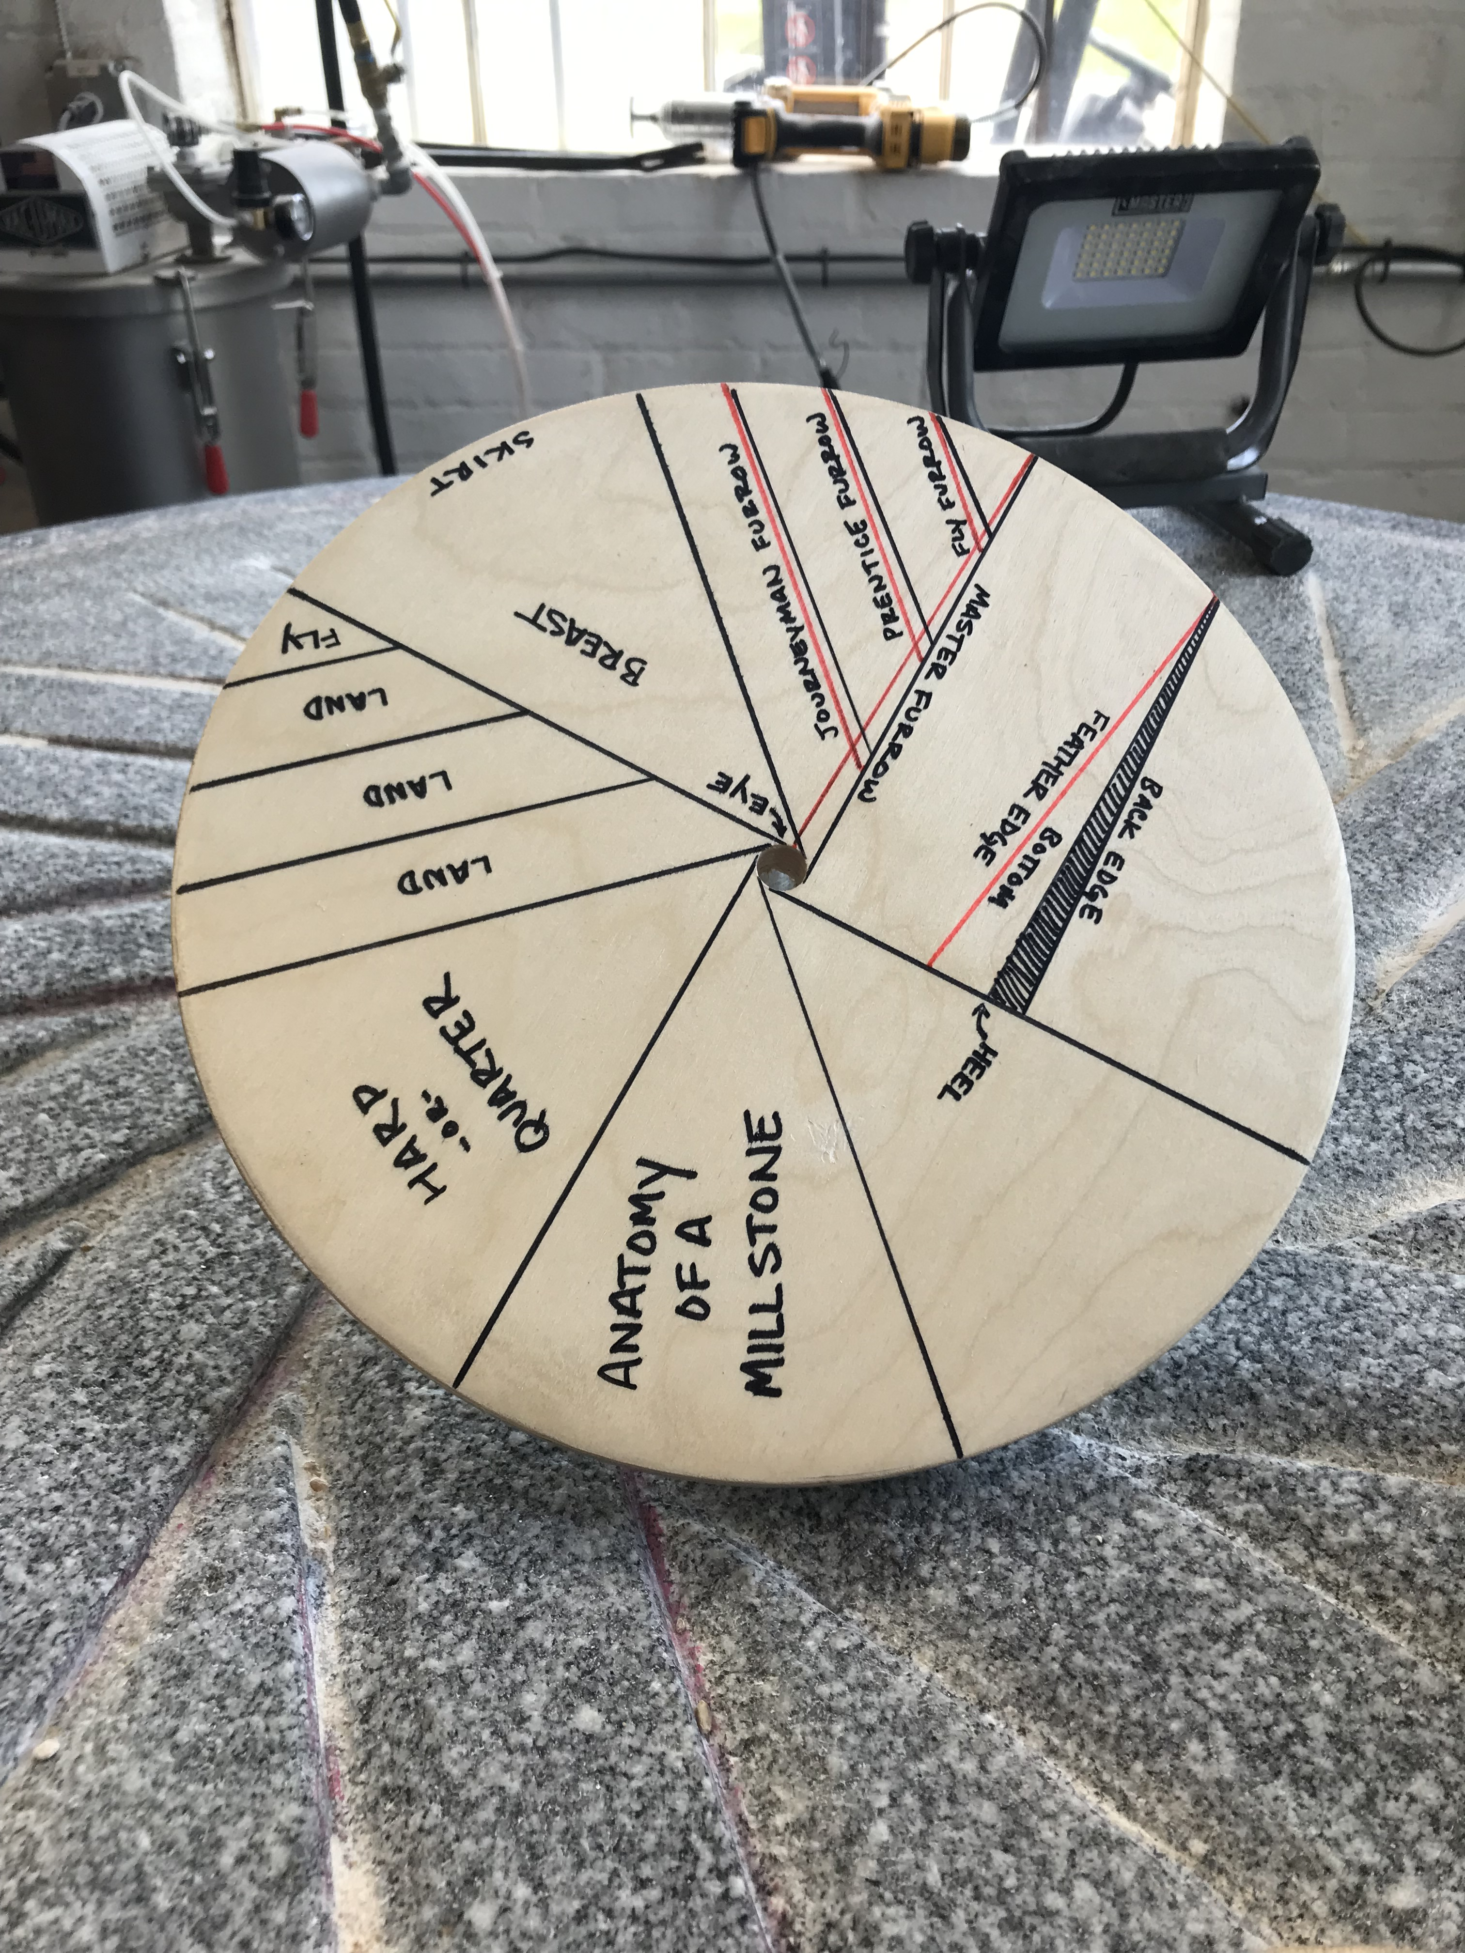
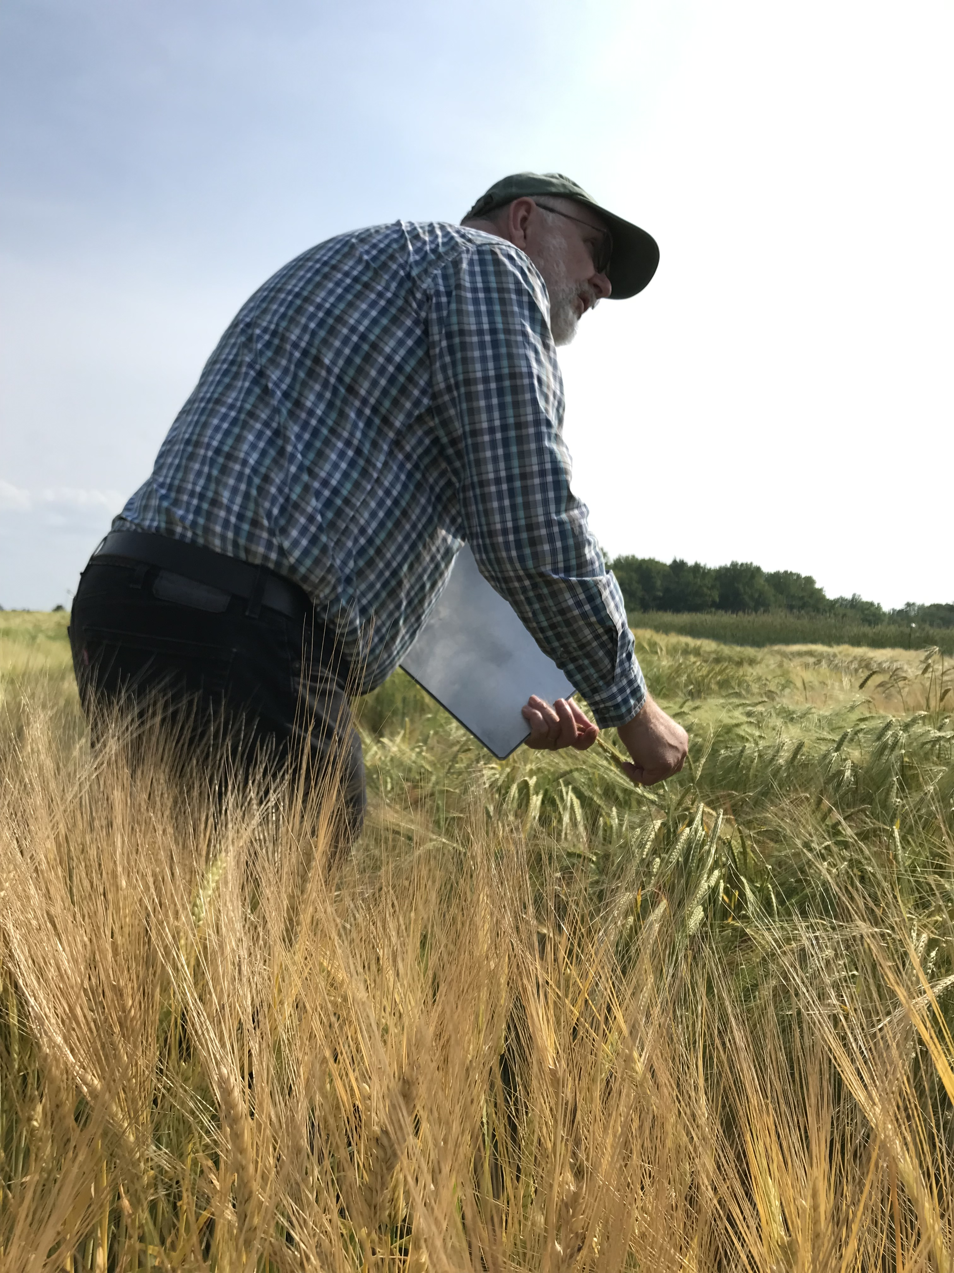
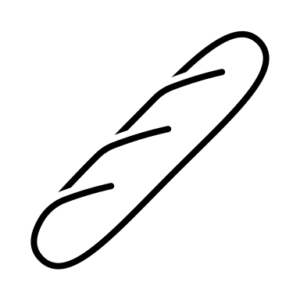
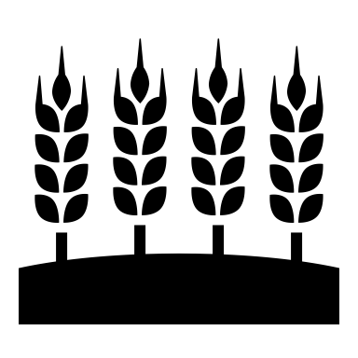
From Seed to Sourdough
and Barley to Beer:
Values-based grain supply chain models to support mid-scale farm viability in the Upper Northeast
Elise Neidecker
M.S. Agricultural Sciences
Bruce Food Systems Lab
Department of Agriculture, Nutrition, & Food Systems
Graduate Research Conference, April 15, 2024

Slide 2
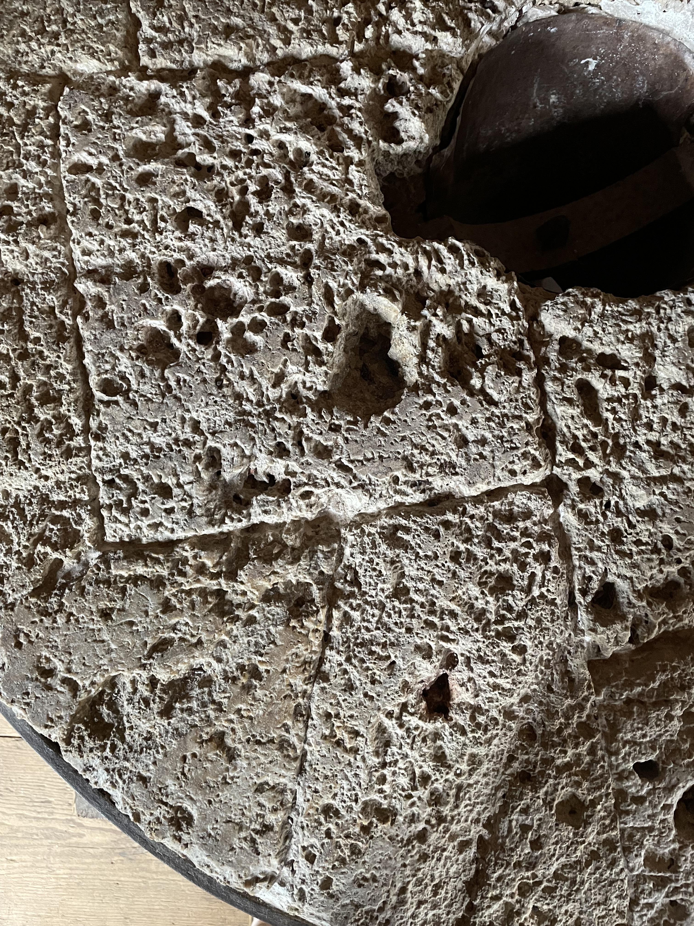
Presentation outline
Background
Research Questions
Methods
Findings
Key Take-Aways

Slide 3
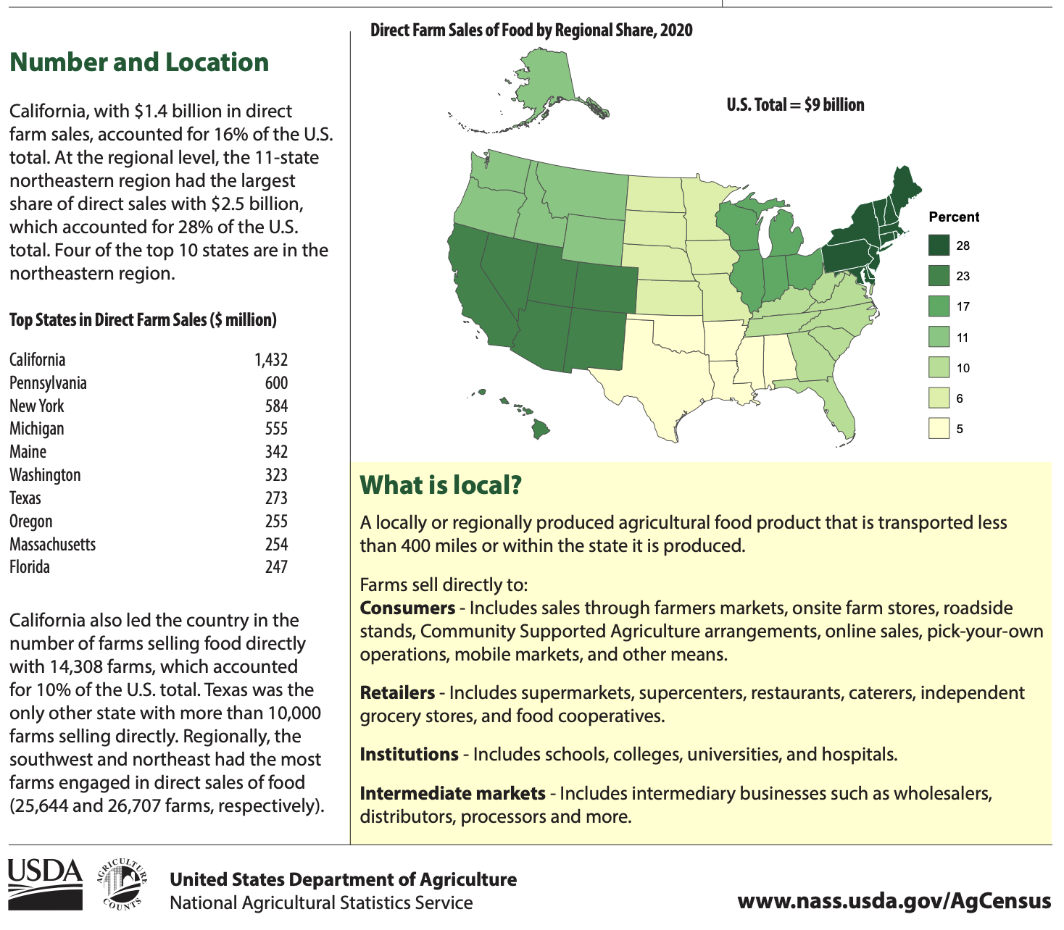
Background: Local Food Systems in the Northeast
“[Direct] markets have been both an attraction and a stabilizing force for the region’s agricultural industry.”
Low et al. 2015; Low & Vogel 2011; Ruhf & Clancy 2022; USDA NASS 2017; USDA NASS 2022

Slide 4
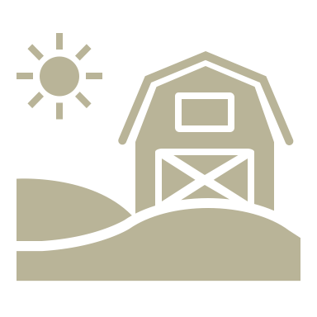
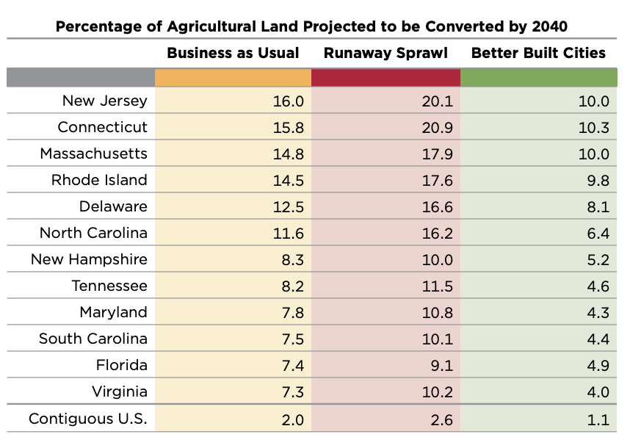
Background: Agriculture under Threat in the Northeast U.S.
“A cluster of smaller states in the Northeast…will see over 10% of their agricultural land lost or fragmented, severely threatening their local food supply and farm economies.”
Buchanan 2020; Donahue et al. 2014; Hunter et al. 2018; Land for Good 2012; Lobao and Meyer 2001; MacDonald, Hoppe, and Newton 2018; Sexton 2010

Slide 5
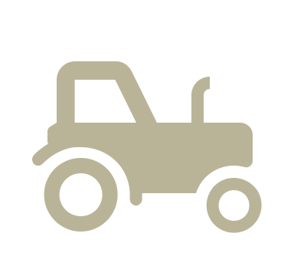
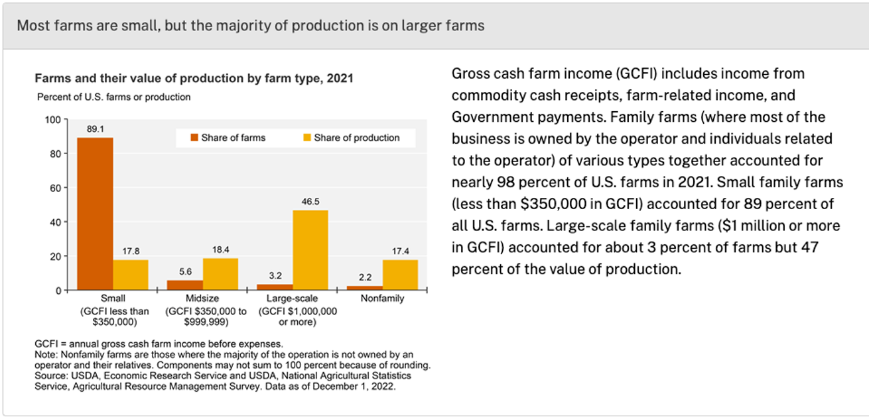
Background:
Agriculture of the Middle
Farms that are “part of the market that falls between the vertically integrated, commodity markets and the direct markets.”
Kirschenmann et al. 2008; Schmit et al. 2016; USDA ERS, “Farming and Farm Income,” August 31, 2023

Slide 6
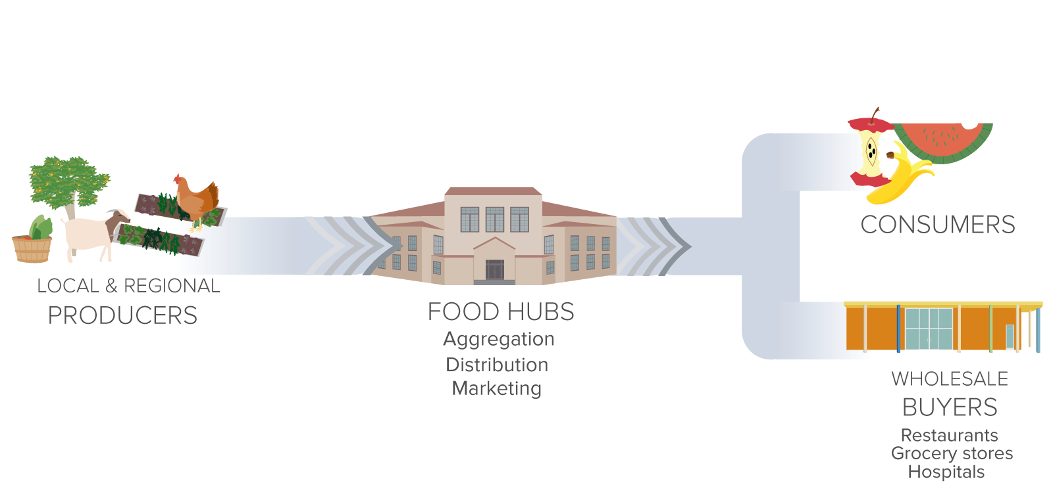
Background:
Values-Based Supply Chains
& Collaborative/Mediated Marketing Models
Multiple farms sell their products jointly or work with a mediating entity that aggregates, distributes, and/or markets their products locally or regionally.
Food Hubs, Farm-to-School, Farm-to-Institution, Multi-Farm CSAs
Supply chain partners form long-term, strategic partnerships based on shared extra-economic values like trust, transparency, and price equity and deliver value-added, differentiated products.
Clark et al. 2021; Crothers 2020; Dimitri and Gardner 2019; Greco et al., 2020; Hardesty et al. 2014; Rosol and Barbosa 2021; Sitaker et al. 2020; Smith et al. 2019; Thilmany et al. 2021

Slide 7
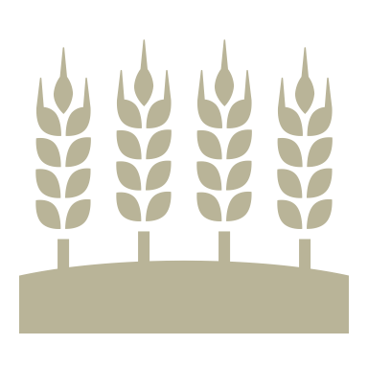
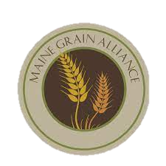
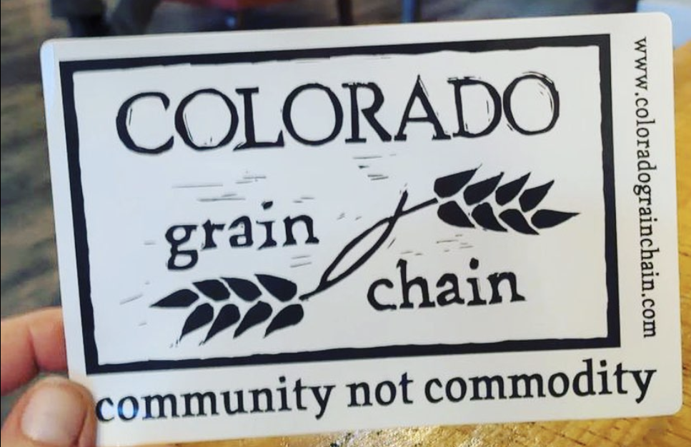
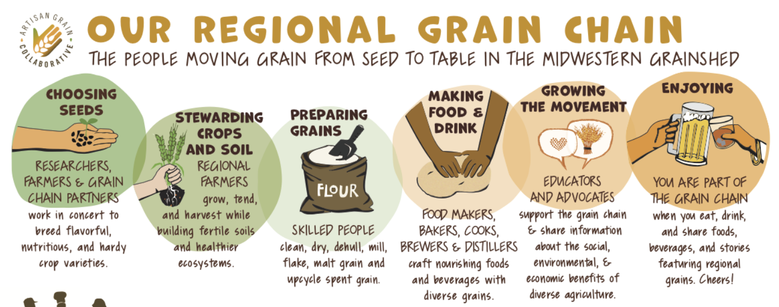
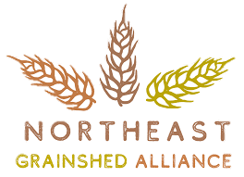
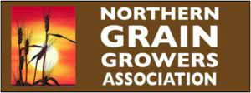
Literature Review: Local Grain Economies & Grain Value Chains
Colorado Grain Chain N.d; Sparks N.d.

Slide 8
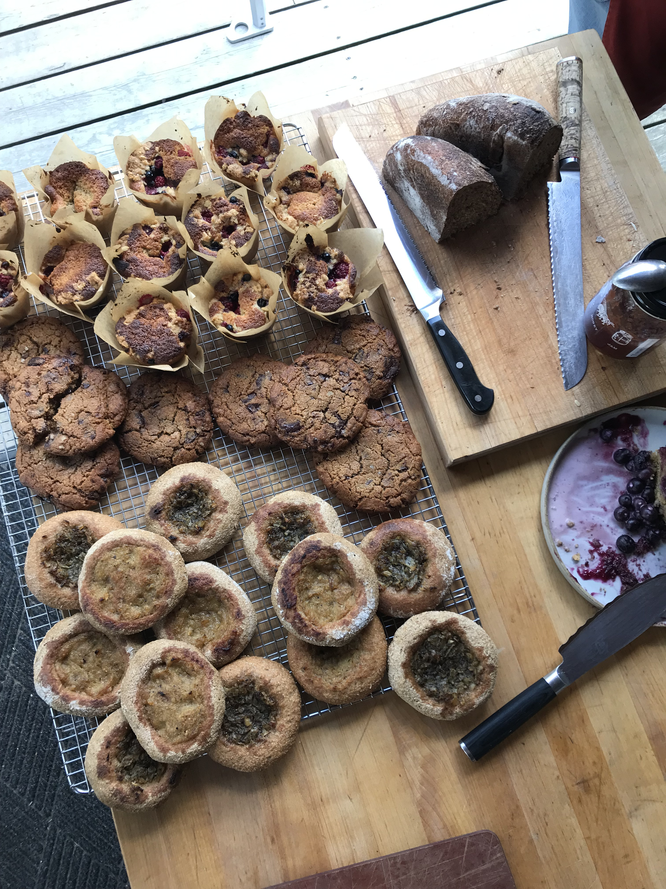
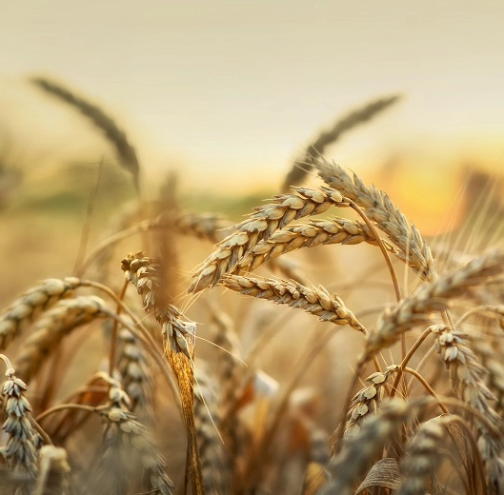
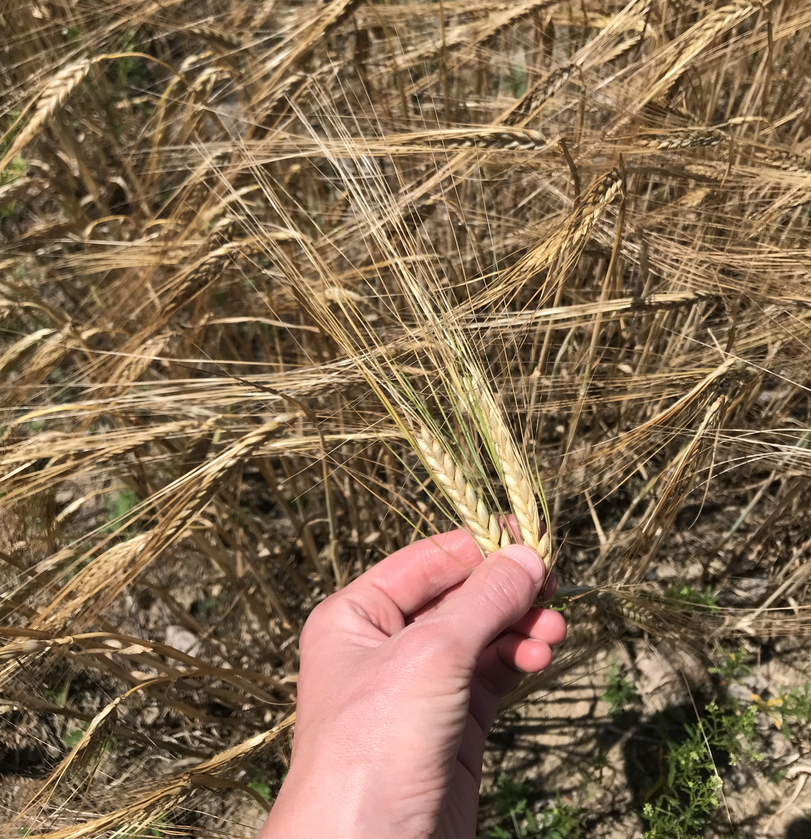
Research Questions
Which Values-Based Supply Chain (VBSC) models and partnership strategies best support the viability of small- and mid-scale farms in the Upper Northeast?
What are the organizational models and ownership structures of grain value chains?
What strategies do grain value chain partners use to address challenging aspects of VBSCs?
Contracts & Agreements
Pricing & Enterprise Viability
Supply/Demand Planning
How do the organizational model and enterprise structure of a value chain relate to the partnership strategies it employs?

Slide 9
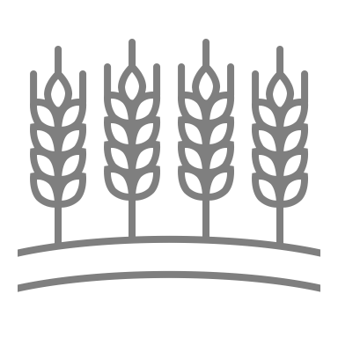
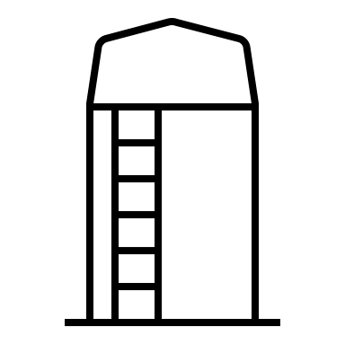
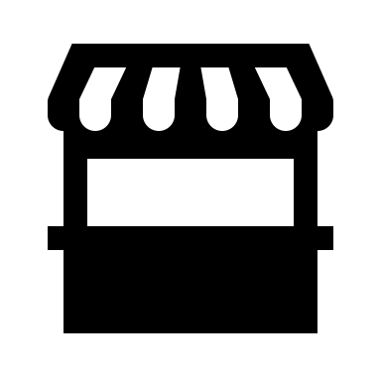
Methods: Multiple-case study design
Values-based grain supply chain conceptual model
 | NY Flour Mill | ME Flour Mill | MA Malthouse & Flour Mill | Key Informants
Growers: | 3 | 4 | 4 | 3
Processors: | 1 | 1 | 1 | 2
End-Users: | 4 | 4 | 4 | 1
Nonprofit/ Extension: | 3 | 2 | 1 | 4
Total Case Interviews: | 11 | 11 | 10 | 10
Total Interviews: |  |  |  | 41
NY MILL

Slide 10
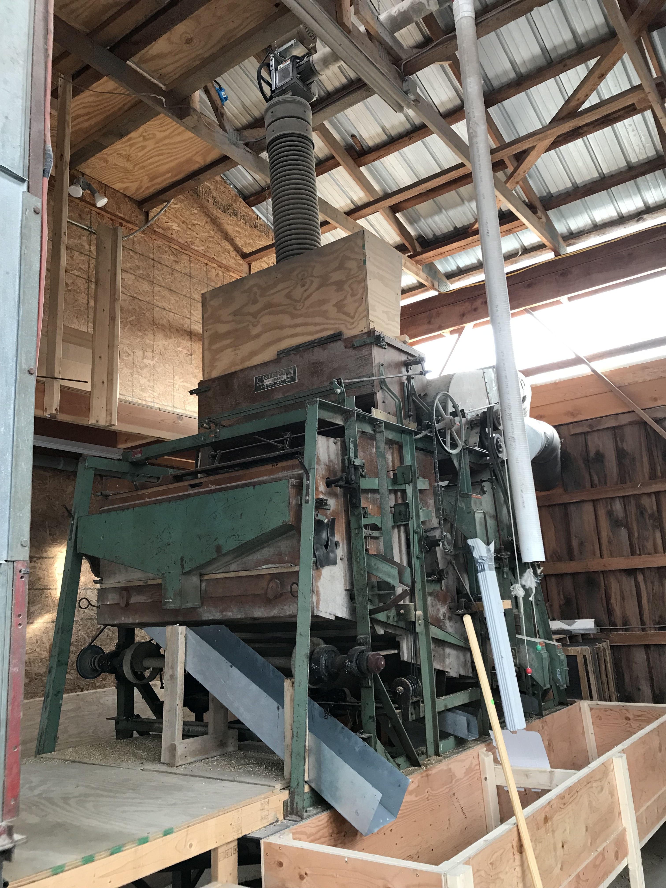
Case 1: NY Mill Value Chain
“A team of conscientious friends working together to provide [their] community with fresh, organic, local, stoneground flour. [They are] committed to leading the growth of a sustainable grain economy.”
Limited Liability Company
Equally owned by 1 grower and 2 employees
Previously owned by 2 growers, 1 employee
1. What are the organizational models and ownership structures of grain value chains?
Case 2: ME Mill Value Chain
“Manufactures [Northeast] grown organic [and] heritage grains through a traditional stone milling process” that sells “wholesale to bakers and chefs and a little bit to brewers and retail products, [making] it easier for people to to make the choice of local brands.”
C Corporation
Previously LLC
Majority owned by CEO/Co-Founder
Case 3: MA Malthouse & Mill Value Chain
A “craft malthouse serving the Northeast region, sourcing 100% of [its] grains from the Northeast, and working with Northeast breweries, distilleries, and some bakeries. [The] sister company also [uses] regional grains for milling fresh flour.”
Each business is a separate Limited Liability Company
Both businesses owned by founders (husband & wife)
Mill previously co-owned by brewer & founders

Slide 11
2. What strategies do grain value chain partners use to address challenging aspects of VBFSCs?
3. How do the organizational model and enterprise structure of a value chain relate to the partnership strategies it employs?
Findings: Contracts & Agreements
For some growers, a contract provides security
“So far, we have never signed contracts. I've been leery to sign contracts because I just don't know if I'm going to be able to fulfill that contract…because of the risk of meeting food grade quality.” (Anonymous Farmer)
For other growers, contracts are restricting
Sometimes, a verbal agreement is sufficient because of the trust between the grower and processor
“I would say 75% of our farmers prefer contracts right now. 25% don't care to have it, and in some cases, it's because they trust the conversation you've had. In some cases, it's because they want to retain some flexibility for themselves.” (Amber, ME Mill)
Forward and Historic Price contracts eliminate price gorging by processors
“I haven't done any contracts. It's all just been on verbal agreements at this point…I've had a pretty comfortable relationship with malthouses I'm working with and so I haven't really gotten too worried on contracts yet.” (Andy, Farmer)
Purchasing by acre rather than yield shares risk between grower and processor
Use contracts with “high-risk” growers
“I would say the highest risk usually are those newer growers that we're working with, because it's just unknown how they operate, unknown how things will [go]… So, trying to get everything in writing makes a lot more sense.” (Andrea, MA Malthouse & Mill)

Slide 12
2. What strategies do grain value chain partners use to address challenging aspects of VBFSCs?
3. How do the organizational model and enterprise structure of a value chain relate to the partnership strategies it employs?
Findings: Pricing & Enterprise Viability
Farmers are price negotiators or price takers
“[One local malthouse] basically said he would love to buy what I grow, but he's really picky because he's a maltster. He said the pricing is really going to depend on the quality. If we have a quality that's usable, then we'll talk about what it is he feels like he can afford. He said, that said, he's happy to pay me a premium because…we're organic, we're [in-state], we're willing to tell our story.” (Seth, Farmer)
Processors have more power to be price setters, but are often price negotiators
Pricing is typically predicated on grain meeting food-grade quality
Processors will give premiums for grain grown in certain locations, by certain practices
“During COVID [and the beginning of the war in] Ukraine, organic grain prices really went up pretty high. So, [we had to get] farmers to understand like, okay, yes, the market price is higher, a tiny bit higher than ours this year, but for the last 10 years, our price has been way higher. So, if you want to stick with us and have that stability in that relationship, that's up to you.” (Greg, NY Mill)
Pricing is based on one farmer’s cost of production, then can be flexible for other farmers based on individual context
End-users are price takers
For end-users, the challenge of pricing depends on when and how they use regional grain in their businesses
“Price is certainly…it is what it is…We've never not used local grains. It's never been a shock, like, "Oh, my God, it's so much!" [Other] people who have been buying commodity grains, …they get sticker shock.” (Zack, Distiller)

Slide 13
2. What strategies do grain value chain partners use to address challenging aspects of VBFSCs?
3. How do the organizational model and enterprise structure of a value chain relate to the partnership strategies it employs?
Findings: Supply/Demand Planning
Processors play a ”matchmaking” role, working with growers to figure out which growers can supply which grains
“[Our] mill plays kind of a matchmaking role. A farmer will tell me that 30 acres of something is getting to be too small… Well, I can punt that grain that I need over to the 30-acre farmer that has ten free acres this year. And so that's not too small for them… So, there’s a little bit of matchmaking there to sort of match scale with demand and popularity of your product.” (Amber, ME Mill)
Organic growers implement crop rotations, which limits their food-grade grain acreage
Communication is very smooth for processors and growers who have been working together over long period of time
“I would just describe it as very, very integrated at this point…obviously, we have to communicate… It's a pretty well-oiled machine, that relationship.” (Andrea, MA Malthouse)
Processors may or may not plan with end-users, depending on their relationship and volume of product needed
“We have to plan with Andrea on the timing of…our single malt whiskey… We try to plan it out six months in advance. We say this is our goal for how many tons of grain we need and the cadence that we'll need them at.” (Zack, Distiller)
Sourcing regional grain products has become easier over time for end-users
“I think earlier on I was requesting like certain types of wheat, perhaps to try, but I haven't done that in so long… I don't think we’ve been on that level of need from them… I feel like we'll use what they have, basically.” (Allison, Baker)

Slide 14
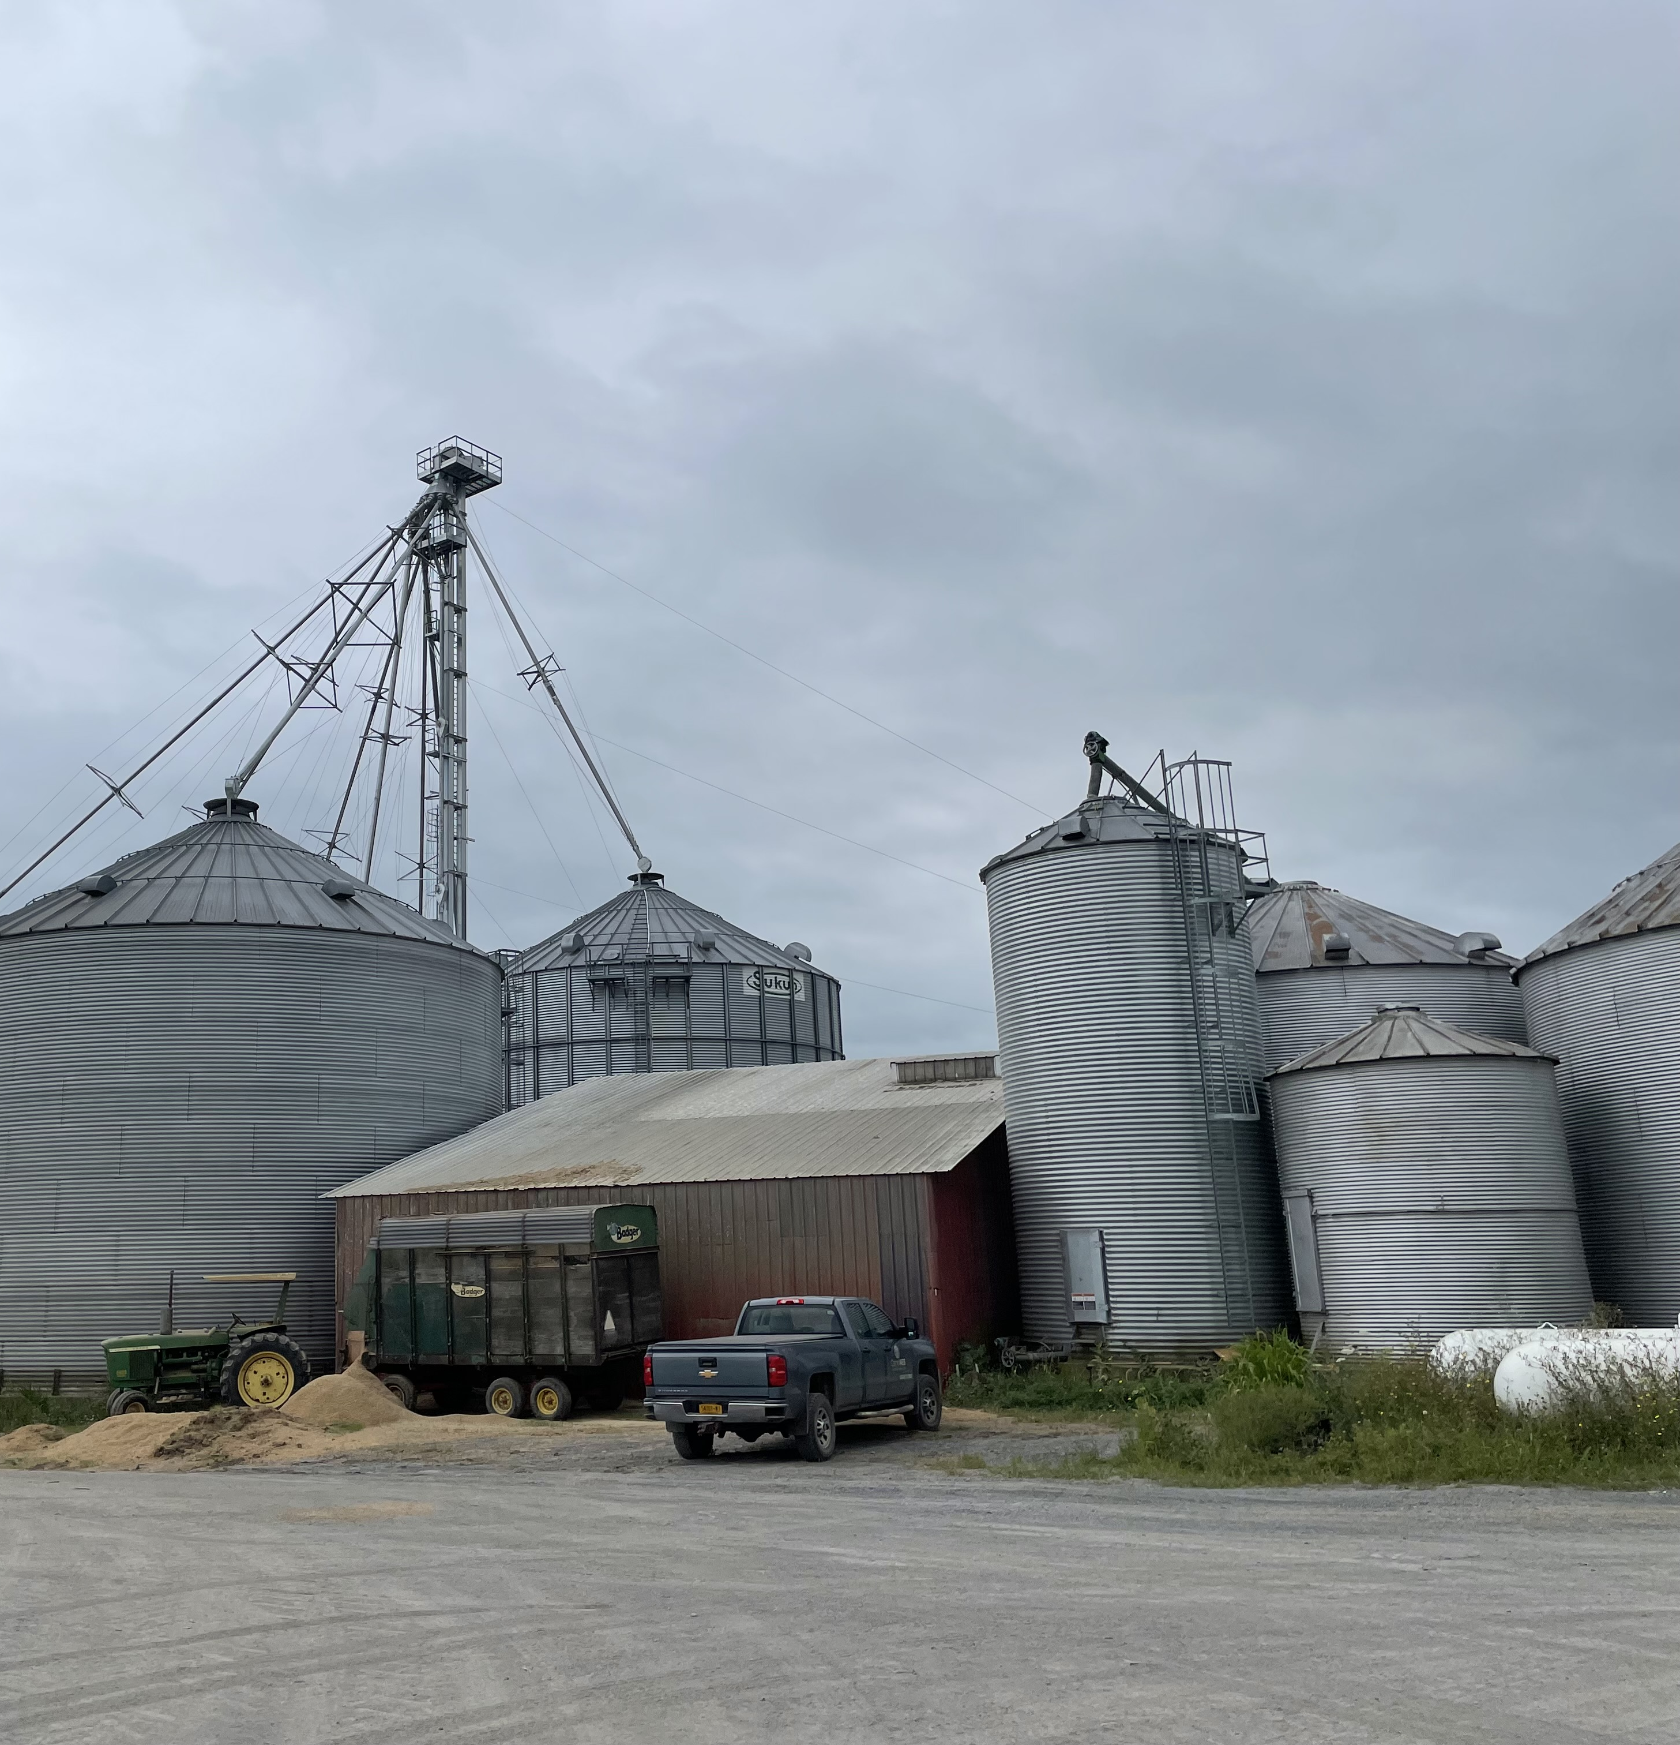
Key Take-Aways: Supporting Small- & Mid-Scale Farm Viability
Which VBFSC models and partnership strategies best support the viability of small- and mid-sized farms?
Close partnerships help to ensure that farmers’ needs are met
Trust and transparency allow partners to overcome challenges together and strengthen their relationships
Values-base grain supply chain models are both riskier and less risky than commodity grain chains
Flexibility is required in all parts of the supply chain

Slide 15
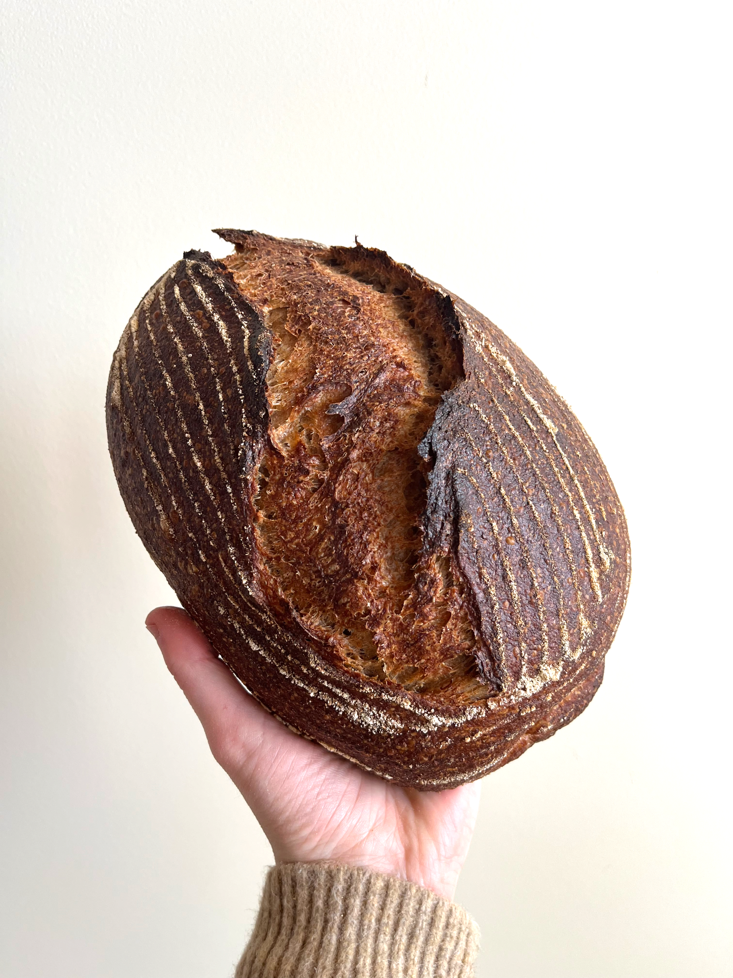
Thank you! I welcome your questions.

Slide 16
References
Buchanan, Mary. 2020. “Potential for Leasing Institutional Lands in Windham County, Connecticut: Toward A New England Food Vision.” Journal of Agriculture, Food Systems, and Community Development 9(4):245–57. doi: 10.5304/jafscd.2020.094.018.
Collins, Jane L. 2005. “New Directions in the Sociology of Global Development.” Pp. 3–17 in New Directions in the Sociology of Global Development. Vol. 11, Research in Rural Sociology and Development, edited by F. H. Buttel and P. McMichael. Emerald Group Publishing Limited.
Dimitri C. and K. Gardner. 2019. “Farmer use of intermediated market channels: a review.” Renewable Agriculture and Food Systems 34:181–197. https://doi.org/10.1017/ S1742170518000182.
Donahue, Brian, Joanne Burke, Molly Anderson, Amanda Beal, Tom Kelly, Mark Lapping, Hannah Ramer, Russell Libby, Linda Berlin. A New England Food Vision. Durham, NH: Food Solutions New England, University of New Hampshire, 2014.
Economic Research Service. 2000. ‘‘Farm Typology for a Diverse Agriculture,’’ USDA-ERS Agriculture Information Bulletin no. 759 (Washington, DC: ERS, September 2000).
Forrest, Nigel, and Arnim Wiek. 2021. “Growing a Sustainable Local Grain Economy in Arizona: A Multidimensional Analytical Case Study of an Alternative Food Network.” Journal of Agriculture, Food Systems, and Community Development 10(2):507–28. doi: 10.5304/jafscd.2021.102.031.
Freidberg, Susanne. 2001. “On the Trail of the Global Green Bean: Methodological Considerations in Multi-Site Ethnography.” Global Networks 1(4):353–68. doi: 10.1111/1471-0374.00020.
Greco, L, J. Kolodinsky,, M. Sitaker, L. Chase, D. Conner, H. Estrin, D. Smith, and Van Soelen Kim, J. 2020. “Farm Fresh Food Boxes: A pilot that examined relationships in value chain partnerships.” Journal of Agriculture, Food Systems, and Community Development 9(4):113–129 https://doi.org/10.5304/jafscd.2020.094.012.
Hardesty, Shermain, Gail Feenstra, David Visher, Tracy Lerman, Dawn Thilmany-McFadden, Allison Bauman, Tom Gillpatrick, and Gretchen Nurse Rainbolt. 2014. “Values-Based Supply Chains: Supporting Regional Food and Farms.” Economic Development Quarterly 28(1):17–27. doi: 10.1177/0891242413507103.
Hunter, M., A. Sorensen, T. Nogeire-McRae, S. Beck, S. Shutts, R. Murphy. 2022. Farms Under Threat 2040: Choosing an Abundant Future. Washington, D.C.: American Farmland Trust.
Kirschenmann, Fred, G. W. Stevenson, Frederick Buttel, Thomas A. Lyson, and Mike Duffy. 2008. “Why Worry about the Agriculture of the Middle?” Pp. 3–20 in Food and the Mid-Level Farm: Renewing an Agriculture of the Middle, edited by T. A. Lyson, G. W. Stevenson, and R. Welsh. The MIT Press.
Land for Good. 2012. Leasing Land to Farmers: A Handbook for New England Land Trusts, Municipalities and Institutions.
Lobao, Linda, and Katherine Meyer. 2001. “The Great Agricultural Transition: Crisis, Change, and Social Consequences of Twentieth Century US Farming.” Annual Review of Sociology 27(1):103–24. doi: 10.1146/annurev.soc.27.1.103.
Low, Sarah A., Aaron Adalja, Elizabeth Beaulieu, Nigel Key, Stephen Martinez, Alex Melton, Agnes Perez, Katherine Ralston, Shellye Suttles, Stephen Vogel, and Becca B. R. Jablonski. 2015. Trends in U.S. Local and Regional Food Systems: A Report to Congress. Administrative Publication No. (AP-068). U.S. Department of Agriculture, Economic Research Service.

Slide 17
References
Low, Sarah A., and Stephen J. Vogel. 2011. “Direct and Intermediated Marketing of Local Foods in the United States.” SSRN Electronic Journal. doi: 10.2139/ssrn.2114361.
MacDonald, James M., Robert A. Hoppe, and Doris Newton. Three Decades of Consolidation in U.S. Agriculture, EIB-189, U.S. Department of Agriculture, Economic Research Service, March 2018.
Rosol, M., and R. Barbosa. 2021. “Moving beyond direct marketing with new mediated models: evolution of or departure from alternative food networks?” Agriculture and Human Values 38:1021–1039 https://doi.org/10.1007/s10460-021-10210-4.
Ruhf, Kathryn, and Kate Clancy. 2022. A Regional Imperative: The Case for Regional Food Systems. Thomas A. Lyson Center for Civic Agriculture and Food Systems. doi: 10.5304/lyson.2022.001.
Saldaña, J. 2014. Coding and Analysis Strategies. The Oxford Handbook of Qualitative Research, 581–605.
Sitaker, Marilyn, Jane Kolodinsky, Weiwei Wang, Lisa C. Chase, Julia Van Soelen Kim, Diane Smith, Hans Estrin, Zoe Van Vlaanderen, and Lauren Greco. 2020. “Evaluation of Farm Fresh Food Boxes: A Hybrid Alternative Food Network Market Innovation.” Sustainability 12(24):10406. doi: 10.3390/su122410406.
Smith, Diane, Weiwei Wang, Lisa Chase, Hans Estrin, and Julia Van Soelen Kim. 2019. “Perspectives from the Field: Adaptions in CSA Models in Response to Changing Times in the U.S.” Sustainability 11(11):3115. doi: 10.3390/su11113115.
Sparks, Amy. N.d. “A Visual Spark.” From Artisan Grain Collaborative. Retrieved February 1, 2023. (https://www.graincollaborative.com/).
Stevenson, G. W., and Rich Pirog. 2008. “Values-Based Supply Chains: Strategies for Agrifood Enterprises of the Middle.” Pp. 119–44 in Food and the Mid-Level Farm: Renewing an Agriculture of the Middle, edited by T. A. Lyson, G. W. Stevenson, and R. Welsh. The MIT Press.
“The Grain Network.” From Tufts University Gerald J. and Dorothy R. Friedman School of Nutrition Science and Policy’s Tufts Food Lab. Retrieved Oct. 1, 2022 (https://foodlab.nutrition.tufts.edu/grain-network-diagram/).
Thilmany, Dawn, Elizabeth Canales, Sarah A. Low, and Kathryn Boys. 2021. “Local Food Supply Chain Dynamics and Resilience during COVID-19.” Applied Economic Perspectives and Policy 43(1):86–104. doi:10.1002/aepp.13121.
USDA NASS. 2017. U.S. Census of Agriculture. United States. Web Archive. Retrieved Oct. 1, 2022 (https://www.nass.usda.gov/Publications/AgCensus/2017/Online_Resources/Local_Food/index.php).
USDA NASS. 2022. Direct Farm Sales of Food: Results from the 2020 Local Food Marketing Practices Survey. U.S. Department of Agriculture. https://www.nass.usda.gov/Publications/Highlights/2022/local-foods.pdf.
Yin, Robert K. and Donald T. Campbell. 2018. Case Study Research and Applications : Design and Methods. Sixth ed. Thousand Oaks, California: SAGE Publications.

