Slide 1
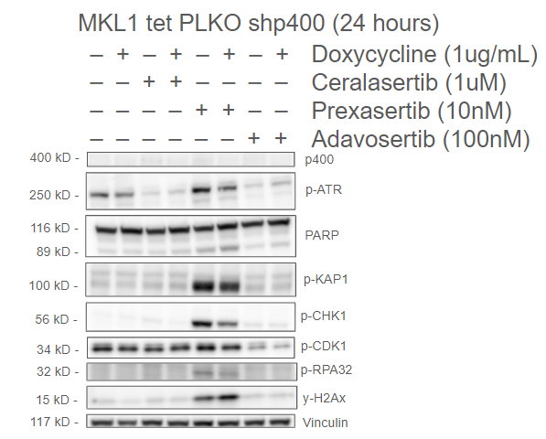
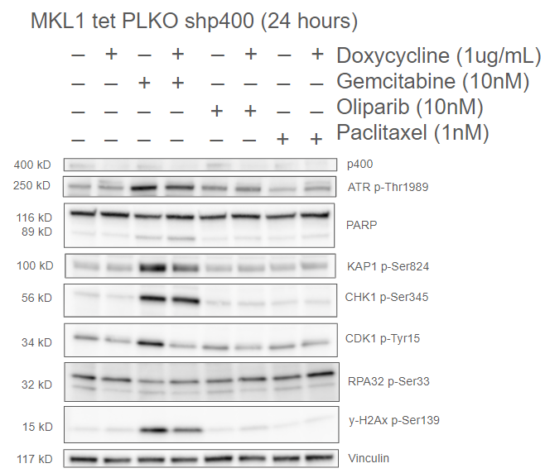
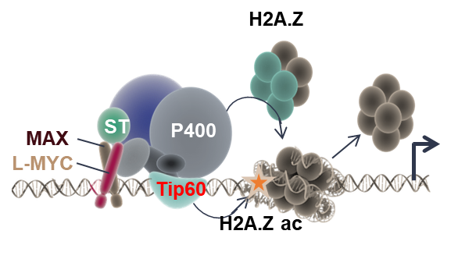
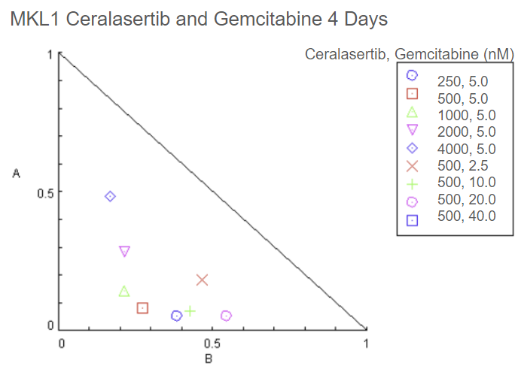
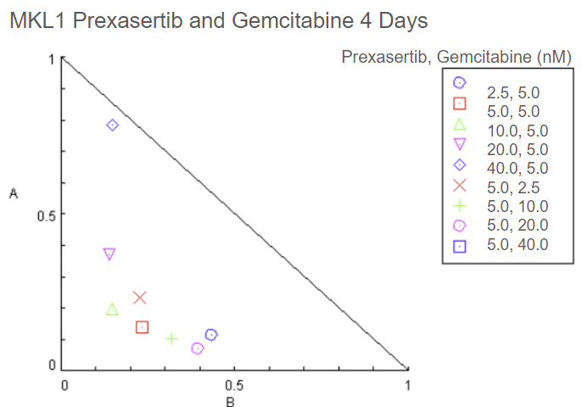
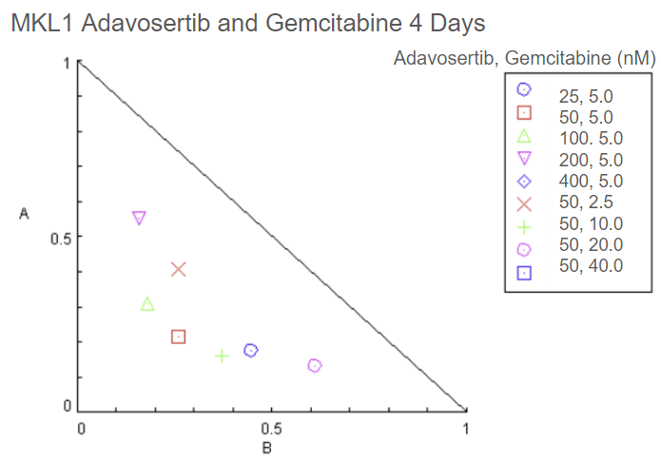
Reliance on the ATR-CHK1-WEE1 pathway due to R-loop
accumulation in Merkel Cell Carcinoma
By Evie Proctor
Introduction:
Merkel Cell Carcinoma (MCC) is a rare, highly aggressive, neuroendocrine skin cancer that can be caused by UV exposure or integration of the Merkel Cell Polyomavirus. The virus positive MCC cells rely on the ATR-CHK1-WEE1 pathway for survival. This pathway aids in cellular recovery after DNA damage is experienced during replication. By inhibiting proteins in this pathway, MCC cells have reduced proliferation and therefore reduced tumorigenesis.
Results:
Project Aims:
1. To determine if DNA damage response inhibitor-based combination therapy will create a mitotic catastrophe in MCC cells.
Hypothesis:
MCC cells rely on the ATR-CHK1-WEE1 axis, when this axis is inhibited the cells will undergo apoptosis.
Figure 2: Western blots with doxycycline inducible p400 knockdown demonstrate that the L-Myc/p400 complex sensitizes MCC cells to ATR-CHK1-WEE1 axis inhibitors.
Figure 1: Transcriptional complex of MCC.
L-Myc is a paralog of the oncogene Myc. L-Myc recruits the Tip60-p400 complex, which is used for transcription in MCC. This causes replication stress and reliance on the ATR-CHK1-WEE1 pathway.
Figure 3: Isobolograms. Demonstrates the synergistic effects of inhibitors of the ATR-CHK1-WEE1 pathway with Gemcitabine.
Discussion:
When the p400 protein is inducibly knocked down by doxycycline, MCC cells become less sensitive to inhibitors targeting the ATR-CHK1-WEE1 axis. Notably, Prexasertib, a CHK1 inhibitor, increases the phosphorylation of several protein targets tested due to a negative feedback loop between CHK1 and ATR. Similar statements can be made for Gemcitabine, a chemotherapy drug. When doxycycline is combined with Gemcitabine, MCC cells become sensitive to Gemcitabine treatments. Regarding the isobolograms, all the inhibitors for the ATR-CHK1-WEE1 pathway synergize well with Gemcitabine at variable concentrations.
References:
Becker, J.C., et al., Merkel cell carcinoma. Nat Rev Dis Primers, 2017. 3:
p. 17077.
Cheng, J., et al., Merkel cell polyomavirus recruits MYCL to the EP400
complex to promote oncogenesis. PLoS Pathog, 2017. 13(10):
p. e1006668.
Simoneau, A. and L. Zou, An extending ATR-CHK1 circuitry: the replication
stress response and beyond. Curr Opin Genet Dev, 2021. 71: p. 92-98.
Supported by an Institutional Development Award (IDeA) from the National Institute of General Medical Sciences of the NIH under grant number P20GM113131.

