Slide 1
From Glycerol to Propanediols: Converting Biodiesel Byproducts to Feedstock Chemicals
Seth Drahusz
Department of Chemical and Bioengineering
University of New Hampshire
April 15th, 2024

Slide 2
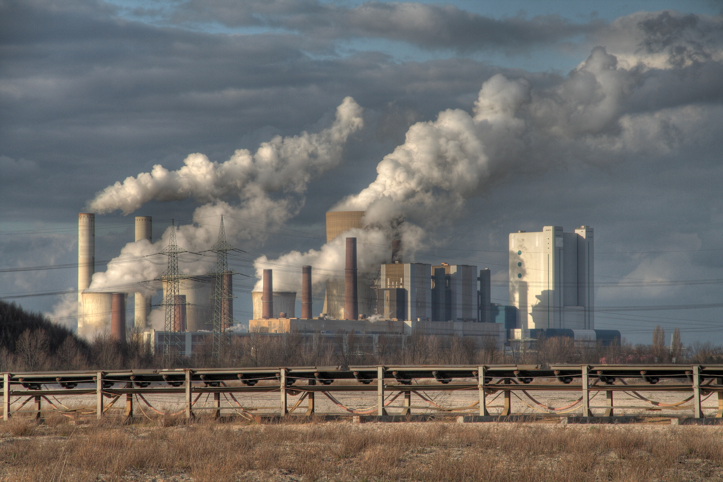
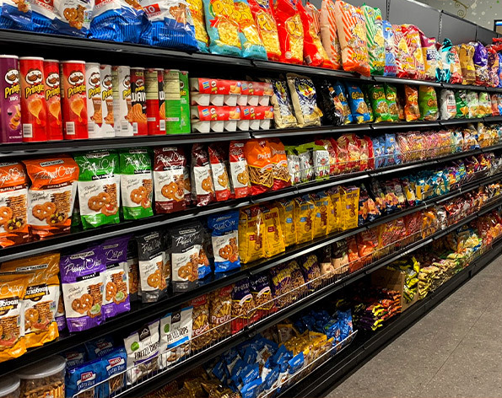
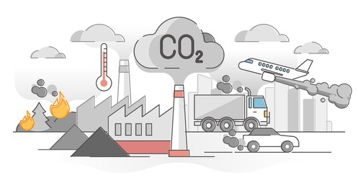
We need a more sustainable production of commercial products!
2

Slide 3
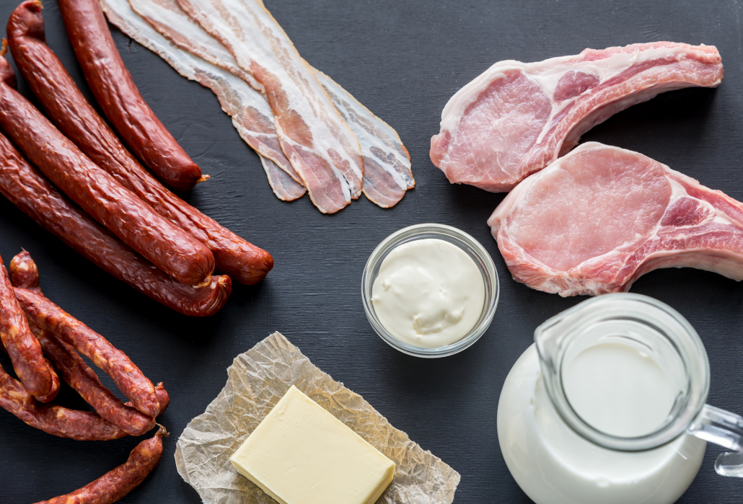
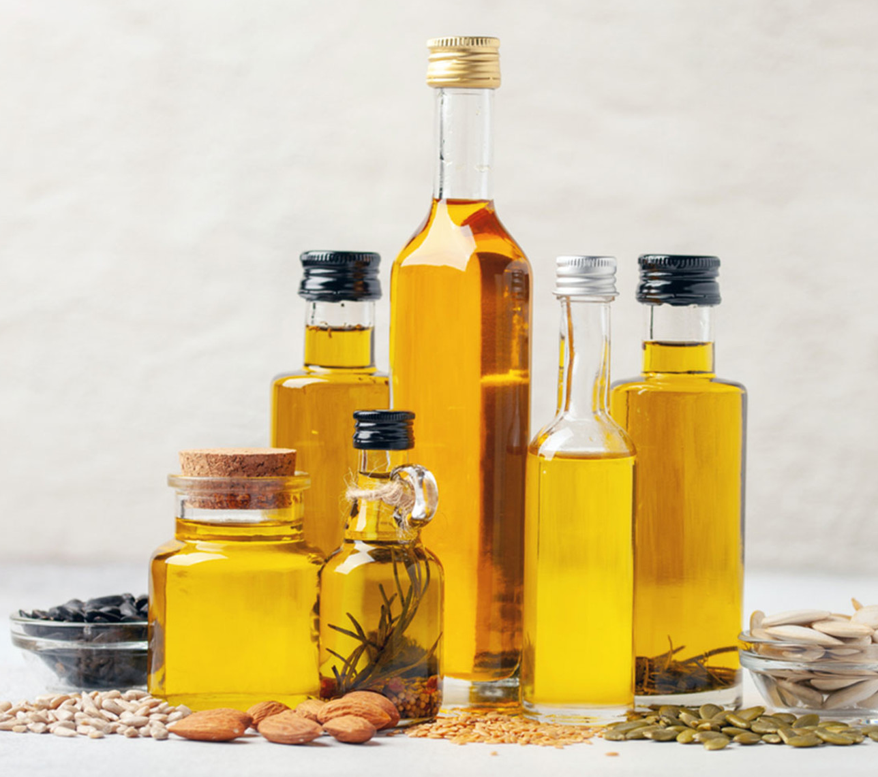
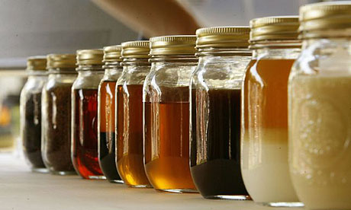
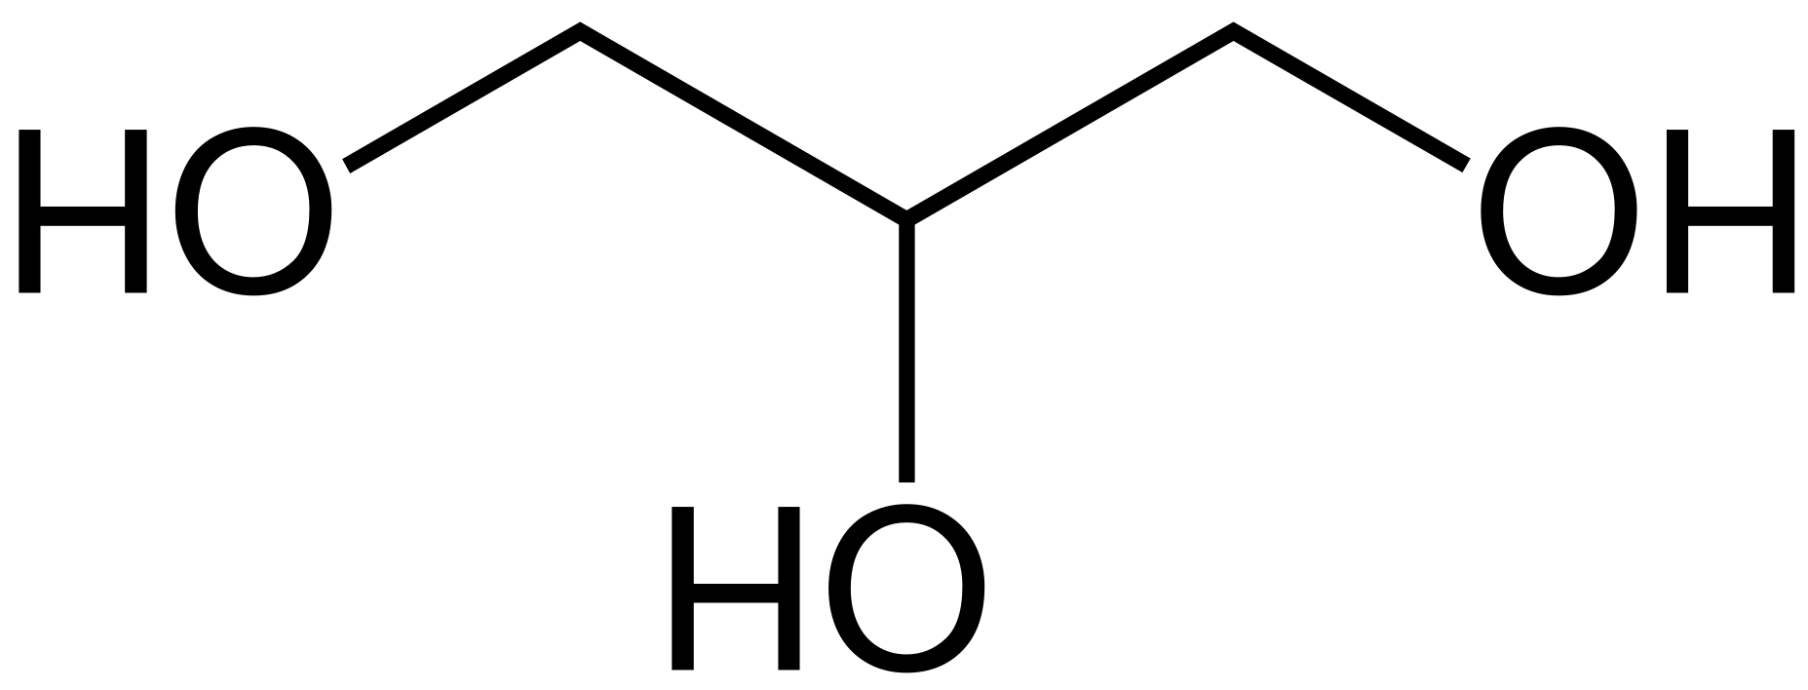
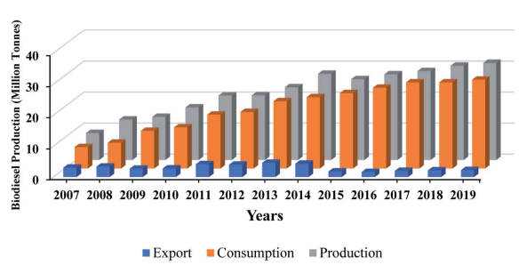
Biodiesel is a Promising Alternative
Glycerol
Sustainable Energy Fuels, 2022, 6, 596–639
3

Slide 4
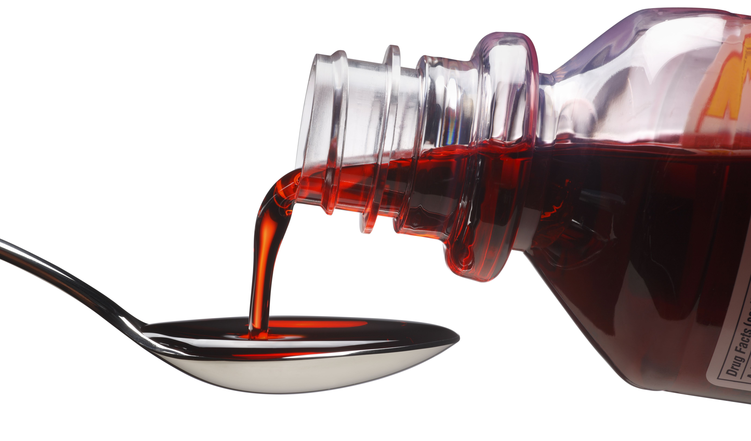
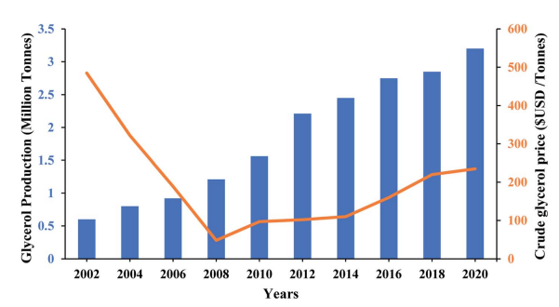
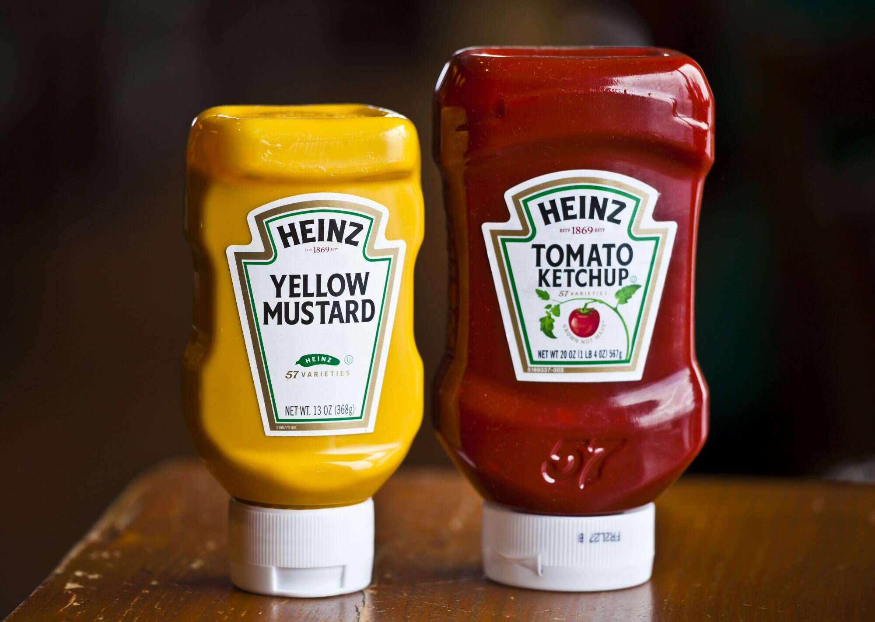
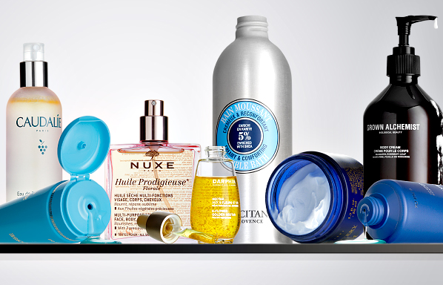
Can We Valorize Glycerol?
Sustainable Energy Fuels, 2022, 6, 596–639
4

Slide 5
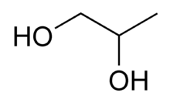
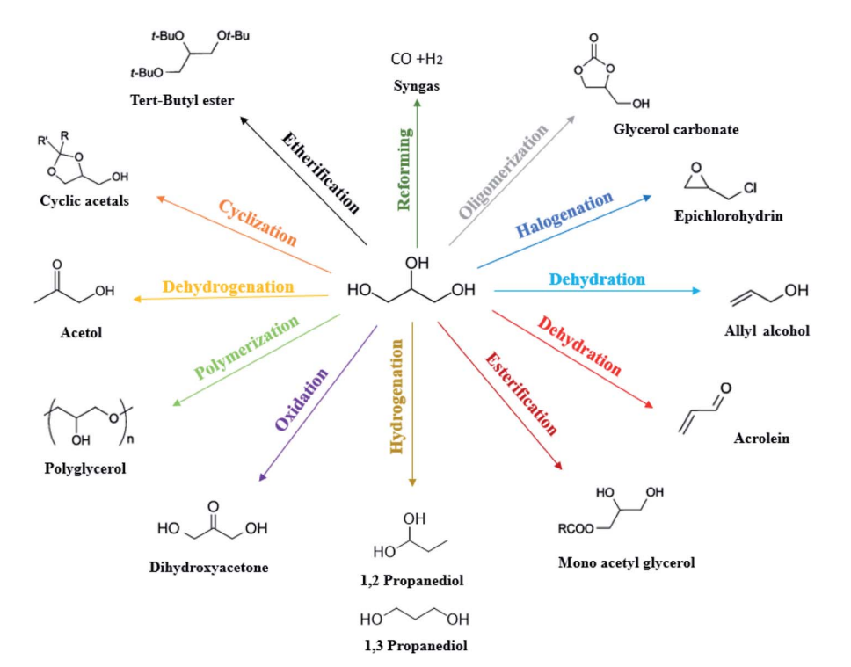
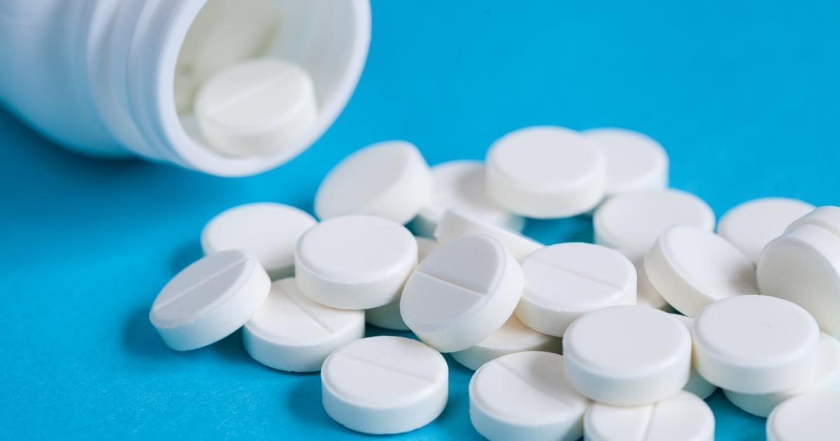
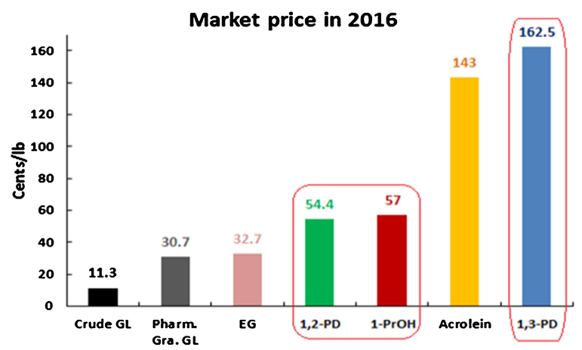
Convert Glycerol to Feedstock Chemicals
1,2-propanediol (1,2-PDO)
1,3-propanediol (1,3-PDO)
Sustainable Energy Fuels, 2022, 6, 596–639
Catalysis Today 291 (2017) 195–203
5
Notes:
Might need to change title

Slide 6
Ir-Re
Pt-W
Activity
H₂ Pressure
Metal Loading
6

Slide 7
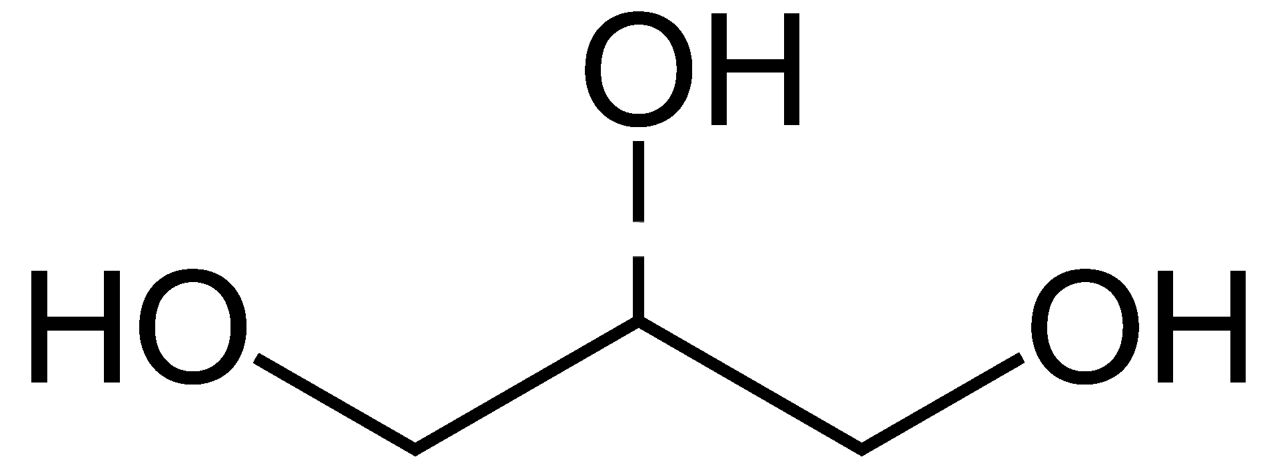
Support
Synergy
Surface sites
Glycerol
1,3-PDO
H₂
H⁺
H⁻
Pt
TiO₂
HPA
7

Slide 8
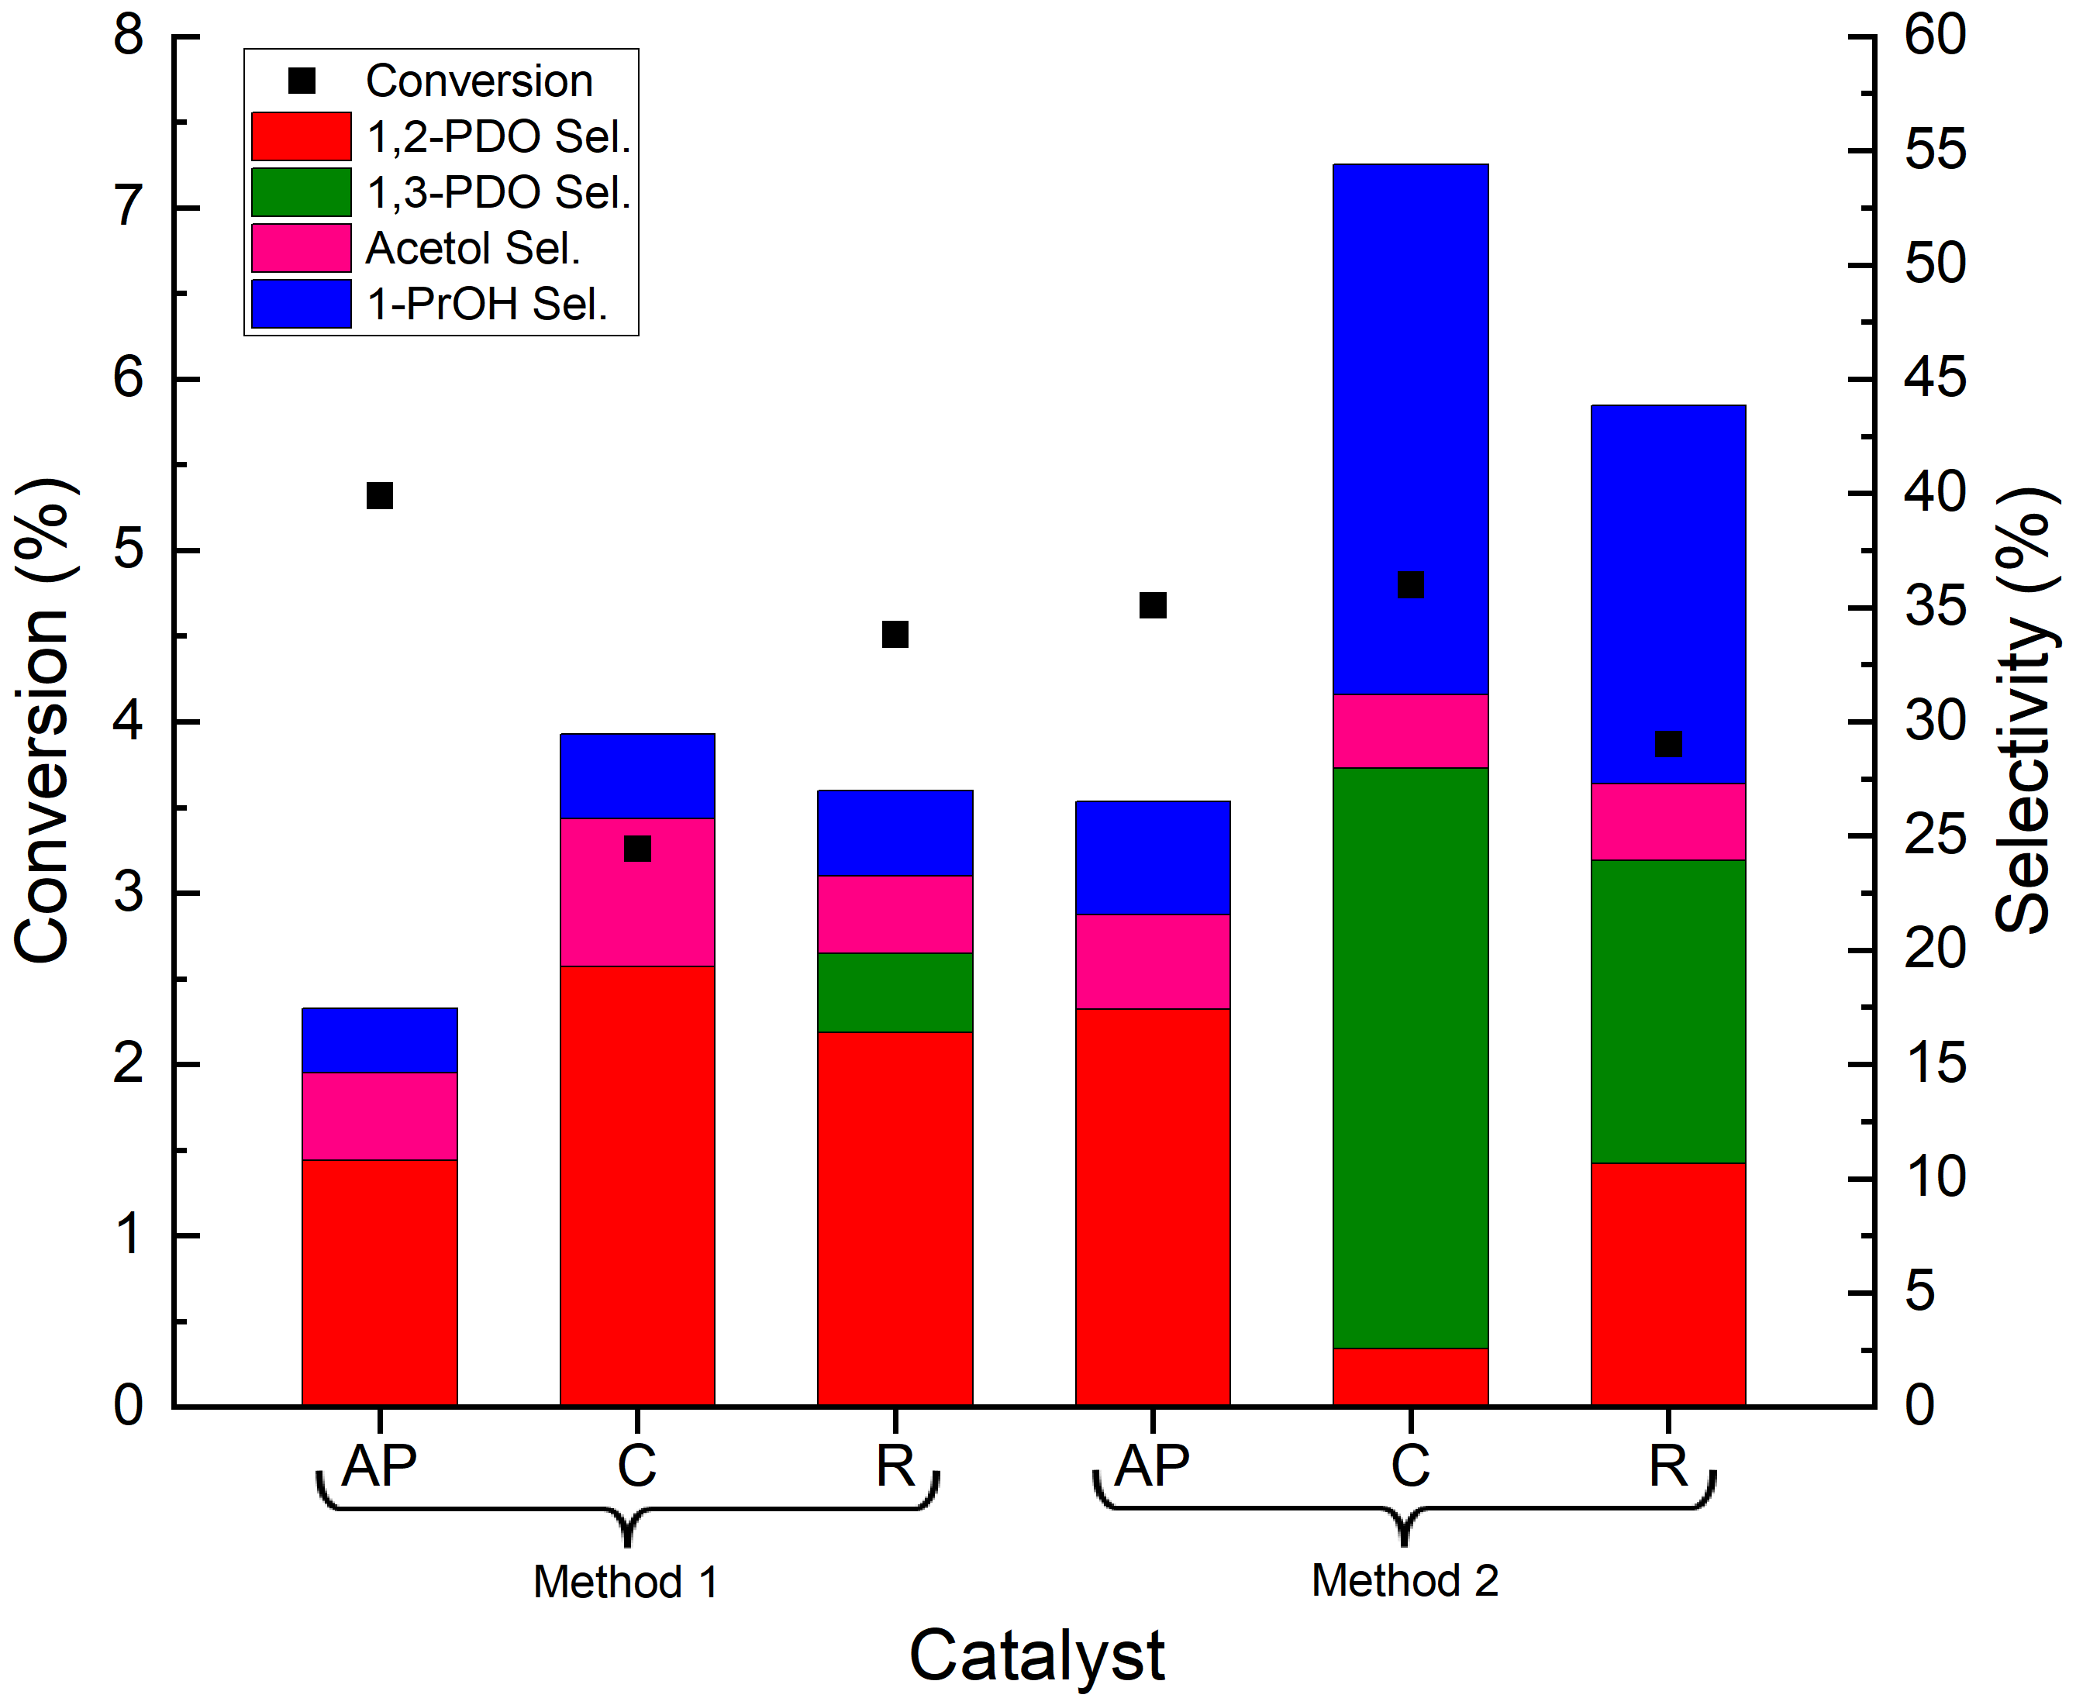
Surface W Dictates 1,3-PDO Selectivity
AP: No pretreatment
C: Calcined @ 400°C for 4h in air
R: Reduced @ 300°C for 1h in H₂
8

Slide 9
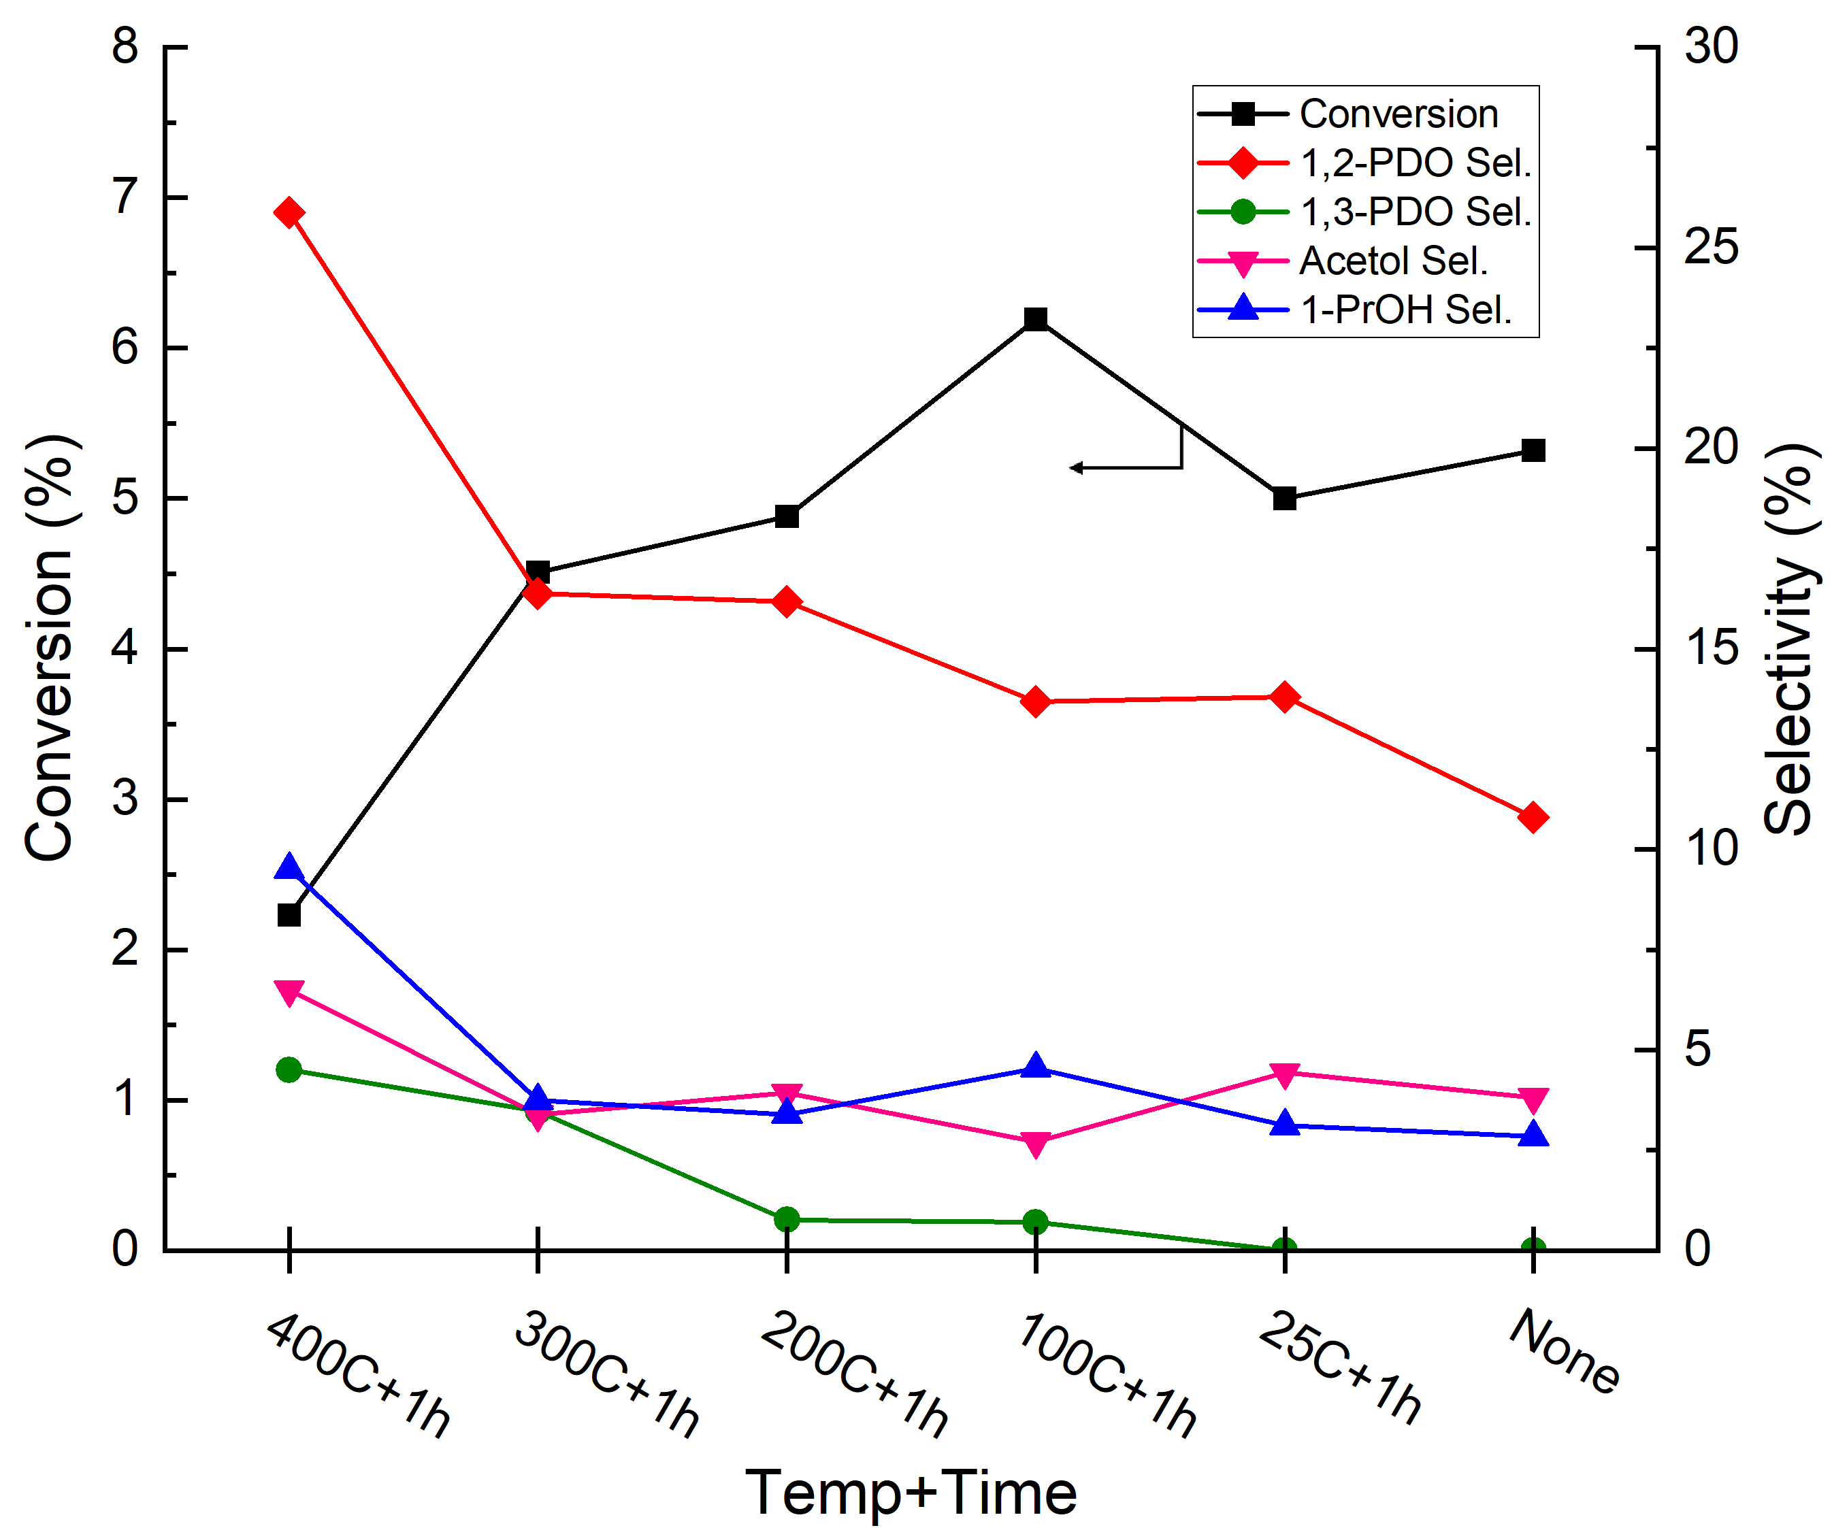
Higher Reduction Temperature Favors PDO Formation
9

Slide 10
Summary
Conversion of glycerol offers a sustainable pathway for chemical production
Pt-W based catalysts selectively convert glycerol to propanediols
Product distribution and activity varied with synthesis and pretreatment
Acknowledgements
Department of Chemical and Bioengineering | UNH Graduate School | Dr. Nan Yi
10

