Slide 1
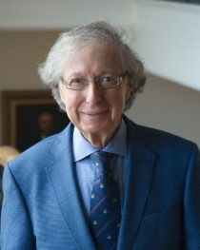
Mathematics in Quantum Computing
Weichen Gu
The Department of Mathematics & Statistics
Collaborators:
Kaifeng Bu
Harvard
Arthur Jaffe
Harvard
PNAS,120.25 (2023), “Quantum Entropy and Central Limit Theorem”, arXiv:2302.08423, “Discrete Quantum Gaussians and Central Limit Theorem”
arXiv:2306.09292 , “Stabilizer Testing and Magic Entropy”

Slide 2
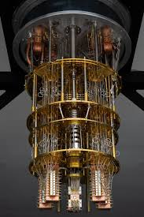
Quantum vs Classical
Quantum Computer
Classical Computer
On certain problems:
one future quantum computer > all the classical computers in the world
Image Source: Google, IBM

Slide 3
Why Quantum Computers Can Be Faster
In Classical Computer:
Bits:
either 0 or 1
0
1
In Quantum Computer:
Qubits:
infinitely many quantum states
0
1

Slide 4
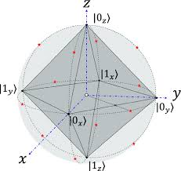
Quantum States
Quantum States are positive
matrices A such that Tr[A]=1
Stabilizer State
Bloch sphere
Image Source: https://doi.org/10.1140/epjp/s13360-024-05011-7

Slide 5
Quantum States
Quantum States are positive
matrices A such that Tr[A]=1
Stabilizer State
Quantum states are
“quantum probability distributions”
Bloch sphere
Image Source: https://doi.org/10.1140/epjp/s13360-024-05011-7

Slide 6
Quantum States
Quantum States are positive
matrices A such that Tr[A]=1
Stabilizer State
Quantum states are
“quantum probability distributions”
Faster quantum computing
(less resources needed)
-> better quantum algorithms
-> more tools for quantum algorithms
-> “quantum probability theory”
Bloch sphere
Image Source: https://doi.org/10.1140/epjp/s13360-024-05011-7

Slide 7
Probability Theory : Classical and Quantum

Slide 8
What is the Classical Convolution?
Value | Prob.
0 | 50%
1 | 50%
Value | Prob.
0 | 50%
1 | 50%
=
Value | Prob.
0 | 25%
1 | 50%
2 | 25%
*

Slide 9
Quantum Convolution
Is there a quantum convolution ? We want:
Prop 1. The convolution of quantum states is a quantum state.
Prop 2. Fourier transform (A B)
= Fourier transform (A) · Fourier transform (B)
Prop 3. The entropy of the convolution A B ≥ the entropy of A or B.
……

Slide 10
Quantum Convolution
For more general definition, see arXiv:2302.07841, 2302.08423.

Slide 11
Central Limit Theorem

Slide 12
Quantum Central Limit Theorem

Slide 13
Applications
Past work:
Stabilizer testing
Clifford testing
Magic gap
Maximal entropy principle
Inequalities for quantum entropies/Fisher information
…
Future work:
Error correcting code
Magic distillation protocols
New convolution on von Neumann algebras
Quantum higher ordered Fourier analysis
…

Slide 14
Probability Theory : Classical and Quantum

Slide 15
Thank You!

