Slide 1
Exploring Graduate Teaching Assistants’ Teaching Practices in a Purposefully Designed Active Learning Environment
Lauren Sager*, Rebecca Butler*, Orly Buchbinder*, Nigar Altindis** and Karen Graham*
*University of New Hampshire and ** University of Alabama
April 15, 2024
Supported by NSF IUSE Award No. 2013427. The opinions expressed herein are those of the authors and do not necessarily reflect the views of the NSF.

Slide 2
Introduction: Collegiate STEM Reform
Introductory STEM courses at the university level are often barriers to continued participation in STEM (Talanquer,2014), typically have high D/W/F rates
One way to reform such courses is through student-centered instruction with an emphasis on active learning (Freeman et al., 2014; Kim et al., 2013)
Active learning Is often difficult to implement in large lectures, so active learning is often facilitated by graduate teaching assistants (GTAs) in smaller sections
GTAS may or may not have training on or experience with the implementation of active learning actives
Notes:
Nationally, almost a million undergraduate students fail their first mathematics course each year, students from underrepresented groups are even more likely to fail (Smith et al. 2021)
active learning engages students through activities and/or discussion in class, as opposed to passively listening to an expert. It emphasizes
higher-order thinking and often involves group work

Slide 3
Project Context
STEM Gateways Project NSF #2013427
Lecture-Recitation model Calculus I course transformed through active learning:
Six researcher-designed activities used over the semester
Students work collaboratively on SMMP activities in groups (3-5 students) during recitation sections facilitated by GTAs and LAs
What teaching actions do GTAs with different pedagogical backgrounds take in a Calculus I course that includes active learning and how do the GTAs discuss these actions?
LA
Graduate TA

Slide 4
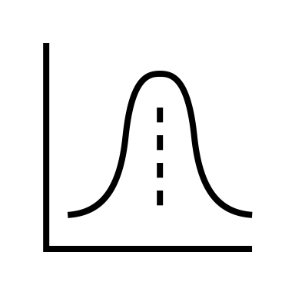
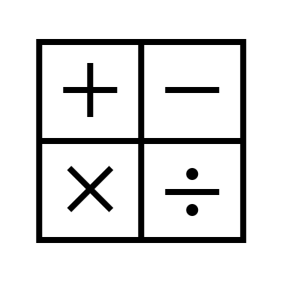
Calculus GTAs
 |  | GTA Experience
 |  | Novice | Experienced
Prior Teaching Experience | No | Cole Stats Ph.D. Student | Ava Math Ph.D. Student
 | Yes | Phoenix Math Ed Ph.D. Student | Ursula Math Ed Ph.D. Student

Slide 5
Data and Analysis
Classroom Video Recordings
Interviews with GTAs
Analyzed using Classroom Observation Protocol for Undergraduate STEM (COPUS) (Smith et al., 2012)
Analyzed with open coding for GTA use of and experience with Active Learning

Slide 6
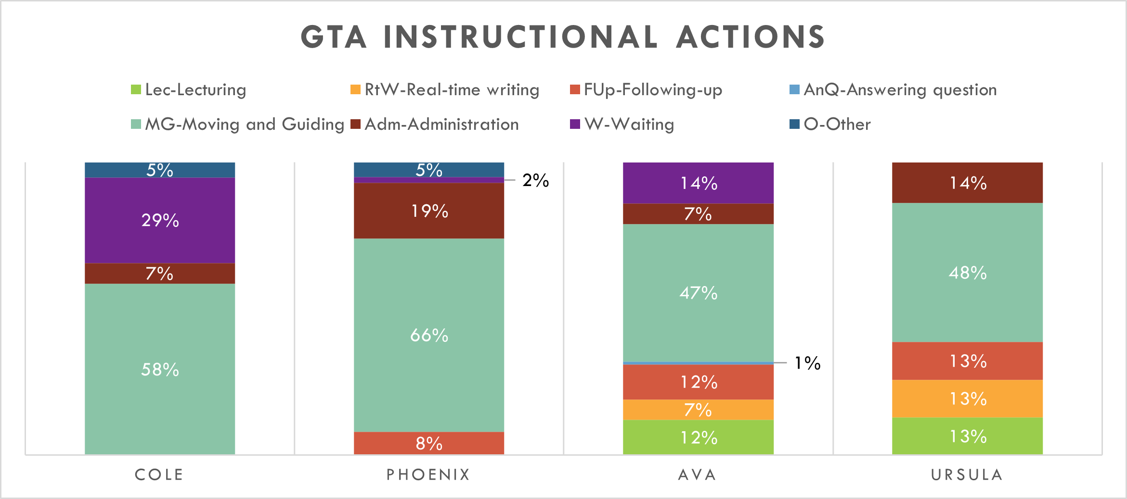
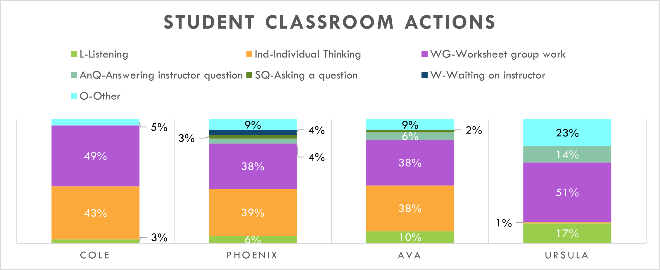
Results- GTA and Student Actions

Slide 7
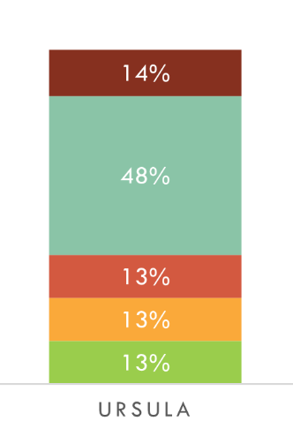
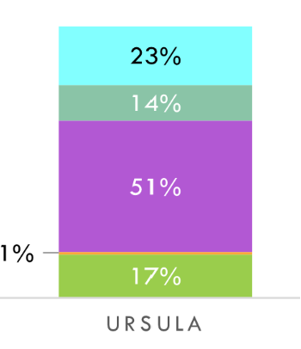
Ursula's Classroom: Intro/Review
Ursula began each lesson with a brief review of content (lecture and real time writing) while students listened
She “reviews concepts” and to make students more “comfortable” participating by fostering “confidence”
Ursula’s Actions
Students’ Actions

Slide 8
Ursula's Classroom: Group Work
Emphasis on group work guided by GTA: Ursula spends nearly half her time moving and guiding, Students spends nearly half their time on worksheet group work
“I’m not going to solve the activity for them, but if they got stuck I will ask them the question to lead them to the next step”
Ursula’s Actions
Students’ Actions
Notes:
Mention 14% of Ursula's Actions (brown at top) are admin – organizing groups and 23% of students' are other (light blue at top) but this is students writing on the board

Slide 9
Ursula's Classroom: Student Sharing
Ursula ended each lesson by having students share their work. She followed up while students answered instructor questions.
Desire to create “balance between the instructors and the student”
Ursula’s Actions
Students’ Actions
Notes:
Brown = Admin – student related – organizing groups
Teal = other – students writing on whiteboards in room
Yellow tiny = individual work

Slide 10
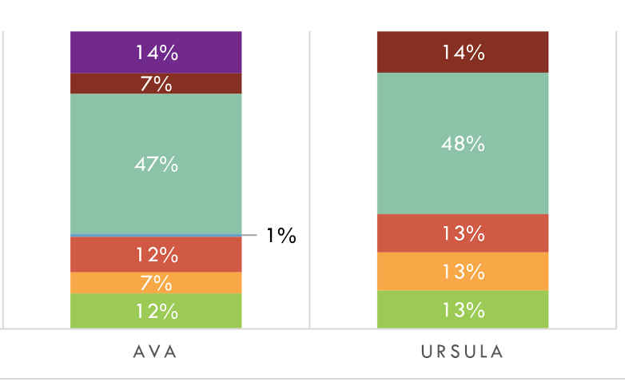
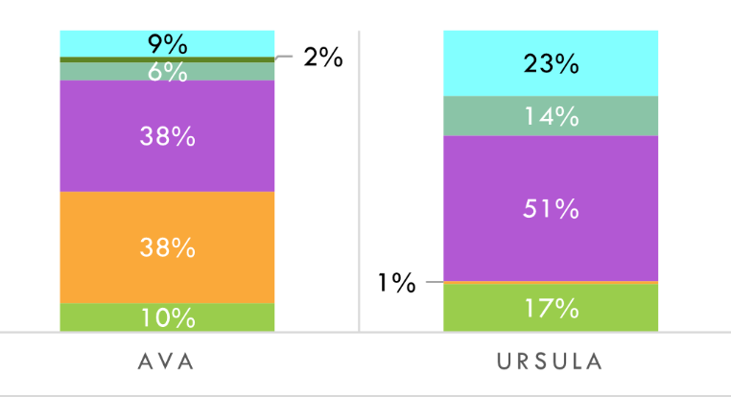
Ava’s Classroom
GTAs’ Actions
Students’ Actions
Ava’s classroom is similar to Ursula’s but with a stronger focus on independent student work; Ava waits and her students independently think

Slide 11
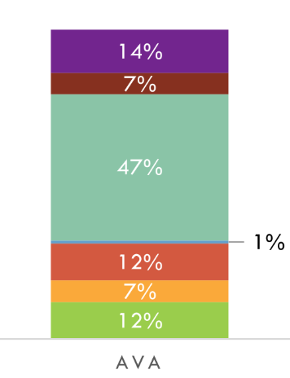
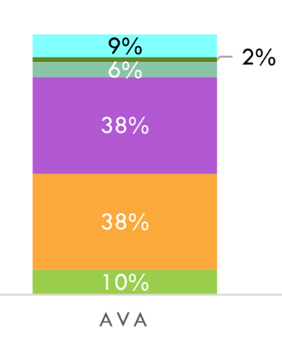
Ava's Classroom
Ava’s classroom is similar to Ursula’s but with a stronger focus on independent student work. Ava waits and her students independently think
Active learning requires “the student thinking more deeply about the topic”
Ava’s Actions
Students’ Actions
Notes:
Blue tiny = Answering questions
Green tiny = Student question

Slide 12
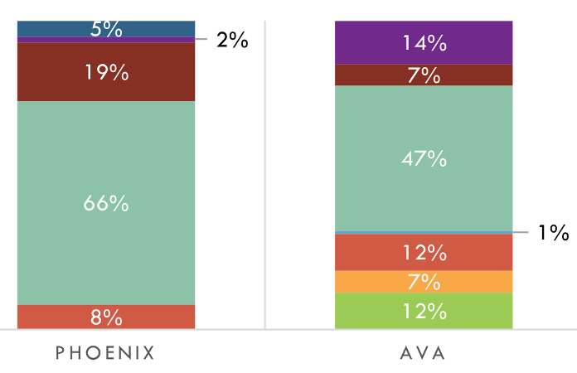
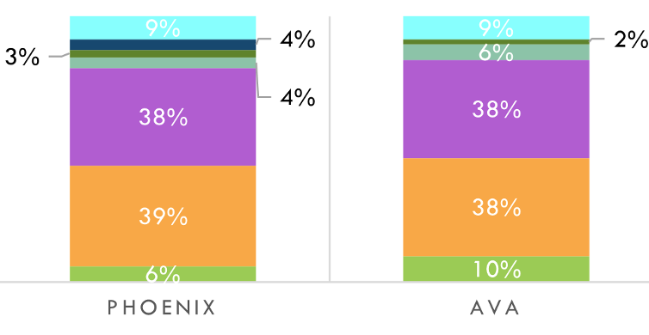
Phoenix’s Classroom
GTAs’ Actions
Students’ Actions
Ava and Phoenix’s students’ actions are relatively similar, but their own actions are distinct. Phoenix does more admin and drops lecture and real time writing

Slide 13
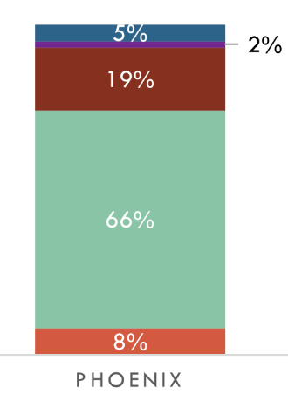
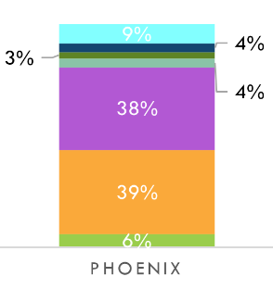
Phoenix's Classroom
Phoenix didn’t have an intro and student sharing at the end of class was briefer (follow up). She focused on admin and moving and guiding
Phoenix’s role is to “help each individual student”
Phoenix’s Actions
Students’ Actions
Notes:
Phoenix has more of a novice status: no TA experience = more time spent on admin/organizing groups

Slide 14
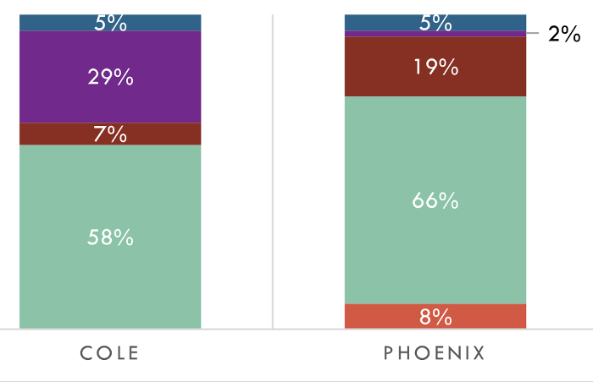
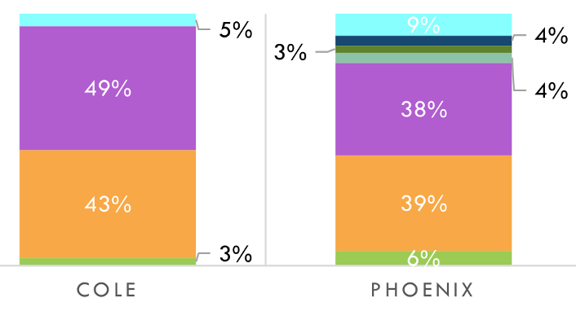
Cole’s Classroom
GTAs’ Actions
Students’ Actions
Cole had the highest percentage of waiting, and other codes marked times that he left the room
Notes:
Tiny percentages on phoenix’s students: asking q, answering q, waiting on instructor

Slide 15
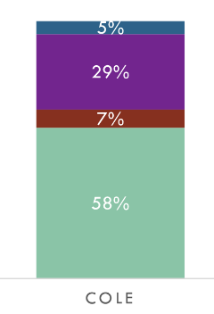
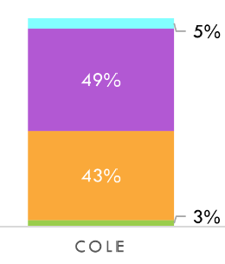
Cole's Classroom
Cole focuses on moving and guiding while his students do group or independent work
Cole’s role is “more like a tutor”
Cole’s Actions
Students’ Actions
Notes:
Cole has no intro or follow up In front of the class
Cole had no active learning experience: only “copy, paste” learning

Slide 16
Discussion
 |  | GTA Experience
 |  | Novice | Experienced
Prior Teaching Experience | No | Cole: inexperienced with active learning, uses only group work and leaves students to their own devices occasionally | Ava: supported group work, but added the option for individual work, used some direct instruction and following up with a whole class discussion
 | Yes | Phoenix: supported group work, but added the option for individual work, followed up with a whole class discussion | Ursula: most experienced with active learning, supported group work with some direct instruction and following up with a whole class discussion

Slide 17
Implications
Implementation of active learning at large universities depends on GTA's experiences with active learning
Pedagogical training of GTAs must take lived experience into account to be effective
GTA's implementation depended heavily on their previous experiences

Slide 18
References
Freeman, S., Eddy, S. L., McDonough, M., Smith, M. K., Okoroafor, N., Jordt, H., & Wenderoth, M. P. (2014). Active learning increases student performance in science, engineering, and mathematics. Proceedings of the national academy of sciences, 111(23), 8410-8415. https://doi.org/10.1073/pnas.1319030111
Kim, K., Sharma, P., Land, S. M., & Furlong, K. P. (2013). Effects of active learning on enhancing student critical thinking in an undergraduate general science course. Innovative Higher Education, 38(3), 223-235. https://doi.org/10.1007/s10755-012-9236-x
Smith, M.K., Jones, F.H.M., Gilbert, S.L., Wieman, C. (2012). The classroom observation protocol for undergraduate STEM (COPUS): A new instrument to characterize university STEM classroom practices. CBE Life Sciences Education, 12, 618 627. https://doi.org/10.1187/cbe.13-08-0154
Talanquer, V. (2014). DBER and STEM education reform: Are we up to the challenge?. Journal of Research in Science Teaching, 51(6), 809-819. https://doi.org/10.1002/tea.21162

Slide 19
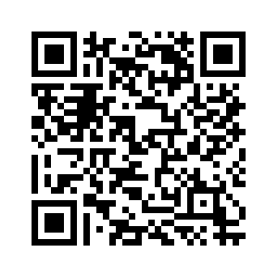
Thank you!
Research Gate
Rebecca.Butler@unh.edu

Slide 20
Why Active Learning in Calculus?
Focus on Active Learning in Introductory Mathematics Courses
Nationally, almost a million undergraduate students fail their first mathematics course each year, students from underrepresented groups are even more likely to fail (Smith et al. 2021)
Active Learning
A productive learning environment that provides meaningful mathematical learning activities for all students, including two key components
(1) The inclusion of cognitively demanding mathematical tasks
(2) Instructor facilitation of collaborative learning opportunities
Notes:
active learning engages students in the process of learning through
activities and/or discussion in class, as opposed to passively listening to an expert. It emphasizes
higher-order thinking and often involves group work”

Slide 21
Future Research
Extended the implementation to Calculus II and Precalculus courses
Added 6 more Calculus I GTAs (along with 6 from Precalculus and Calculus II)
We have 4+ recordings for each Calculus I GTA and 2 for each Precalculus and Calculus II GTA
Cole worked with a very experienced LA in his second
semester
and we've already seen that impact his classroom actions
Future Questions:
Some GTAs have worked in several classes – do their actions change based on course?​
How do the GTAs' actions change in subsequent semesters in Calculus I?

Slide 22
Methods (COPUS)
Classroom Observation Protocol for Undergraduate STEM from Smith, et al. (2012)
For each 2-minute interval, observer marks any of 25 codes (13 for instructor, 12 for students) that occurs.
Codes are meant to be judgement-free and represent the classroom actions in a 2-minute interval.
Example instructor codes: lecturing, demonstration, moving around the classroom
Example student codes: listening, worksheet group work, predicting
Percentages were calculated as follows:
Number of times a particular code is marked
Total number of times any code is marked
Percentage of actions marked as a given code
Notes:
Codes represent "what is the instructor doing" and "what are students doing"

Slide 23
Methods (Interviews)
Semi-structured interviews near beginning and end of each semester
Example Questions:
Describe how you see your role and responsibilities as a teaching assistant?
What is your definition of active learning?
How do you envision the instructor and student's role in a classroom where active learning is happening? How do you imagine these students' and instructor's roles?
Who do you think benefits from active learning? Instructors or students or both? In what ways do they benefit?
What is the difference between a mathematical task and active learning activities?

Slide 24
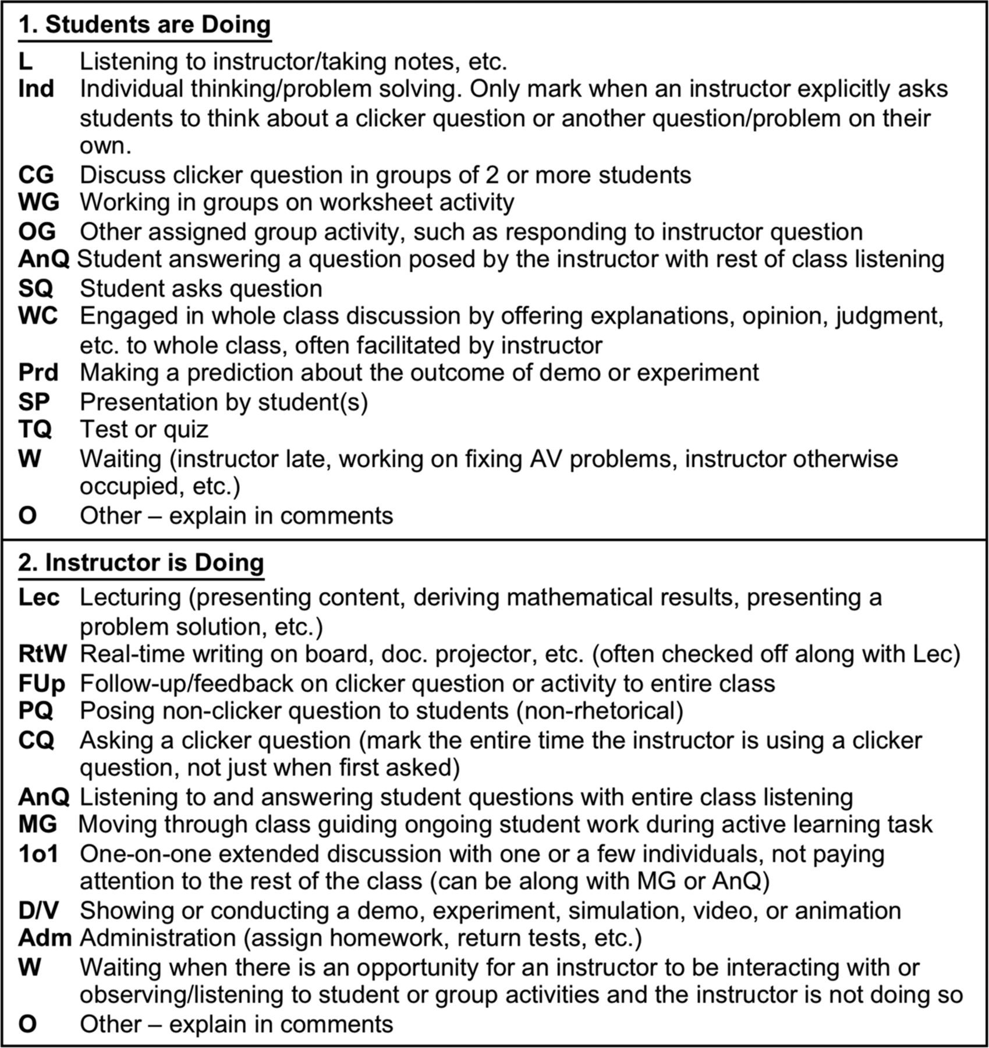
COPUS Codes
From Smith, et al. (2013)

